Slide 1
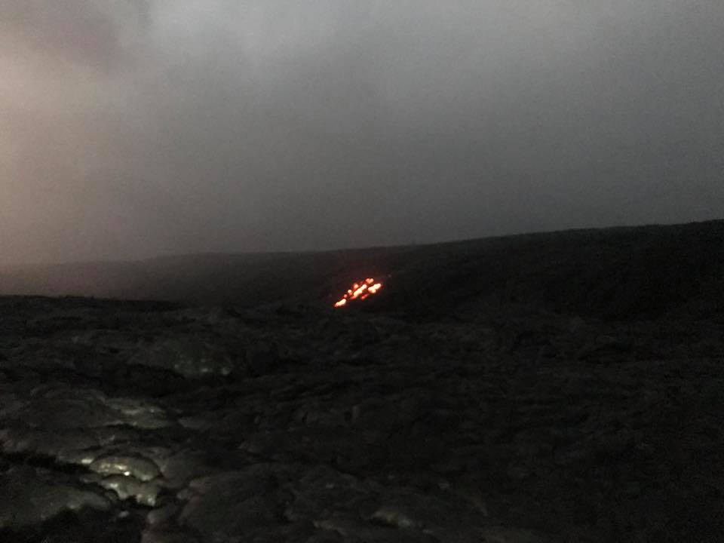
Gamze Gürsoy
Journal Club
01.17.2018
Notes from PSB18
file://localhost/.file/id=6571367.8595190021

Slide 2
Keynote: Carlos Bustamente
-disappointing talk with full of advertisement
-talked about how bad the healthcare system is
-according to him, solution is not what government will do but the direct-to-consumer health products
-eg. You have to pay a lot for health insurance while you can test if you have cancer for a few hundred dollars using color genomics

Slide 3
Keynote Jennifer Wagner, JD, PhD from Geisinger
Has a k99 from nhgri to study ethics, diversity and privacy
Pointed out that text mining to past psb proceedings only yield 2 hits for “privacy” – yet didn’t show up to my poster
Talked about current issues in terms of diversity and privacy in genomics
the medicalization of the human genome and its policy implications; perspectives on DNA identification technologies and their utility in law enforcement, immigration, and other non-medical contexts; limitations of the Genetic Information Nondiscrimination Act
Interested in policy making
She could be a resource for the privacy and related work

Slide 4
vence bonham - invited speaker
insights: https://www.genome.gov/27564728/insights-eligibility/
Look out for more data, currently recruiting patients

Slide 5
Joe Corkery Head of Product, Google Cloud in Boston
Mentions importance of differential privacy while using cloud
Subha Madhavan
clinicalgenome.org
clinically relevant variants and share
somatic variants in cancer patients
mvld = minimum variant level data - journal of genome medicine
clinvar
subha.madhavan@georgetown.edu

Slide 6
Craig Ventor institute has a lot of data through human microbiome project
Data-driven Advice for Applying Machine Learning to Bioinformatics Problems from Jason Moore from Upenn
They have an accessible comparison of many many ML algorithms using same benchmark- check out if interested

Slide 7
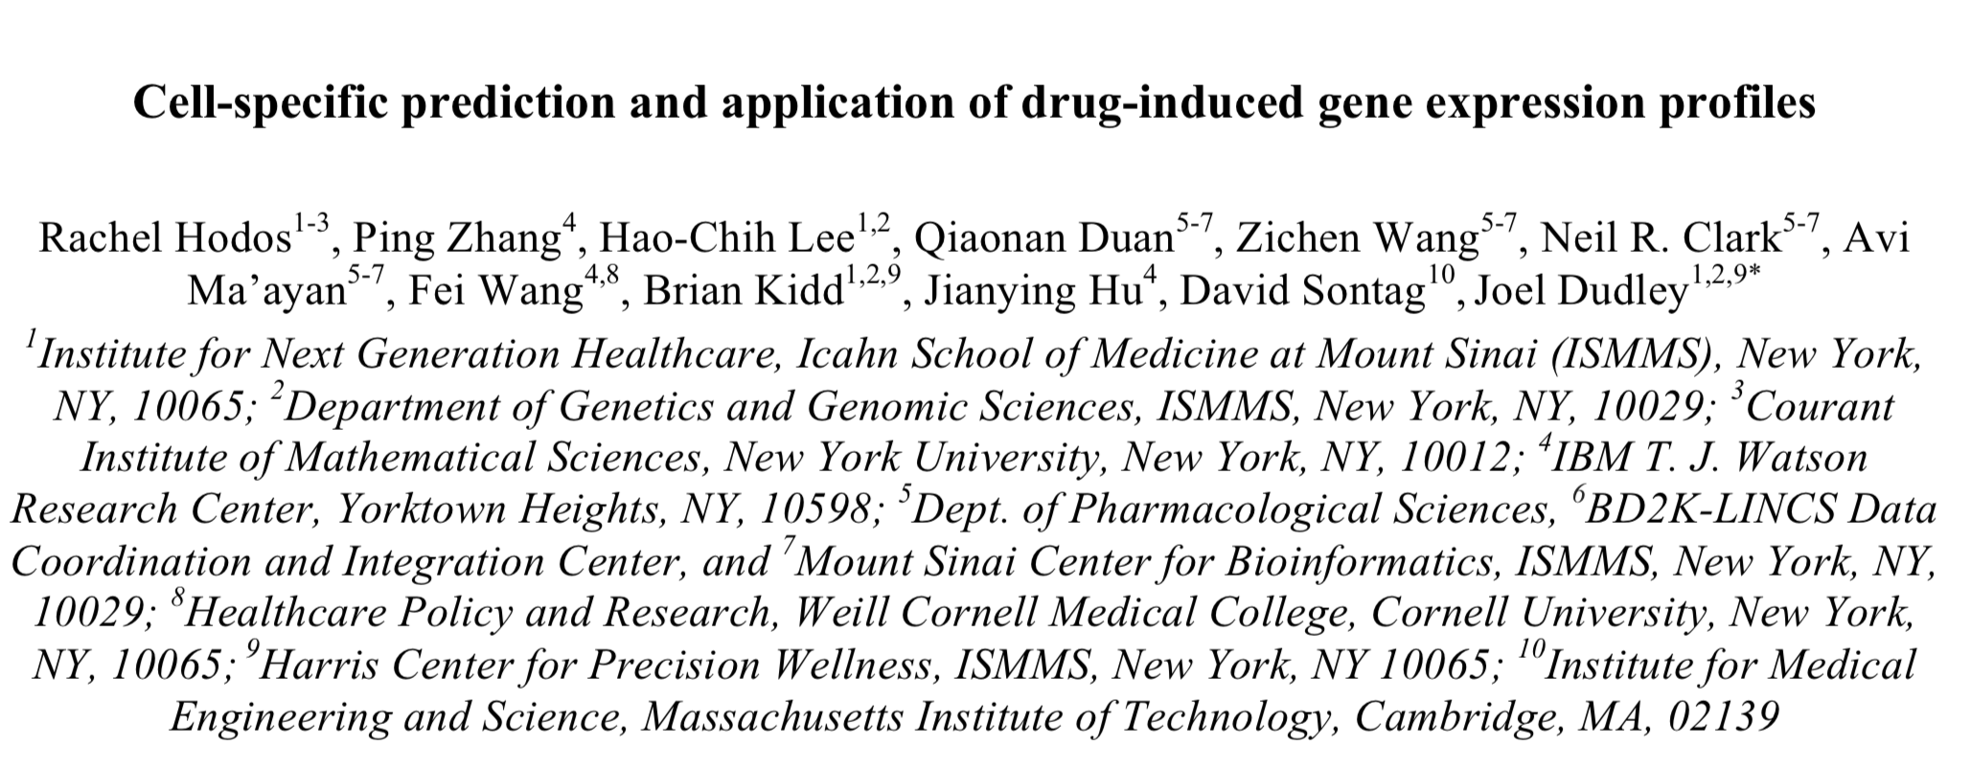

Slide 8
To study cell specific response to drug
Library of integrated cellular signatures (LINCS) program: 1m expression data from different cells exposed to different drugs
20k drugs
71 cell lines
There are still gaps in the data
Goal: predicting entire expression profiles for cell-specific drug perturbations that have not yet been measured

Slide 9
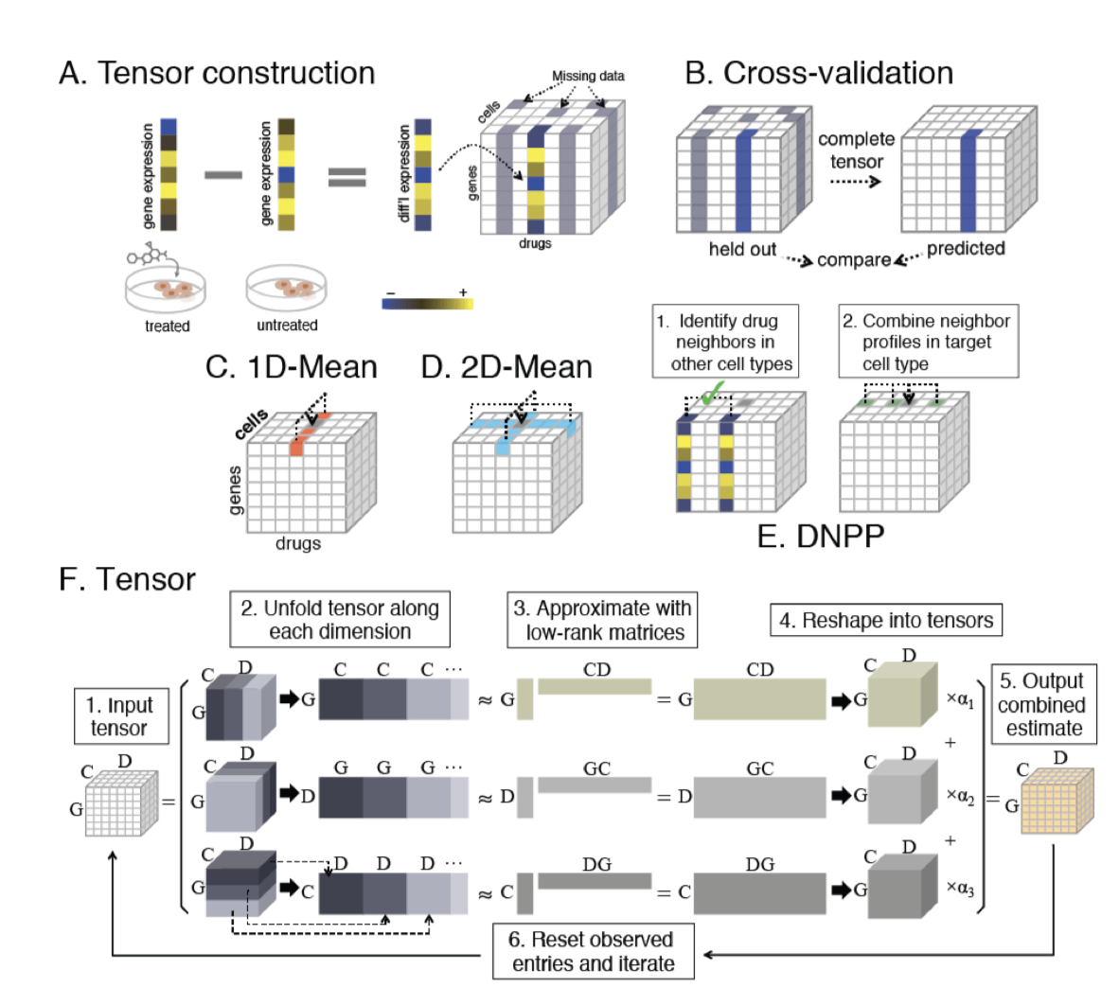
2 complementary approaches:
Drug Neighbor Profile Prediction (DNPP) is inspired by K-nearest neighbors – local
Fast Low-Rank Tensor Completion (FaLRTC) fills in the missing entries of a tensor using the observed entries - global

Slide 10
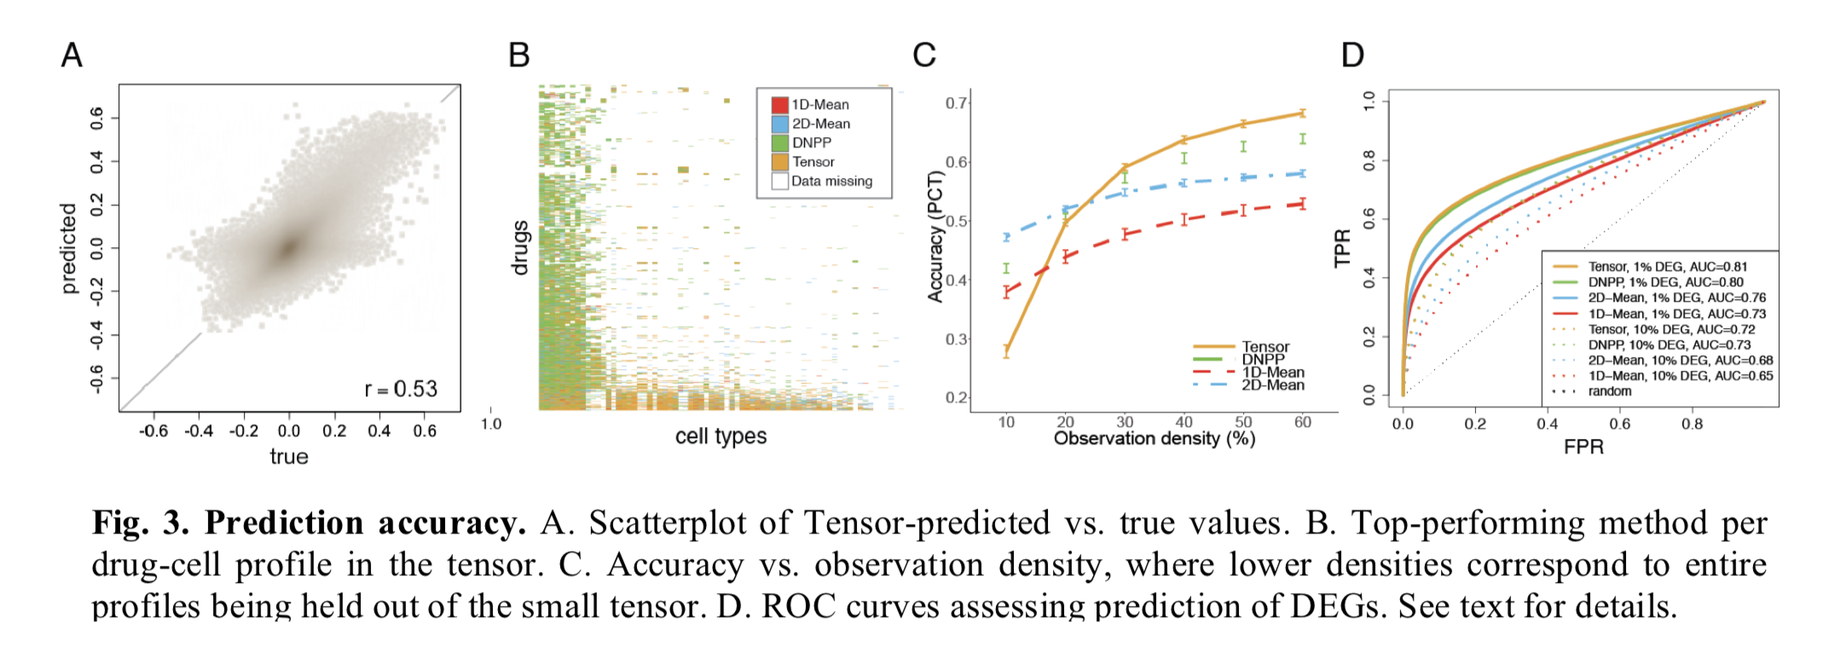
dnpp is good at drugs space, tensor is good at cell space
predict drug-target after the completing the data
there is improvement in accuracy per drug profile after completion

Slide 11
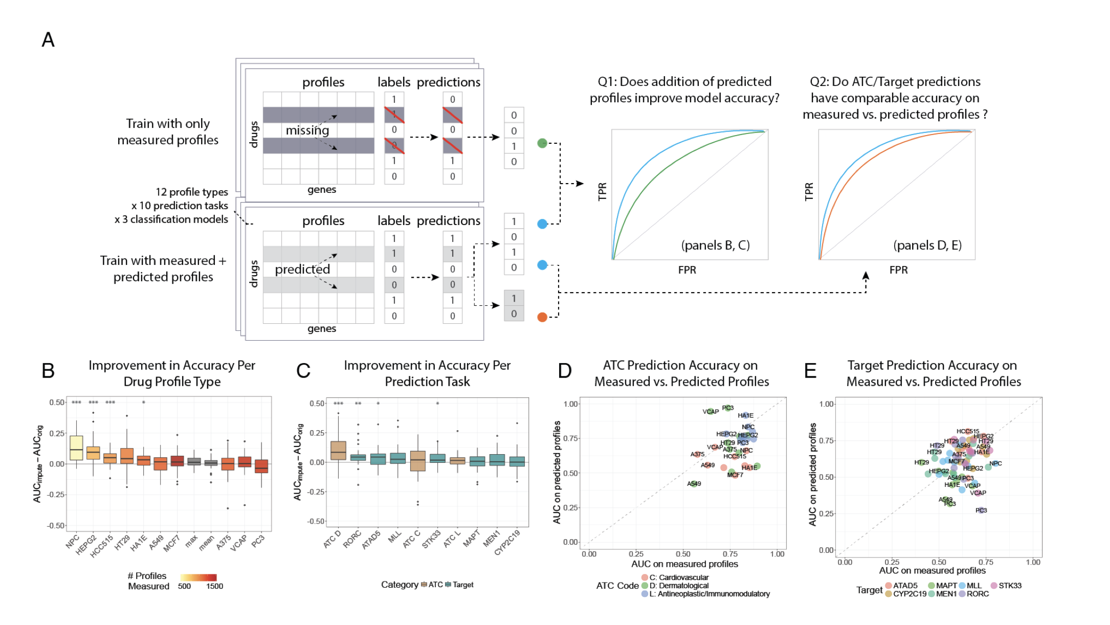
Notes:
A. Illustration of experimental setup. Binary classification models are trained to predict drug targets and ATC codes (antineoplastic and immunomodulating agents
), using either the measured subset of profiles (e.g. for a particular cell type) or the completed data, and cross-validated prediction scores are recorded. Then two types of ROC curve comparisons are made, as described in the text. B. Improvements in AUC per drug profile type, across experiments for different prediction tasks and models. C. Improvements in AUC per prediction task, across different profile types and models. D. ATC prediction accuracy on measured vs. predicted profiles, for different profile types. E. Target prediction accuracy on measured vs. predicted profiles. For both D and E, median values across models were computed to simplify the plots, but were kept distinct for all reported results.

Slide 12
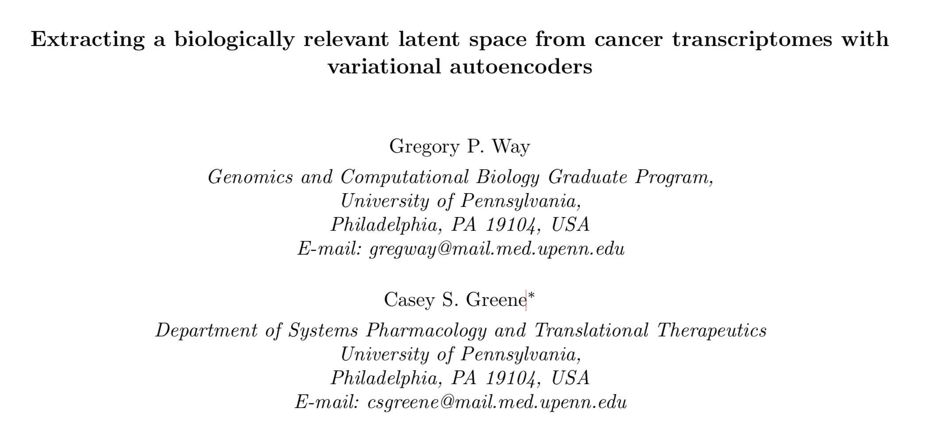

Slide 13
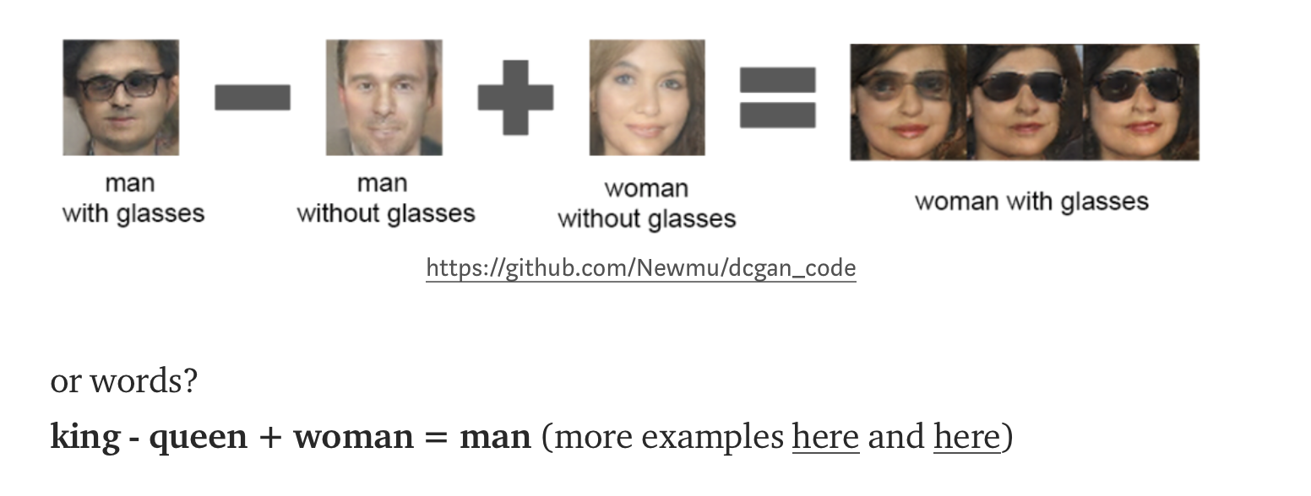
latent space: smiling woman - neutral woman + neutral man = smiling man

Slide 14
variational autoencoders (VAEs) harness the modeling power of deep learning without the need for accurate labels
Input= TCGA RNA-Seq data
goal: patient stratification by gene expression signatures to see which pathways are affected in which cancer types
Latent space: mesenchymal - immunoreactive = immune respone and defense response
m - i = collagen and extracellular matrix

Slide 15
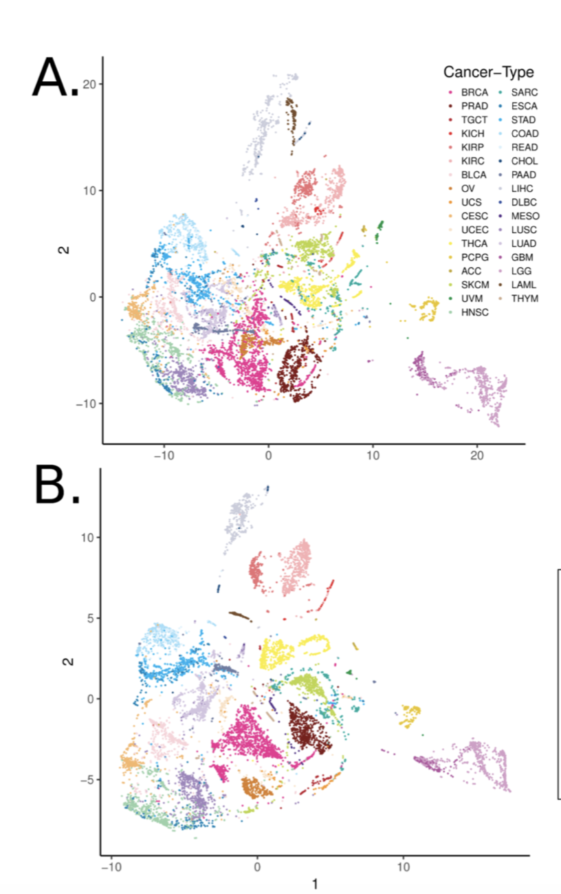
T-SNE
autoencoder:
genes vs samples encode compression network Z vector and decompress with decoder —> variational autoencoder - tybalt
latent space is a compressed, non-linear combination of input genes
p=5000 raw gene expression t-sne can be represented by tybalt features p=500
I’m guessing similar to compress sensing algorithm by Aviv Regev and Eric Lander published in Cell recently?
tybalt

Slide 17
Differential gene expression data -> set of genes
Set of genes to infer biological pathways based on overrepresentation
They did simulation showing standard overrepresentation analysis identifies many false positive pathways along with the true positives.
Goal: reducing the noise of the gene list input via community detection might decrease the number of false positive pathway

Slide 18
Candidate genes are overlaid onto a functional network
Network is separated into communities via community detection
Communities are subject to overrepresentation analysis
Multiple testing corrections
4 community detection approaches are evaluated
Fastgreedy
Walktrap
Multilevel
infomap
Above applied to identifying enriched pathways across high grade serous ovarian cancer (HGSC) subtypes.

Slide 19
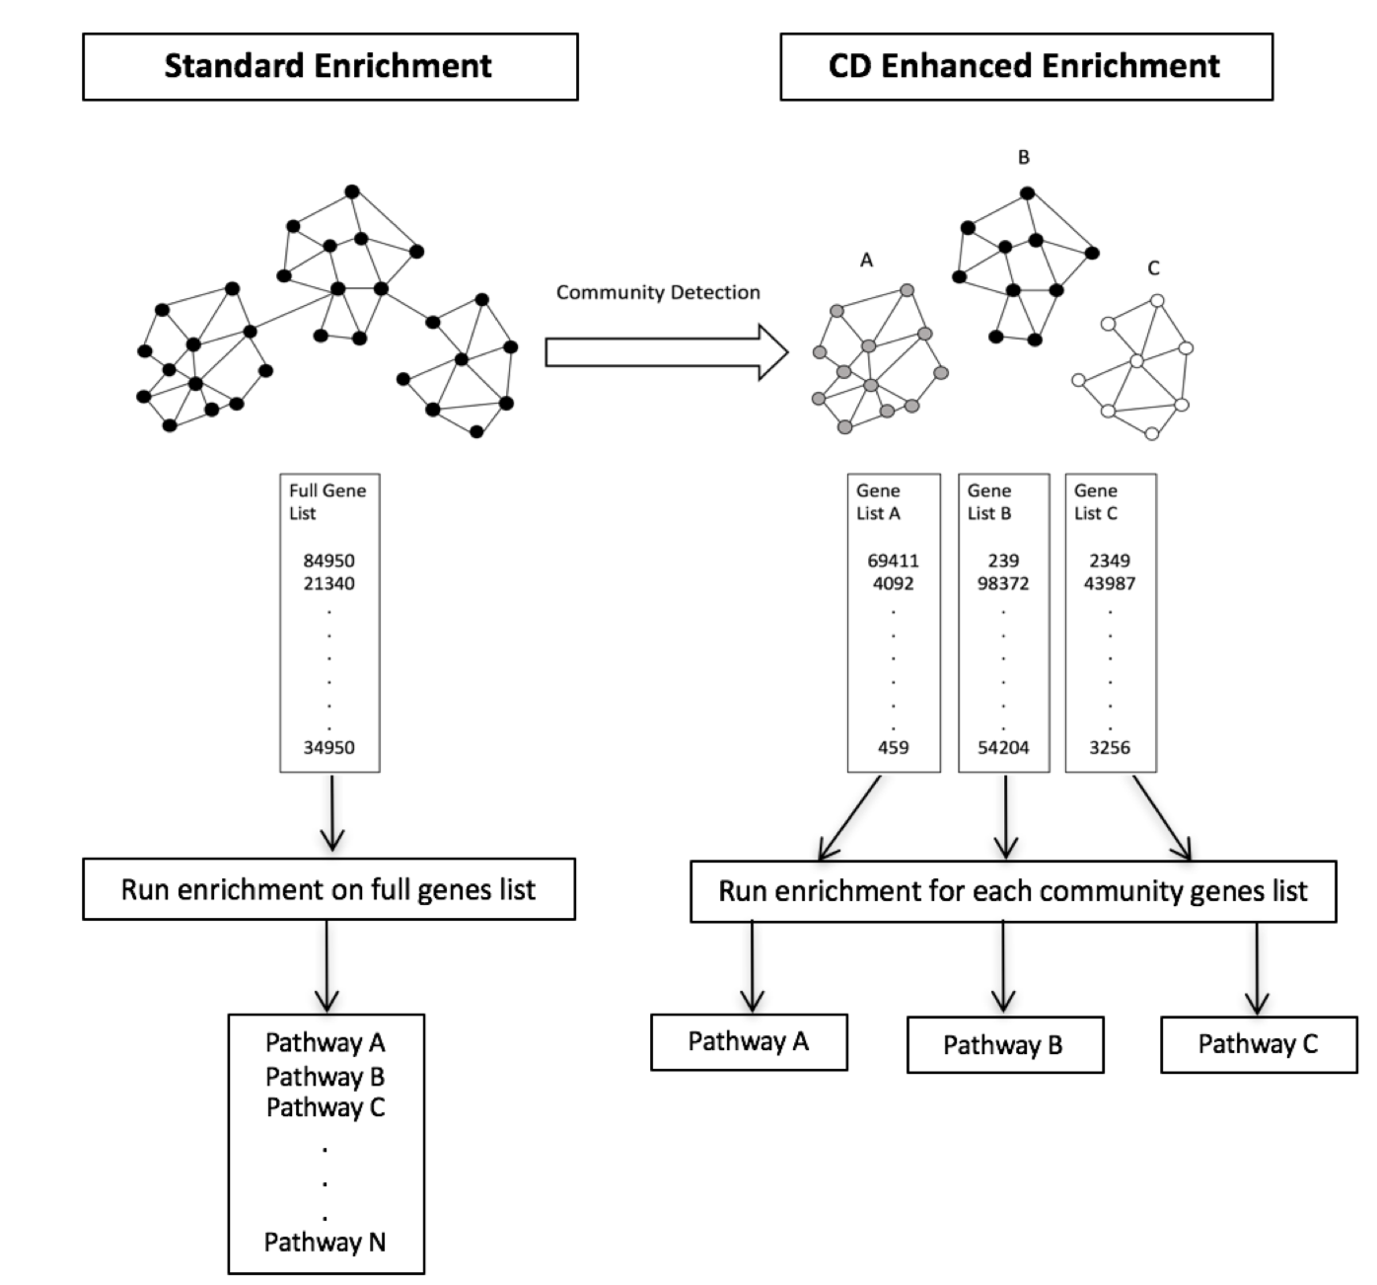

Slide 20
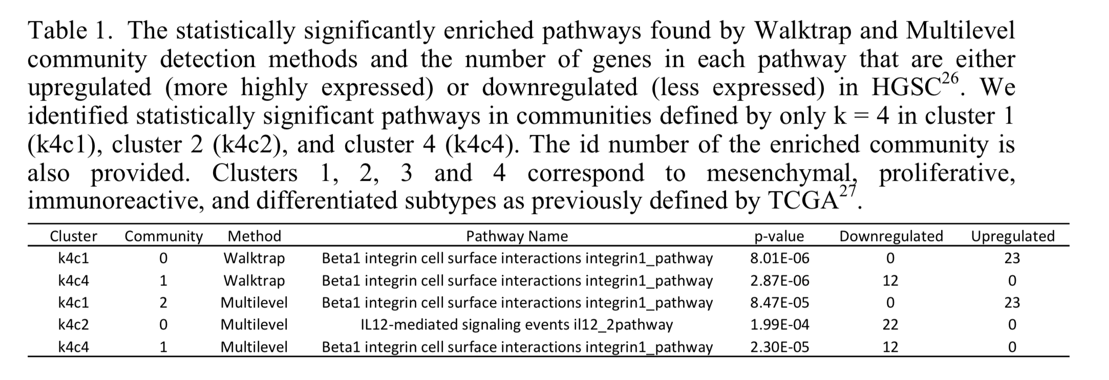

Slide 22
Restriction to access to data hinders the development and evaluation of ML algorithms
Open data helps with the problem but oftentimes biomedical data doesn’t have ground truth
Goal: simulate complex biomedical data to use as benchmark for ML algorithms

Slide 23
Heuristic Identification of Biological Architectures for simulating Complex Hierarchical Interactions (HIBACHI) simulation method
5 components
1- A biology-based framework for simulation of complex biological systems
Protein-coding gene with a single non-synonymous genetic variant
Promoter and enhancer with single regulatory variants
Two genes code for TF with a variant
A variant in microRNA gene that participates in post-translational regulation
In total, this structure allowed for six genetic variants (coded 0, 1, 2) all influencing a protein product as a quantitative trait + an environmental factor (coded -2, -1, 0, 1, 2) to allow for non-genetic variation in the phenotypic values

Slide 24
2- A mathematical framework for simulation of complex patterns
A set of mathematical functions that combines the genetic and enviromental effects that result in protein expression
the protein expression value is dependent on mathematical functions of the six loci and the environmental factor
that way we know the complex role of each component a priori

Slide 25
3- A liability threshold model for biology-based simulation
to simulate disease from the distribution of phenotypic values generated from the genotypic values and mathematical functions.
liability threshold → particular disease prevalence.

Slide 26
4- Genetic programming for model representation and stochastic search
To discover higher order models through fitness optimization
mix and match genomic modules (gene, TF binding, promoter, enhancer etc) → new models that meet a simulation objective.
5-An open-source HIBACHI software package
to generate synthetic datasets that have tailored performance for any given machine learning methods.

Slide 28
Players have mutual benefit
Predicting which coalitions will form, the joint actions that the groups take and the resulting collective benefit
seeking to identify players who tend to improve the performance--the relationship to a specific disease phenotype--of any coalition they join.
ASD may be best explained by a combinatorial genetic model with varying epistatic interactions across many small effect mutations.

Slide 29
DATA: 30x-coverage whole genome sequencing data from the Hartwell Foundation’s Autism Research and Technology Initiative (iHART)
the genomes and phenotypic measurements from 756 multiplex families containing at least two children affected by ASD, unaffected parents, and zero or more unaffected siblings.
Quality control : removal of non-mendelian variants, which removed sequencing error as well as de novo mutations.

Slide 30
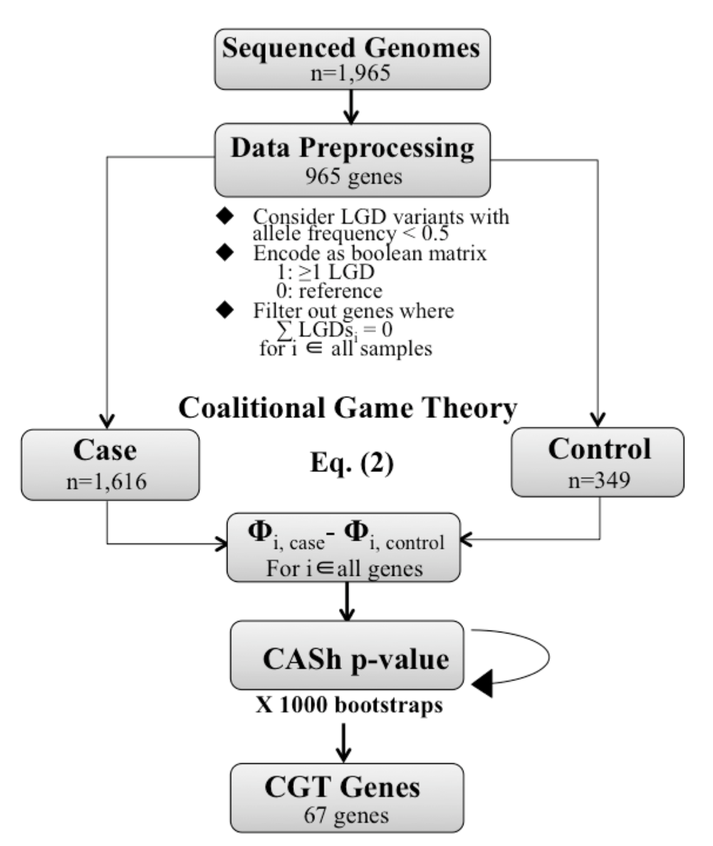
LGD: likely gene disrupting
include only loss-of-function
variants
CASh: multiple hyphotesis testing
for coalition game theory
Goal: identify players who tend to
increase the score of any coalition
they join.
Compare CGT genes to knows ASD genes

Slide 31
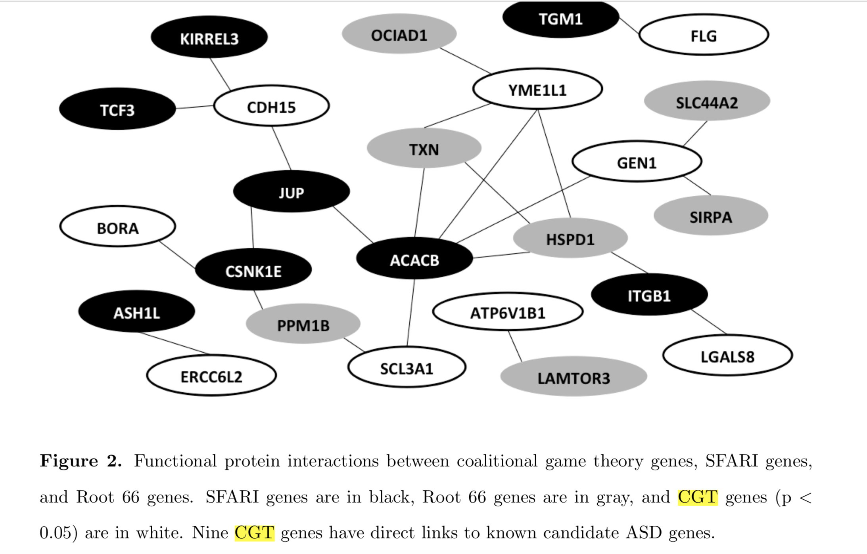

Slide 32
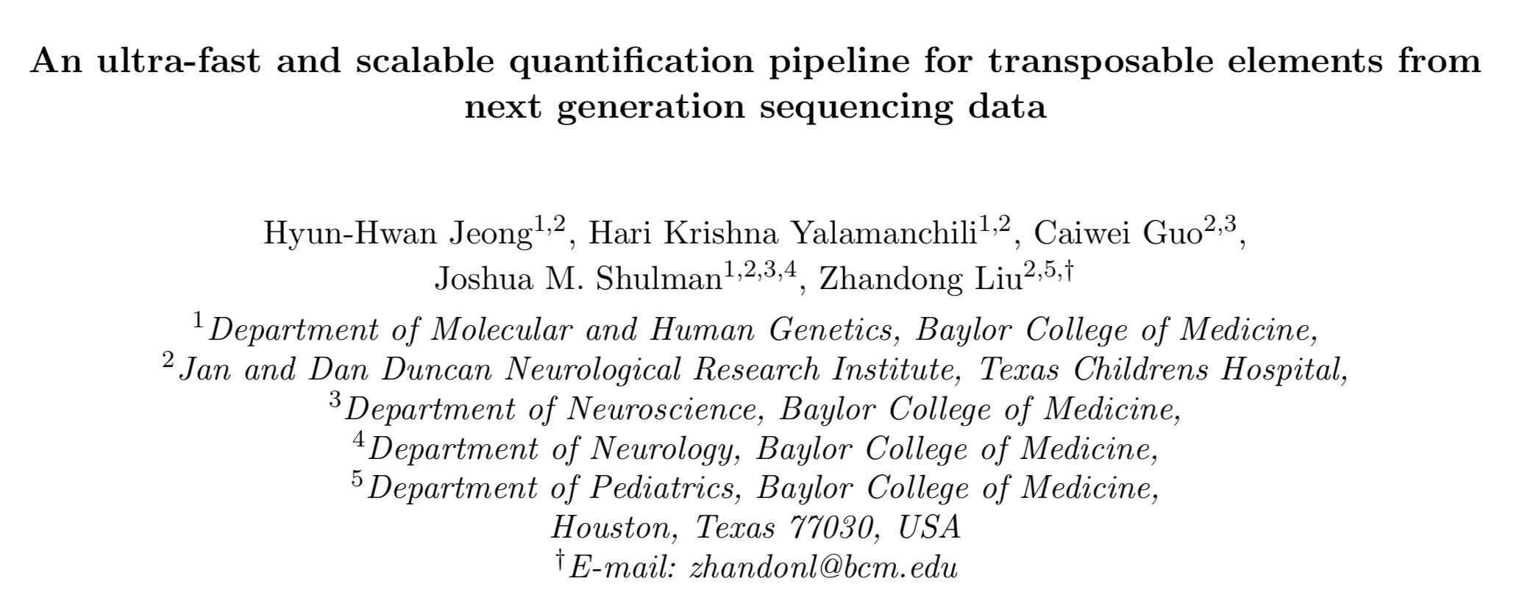
Notes from posters
Uses Salmon for expression of Tes
Incorporates some chip-seq data for the targets of Tes
600 rnaseq data from Ampad consortium about brain
Submitted to cell reports, currently reviewing

Slide 33
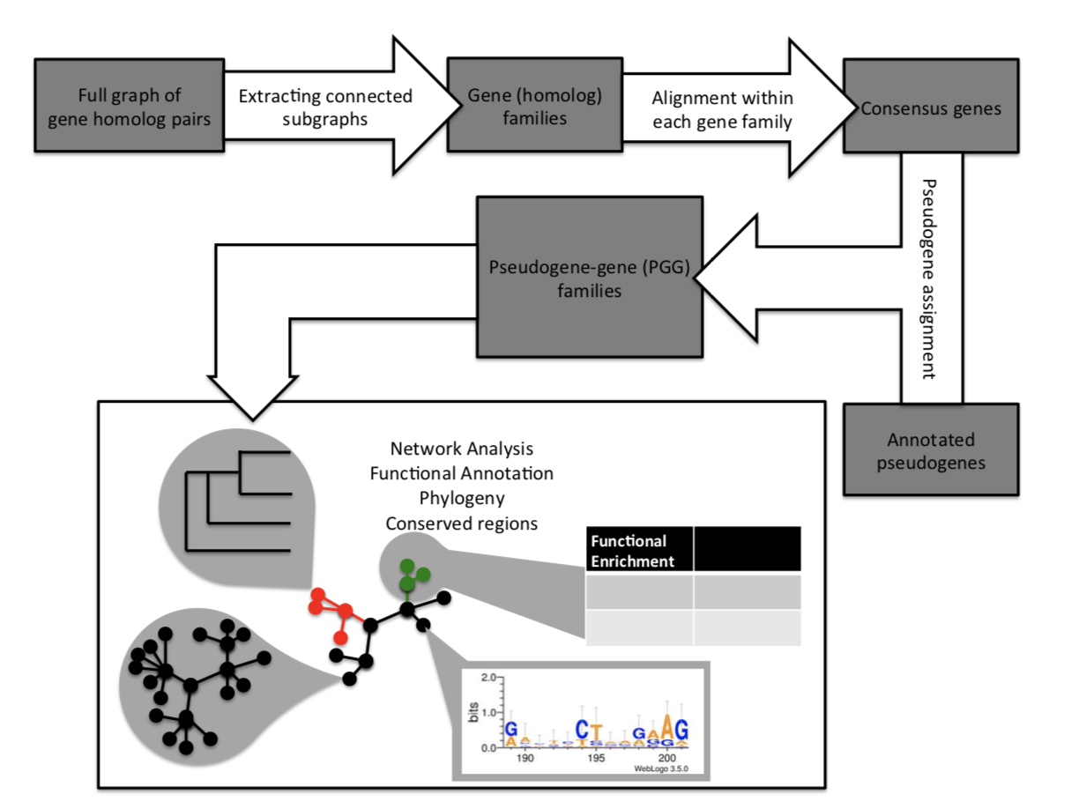
integrating graph analysis, sequence alignment and functional analysis to evaluate pseudogene-gene relationship

Slide 34
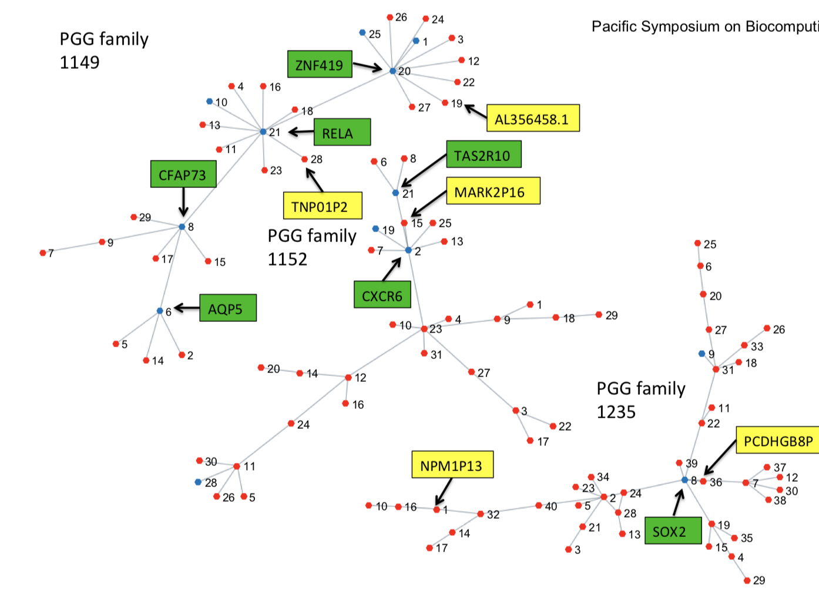

Slide 35
Person from craig venter institute that I cannot find in the program
– tons of single cell rnaseq data from allen institute for brain research
single cell phenotypes:
cell type identification in postmorted human brain tissue: single cell rnaseq- cluster the data and clusters are different cell types. use it to classify cell types in new rna-seq data
- transcriptional patterns
which gene features are most useful in classifying different cell types
are they useful in positively identifying cell types or excluding other cell types
minimum number of gene features that provide optimal cell type classification?
NSForest: a computational strategy to identify necessary and sufficient marker genes
- cluster membership& lists of differential genes
-ranked list of useful genes
-necessary and sufficient genes = cluster specific marker genes
do FISH for their spatial organization
semantic definitions: cell ontology
reference database for statistical comparison

Slide 36
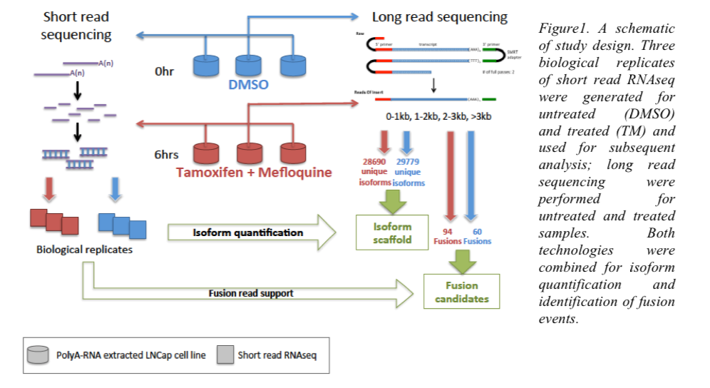
Characterization of drug-induced splicing complexity in prostate cancer cell line using long read technology by Bojan Losic from Icahn School of Medicine at Mount Sinai
Transcriptional landscape of drug synergy
synergistic gene expression&splicing: short read RNA-Seq
stably expressed but alternatively spliced -> differentially spliced genes are not differentially expressed
do long-read with pacbio: splice isoform phasing
long read assembly as de novo scaffold to find splicing phasing
treatment specific isoforms

