Slide 1


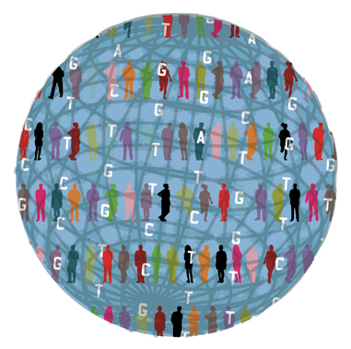
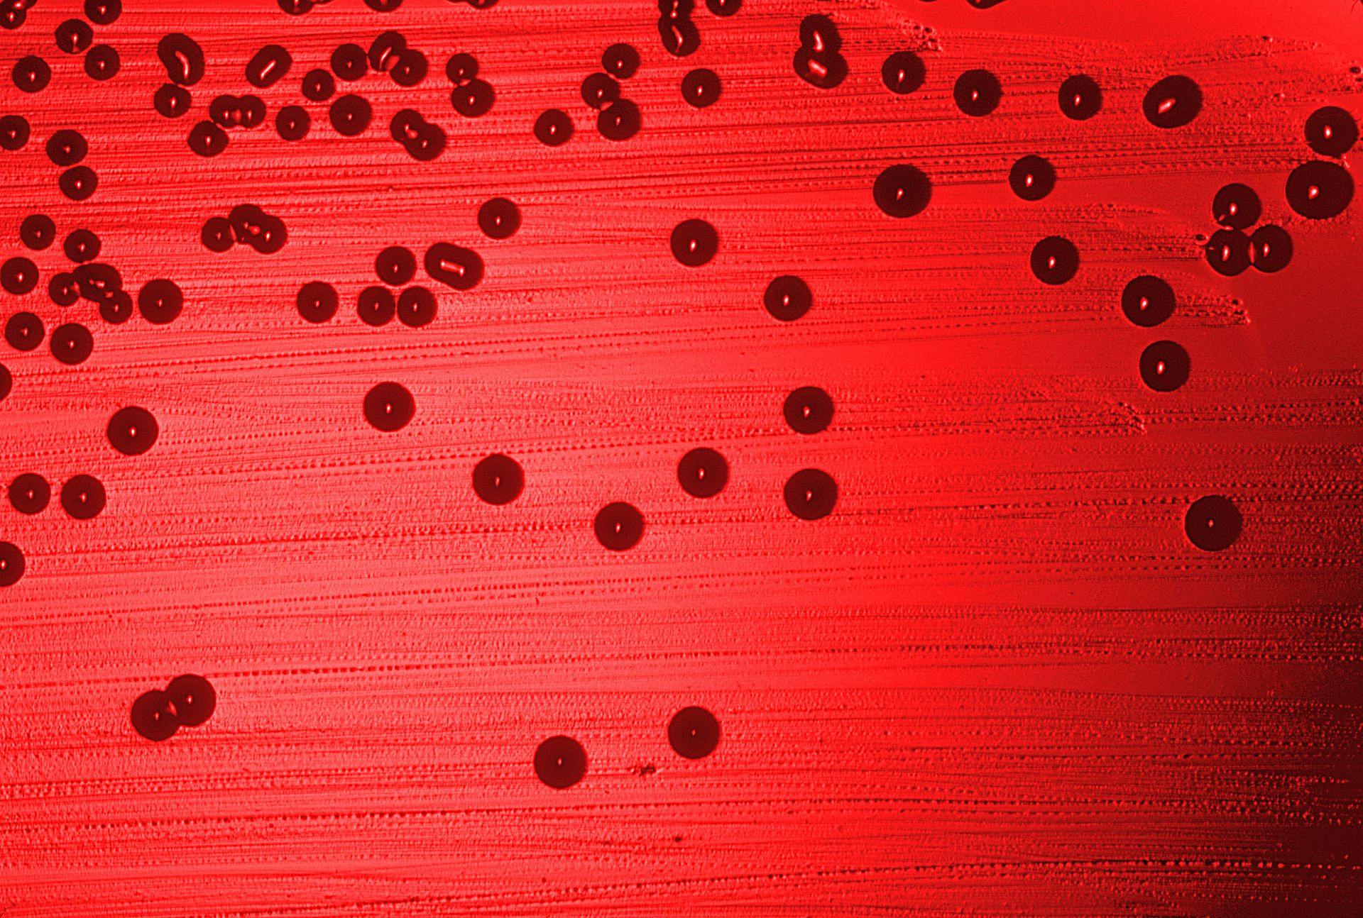
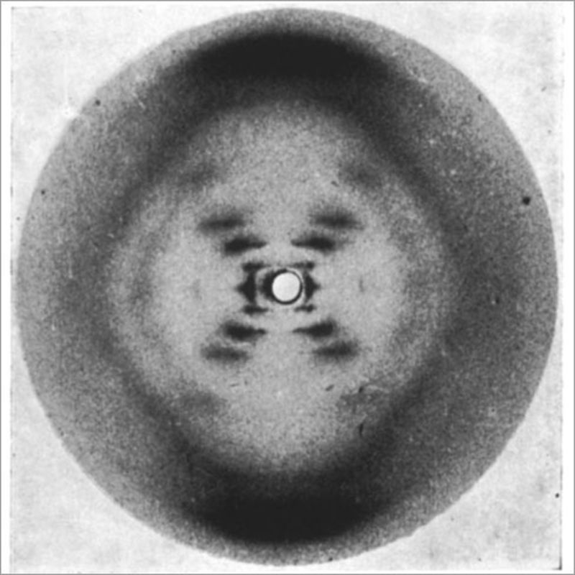
2015
2008
Integrated health data
1995
Thousand Genomes
Study with over 0.5M participants collecting integrated data from genotypes to phenotypic details and clinical information
1953
Sequenced Genome
By far the most detailed catalogue of human genetic variation
Double Helix
Haemophilus influenzae as the first organism’s genome completely sequenced
The discovery of double helix by James Watson and Francis Crick

