Slide 1
RADAR: an RNA binDing protein regulatory network resource for cAncer Research
Figure Mockup
Workflow walkthrough

Slide 2
A
C
B

Slide 3
C
RBP Specific Annotations
A
B
Length of Genomic Elements
D
Rare DAF Comparison

Slide 5
A
Noncoding
B
Coding
C
D

Slide 7
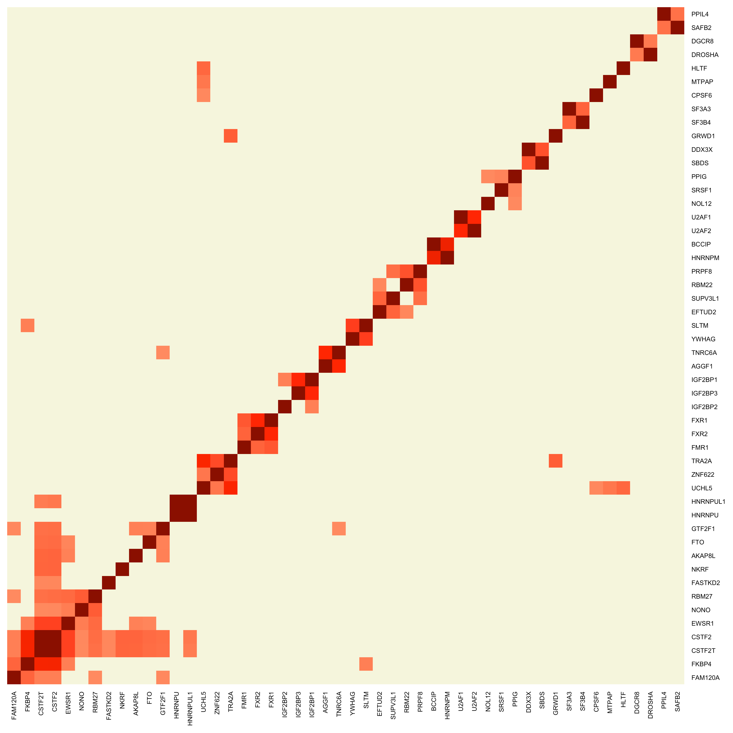

Slide 8
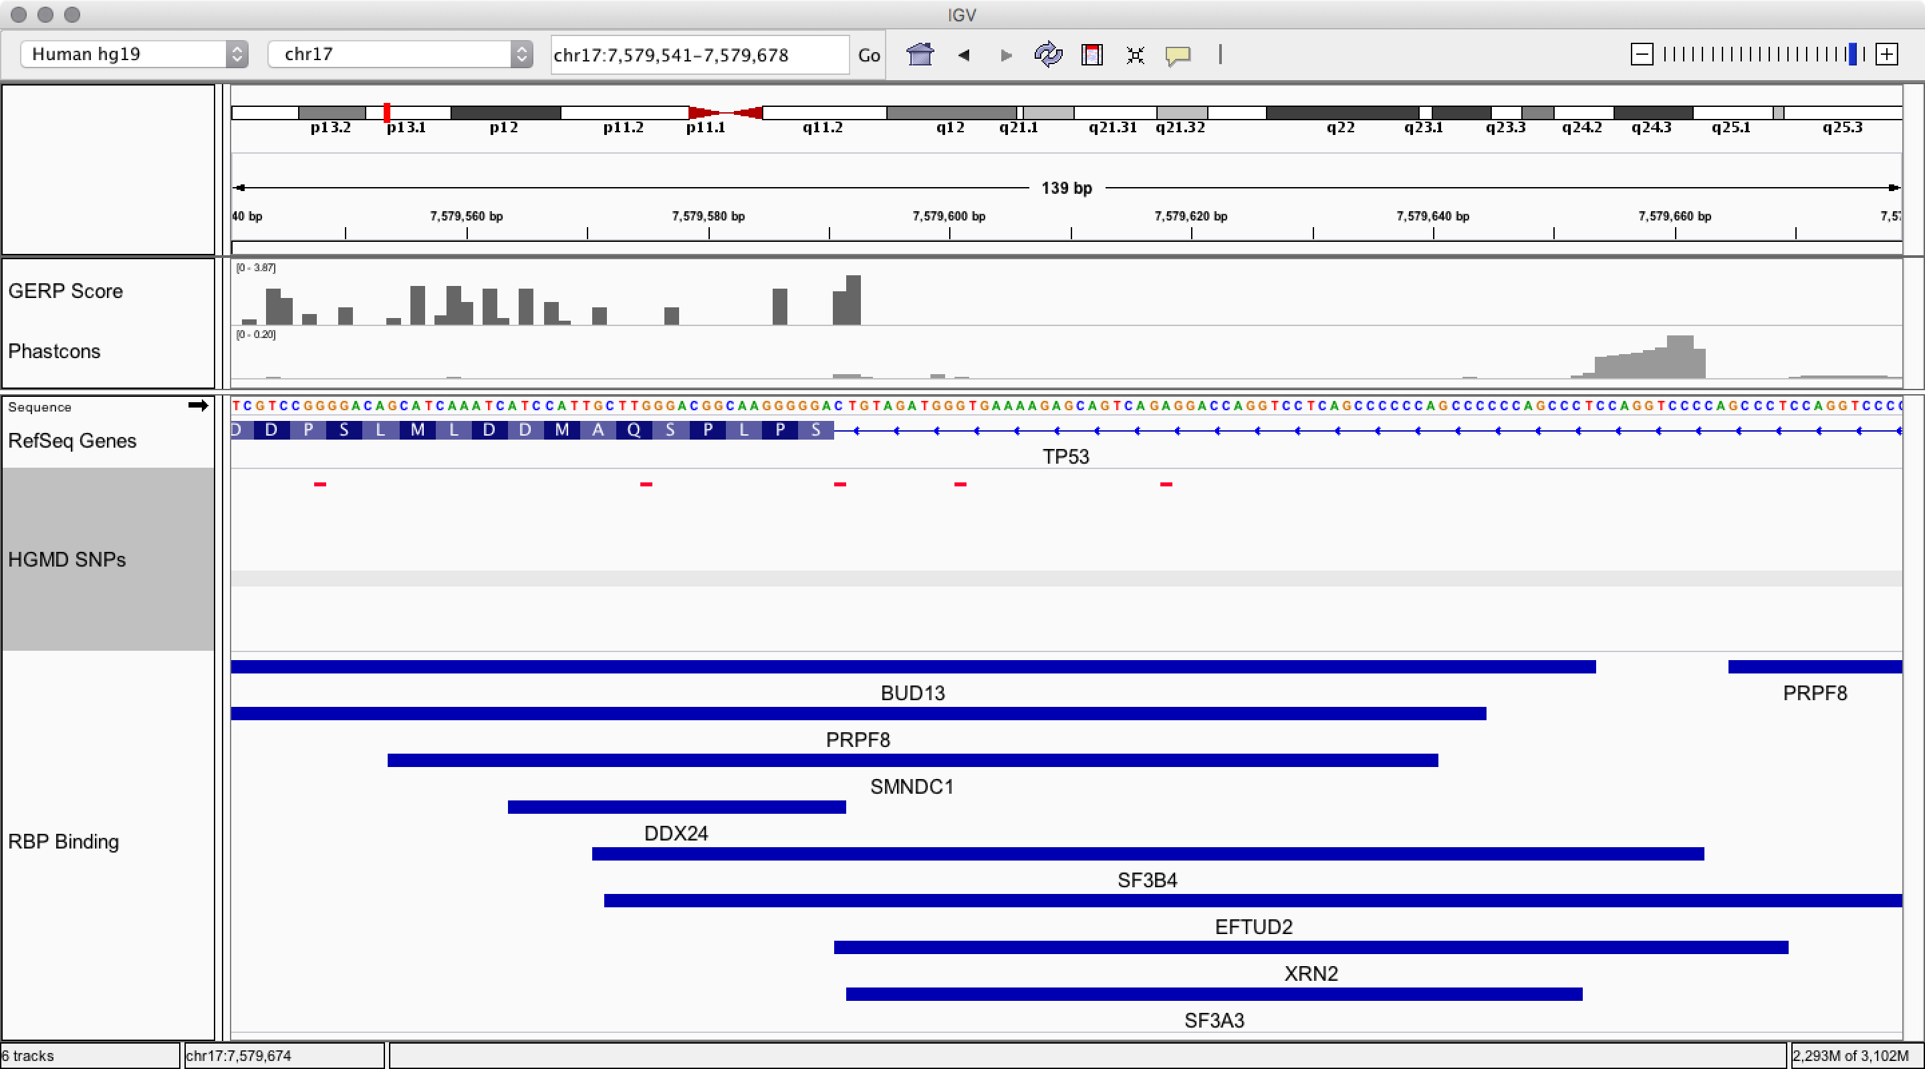
B
HGMD Variants
C
HGMD Nearby Intron Variants
A
mean
Binding profiles
median
QC
Binding Annotation
Network Construction
Motif Scanning
SNPs
D
Rare DAF%
Features, e.g. GC
Background Correction
chr17 : 7,579,618
A>T
28 bp
Annotation score
Hot score
Motif score
Breaks SF3B4 Motif
Rscore

Slide 9
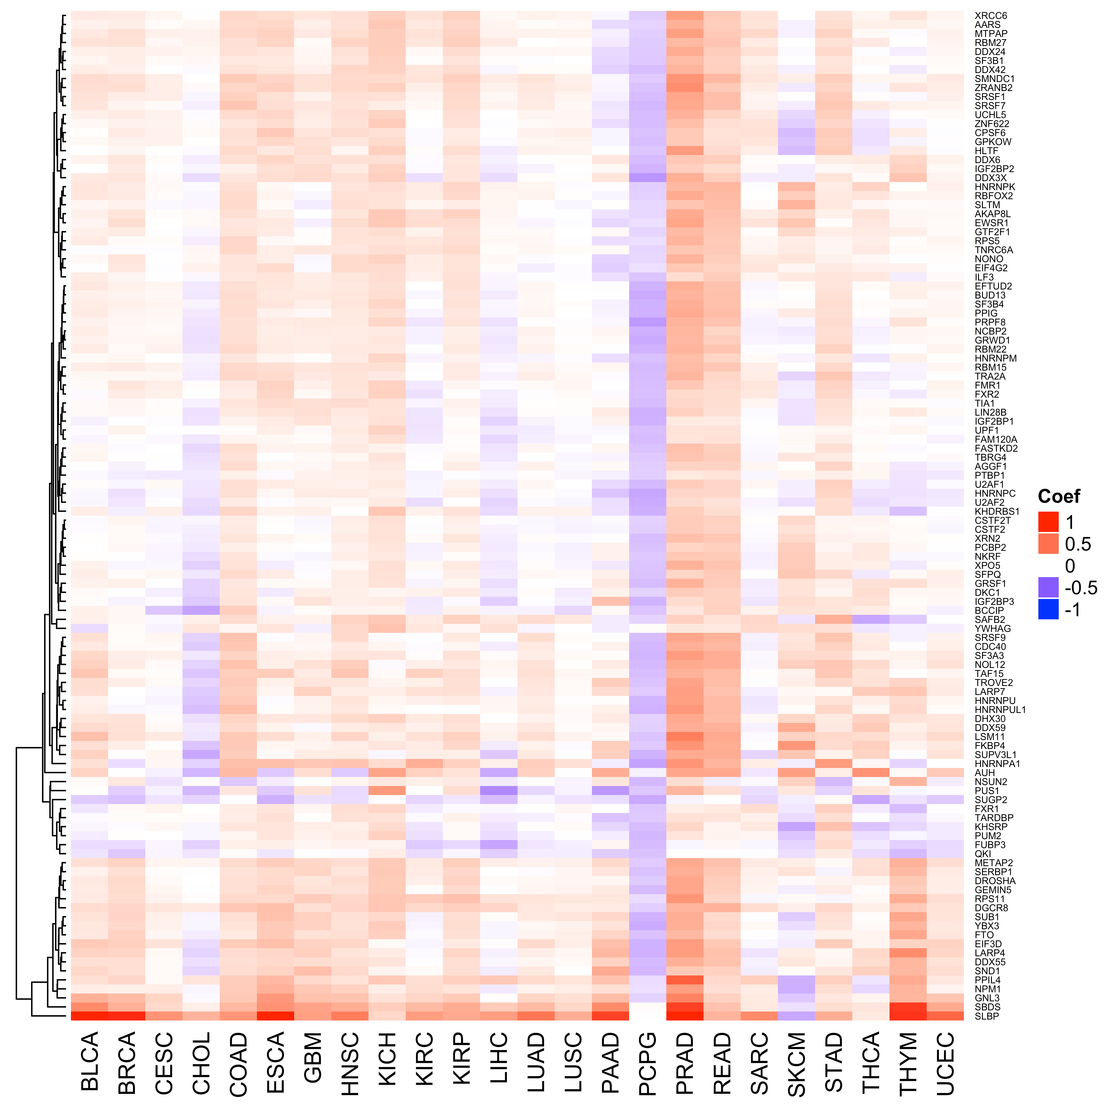
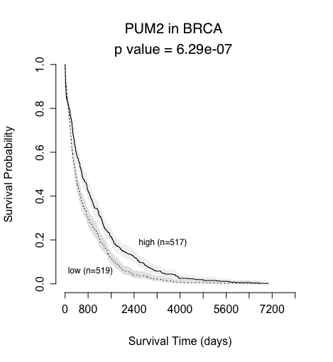
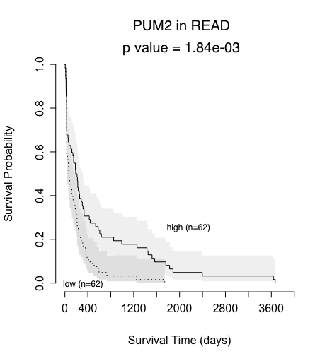
A
1 kb
B
1 kb
5’ UTR
exon
intron
exon
3’UTR
1 kb
1 kb
RBP₁
RBP₂
RBP₃
RBP_{k}
G₁
G₂
G₃
G_{n-1}
G_{n}
RBP₃
RBP₂
RBP2
G₃
G₁
G₂
G_{n-1}
G_{n}
RBP₁
 |  |  |  | … |  |  | Significance
 | G₁ | G₂ | G₃ | … | G_{n-1} | G_{n}
RBP₁ | 1 | 1 | 1 | … | 0 | 0
RBP₂ | 1 | 1 | 0 | … | 0 | 1
RBP₃ | 1 | 0 | 1 | … | 1 | 0
RBP_{k} | 0 | 0 | 0 | … | 1 | 1
C
****
**

Slide 10
Walkthrough of RADAR
Supplemental Information

Slide 11
Motivation of RADAR
Annotation
  Targets of RBPs (regulatory network)
  Classification of peaks or variants: CDS, 3’ UTR, 5’UTR, 3’ Extended, 5’ extended, nearby Intron, other
Prioritization of RBPs
  RBP Activity prediction (logistic regression)
  RBP as prognostic marker
Variant Scoring
  FunSeq2-like entropy-based scoring system for variants specific to RBP binding regions
    Discrete Score (Annotation Score)
    Motif Score
    Recurrence Score

Slide 12
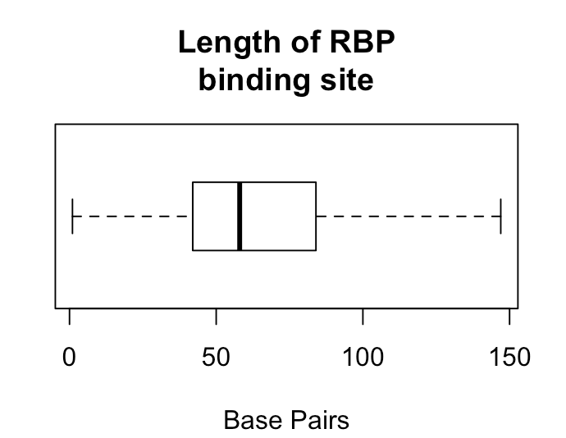
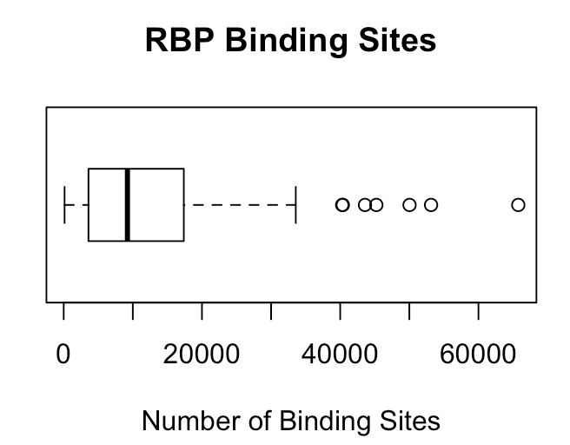
Binding profiles
Binding profiles
eCLIP ENCODE | HepG2 | K562
# RBPs | 70 | 89
# Replicates | 140 | 178
QC
Binding Annotation
Network Construction
Motif Scanning
SNPs
QC
1. Merge RBPs across cell type, taking the union of binding sites
Rare DAF%
K562, RBFOX2
HepG2, RBFOX2
Features, e.g. GC
merged, RBFOX2
2. Only select peaks that have a quality check score of 1000
Background Correction
Annotation score
Hot score
Motif score
Rscore

Slide 13
Nearby intron
Binding profiles
Binding Annotation
1 kb
1 kb
5’ UTR
exon
intron
exon
3’UTR
RBFOX2
QC
RBFOX2
Exon
RBFOX2
Nearby
intron
Binding Annotation
Network Construction
Motif Scanning
SNPs
1. De novo motif discovery using DREME (MEME Suite)
Motif Scanning
Example: RBFOX2, well known motif: TGCATG
Rare DAF%
DREME Result
Features, e.g. GC
Background Correction
Annotation score
Hot score
Motif score
Of the 112 RBP, motifs found for 108 RBPs
Motif with best p-value kept
Rscore

Slide 14
Network Construction
1 kb
1 kb
Binding profiles
5’ UTR
exon
intron
exon
3’UTR
1 kb
1 kb
QC
RBP₁
RBP₂
Binding Annotation
Network Construction
Motif Scanning
RBP₃
RBP_{k}
SNPs
G₁
G₂
G₃
G_{n-1}
G_{n}
RBP₃
RBP₂
RBP2
Rare DAF%
G_{n-1}
G_{n}
G₃
G₁
G₂
Features, e.g. GC
RBP₁
 |  |  |  | … |  |  | Significance
 | G₁ | G₂ | G₃ | … | G_{n-1} | G_{n}
RBP₁ | 1 | 1 | 1 | … | 0 | 0
RBP₂ | 1 | 1 | 0 | … | 0 | 1
RBP₃ | 1 | 0 | 1 | … | 1 | 0
RBP_{k} | 0 | 0 | 0 | … | 1 | 1
Background Correction
****
Annotation score
Hot score
Motif score
Rscore
**

Slide 15
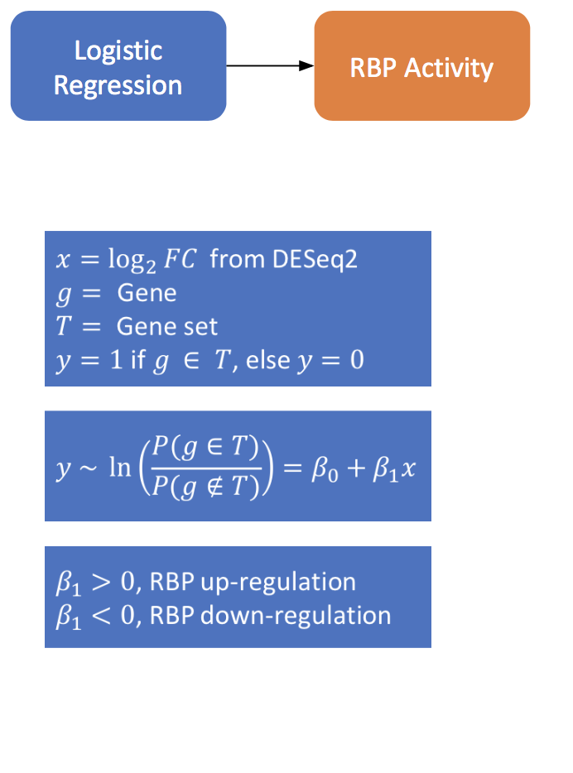
1 kb
1 kb
Network Construction
5’ UTR
exon
intron
exon
3’UTR
1 kb
1 kb
RBP₁
RBP₂
RBP₃
RBP_{k}
G₁
G₂
G₃
G_{n-1}
G_{n}
RBP₃
RBP₂
RBP2
G₃
G₁
G₂
G_{n-1}
G_{n}
RBP₁
 |  |  |  | … |  |  | Significance
 | G₁ | G₂ | G₃ | … | G_{n-1} | G_{n}
RBP₁ | 1 | 1 | 1 | … | 0 | 0
RBP₂ | 1 | 1 | 0 | … | 0 | 1
RBP₃ | 1 | 0 | 1 | … | 1 | 0
RBP_{k} | 0 | 0 | 0 | … | 1 | 1
****
**

Slide 16
Analysis from pooled patients
Network Construction
RBP
Prioritization
Analysis from individual patients

Slide 17
Binding profiles
SNPs
1000 Genomes Project rare and common SNPs are used
QC
Binding Annotation
Network Construction
Motif Scanning
Rare DAF%
For each RBP, we can obtain a Rare DAF %, for coding and noncoding regions
SNPs
RBFOX2, BS₁
RBFOX2, BS_{n}
rare
Rare DAF%
common
Features, e.g. GC
Background Correction
Annotation score
Hot score
Motif score
Rscore

Slide 18
Features, e.g. GC
Binding profiles
Background Correction
500bp
QC
GC
…
…
30.3
31.2
32.6
64.3
65.2
65.1
30.3
29.5
28.1
Binding Annotation
Network Construction
Motif Scanning
SNPs
…
GC
28-30%
GC
30-32%
GC
32-34%
…
GC
62-64%
GC
64-66%
GC
66-68%
…
Rare DAF%
Calculate rare DAF for each 2% bin (coding and noncoding)
Features, e.g. GC
Background Correction
Annotation score
Hot score
Motif score
Rscore

Slide 19
Features, e.g. GC
Background Correction

Slide 20
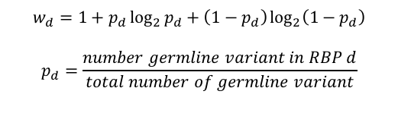
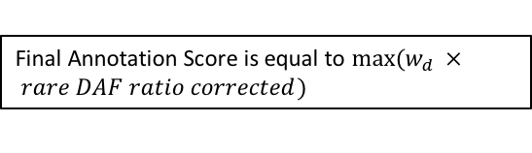
Binding profiles
Binding Annotation
 | Regulatory Noncoding | Coding
Classification | 3’ UTR, 3’ UTR extended, 5’ UTR, 5’ UTR extended, Nearby Intron | Coding Exon
QC
Binding Annotation
Network Construction
Motif Scanning
SNPs
Annotation score
Rare DAF%
RBFOX2, BS₁
RBFOX2, BS_{n}
coding BS₁
coding BS_{n}
RBFOX2, noncoding BS₁
noncoding BS_{n}
Features, e.g. GC
rare
All RBPs
common
Background Correction
Obtain a Rare DAF ratio (GC corrected) for noncoding, and coding regions of each RBP.
Annotation score
Hot score
Motif score
$$w_{d}=1+p_{d}\log_{2}{p_{d}}+\left(1−p_{d}\right)\log_{2}\left(1−p_{d}\right)$$
$$p_{d}=\frac{number germline variant in RBP d}{total number of germline variant}$$
Final Annotation Score is equal to $max(w_{d } × rare DAF ratio corrected)$
Rscore

Slide 21
Hot score
Binding profiles
QC
Binding Annotation
Network Construction
Motif Scanning
SNPs
Rare DAF%
Features, e.g. GC
Background Correction
Annotation score
Hot score
Motif score
Rscore

Slide 22
Coding Region GC Analysis
Noncoding Region GC Analysis

Slide 23
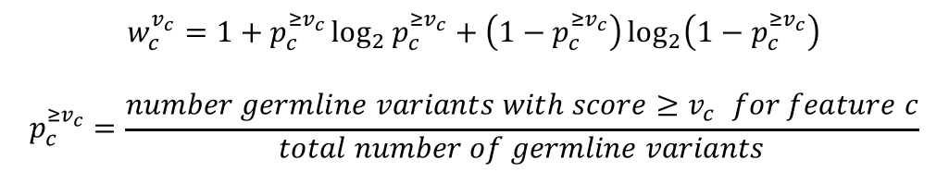
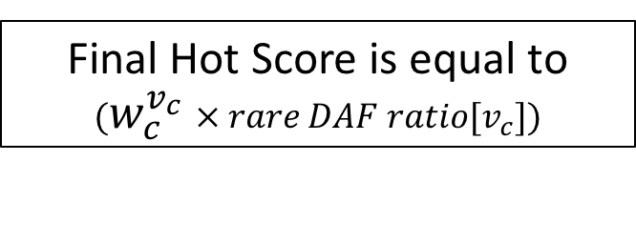
Hot score
Noncoding
Coding
*
*The cutoff where 1% of the data falls results in an unstable Rare DAF Ratio, and therefore the max rare DAF ratio before this cutoff is used.
*
We select the Recurrence cutoff for considering a region “hot” such that 5% of the data falls above that cutoff
$$w_{c}^{v_{c}}=1+p_{c}^{{≥v}_{c}}\log_{2}{p_{c}^{{≥v}_{c}}}+\left(1−p_{c}^{{≥v}_{c}}\right)\log_{2}\left(1−p_{c}^{{≥v}_{c}}\right)$$
$$p_{c}^{{≥v}_{c}}=\frac{number germline variants with score{≥v}_{c} for feature c}{total number of germline variants}$$
Final Hot Score is equal to $(w_{c}^{v_{c}} × rare DAF ratio{[v}_{c}])$

Slide 24
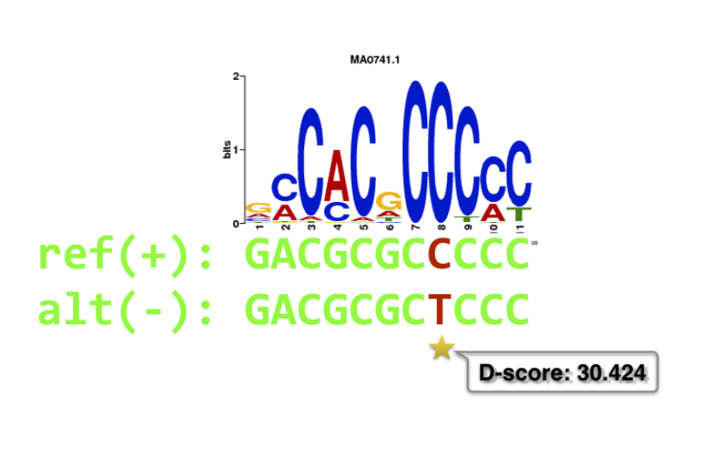
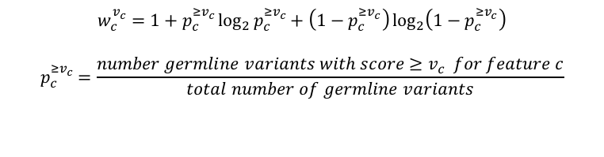
Binding profiles
Motif score
QC
Binding Annotation
Network Construction
Motif Scanning
SNPs
Rare DAF%
Features, e.g. GC
$$w_{c}^{v_{c}}=1+p_{c}^{{≥v}_{c}}\log_{2}{p_{c}^{{≥v}_{c}}}+\left(1−p_{c}^{{≥v}_{c}}\right)\log_{2}\left(1−p_{c}^{{≥v}_{c}}\right)$$
$$p_{c}^{{≥v}_{c}}=\frac{number germline variants with score{≥v}_{c} for feature c}{total number of germline variants}$$
Background Correction
Motif
Breaking
Annotation score
Hot score
Motif score
Rscore

Slide 25
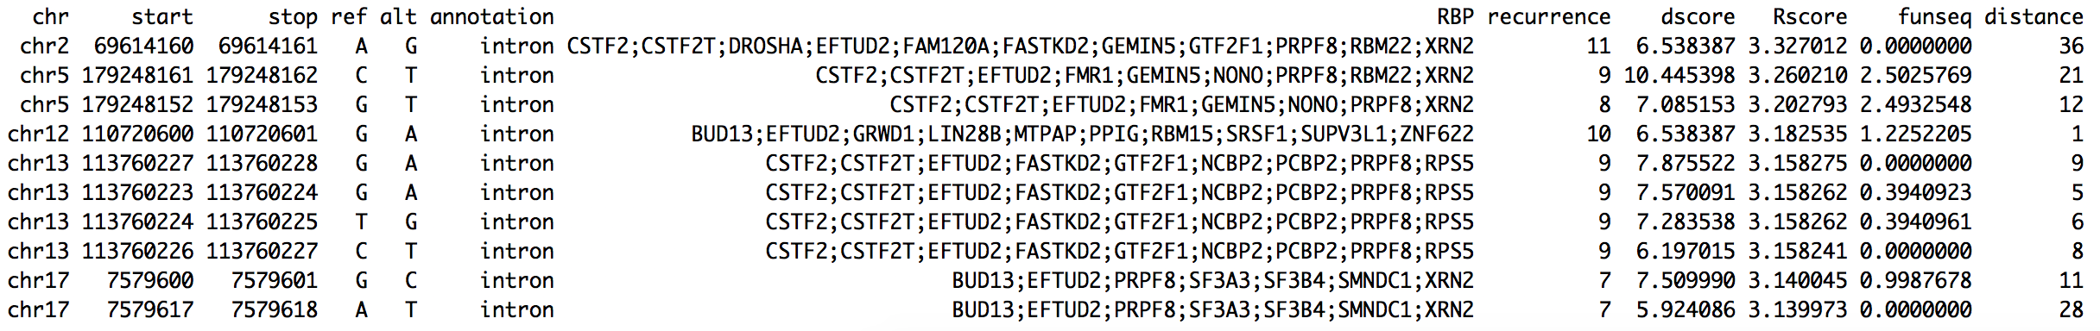
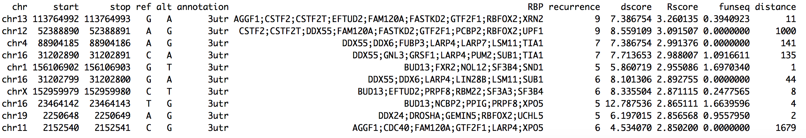
Enrichment of HGMD variants in RBP regions
 | # Genomic variants | Genomic length | Genomic p | RBP Variants | RBP length | RBP p | Enrichment | Binomial p_{val} | Length Ratio
3’ UTR | 770 | 41676932 | 1.85e-05 | 220 | 5640993 | 3.90e-05 | 2.11 | 4.01e-23 | 13.54%
3’ UTR ext. | 1588 | 63984260 | 2.48e-05 | 532 | 2534367 | 2.10e-04 | 8.46 | 4.97e-292 | 3.96%
5’ UTR | 930 | 17075609 | 5.45e-05 | 268 | 2120360 | 1.26e-04 | 2.32 | 7.56e-34 | 12.42%
5’ UTR ext. | 2126 | 70816790 | 3.00e-05 | 390 | 2795556 | 1.40e-04 | 4.65 | 1.36e-129 | 3.95%
Nearby intron | 9103 | 33380774 | 2.73e-04 | 2149 | 4272630 | 5.03e-04 | 1.84 | 1.53e-146 | 12.80%
Coding | 95510 | 35345952 | 2.70e-03 | 31284 | 10841177 | 2.89e-03 | 1.07 | 5.87e-31 | 30.67%
Rscore
Top 10 intron HGMD variants, based on Rscore
Top 10 3’ UTR HGMD variants, based on Rscore

Slide 26
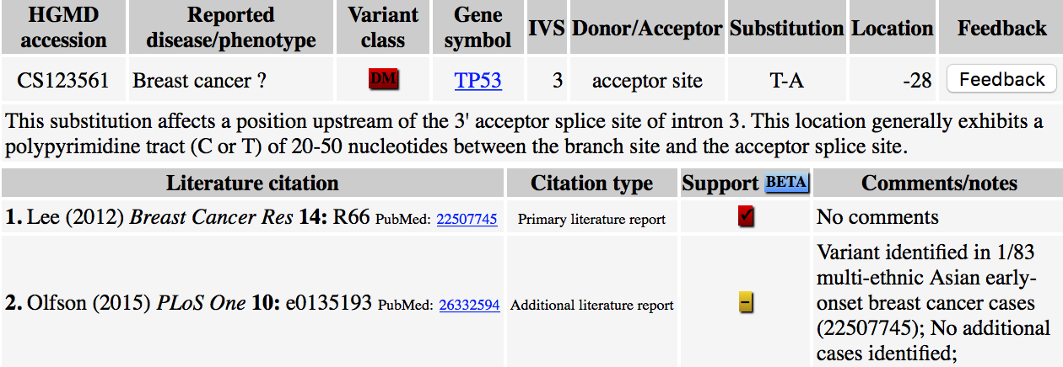
Example 1
chr17 : 7,579,618
A>T
28 bp
Breaks SF3B4 Motif

Slide 27
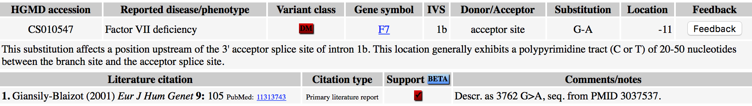
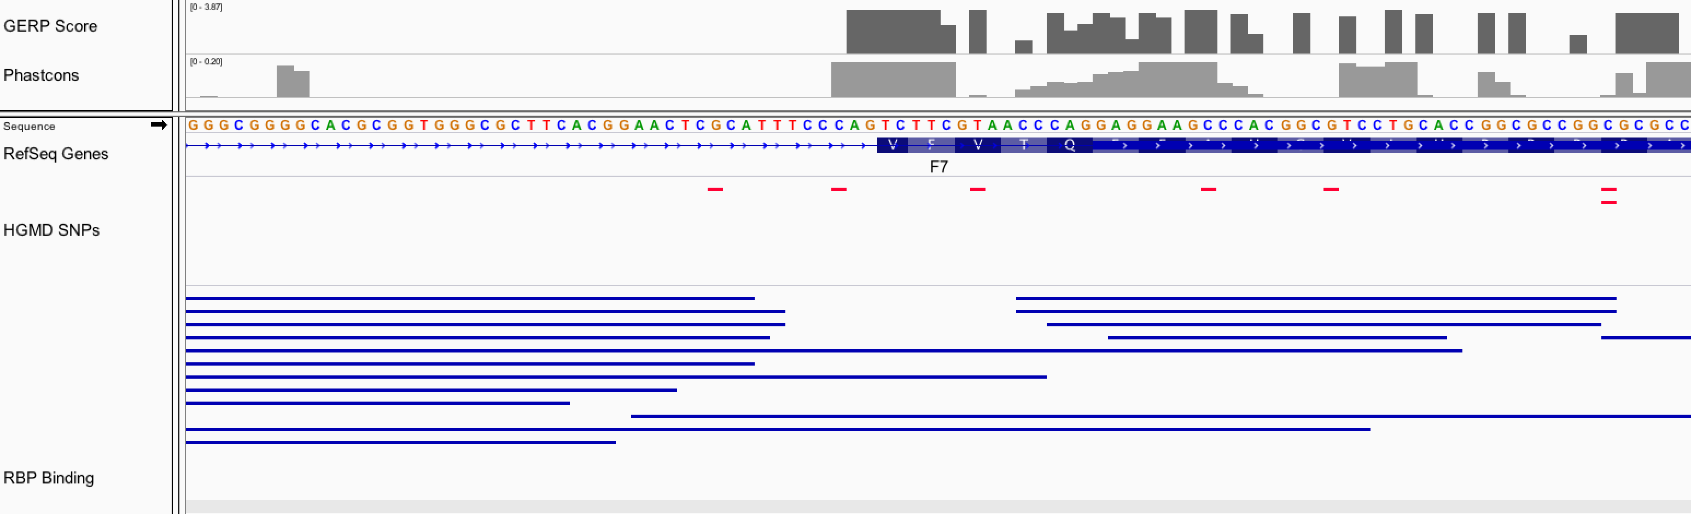
11 bp
chr13 : 113,764,993
G>A

