Slide 1
Analysis of chemical probing with large sets of replicate experiments
Michael Rutenberg-Schoenberg
26 Dec 2017

Slide 2
Outline
Review of chemical probing
New datasets with 60 replicates
Testing distribution fits for new replicate data
Inference of biochemical properties with different distributional assumptions in chemical probing data

Slide 3
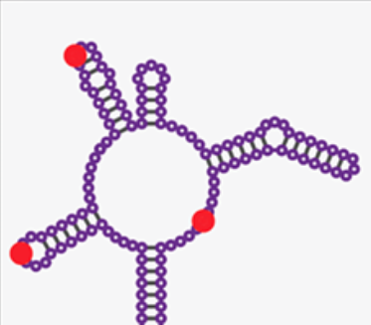
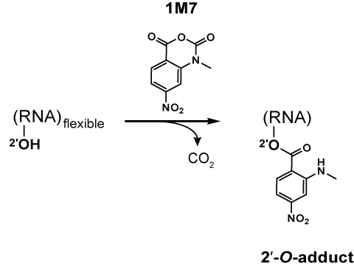
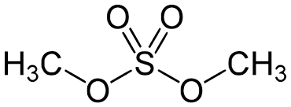
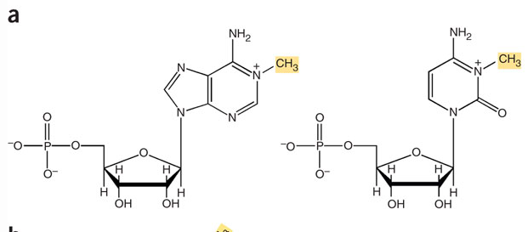
Chemical probing of RNA
Chemically modify RNA
Usually unstructured nucleotides are modifiable
Read out with reverse transcriptase
Stops & Mutations
Chemically modify RNA
(mainly unstructured regions)
SHAPE
(Selective 2’-hydroxyl acylation & primer extension)
Dimethyl Sulfate (DMS)
A
C
Reviewed in Kubota et al Nat Chem Biol 2016; https://en.wikipedia.org/wiki/Nucleic_acid_structure_determination, Tijerna et al. Nat Protocols 2007
Notes:
DMS – methylates the Watson-Crick face of A,C
1M7 (SHAPE reagent) – acylate flexible 2’ OH in the ribose sugar

Slide 4
Chemical probing of RNA
Chemically modify RNA
Usually unstructured nucleotides are modifiable
Read out with reverse transcriptase
Stops & Mutations
Chemically modify RNA
(mainly unstructured regions)
Read out with Reverse Transcriptase
Stops
Reviewed in Kubota et al Nat Chem Biol 2016
Notes:
DMS – methylates the Watson-Crick face of A,C
1M7 (SHAPE reagent) – acylate flexible 2’ OH in the ribose sugar

Slide 5
Chemical probing: statistical process
Y_{ij} reads reach nucleotide i in sample j = “Coverage”
X_{ij} reads stop at nucleotide i in sample j = “Counts”
p_{ij} = X_{ij}/Y_{ij} is the probability of stopping at nucleotide i in sample j
If no overdispersion, counts should follow the Binomial distribution
If p_{ij} is small and Y_{ij} is large, then should follow Poisson

Slide 6
Chemical probing: inferring nucleotide reactivity
Y_{ij} reads reach nucleotide i in sample j = “Coverage”
X_{ij} reads stop at nucleotide i in sample j = “Counts”
p_{ij} = X_{ij}/Y_{ij} is the probability of stopping at nucleotide i in sample j
Stopping can occur due to natural RT dropoff, or can be induced by the chemical.
The control experiment can enable inference of the natural stop rate:
ß_{i} = mean_{j}(p_{ij}) for all samples j that are controls
Combining the treatment and control enables inference of the chemical induced stop rate
γ_{i} = (mean_{j}(p_{ij}) – ß_{i} )/(1-ß_{i}) for all samples j that are treatment

Slide 7
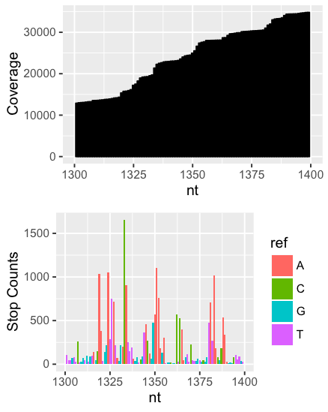
Inferring reactivity from chemical probing data
p_{i} = (Reads stopping at nucleotide i)/
(All reads reaching nucleotide i)
If not overdispersed, this should be a binomial process. If p_{i} is small and coverage is large, then this should fit Poisson
Fang, Moss et al. PLoS Genet. 2015
Notes:
Fang, Moss et al. PLoS Genet. 2015

Slide 8
Inferring reactivity from chemical probing data
DMS-Seq data for Xist RNA
A and C should be modified
Treated
Treated - Control
Control
i∈nucleotides; N total
P_{stop}(i) = stops(i)/coverage(i)
∆P_{stop}(i) = P_{stop}(treated) - P_{stop}(control)
Fang, Moss et al. PLoS Genet. 2015
Notes:
Fang, Moss et al. PLoS Genet. 2015

Slide 9
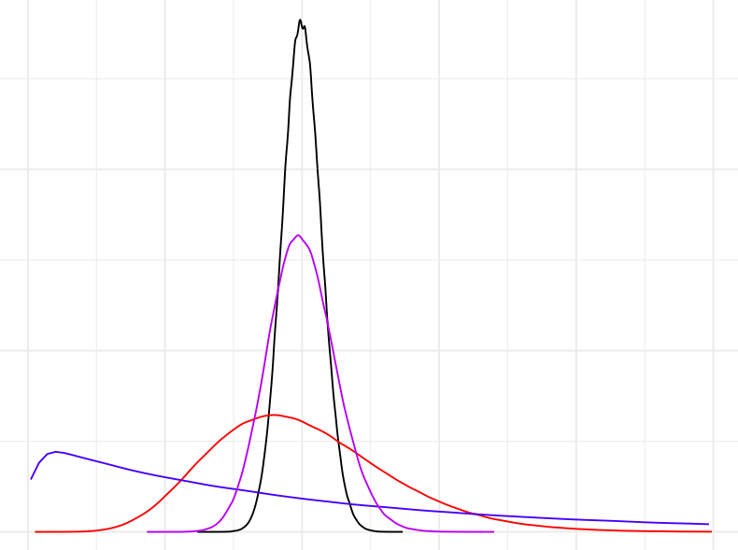
Can we fit a distribution with a small number of replicates?
Replicate observations
Probability Density
Distributions have identical means
Counts

Slide 10
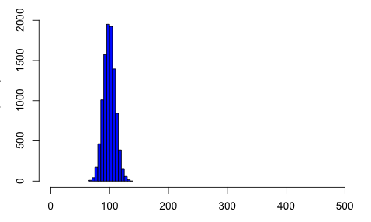
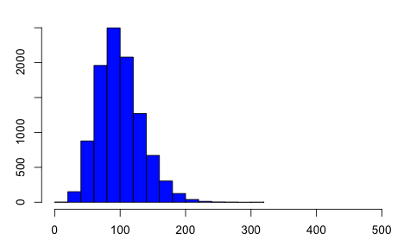
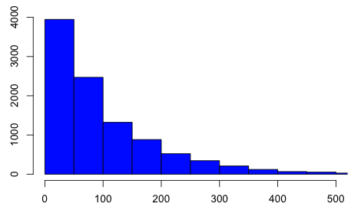
Negative binomial distribution is an extension of Poisson that can allow greater variability
σ² = µ + αµ²
α = 0 → Poisson
Larger alpha → more overdispersed
α = 0
α = 0.01
α = 1
Notes:
----- Meeting Notes (10/27/16 15:24) -----
Estimate variance
DESeq/edgeR

Slide 11
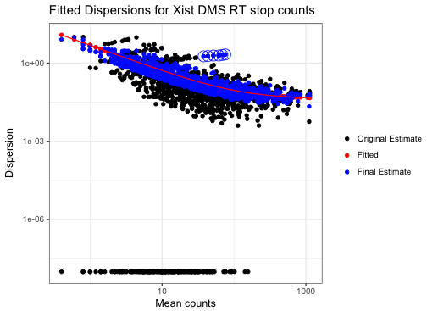
Fitting the negative binomial distribution with DESeq2
DESeq2 is a tool originally designed to analyze RNA-Seq
Fit α parameter using shared information between nucleotides (genes).
α = 0
α = 0.01
α = 1
Notes:
----- Meeting Notes (10/27/16 15:24) -----
Estimate variance
DESeq/edgeR

Slide 12
Outline
Review of chemical probing
New datasets with 60 replicates
Testing distribution fits for new replicate data
Inference of biochemical properties with different distributional assumptions in chemical probing data

Slide 13
New datasets with 60 replicates
Larger replicate datasets constructed by multiplexing library preps
Experiments done in mouse embryonic fibroblasts in 3 formats:
Targeted to 7SK RNA
Targeted to GapDH mRNA
Untargeted (genome-wide, but most data are for rRNAs)

Slide 14
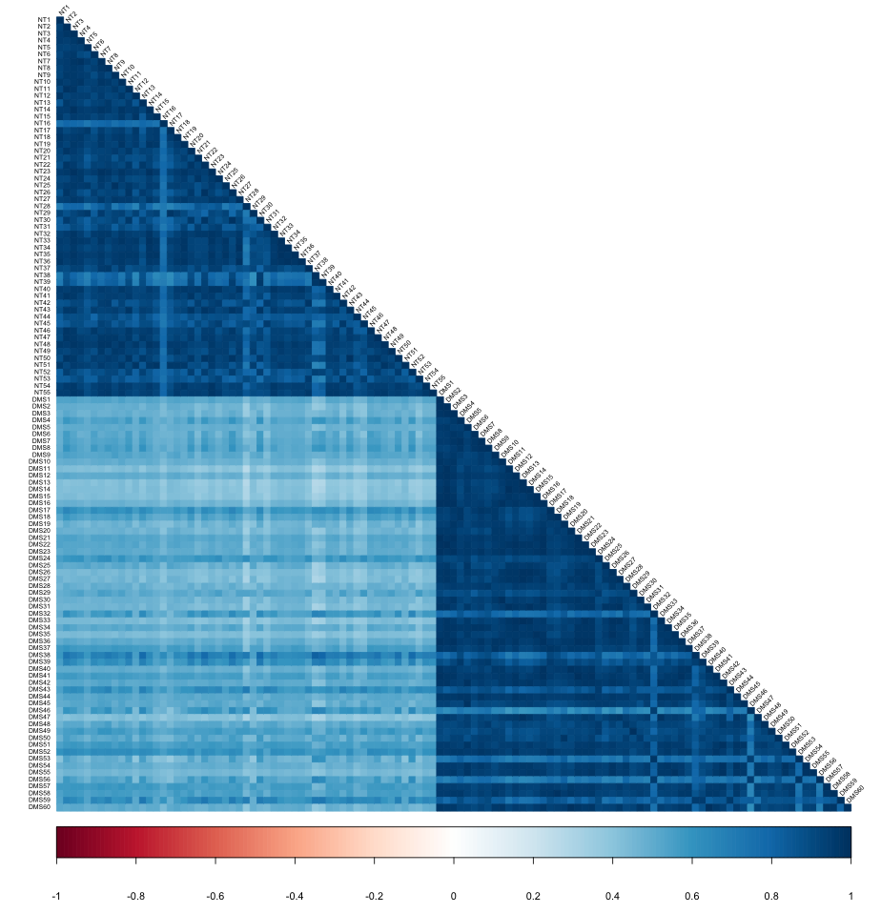
Mouse 18S: NT and DMS treatments cluster together
Correlations of probability of RT stopping at each nucleotide
NT
DMS
Data: Alec Sexton

Slide 15
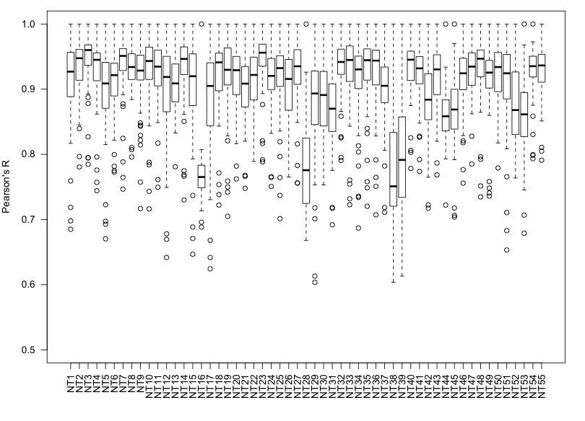
Within group correlations of m18S untreated samples
Boxplots of Pearson’s R for each mouse 18S control sample against all of its replicates
A few samples look like outliers (see arrows for examples)

Slide 16
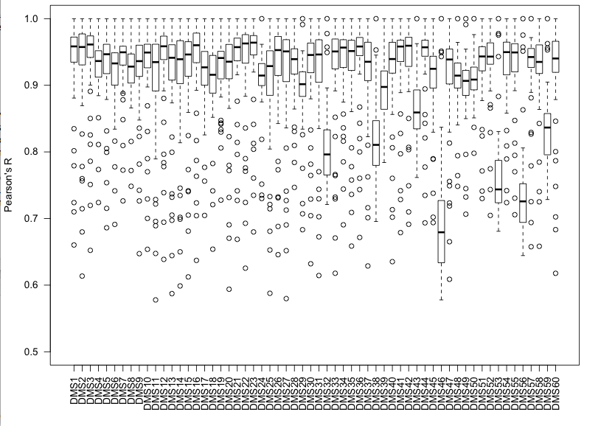
Within group correlations of m18S DMS treated samples
Boxplots of Pearson’s R for each mouse 18S DMS sample against all of its replicates
A few samples look like outliers (see arrows for examples)

Slide 17
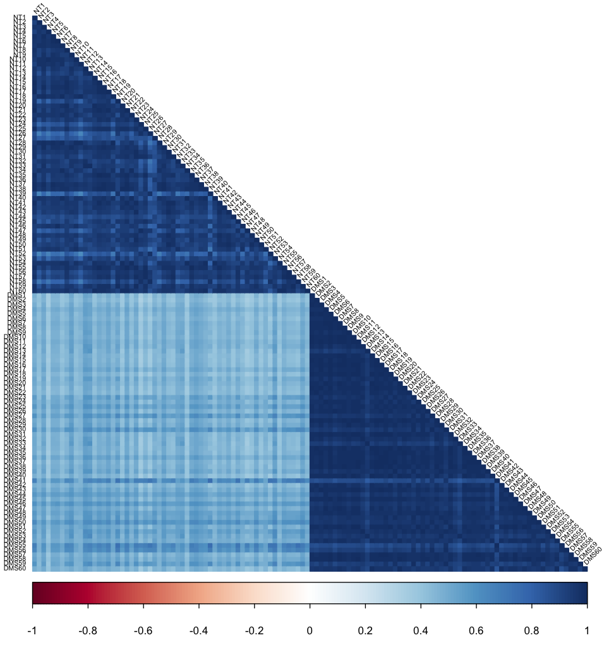
Mouse 7SK: NT and DMS treatments cluster together
Correlations of probability of RT stopping at each nucleotide
NT
DMS

Slide 18
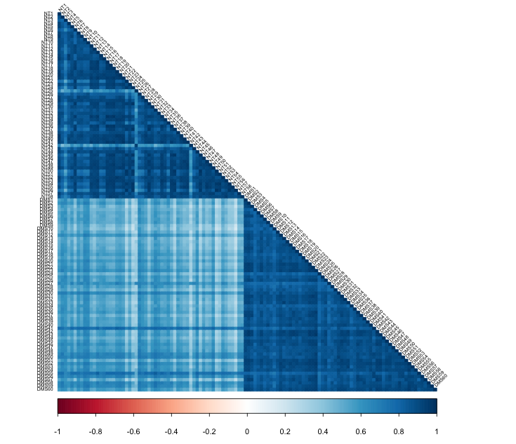
Mouse GapDH: NT and DMS treatments cluster together
Correlations of probability of RT stopping at each nucleotide
Lower coverage corresponds to lower correlations
NT
DMS

Slide 19
Outline
Review of chemical probing
New datasets with 60 replicates
Testing distribution fits for new replicate data
Inference of biochemical properties with different distributional assumptions in chemical probing data

Slide 20
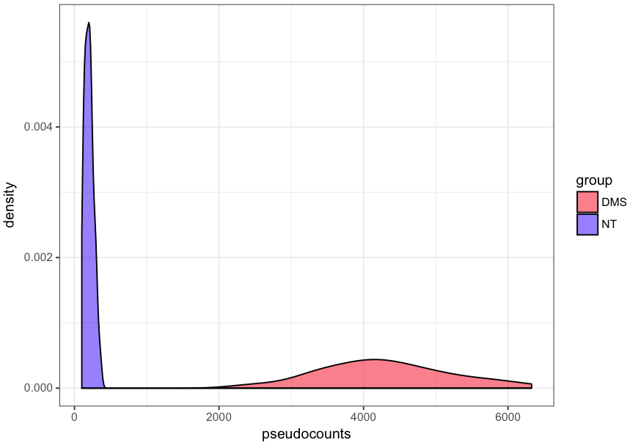
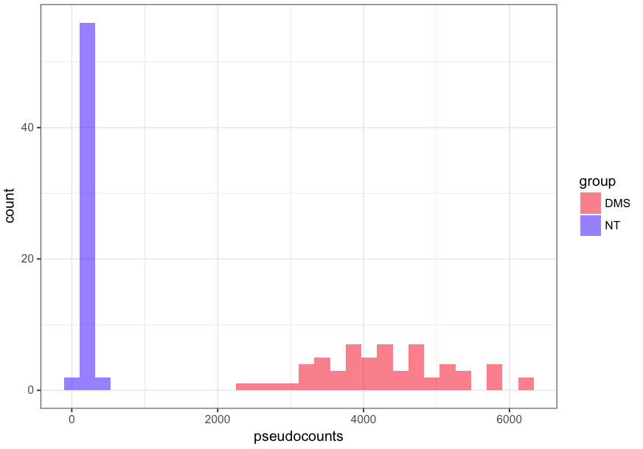
Single nucleotide: mouse 7SK #152
Kernel density plots of stop counts, normalized to coverage
stop counts, normalized to coverage

Slide 21
Single nucleotide: mouse 7SK #152
Kernel density plots of stop counts, normalized to coverage

Slide 22
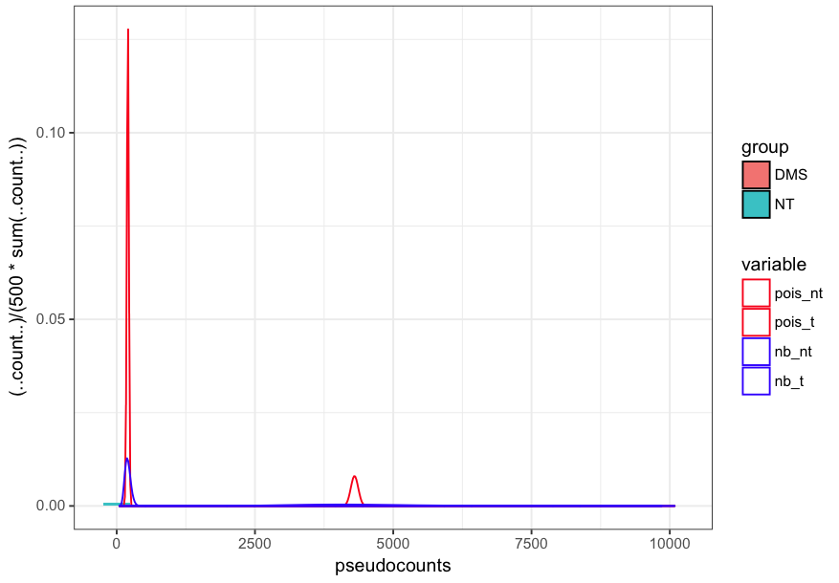
Single nucleotide: mouse 7SK #152
Kernel density plots of Poisson and Negative Binomial fits to normalized stop counts

Slide 23
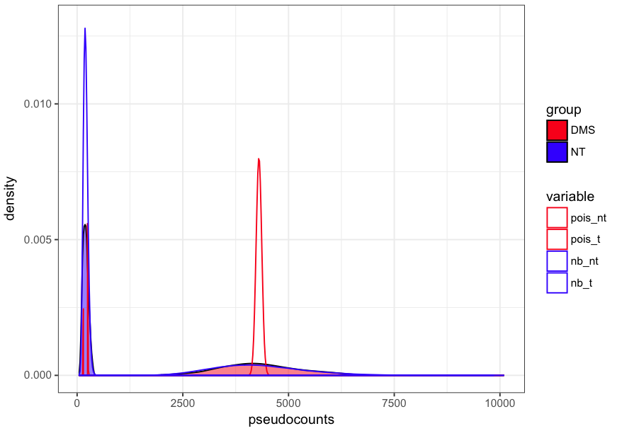
Single nucleotide: mouse 7SK #152
Kernel density plots of Poisson and Negative Binomial fits to normalized stop counts

Slide 24
Assessing goodness of fit
From 60 total replicates, use randomly select 2-30 replicates to fit and 30 others to test fit.
Likelihood-based metrics
Akaike Information Criterion
AIC = 2k – 2*log(L)
Bayesian Information Criterion
BIC = 2nk – 2*log(L)
n = # of observations (nucleotides), k = # of parameters
Should I use other metrics, e.g. KS test?

Slide 25
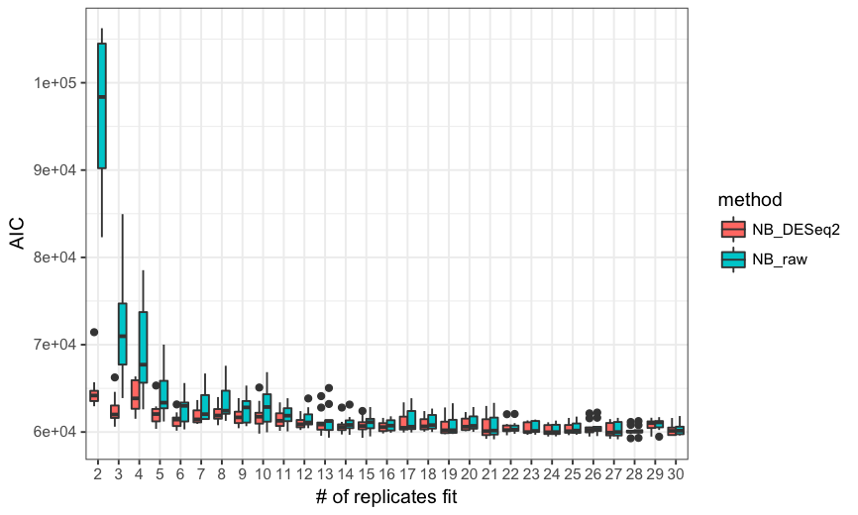
Comparison of DESeq2 vs. NB raw fits

Slide 26
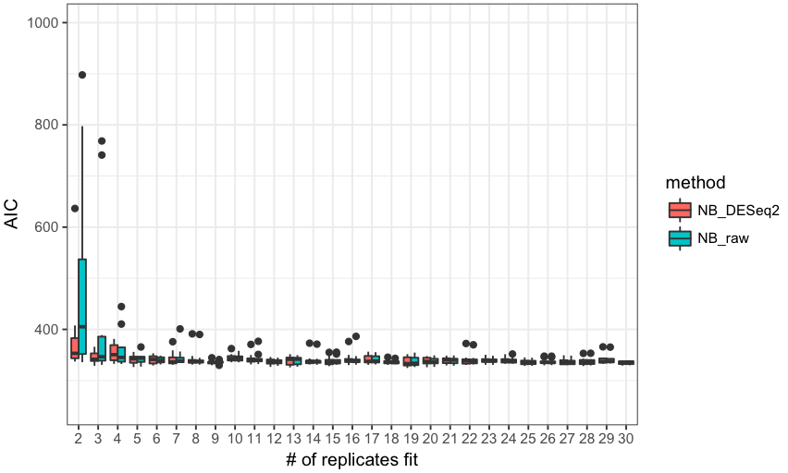
m7SK nucleotide 152

Slide 27
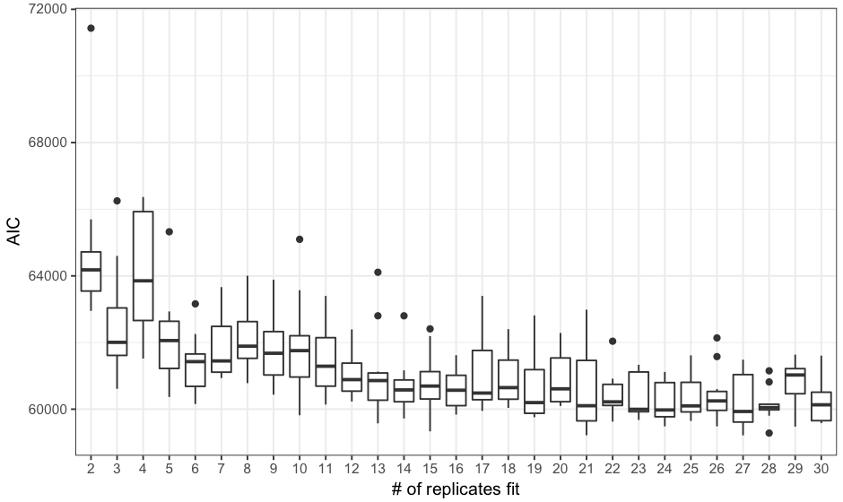
7SK all nucleotides negative binomial fit as a function of replicates used

Slide 28
Outline
Review of chemical probing
New datasets with 60 replicates
Testing distribution fits for new replicate data
Inference of biochemical properties with different distributional assumptions in chemical probing data

Slide 29
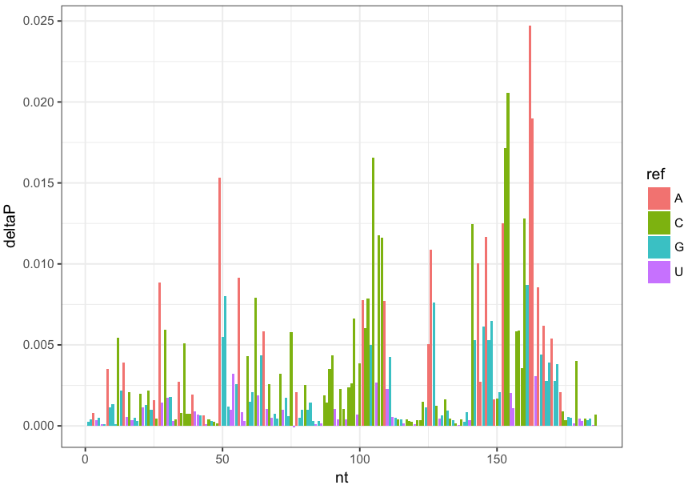
Can we recover biochemical bias of chemical reagent using probing data?
DMS is specific for A and C nucleotides (and also for those A/C nucleotides that are double stranded)

Slide 30
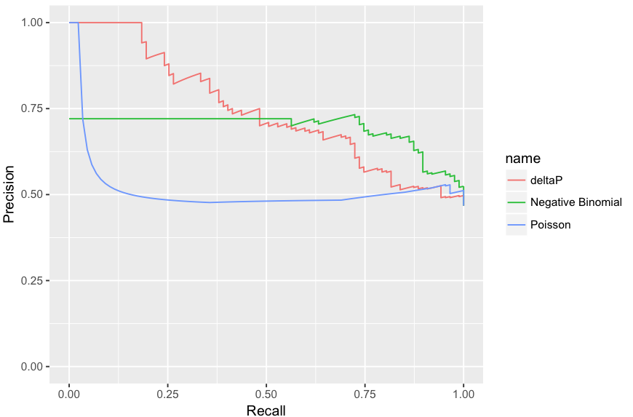
Precision-Recall of mouse 7SK AC nucleotides using different chemical probing metrics
Negative binomial p-values do not perform well, because almost all p-values are highly significant

Slide 31
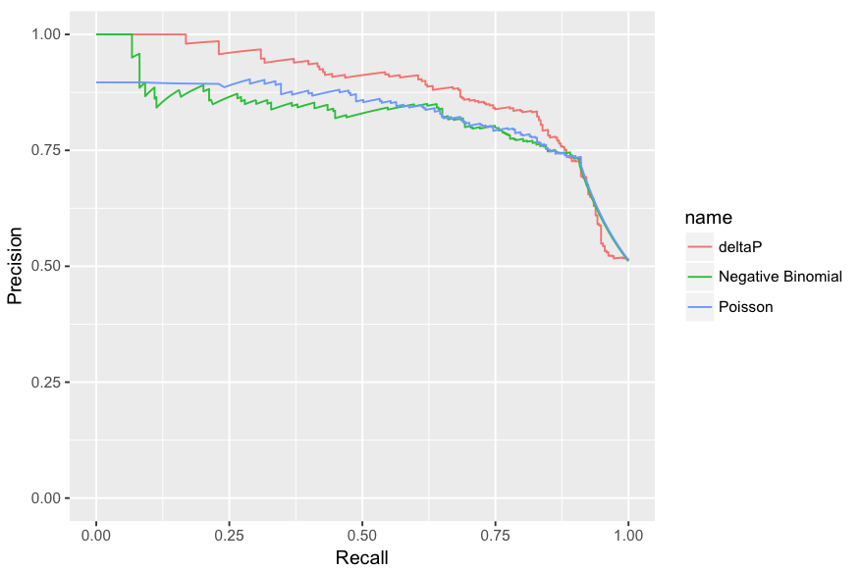
Precision-Recall of mouse 7SK AC nucleotides using different chemical probing metrics
Negative binomial p-values do not perform as well as deltaP, the simple metric of chemical induced stop rate from pooled data

Slide 32
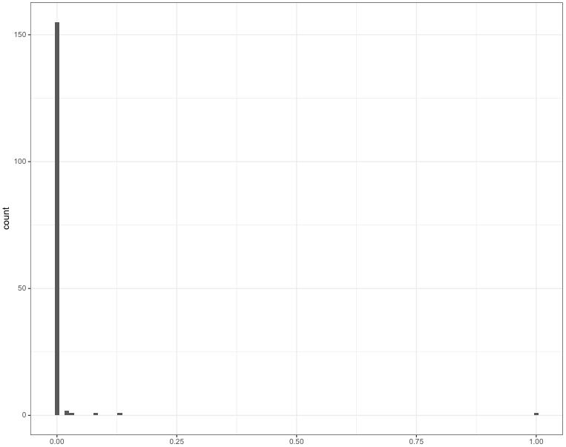
Mouse 7SK nucleotides are (almost) all significantly modified!
Almost all nucleotides (big peak) have fdr < 0.01
FDR

Slide 33
Are p-values for treated vs. control comparison the best way to think about probing data?
What if the probe is selective, but with some nonspecific reactivity?
Property of interest
Treatment
Reactivity
0
Control
Reactivity
0

Slide 34
Testing for ∆P cutoffs
Property of interest
Test the probability that the chemical induced stop rate is above a certain value.
High cutoffs should enable high stringency identification of the most reactive nucleotides, though perhaps at the cost of sensitivity
Treatment
Reactivity
0

Slide 35
Testing for ∆P cutoffs
Null hypothesis: ∆P ≤ k
Test by sampling 10⁵ (should be more) sets of treated and control RT event counts.
Compute Prob(∆P > k) for many cutoffs k. This is the p-value for the above test.
More random sampling would lead to more robust p-value determination.

Slide 36
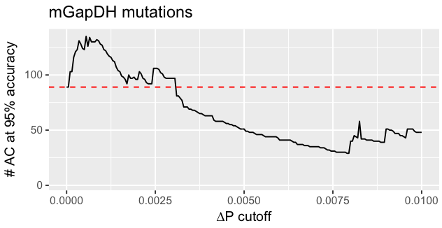
How do we evaluate performance?
Precision-Recall curve
Metrics focusing on top hits
Current plan: # of ACs (or other positive nucleotides) detected at 95% accuracy

Slide 37
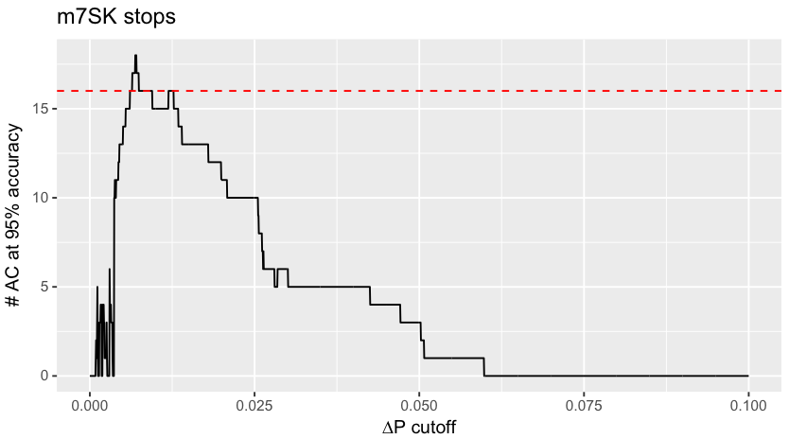
Recall at 95% accuracy for mouse 7SK stops
There is some ∆P cutoff at which more AC’s are detected at 95% accuracy than with ∆P
AC recall at 95% accuracy for ∆P shown by red dashed line

Slide 38
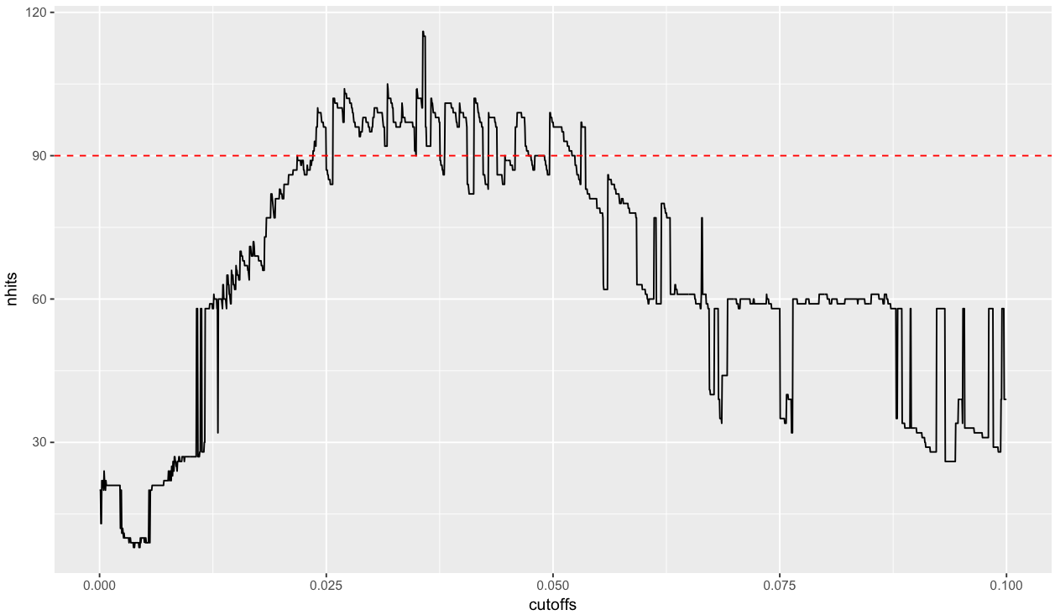
m7SK and mGapDH achieve best recall at 95% accuracy at very different cutoffs
mGapDH stops

Slide 39
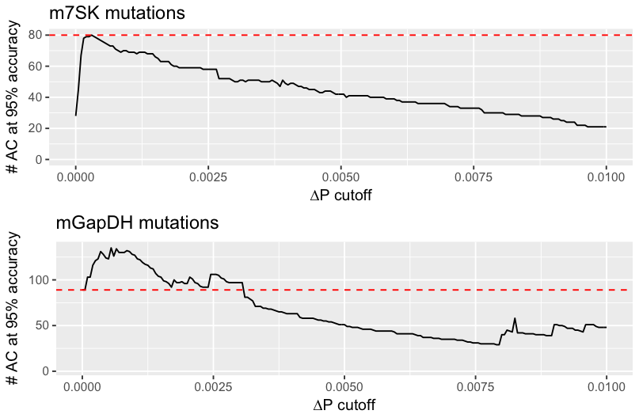
m7SK and mGapDH achieve peak recall at 95% accuracy at more similar ∆P cutoffs
m7SK does not have any ∆P cutoff that exceeds the performance of ∆P

Slide 40
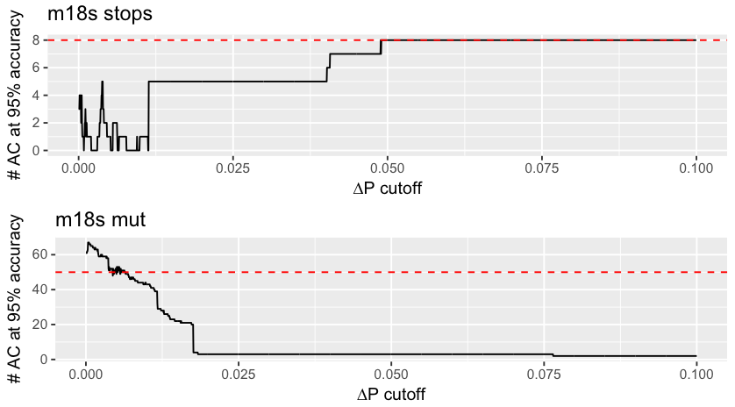
Mouse 18S

Slide 41
