Slide 1
PrivaSeq2 Figures

Slide 2
Fig 1a
Genomewide Signal Profile Dataset (Public)
$$(S)$$
Anonymized
Sample ID
Genomewide Signal Profiles
HIV Status
SIND-1
Signal
Genomic Coordinate
SIND-2
2
SV
Discovery
(Optional)
$$⋮$$
$$⋮$$
$$⋮$$
SIND-n
3
1
SV
Genotyping
or
SV-1
SV-2
SV-3
$$⋮$$
SV-N
2
Genomic Coordinate
Discovered/Supplied
SV Panel for Signal Profiles
$${(p}_{S})$$
1
Supplied
SV Panel
(Optional)
Anonymized
Sample ID
SV Genotypes
HIV Status
SV-1
SV-2
SV-3
$$⋮$$
SV-N
SIND-1
0
0
2
$$⋮$$
2
SIND-2
2
0
X
$$⋮$$
0
$$⋮$$
$$⋮$$
$$⋮$$
$$⋮$$
$$⋮$$
$$⋮$$
$$⋮$$
SIND-n
0
X
X
$$⋮$$
0
$$(\tilde{G})$$
Predicted SV Genotype Dataset

Slide 3
Structural Variants Panel
(Stolen/Legally Obtained)
$${(p}_{S})$$
$${(p}_{G})$$
SV Panel for Signal Profiles
SV-1
SV-2
SV-3
$$⋮$$
SV-N
SV-1
SV-b
SV-3
$$⋮$$
SV-N
Anonymized
Sample ID
SV-1
SV-2
SV-3
$$⋮$$
SV-N
HIV Status
Patient
Name
$$⋮$$
$$⋮$$
SV-1
SV-b
SV-3
SV-N
SIND-1
0
0
2
2
Comparison of SV Panels and Genotype Matching
0
1
2
$$⋮$$
0
GIND-1
SIND-2
2
0
X
$$⋮$$
0
$$⋮$$
GIND-2
2
0
2
1
$$⋮$$
$$⋮$$
$$⋮$$
$$⋮$$
$$⋮$$
$$⋮$$
$$⋮$$
GIND-3
0
1
1
$$⋮$$
0
$$⋮$$
$$⋮$$
$$⋮$$
$$⋮$$
$$⋮$$
$$⋮$$
SIND-n
0
X
X
$$⋮$$
0
GIND-K
1
2
2
$$⋮$$
2
Predicted SV
Genotype Dataset
$$(\tilde{G})$$
Structural Variants Genotype
Dataset
(Stolen/Legally Obtained)
Genotype in $G$ / Genotype in $\tilde{G}$
$$(G)$$
Anonymized
Sample ID
Patient
Name
HIV Status
SV-1
SV-3
$$⋮$$
SV-N
SIND-1
GIND-2
0/0
1/0
$$⋮$$
0/2
SV-N
SIND-2
GIND-1
0/2
1/0
$$⋮$$
0/0
0 / 2
$$⋮$$
$$⋮$$
$$⋮$$
$$⋮$$
$$⋮$$
$$⋮$$
$$⋮$$
SIND-n
GIND-3
0/0
1/X
$$⋮$$
0/0
Genotype of SV-N in
SV Genotype
Dataset ($G$)
Genotype of SV-N in
Predicted Genotype
Dataset ($\tilde{G}$)
Fig 1b

Slide 4
Fig 1c

Slide 5
Fig 1d
Detection and Genotyping of small and large deletions from signal profiles
RNA-Seq
Signal
Genomic
Coordinate
ChIP-Seq
Signals
A C G T A C G
Large Deletion
Genomic
Coordinate
Small Deletion

Slide 6
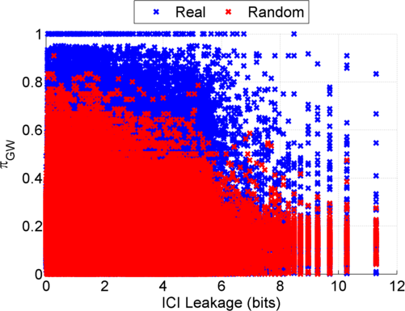
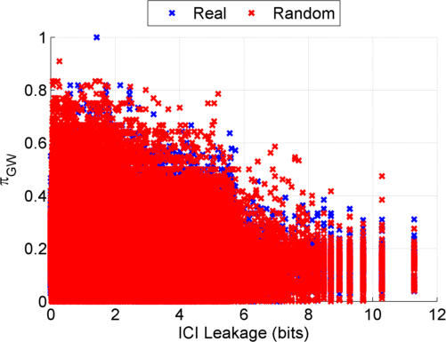
Fig 2
Before Anonymization
b) After Anonymization
Notes:
GEUVADIS ICI-\Pi_GW estimates:

Slide 7
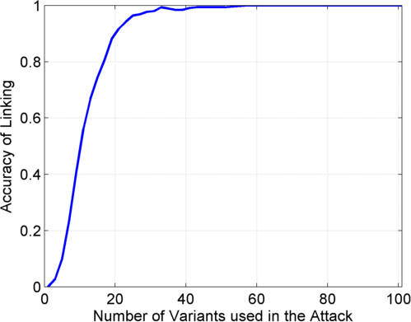
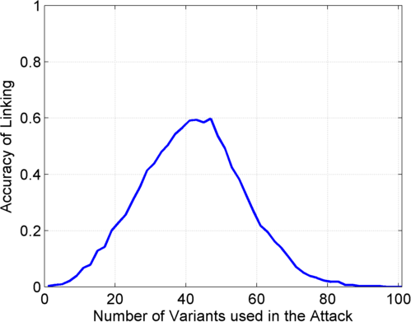
Fig 2
GEUVADIS extremity attack: c) Genotyping only
d) Joint Discovery + Genotyping
c) Genotyping
(1kG MAF>0.01)
d) Discovery + Genotyping
Sorted in Decreasing
Predictability
Sorted in Decreasing
Predictability

Slide 8
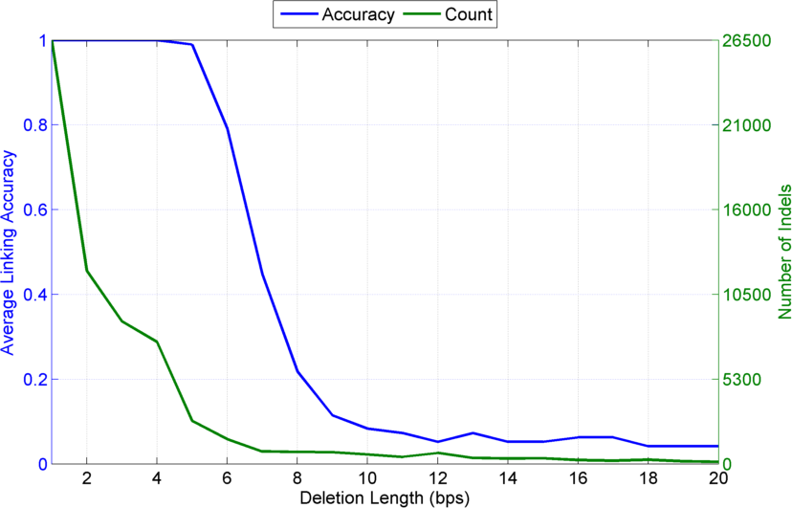
Fig 2
e) Indel length vs vulnerability statistics

Slide 9
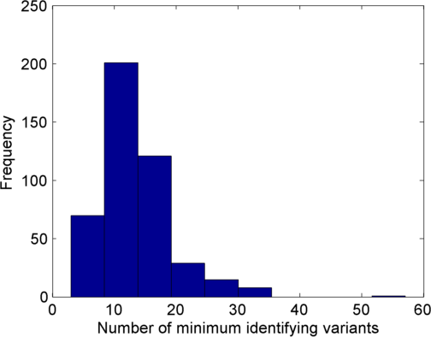
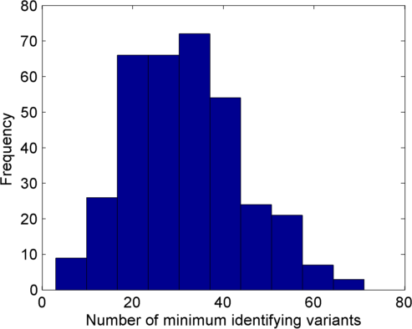
Fig 2
f) Genotyping only (1kG MAF>0.01)
g) Discovery + Genotyping
Notes:
f,g) Min # of identifying variants (GEUVADIS)

Slide 10
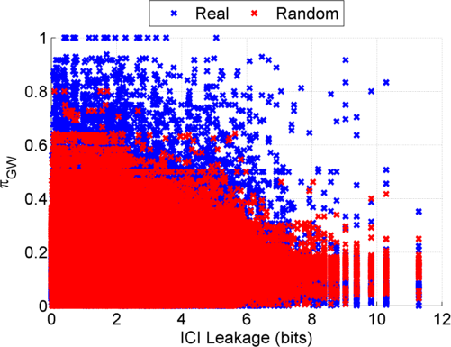
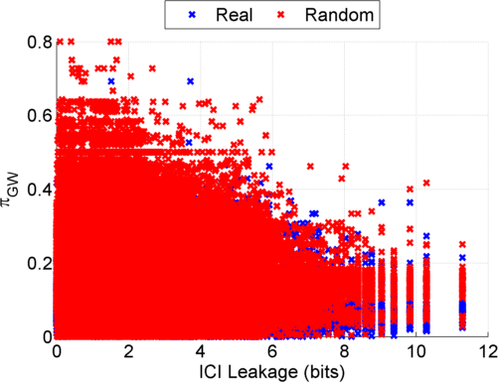
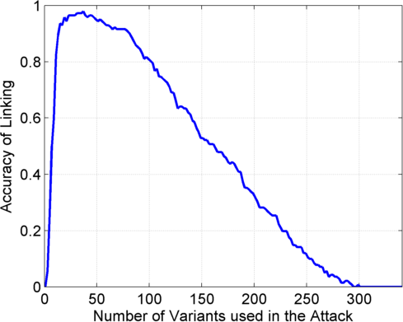
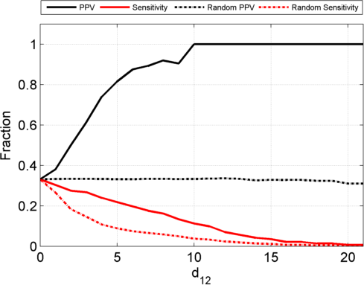
Fig 3
a) Before Anonymization
b) After Anonymization
c) GTex Dataset: Genotyping Only (1kG MAF>0.01)
Sorted in Decreasing Predictability

Slide 11
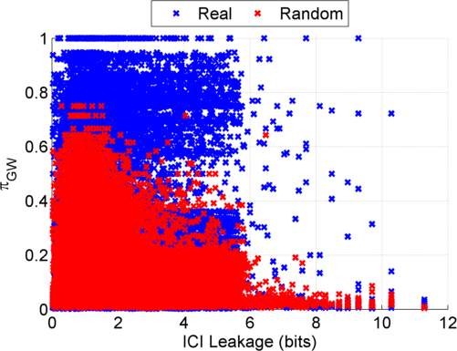
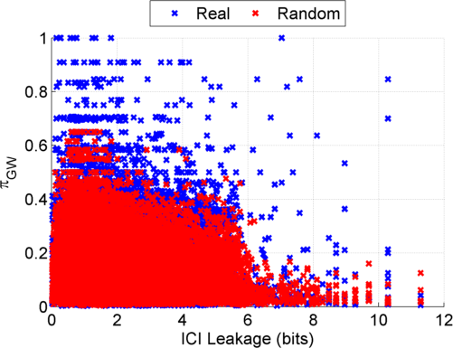
Fig 4
a) Kasowski
b) Kilpinen
Notes:
a) Genotyping large deletions

Slide 12
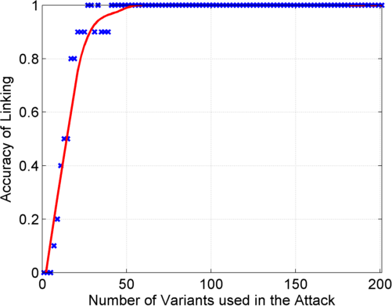
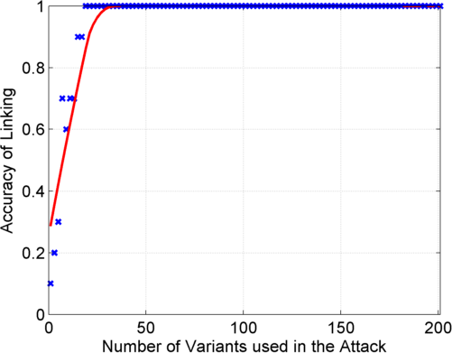
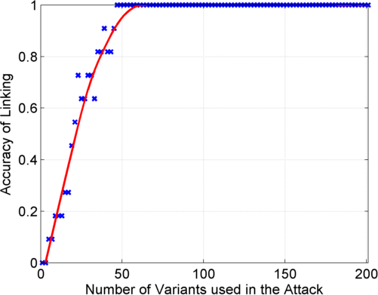
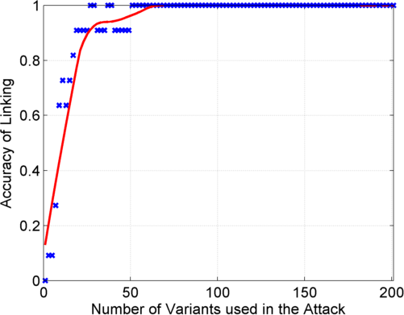
Fig 4
c) Genotyping only
d) Discovery + Genotyping
Kasowski
Kilpinen

Slide 13
Fig 4
e) Combinations of datasets imply different vulnerability levels
Selected Profiles
Is NA12878
vulnerable?
Genomic Signal Profiles
H3K27ac
H3K27ac+H3K36me3
H3K27ac+H3K36me3+H3K79me2
H3K36me3+H3K27me3
H3K79me2+H3K27me3
H3K36me3+H3K9me3
H3K27ac+H3K9me3
H3K79me2+H3K9me3
H3K27me3+H3K9me3

Slide 14
Fig 5
Signal Profile
Generation
b) Vulnerability of NA12878
Genomic Coordinates
Resolution (kbs) | Is NA12878 vulnerable among 1kG samples?
1
5
10
25
50
Hi-C Contact
Matrix
Add rows for each column
Genomic Signal
Profile

Slide 15
Supplementary Figures

Slide 16
What is a linking attack?
Fig S1a
Anonymized Netflix Prize Training Dataset
made available to contestants
Movie ratings database
User (ID) | Movie (ID) | Date of Rating | Rating [1,2,3,4,5]
NTFLX-0 | NTFLX-19 | 10/12/2008 | 1
NTFLX-1 | NTFLX-116 | 4/23/2009 | 3
NTFLX-2 | NTFLX-92 | 5/27/2010 | 2
NTFLX-1 | NTFLX-666 | 6/6/2016 | 5
… | … | … | …
… | … | … | …
100 million ratings
500,000 users
200 movie ratings/user
5,000 users/movie rating
Notes:
Before presenting our work in detail, I would like to motivate the our study with an example.
Netflix, the movie rental company, had organized these contests to improve their movie recommendation system.
The setup was like this: Netflix released this huge data matrix with user ids, movie titles, date of movie rating and the actual rating. There were 100 million entries for 500k users. On average each user rated 200 movies and each movie has been rated, on average by 5000 users.
This data matrix was used to train recommendation algorithms, which were then tested on other datasets.
This dataset was anonymized by removing names of users but Netflix also added noise and removed some other entries in the matrix to make it more secure.

Slide 17
Linking Attacks: Case of Netflix Prize
Fig S1b
Names available for many users!
User (ID) | Movie (ID) | Date of Grade | Grade [1,2,3,4,5]
NTFLX-0 | NTFLX-19 | 10/12/2008 | 1
NTFLX-1 | NTFLX-116 | 4/23/2009 | 3
NTFLX-2 | NTFLX-92 | 5/27/2010 | 2
NTFLX-1 | NTFLX-666 | 6/6/2016 | 5
… | … | … | …
… | … | … | …
User (ID) | Movie (ID) | Date of Grade | Grade [0-10]
IMDB-0 | IMDB-173 | 4/20/2009 | 5
IMDB-1 | IMDB-18 | 10/18/2008 | 0
IMDB-2 | IMDB-341 | 5/27/2010 | -
… | … | … | …
… | … | … | …
… | … | … | …
Notes:
Secondly, although another movie in Netflix system is not rated by this user in imdb system, namely the netflx666, the adversary can see the rating of the individual for this movie.

Slide 18
Fig S2a
Signal Profile
Generation
Reads
Read Mapping
RD
4
2
1
Genomic Coordinates
Genomic Coordinates
GATATGCAGTATAT…

Slide 19
ATATGCAGTATA
ATATGCAGTATA
Mapped reads
GATATGCAGTATAT
GATATGCAGTATAT
All the genetic
variants
GAGACGCCATCG
CCATCGATATGCAGTATA
1) Raw Reads
GAGACGCCATCG
TATGCAGTATATG
GGAGACGCCATCGA
GGAGACGCCATCGA
TGCAGTATATGACGACG
CAGGAGACGCCATCGA
CAGGAGACGCCATCGA
TATATGACGACGATG
CCATCGATATGCAGTATA
GGAGACGCCATCG
TATGCAGTATAT
GGACCAGGAGAC
ATCGATATGCAG
ATGACGACGATGATC
...
…ACGGACCAGGAGACGCCATCGATATGCAGTATATGACGACGATGATC…
Reference Genome
Small and Large Deletions
2) Read Depth
Signal Profile
(This Study)
Signal
Gene Expression Levels
$$Σ$$
Gene 1 | Gene 2 | Gene 3
0.5 | 10.1 | 2.7
Gene 1
Gene 2
Gene 3
Genomic Coordinates
Compute Average
Signal on Genes
3) Gene Expression
Levels
 | Gene 1 | Gene 2 | Gene 3
Individual 1 | 0.5 | 10.1 | 2.7
Individual 2 | 3.8 | 110.3 | 4.1
Individual 3 | 1.9 | 350.9 | 3.7
Expression QTL SNPs
(Harmanci, Gerstein, 2016)
Fig S2b
Notes:
Fixing integrator signs

Slide 20
Fig S3

Slide 21
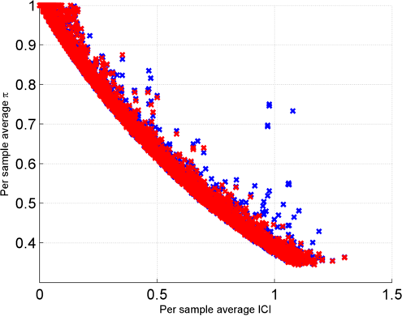
Fig S4
Population-wide predictability of 1kG SVs
$π_{PW}$ vs ICI for 1kG Structural Variants
ICI in 1000 Genomes SVs and Predictability ($π$) of SV genotypes from GEUVADIS expression levels of overlapping genes

Slide 22
Features for genotyping deletions
Fig S5
$$S$$
$$2i−j−1$$
$$i$$
$$j$$
$$2j−i+1$$
Left
Neighbor
Deletion
Right
Neighbor
$${\overline{s}}_{\left[2i−j−1,i−1\right]}$$
$${\overline{s}}_{\left[i,j\right]}$$
$${\overline{s}}_{\left[j+1, 2j−i+1\right]}$$
$$η_{\left[i,j\right]}:$$
How balanced are the
neighbor signal levels?
$$ρ_{\left[i,j\right]}:$$
How deep is the dip in the
signal?
$$τ_{\left[i,j\right]}:$$
How high are the neighbor
signal levels?

Slide 23
Genotype prediction accuracy
Fig S6

