Slide 1
Understanding the Role of Genome 3D Organization in Gene Regulation through Tracking 4D Nucleosome
JClub by Chengfei Yan

Slide 2
Genome 3D organization plays an important role in regulating gene expressions

Slide 3
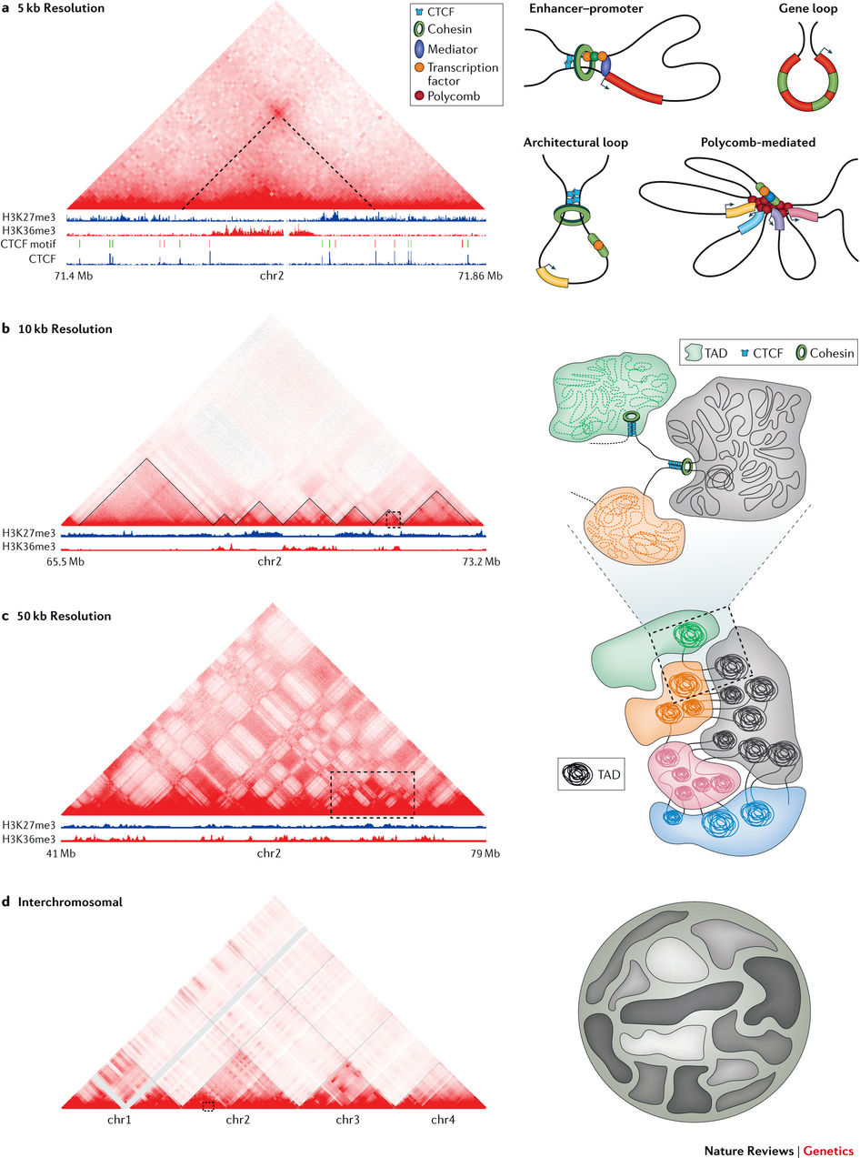
HiC and ChiA-PET
HiC
ChiA-PET

Slide 4
The functional consequences of genome organization are not well understood
Fit-HiC calls millions of or even tens of millions of significant contacts using a global background model
HiCCUPS call about 10,000 2D peaks using a local background model, define these 2D peaks as loops
Suhas Rao et al. Cell, 2014
Ferhat Ay et al. Genome Research, 2014
Which type of method should be used to call functional interactions?
(eg. enhancer-promoter interactions )

Slide 5
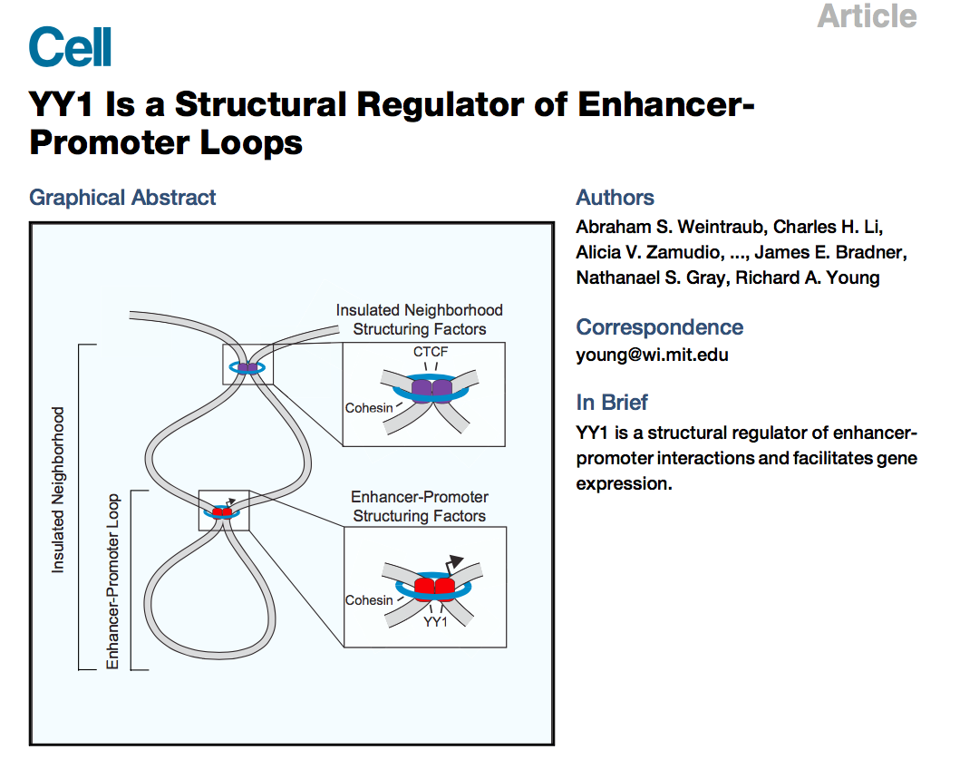
Two Cell Papers on 4D Nucleosome

Slide 6
Cohesion Loss Eliminates All Loop Domains

Slide 7
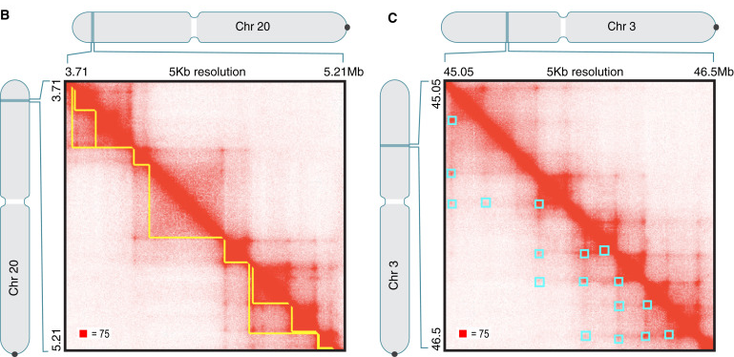
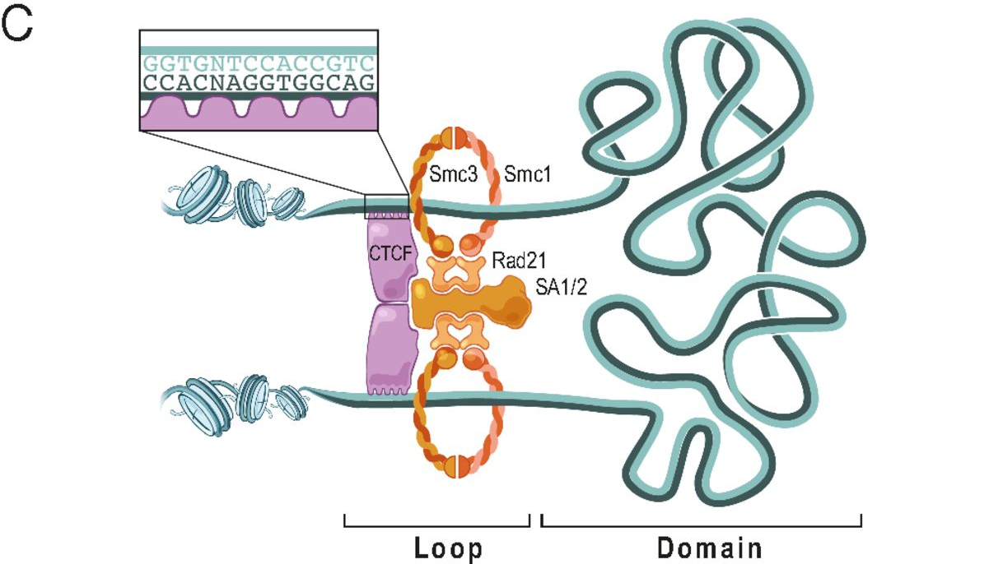
Glossary
Compartments:
Domains:
Loops
Cohesion-dependent loops
Cohesion-independent loops
Loop Domains:

Slide 8
Auxin Induces Cohesion Degradation
Cell line: HCT-116, a human colorectal carcinoma cell line

Slide 9
Loop domains are rapidly lost after degradation, but histone modification patterns are unaffected

Slide 10
Genome compartmentalization is strengthened after cohesion degradation

Slide 11
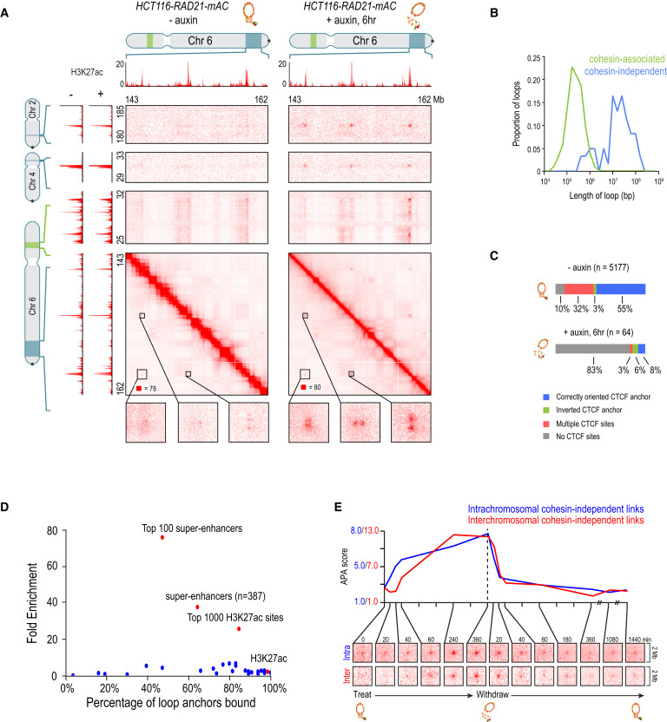
Links between super enhancers are strengthened after loss of cohesion
Cohesion-independent loops are highly enriched for super enhancers

Slide 12
Cohesin loss only results in modest transcription change, with strongly down-regulated genes near super enhancers.

Slide 13
Loop domain recovery after auxin withdraw

Slide 14
Summary
1.With auxin treatment of HCT-116 cell line, cohesions are degraded, but CTCF binding and Histone modification patterns are unaffected.
2. After the degradation of cohesin, loop domains are rapidly lost.
3. Genome compartmentalization is kept and strengthened with the loss of loop domains.
4. Cohesin-independent loops, which often overlap super enhancer, are strengthened with the loss of cohesion.
5.Cohesion loss only results in modest transcription change, with strongly down-regulated genes near super enhancers.
6 After withdrawal of auxin, loop domains recover, with loop domains spanning NIPBL and super enhancers
Recover More Rapidly.

Slide 15
YY1 is a Structural Regulator of Enhancer-Promoter Loops

Slide 16
YY1 Is a Candidate Enhancer-Promoter Structuring Factor
mESCs
YY1 proteins dimerize in vivo

Slide 17
YY1 Generally Occupies Enhancers and Promoters in Mammalian Cells

Slide 18
Enhancer-Promoter Interactions Depend on YY1 in Living Cells

Slide 19
Depletion of YY1 Disrupts Gene Expression

Slide 20
Depletion of YY1 Disrupts Enhancer-Promoter Looping

Slide 21
Rescue of Enhancer-Promoter Interactions in Cells

Slide 22
Summary
1. YY1 generally occupies active enhancers and promoters, and mediates enhancer-promoter interactions across cell types.
2. Perturbation of YY1 binding disrupts enhancer-promoter looping and gene expression.
3. Artificially tethered YY1 protein rescues enhancer-promoter interactions disrupted by YY1 binding site mutations.

Slide 23
Discussion
1. YY1 loops can not be detected by HiC (2D peaks ). (E-P interactions are too dynamic?)
2. If we trust both works, why the degradation of cohesion does not significantly impact gene expression? (YY1 mediates E-P loops does not that dependent on cohesion?)
3. Why are many genes upregulated when losing YY1?

