Slide 1
Luciferase measurements
For every element
Firefly luciferase (fluorescence activity for element of interest)
Renilla luciferase (orthogonally detected control for level of transfection)
Control elements
eGFP with no enhancer – negative control (low firefly/renilla ratio)
RSV strong enhancer – positive control (high firefly/renilla ratio)

Slide 2
Relevant quantities for luciferase experiment
Raw luciferase activity:
Firefly luciferase/renilla luciferase
Luciferase activity relative to eGFP negative control
(Firefly luciferase/renilla luciferase)_{element} / (Firefly luciferase/renilla luciferase)_{eGFP}
Luciferase acitivity relative to RSV positive control
(Firefly luciferase/renilla luciferase)_{element} / (Firefly luciferase/renilla luciferase)_{RSV}

Slide 3
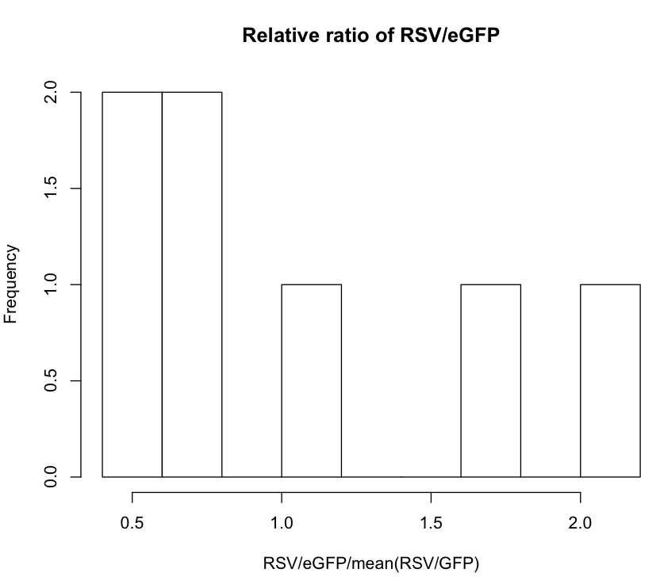
RSV/GFP signal varies about 4-fold between experimental days
Mean(firefly/renilla) for RSV & eGFP for each day

Slide 4
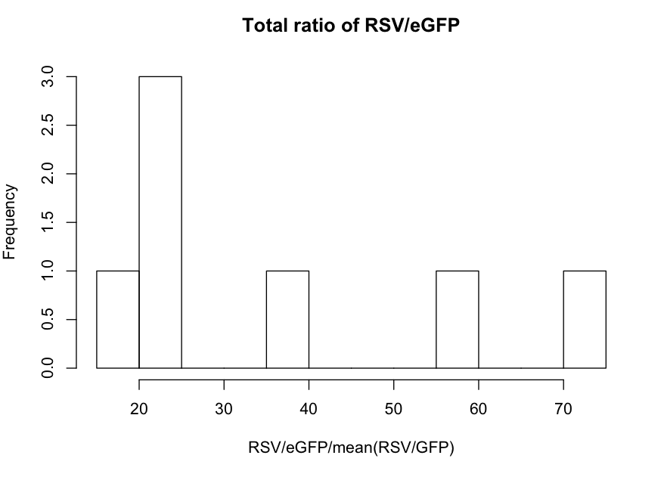
RSV/GFP signal varies about 4-fold between experimental days
This ratio should always be the same, so we think that the data are fairly noisy.
Mean(firefly/renilla) for RSV & eGFP for each day

Slide 5
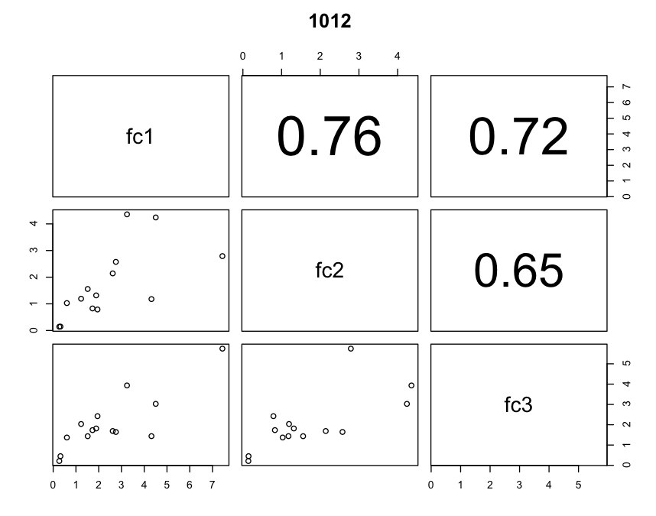
Comparison of replicates on the same day
Firefly/Renilla ratio for each element should correlate between replicates
Replicates even on the same day can correlate poorly

Slide 6
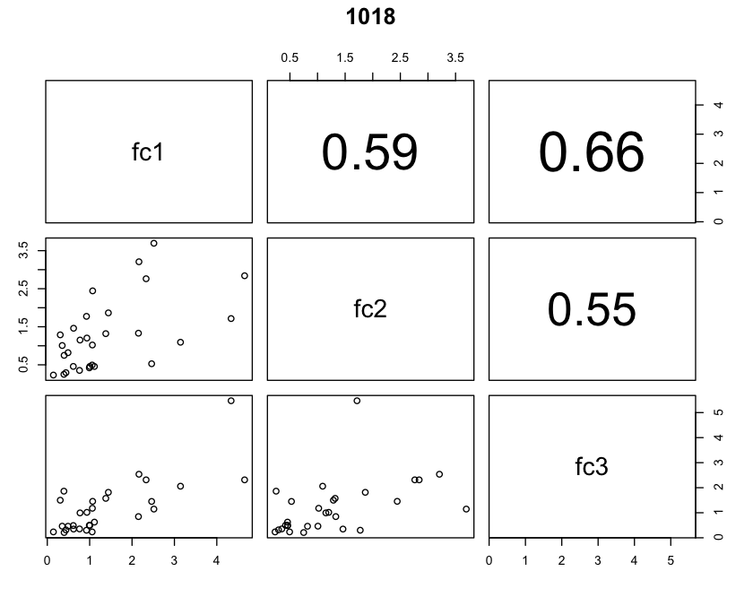
Comparison of replicates on the same day
Firefly/Renilla ratio for each element should correlate between replicates
Replicates even on the same day can correlate poorly

Slide 7
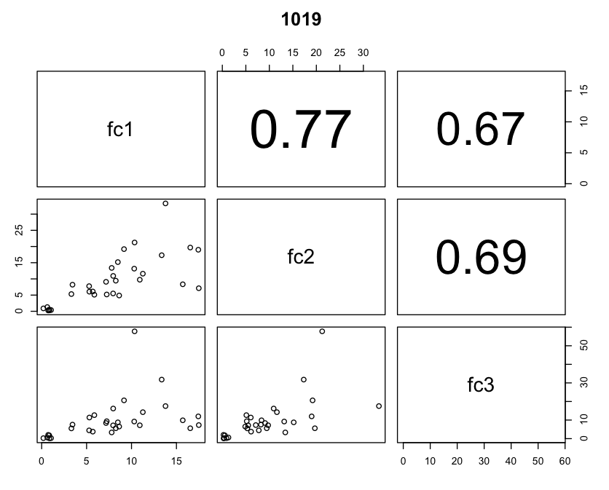
Comparison of replicates on the same day
Firefly/Renilla ratio for each element should correlate between replicates
Replicates even on the same day can correlate poorly

Slide 8
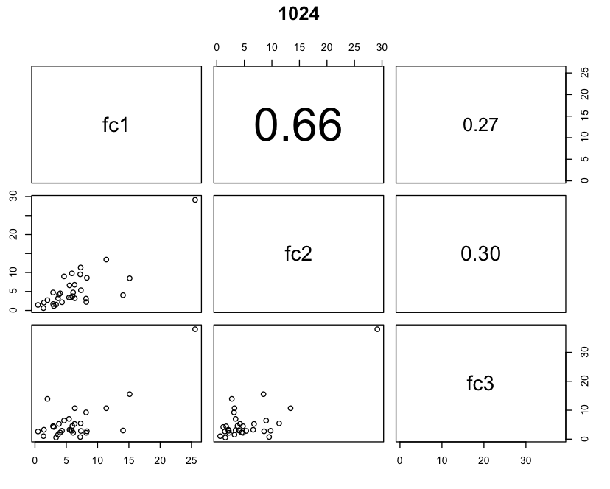
Comparison of replicates on the same day
Firefly/Renilla ratio for each element should correlate between replicates
Replicates even on the same day can correlate poorly

Slide 9
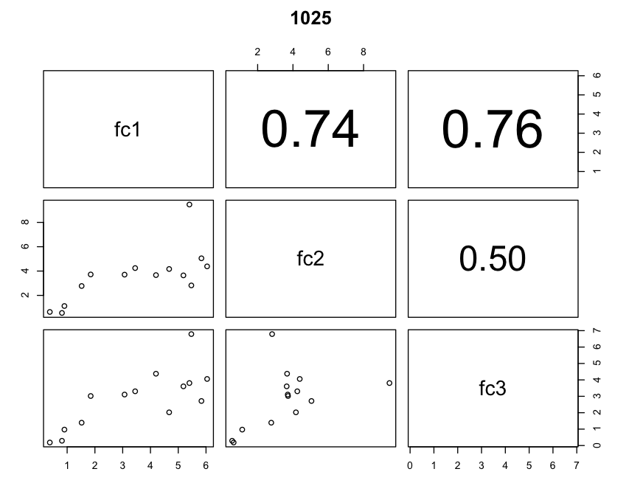
Comparison of replicates on the same day
Firefly/Renilla ratio for each element should correlate between replicates
Replicates even on the same day can correlate poorly

Slide 10
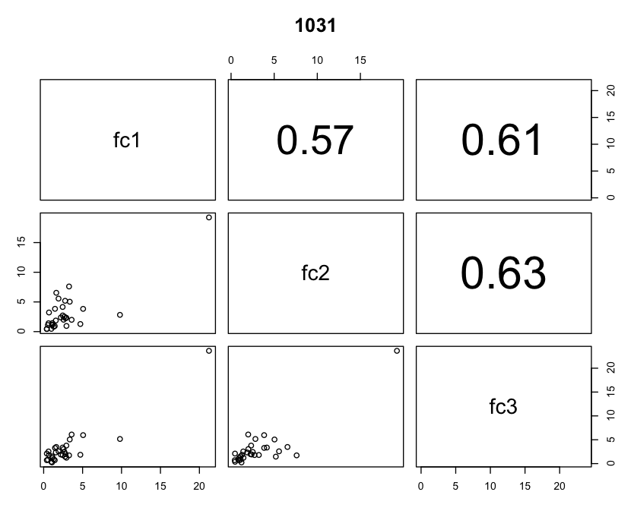
Comparison of replicates on the same day
Firefly/Renilla ratio for each element should correlate between replicates
Replicates even on the same day can correlate poorly

Slide 11
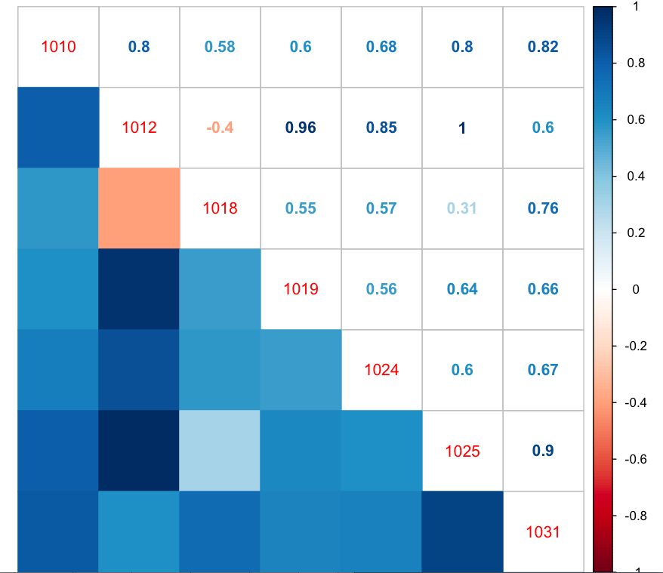
Comparison of luciferase signal (firefly/renilla) correlations between days
Spearman correlations
Note: some correlations are based upon few data points

Slide 12
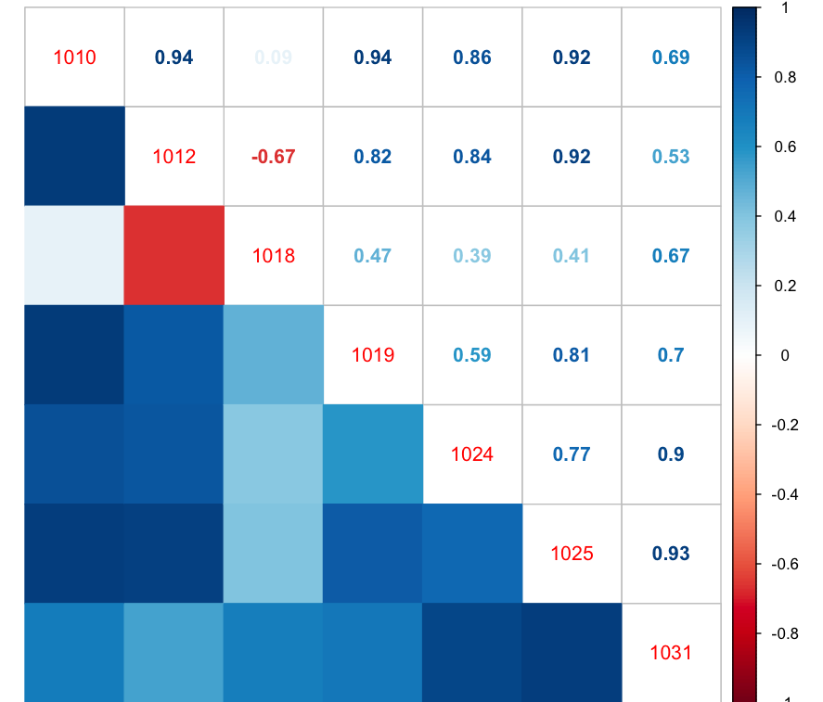
Comparison of luciferase signal (firefly/renilla) correlations between days
Pearson correlations

