Slide 1
Single-cell Analysis

Slide 2
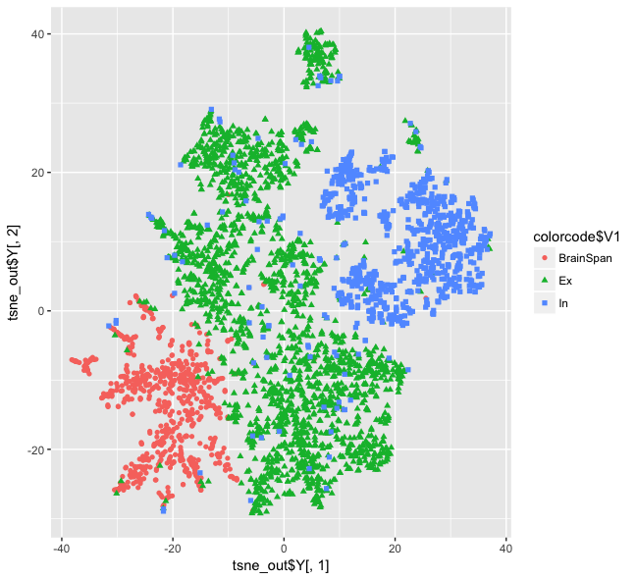
t-sne plot with Lake data
Based on marker genes from Lake data
Quantile normalization is applied to the dataset
Lake

Slide 3
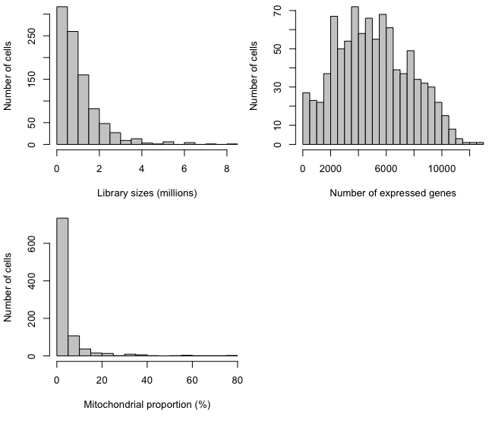
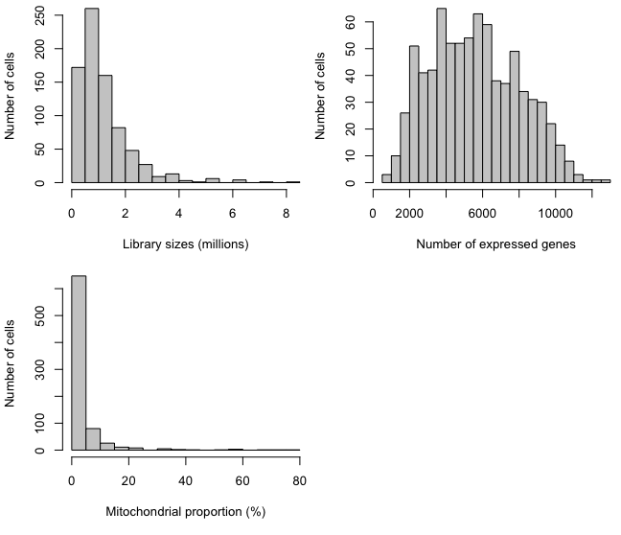
single cell data QC
Before QC
After QC
Filtering
By libsize (outlier): 66
By libsize (0.2 million): 74
By Mitochondrial proportion: 43
Remaining 787 cells

Slide 4
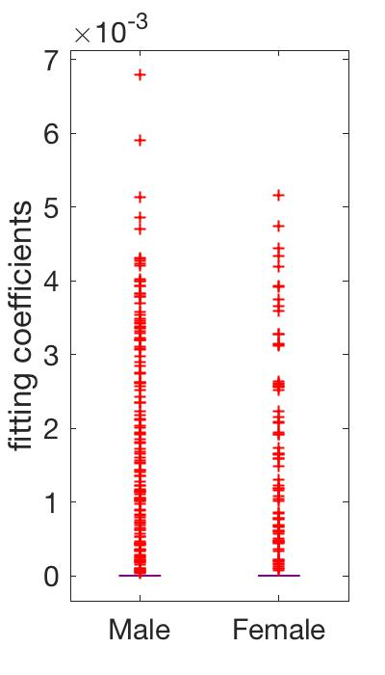
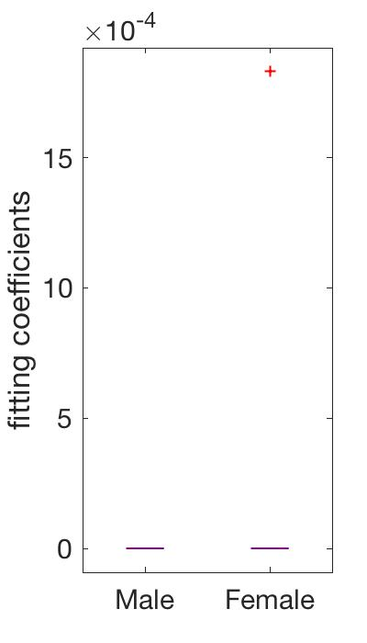
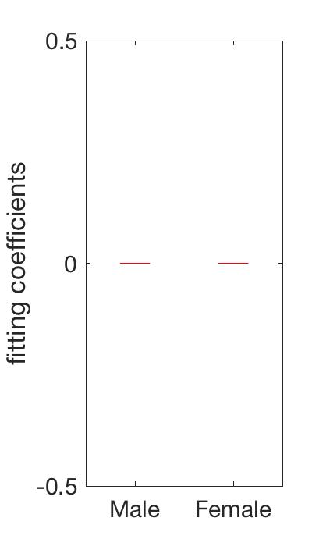
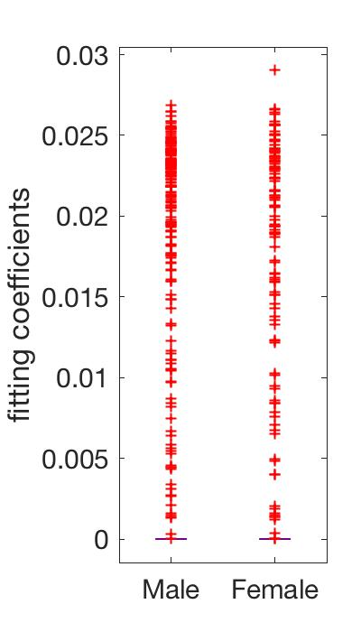
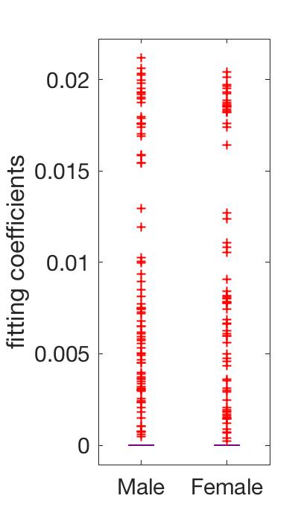
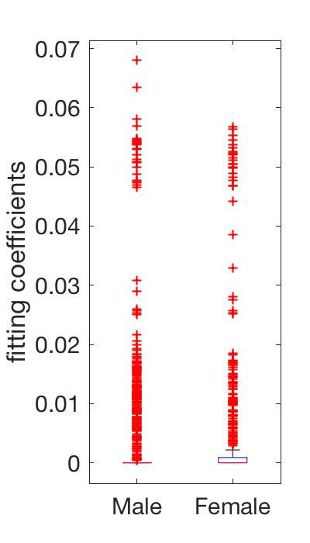
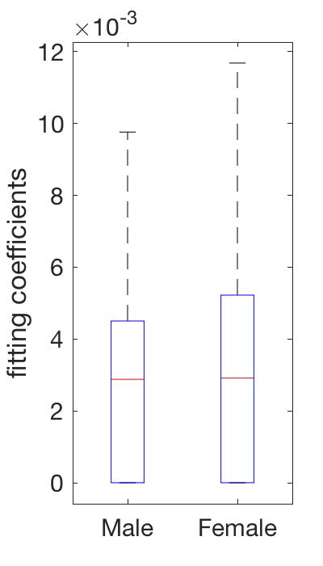
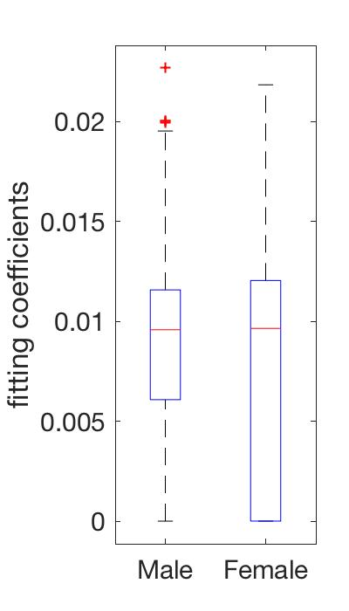
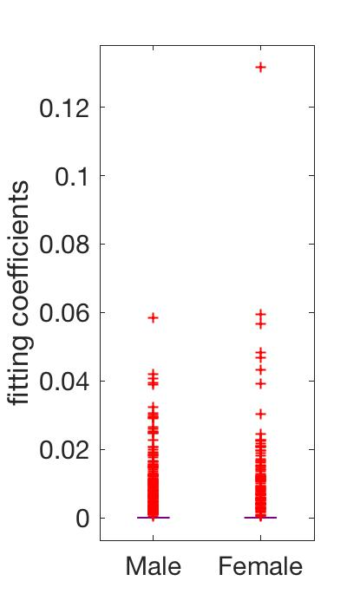
Tissue deconvolution with Lake data – whole gene set
Ex1
Ex2
Ex3
Ex4
Ex5
Tissue expression = cell proportion * Lake data
23712 genes
Tissue expression:
1931 sample TPM
In1
In2
In3
In4
In5
Lake data:
16 types TPM

Slide 5
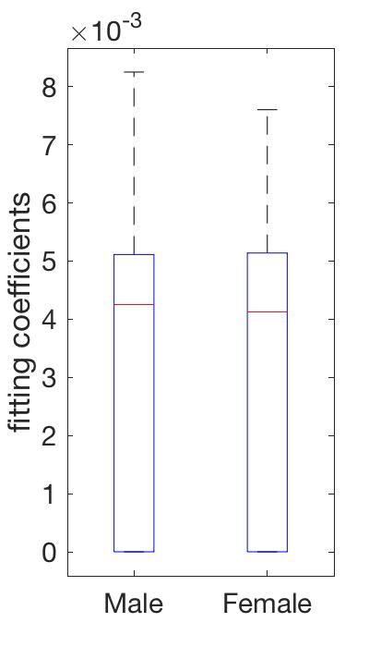
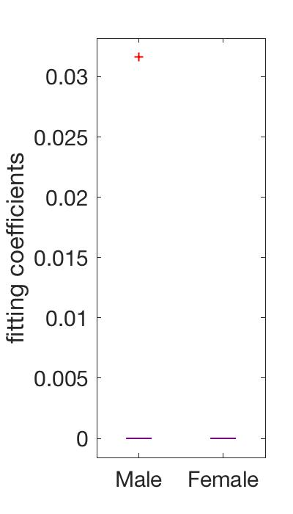
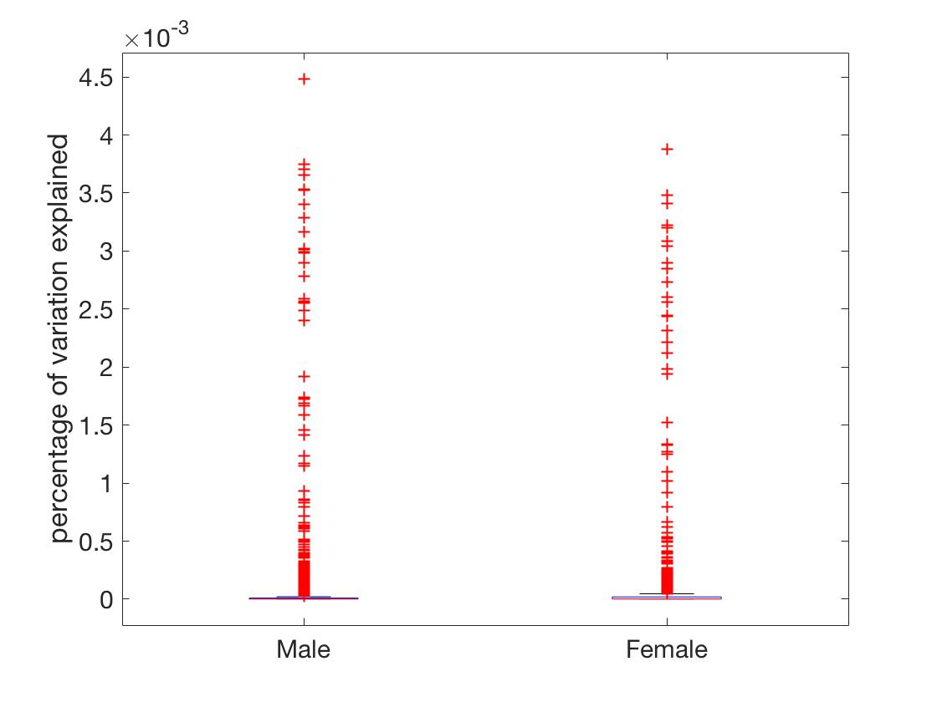
Tissue deconvolution with Lake data – whole gene set
Ex6
Ex7
Ex8
$R^{2}$: percentage of variation explained by the model
In6
In7
In8

Slide 6
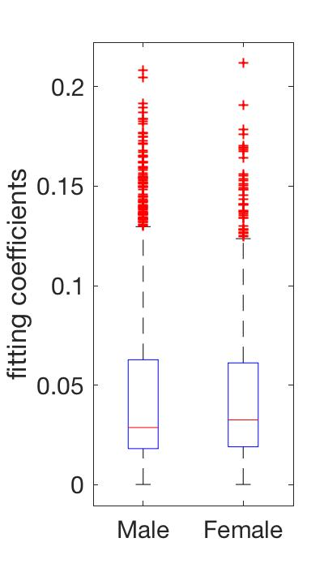
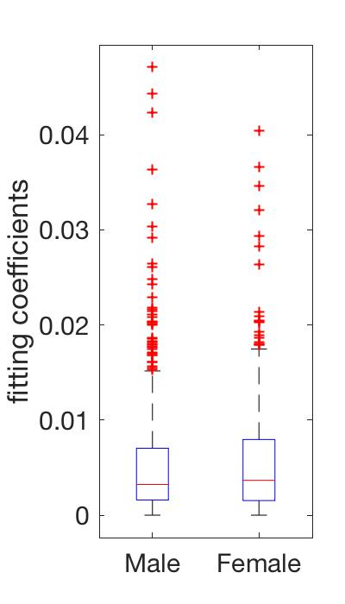
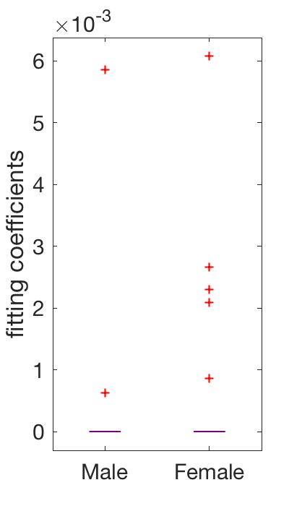
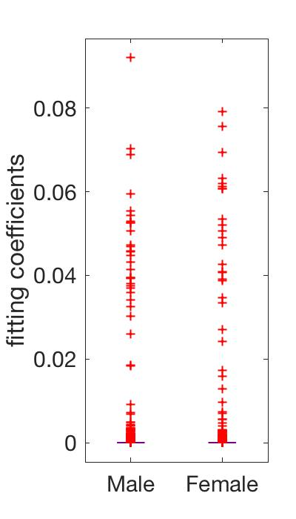
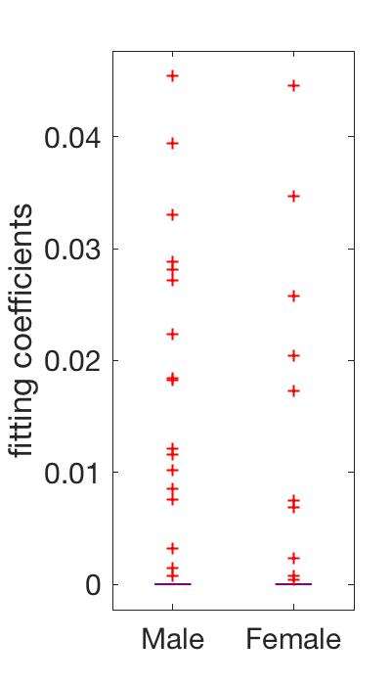
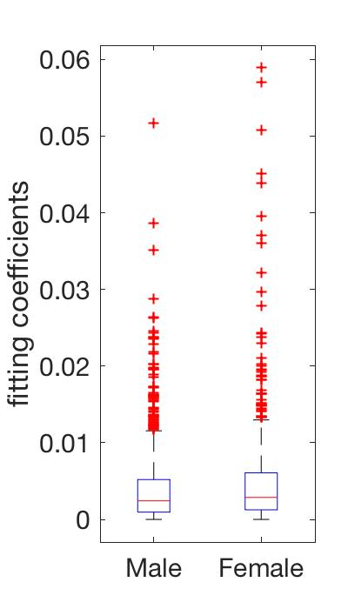
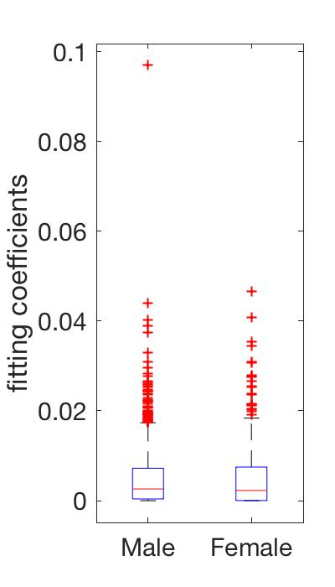
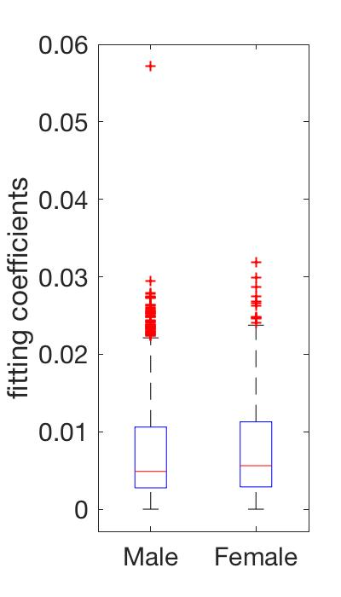
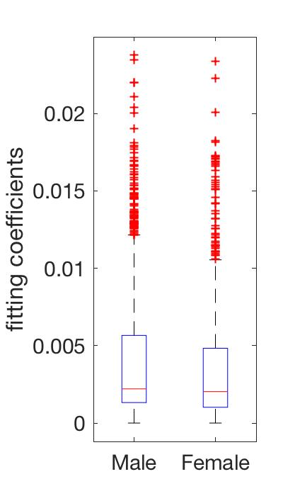
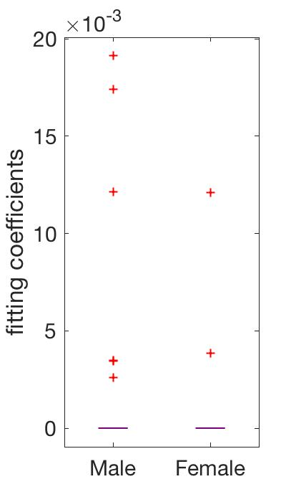
Tissue deconvolution with Lake data – marker gene set
Ex1
Ex2
Ex3
Ex4
Ex5
Tissue expression = cell proportion * Lake data
180 genes
Tissue expression:
1931 sample TPM
In1
In2
In3
In4
In5
Lake data:
16 types TPM

Slide 7
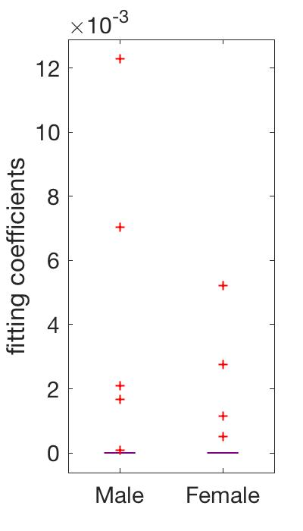
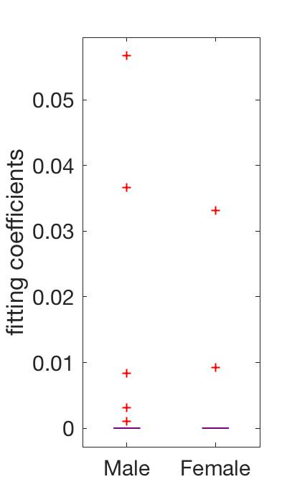
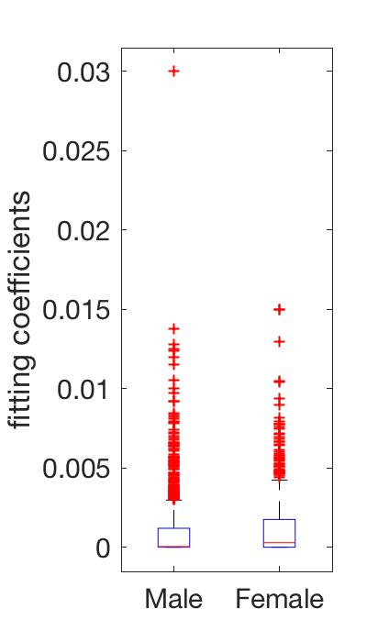
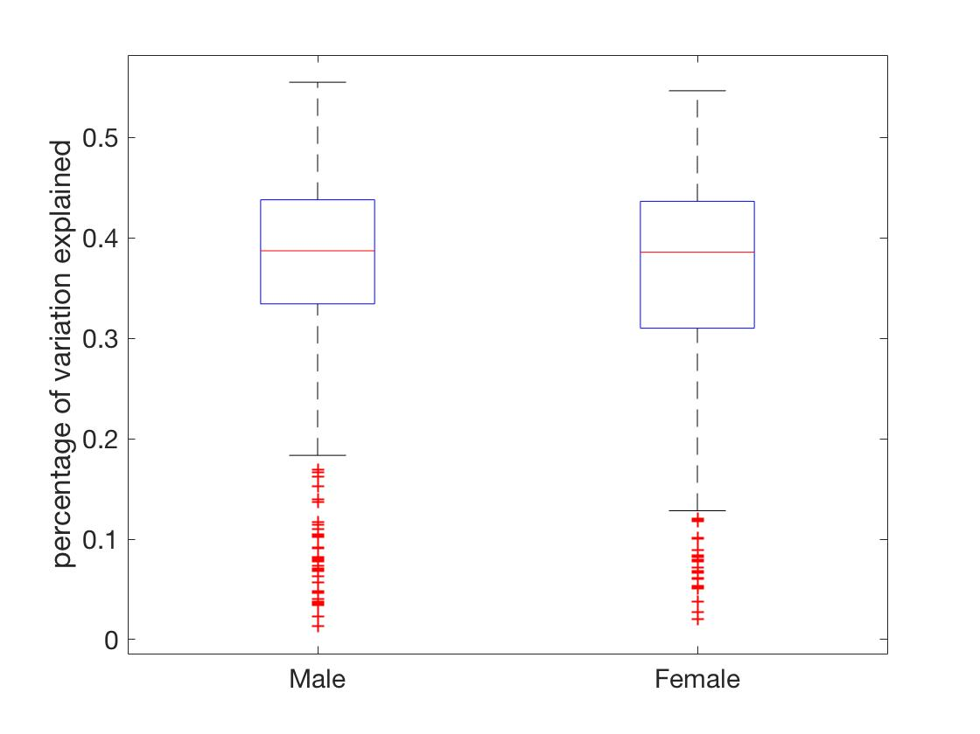
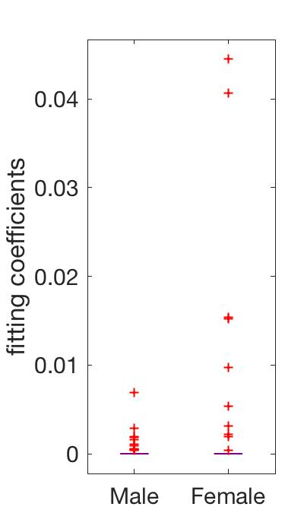
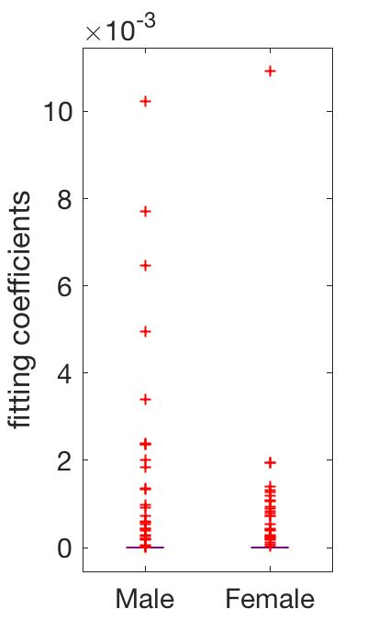
Tissue deconvolution with Lake data – marker gene set
Ex6
Ex7
Ex8
$R^{2}$: percentage of variation explained by the model
In6
In7
In8

