Slide 1
Prospectus: Universal mutability across germline and somatic settings
Will Meyerson

Slide 2

What does the The Tree of Life …
Notes:
https://inhabitat.com/wp-content/blogs.dir/1/files/2016/04/Tree-of-Life.jpg

Slide 3
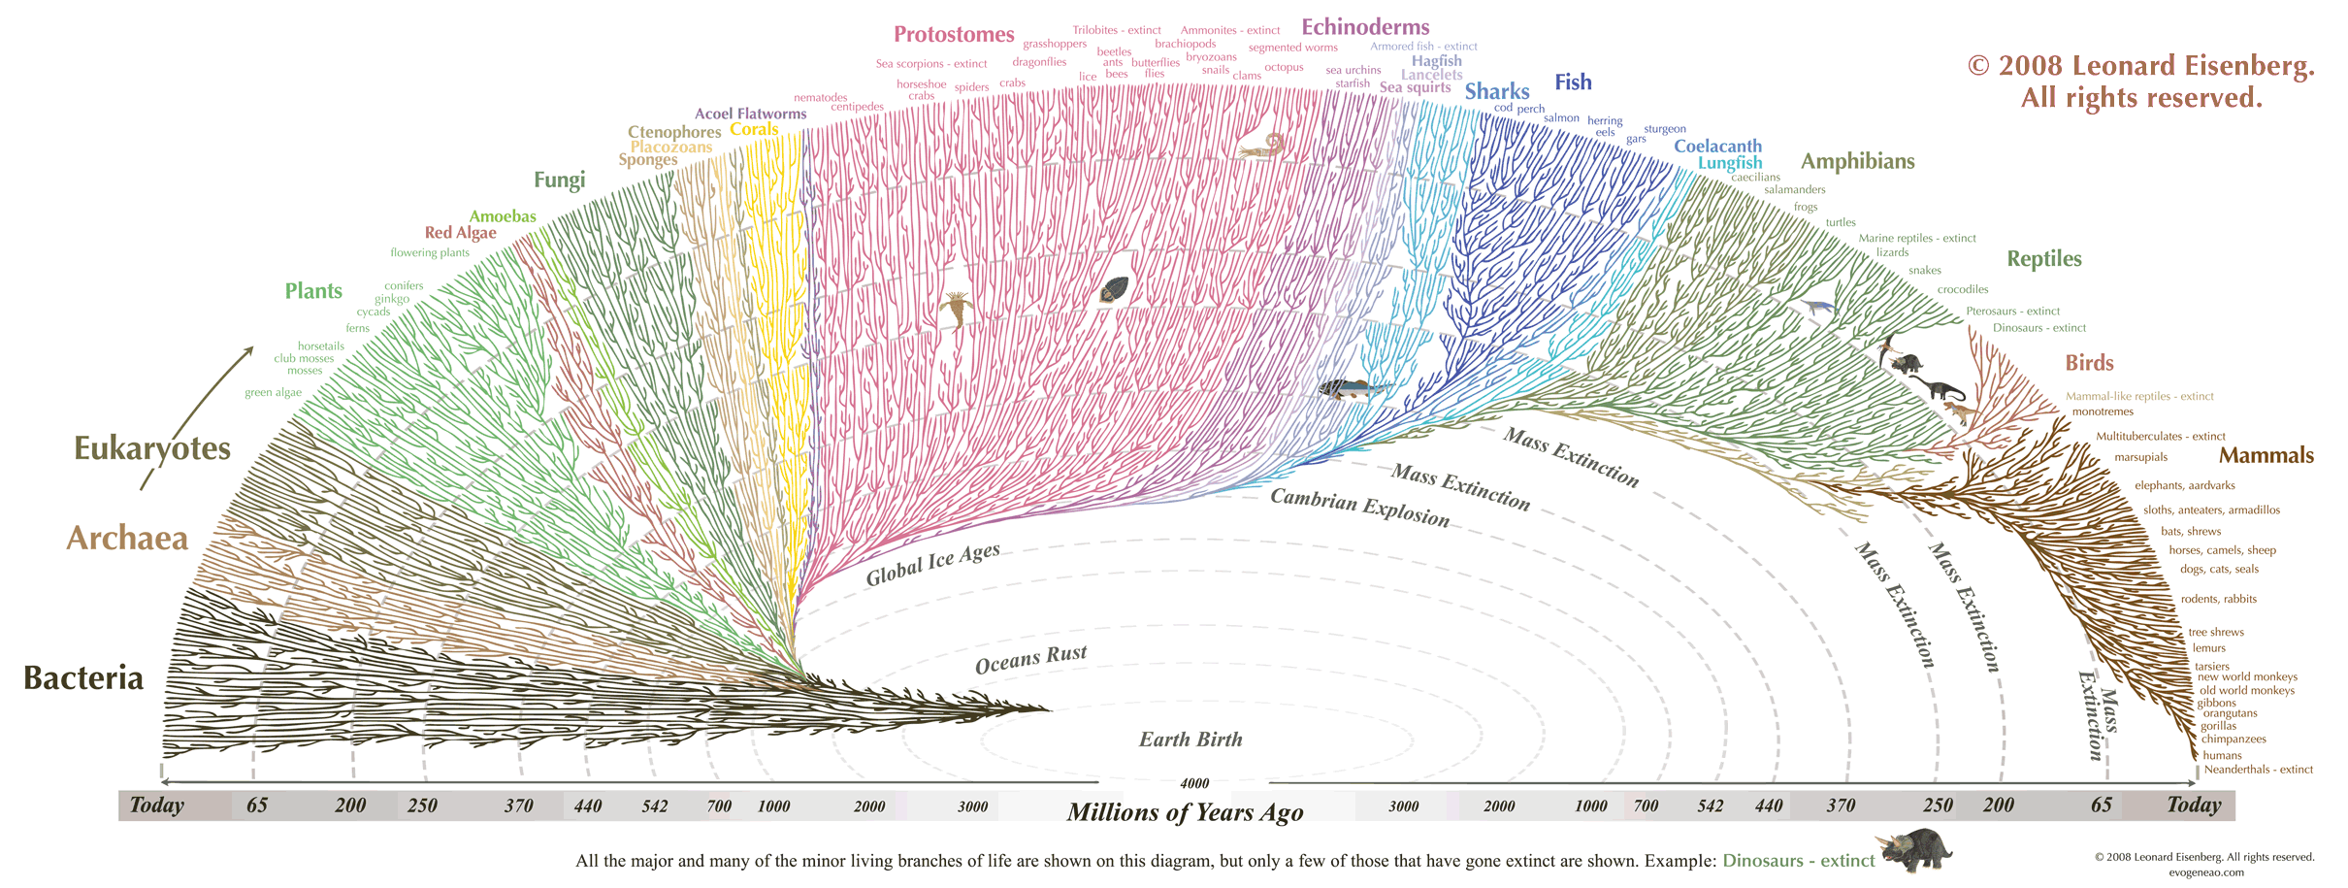
… from which all manner of creature flourishes …
Notes:
https://thumbnails-visually.netdna-ssl.com/the-great-tree-of-life_505ba0c07cda2.gif
https://en.wikipedia.org/wiki/Escherichia_coli#/media/File:E_coli_at_10000x,_original.jpg
https://en.wikipedia.org/wiki/Haloquadratum_walsbyi#/media/File:Haloquadratum_walsbyi00.jpg
https://en.wikipedia.org/wiki/Slime_mold#/media/File:Haeckel_Mycetozoa.jpg
https://upload.wikimedia.org/wikipedia/commons/thumb/6/6e/Diversity_of_plants_image_version_5.png/800px-Diversity_of_plants_image_version_5.png
https://upload.wikimedia.org/wikipedia/commons/1/14/Animal_diversity.png

Slide 4
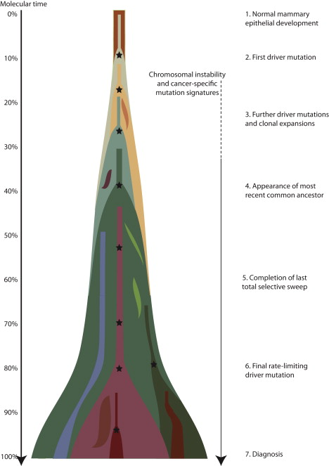
… have in common with its ugly stepchild, Cancer?
(Nik-Zainal 2012)
Notes:
http://www.cell.com/action/showImagesData?pii=S0092-8674%2812%2900527-2

Slide 5
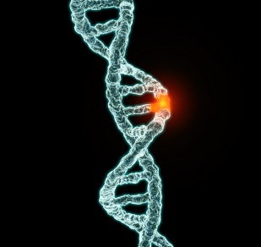
They are both driven by mutation and natural selection.
Notes:
https://www.unz.com/gnxp/author/gnxp-kjmtchl/

Slide 6
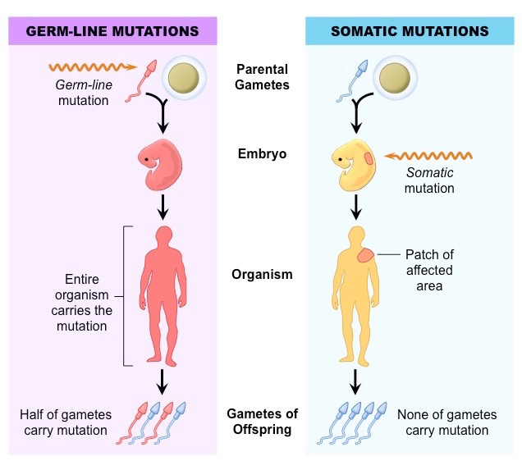
Every mutational occurrence begins in a single cell
Notes:
http://ib.bioninja.com.au/standard-level/topic-3-genetics/33-meiosis/somatic-vs-germline-mutatio.html

Slide 7
I seek the universal patterns of human mutation that are common to germline and somatic cells.
Explore: Mutations that co-occur in the germline and somatic settings - what is the extent and distribution?
Explain: Why do mutations co-occur in germline and somatic settings?
Exploit: How can we use these observations to discover novel biology and treat human disease?

Slide 8
This research matters
It is of fundamental in biology to understand mutational processes shared between somatic and germline settings
Offers a new perspective on the most mutable sites of the human genome
  Applications to coherent somatic mutation in autoimmunity
Would potentially support the construction of neutral models of mutation
  Rare cancer types
  Exploit differential selection patterns between germline and somatic settings
Facilitates exchange of data and insights between somatic and germline genomics

Slide 9
Two new vast, complementary databases support the inter-relation of germline and somatic mutational processes
gnomAD – 15,000 whole genomes of healthy germline samples
PCAWG – 2,500 whole genomes of cancerous somatic samples

Slide 10
The life history of an observed mutation proceeds in 5 stages
Generation
Propagation
Sequencing
Mapping
Variant calling
For any observed pattern in mutation, we care to distinguish the contributions of these stages

Slide 11
A mechanism for a ubiquitous mutation type
Uracil
easily detected as wrong by DNA repair enzymes, since Uracil does not belong in the genome
Cytosine
Thymine
Since thymine belongs in genome, cell has to guess which member of base pair is wrong
5-methyl Cytosine

Slide 12
Many known processes contribute to the generation of new mutations
Spontaneous deamination (Shen et al., 1994)
DNA replication errors (Korona et al., 2010), (Supek and Lehner, 2015)
UV radiation (Pfeifer et al. , 2005)
Oxidation
Mutagens
Direct enzymatic activity, e.g. AID/APOBEC (Conticello, 2008)
Failures of DNA repair
Nonhomologous recomobination

Slide 13
Genomic samples (e.g. from different tissues) differ in the loadings of mutational processes
Anatomy affects exposure to environmental toxins (e.g. UV penetrates skin but not brain)
Cell-type-dependent epigenome affects predisposition to various kinds of mutations (e.g. methylation increases rate of NCpG -> T mutations) (Polak 2015)
Cell-type-dependent RNA expression affects DNA repair of various kinds of mutations via transcription-coupled repair (Haradhvala 2016)
Cell-types/samples differ with respect to expression and activity of DNA repair and editing enzymes (Dion 2014)
Manner of DNA replication (mitotic vs meiotic) differs between somatic (100 % mitotic) and germline (95% mitotic, 5% meiotic)

Slide 14
Mutational signature analysis can suggest undiscovered processes that create mutations
Five popular kinds of tell-tale signs that a mutation comes from a particular process even if undiscovered:
  Specificity to patients with a known environmental exposure
  Motif bias
  Local clustering (“kataegis”) (Taylor 2013)
  Cell-type specificity
  Strand-asymmetry (Haradhvala 2016)
Potential result of my analysis: may help discover/explain/clarify novel or poorly understood mutational processes/signatures

Slide 15
Mutation signature analysis has been best developed for trinucleotide context
Trinucleotide context of a mutation is the reference allele, alternate allele, and flanking alleles: ACG_T
Trinucleotide spectra vary by sample
Believed to result from the loadings of various mutation processes crossed with the trinucleotide biases of those processes
Popular approach: Non-negative matrix factorization to decompose trinucleotide spectra into inferred mutational processes and their loadings across samples
Indications that might be fruitful to extend this to pentanucleotide context in some cancer types (e.g. melanoma)

Slide 16
Preliminary Results

Slide 17
A substantial number of somatic mutations in PCAWG are elsewhere listed as germline mutations
Median tumor: 4786 autosomal somatic mutations; of which
429 are co-mutations
2.8 million co-mutations total
Is this due to germline contamination of PCAWG samples? (Spoiler: No)
Is this a greater number of co-mutations than we would expect by sheer chance? (Spoiler: Yes.)
What does explain this high co-mutation number (Stay tuned.)

Slide 18
Germline contamination is a threat that must be considered in any somatic sequencing study
Typical patient has 3-4 million germline variants, compared with 5,000 somatic variants;
In a typical cancer sample, 99.9% of raw differences from the human reference genome are germline variants
In a cancer sequencing experiment, any mutations present in a normal tissue sample (e.g. blood) are excluded from the somatic sample
Ideally this would prevent contamination of SNPs of germline origin from being leaked into a somatic call-set, but this mechanism is imperfect
Some true germline mutations are randomly missed in the patient’s normal and recovered in the tumor, and so are erroneously called as somatic mutations; the question is: how many?

Slide 19
Germline contamination is well-controlled in PCAWG
PCAWG panel of normal filtering successfully removed common (AF>0.5%) variants:
  Only 8,592 of 41 million autosomal PCAWG somatic mutations are common gnomAD SNPs, 3-4 per person
PCAWG normal coverage unlikely to miss rare variants:
  PCAWG normal coverage is reported as mean of 25X.
  Assume normal read depth across sites and patients is Poisson distributed around 25
  Assume 200,000 rare variants per patient (based on analysis of benchmark individual NA12878) distributed uniformly across read depths
  For each expected rare variant draw simulated reads from a binomial distributions with p=0.5 and ntrials=simulated read depth at that patient-site
  Missed germline rare variants are those with ≤ 1 alternative read and ≥ 8 normal reads at that site
  Result: ~15,000 PCAWG somatic mutation calls are expected to be rare germline contaminants
In total, expect no more than 24,000 contaminating germline variants, 0.06% of all PCAWG somatic mutation occurrences
Future step: examine PCAWG read stacks for more precise coverage information

Slide 20
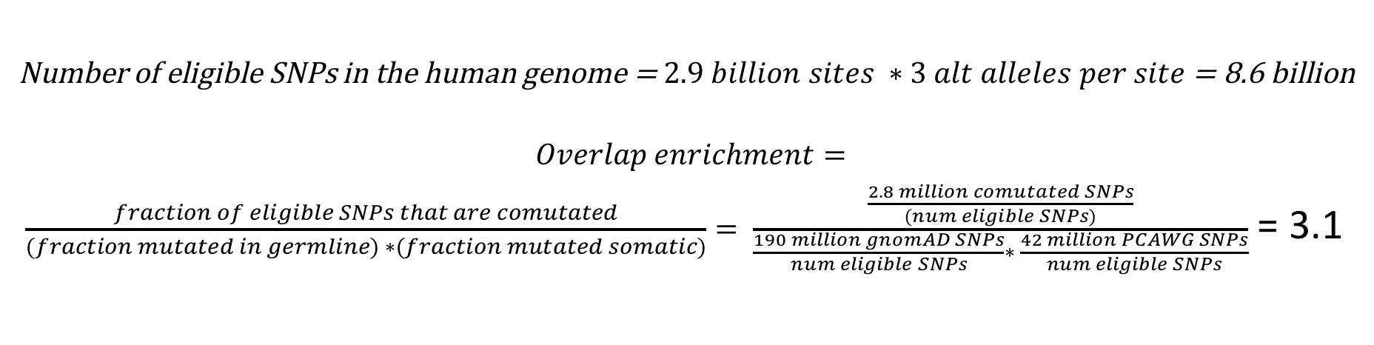
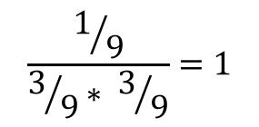
The co-mutation count is three times higher than expected by sheer chance
Number of eligible SNPs in the human genome = $2.9 billion sites ∗3 alt alleles per site$ = 8.6 billion
$$Overlap enrichment=$$
$\frac{fraction of eligible SNPs that are comutated}{(fraction mutated in germline) ∗(fraction mutated somatic)}= \frac{\frac{2.8 million comutated SNPs}{\left(num eligible SNPs\right)}}{\frac{190 million gnomAD SNPs}{num eligible SNPs}∗ \frac{42 million PCAWG SNPs}{num eligible SNPs}}$ = 3.1
Toy Germline
Toy Somatic
Toy Overlap
Overlap enrichment
$$\frac{1/9}{3/9∗ 3/9}=1$$

Slide 21
Why might overlap occur?
Technical Reasons
Biological Reasons
Sequencing artifacts (Costello 2013)
Mapping artifacts (Li 2014)
Variant calling artifacts
Analysis artifacts
Shared propensity to mutation of certain sites or kinds of sites
Incidental correlation between a germline process and somatic process

Slide 22
So what does explain this overlap?
Biologically, I put forward that three putative facts about mutational covariates would explain these shared mutational patterns; namely, that some genomic or epigenomic covariate:
1. Where present at some sites or regions of a genome, strongly influences the mutations rate there; and
2. Exerts a similar impact on the mutation rate regardless of the tissue or setting; and
3. Exhibits a similar positional or regional distribution of occurrence regardless of the tissue or setting.
Conceptually: Correlated tendencies of sites to mutate across settings.
Conceptual patterns of germline-somatic mutability concordance. Top-left: Both uniform, overlap enrichment = 1; Top-right: Independently-varying: oe = 1; Bottom-left: Correlated mutability of SNPs, oe > 1; Bottom-right: Anti-correlated mutability, oe < 1

Slide 23
Overlap Enrichment is particularly high in some cancer types

Slide 24
Overlap enrichment by somatic sample is nearly completely explained by the share of mutations in that sample attributed to spontaneous deamination

Slide 25
Co-Mutations are predominantly NCpG -> T
Germline
Somatic
Both
C -> A
C -> G
C -> T
T -> A
T -> C
T -> G
Raw Mutation Counts
Normalized Mutation Probabilities

Slide 26
After conditioning on trinucleotide context, some overlap enrichment remains
C -> A
C -> G
C -> T
T -> A
T -> C
T -> G
TCT -> TAT
TTA -> TAA
Log2 Conditional Overlap Enrichment
Raw Surplus of Co-mutations vs trinucleotide-specific expectations
TTT -> TGT

Slide 27
Extended motif analysis implicates repetitive sequences, either biologically or artefactually
The extended kmers around unique co-mutations are frequently very similar to each other
“GTCAGGAGTTCGAGACCAGCC” occurs 1,932 times among the 2.6 million unique co-mutations
This raises questions about mapability issues biasing the results
Nonetheless the potential problem is confined insofar as, despite suspiciously high recurrence of some motifs, the 21-mer context of 89% of the unique mutations are themselves unique
Intriguingly, the 7th most common 21-mer among co-mutated sites is "CCCAGCTACTCGGGAGGCTGA”, occurring in 728 unique mutations
This has 100% sequence identity with the ancestor of the Alu transposable element, which makes up 10% of the human genome, with the mutated allele occurring at the Alu endonuclease recognition site

Slide 28
Summary of Results
The number of SNPs mutated in both germline and somatic samples is, initially, surprisingly high
Except in rare, possibly artefactual cases, this degree of co-mutation is mostly expected from the trinucleotide biases of mutations in germline and somatic settings
The major overlap between the trinucleotide biases in germline and somatic settings is at NCpG→ T contexts, which relates to the ubiquity of spontaneous deamination

Slide 29
Future Plans
Notes:
This next section, though brief, is in some ways the most important, because what we say here is going to affect how I pusue this topic.

Slide 30
Unanswered Questions
How much of the observed overlap enrichment is real vs artefactual?
Why does trinucleotide context explain such an outsized share of overlap enrichment in most cases? Does this mean that other factors, such as regional or local factors are highly cell-type-dependent?
Conversely, why does trinucleotide context explain so little of overlap enrichment for TTA->TAA mutations?
What are the precise biomedical implications of this research?
Notes:
My future plans are guided by my unanswered questions. So let me list some here:

Slide 31
How much of the observed overlap enrichment is real vs artefactual?
Sequencing artifacts
  Estimate the number of co-mutations which arise from oxidation during sample prep by running oxidation software
  Gauge the extent of overlap enrichment inflation due to unequal sequencing depth using simulations
Mapping artifacts
  Simulate reads bearing observed motifs plus SNPs, run them through standard mapping pipeline (e.g. BWA) and check their mapping quality
Variant calling artifacts
  Obtain Mutect-only read stack to better ground assumptions in germline contamination simulations
(Analysis artifacts)
(Biological plausibility)

Slide 32
Does the explainability of co-mutation via trinucleotide context mean that other factors, such as regional or local factors are unimportant or highly cell-type-dependent?
Not necessarily because co-mutation rates are overexplained
Many correlations, find the causation or at least the limits of our uncertainty

Slide 33
Acknowledgements
Lab
Sushant Kumar
Donghoon Lee
Shantao Li
Jason Liu
Patrick McGillivray
Leonidas Salichos
Jonathan Warrell
Jing Zhang
Lab Admin
Lori Iannicelli
Mihali Felipe
Mark Gerstein (PI)
Committee
Joseph Chang
Gad Getz
David Hafler
Coordination
Susan Durant
Dana Eckstein
Eliza Katz
Support
Yale Center for Research Computing
Yale Computational Biology & Bioinformatics
Yale MD-PhD program
NIH

Slide 34
References
LB Alexandrov, YS Ju, K Haase, Loo P Van, I Martincorena, S Nik-Zainal, Y Totoki, A Fujimoto, H Nakagawa, T Shibata, PJ Campbell, P Vineis, DH Phillips, MR Stratton. Mutational signatures associated with tobacco smoking in human cancer.. Science 354, 618-622 (2016).
LB Alexandrov, S Nik-Zainal, DC Wedge, PJ Campbell, MR Stratton. Deciphering signatures of mutational processes operative in human cancer.. Cell Rep 3, 246-59 (2013).
LB Alexandrov, MR Stratton. Mutational signatures: the patterns of somatic mutations hidden in cancer genomes.. Curr Opin Genet Dev 24, 52-60 (2014).
Alexej Abyzov, Livia Tomasini, Bo Zhou, Nikolaos Vasmatzis, Gianfilippo Coppola, Mariangela Amenduni, Reenal Pattni, Michael Wilson, Mark Gerstein, Sherman Weissman, Alexander E. Urban, Flora M. Vaccarino. One thousand somatic SNVs per skin fibroblast cell set baseline of mosaic mutational load with patterns that suggest proliferative origin. Genome Research 27, 512–523 Cold Spring Harbor Laboratory, 2017. Link
Andy Liaw, Matthew Wiener. Classification and Regression by randomForest. R News 2 (2002).
B Arbeithuber, AJ Betancourt, T Ebner, I Tiemann-Boege. Crossovers are associated with mutation and biased gene conversion at recombination hotspots.. Proc Natl Acad Sci U S A 112, 2109-14 (2015).
Bradley E Bernstein, John A Stamatoyannopoulos, Joseph F Costello, Bing Ren, Aleksandar Milosavljevic, Alexander Meissner, Manolis Kellis, Marco A Marra, Arthur L Beaudet, Joseph R Ecker, Peggy J Farnham, Martin Hirst, Eric S Lander, Tarjei S Mikkelsen, James A Thomson. The NIH Roadmap Epigenomics Mapping Consortium. Nature Biotechnology 28, 1045–1048 Springer Nature, 2010. Link
PJ Campbell, Gad Getz, Joshua M. Stuart, Jan O. Korbel, Lincoln D. Stein, ICGC/TCGA Pan-Cancer Analysis of Whole Genomes Net. Pan-cancer analysis of whole genomes. bioRxiv (2017). Link
SG Conticello. The AID/APOBEC family of nucleic acid mutators. Genome Biol 9, 229 (2008).
SG Conticello, CJ Thomas, SK Petersen-Mahrt, MS Neuberger. Evolution of the AID/APOBEC family of polynucleotide (deoxy)cytidine deaminases.. Mol Biol Evol 22, 367-77 (2005).

Slide 35
M Costello, TJ Pugh, TJ Fennell, C Stewart, L Lichtenstein, JC Meldrim, JL Fostel, DC Friedrich, D Perrin, D Dionne, S Kim, SB Gabriel, ES Lander, S Fisher, G Getz. Discovery and characterization of artifactual mutations in deep coverage targeted capture sequencing data due to oxidative DNA damage during sample preparation.. Nucleic Acids Res 41, e67 (2013).
D. A. Korona, K. G. LeCompte, Z. F. Pursell. The high fidelity and unique error signature of human DNA polymerase . Nucleic Acids Research 39, 1763–1773 Oxford University Press (OUP), 2010. Link
ENCODE. The ENCODE (ENCyclopedia Of DNA Elements) Project. Science 306, 636–640 American Association for the Advancement of Science (AAAS), 2004.Link
ENCODE. An integrated encyclopedia of DNA elements in the human genome. Nature 489, 57–74 Springer Nature, 2012. Link
Gregory M Cooper, David L Goode, Sarah B Ng, Arend Sidow, Michael J Bamshad, Jay Shendure, Deborah A Nickerson. Single-nucleotide evolutionary constraint scores highlight disease-causing mutations. Nature Methods 7, 250–251 Springer Nature, 2010. Link
T Helleday, S Eshtad, S Nik-Zainal. Mechanisms underlying mutational signatures in human cancers.. Nat Rev Genet 15, 585-98 (2014).
Hongshan Guo, Boqiang Hu, Liying Yan, Jun Yong, Yan Wu, Yun Gao, Fan Guo, Yu Hou, Xiaoying Fan, Ji Dong, Xiaoye Wang, Xiaohui Zhu, Jie Yan, Yuan Wei, Hongyan Jin, Wenxin Zhang, Lu Wen, Fuchou Tang, Jie Qiao. DNA methylation and chromatin accessibility profiling of mouse and human fetal germ cells. Cell Research 27, 165–183 Springer Nature, 2016. Link
Hui Shen, Jian Li, Jigang Zhang, Chao Xu, Yan Jiang, Zikai Wu, Fuping Zhao, Li Liao, Jun Chen, Yong Lin, Qing Tian, Christopher J. Papasian, Hong-Wen Deng. Comprehensive Characterization of Human Genome Variation by High Coverage Whole-Genome Sequencing of Forty Four Caucasians. PLoS ONE 8, e59494 Public Library of Science (PLoS), 2013. Link
Kristian Cibulskis, Michael S Lawrence, Scott L Carter, Andrey Sivachenko, David Jaffe, Carrie Sougnez, Stacey Gabriel, Matthew Meyerson, Eric S Lander, Gad Getz. Sensitive detection of somatic point mutations in impure and heterogeneous cancer samples. Nature Biotechnology 31, 213–219 Springer Nature, 2013. Link
KK Kumar, G Pugalenthi, PN Suganthan. DNA-Prot: identification of DNA binding proteins from protein sequence information using random forest.. J Biomol Struct Dyn 26, 679-86 (2009).
Laurence H. Pearl, Renos Savva. The problem with pyrimidines. Nature Structural & Molecular Biology 3, 485–487 Springer Nature, 1996. Link
M Lek, KJ Karczewski, EV Minikel, KE Samocha, E Banks, T Fennell, AH O’Donnell-Luria, JS Ware, AJ Hill, BB Cummings, T Tukiainen, DP Birnbaum, JA Kosmicki, LE Duncan, K Estrada, F Zhao, J Zou, E Pierce-Hoffman, J Berghout, DN Cooper, N Deflaux, M DePristo, R Do, J Flannick, M Fromer, L Gauthier, J Goldstein, N Gupta, D Howrigan, A Kiezun, MI Kurki, AL Moonshine, P Natarajan, L Orozco, GM Peloso, R Poplin, MA Rivas, V Ruano-Rubio, SA Rose, DM Ruderfer, K Shakir, PD Stenson, C Stevens, BP Thomas, G Tiao, MT Tusie-Luna, B Weisburd, HH Won, D Yu, DM Altshuler, D Ardissino, M Boehnke, J Danesh, S Donnelly, R Elosua, JC Florez, SB Gabriel, G Getz, SJ Glatt, CM Hultman, S Kathiresan, M Laakso, S McCarroll, MI McCarthy, D McGovern, R McPherson, BM Neale, A Palotie, SM Purcell, D Saleheen, JM Scharf, P Sklar, PF Sullivan, J Tuomilehto, MT Tsuang, HC Watkins, JG Wilson, MJ Daly, DG MacArthur. Analysis of protein-coding genetic variation in 60,706 humans.. Nature 536, 285-91 (2016).

Slide 36
S Levy, G Sutton, PC Ng, L Feuk, AL Halpern, BP Walenz, N Axelrod, J Huang, EF Kirkness, G Denisov, Y Lin, JR MacDonald, AW Pang, M Shago, TB Stockwell, A Tsiamouri, V Bafna, V Bansal, SA Kravitz, DA Busam, KY Beeson, TC McIntosh, KA Remington, JF Abril, J Gill, J Borman, YH Rogers, ME Frazier, SW Scherer, RL Strausberg, JC Venter. The diploid genome sequence of an individual human.. PLoS Biol 5, e254 (2007).
Ludmil B. Alexandrov, Serena Nik-Zainal, David C. Wedge, Peter J. Campbell, Michael R. Stratton. Deciphering Signatures of Mutational Processes Operative in Human Cancer. Cell Reports 3, 246–259 Elsevier BV, 2013. Link
Mark A DePristo, Eric Banks, Ryan Poplin, Kiran V Garimella, Jared R Maguire, Christopher Hartl, Anthony A Philippakis, Guillermo del Angel, Manuel A Rivas, Matt Hanna, Aaron McKenna, Tim J Fennell, Andrew M Kernytsky, Andrey Y Sivachenko, Kristian Cibulskis, Stacey B Gabriel, David Altshuler, Mark J Daly. A framework for variation discovery and genotyping using next-generation DNA sequencing data. Nature Genetics 43, 491–498 Springer Nature, 2011. Link
Martin Kircher, Daniela M Witten, Preti Jain, Brian J ORoak, Gregory M Cooper, Jay Shendure. A general framework for estimating the relative pathogenicity of human genetic variants. Nature Genetics 46, 310–315 Springer Nature, 2014. Link
Martin Morgan, Hervé Pagès, Valerie Obenchain, Nathaniel Hayden. Rsamtools: Binary alignment (BAM), FASTA, variant call (BCF), and tabix file import. R package(2017).
Matthew T. Webster, Nick G.C. Smith. Fixation biases affecting human SNPs. Trends in Genetics 20, 122–126 Elsevier BV, 2004. Link
Maura Costello, Trevor J. Pugh, Timothy J. Fennell, Chip Stewart, Lee Lichtenstein, James C. Meldrim, Jennifer L. Fostel, Dennis C. Friedrich, Danielle Perrin, Danielle Dionne, Sharon Kim, Stacey B. Gabriel, Eric S. Lander, Sheila Fisher, Gad Getz. Discovery and characterization of artifactual mutations in deep coverage targeted capture sequencing data due to oxidative DNA damage during sample preparation. Nucleic Acids Research 41, e67–e67 Oxford University Press (OUP), 2013. Link
Michael Lawrence, Wolfgang Huber, Hervé Pagès, Patrick Aboyoun, Marc Carlson, Robert Gentleman, Martin T. Morgan, Vincent J. Carey. Software for Computing and Annotating Genomic Ranges. PLoS Computational Biology 9, e1003118 Public Library of Science (PLoS), 2013. Link
Michael M Hoffman, Orion J Buske, Jie Wang, Zhiping Weng, Jeff A Bilmes, William Stafford Noble. Unsupervised pattern discovery in human chromatin structure through genomic segmentation. Nature Methods 9, 473–476 Springer Nature, 2012. Link
Michael R. Stratton, Peter J. Campbell, P. Andrew Futreal. The cancer genome. Nature 458, 719–724 Springer Nature, 2009. Link
JJ Michaelson, Y Shi, M Gujral, H Zheng, D Malhotra, X Jin, M Jian, G Liu, D Greer, A Bhandari, W Wu, R Corominas, A Peoples, A Koren, A Gore, S Kang, GN Lin, J Estabillo, T Gadomski, B Singh, K Zhang, N Akshoomoff, C Corsello, S McCarroll, LM Iakoucheva, Y Li, J Wang, J Sebat. Whole-genome sequencing in autism identifies hot spots for de novo germline mutation.. Cell 151, 1431-42 (2012).
S Nik-Zainal, LB Alexandrov, DC Wedge, Loo P Van, CD Greenman, K Raine, D Jones, J Hinton, J Marshall, LA Stebbings, A Menzies, S Martin, K Leung, L Chen, C Leroy, M Ramakrishna, R Rance, KW Lau, LJ Mudie, I Varela, DJ McBride, GR Bignell, SL Cooke, A Shlien, J Gamble, I Whitmore, M Maddison, PS Tarpey, HR Davies, E Papaemmanuil, PJ Stephens, S McLaren, AP Butler, JW Teague, G Jönsson, JE Garber, D Silver, P Miron, A Fatima, S Boyault, A Langerød, A Tutt, JW Martens, SA Aparicio, Å Borg, AV Salomon, G Thomas, AL Børresen-Dale, AL Richardson, MS Neuberger, PA Futreal, PJ Campbell, MR Stratton. Mutational processes molding the genomes of 21 breast cancers.. Cell 149, 979-93 (2012).
Paul Modrich, Robert Lahue. Mismatch Repair in Replication Fidelity Genetic Recombination, and Cancer Biology. Annual Review of Biochemistry 65, 101–133 Annual Reviews, 1996. Link

Slide 37
Paz Polak, Rosa Karlić, Amnon Koren, Robert Thurman, Richard Sandstrom, Michael S. Lawrence, Alex Reynolds, Eric Rynes, Kristian Vlahoviček, John A. Stamatoyannopoulos, Shamil R. Sunyaev. Cell-of-origin chromatin organization shapes the mutational landscape of cancer. Nature 518, 360–364 Springer Nature, 2015. Link
GP Pfeifer, YH You, A Besaratinia. Mutations induced by ultraviolet light.. Mutat Res 571, 19-31 (2005).
Roadmap. Integrative analysis of 111 reference human epigenomes. Nature 518, 317–330 Springer Nature, 2015. Link
KA Ross. Coherent somatic mutation in autoimmune disease.. PLoS One 9, e101093 (2014).
JC Shen, WM 3rd Rideout, PA Jones. The rate of hydrolytic deamination of 5-methylcytosine in double-stranded DNA.. Nucleic Acids Res 22, 972-6 (1994).
F Supek, B Lehner. Differential DNA mismatch repair underlies mutation rate variation across the human genome.. Nature 521, 81-4 (2015).
Tychele N. Turner, Bradley P. Coe, Diane E. Dickel, Kendra Hoekzema, Bradley J. Nelson, Michael C. Zody, Zev N. Kronenberg, Fereydoun Hormozdiari, Archana Raja, Len A. Pennacchio, Robert B. Darnell, Evan E. Eichler. Genomic Patterns of De Novo Mutation in Simplex Autism. Cell 171, 710–722.e12 Elsevier BV, 2017. Link
Wentian Li, Jan Freudenberg. Mappability and read length. Frontiers in Genetics 5 Frontiers Media SA, 2014. Link

