Slide 1
Prospectus: Universal mutability across germline and somatic settings
Will Meyerson

Slide 2

What does the The Tree of Life …
Notes:
https://inhabitat.com/wp-content/blogs.dir/1/files/2016/04/Tree-of-Life.jpg

Slide 3
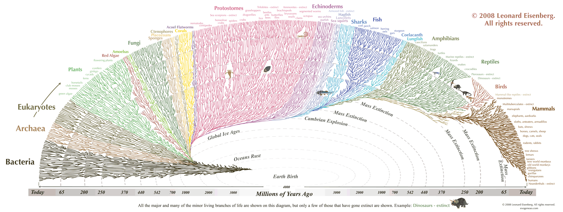
… from which all manner of creature flourishes …
Notes:
https://thumbnails-visually.netdna-ssl.com/the-great-tree-of-life_505ba0c07cda2.gif
https://en.wikipedia.org/wiki/Escherichia_coli#/media/File:E_coli_at_10000x,_original.jpg
https://en.wikipedia.org/wiki/Haloquadratum_walsbyi#/media/File:Haloquadratum_walsbyi00.jpg
https://en.wikipedia.org/wiki/Slime_mold#/media/File:Haeckel_Mycetozoa.jpg
https://upload.wikimedia.org/wikipedia/commons/thumb/6/6e/Diversity_of_plants_image_version_5.png/800px-Diversity_of_plants_image_version_5.png
https://upload.wikimedia.org/wikipedia/commons/1/14/Animal_diversity.png

Slide 4
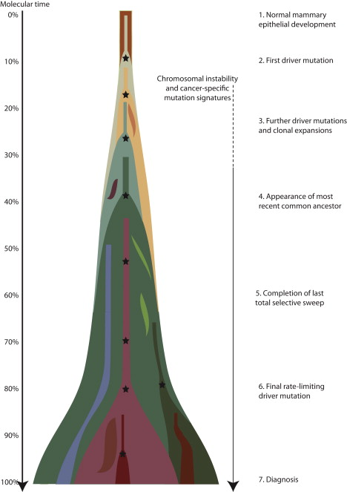
… have in common with its ugly stepchild, Cancer?
(Nik-Zainal 2012)
Notes:
http://www.cell.com/action/showImagesData?pii=S0092-8674%2812%2900527-2

Slide 5
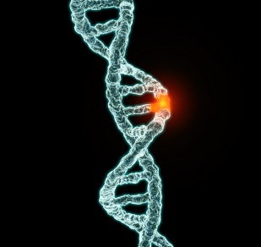
They are both driven by mutation and natural selection.
Notes:
https://www.unz.com/gnxp/author/gnxp-kjmtchl/

Slide 6
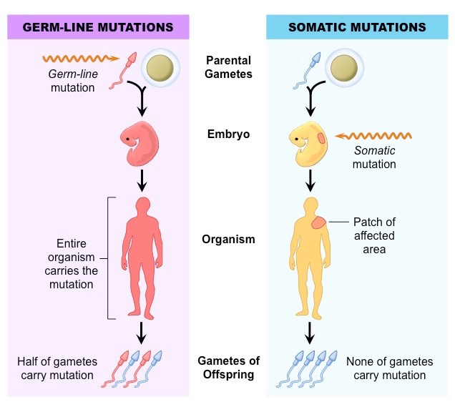
Every mutational occurrence begins in a single cell
Notes:
http://ib.bioninja.com.au/standard-level/topic-3-genetics/33-meiosis/somatic-vs-germline-mutatio.html

Slide 7
I seek the universal patterns of human mutation that are common to germline and somatic cells.
Explore: What is the extent and distribution of mutations that co-occur in the germline and somatic settings?
Explain: Why do mutations co-occur in germline and somatic settings?
Exploit: How can we use these observations to discover novel biology and treat human disease?

Slide 8
This research matters
It is of fundamental in biology to understand mutational processes shared between somatic and germline settings
Offers a new perspective on the most mutable sites of the human genome
  Applications to coherent somatic mutation in autoimmunity
Would potentially support the construction of neutral models of mutation
  Rare cancer types
  Exploit differential selection patterns between germline and somatic settings
Facilitates exchange of data and insights between somatic and germline genomics

Slide 9
Two new vast, complementary databases support the inter-relation of germline and somatic mutational processes
gnomAD – 15,000 whole genomes of healthy germline samples
PCAWG – 2,500 whole genomes of cancerous somatic samples

Slide 10
The life history of an observed mutation proceeds in 5 stages
Generation
Propagation
Sequencing
Mapping
Variant calling
For any observed pattern in mutation, we care to distinguish the contributions of these stages

Slide 11
Many known processes contribute to the generation of new mutations
DNA replication errors
Spontaneous deamination
UV radiation
Oxidation
Mutagens
Direct enzymatic activity (e.g. AID/APOBEC)
Failures of DNA repair

Slide 12
Genomic samples (e.g. from different tissues) differ in the loadings of mutational processes
Anatomy affects exposure to environmental toxins (e.g. UV penetrates skin but not brain)
Cell-type-dependent epigenome affects predisposition to various kinds of mutations (e.g. methylation increases rate of NCpG -> T mutations)
Cell-type-dependent RNA expression affects DNA repair of various kinds of mutations via transcription-coupled repair
Cell-types/samples differ with respect to expression and activity of DNA repair and editing enzymes
Manner of DNA replication (mitotic vs meiotic) differs between somatic (100 % mitotic) and germline (95% mitotic, 5% meiotic)

Slide 13
Mutational signature analysis points to undiscovered processes that create mutations
Trinucleotide context of a mutation is the reference allele, alternate allele, and flanking alleles: ACG_T
Trinucleotide spectra vary by sample
Believed to result from the loadings of various mutation processes crossed with the trinucleotide biases of those processes
Popular approach: Non-negative matrix factorization to decompose trinucleotide spectra into inferred mutational processes and their loadings across samples
Potential byproduct of my analysis: may help discover/explain/clarify novel or poorly understood mutational processes/signatures

Slide 14
A substantial number of somatic mutations in PCAWG are elsewhere listed as germline mutations
Median tumor: 4786 autosomal somatic mutations; of which
429 are co-mutations
2.8 million co-mutations total
Is this due to germline contamination of PCAWG samples? (Spoiler: No)
Is this a greater number of co-mutations than we would expect by sheer chance? (Spoiler: Yes.)
What does explain this high co-mutation number (Stay tuned.)

Slide 15
The threat of germline contamination
Typical patient has 3-4 million germline variants, compared with 5,000 somatic variants;
In a typical cancer sample, 99.9% of raw differences from the human reference genome are germline variants
In a cancer sequencing experiment, any mutations present in a normal tissue sample (e.g. blood) are excluded from the somatic sample
Ideally this would prevent contamination of SNPs of germline origin from being leaked into a somatic call-set, but this mechanism is imperfect
Some true germline mutations are randomly missed in the patient’s normal and recovered in the tumor, and so are erroneously called as somatic mutations; the question is: how many?

Slide 16
Germline contamination is well-controlled in PCAWG
PCAWG panel of normal filtering successfully removed common (AF>0.5%) variants:
  Only 8,592 of 41 million autosomal PCAWG somatic mutations are common gnomAD SNPs, 3-4 per person
PCAWG normal coverage unlikely to miss rare variants:
  PCAWG normal coverage is reported as mean of 25X.
  Assume normal read depth across sites and patients is Poisson distributed around 25
  Assume 200,000 rare variants per patient (based on analysis of benchmark individual NA12878) distributed uniformly across read depths
  For each expected rare variant draw simulated reads from a binomial distributions with p=0.5 and ntrials=simulated read depth at that patient-site
  Missed germline rare variants are those with ≤ 1 alternative read and ≥ 8 normal reads at that site
  Result: ~15,000 PCAWG somatic mutation calls are expected to be rare germline contaminants
In total, expect no more than 24,000 contaminating germline variants, 0.06% of all PCAWG somatic mutation occurrences
Future step: examine PCAWG read stacks for more precise coverage information

Slide 17
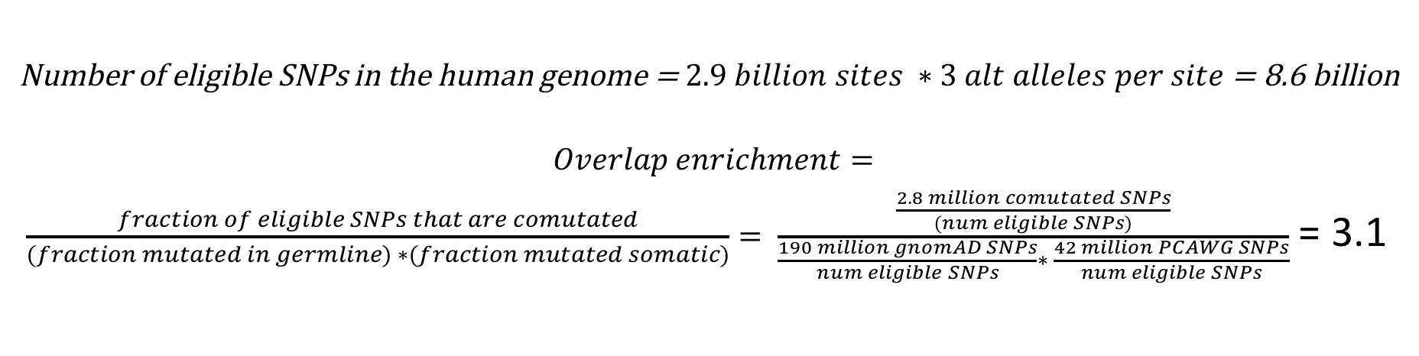
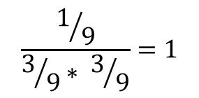
The co-mutation count is three times higher than expected by sheer chance
Number of eligible SNPs in the human genome = $2.9 billion sites ∗3 alt alleles per site$ = 8.6 billion
$$Overlap enrichment=$$
$\frac{fraction of eligible SNPs that are comutated}{(fraction mutated in germline) ∗(fraction mutated somatic)}= \frac{\frac{2.8 million comutated SNPs}{\left(num eligible SNPs\right)}}{\frac{190 million gnomAD SNPs}{num eligible SNPs}∗ \frac{42 million PCAWG SNPs}{num eligible SNPs}}$ = 3.1
Toy Germline
Toy Somatic
Toy Overlap
Overlap enrichment
$$\frac{1/9}{3/9∗ 3/9}=1$$

Slide 18
Overlap Enrichment is particularly high in some cancer types

Slide 19
Overlap enrichment by somatic sample is nearly completely explained by the share of mutations in that sample attributed to spontaneous deamination

Slide 20
Co-Mutations are predominantly NCpG -> T

Slide 21
Trinucleotide context explains most of the observed overlap enrichment except at select contexts, such as TTA -> TAA
oe
Surprised that NCpG -> T mutations don’t have higher overlap enrichment (e.g. would expect CpG islands to inflate this)
Still some amount of overlap enrichment (and depletion) to explain across the board

Slide 22
The broader context of TTA_A co-mutations is AT-rich and repetitive
TTTTTTTTTTTAATTATACTT
ATAAATAAATTAATTAATTAA
CTTTTTTTTTTAATTATACTT
85% of T->A co-mutations in a TTA context have 14 or more As and Ts in the 18 nucleotides neighboring that TTA context
Is this a mapping artifact or a biological finding (e.g. due to strand slippage)?
Mean 36-bp mapability of reference genome at TTA_A co-mutations is 97% (BUT! This does not seem to take into account the alternate allele)
I assume this is a mapping artifact until proven otherwise
Still need to check other trinucleotide contexts
Notes:
Job dekker 2007. low information is the name of game in nobncoding …. Sequencing artifact (… how significant in illumina) [explore further]

Slide 23
Explaining trinucleotide context: Epigenomic features?
Germline NCpG -> T mutation rate strongly depends on methylation in spermatagonial stem cells (right)
For conditional NCpG -> T overlap enrichment to be so low, there needs to be little correlation between spermatagonial methylation and somatic methylation at CpG context
preliminary data [not shown] suggests correlation in 0.1-0.2 range, suitably low (but due to noise?)

Slide 24
Beyond nucleotide context: Features of genomic intervals with more co-mutations than expected
Regions with immunglobulin genes or olfactory receptor genes have more co-mutations than expected. (not shown)
Genomic intervals with fewer somatic mutations have more co-mutations than expected (right, top)
More conserved genomic intervals have more co-mutations than expected (right, bottom)
(Still need to condition on / integrate trinucleotide context)

Slide 25
So what does explain this overlap?
Biologically, I put forward that three putative facts about mutational covariates would explain these shared mutational patterns; namely, that some genomic or epigenomic covariate:
1. Where present at some sites or regions of a genome, strongly influences the mutations rate there; and
2. Exerts a similar impact on the mutation rate regardless of the tissue or setting; and
3. Exhibits a similar positional or regional distribution of occurrence regardless of the tissue or setting.
Conceptually: Correlated tendencies of sites to mutate across settings.
Conceptual patterns of germline-somatic mutability concordance. Top-left: Both uniform, overlap enrichment = 1; Top-right: Independently-varying: oe = 1; Bottom-left: Correlated mutability of SNPs, oe > 1; Bottom-right: Anti-correlated mutability, oe < 1

Slide 26
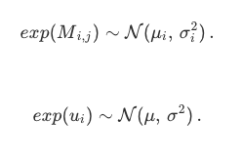
Conceptual forward model of co-mutation enrichment.
My model assumes that mutations come in different flavors, with distinct relative rates of occurrence.
For now, we can think of a flavor as an ordered pair from a reference allele to an alternative allele (e.g. C->T), but the concept is more general and could be modeled to include additional features, such a a C->T mutation within a CpG island or within a promoter.
The exact relative propensities to mutation of the various flavors may change across tissue types, but my model assumes that each flavor nonetheless has some central tendency of high or low mutability that is preserved across tissues.
My simulations show, quite intuitively, that mutation overlap rates increase with flavor distinctiveness and decrease with tissue distinctiveness

Slide 27
Summary of Results
The number of SNPs mutated in both germline and somatic samples is, initially, surprisingly high
Except in rare, possibly artefactual cases, this degree of co-mutation is mostly expected from the trinucleotide biases of mutations in germline and somatic settings
The major overlap between the trinucleotide biases in germline and somatic settings is at NCpG→ T contexts, which relates to the ubiquity of spontaneous deamination
Genomic-regional features also correlate with co-mutation rate

Slide 28
Next Steps
Test the mapability of TTA -> A mutations
Follow-up with the broader context behind co-mutations at other trinucleotide contexts
Investigate why NCpG -> T lacks conditional overlap enrichment
  E.g. compare CpG methylation profiles of somatic and germline cells
Integrate regional features that correlate with co-mutation propensities with trinucleotide features
Deeper analysis of germline contamination

Slide 29
Acknowledgements
SK, JZ, DL, XL, JL, LL, MTG, LS, STL, DC, MRS, JW, JR, PDM, GG, PE, DC
Committee: David Hafler, Joe Chang, Gad Getz
Mark
Lab Support
LI, MF, HPC, MBB
CBB
MD-PhD Program
NHGRI, NIH
Notes:
CY

Slide 30
Feedback from Lab
GG: Choose a few mutations that are truly somatic, coverage analysis, pileup
Follow up with GG about haploblocks
PE: enrichment of mutations that are functionally relevant; make arguments about stage 1-5
DC: much bigger axis
DL: increased co-mutation in conserved region he thought of repair? / strandedness (DC: GadGetz has paper)
LS: ongoing debate – show the literature; Separate into aims of proposal

Slide 31
Feedback from Mark
Don’t acknowledge ENCODEC

