Slide 1
Prospectus: Universal mutability across germline and somatic settings
Will Meyerson

Slide 2


What does …

Slide 3

... The Tree of Life …
Notes:
https://inhabitat.com/wp-content/blogs.dir/1/files/2016/04/Tree-of-Life.jpg

Slide 4
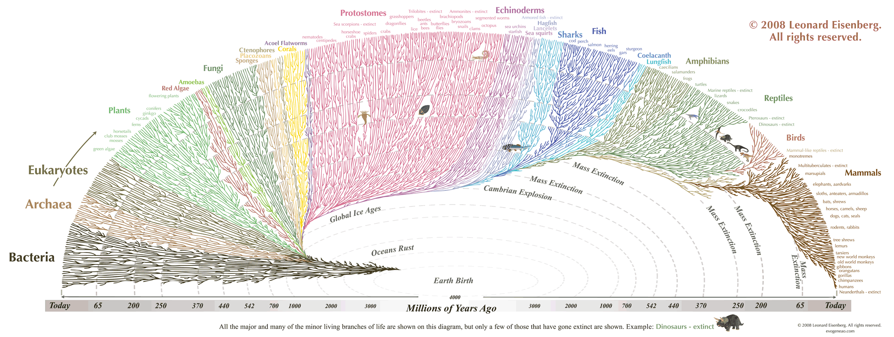
… from which all manner of creature flourishes …
Notes:
https://thumbnails-visually.netdna-ssl.com/the-great-tree-of-life_505ba0c07cda2.gif
https://en.wikipedia.org/wiki/Escherichia_coli#/media/File:E_coli_at_10000x,_original.jpg
https://en.wikipedia.org/wiki/Haloquadratum_walsbyi#/media/File:Haloquadratum_walsbyi00.jpg
https://en.wikipedia.org/wiki/Slime_mold#/media/File:Haeckel_Mycetozoa.jpg
https://upload.wikimedia.org/wikipedia/commons/thumb/6/6e/Diversity_of_plants_image_version_5.png/800px-Diversity_of_plants_image_version_5.png
https://upload.wikimedia.org/wikipedia/commons/1/14/Animal_diversity.png

Slide 5
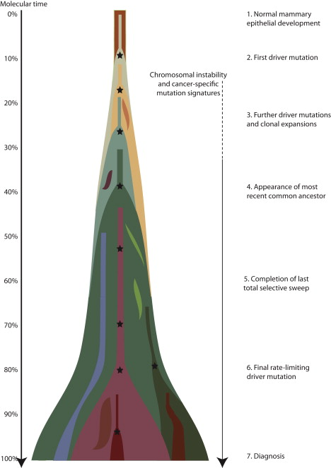
… have in common with its ugly stepchild, Cancer?
(Nik-Zainal 2012)
Notes:
http://www.cell.com/action/showImagesData?pii=S0092-8674%2812%2900527-2

Slide 6
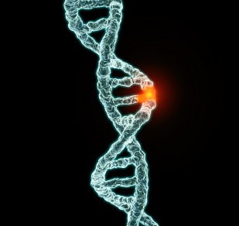
They are both driven by mutation and natural selection.
Notes:
https://www.unz.com/gnxp/author/gnxp-kjmtchl/

Slide 7
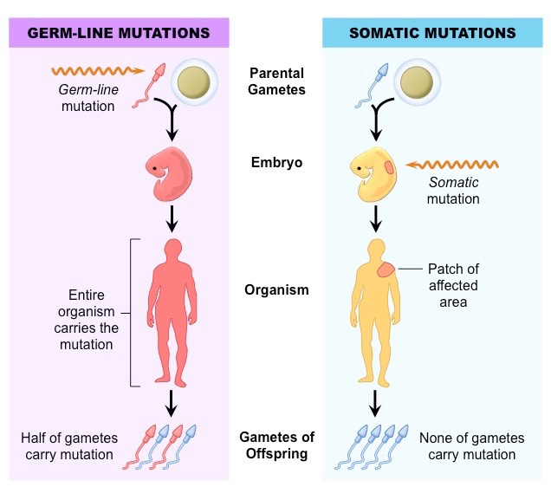
Every mutational occurrence begins in a single cell
Notes:
http://ib.bioninja.com.au/standard-level/topic-3-genetics/33-meiosis/somatic-vs-germline-mutatio.html

Slide 8
I seek the universal patterns of human mutation that are common to germline and somatic cells.
Explore: What is the extent and distribution of mutations that co-occur in the germline and somatic settings?
Explain: Why do mutations co-occur in germline and somatic settings?
Exploit: How can we use these observations to discover novel biology and treat human disease?

Slide 9
This research matters
It is of fundamental in biology to understand mutational processes shared between somatic and germline settings
Offers a new perspective on the most mutable sites of the human genome
  Applications to coherent somatic mutation in autoimmunity
Would potentially support the construction of neutral models of mutation
  Rare cancer types
  Exploit differential selection patterns between germline and somatic settings
Facilitates exchange of data and insights between somatic and germline genomics

Slide 10
Two new vast, complementary databases support the inter-relation of germline and somatic mutational processes
gnomAD – 15,000 whole genomes of healthy germline samples
PCAWG – 2,500 whole genomes of cancerous somatic samples

Slide 11
The life history of an observed mutation proceeds in 5 stages
Generation
Propagation
Sequencing
Mapping
Variant calling
For any observed pattern in mutation, we care to distinguish the contributions of these stages

Slide 12
Many known processes contribute to the generation of new mutations
DNA replication errors
Spontaneous deamination
UV radiation
Oxidation
Direct enzymatic activity (e.g. AID/APOBEC)
Failures of DNA repair

Slide 13
Genomic samples (e.g. from different tissues) differ in the loadings of mutational processes
Anatomy affects exposure to environmental toxins (e.g. UV penetrates skin but not brain)
Cell-type-dependent epigenome affects predisposition to various kinds of mutations (e.g. methylation increases rate of NCpG -> T mutations)
Cell-type-dependent RNA expression affects DNA repair of various kinds of mutations via transcription-coupled repair
Cell-types/samples differ with respect to expression and activity of DNA repair and editing enzymes
Manner of DNA replication (mitotic vs meiotic) differs between somatic (100 % mitotic) and germline (95% mitotic, 5% meiotic)

Slide 14
Mutational signature analysis points to undiscovered processes that create mutations
Trinucleotide context of a mutation is the reference allele, alternate allele, and flanking alleles: ACG_T
Trinucleotide spectra vary by sample
Believed to result from the loadings of various mutation processes crossed with the trinucleotide biases of those processes
Popular approach: Non-negative matrix factorization to decompose trinucleotide spectra into inferred mutational processes and their loadings across samples
Potential byproduct of my analysis: may help discover/explain/clarify novel or poorly understood mutational processes/signatures

Slide 15
First step in somatic-germline comparison: Calculation of Overlap Enrichment
SNP-level overlap enrichment: the fraction of potential SNPs that are co-mutated across two settings, divided by the product of the fractions of potential SNPs that are mutated in either setting.
An overlap enrichment of 1 indicates perfectly orthogonal processes; 0, perfectly exclusive processes; scores greater than 1 indicate some degree of shared mutational patterns.
Strength: Mostly robust to coverage bias over genomic intervals
Weakness: Particularly susceptible to germline contamination if present

Slide 16
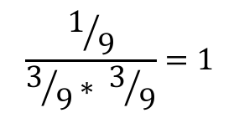
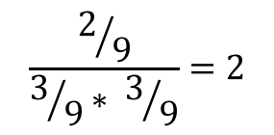
Data Set 1
Data Set 2
Overlap Enrichment
Overlap
$$\frac{1/9}{3/9∗ 3/9}=1$$
Case 1
$$\frac{2/9}{3/9∗ 3/9}=2$$
Case 2

Slide 17
Germline and somatic variants substantially overlap each other
2,858,108 or 6.9% of PCAWG somatic SNPs overlap gnomAD germline SNPs.
This is more than three times the 2.2% overlap expected if these processes were orthogonal.
Most pronounced (~5x) at gnomAD tripletons and quadrupletons
  Why? Mutability considerations
Bonus result:
PCAWG’s variant calling pipeline effectively removed common variants
Site-level overlap enrichment in black (only chromosome and position have to match); SNP-level overlap enrichment in blue (alternate allele must match in addition). GnomAD allele frequency is reported in log base 2; hence, -14 represents 2⁻¹⁴ = 6.1*10⁻⁵, corresponding to 1 gnomAD individual; -13 corresponds to 2 gnomAD individuals; -12 corresponds to 3-4 individuals, and so forth.

Slide 18
The overlap between germline and somatic variants is not explained by germline contamination of PCAWG
PCAWG panel of normal filtering successfully removed common (AF>0.5%) variants:
  Only 8,592 of 41 million autosomal PCAWG somatic mutational occurrences are common gnomAD SNPs, 3-4 per person
PCAWG normal coverage unlikely to miss rare variants:
  PCAWG normal coverage is reported as mean of 25X.
  Assume normal read depth across sites and patients is Poisson distributed around 25
  Assume 200,000 rare variants per patient (based on analysis of benchmark individual NA12878) distributed uniformly across read depths
  For each expected rare variant draw simulated reads from a binomial distributions with p=0.5 and ntrials=simulated read depth at that patient-site
  Missed germline rare variants are those with ≤ 1 alternative read and ≥ 8x normal coverage
  Result: ~15,000 PCAWG somatic mutation calls are expected to be rare germline contaminants
In total, expect no more than 24,000 contaminating germline variants, 0.06% of all PCAWG somatic mutation occurrences

Slide 19
So what does explain this overlap?
Biologically, I put forward that three putative facts about mutational covariates would explain these shared mutational patterns; namely, that some genomic or epigenomic covariate:
1. Where present at some sites or regions of a genome, strongly influences the mutations rate there; and
2. Exerts a similar impact on the mutation rate regardless of the tissue or setting; and
3. Exhibits a similar positional or regional distribution of occurrence regardless of the tissue or setting.
Conceptually: Correlated tendencies of sites to mutate across settings.
Conceptual patterns of germline-somatic mutability concordance. Top-left: Both uniform, overlap enrichment = 1; Top-right: Independently-varying: oe = 1; Bottom-left: Correlated mutability of SNPs, oe > 1; Bottom-right: Anti-correlated mutability, oe < 1

Slide 20
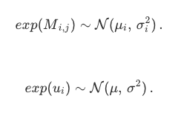
Conceptual forward model of co-mutation enrichment.
My model assumes that mutations come in different flavors, with distinct relative rates of occurrence.
For now, we can think of a flavor as an ordered pair from a reference allele to an alternative allele (e.g. C->T), but the concept is more general and could be modeled to include additional features, such a a C->T mutation within a CpG island or within a promoter.
The exact relative propensities to mutation of the various flavors may change across tissue types, but my model assumes that each flavor nonetheless has some central tendency of high or low mutability that is preserved across tissues.
My simulations show, quite intuitively, that mutation overlap rates increase with flavor distinctiveness and decrease with tissue distinctiveness

Slide 21
Cancer subtype analysis implicates the clock-like signature as a driver of shared mutation patterns between germline and somatic contexts

Slide 22
Co-Mutations are predominantly NCpG -> T

Slide 23
Trinucleotide context explains most of the observed overlap enrichment except at select contexts, such as TTA -> TAA
oe
Surprised that NCpG -> T mutations don’t have higher overlap enrichment (e.g. would expect CpG islands to inflate this)
Still some amount of overlap enrichment (and depletion) to explain across the board

Slide 24
The broader context of TTA_A co-mutations is AT-rich and repetitive
TTTTTTTTTTTAATTATACTT
ATAAATAAATTAATTAATTAA
CTTTTTTTTTTAATTATACTT
85% of T->A co-mutations in a TTA context have 14 or more As and Ts in the 18 nucleotides neighboring that TTA context
Is this a mapping artifact or a biological finding (e.g. due to strand slippage)?
Mean 36-bp mapability of reference genome at TTA_A co-mutations is 97% (BUT! This does not seem to take into account the alternate allele)
I assume this is a mapping artifact until proven otherwise
Still need to check other trinucleotide contexts

Slide 25
Explaining trinucleotide context: Epigenomic features?
Germline NCpG -> T mutation rate strongly depends on methylation in spermatagonial stem cells (right)
For conditional NCpG -> T overlap enrichment to be so low, there needs to be little correlation between spermatagonial methylation and somatic methylation at CpG context
preliminary data [not shown] suggests correlation in 0.1-0.2 range, suitably low (but due to noise?)

Slide 26
Beyond nucleotide context: Features of genomic intervals with more co-mutations than expected
Regions with immunglobulin genes or olfactory receptor genes have more co-mutations than expected. (not shown)
Genomic intervals with fewer somatic mutations have more co-mutations than expected (right, top)
More conserved genomic intervals have more co-mutations than expected (right, bottom)
(Still need to condition on / integrate trinucleotide context)

Slide 27
Summary of Results
The number of SNPs mutated in both germline and somatic samples is, initially, surprisingly high
Except in rare, possibly artefactual cases, this degree of co-mutation is mostly expected from the trinucleotide biases of mutations in germline and somatic settings
The major overlap between the trinucleotide biases in germline and somatic settings is at NCpG→ T contexts, which relates to the ubiquity of spontaneous deamination
Genomic-regional features also correlate with co-mutation rate

Slide 28
Next Steps
Test the mapability of TTA -> A mutations
Follow-up with the broader context behind co-mutations at other trinucleotide contexts
Investigate why NCpG -> T lacks conditional overlap enrichment
  E.g. compare CpG methylation profiles of somatic and germline cells
Integrate regional features that correlate with co-mutation propensities with trinucleotide features

Slide 29
Acknowledgements
Paper E + ENCODEC
SK, JZ, DL, XL, JL, LL, MTG, LS, STL, DC, MRS, JW, JR, PDM
Committee: David Hafler, Joe Chang, Gad Getz
Mark
Lab Support
LI, MF, HPC, MBB
CBB
MD-PhD Program

