Slide 1
Cloud computing platforms
jclub 2017.11.28
Patrick McGillivray

Slide 2



Major cloud service providers
Amazon -- Amazon Web Services (AWS) (est. March 2006)
Microsoft -- Microsoft Azure ("Windows Azure" est. 2010, "Microsoft Azure" March 25, 2014)
Google -- Google Cloud Platform (GCP) (est. October 6, 2011)

Slide 3
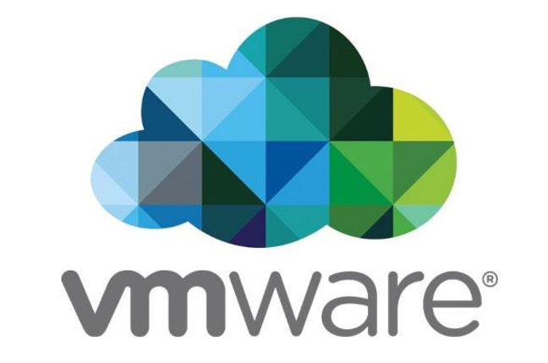
Virtual machines
Reduce all computing tasks (network, storage, compute) into virtual atomic units.
e.g. on Amazon Web Services:
Virtual CPU (vCPU) on Elastic Cloud Compute 2 (EC2)
Priced by hour, only for what you use:
e.g.: 1 vCPU, 1GB RAM (t2.micro):
$0.0116 per hour in North Virginia.
$0.0152 per hour from Tokyo.
VMware -- first company to virtualize x86 architecture.
VMware cofounder Diane Greene now leads Google’s cloud division.

Slide 4
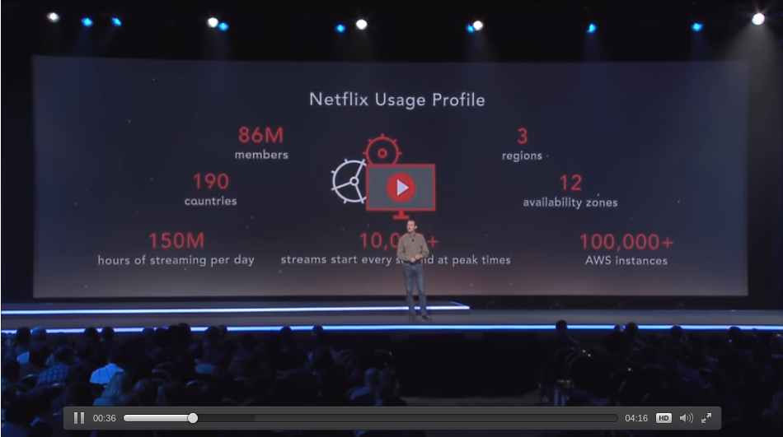
Even large internet companies...
Netflix runs on AWS → 100,000 running AWS instances.
Dropbox recently/famously migrated off AWS in 2016.
https://aws.amazon.com/solutions/case-studies/netflix/
https://www.wired.com/2016/03/epic-story-dropboxs-exodus-amazon-cloud-empire/

Slide 5

Corporate --> consumer facing?

Slide 6
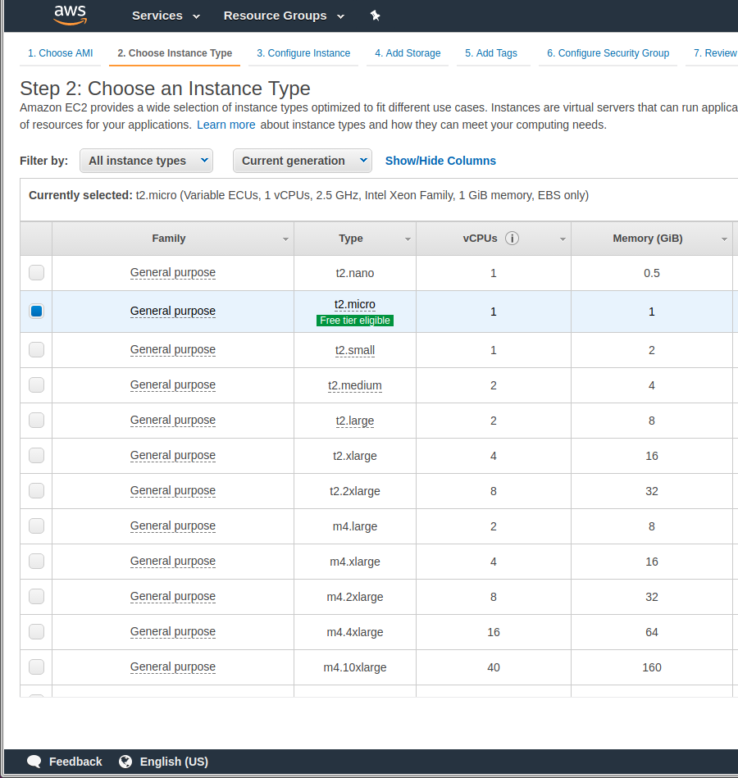

Many VM types / applications
“Compute optimized”
“Storage optimized”
“Memory optimized”
“General purpose”
“GPU”
“FPGA” field-programmable gate array
All w/ various Linux flavors or Windows.
Similar offerings between cloud platforms.
Third party preconfig. instances available.

Slide 7
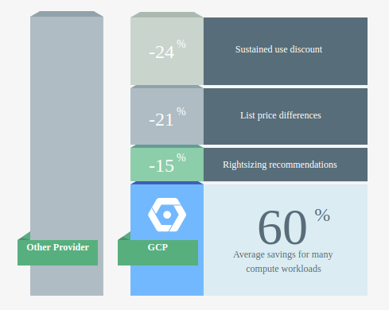
Instance (virtual machine) reservations
Reservations based on expected use
On-Demand -- whenever you require, for as long as you require.
Spot Instances -- bid on spare resources from other cloud users.
Reserved Instances -- discount for committing to a resource for a time duration.
Dedicated Hosts -- not a virtual machine, a physical server.
E.g. M3.medium general computing (AWS):
On-demand $0.067 per Hour
Spot ~$0.009 per Hour (2-minute termination warning)
Reserved (1-year) upfront $0.046, no upfront $0.050.
Dedicated host $2.341 per hour
GCP offers automatic sustained use discount

Slide 8
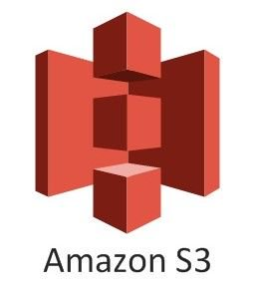
Cloud Storage (Amazon model)
E.g., on Amazon S3 distributed storage for data ‘objects’ (i.e. files) in ‘buckets’ (i.e. folders).
Accessible via REST API / HTTP
“99.999999999% durability “99.99% availability”
Glacier Tier (what Amazon did with all their extra spinning disk space).
Glacier Tier Data Access Time:
1 - 5 minutes ($0.03 per GB) 3 - 5 hours ($0.01 per GB) 5 - 12 hours ($0.0025 per GB)
Standard Storage | Standard - Infrequent Access Storage † | Glacier Storage
$0.023 per GB / month | $0.0125 per GB / month | $0.004 per GB / month

Slide 9
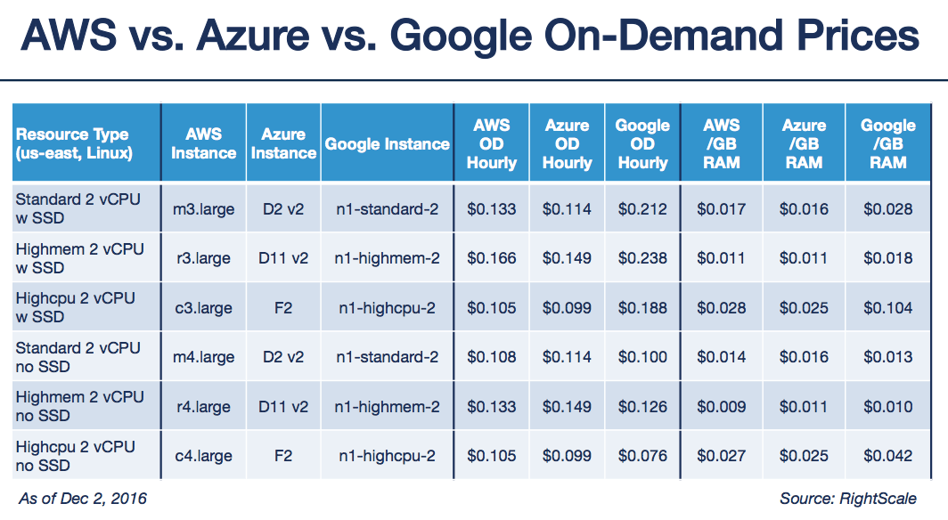
https://www.rightscale.com/blog/cloud-cost-analysis/aws-vs-azure-vs-google-cloud-pricing-compute-instances

Slide 10
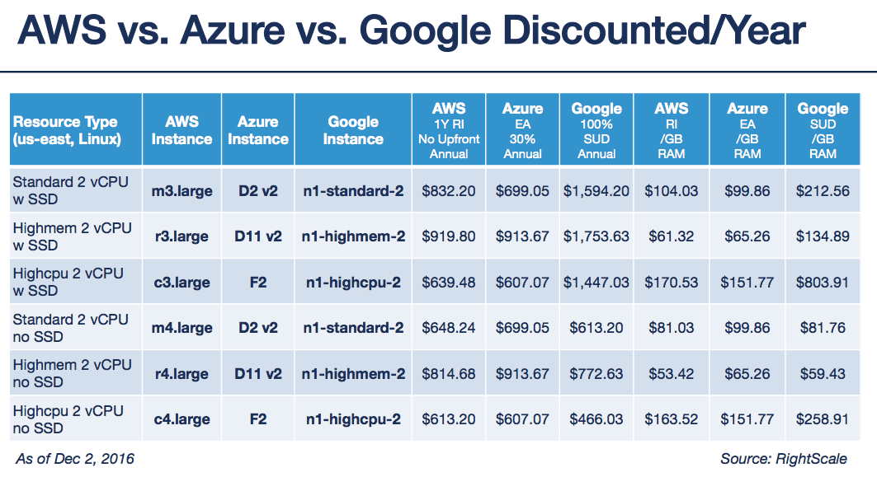
https://www.rightscale.com/blog/cloud-cost-analysis/aws-vs-azure-vs-google-cloud-pricing-compute-instances

Slide 11
Non-cost Differentiation among cloud providers
Software services, e.g.:
-- Amazon Machine Learning vs. Google ML Engine.
-- Google Genomics?
-- Third party services + vendors (AWS has largest ecosystem).
-- Software licensing (e.g. Windows licenses least expensive on Microsoft Azure).
-- Location of data centers in proximity to users (network latency -- will return to this topic).

Slide 12
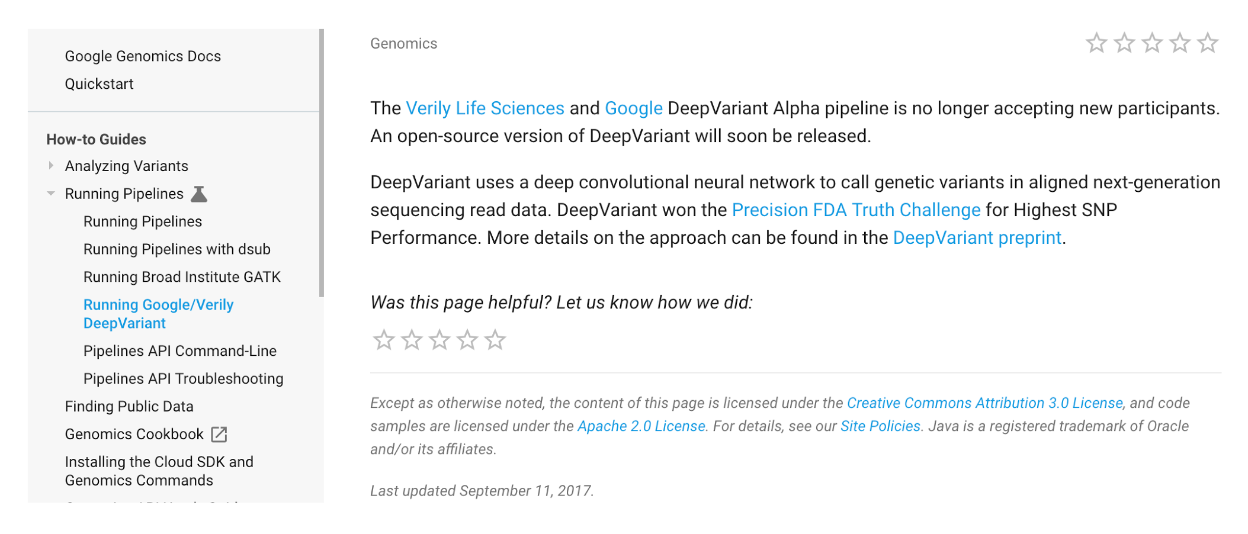
Google Genomics: DeepVariant, GATK, BigQuery, API

Slide 13
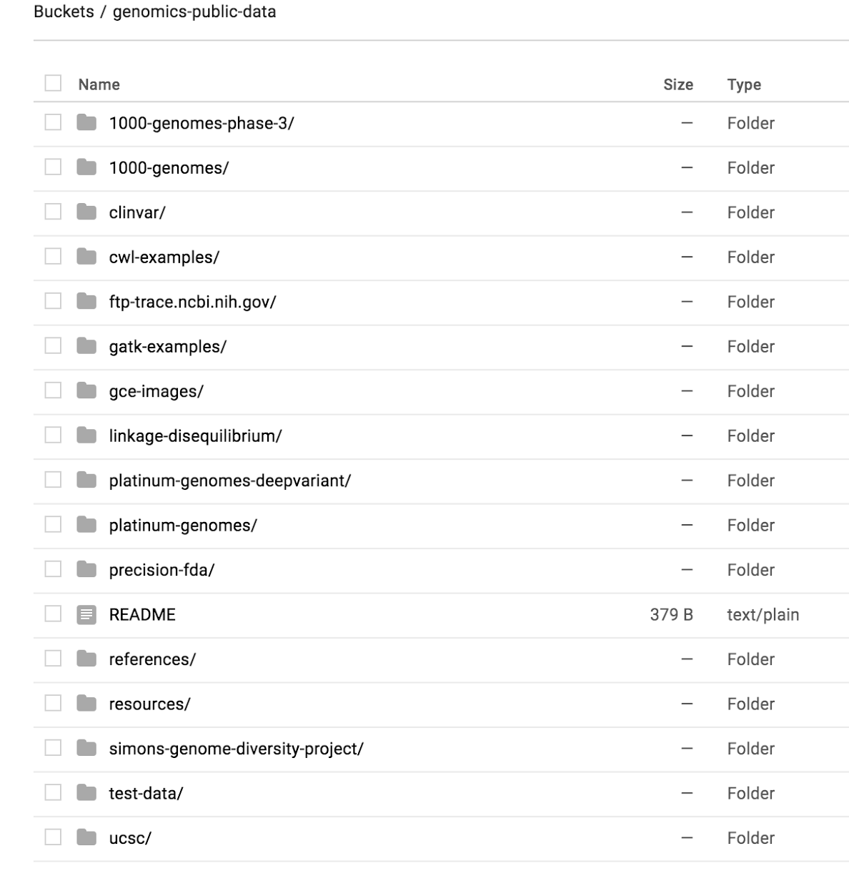
Google Genomics Public Datasets...
gs://genomics-public-data

Slide 14
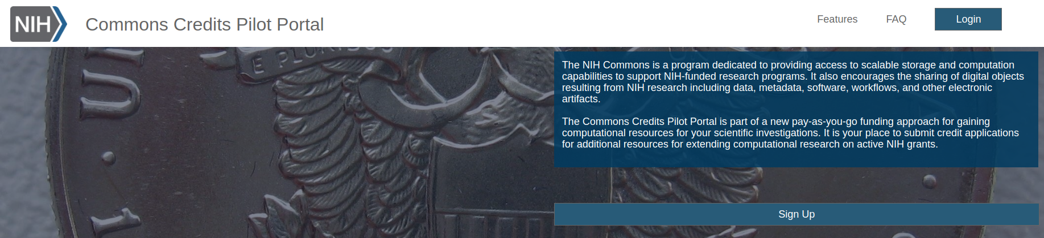
Reasons we may do more cloud computing
Genome Sequencing Project (GSP)
“Multicloud” on AWS and Google
Data processing and storage is on these cloud platforms.
Will we do data analysis using cloud compute?
NIH Commons Credits Model...

Slide 15
Brief notes from commons credits conference call
Google Cloud Platform
Google Genomics -- Handful of genomics tools/datasets preloaded incl. Broad GATK.
Verily -- DeepVariant (deep learning variant caller).
[third] Onix Cloud Consulting -- ‘make it more accessible to do research’ -- workload estimation, training, grant assistance.
AWS
[third] DLT -- can’t answer any questions, little academic/healthcare experience.
[third] REAN Cloud -- drag and drop files -- AHA precision medicine program, existing stroke and CVD data sets. Jupyter.
[third] Cloudy cluster -- HPC instances prebuilt, cluster computation, elastic compute. 5% cost overhead.
[third] Seven bridges -- cancer genomics data sets, analysis tools, built around NIH security.
[third] MolBioCloud -- biomedical research focus, however very limited website, tools.
[third] Fig-share -- for sharing data/images, all with DOI. Not a data analysis/computing platform (built on Amazon S3).
Microsoft Azure
[third] CDWG
IBM
IBM Softlayer Cloud
* [third] = third party reseller.

Slide 16
Free tier services

Slide 17
Patrick’s cloud services free tier experiment
Tested time/difficulty to start + run a free tier linux virtual machine on each major cloud service provider platform.

Slide 18
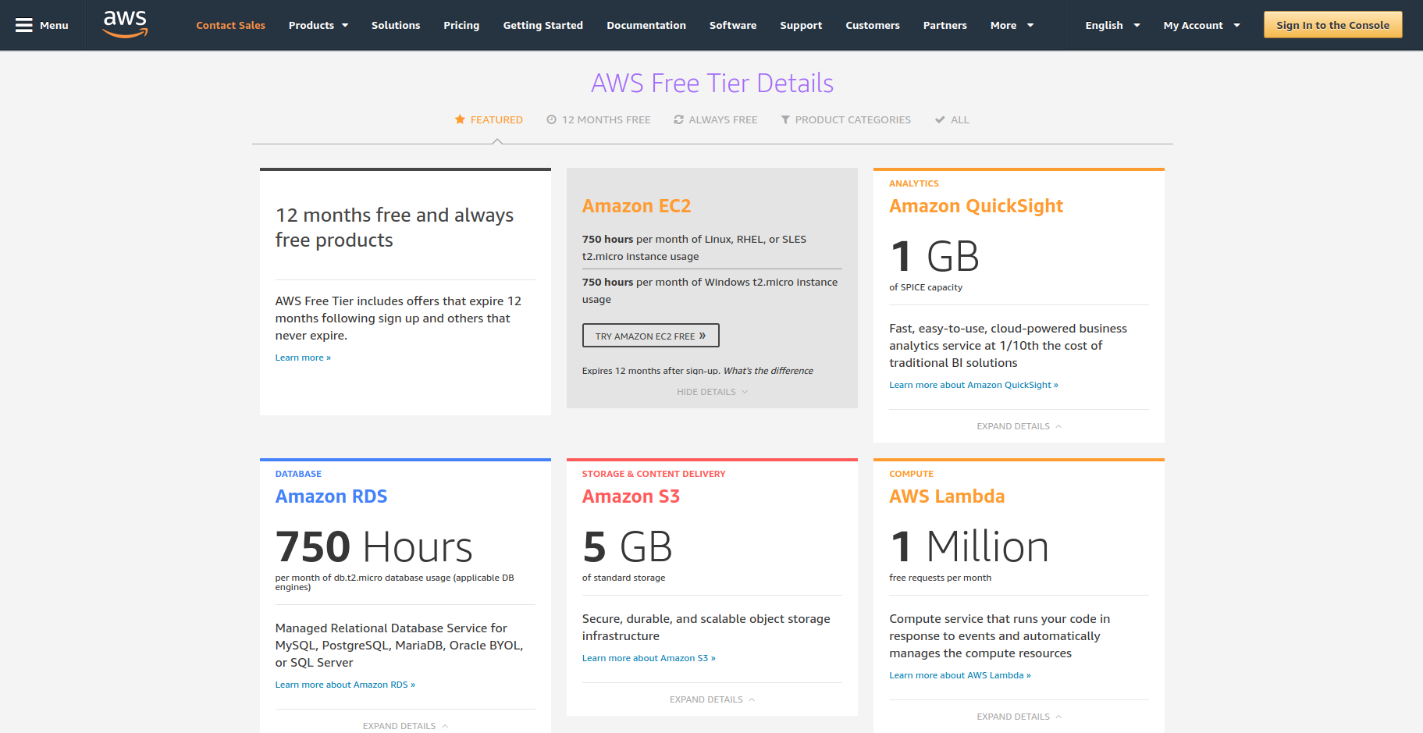
Amazon Web Services 1 year access to ‘free tier’ services.

Slide 19
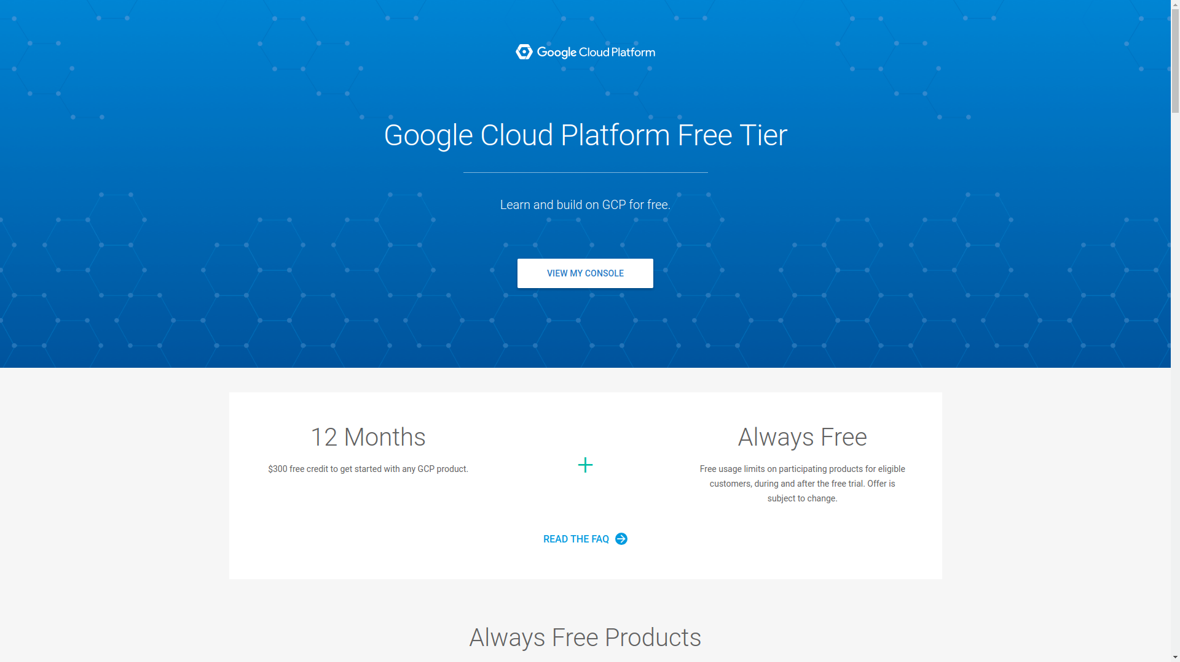
Google Cloud Platform 12mo. $300 credit

Slide 20
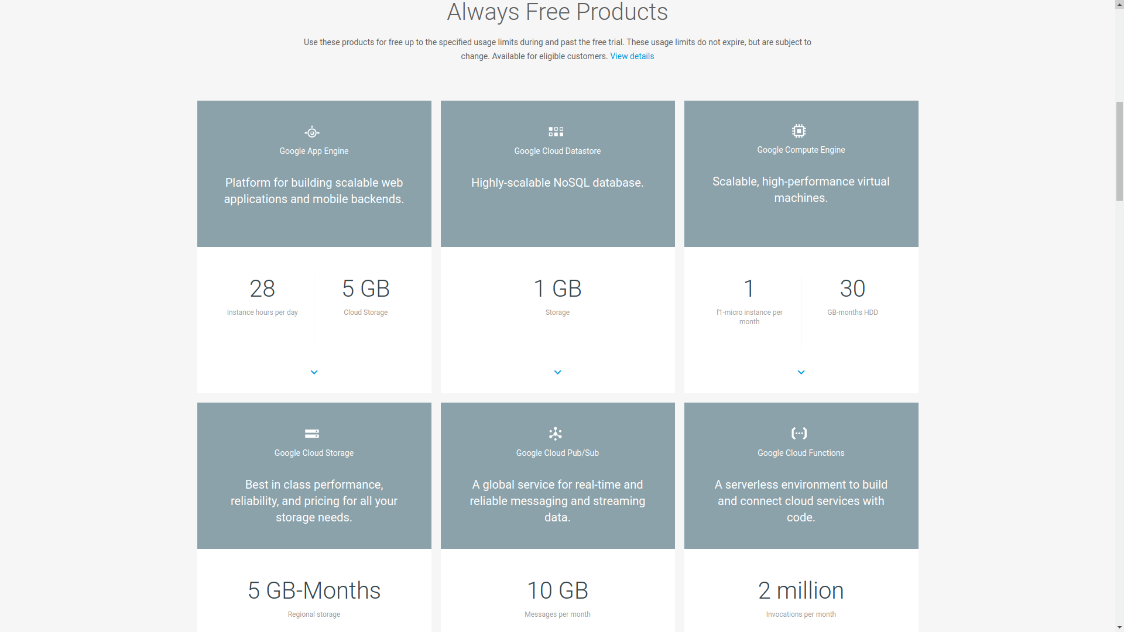
Google Cloud Platform always free includes compute!

Slide 21
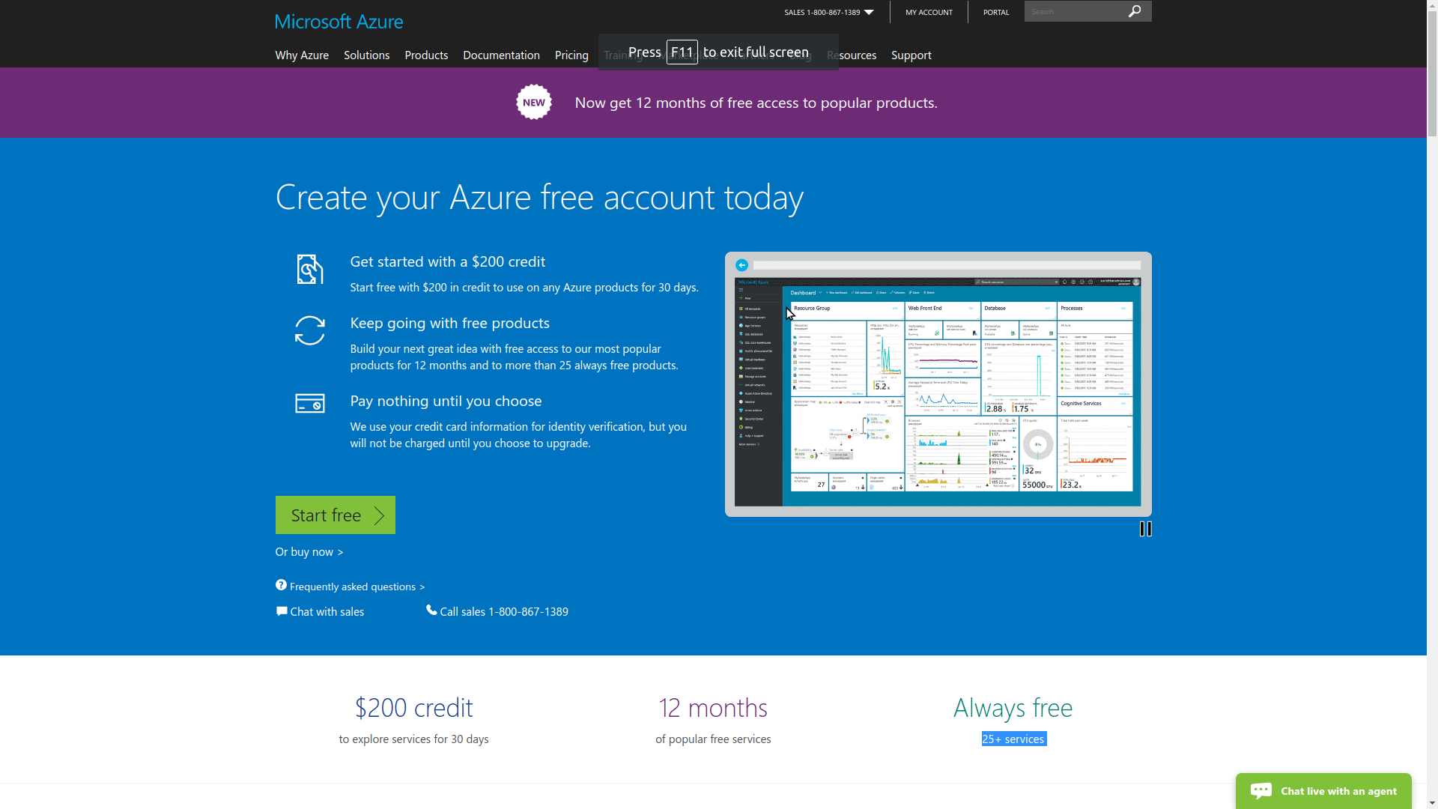
Microsoft Azure $200 credit, 30 days.

Slide 22


Patrick’s reviews
Google Cloud Platform
Amazon Web Services
Microsoft Azure
-- Suggested several instance types to run an Ubuntu VM that wouldn’t start. No information provided to troubleshoot. Later determined lower spec. machines incapable of running Ubuntu.
-- Each VM component must be discontinued individually + sequentially (e.g. networking --> OS --> compute --> storage, etc.) even though started as one unit.
-- Sales e-mails with no unsubscribe “This message from Microsoft is an important part of a program, service, or product that you or your company purchased or participates in.”
-- Free tier compute options rapidly consumed credits -- “spent” >$100 credits (50%) in 2 weeks on 2nd lowest tier linux virtual machine.
-- Credits expire in 30 days without subscribing to a continuous billing cycle.

Slide 23
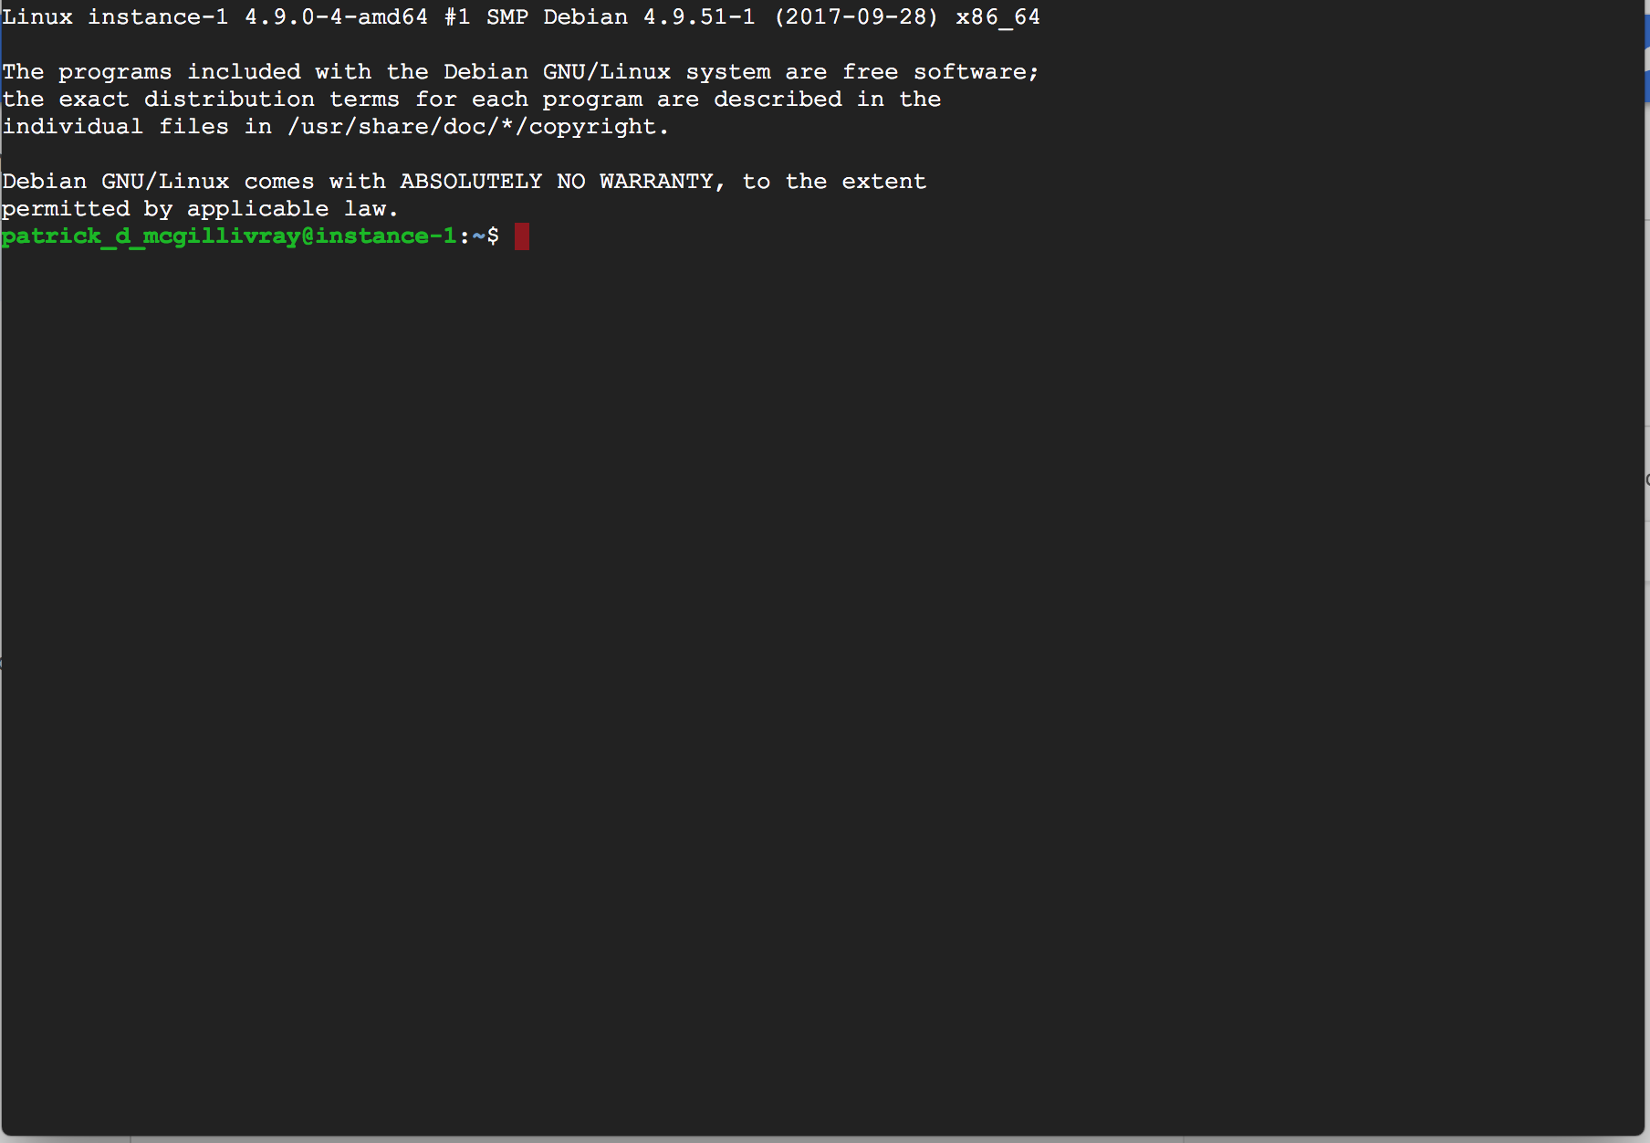
Google Compute Engine (free tier VM example)
Uses existing Google credentials
(AWS login also == amazon.com).
2 clicks to launch.
Free indefinitely for lowest tier.
SSH via Google browser interface.

Slide 24
Physical infrastructure

Slide 25
AWS North Virginia region (08/2016)
Based on State of Virginia permit filings (locations are not disclosed by company -- physical security risk -- e.g. wrench in the air conditioner).
Chantilly AZ Chantilly "IAD-1" 4101 Westfax Dr, Chantilly, VA 20151 "IAD-9" 4100 Westfax Dr, Chantilly, VA 20151 South Riding "IAD-61" 43736 Clubber Ln, Chantilly, VA 20152 South Ashburn / Ryan AZ Greenway Substation "IAD-6" 43831 Devin Shafron Dr, Ashburn, VA 20147 "IAD-13" 43790 Devin Shafron Dr, Ashburn, VA 20147 "IAD-54" 43791 Devin Shafron Dr, Ashburn, VA 20147 Manassas AZ Wellington / Bull Run "IAD-7" 7505 Mason King Ct, Manassas, VA 20109 "IAD-11" 7510 Mason King Ct, Manassas, VA 20109 "IAD-24" 7610 Mason King Ct, Manassas, VA 20109 "IAD-14" 11801 Brewer Springs Rd, Manassas, VA 20109 "IAD-52" 11800 Brewer Springs Rd, Manassas, VA 20109 "IAD-59" 7600 Doane Dr, Manassas, VA 20109 "IAD-73/74" 7060 Wellington Rd, Manassas, VA 20109 | Haymarket "IAD-55" 15395 John Marshall Hwy, Haymarket, VA 20169 East Ashburn / Sterling AZ Route 28 / BECO Substation "IAD-10" 45630 W Severn Way, Sterling, VA 20166 "IAD-32" 1304 Squire Ct, Sterling, VA 20166 Gloucester Parkway / Beaumeade Substation "IAD-50" 21271 Smith Switch Rd, Ashburn, VA 20147 "IAD-60" 21271 Smith Switch Rd, Ashburn, VA 20147 "IAD-71" 21273 Smith Switch Rd, Ashburn, VA 20147 "IAD-78" 44862 Interconnection Plaza, Ashburn, VA 20147 North Dulles AZ North Dulles Business Park "IAD-12" 22630 Dulles Summit Ct, Sterling, VA 20166 "IAD-15" 22651 Dulles Summit Ct, Sterling, VA 20166 "IAD-16" 22631 Dulles Summit Ct, Sterling, VA 20166 "IAD-51/56" 45220 and 45210 Prologis Plaza, Sterling, VA 20166 "IAD-57/58" 22745 Relocation Dr, Sterling, VA 20166 "IAD-76" 22520 Randolph Dr, Sterling, VA 20166
https://gist.github.com/zorangagic/fd989374e2a4b3322bff9ab042a595af

Slide 26
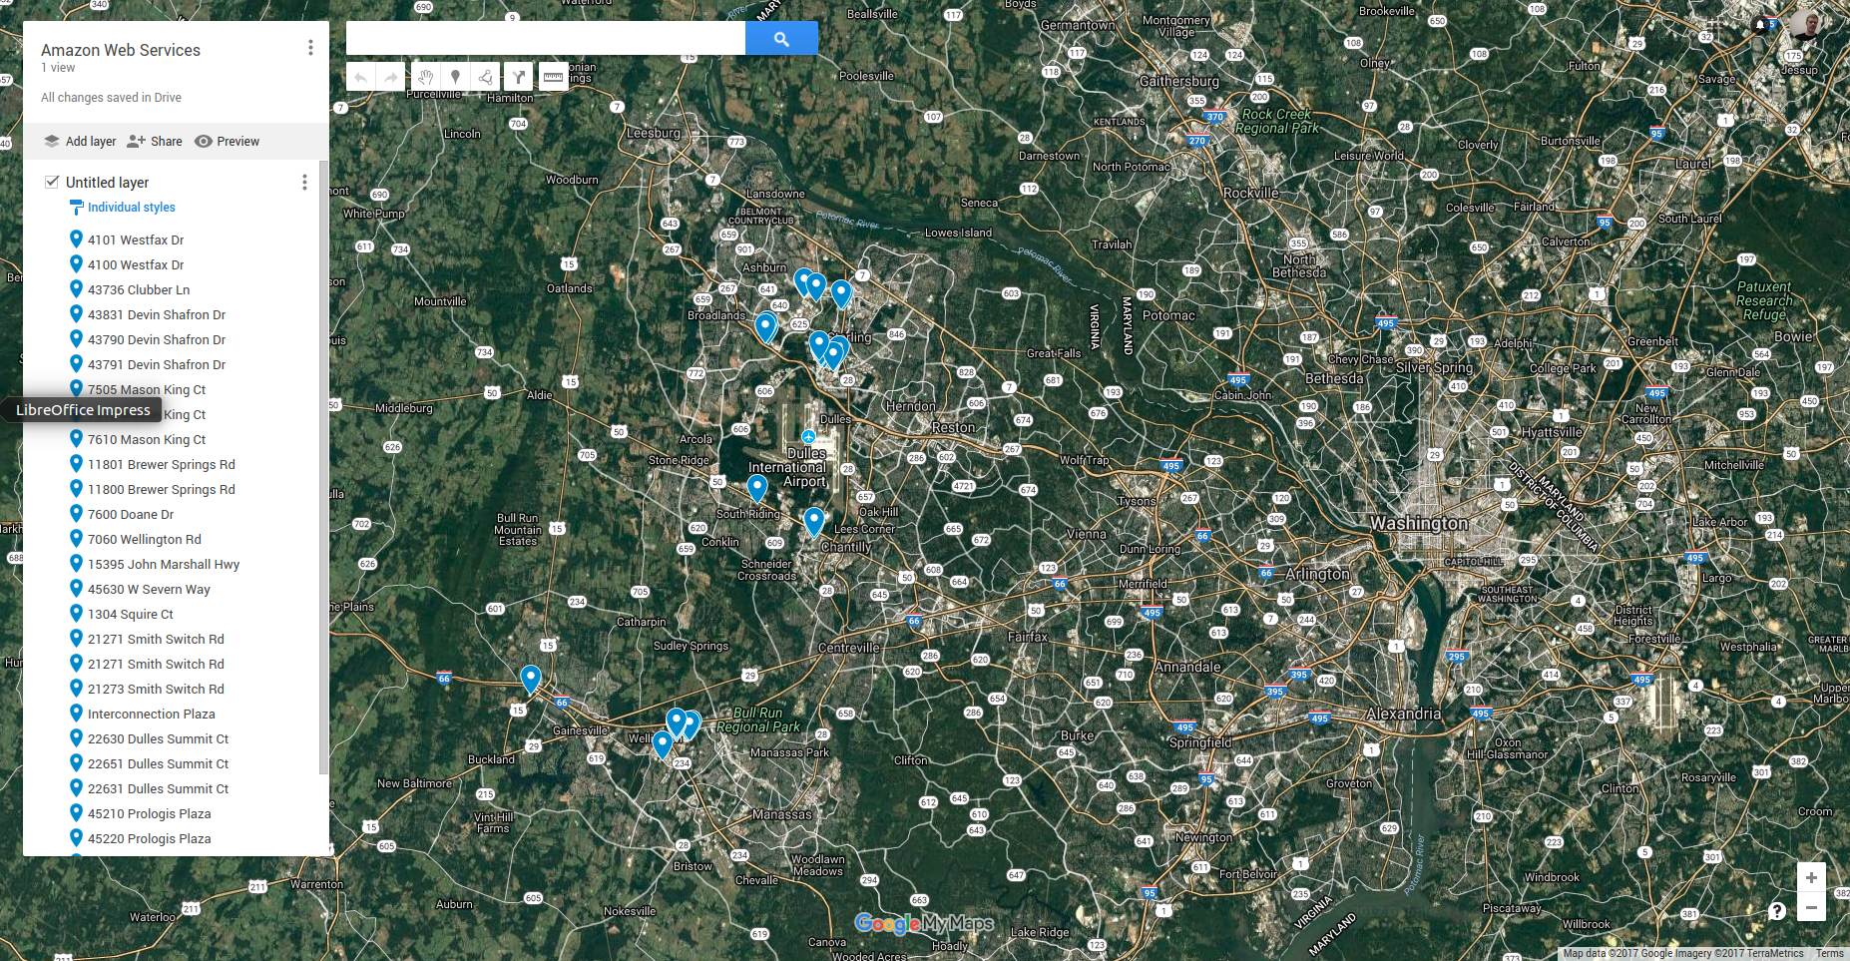

Slide 27
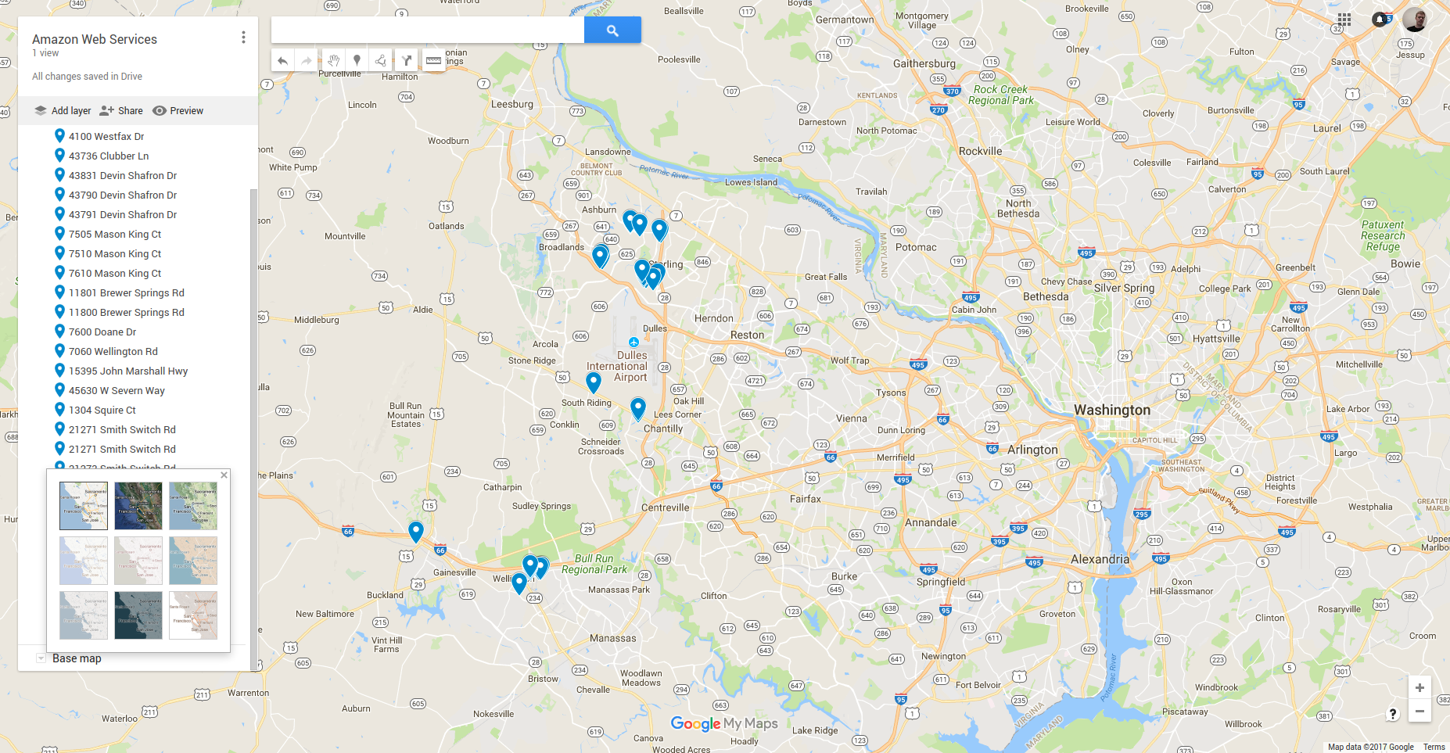

Slide 28
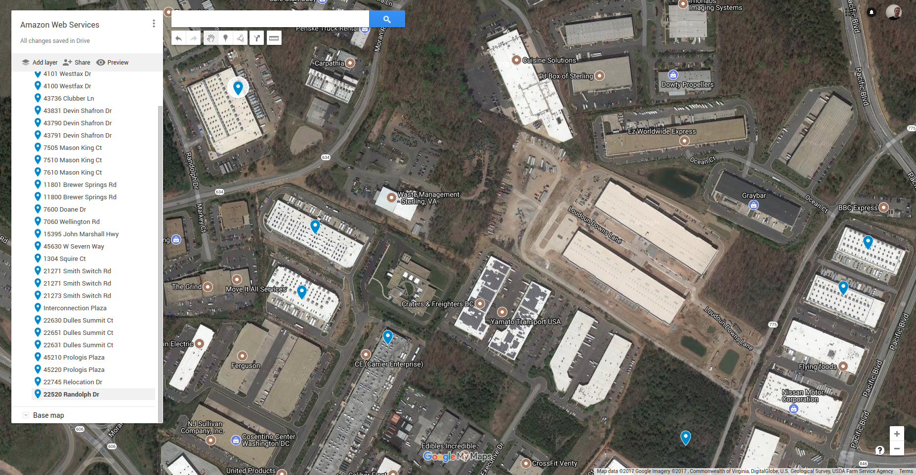

Slide 29
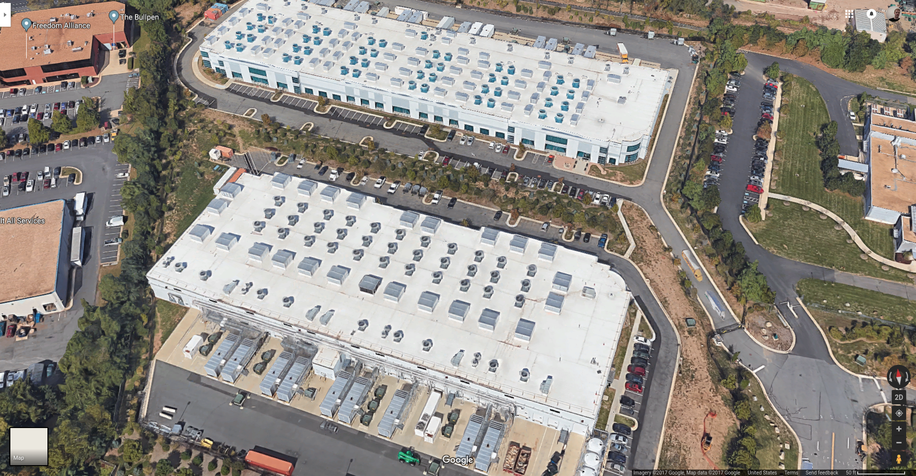

Slide 30
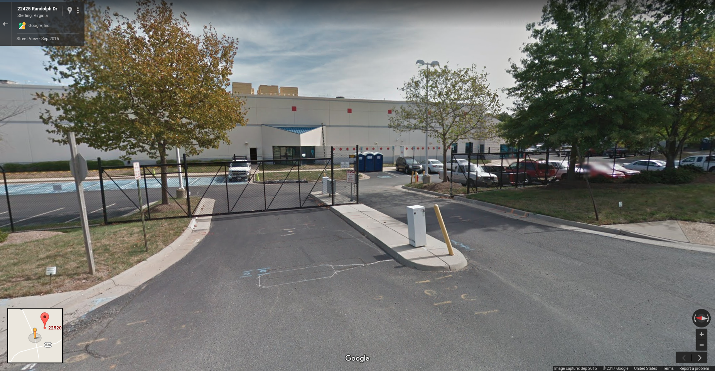

Slide 31
Why North Virginia?
Established government / defense contractor networking?
https://en.wikipedia.org/wiki/Dulles_Technology_Corridor
Electricity rates?

Slide 32
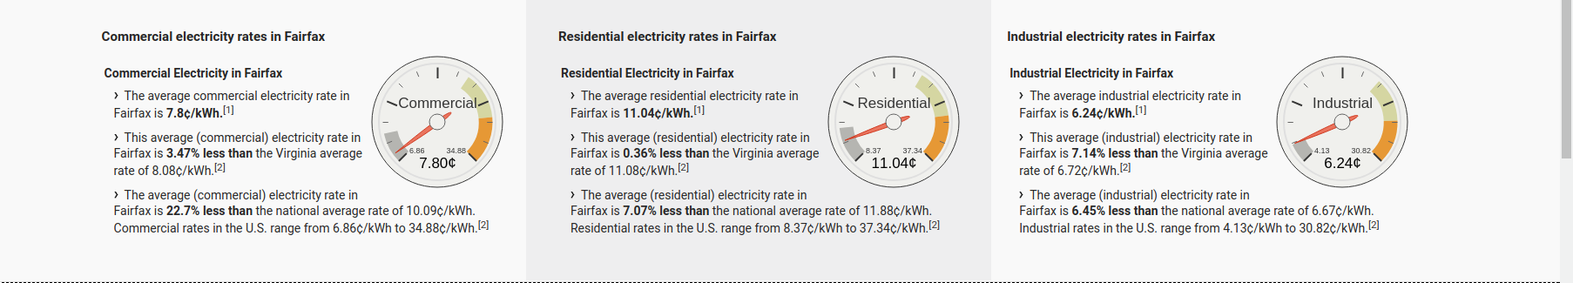
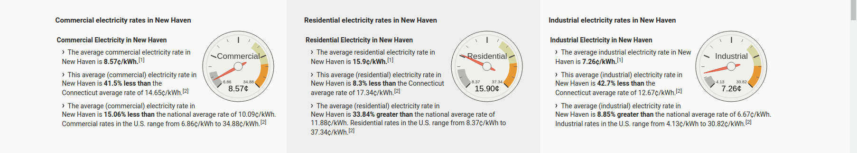
Electricity rate comparison (Fairfax vs. New Haven)
https://www.electricitylocal.com/

Slide 33
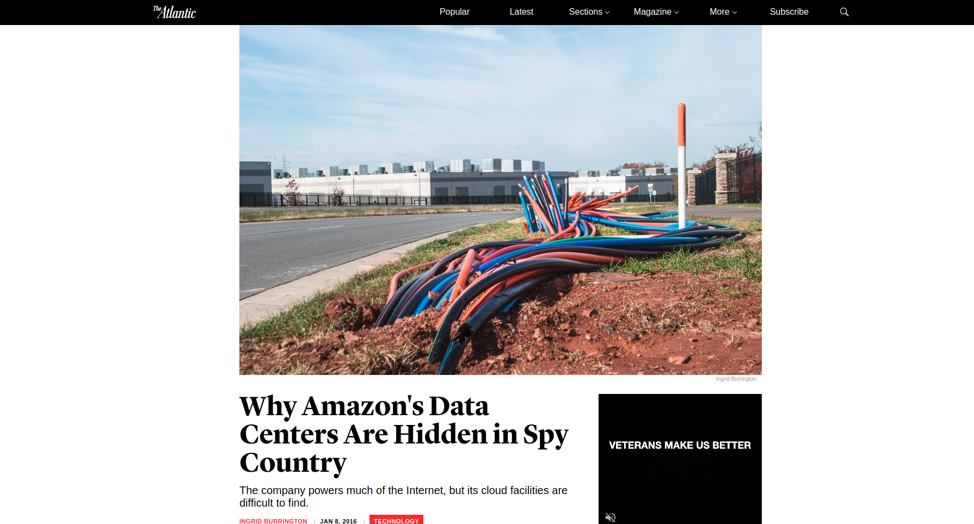
https://www.theatlantic.com/technology/archive/2016/01/amazon-web-services-data-center/423147/

Slide 34
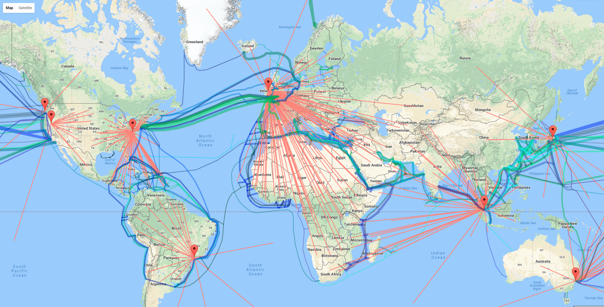
Unikernels.

Slide 35
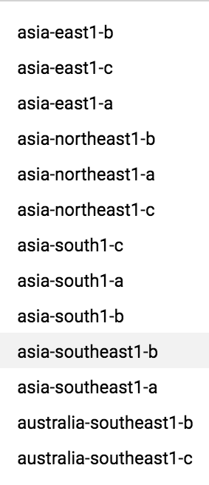
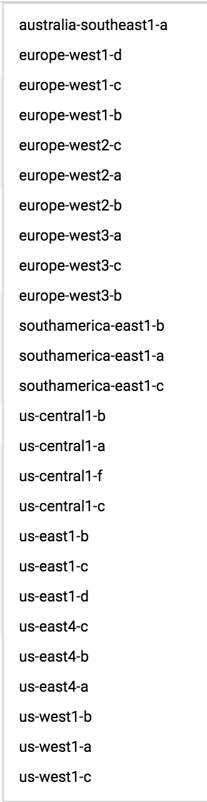
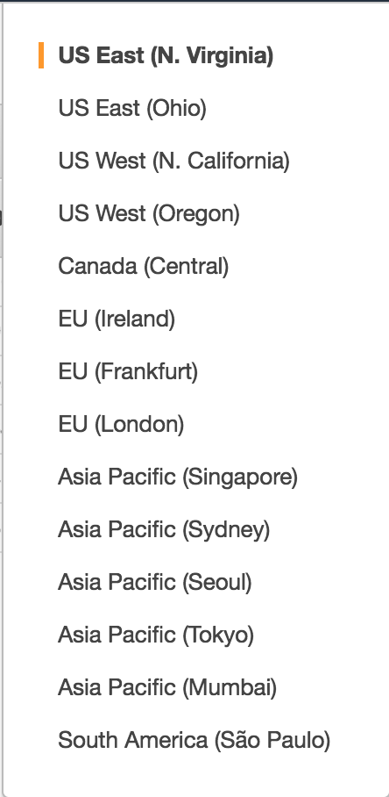
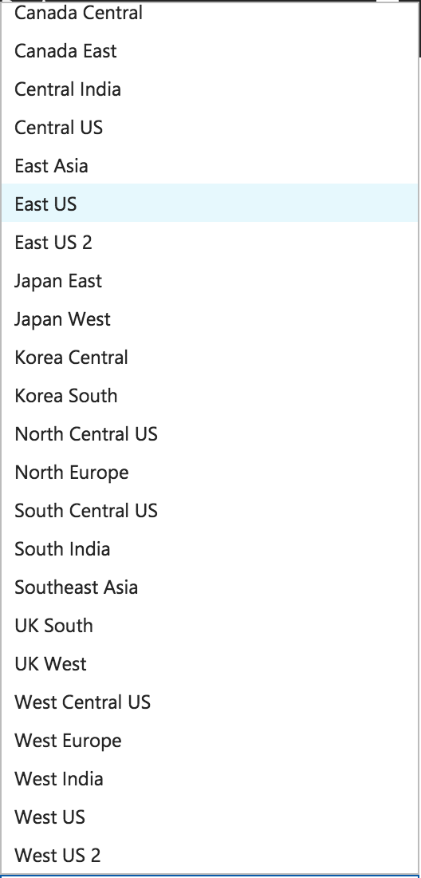
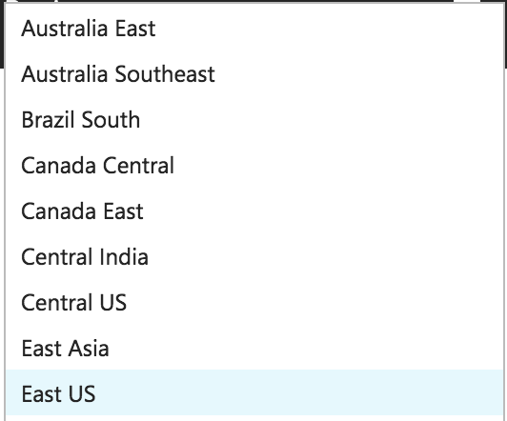
Google 10 zones
Amazon 14 zones
Azure 32 zones

Slide 36
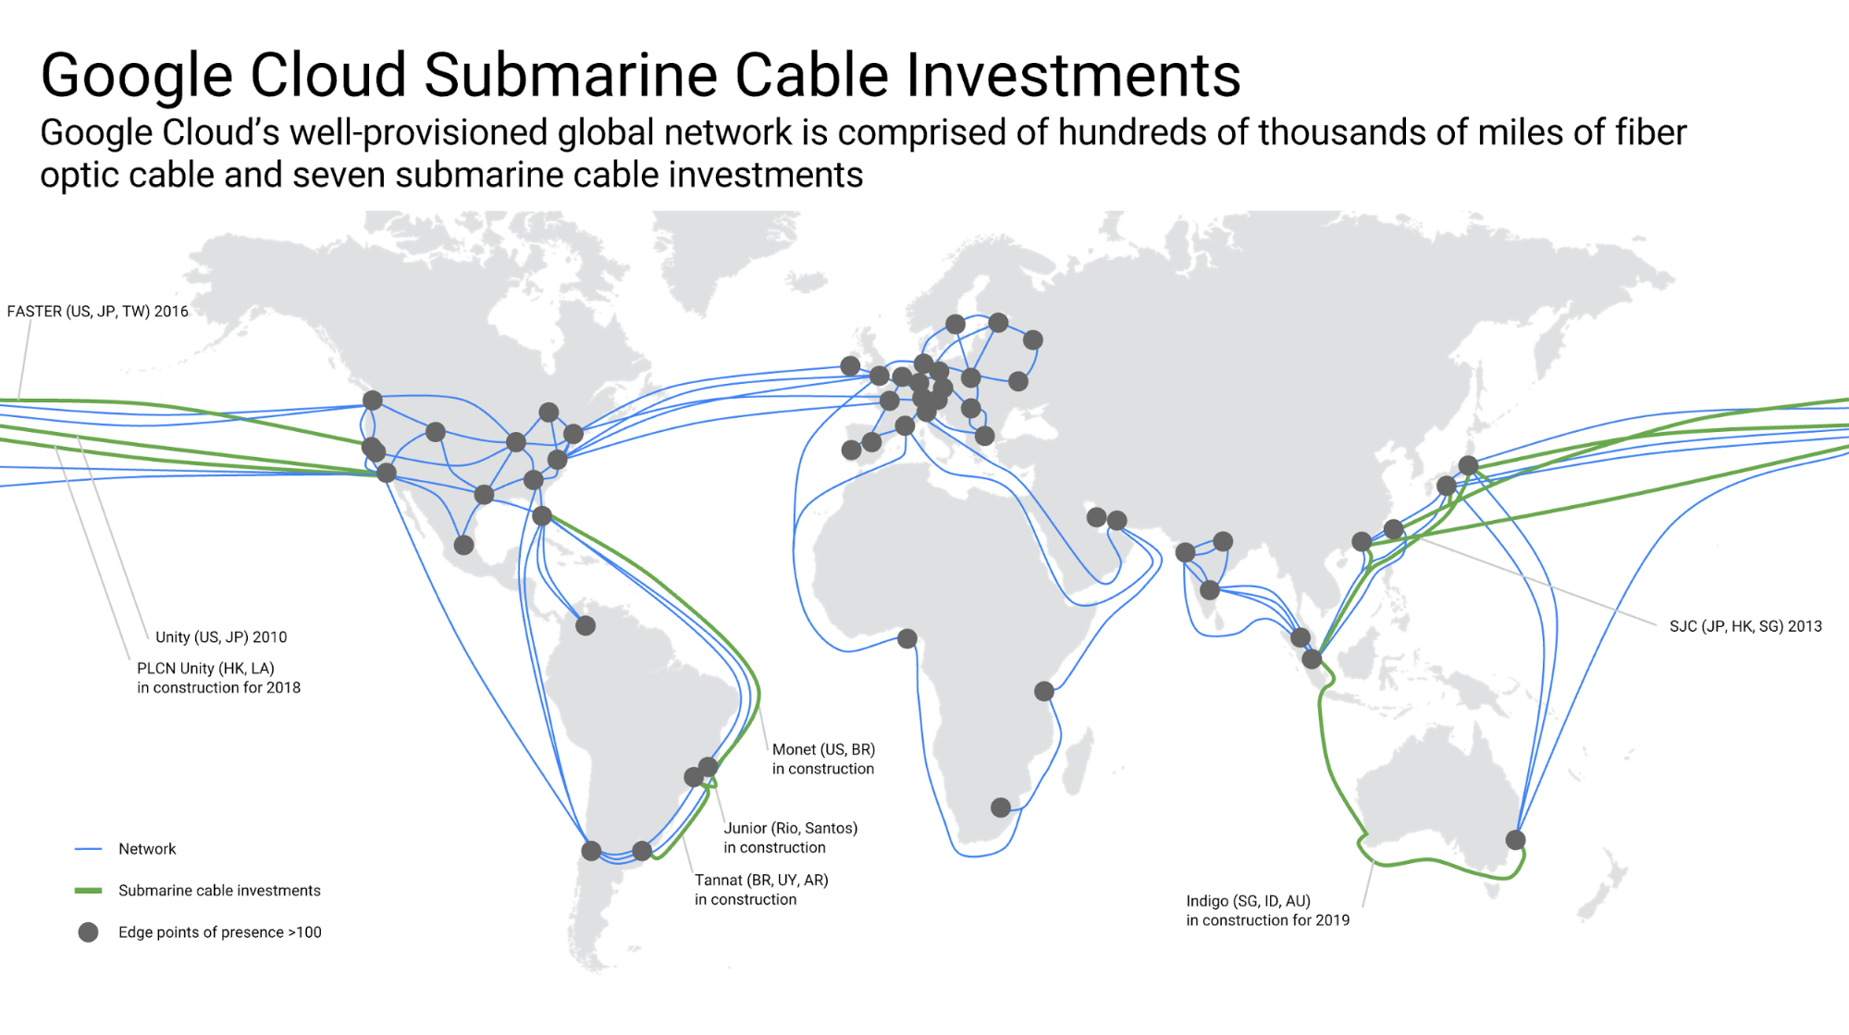
Google investments in cloud infrastructure
https://storage.googleapis.com/gweb-uniblog-publish-prod/images/indigo-2.width-1999.png

Slide 37
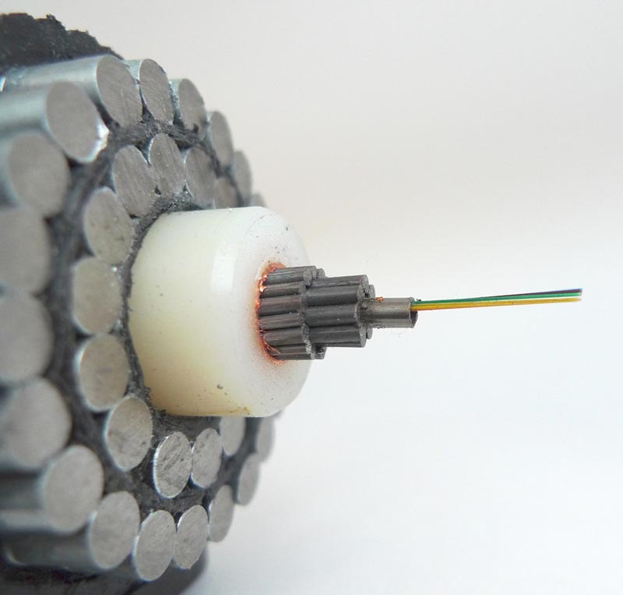

Slide 38
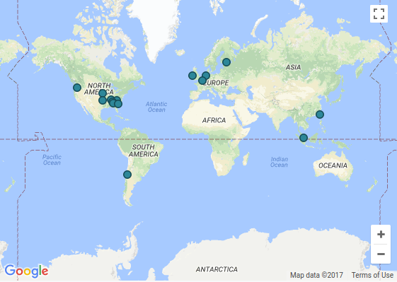
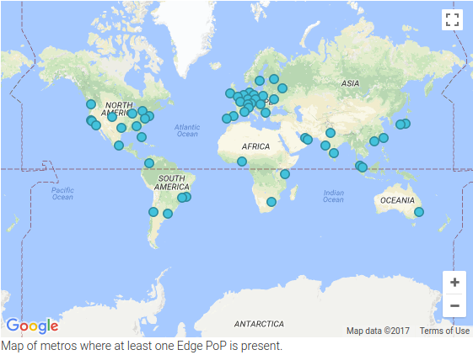
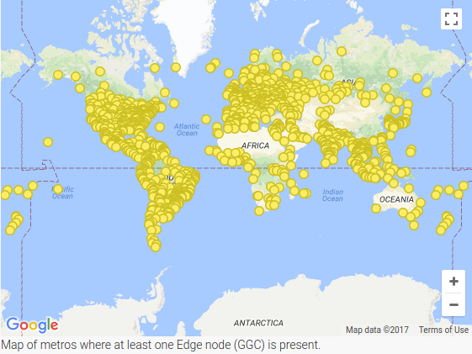
Network infrastructure
Google’s network: datacenter → network edge points → edge node cache
https://peering.google.com/

Slide 39
Curious topics in cloud computing

Slide 40




Future of cloud computing?
Unikernels:
Many unnecessary features running Linux/Windows in the cloud.
E.g. USB support, device drivers, etc.
Unikernels -- select minimal set of OS functions necessary to run an application, compile and run directly on hardware.
Decentralization:
Berkeley Open Infrastructure for Network Computing (e.g. SETI @ home).
Golem cryptocurrency accessible distributed/decentralized cloud computing.
IPFS cryptocurrency accessible distributed/decentralized cloud storage.

Slide 41
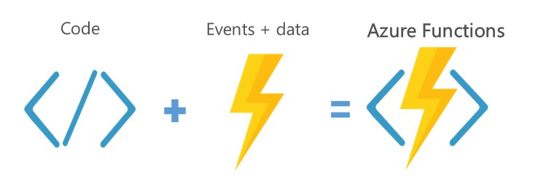
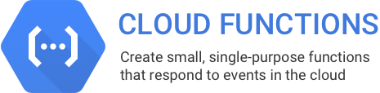

“Serverless”
Basic flow:
You submit code and trigger conditions.
Cloud provider chooses when/where to run the code (e.g. what virtual machine, in what location).
You receive result.
-- Billing by the millisecond and per function call.
-- Only certain languages supported, e.g. (AWS → Node.js, Python, Java and C#)

Slide 42
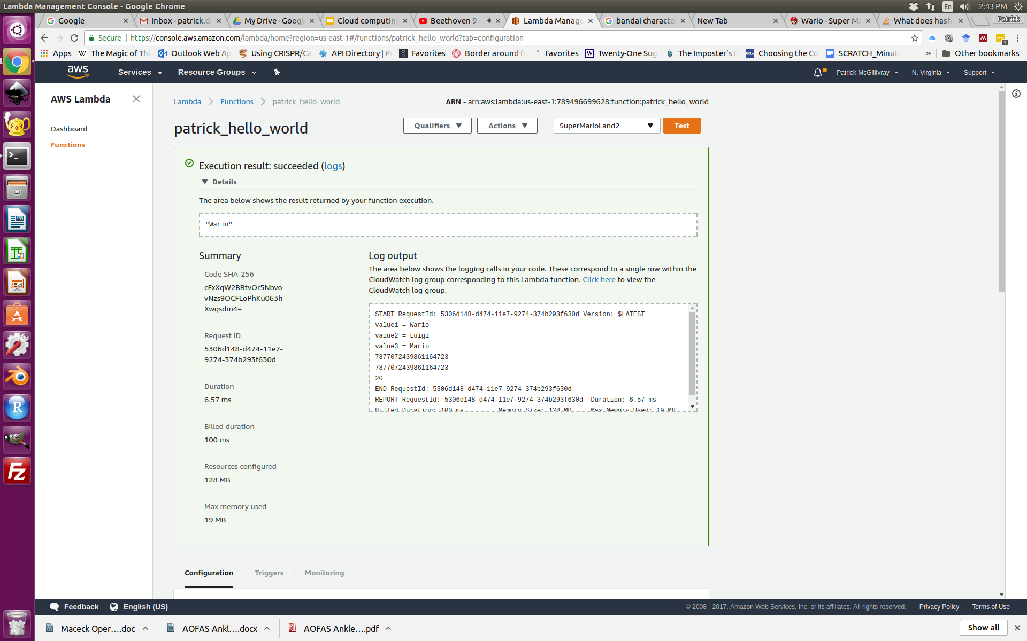
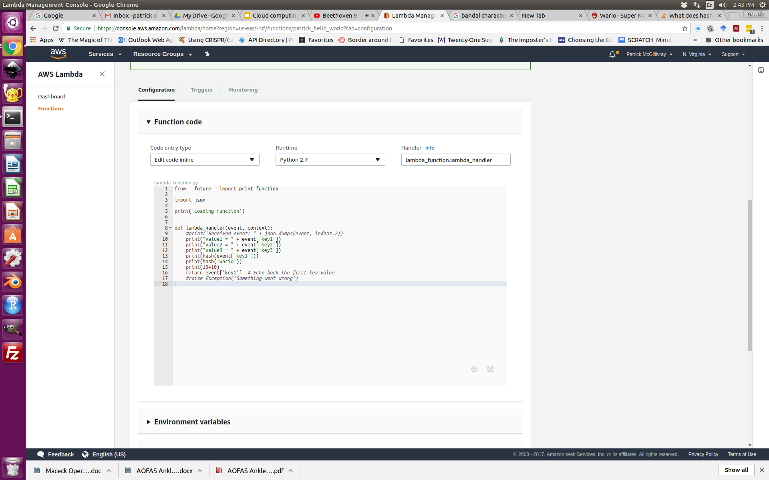
AWS Lambda sample

Slide 43
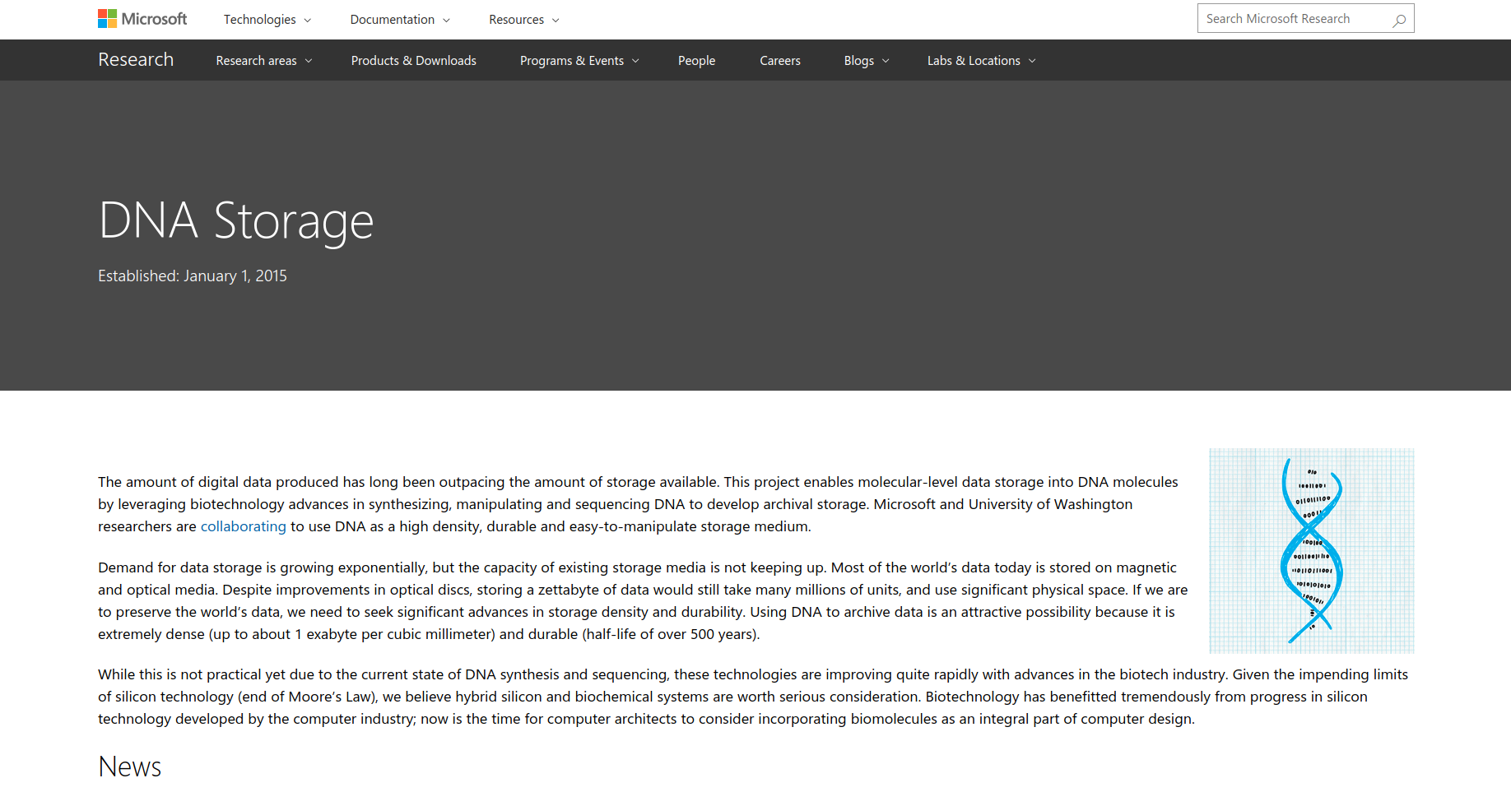
DNA Storage?!
“Using DNA to archive data is an attractive possibility because it is extremely dense (up to about 1 exabyte per cubic millimeter) and durable (half-life of over 500 years).”
Read/write times...
Sequencing errors...
https://www.microsoft.com/en-us/research/project/dna-storage/

Slide 44
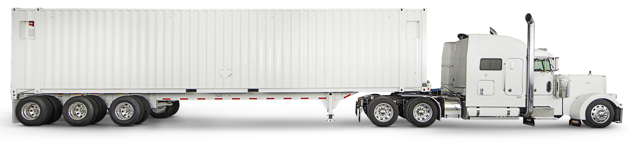
AWS Snowmobile ‘massive exabyte-scale data transfer service’
“You can transfer up to 100PB per Snowmobile, a 45-foot long ruggedized shipping container, pulled by a semi-trailer truck [...] Snowmobile uses multiple layers of security designed to protect your data including dedicated security personnel, GPS tracking, alarm monitoring, 24/7 video surveillance, and an optional escort security vehicle while in transit.”
https://aws.amazon.com/snowmobile/

Slide 45
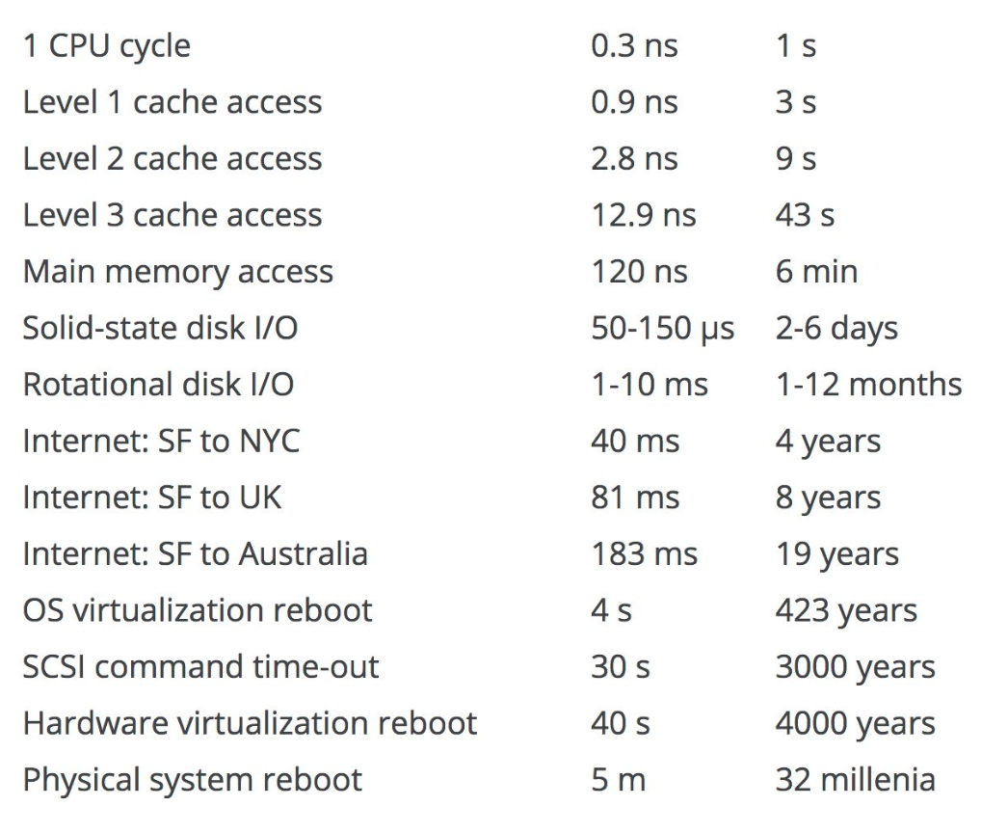
Comparative timer intervals in computing
http://www.pcgamer.com/heres-a-neat-trick-for-understanding-how-long-computer-processes-take/

