Slide 1
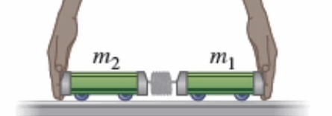
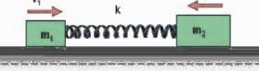
Is gene regulation among orthologs conserved?
To what degree can’t ortholog expression levels be predicted due to species-specific regulation?
Species A
Species B
orthologs
co-expressed
[Wang et al. PLOS CB, ‘16]
Regulation among orthologs (internal)
Regulation from species-specific factors (external)
Orthologous genes (orthologs)
Species-specific transcription factors
With External force
Purely Internal Dynamics
Notes:
connect loregic to here too! to see regulatory mechanisms similar too

Slide 2
State-space model for internal and external gene regulatory networks
State X_{t}: Gene expression vector of internal group at time t
A_{ij} captures temporal casual influence from Gene i to Gene j in internal group
B_{kl} captures temporal casual influence from external factor k to Gene l in internal group
Control U_{t}: Gene expression vector of external factors at time t
[Wang et al. PLOS CB, ‘16]

Slide 3
State-space model for internal
and external gene regulatory networks
Not enough data to estimate state space model for genes
(e.g., 25 time points per gene to estimate 4 million elements of A or B for 2000 genes)
Dimensionality reduction from genes to meta-genes (e.g., SVD)
Effective state space model for meta-genes
(e.g., 250 time points to estimate 50 matrix elements if 5 meta-genes)
[Wang et al. PLOS CB, ‘16]

Slide 4
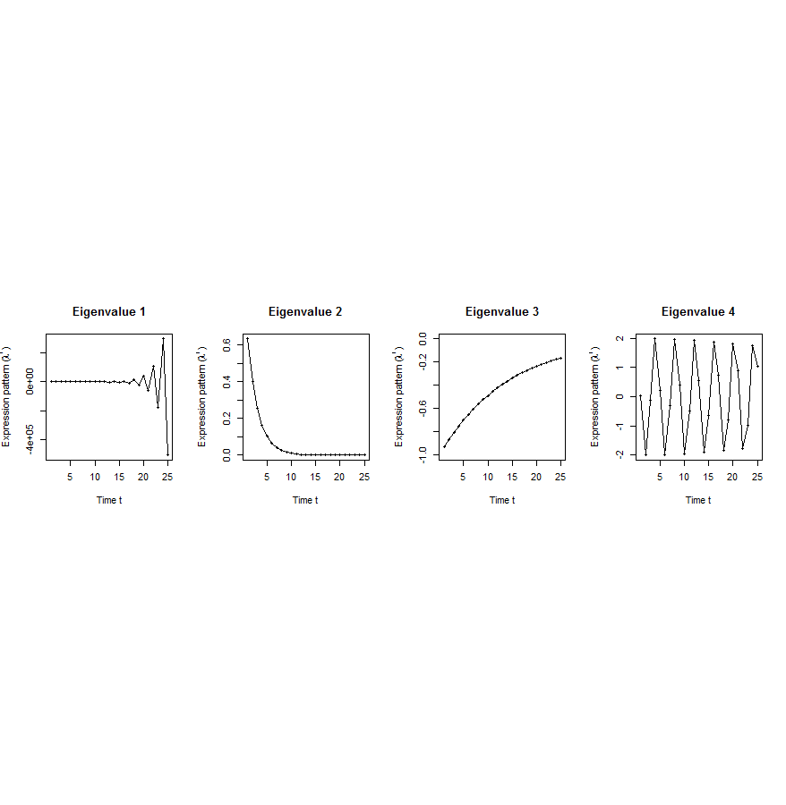
Canonical temporal expression trajectories from effective state space model
Is a std. 1st order homogeneous matrix difference equation. It can solved by diagonalizing A giving….
p^{th} internal principal dynamic pattern (iPDP): [λ_{p}¹, λ_{p}², …, λ_{p}^{T}],
where λ_{p} is p^{th} eigenvalue of Ã.
Canonical temporal expression trajectories
(e.g., degradation, growth, damped oscillation, etc.)
iPDP expression
time
[Wang et al. PLOS CB, ‘16]
Notes:
if we look at A tilde, it controls the dynamic trajectory of expression part internally driven by meta-genes of X. according to the analytic solution, the internally driven expression part Xtilde I can be linear combinations of A tilde’s eigenvalue’s exponentials across time, which are defined by us as internal principal dynamic pattern (iPDP). B tilde controls the dynamic trajectory of X’s metagene expression part externally driven by U. similarly, we can find external principal dynamic pattern (ePDP) based on B tilde’s eigenvalue exponentials across time. Actually, those patterns are canonical temporal expression trajectories, which are as simple as degradation, growth, damped oscillation temporal processes). In short, from metagene effective model, we are able to identify internal and external driven canonical temporal expression trajectories.

Slide 5
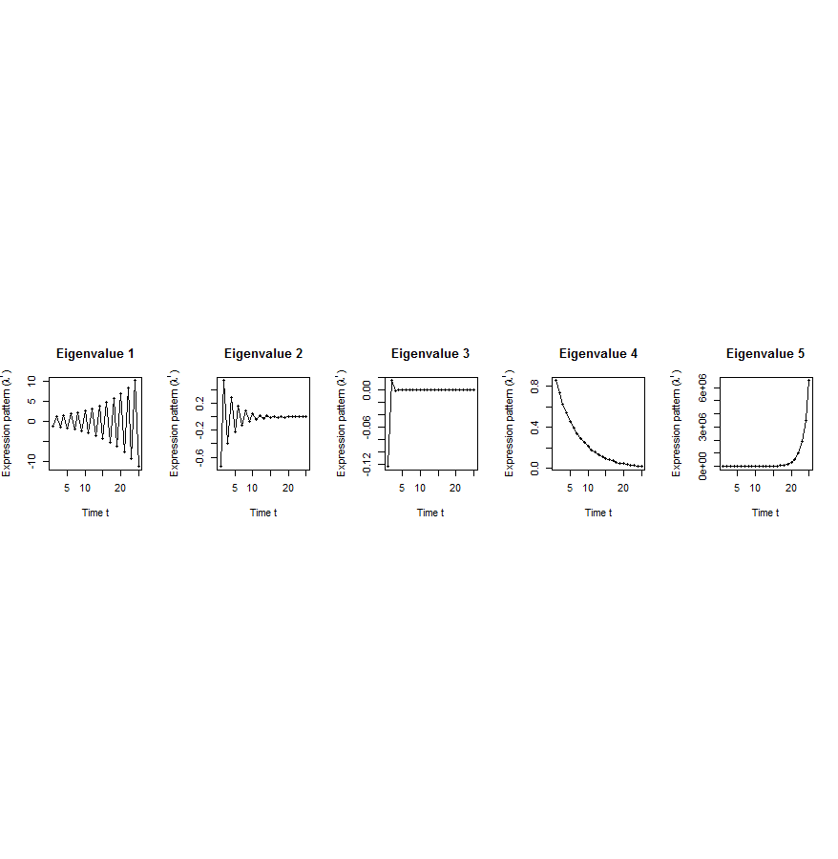
Flowchart
[Wang et al. PLOS CB, ‘16]
A. Gene state-space model
C. Meta-gene state-space model
B. Dimensionality Reduction
X_{t+1}=AX_{t}+BU_{t}
Genes of X
Meta-genes of X
time
E. Gene’s internal (INT) and external (EXT) driven expression dynamics composed of PDPs
time
D. Internal/External Principal Dynamic Patterns (PDPs)
x^{INT} = c₁ +c₂
+c₃ +c₄
[λ_{p}¹, λ_{p}², …, λ_{p}^{T}]
Genes of U
Meta-genes of U
time
time
x^{EXT} = d₁ +d₂
+d₃ +d₄
Internal regulation among internal genes/meta-genes by A/Ã
External regulation from external genes/meta-genes to internal genes/meta-genes in Group X by B/
Internal genes/meta-genes
External genes/meta-genes

Slide 6
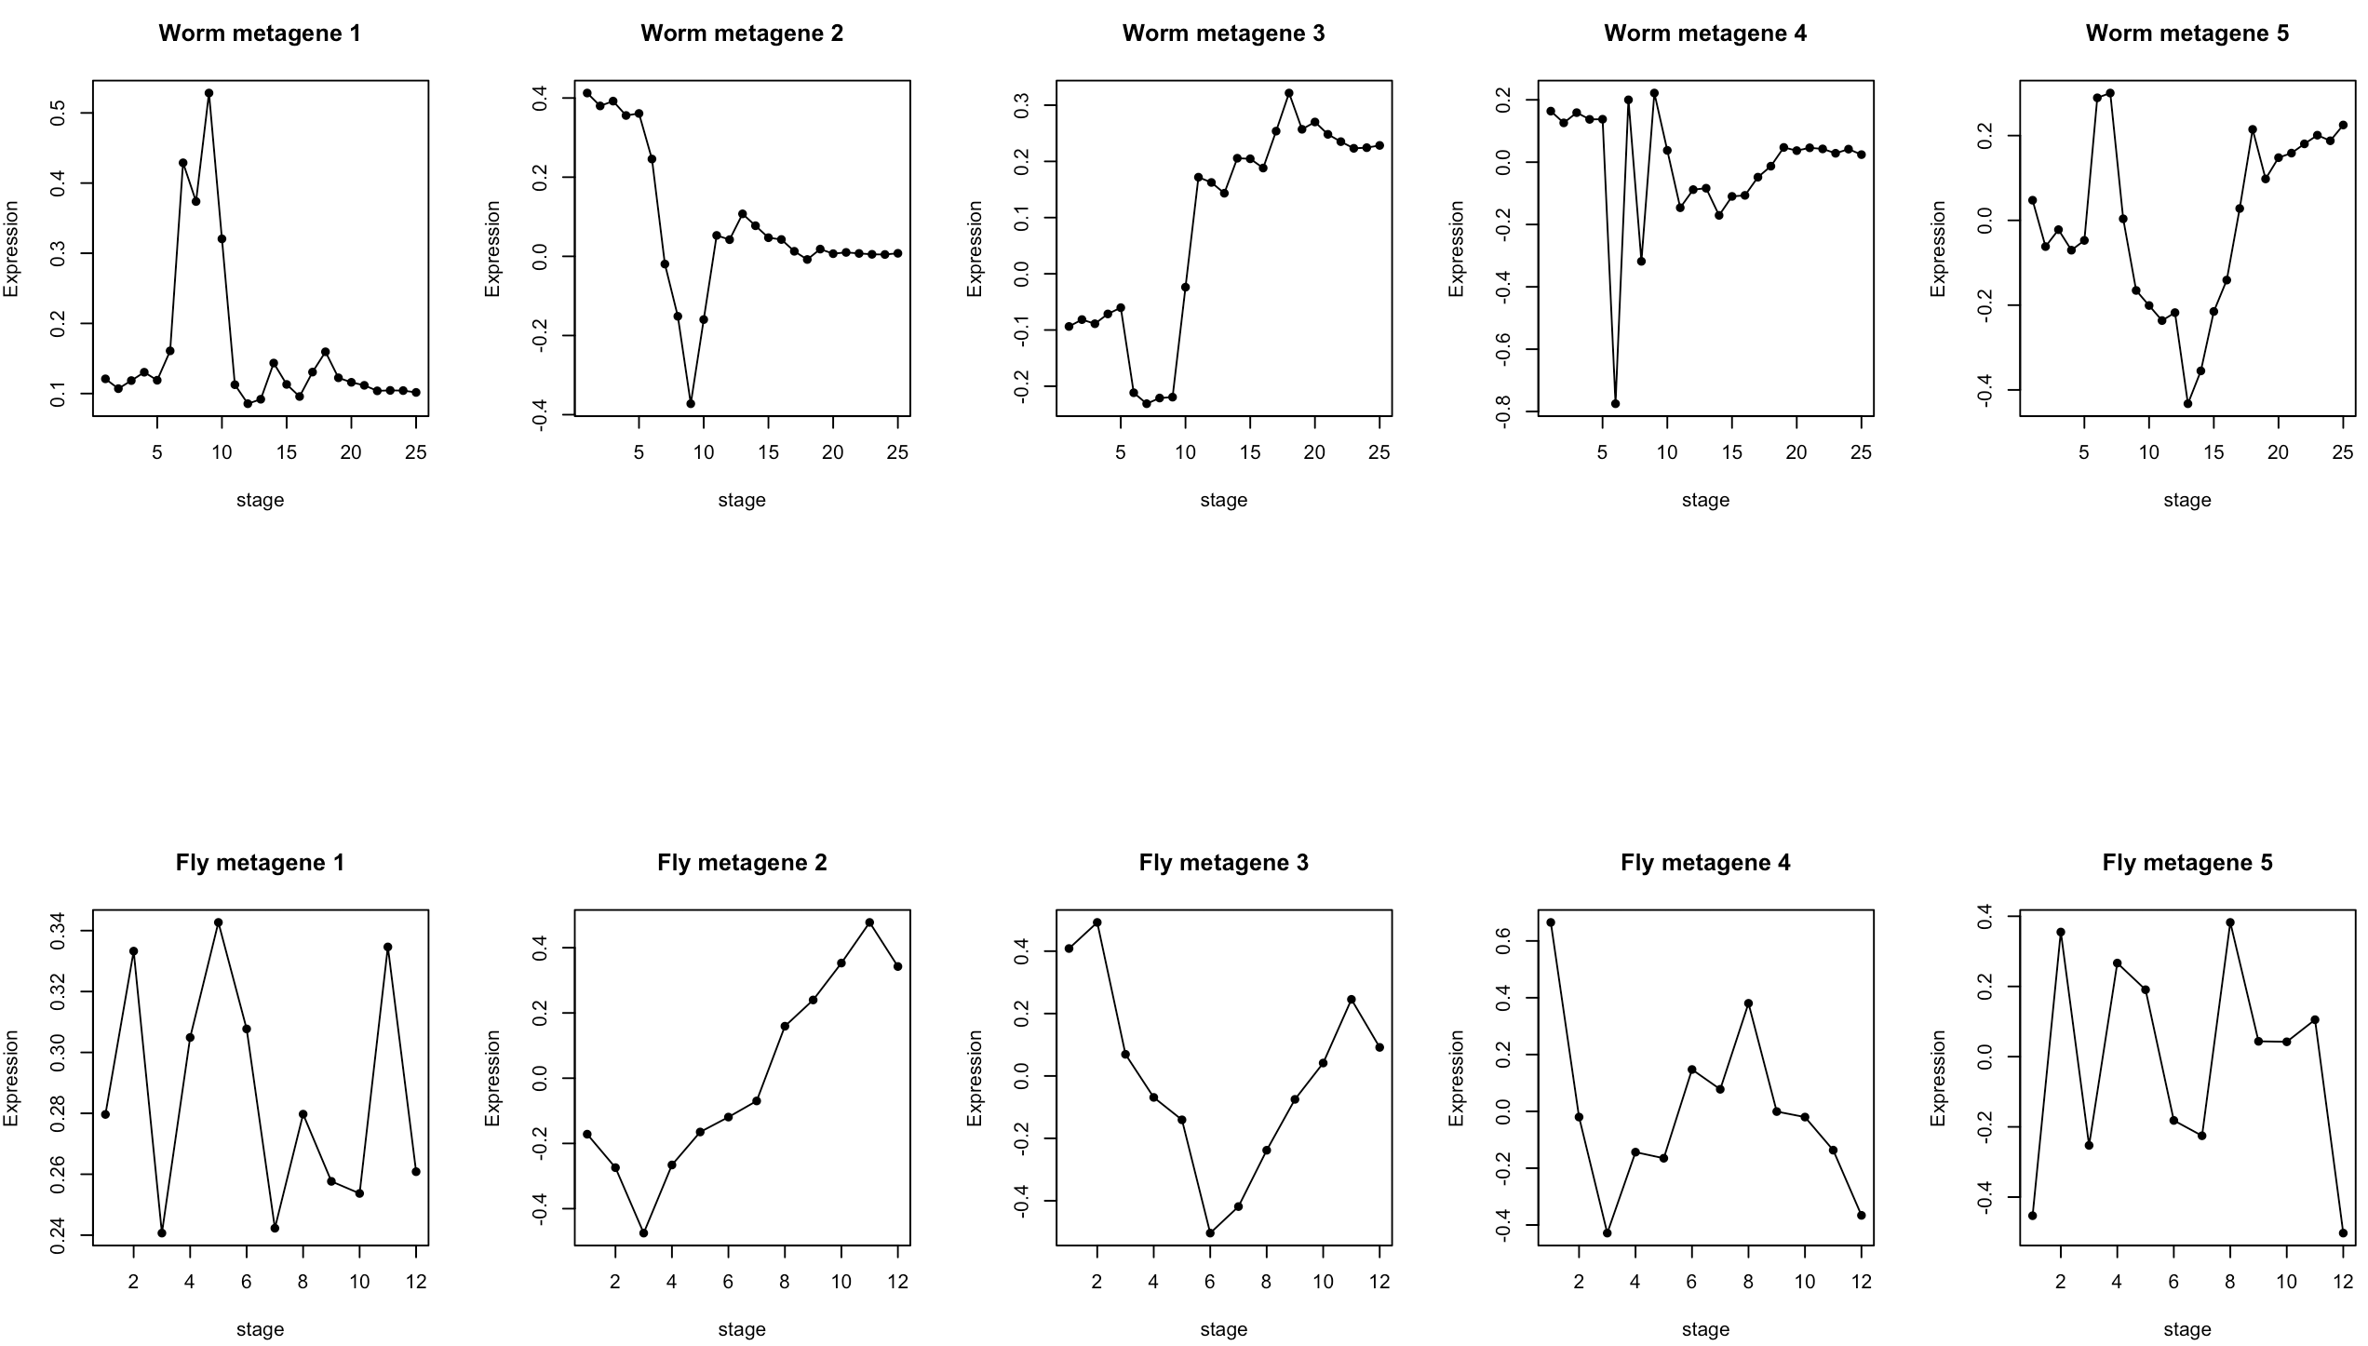
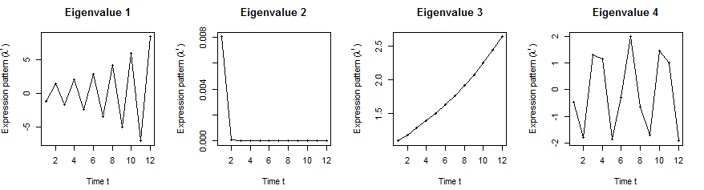
Orthologs have similar internal but different external dynamic patterns during embryonic development
Worm
Expession
Expression
Expression
Expression
Fly’s effective state space model
[Wang et al. PLOS CB, ‘16]

Slide 7
Orthologs have correlated iPDP coefficients
1st iPDP
2nd iPDP
r=+0.33
r=+0.66
Coefficients of orthologs on fly
3rd iPDP
4th iPDP
r=+0.67
r=+0.73
Coefficients of orthologs on worm
[Wang et al. PLOS CB, ‘16]

Slide 8
Evolutionarily conserved & younger genes exhibit the opposite internal & external PDP coefficients
p<2.2e-16
p<2.6e-13
p<5.6e-11
p<8.3e-4
Worm
Fly
Ribosomal genes have significantly larger coefficients for the internal than external PDPs, but signaling genes exhibit the opposite trend
[Wang et al. PLOS CB, ‘16]

Slide 9
Human-specific TFs respond more strongly to hormonal stimulation during cell-cycle than conserved genes in breast cancer cell
Applied to Breast Cancer Cell Cycle
(2 periods) under hormonal stim.
  INT = conserved human genes
    ~1100 H-F-W orthologs
    follow normal cell cycle
  EXT = human spec TFs
    diff from above
    perhaps responding to stimulation
IDPs
EDPs

