Slide 1
RAD

Slide 2
Figure 1
(A)
(C)
Pre-built context
User-Specific Inputs
112 RBP
Profiles
SNP
Data
Expression
Profiles
Mutation
Profiles
Base Pair
Features
RBP DAF%
Regulatory
Potential
Co-binding
Differential
Expression
Recurrence
Motif
Base Pair
DAF%
(B)
Regulator Score
Element Score
Nucleotide Score
RAD Score
Mandatary process
Optional process
Baseline
Tissue

Slide 3
Figure 2
(A)
(B)
(C)
Chromosome 1
(D)
Hotness

Slide 4
Figure 2
(A)
(B)
(C)
(D)
Rare Variant

Slide 5
Figure 3
A
 | G₁ | G₂ | G₃ | … | G_{n-1} | G_{n} | Power
RBP₁ | 1 | 1 | 1 | … | 0 | 0 | ***
RBP₂ | 1 | 1 | 0 | … | 0 | 1 | N
 |  |  |  |  |  |  | N
RBP_{k} | 0 | 0 | 0 | … | 1 | 1 | **
PPIL4 in PAAD
SUB1 in BRCA

Slide 6
PPIL4 in PAAD
Increasing Uniform Power
SUB1 in BRCA

Slide 7
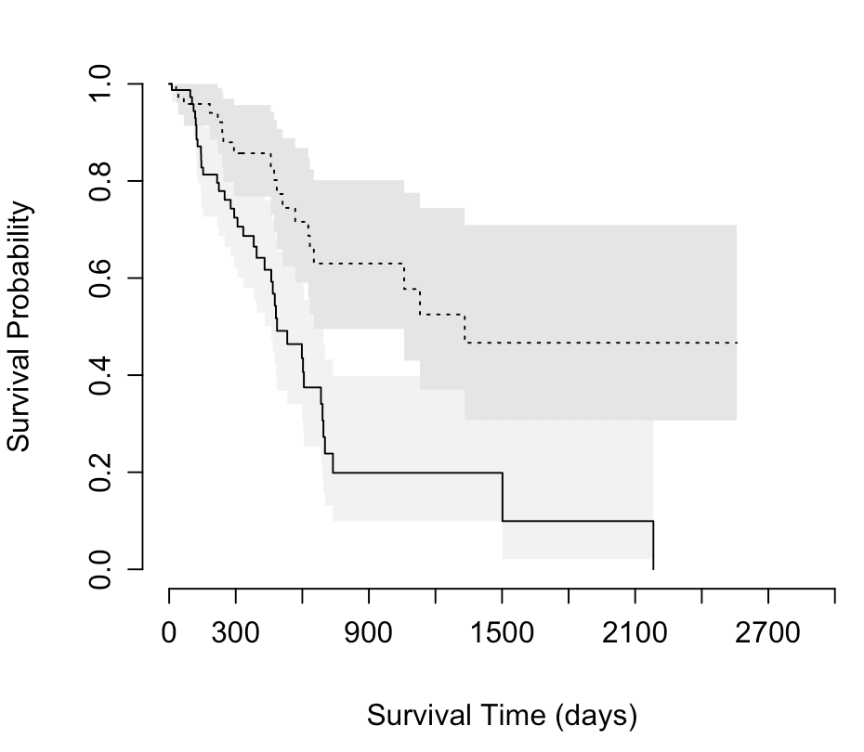
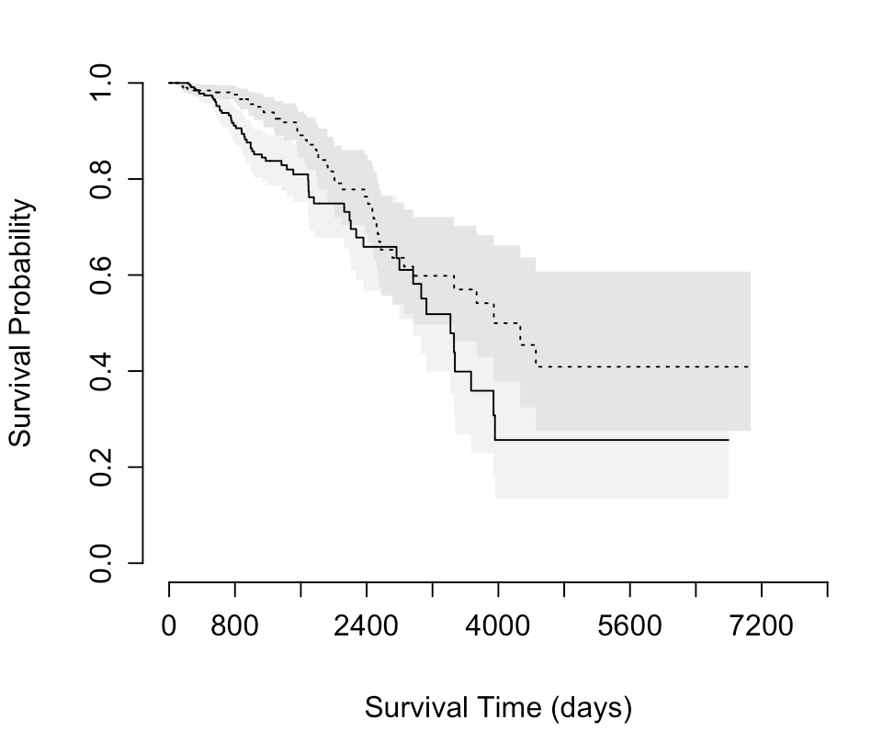
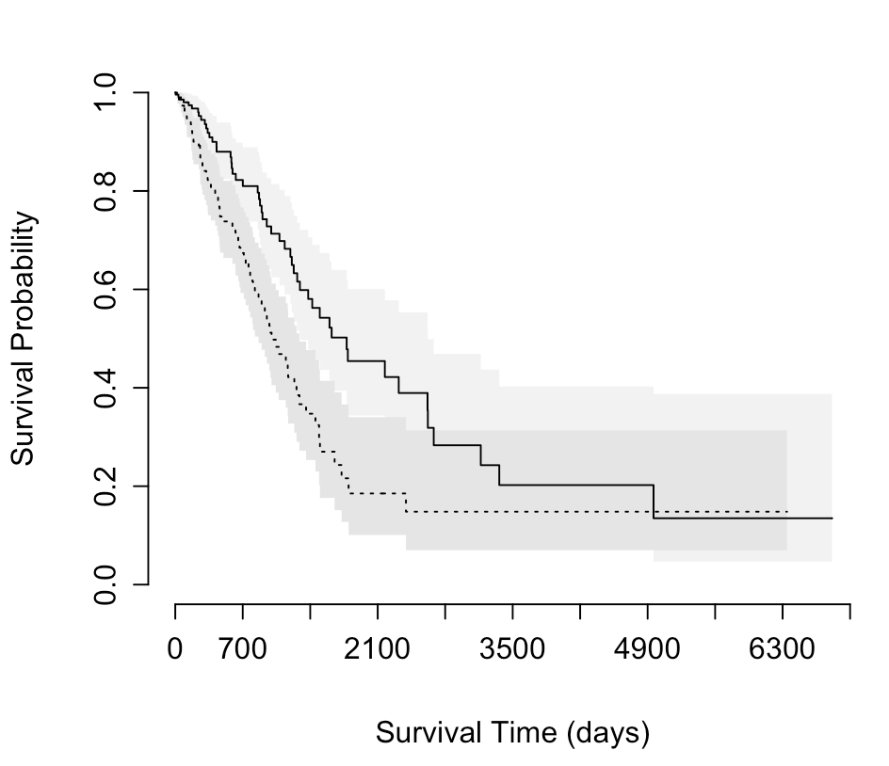
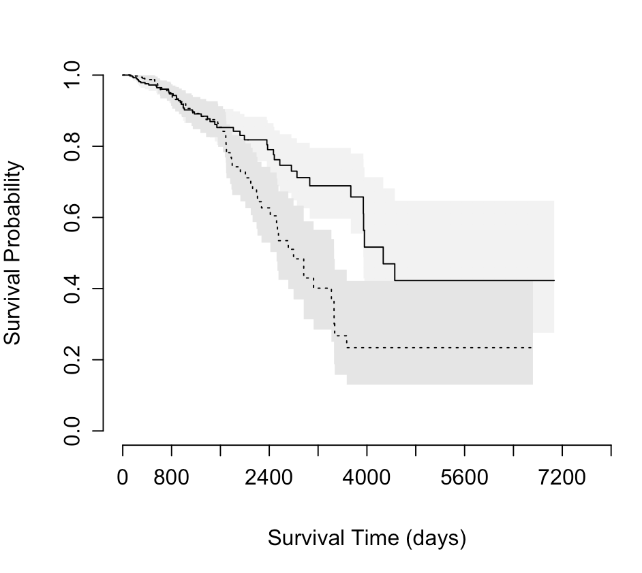
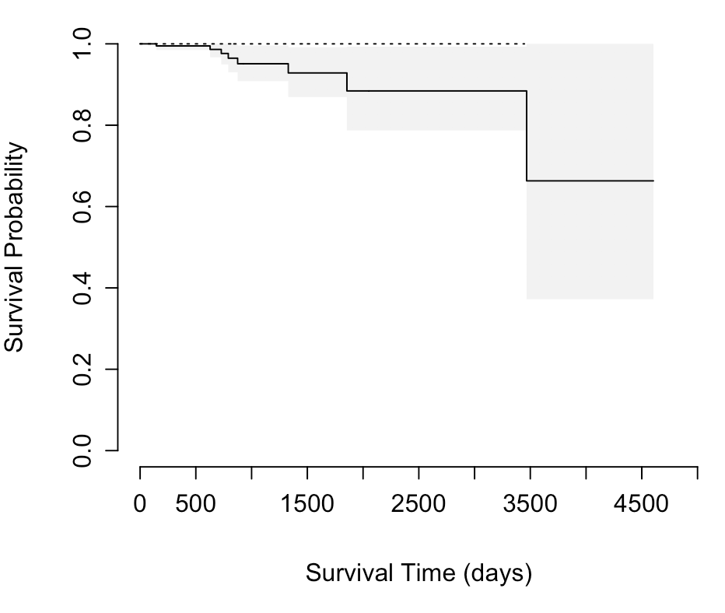
PPIL4 in PAAD
BCCIP in BRCA
NSUN2 in LUAD
NPM1 in BRCA
logistic
SRSF1 in PRAD

Slide 8
Figure 4
(A)
(B)
TP53
28bp
Baseline RAD Score

Slide 9
(A)
(C)
Breast Cancer
(B)

