Slide 1
GSP-AC Updates
Manny Rivas and Xihong Lin

Slide 2
Functional annotation of noncoding variants
Vanderbilt AC
Integrative framework: ~1000 genomics features
Unsupervised: no need of labeled training set
Multi-class modeling: discovery of inherent clusters
  Different regulatory elements have distinct genomics patterns
Sensitivity
1-specificity

Slide 3
From associated loci to risk genes
Vanderbilt AC
Rationales
  Genomics features characteristics of risk genes
  Risk genes converge to common pathways
An integrative framework to locate risk genes
  Genomics features (multi-dimensional)
  Gene Ontology network
Risk genes identified for SCZ
  Consistently involved in known SCZ pathophysiology
  Enriched for drug targets
Extension to WGS analysis
  Prioritize genes for gene-based analysis
  Analyze sub-genome-wide significance signals to increase power
b)
a)

Slide 4
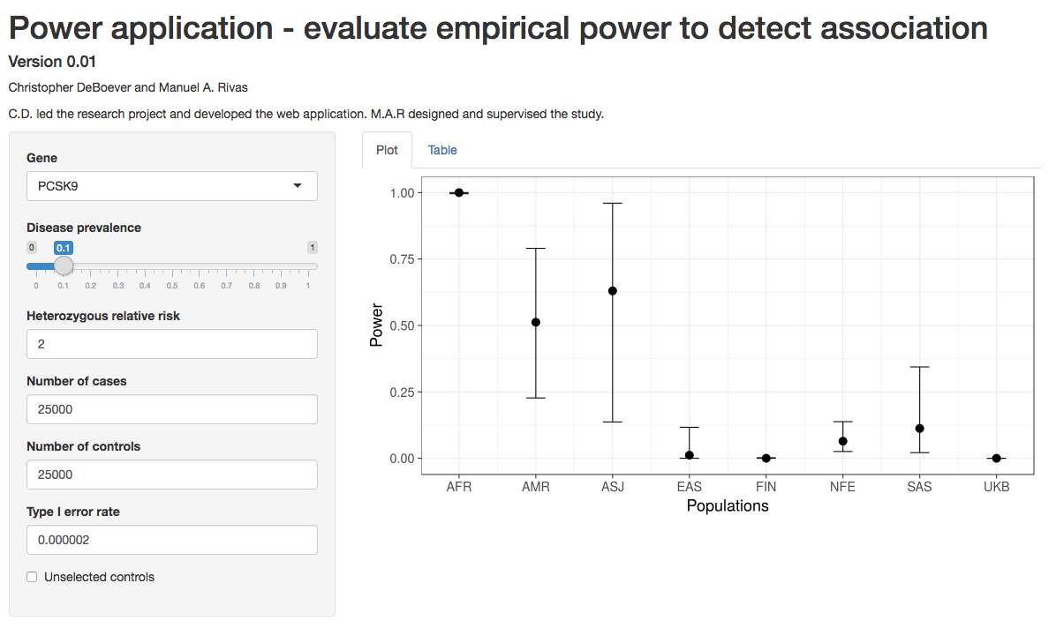
Statistical power across ancestries
Stanford/UCSF/Mt. Sinai GSPAC
Genetic parameter estimation
Phenotype 1 |  | Phenotype 2
BETA | SE | BETA | SE
1.2 | 0.03 | 1.15 | 0.04
1.5 | 0.9 | 1.3 | 0.1
-1.1 | 0.006 | -1.2 | 0.05
… | … | … | …
  MVPMM
Power to detect rare variant associations differs across ancestries
Loss-of-function variants enriched in different ancestries
Public app for exploring power differences
heritability
polygenicity
genetic correlation
scale of effects
Mixture model for estimating genetic parameters from GWAS summary statistics

Slide 5
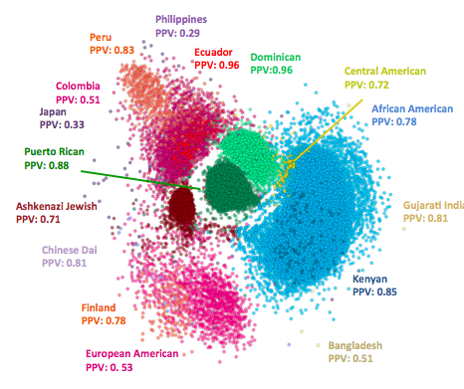
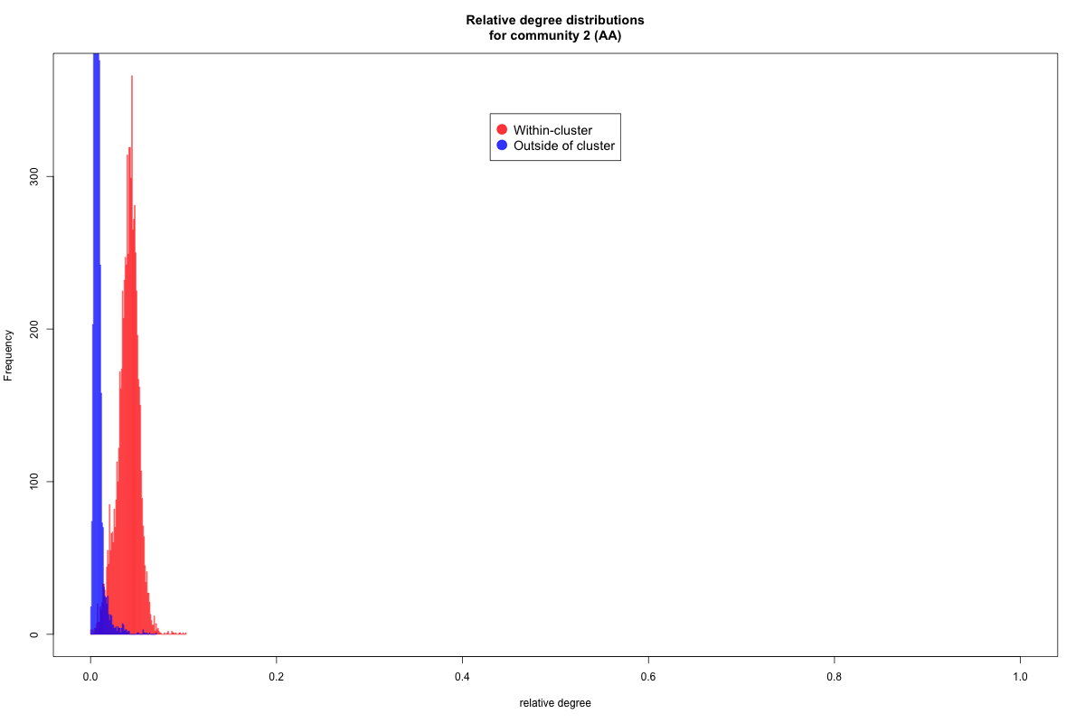
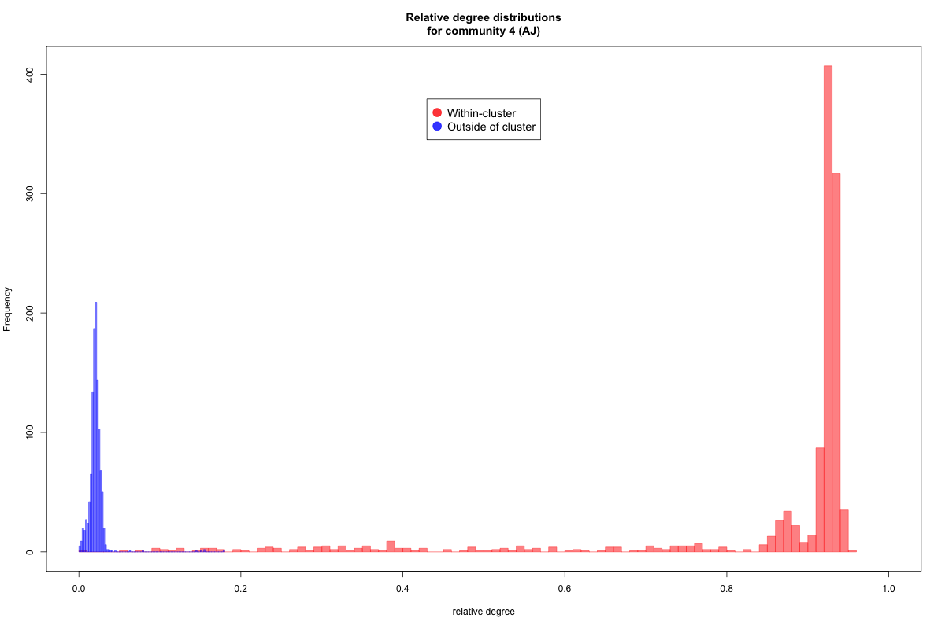
Ancestry and population structure detection
Stanford/UCSF/Mt. Sinai GSPAC
ADMIXTURE 1.3: projection approach to efficiently estimate ancestry for 10k’s of subjects using reference panel
RFMIX 1.66: efficient local ancestry assignment, including rare variants
FOUNDER 1.0: efficient community detection, including founder effects
BioMe Biobank
Shringarpure et al. 2016
I-LASH 1.0
I-LASH: Ultra-rapid and sensitive detection of identity-by-descent tracts
Belbin et al., in prep
Relative degree within community
Relative degree outside community
African Americans
Shemirani et al., in prep
Ashkenazi Jews
Relative degree

Slide 6
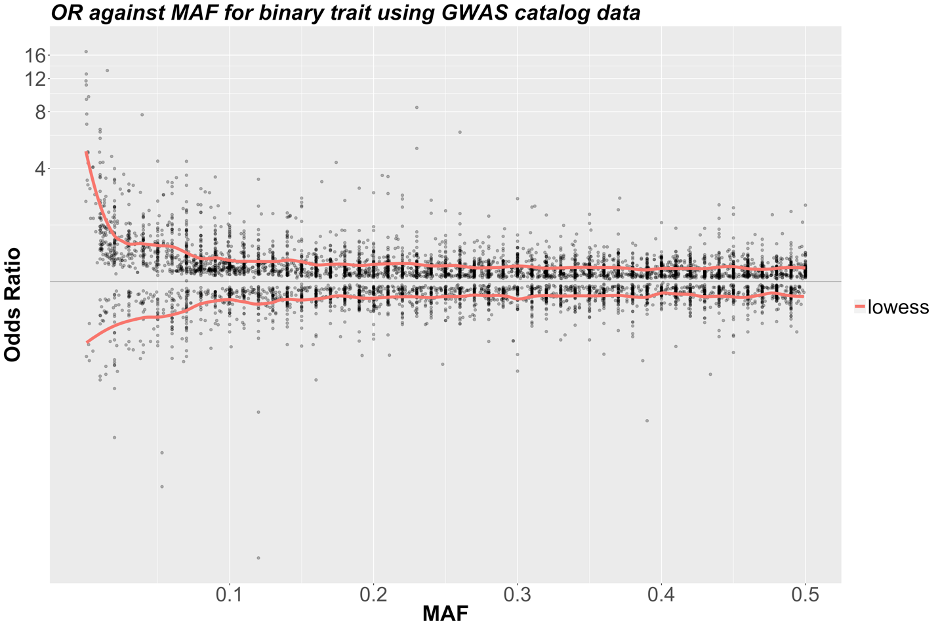
Rare Variant Association Analysis Weighting Strategies: Low Freq/Rare Variants Have Bigger Effects than Common Variants Using the GWAS Catalog (MAF>10^-3)
Harvard AC

Slide 7
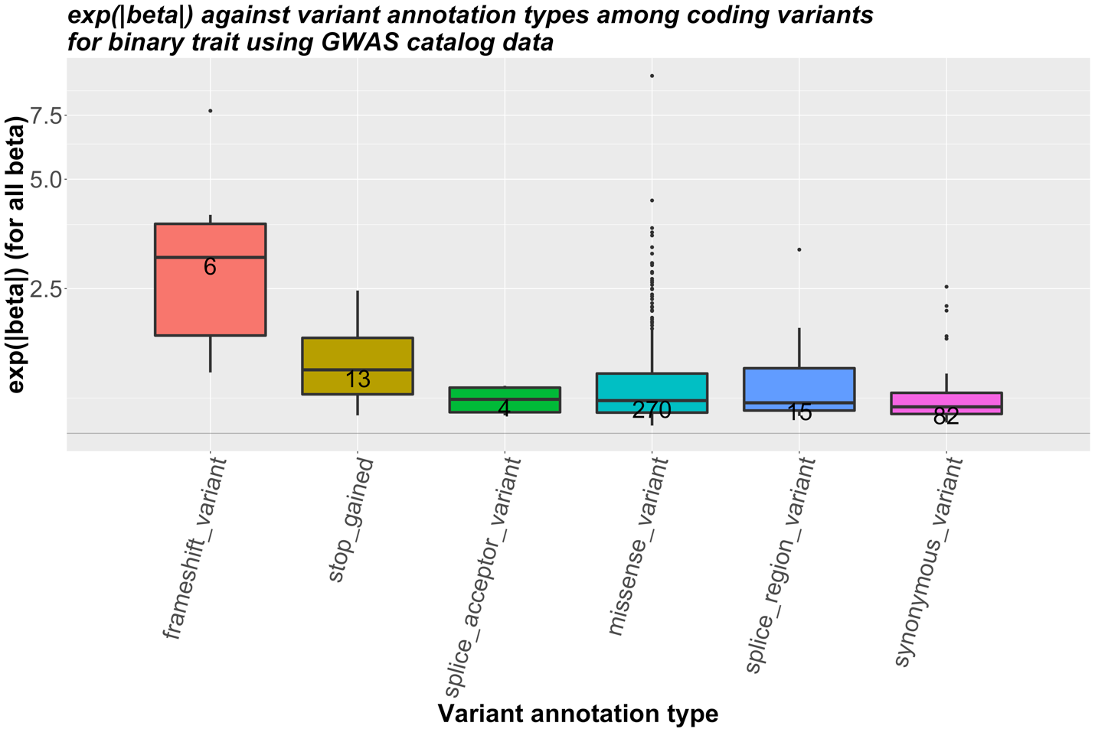
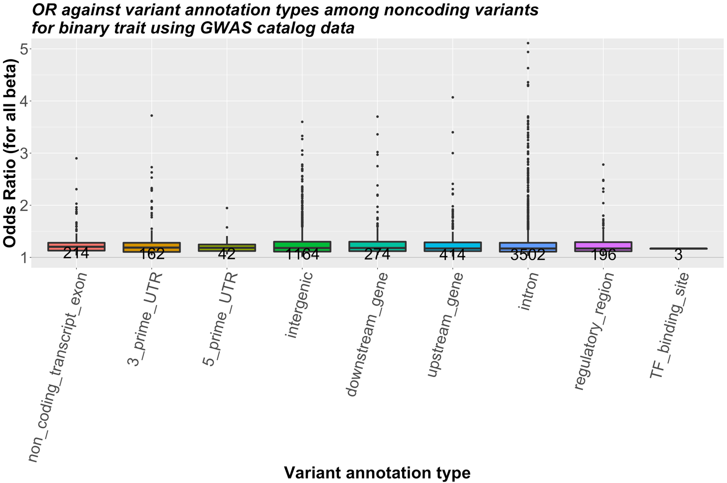
Weighting using Annotation: Frameshift and stop-gain variants have bigger effects; Other Coding variants and non-coding variants have similar (small) effects from the GWAS Catalog
Coding Variants
Non-Coding Variants

Slide 8
SCAN the genome using varying data-driven optimal windows:
Non-GSP ARIC WGS data (n=2000) (Thanks Eric Boerwinkle)
Most significant regions have smaller p-values than using fixed windows across chromosomes
Coding Variants
Non-Coding Variants

Slide 9

Scalable WGS Analysis Software Development
http://hail.is
Scalable analytic software for genetic analysis
26 Billion associations in 27 hours (see here)
Used to perform QC and analysis of joint callset
Annotation database development here
Harvard AC

Slide 10
Background
CCDG has been developing two documents: CCDG goals and CCDG strategies
Following the CCDG steering committee discussions, the ACs will work with Data Analysis WG and Methods WG on preparing an analytic strategies document to help achieve CCDG and CMG goals.
The goals of the analytic strategies document are to provide a document on (1) infrastructure and resources, and (2) analytic methods that need to be developed by GSP to facilitate WGS analysis of complex diseases and Mendelian diseases

Slide 11
Initial Thoughts on Needed Resources
Create population-scale maps of genome variation and eeply characterize genome variation, joint with TOPMed and others
Improve imputation resources, e.g., rare variant imputation server
Improve annotation for both coding and non-coding variants
Build functional and weighting score databases to prioritize coding and non-coding variants for RV association analysis
Build low frequency and rare variant association catalog
Build variant-level and gene/set level association summary statistics database

Slide 12
Initial Thoughts on Needed Resources
Build functional and weighting score databases to prioritize coding and non-coding variants for RV association analysis
    CADD does not work well for non-coding variants
    Functionality is tissue and disease specific
Build low frequency and rare variant association catalog
How the GSP WGS data and phenotype data will be stored and shared
Build variant-level and gene/set level association summary statistics database

Slide 13
Data Sharing Updates
Joint call set will be shared across GSP including ACs
Phenotyping sharing plans need to be developed

