Slide 1
CMG/KOMP Collaboration
David Valle, MD
Baylor-Hopkins Center for Mendelian Genomics
17 Nov 2017
dvalle@jhmi.edu

Slide 2
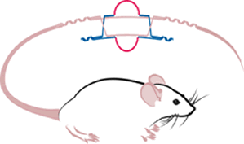





KOMP² Organizational Overview
The Knockout Mouse Phenotyping Program (KOMP²) is funded by the NIH and is partnered with organizations from ten countries as part of the International Mouse Phenotyping Consortium (IMPC) in an internationally coordinated effort to undertake broad-based, systematic genome-wide phenotyping of null allele mice. KOMP² work is carried out by three consortia.
Arthur L. Beaudet, M.D.
Robert Braun, Ph.D.
K.C. Kent Lloyd, D.V.M., Ph.D.
Mary E. Dickinson, Ph.D.
Stephen Murray, Ph.D.
Colin McKerlie, D.V.M., D.V.S.C.
Steve Brown, FMedSci, FRS
Karen Svenson, Ph.D.
Colin Fletcher, Ph.D.
Oleg Mirochnitchenko, Ph.D.
This work is supported by KOMP2 awards (UM1, U42, and U54) from the National Human Genome Research Institute, National Institute Of Arthritis And Musculoskeletal And Skin Diseases, National Cancer Institute, National Institute of Neurological Disorders and Stroke, National Institute on Deafness and Other Communication Disorders, National Institute of Environmental Health Sciences, National Institute of Drug Abuse, the Office of Research on Women's Health, and the Common Fund.

Slide 3

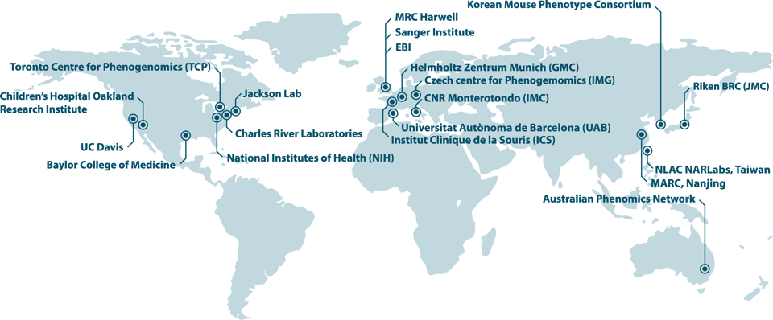
International Mouse
Phenotyping Consortium
Creating a comprehensive catalogue
of mammalian gene function
The function of around two thirds of all mammalian genes remains unknown.
Building the first truly complete, functional catalogue of a mammalian genome
Systematically phenotyping a genome-wide collection of knockout mouse strains
Making all data and resources readily available to the scientific community
Notes:
Steve Brown comment

Slide 4
Progress to Date
GOAL: Production and broad-based primary phenotyping of ~20,000 murine null alleles
  6,786 single-gene null allele mouse strains generated
    ~5,200 through conversion of ES cells, primarily during KOMP2 Phase 1
    ~1,500 utilizing newly-implemented CRISPR/Cas9 technology
  5,000 lines entered into phenotyping
Mouse lines distributed through repository system and production centers
Phenotyping results freely available through web portal
  43.5 million data points, incl 200,000 images
Generating valuable models and observations for improving human health
  650 new potential disease models, incl ~175 new human disease genes
      227 with no previous extant mouse allele
      423 with previous mouse in MGI not yet asserted as a disease model
Notes:
~3600 orders for lines
Relationships between essential genes and human disease genes

Slide 5
KOMP² Pipelines Overview
Generation of null allele lines on a specific background strain in a high-throughput and agile production pipeline.
Standardized, broad-based, and quality-controlled adult and embryonic high-throughput phenotyping pipelines provide robust, high quality datasets.
Fertility
LacZ
Expression
Primary
Allele QC
Primary Cohort Production Breeding
Null allele
generation
8♂ & 8♀
Adult
Phenotyping
Pipeline
Viability
Pilot
projects
Non-viable
Embryo
Phenotyping
Pipeline
Notes:
past six years
established comprehensive infrastructure and expertise
established mechanism to fulfill sex as a biological variable and resource sharing requirements
precision disease modeling
5

Slide 6
Phenotyping examines multiple systems
Neurological/
Behaviour
Sensory
Open Field with Light/Dark Challenge
Auditory Brain Stem Response
Modified SHIRPA/Dysmorphology
Slit Lamp/Ophthalmoscope
Grip Strength
Eye morphology
Acoustic Startle/PPI
Electroretinography
Fear conditioning
Musculo-
skeletal
Grip Strength
Metabolism
Body Composition (DEXA)
Weight
Whole body X-ray
Calorimetry
Intraperitoneal Glucose Tolerance Test
Immunology
Hematology
Body Composition (DEXA)
FACS analysis – blood/spleen
Clinical Blood Chemistry
General
Cardiovascular
Modified SHIRPA/Dysmorphology
ECG / Echo
Gross Pathology & Tissue Collection
Heart Weight
Tissue embedding & Block Banking
Reproduction
Histopathology
Fertility
Notes:
Clinically relevant

Slide 7
CMG/KOMP Collaboration: Rationale
CMGs are generating large numbers of high quality candidate Mendelian disease genes and variants (tier 1 & 2)
KOMP Centers are producing ko mouse models for large numbers of genes and submitting the mice to standard phenotyping protocols
  Moreover, their own interests in specific genes and gene sets fall far short of their quotas

Slide 8
CMG/KOMP Collaboration: Rationale - 2
Early access to CMG tier 1 & 2 candidates and will enable KOMP to incorporate these “high value” genes into their gene list
This will help validate responsible genes and improve quality of CMG publications
Interactions with CMG phenotype experts will help inform KOMP phenotyping
Will also provide investigators early access to mouse models

Slide 9
CMG/KOMP Collaboration: Steps so far - 1
Series of conference calls August – October, 2017
Half day CMG/KOMP get acquainted meeting at ASHG (Beaudet and Valle, co-moderators)
  Representatives of all 3 CMGS and all 3 KOMP centers
  IMPC also well represented
  Lu Wang, Colin Fletcher, Carolyn Hutter also attended
  Exchanged lists of tier 1 & 2 genes & evaluated existing CMG/KOMP overlaps

Slide 10
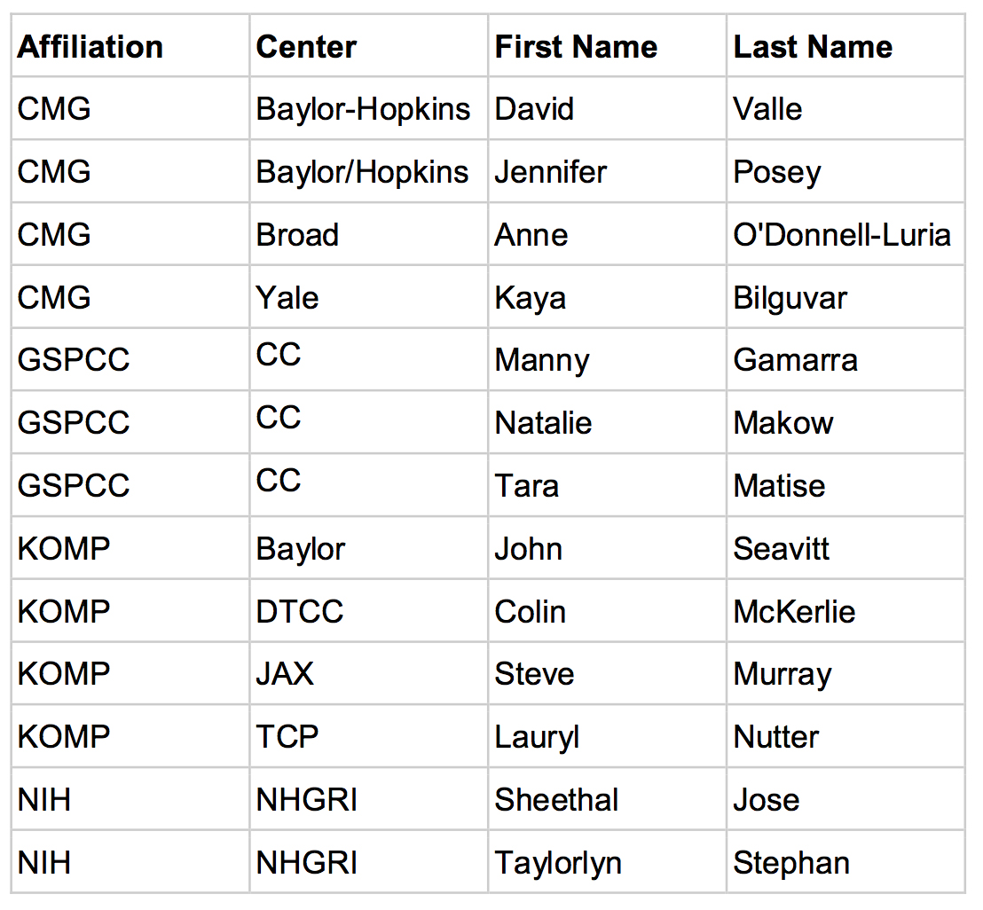
CMG/KOMP Collaboration: Steps so far - 2
Follow up meeting of small CMG/KOMP working group
*
*
*
*
*
*

Slide 11
CMG/KOMP Collaboration: Steps so far - 2
Follow-up conference call 8 November
Key points
  Monthly calls of small CMG/KOMP group
  Random gene allocation with provision for specific request
  Quarterly data dump
  Confidential within CMG/KOMP
  Tracking web site
  Review with CMG Steering committee

Slide 12
Thanks for your attention !
Special thanks to John Seavitt for KOMP slides and Steve Murray and members of the CMG/KOMP small working group for making this happen

