Slide 1
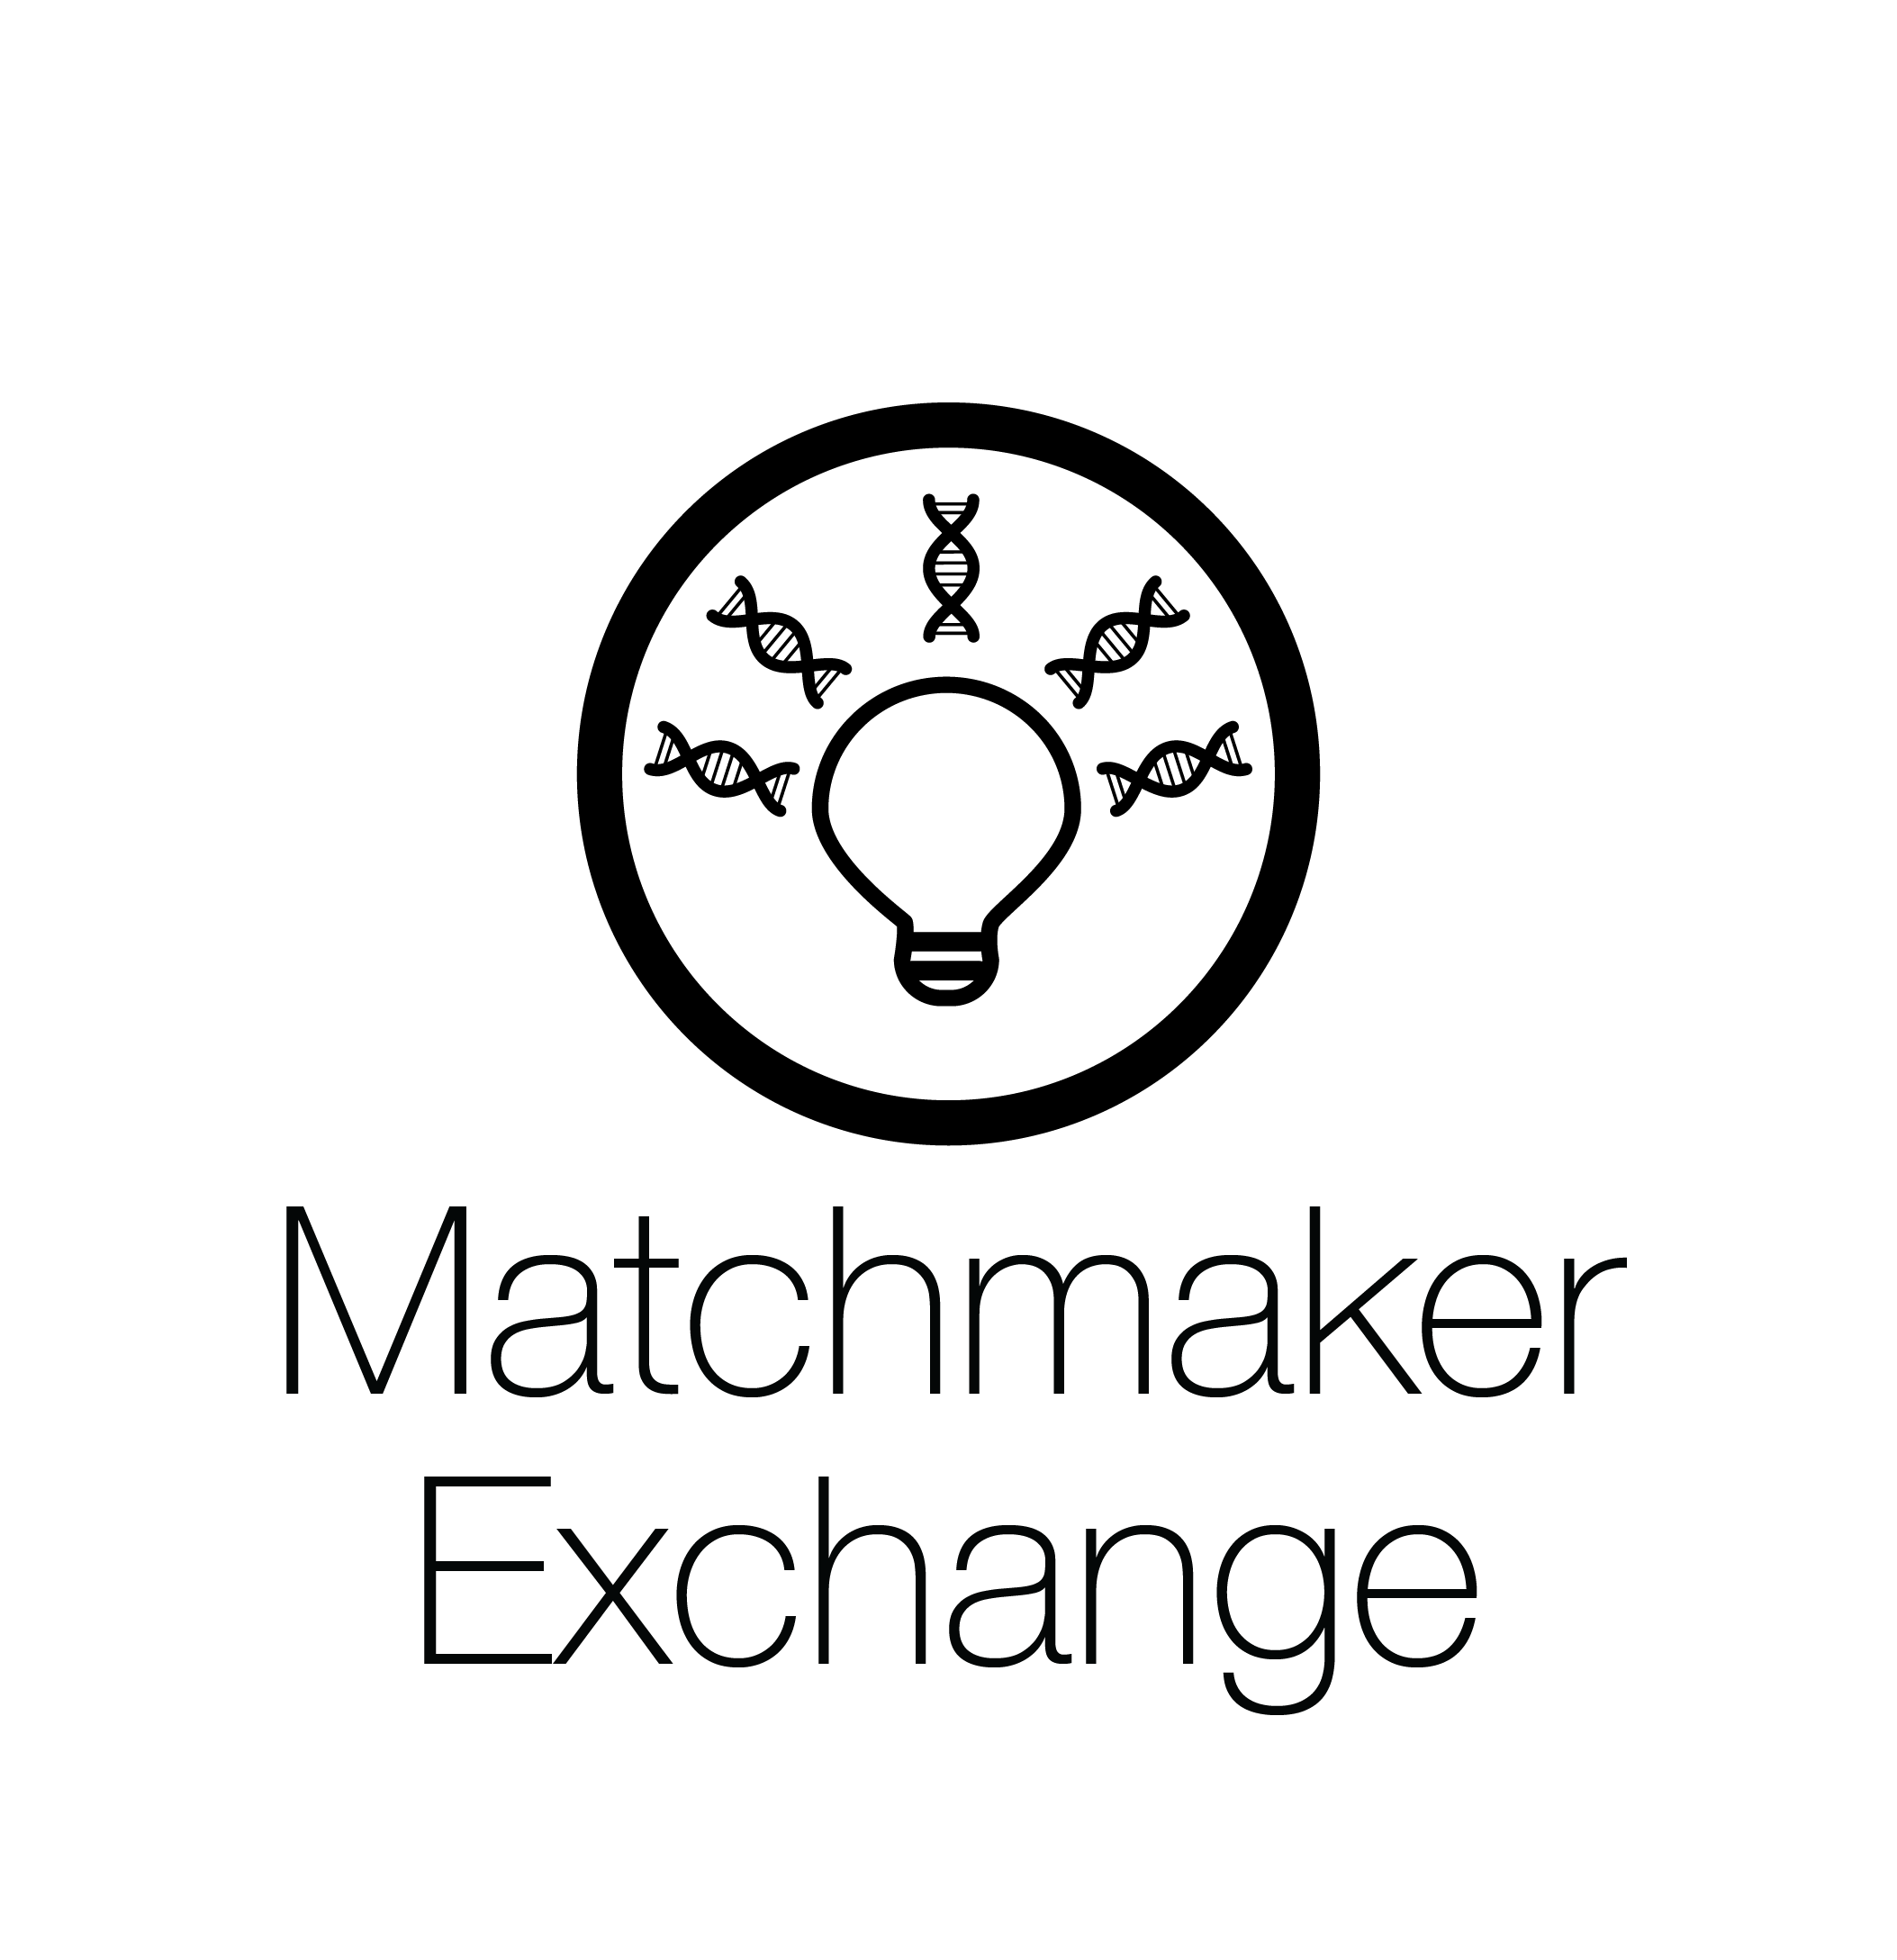
Updates from the Matchmaker Exchange
Heidi Rehm, Jessica Chong, Ada Hamosh
Genomic Sequencing Program
November 17th, 2017

Slide 2
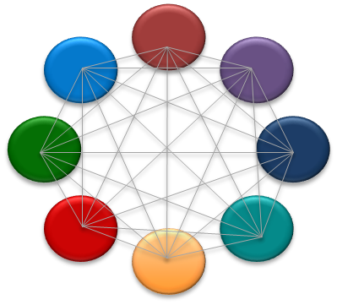
MME is a Federated Network
API Fields
ID (Mandatory) +/- Label
Submitter (Mandatory)
Phenotypic Features and/or
Gene Names (Mandatory)
Disorders (Optional) - OMIM or OrphaNet
Sex, Age of Onset, Inheritance (Optional)
Matching typically on gene with phenotype used for ranking
Supported today:
Match on Gene (rank by Phenotype)
1 strong candidate gene (e.g. de novo variant in GUS)
10 candidate genes each with rare variant
Match on phenotype only
Match case to non-human models
Patient-initiated matching
Philippakis et al. The Matchmaker Exchange: A Platform for Rare Disease Gene Discovery. Hum Mutat. 2015;36(10):915-21.
Buske et al. The Matchmaker Exchange API: automating patient matching through the exchange of structured phenotypic and genotypic profiles. Hum Mutat. 2015;36(10):922-7

Slide 3
Matchmaker Exchange Statistics
Data from >100,000
patients
From >4000 contributors from 69 countries
7 papers
across MME
(21 in prep)
Patients/cases
MyGene 2 | 1241 (311 in MME)
GeneMatcher | 17,237 (all open to query by MME)
DECIPHER | 67,105 (24,745 in MME)
seqr/matchbox | 17,120 (91 in MME)
PhenomeCentral | 3968 (3017 in MME)
AGHA Patient Archive | 67 (9)
Unique genes
MyGene 2 | 748
GeneMatcher | 7,907
DECIPHER | 6,100 (includes genes in CNVs)
matchbox | 122
PhenomeCentral | 1128
AGHA Patient Archive | 9
and 100s of gene discoveries within sites
Stats from Nov 2017

Slide 4
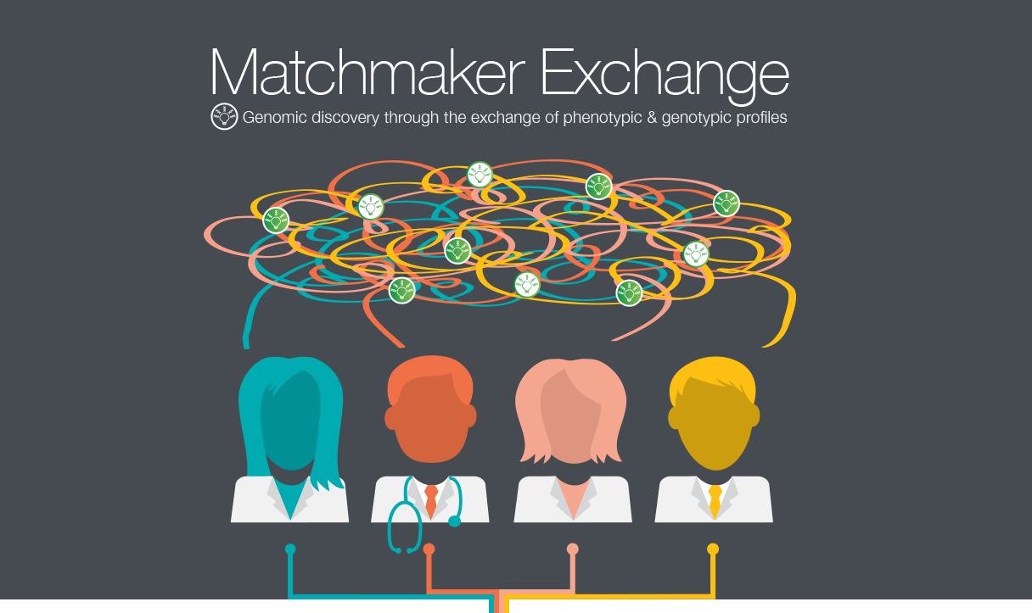
Guidance on Use of the Matchmaker Exchange
Current Protocols in Human Genetics
MME Unit Published October 18, 2017
www.matchmakerexchange.org

Slide 5
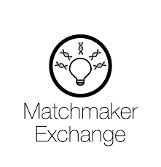
New additions to Matchmaker Exchange
New centers joining from:
Seoul National University gene matching system in Korea,
PI: Murim Choi
Testing: matchbox
Japanese IRUD Initiative for Rare and Undiagnosed Diseases Program
PI: Kenjiro Kosaki, Keio University, Japan
Testing: Patient Archive
Other open data sources in progress as well.

Slide 6
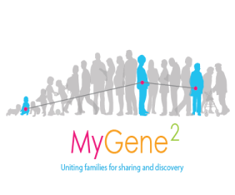
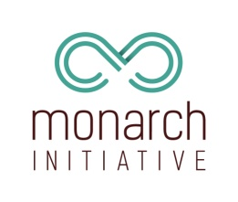
Gene Matcher
Phenome Central
DECIPHER
Launched Sept 14th
MyGene2
matchbox
Monarch Initiative
Patient Archives

Slide 7
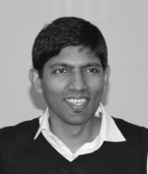
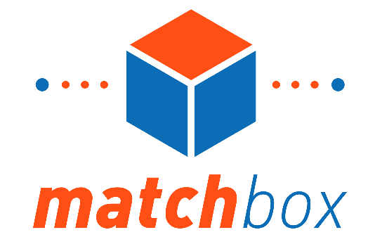
matchbox
Harindra Arachchi
Senior Software Engineer
Our bridge to the Matchmaker Exchange
matchbox is an atomic piece of software that can be installed anywhere in the world. Our goal was to reduce barriers to entry to the Matchmaker Exchange by building this software distinct from Broad, and making it freely available.
seqr is our main analysis platform
Variants
Databases
Phenotypes
Other Matchmaker Exchange nodes
Annotations

Slide 8
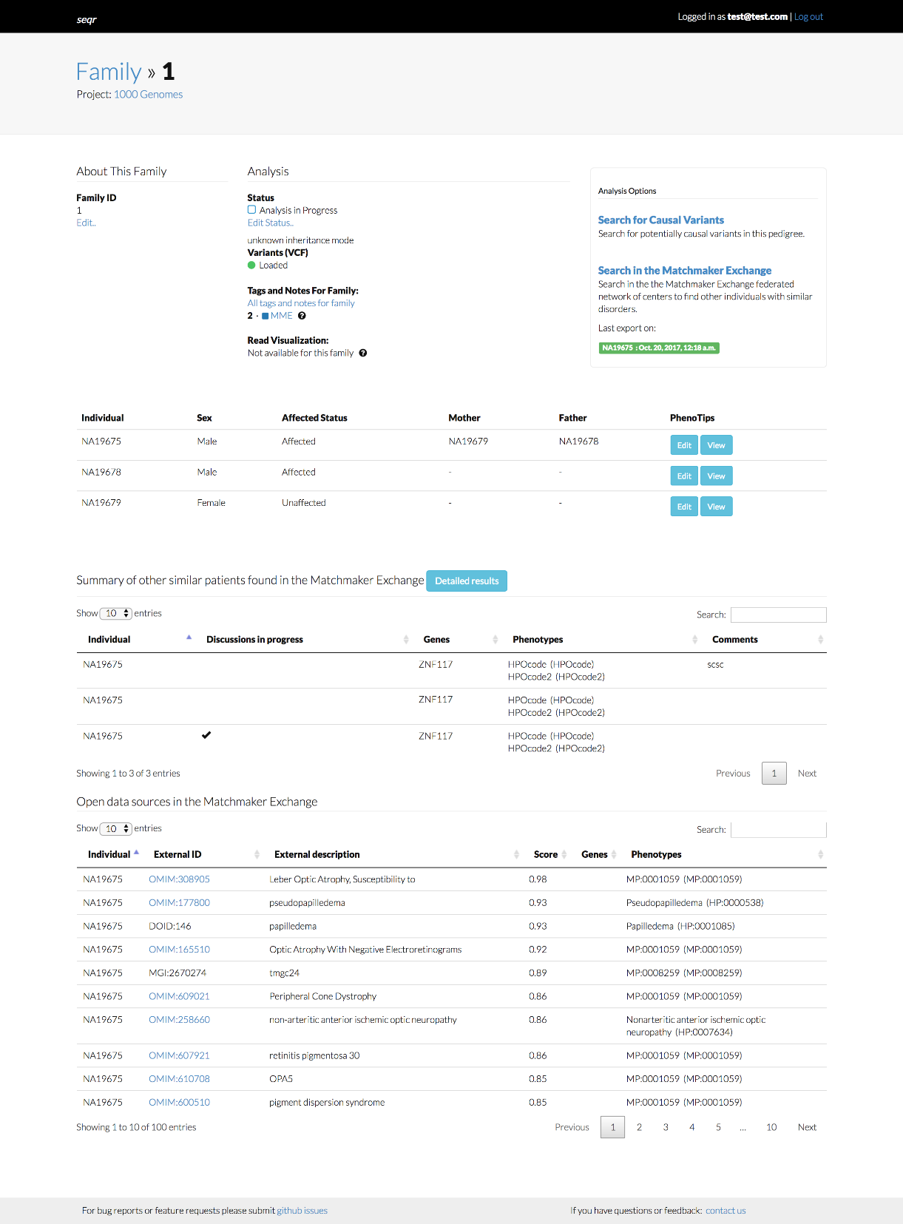
User Interface
[1.] Users search for variants and annotate them for submission to Matchmaker Exchange (MME)
[2.] Users add phenotypes for submission to MME
[3.] Summary-view (with a link to detailed-view) show other matched patients around the world with similar profiles found automatically by matchbox
[4.] We also show results of a search in Monarch Initiative

Slide 9
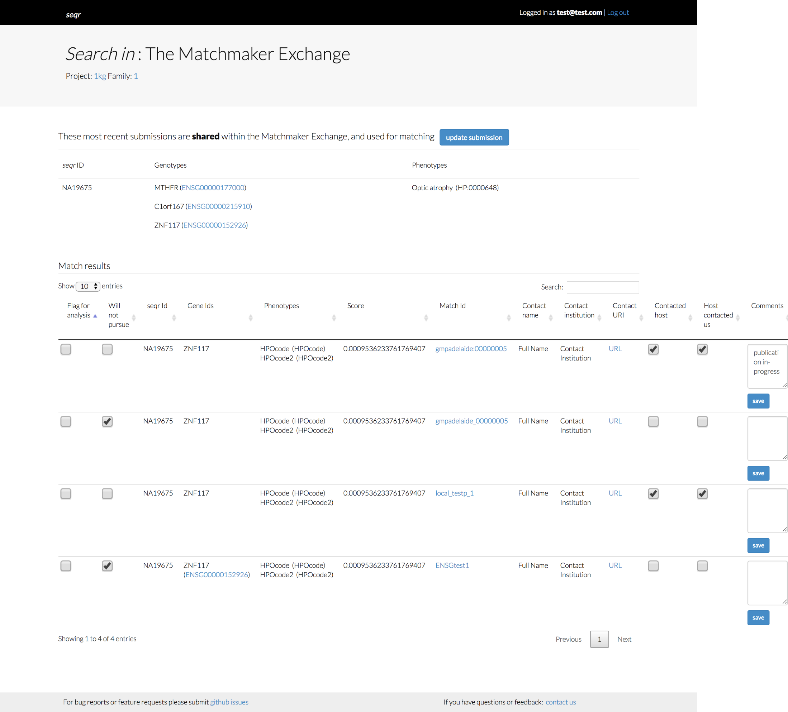
Tracking matches
Detailed MME search result page allows recording of information related to matches for tracking and quality control. These are updated by the user.
It also allows updating of submissions.

Slide 10
Publications
In our first year, we have two gene discovery publications:
De novo mutations in HNRNPU result in a neurodevelopmental syndrome. Yates TM et al. Am J Med Genet A. 2017 Sep 25. doi: 10.1002/ajmg.a.38492. [Epub ahead of print]
High Rate of Recurrent De Novo Mutations in Developmental and Epileptic Encephalopathies. Hamdan FF et al. Am J Hum Genet. 2017 Nov 2;101(5):664-685. doi: 10.1016/j.ajhg.2017.09.008
And many more matches with potential under discussions!

Slide 11
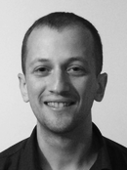
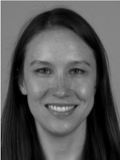
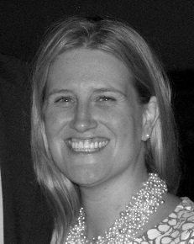
matchbox Acknowledgements
Broad Center for Mendelian Genomics
Harindra Arachchi
Senior Software Engineer
And the entire
Broad CMG Team!
Ben
Weisburd
Monica
Wojcik
Samantha
Baxter

Slide 12
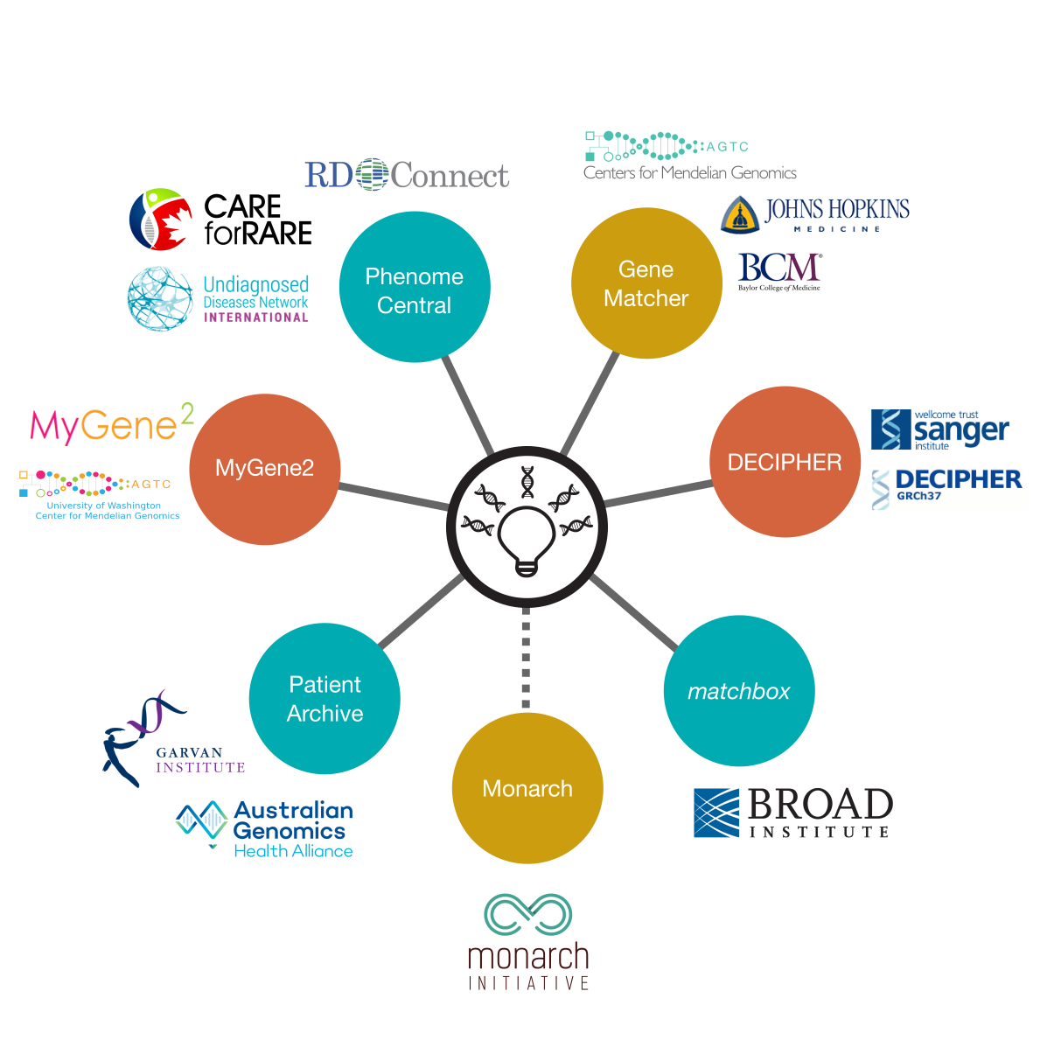

Slide 13
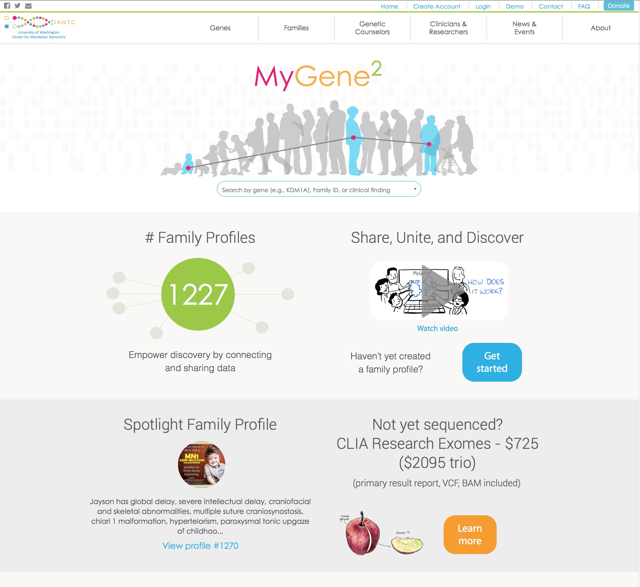

Slide 14
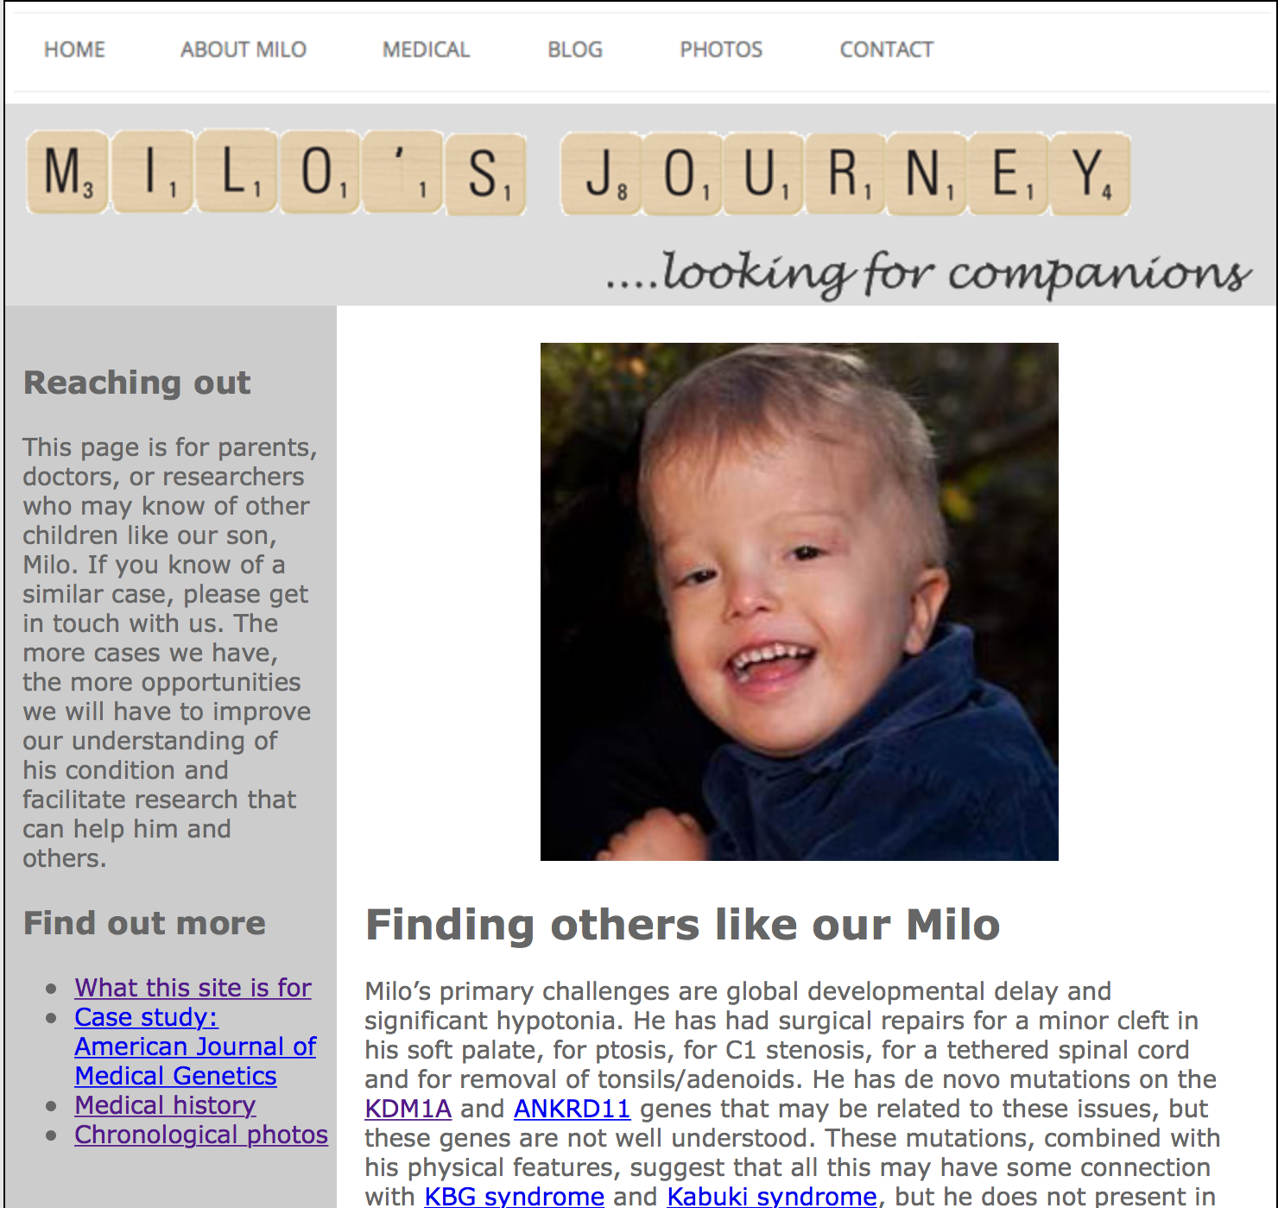
Families as citizen scientists
Not so simple: 1.5 years + collaboration with researchers
Notes:
A number of families have successfully linked up with researchers studying their families’ candidate genes by creating blogs or Facebook pages, however not all families have the resources or know-how to maintain a page, and even if they do, individual family pages are not easily indexed or discovered. Moreover, many families need guidance in figuring out what types of phenotypic and genetic data are most useful to share with researchers.

Slide 15
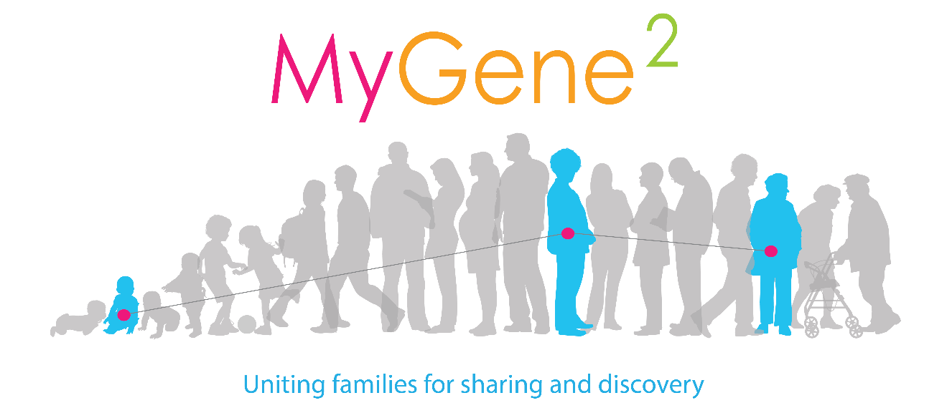
Expanding the gene discovery community: families
researchers, clinicians, industry can share de-identified data
limited ability to follow-up – time, resources
families outnumber us
What do they want?
find a diagnosis (gene discovery)
know what to expect given diagnosis/mutation (genotype-phenotype relationships)
help discover treatments
share experiences
can share all data (identifiable and not)
need:
guidance (to research/gene discovery process)
support (answers to questions)
structure (knowing what to share)
https://www.mygene2.org
@MyGene2
Notes:
Researchers, clinicians, and diagnostic labs can share de-identified data, but have limited time or resources to follow-up on potential matches. Meanwhile, families with rare diseases are highly motivated to find a diagnosis, help discover treatments, and share their experiences with others. Most importantly, families can and already are sharing identifiable data through blogs and Facebook pages. So we are interested in casting a broader net, and including families directly in matchmaking.

Slide 16
Our solution: MyGene2
web platform for radically open data sharing – rapid data release, public, searchable
removes barriers to access
democratizes gene discovery, genotype-phenotype relationships
share with families, clinicians, and researchers – equal access
users share clinical findings and genetic data
health data:
free text descriptions converted to standardized vocabulary (HPO terms)
genetic data:
candidate gene/variants
genetic test reports
VCF/BAM files
Notes:
Genetic data can be as simple as the name of a candidate gene, or a specific variant, as well as uploaded files like genetic test reports and VCFs containing exome or genome data.

Slide 17
Data in MyGene2
Submissions
1,241 profiles
~30% submitted by families
~70% submitted by clinicians or researchers
UW-CMG posts all candidate genes in MyGene2 within 7 months of data release
Genes
748 unique genes
301 genes submitted by families
340 genes submitted by clinicians or researchers
Disorders + features
1,318 unique HPO terms
Notes:
Currently, MyGene2 contains over 1200 profiles submitted by a combination of families, clinicians, and researchers. These profiles share over 700 unique genes, some of which appear to be novel gene discoveries. There are 11 families sharing VCFs through MyGene2, many of whom are undiagnosed and waiting for an enterprising researcher to identify the genetic basis for their condition.

Slide 18
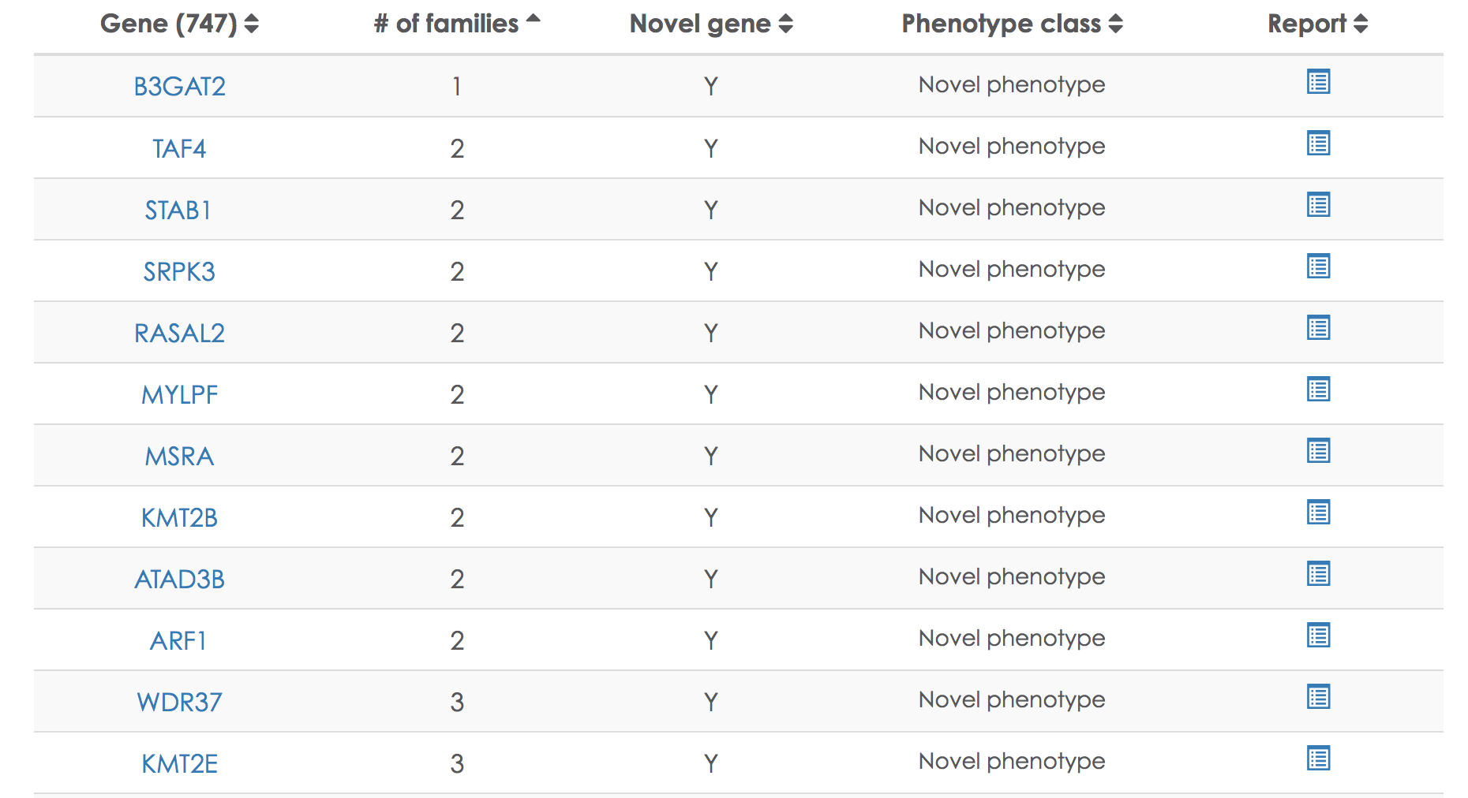
Automated reporting of gene discoveries
all matches in MyGene2 made public in real-time
putative novel discoveries publicly highlighted
https://mygene2.org/MyGene2/genes

Slide 19
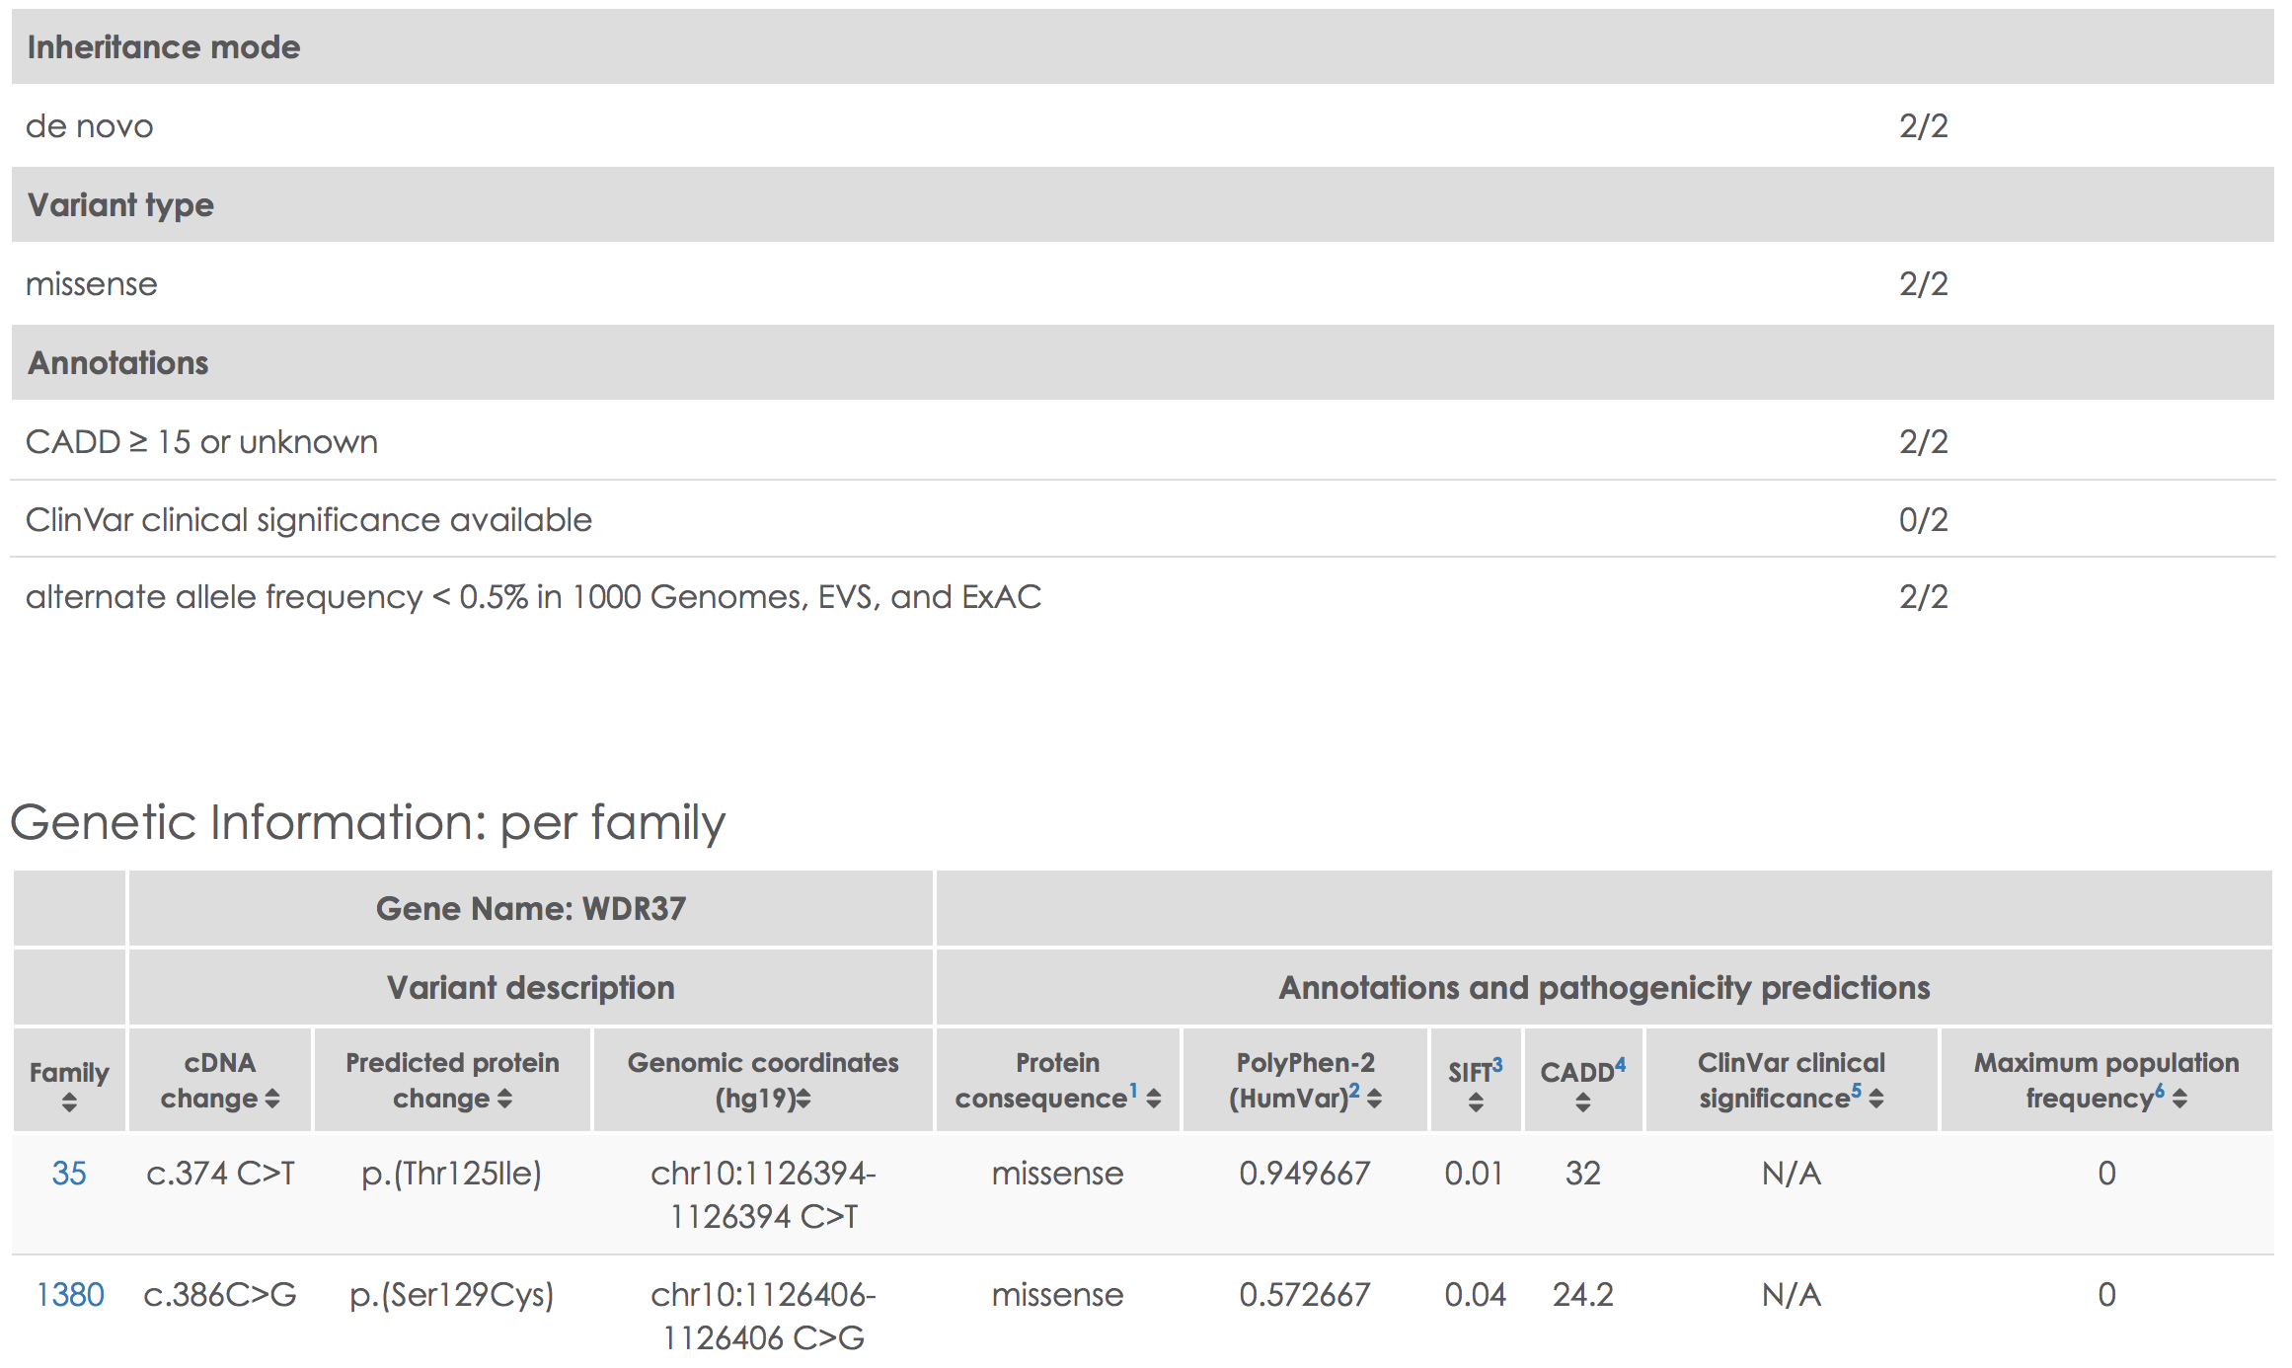
WDR37 Match Report: Novel gene discovery
Notes:
Match reports also contain a table with basic information on the types and annotations of candidate variants in that gene. This enables viewers to quickly evaluate the strength of genetic evidence for a given match.

Slide 20
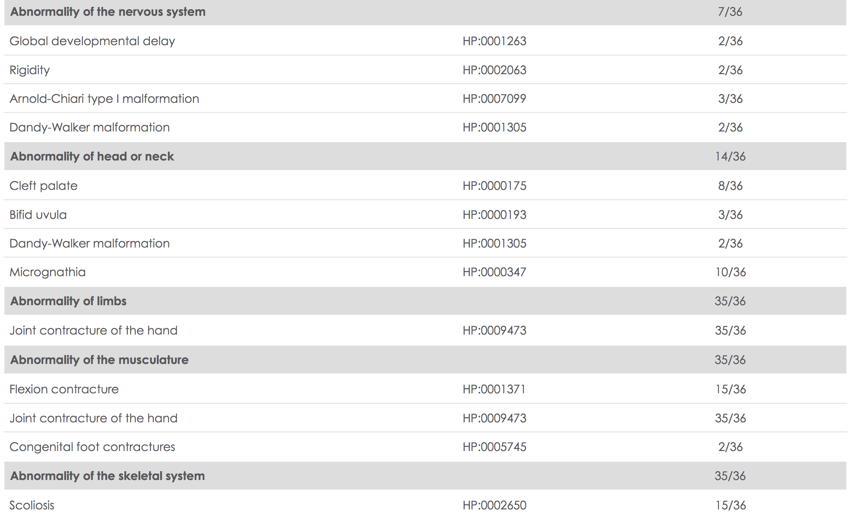
PIEZO2 Match Report: Genotype-phenotype relationships
Notes:
Match reports also contain a table with basic information on the types and annotations of candidate variants in that gene. This enables viewers to quickly evaluate the strength of genetic evidence for a given match.

Slide 21
Data sharing and matchmaking via MyGene2
141 automated match reports
20% (N=28) potential novel discoveries to date
3 matches - clinician/researcher + family
2 manuscripts in progress
novel candidate genes not yet matched:
14+ novel genes shared by a MyGene2 family
hundreds posted by investigators
outlet for known variants/VUS in known genes
facilitates genotype-phenotype studies
makes information available to families
Novel, unpublished candidate genes shared by families:
ARF1
ATAD3B
ATG4D
B3GAT2
COPB2
H3F3B
KMT2E
KMT2C
MSRA
NUP188
SPRK3
WDR37
ZMYND8
ZNF292
Posted by family to MyGene2 before publication:
KMT2B
QRICH1
SLC12A2
ZNF462
Notes:
To date, there have been 141 internal MyGene2 matches, 20% of which may be novel gene discoveries based on our manual review.
We are aware of 2 matches between investigators and a family and we know at least one manuscript is in progress.

Slide 22
Summary: Benefits of MyGene2
families
obtain candidate genes via re-analysis, research sequencing
easier to share and study genetic data in a more organized, efficient, and scientifically-fruitful manner
clinicians and researchers
identify additional cases to confirm a discovery or conduct genotype-phenotype studies
provide options for families that were “mutation negative” after sequencing
provide families in clinic immediate access to detailed data about their condition
real-time, public reporting of gene discoveries and genotype-phenotype relationships
Notes:
In conclusion, MyGene2 makes it easier for families to obtain, share and study their own genetic data in a more organized and efficient manner.
It gives researchers the opportunity to identify additional families in order to confirm a gene discovery or to recruit families for further studies. Clinicians can use match reports to provide families in clinic immediate information about their condition and specific variant. By providing free re-analysis as well as the ability to share VCFs, MyGene2 provides a followup option for families who were “mutation negative” after diagnostic testing.
Our goal is to make family engagement a frequent part of the future of matchmaking and we hope that all researchers, clinicians, and diagnostic laboratories will join us in radically open data sharing to transform how, and how quickly, these critical discoveries are shared with the world.

Slide 23
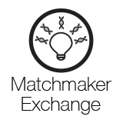
Acknowledgements
MyGene2 community – families, clinicians, researchers
MyGene2 team
Project team leaders
Mike Bamshad
Jessica Chong
Collaborators
Tudor Groza (KCCG Phenomics team)
Family Advisory Committee
Peter Lorentzen
Cristina Might
Matthew Might
Karen Park
Gina Szajnuk
Scientific and Bioethics Advisory Committee
Kyle Brothers
Karin Dent
Pilar Magoulas
Joon-Ho Yu
Data collection, processing, and analysis
Rodolfo Cornejo
Jennifer Chin
Colby Marvin
Daniel McGoldrick
Karynne Patterson
Funding:
University of Washington Center for Mendelian Genomics - NHGRI and NHLBI - HG006493-05
Open Science Prize - Wellcome Trust, U.S. National Institutes of Health, Howard Hughes Medical Institute
University of Washington Center for Mendelian Genomics
Debbie Nickerson, Mike Bamshad, Suzanne Leal
MyGene2 Partners
Josh Smith
Alice Tattersall
Marsha Wheeler
Qian Yi
MyGene2 Memberships

Slide 24
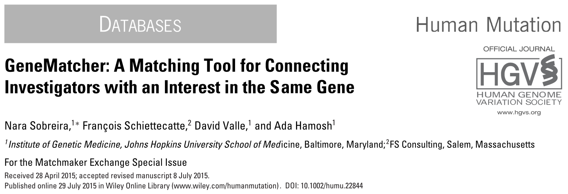
http://genematcher.org
At least 84 citations, including >65 new disease genes.

Slide 25
GeneMatcher overview
Intended to find other patients/animal models for a novel candidate disease gene
Only deidentified data and genes
Automated matching
Submitters choose to follow up at their discretion
Also matches on phenotypic features, OMIM phenotype number and genomic location

Slide 26
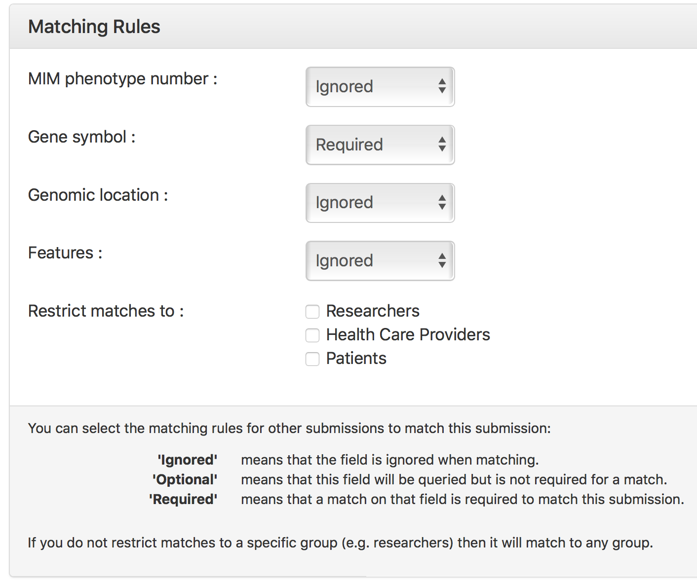
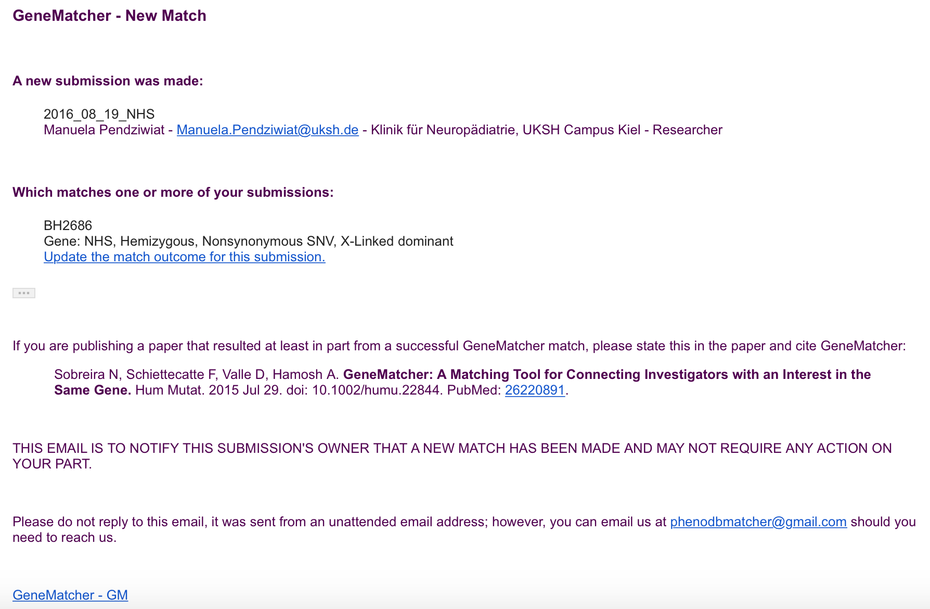
GeneMatcher
matching options
email notification

Slide 27
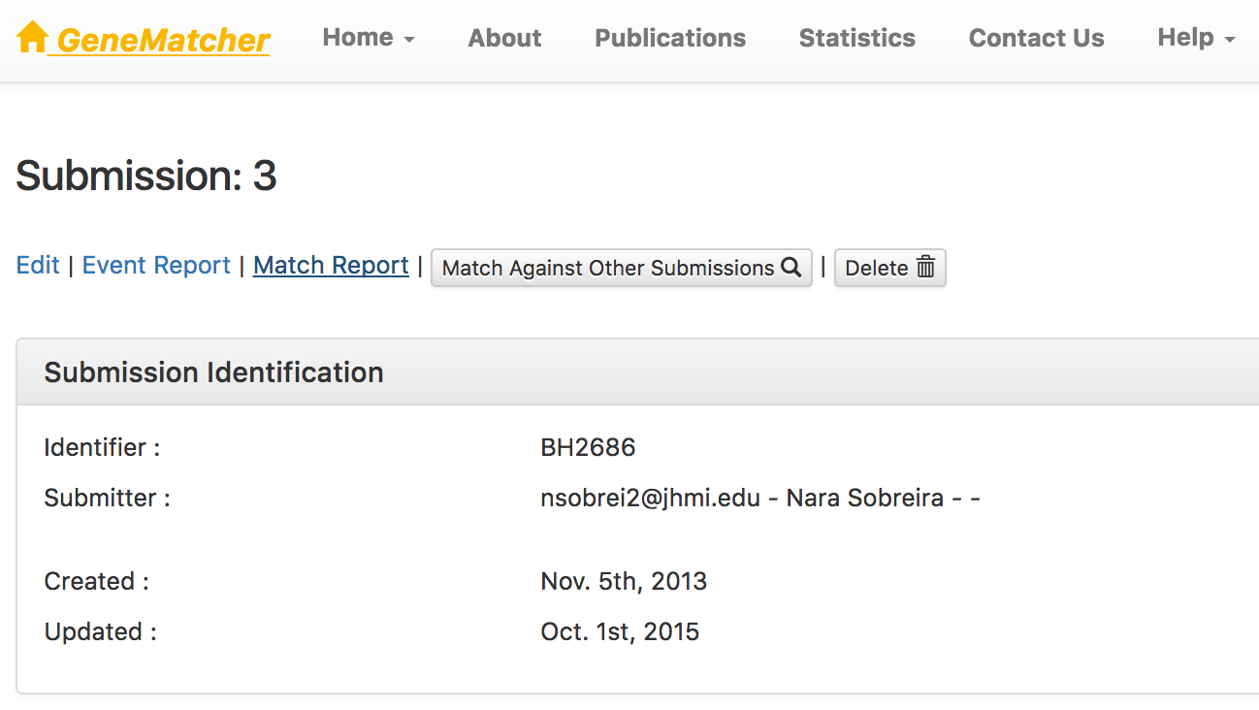
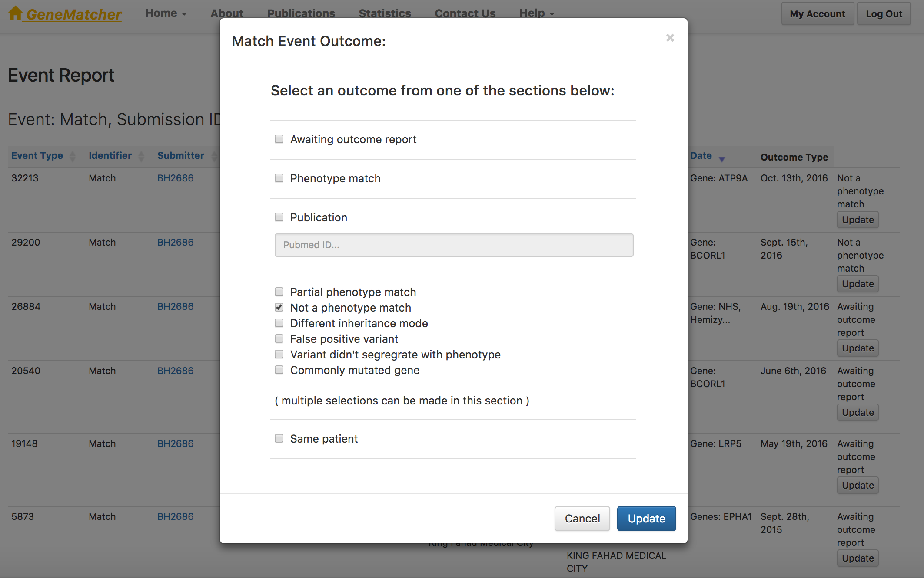
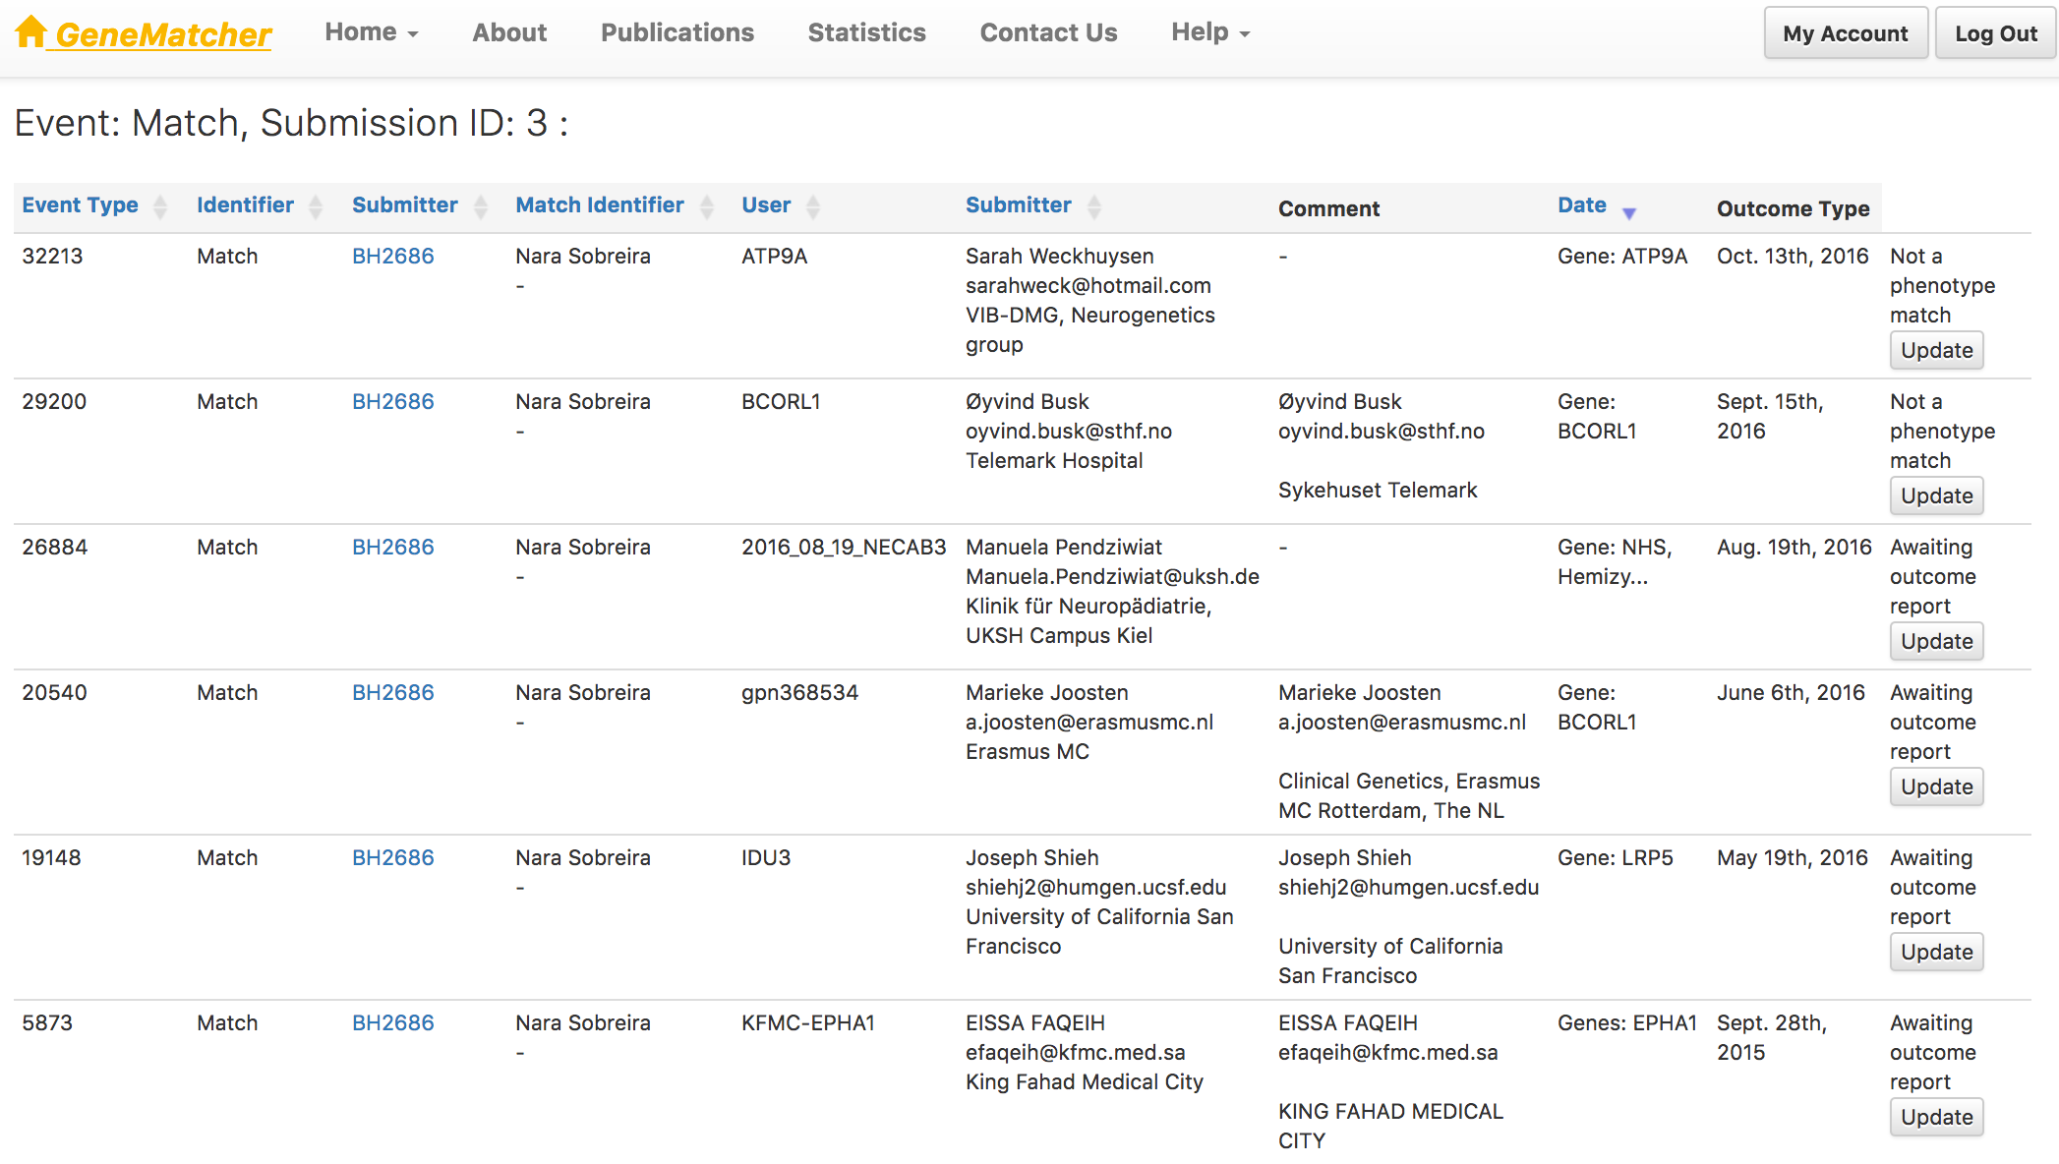
Match outcome tracking system

Slide 28
GeneMatcher Publications - 85
62 describing novel disease genes

Slide 29
GeneMatcher genes and matches over time
As of 1 November 2017
7,907 genes in 16,963 submissions from 4,177 submitters
36,347 matches
3,435 (43%) matched genes
Number
Date

Slide 30
GeneMatcher Investigators in 69 Countries

Slide 31
Matches per Gene November 1, 2017
Number of Genes | Number of Submission Matches | Number of Genes | Number of Submission Matches
4,097 | 0 | 16 | 12
1,703 | 1 | 14 | 13
765 | 2 | 9 | 14
421 | 3 | 10 | 15
221 | 4 | 11 | 16
162 | 5 | 12 | 17
113 | 6 | 9 | 18
66 | 7 | 5 | 19
44 | 8 | 9 | 20
44 | 9 | 3 | 25, 29*
32 | 10 | 2 | 24, 32, 53**
29 | 11 | 1 | 23, 26, 30, 35, 36, 38, 39***
* There are three genes each with 25 & 29 matches; **There are two genes each with 24, 32 and 53 matches;
***There is one gene each with 23, 26, 30, 35, 36, 38 & 39 matches

Slide 32
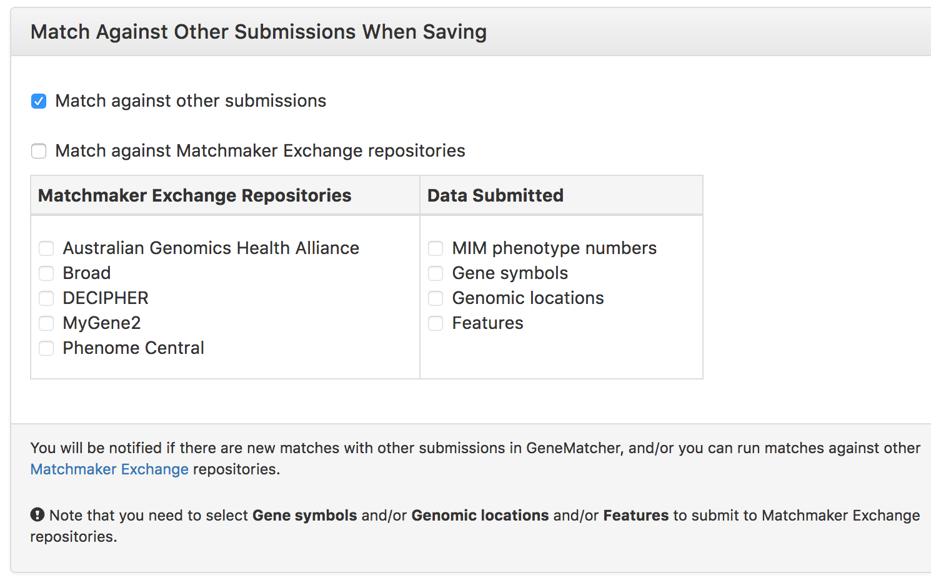
GeneMatcher options for MME

Slide 33
GeneMatcher Activity on the Matchmaker Exchange over time
Outbound: number of requests sent out by GeneMatcher = 22,448
Inbound: number of requests received by GeneMatcher = 4,768

Slide 34
GeneMatcher on the Matchmaker Exchange
As of November 1, 2017
 | Outbound | Inbound
Requests | 22,448 | 4,786
Submissions | 2,403 | 1,832
Submission Matches | 10,046 | 4,109
Unique Genes | 3,133 | 1,557
Unique Gene Matches | 1,096 | 601
Outbound: number sent out by GeneMatcher
Inbound: number received by GeneMatcher

Slide 35
Acknowledgements
Nara Sobreira, François Schiettecatte, Corinne Boehm, David Valle at JHU
V. Reid Sutton, Jennifer Posey, James Lupski, and other colleagues at BCM
Heidi Rehm, Kym Boycott, Danielle Azzariti, Orion Buske, Michael Brudno, Ben Hutton, Matt Hurles, Harindra Arachchi, Tudor Groza, and others in the MME
Patients, Families, Clinicians and Researchers who have submitted and shared their data!
Funders
NHGRI GSPCC
CMG projects
BHCMG
the Sutland-Pakula Family

