Slide 1
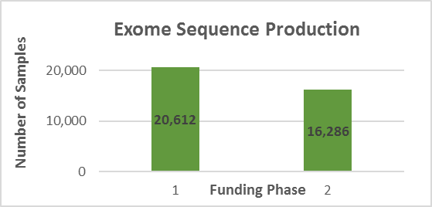
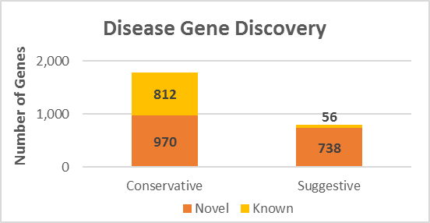
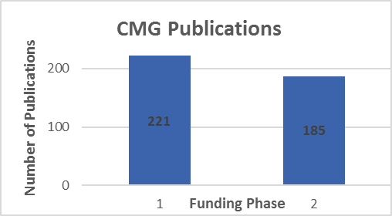
Genome Sequencing Program
      Centers for Mendelian Genomics
Document #
Notes:
The Centers for Mendelian Genomics program is halfway through its funding cycle. The program aims to use genome sequencing and analysis to discover the genomic basis underlying as many Mendelian diseases as possible. By doing so, they plan to accelerate gene discovery by disseminating methods and results.
The four CMGs have generated genome-sequence for over 35,000 individuals to date, mostly by whole-exome sequencing. About 42% of sequencing was done during this funding cycle.
* The CMGs have found about 1,800 disease genes by ‘conservative’ criteria. 970 of those represent novel gene/phenotype associations. Additionally, about 800 disease genes have been identified by ‘suggestive’ criteria. Most of those potentially represent novel associations.
* The CMGs have published over 370 papers.153 were published in the second funding cycle. These outline disease gene discoveries, method and tool development, collaborations with disease diagnosis groups, choices made by research participants, and future perspectives.
In addition to publications, the CMGs also publicly share appropriately consented genomic data. Matchmaker Exchange, or MME, is one of the data sharing venues that they use. It is a federated network of databases facilitating case matching based on phenotypic and/or genotypic profiles. The CMGs have been among the leaders to develop the network since its launch in late 2013, and currently contribute to three nodes.

