Slide 1
CCDG autism genome sequencing at NYGC
No family history, negative for large CNVs and no de novo likely gene disruptive (LGD) mutations (WES)
516 quad autism families
2,064 genomes at >30-fold sequence coverage
2 SNV and 5 CNV callers
89.4 SNV and ~4.8 indel DNMs per individual
1.5x10⁻⁸ SNVs per site per generation based on 1,964 Sanger validations
De novo mutation (DNM)

Slide 2
1. Increased sensitivity for severe de novo coding mutations
12 de novo loss of function SNV or indel mutations detected in probands that had been previously WES (2.5%-4% false negative)
de novo LGD
14228
14640
PHIP
ARID1B

Slide 3
2. Increased CNV sensitivity for exon-affecting events
de novo
deletion
14404
DDX43
167
validation
rate = 37%
53
validation
rate = 71%
30
validation
rate = 0%
DDX43
7.7 kbp de novo deletion
Genome
CNV size = 10 ± 24 kbp
Median = 2 kbp
Exome
CNV size = 38 ± 64 kbp
Median = 7 kbp
14151
LNPEP
Excess of de novo exon-intersecting deletions: 20 proband vs. 9 in siblings (p=0.03, OR=2.8)
LNPEP
5.1 kbp de novo deletion
Turner et al. AJHG 2016, Turner et al., Cell, 2017
Notes:
n=76 individuals for the Venn

Slide 4
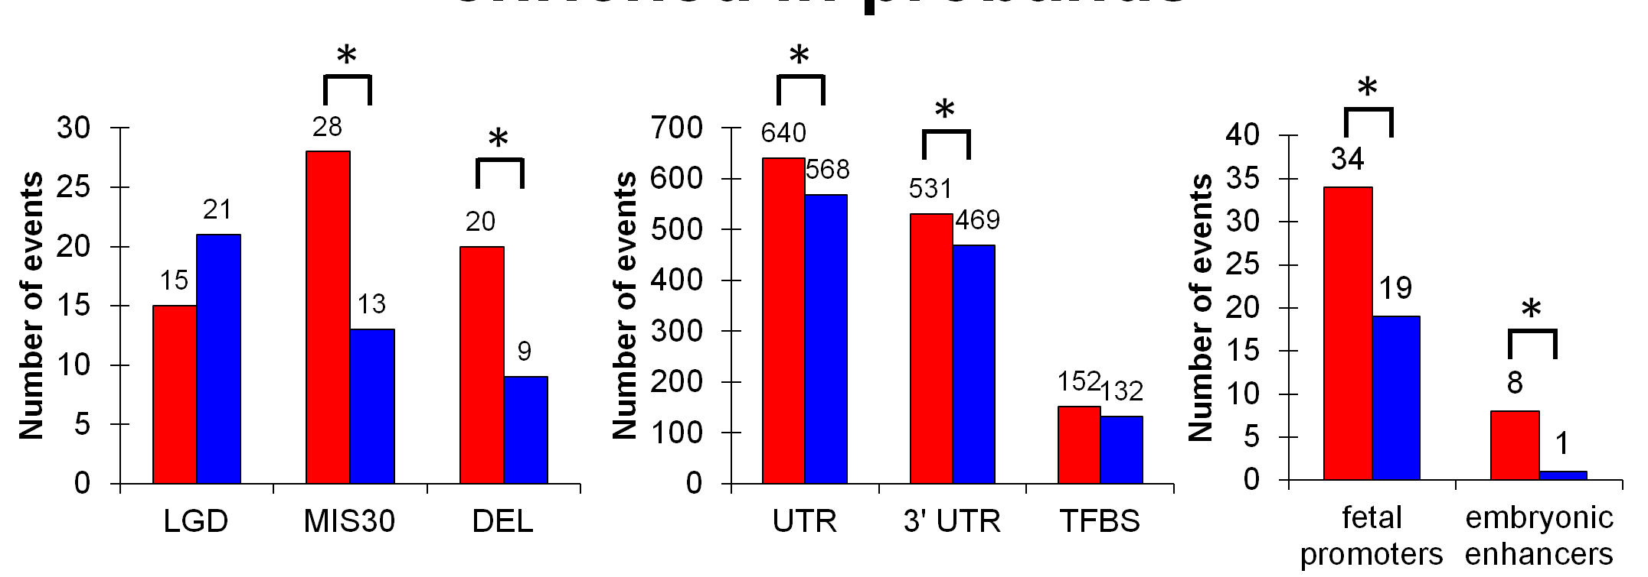
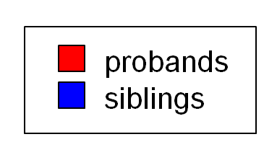
3. Trends of DNM in autism probands
coding | LGD = | likely gene-disrupting
 | MIS30 = | missense CADD > 30
 | DEL = | exonic deletion
noncoding | UTR = | untranslated region
 | TFBS = | transcription factor binding site
 | TSS = | transcription start site
 | hESC = | human embryonic stem cell enhancer
* indicates p < 0.05
Turner et al. , Cell, 2017

Slide 5
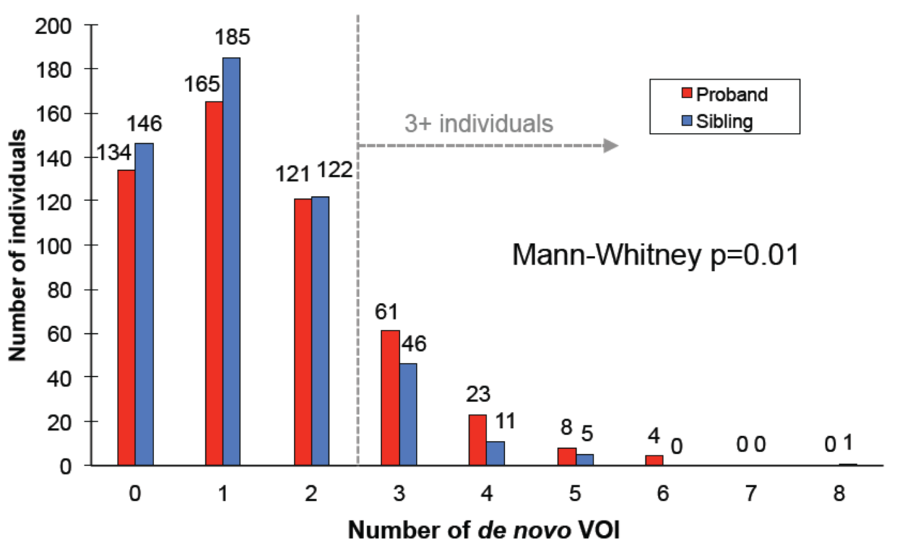
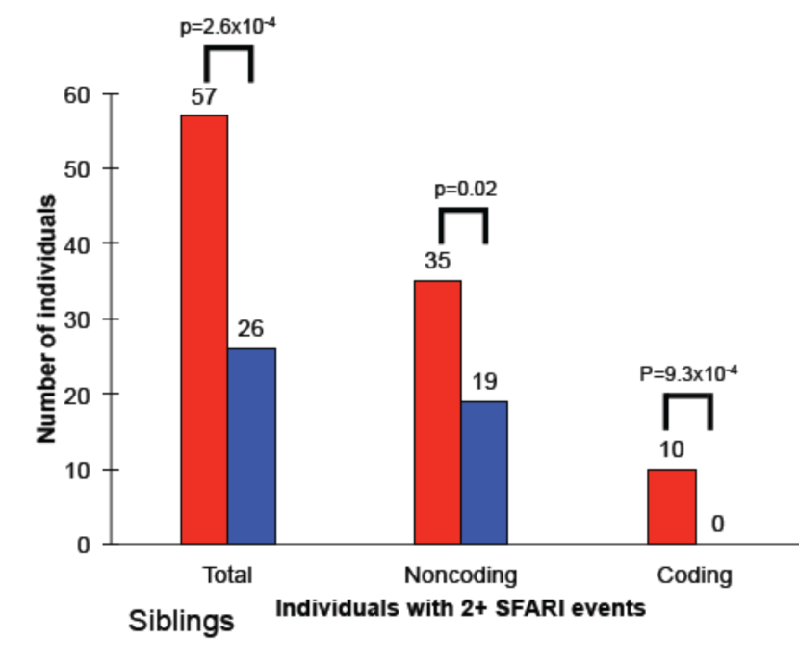
4. More multiple DNM in probands vs. siblings
Genome-wide
Autism-risk genes
Mann-Whitney p = 0.01
Mann-Whitney p = 0.01
≥ 3 estimated attributable fraction for simplex autism of 7.83%
Mann-Whitney p = 0.01
≥ 3 estimated attributable fraction for simplex autism of 7.83%
proband excess of 3+ DNM (96 prob vs. 63 sib, p=2.8 X 10⁻³, OR=1.6).
Excess becomes more significant if restrict to SFARI genes
Notes:
Score ≥ 3 with at least one pNCRTFBS and one 3’ UTR estimated attributable fraction for simplex autism of 7.83% [2.62%–12.77%]

Slide 6
5. Signals confirmed in larger autism genome cohort
Combined WGS DNM dataset (SNVs/indels)
  Additional 374 autism Quads and published de novo calls from MSSNG
  Excluded all families with known and/or LGD events
Total 2,303 proband and 890 sibling whole genomes
Category | SSC Phase 1 (Fisher’s exact, Turner et al, 2017) | SSC Phase 1+ 2 + MSSNG Fisher’s exact (unpub.)
Missense CADD > 30 | p=0.01, OR=2.1 | p=4.37x10⁻⁴, OR=2.0
UTR | p=0.03, OR=1.1 | p=0.02, OR=1.1
pNCR TFBS | p=0.15, OR=1.1 | p=7.42x10⁻³, OR=1.2
Synonymous | p=0.30, OR=1.1 | p=0.98, OR=0.9
Autism - Turner57 (All VOI) | p=1.8x10⁻³, OR=2.2 | p=8.7x10⁻⁴, OR=1.8
Autism - SFARI845 (All VOI) | p=1.4x10⁻³, OR=1.3 | p=6.6x10⁻⁸, OR=1.4
Autism - SFARI845 oligogenic (2+) | p=2.6x10⁻⁴, OR=2.3 | p=4.5x10⁻³, OR=1.5
Classes
of
DNM
Autism
Risk
Genes
Turner et al. , unpublished
Notes:
Link to MSSNG

Slide 7
de novo indels in the introns of targets
gene set | number of genes | events in affected | events in unaffected | delta | p-value
All genes | 23,953 | 1,006 | 945 | 61 | 0.51
LGD targets | 546 | 63 | 37 | 26 | 0.0012
Vulnerable LGD targets | 273 | 43 | 20 | 23 | <0.0001
Non-vulnerable LGD targets | 273 | 20 | 17 | 3 | 0.34
NOTES and EXTRAPOLATIONS:
Results are from WGS from 510 of the SSC quads.
p-values are by simulation.
Vulnerability is based on Iossifov et al PNAS 2015,
and we call vulnerable genes with DN LGDs ‘confident’ targets.
De novo intronic indels in confident target class contribute to 5 % of autism in SSC.
It’s likely confident class is ~ 1/2 total target class,
predicting an additional ~5 % DNM indels in target introns.
Double that for other types of DNM in introns, we reach 20% for intronic,
add an additional ~10 % in flanking regulatory regions,
so we guesstimate ~30 % DNM contribution are regulatory mutations .

Slide 8
Contributory regulatory variation?
Circulatory or lineage-induced cells
Biallelic RNA analysis
Case-control
Recurrent gene target discovery
WGS
Trios and Quads
Identifying de novo causal variants
Molecular
biology

Slide 9
de novo indels in the introns of targets
FURTHER EXTRAPOLATIONS and EXPECTATIONS:
~ 2 de novo intronic indels (dnii) per person
~ 5% of dnii are harmful
For a target gene with 2 mb of intron,
(and ~ 1000 mb of intronic space per genome, and 1,000 persons)
we expect (2/1,000)*2*1,000 or a total of 4 dnii in that target.
As most all would be neutral, expect equal incidence in affected and unaffected...
Unless there is ascertainment bias…
AND WE OBSERVE…

Slide 10
Excess of de novo intronic indels in MACROD2
gene | intron length (MB) | coding length (KB) | events in affected | events in unaffected | binomial p-value
CNTNAP2 | 2.3 | 4.0 | 4 | 7 | 0.5
DMD | 2.2 | 11.3 | 1 | 3 | 0.6
LOC100288142 | 2.2 | 14.9 | 1 | 3 | 0.6
DLG2 | 2.1 | 3.4 | 5 | 3 | 0.7
MACROD2 | 2.0 | 1.3 | 13 | 0 | 0.0002
CSMD1 | 2.0 | 10.7 | 6 | 4 | 0.8
LRP1B | 1.9 | 13.8 | 6 | 7 | 1
EYS | 1.8 | 9.5 | 2 | 5 | 0.5
CTNNA3* | 1.7 | 2.7 | 3 | 3 | 1
AGBL4 | 1.5 | 1.5 | 3 | 3 | 1
GPC5 | 1.5 | 1.7 | 5 | 2 | 0.5
GRID2 | 1.5 | 3.0 | 4 | 5 | 1
MAGI2 | 1.4 | 4.4 | 3 | 5 | 0.7
DPP10 | 1.4 | 2.5 | 2 | 4 | 0.7
PARK2 | 1.4 | 1.4 | 0 | 2 | 0.5
PRKG1 | 1.3 | 2.3 | 2 | 1 | 1
CCSER1* | 1.3 | 2.7 | 8 | 3 | 0.2
NOTES:
Results are from WGS from 1,098 of the SSC quads.
2 large (>100 kb) de novo deletions in affecteds reported entirely within introns of MACROD2.
MACROD2 associated with Kabuki Syndrome

Slide 11
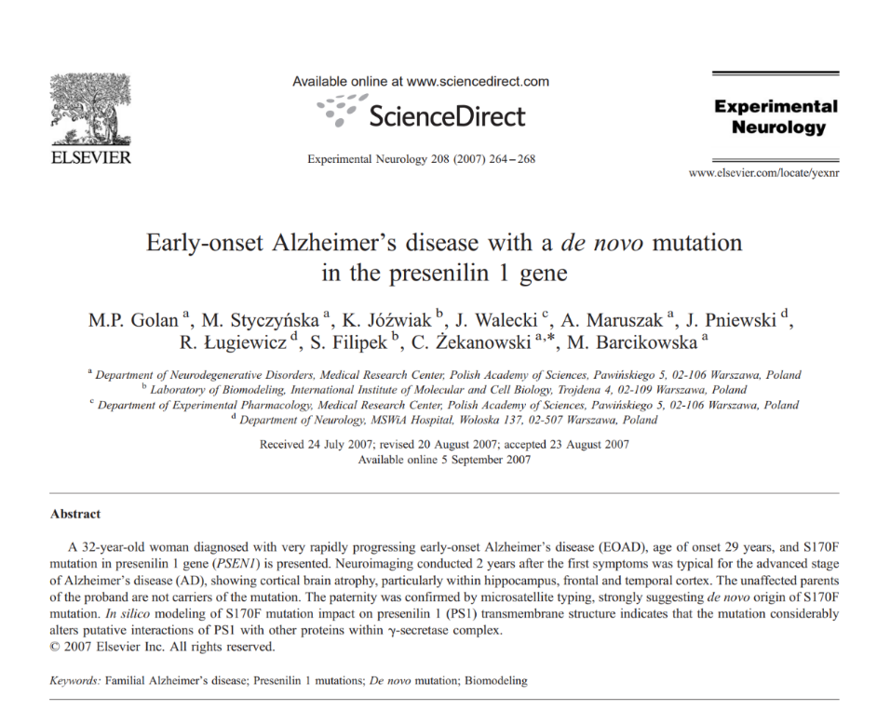
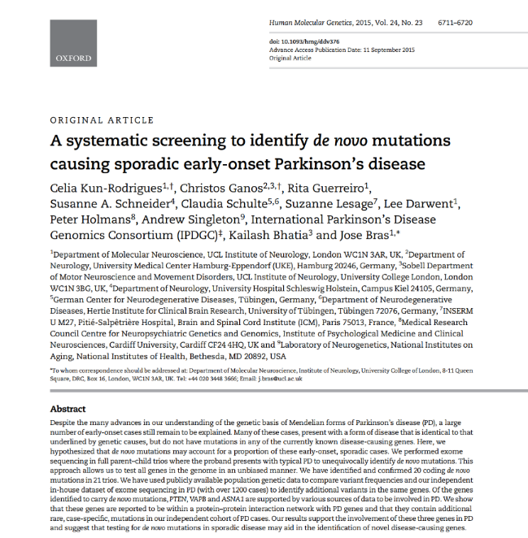
n

Slide 12
N _ 25000 #total number of genes
tar _ 200 #vulnerable target genes for X
R1 _ 1 #rate of background denovo in a gene
R2 _ 0.1 #proportion denovo in a gene that is damaging/killer
popXdn _ R1*R2*(tar/N) # proportion of population with de novo LGD in target
probXESHcLGD_0.3 #proportion of people with dn in target that have X with ESH
ans2_probXESHcLGD*popXdn #proportion people in pop with X and ESH due to dn in target
#ESH means early onset, severe, no family history
proX _ 0.1 #proportion of people in the population with X
ESHthresh _ 0.05 #proportion of people with X selected for having the most ESHness
ans1 _ ans2/(proX*ESHthresh)
#probility that given X.ESH there is a denovo in target
K_3000
pop _ K #number of X.ESH samples
ddc _ pop*R1*R2 # killer denovos due to chance
dda.hyp _ pop*ans1 # killer denovos due to ascertainment (all in target) given hypothesis
dda.null _ 1 #assuming no de novo play a role
tot.hyp _ ddc + dda.hyp #total de novos with hypothesis
tot.null _ ddc + dda.null #total de novos with null hypothesis
iter _ 100
recurrences.hyp _ rep(0, iter)
recurrences.null _ rep(0, iter)
for(i in 1:iter)
{
## sampling from the hypothesis
random.draws _ sample(1:N, ddc, replace=T)
ascertain.draws _ sample(1:tar, dda.hyp, replace=T)
recurrences.hyp[i] _ sum(table(c(random.draws, ascertain.draws)) > 1)
## sampling from the null
random.draws _ sample(1:N, ddc, replace=T)
ascertain.draws _ sample(1:tar, dda.null, replace=T)
recurrences.null[i] _ sum(table(c(random.draws, ascertain.draws)) > 1)
}
recurrences _ matrix(c(recurrences.hyp,recurrences.null), nrow=2, byrow=T)
apply(recurrences, 1, mean)
apply(recurrences, 1, stdev)
ddc
dda.hyp
Back of the envelope R-script
for computing recurrent DNM target signal for adult onset that is Early, Severe, with little family History (ESH)
> apply(recurrences, 1, mean)
[1] 34.42 1.70
> apply(recurrences, 1, stdev)
[1] 2.916965 1.417780
> ddc
[1] 300
> dda.hyp
[1] 144
→
Signal to noise 34 to 2.

