Slide 1
Genome Sequencing Technical Issues
Genome Sequencing Program Steering Committee Teleconference
11/17/17

Slide 2
Sequencing Technology Working Group
Created to share information on development activities
Originally formed between BCM, WU-MGI, and The Garvan Institute
Development of the HiSeq X Platform – Focus now shifted to NovaSeq and some 10X Genomics
Expanded to all CCDG sites Early 2016
Goals
Provide a mechanism to share ideas/issues to shorten development cycle of new technologies
Enable rapid identification of potential reagent/platform issues independent of vendors
Provide interface with industry partners to shape development priorities and standards
Engaged with Illumina
Had face to face at ASHG 2017
Planning quarterly phone calls with Illumina
Planning face to face technical summit
Illumina has expressed interest in engaging our group in general as we’re key to their development

Slide 3
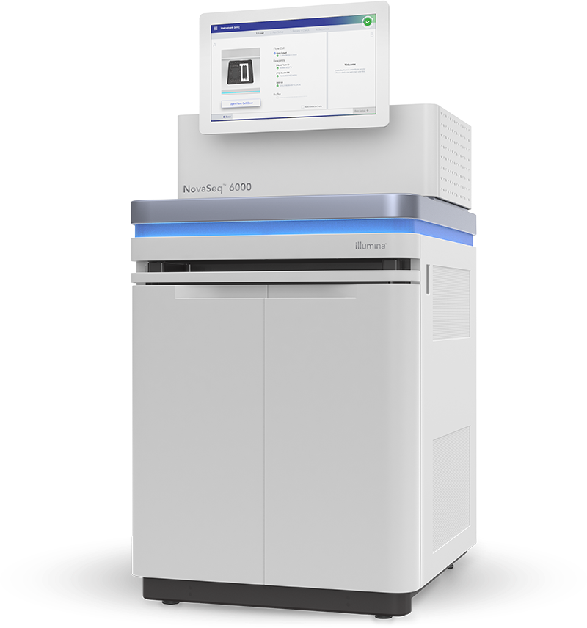
NovaSeq Development
NovaSeq 6000
2 X 150 bp in ~40 hours for S2 flow cell - >1Tb/FC
S4 FC recently released (10/17) with >3Tb/FC in ~40 hrs
Advantages of NovaSeq
Automated on board cluster gen, cassette loading for ease of loading, loading pool to denaturation to load in 15 Min, two flowcells that are completely independent of each other, automatic post run wash
Open to WGS, WES, Targeted Sequencing, and RNAseq

Slide 4
NovaSeq Development
Active development at all CCDG sites
Platform challenges
Patterned flow cell issues
Duplication rates
ExAmp/Index switching contamination (alleviated by some dual indexing schemes)
Reduced quality index reads
Alleviated by alternative sequencing protocol
Huge flow cell capacity and reduction of granularity of flow cell
S4 flow cell = >3Tb = >33 - 30X WGS samples = 300-600 WES
S2 flow cell = >1Tb
Lane loader in development at Illumina to provide 2-4 independent lanes - $2K for device but $800-$1000 list price for disposable for each flow cell. Increased loading times and manual intervention

Slide 5
NovaSeq Development
Sample Indexing
Currently 24 dual unique Illumina supported indexes available with 96 by end of 2017/early 2018.
384 indexes for PCR only protocol available 2018.
Other indexing available or in development independent of Illumina
Sample Pooling
HiSeq X – Wash U – Pools of 24 WGS samples – Titration run (typically 4 lanes), Primary run (16 lanes) – Final top-up for pools of samples if necessary
NovaSeq
In development
Potentially involving different data types – WGS, WES, RNA seq
Indexing schemes critical
Similar Quality to HiSeq X
Comparisons are underway of quality and variant calling results
All indications thus far suggest similar quality

Slide 6
SNP Concordance: NIST Standard NA12878
NovaSeq NA12878 (36X) vs NIST
NovaSeq NA12878 (36X)
vs
HiSeq X NA12878 (37X)
0.41%
96.18%
3.41%
0.88%
98.11%
0.98%
HiSeq X NA12878 (37X) vs NIST
A direct comparison of SNP calls from the two platforms were found to be highly concordant (98.11%) and typical of technical replicates on the same platform. (Comparison limited to NIST high confidence calls)
0.37%
96.95%
2.67%
Both platforms have >96% overlap to the NIST NA12878 standard.
(Comparison data: BCM-HGSC)

Slide 7
OMIM Gene Coverage (100% at ≥20X) vs Mean Coverage
Number of Genes 100% at ≥ 20X
Similar performance shown between platforms when comparing coverage of clinically relevant genes
(Comparison data: BCM-HGSC)

Slide 8
10X Genomics Overview
(Church 10X Genomics)

Slide 9
10X Genomics Phasing – Important for Het vs. Repeat Copy Resolution
(Church 10X Genomics)

Slide 10
10X Genomics Development
Advantages
Can make a library with 1ng inputs
Provides long phasing information (Mbs)
Provides long linking information – enables enhanced read mapping in repetitive regions of the genome
Enhanced SV detection
Disadvantages
$$$ - ~5-10 times more expensive than standard short read library
~1.5X more expensive than standard short read sequencing
PCR based strategy so has more biases than PCR-free libraries
Requires high molecular weight DNA for optimal performance
Example Application
WU CCDG development project
Utilize 10X genomics to identify (& phase) variation in regions not interpretable from short reads alone
Develop methods to genotype and/or impute variants using other data types (standard WGS or genotype data)
Samples: diverse populations, GRU consents
Leverage high quality genome assemblies from other projects (i.e., Genome Reference, 1000 Genomes, Genome in a Bottle)

Slide 11
Other Sequencing Development
PacBio Sequel – Long read data production
Average read lengths >12-13kb with N50 read lengths >20kb
~20 times more expensive per base than short reads
Typically requires more coverage than short read data
High error rates (10-15%)
Requires micrograms of DNA for library construction
New reports indicate confirmation of 80% of known SVs with 10-15x coverage
Oxford Nanopore – Long read data production
Similar if not greater lengths than PacBio
Similar cost model
Similar error rate, although a bit more systematic
DNA input requirements are ~10x more than PacBio
Performance - greater run-to-run variability

Slide 12
Proposed CCDG Joint Technical Pilot
Current CCDG Tech Dev Proposals
Similar technology development cycles at each CCDG site.
Similar proposals to incorporate new long-range technologies to WGS to achieve comprehensive genomes.
Other groups already achieved technical demonstration: Chaisson, M., et al bioRxiv, 2017. https://www.biorxiv.org/content/biorxiv/early/2017/09/23/193144.full.pdf
Joint Technical Pilot
Aim to identify new disease associations with CNVs, SVs, and haplotype phasing methods not in play using standard WGS/WES.
Coordinate plans to generate long-read data across centers, cohorts, ethnic groups, target phenotype/disease.
Collaborate with Analysis Centers for new imputation methods.
Collaborate with Data Working Group to improve variant calling.
Develop a pilot plan for coordination to achieve above aims across centers.

