Slide 1
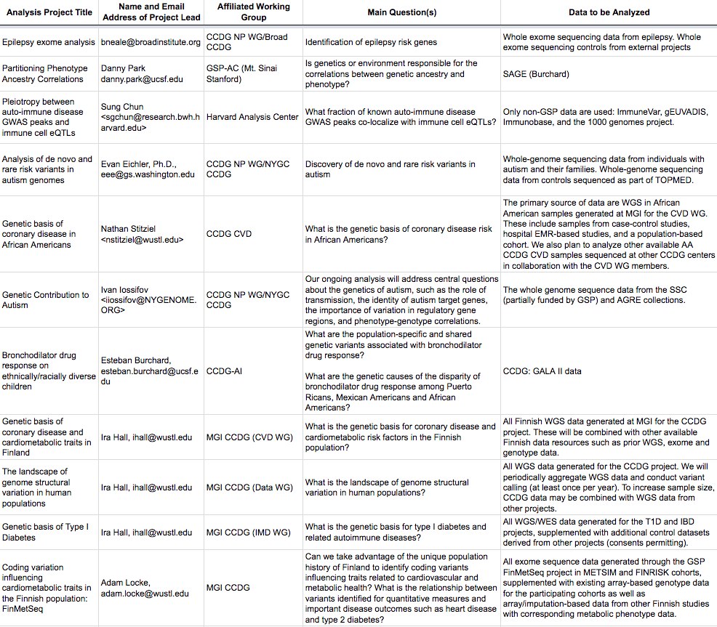
GSP Analysis Projects
http://tiny.cc/GSP_AnalysisProjects

Slide 2
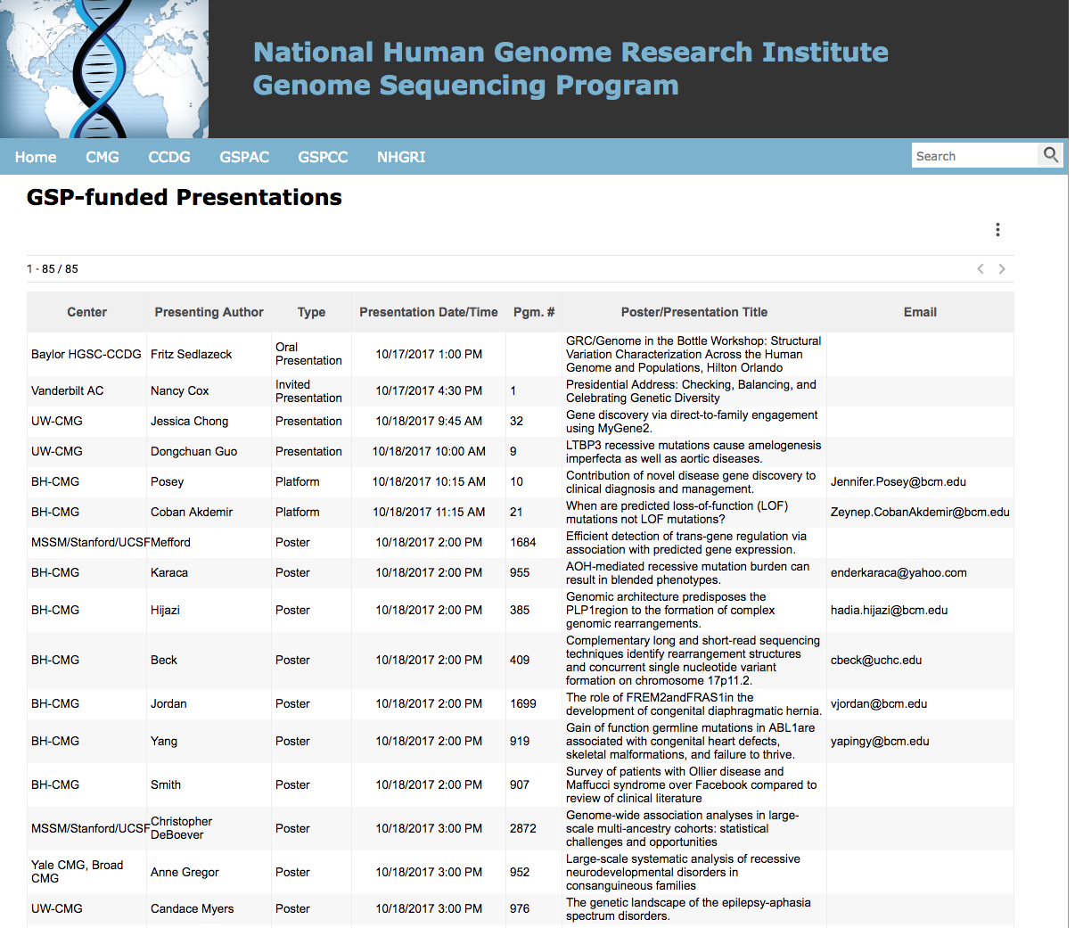
GSP-funded Presentations at ASHG 2017
http://gsp-hg.org/gsp-funded-presentations

Slide 3
Goals of NHGRI CCDG-NHLBI TOPMed Joint Calling
Currently, TOPMed has ~65k WGS samples sequenced, CCDG has ~22k (ultimately, ~120k and ~85k, respectively). Jointly calling all the samples together would improve the overall quality of the calls and provide a large dataset of “harmonized” genotypes for further analysis.
Forging mechanisms for such data sharing across NIH programs will help advance the best science, increased sample sizes and ethnic diversity.
This joint calling exercise will allow the identification of computational issues, refinement and enhancement of pipelines, and assessment of the relative merits of different calling algorithms to develop ”best practices” for different variant types.

Slide 4
Proposed Use-cases for the Jointly-called Data
Enhance the information in variant servers (e.g. Bravo, gnomAD)
Enhance information for cosmopolitan imputation reference panels
Facilitate functional annotation
Develop large samples to serve as common controls
Enable population genetic studies
Enable yet larger studies of genotype:phenotype association.
Red indicates initial use case; others will follow after detailed discussions related to consent and controlled access.

Slide 5
CCDG studies
…
…
TOPMed studies
TOPMed Seq Ctrs
CCDG Seq Ctrs
TOPMed IRC
Amazon
Google
5 Calling Groups
Variant Server
CCDG vcfs
CCDG CC
pVCFs
dbGaP
Imputation server
TOPMed vcfs
TOPMed Ex Area
Haplotype data

Slide 6
Ongoing efforts
1. Permission from studies for CCDG and TOPMed CRAMs to have variants jointly called.
2. Permission for distribution of variant summary data to Variant and Imputation Servers.
3. Distribution of gVCFs to TOPMed, CCDG and dbGaP (for public release) can be handled in the same way as currently done for program-specific data distribution; no new permissions are needed.
4. Permissions for other downstream use-cases (common controls, population genetics, genotype-phenotype association studies) may be via the usual DAC mechanism or a new mechanism TBD.

