Slide 1
CCDG CVD Working Group
Following a multi-pronged diverse approach and
a unified approach combining resources to
promote CVD gene discovery.
Sek Kathiresan: People at high risk are a mixture of monogenic and polygenic risk.
Nate Stitziel: Leveraging population history for discovery: African-Americans and Finns.
Eric Boerwinkle: Analyses of intermediate traits as a path to disease gene discovery.

Slide 2
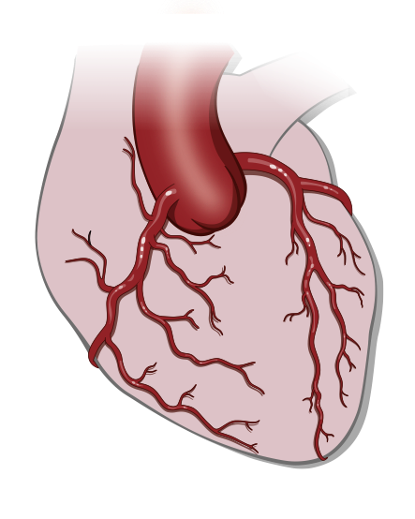


Whole genome sequencing study
2,369 early-onset MI cases and 4,218 controls
Myocardial infarction cases
Patients hospitalized with
first MI at age ≤ 55 years
N = 2,369
Population controls
Multiethnic population
free of coronary disease
N = 4,218

Slide 3
Burden of rare, coding mutations in genes associated with early MI
Gene | Lipid/Non-lipid | Sample size WGS (cases) | Sample size WES (cases) | Odds ratio | P value
Risk
LDLR (Low-density lipoprotein receptor) | Lipid (LDL-C) | 2369 | ~20,000 | 3.8 | 9.5 x 10⁻²³
PTGIR (Prostacyclin receptor) | Non-lipid (prostacyclin) | 2369 | ~20,000 | 1.4 | 7.4 x 10⁻⁴
Protection
F7 (Factor 7) | Non-lipid (Factor VII) | 2369 | ~20,000 | 0.4 | 1.4 x 10⁻⁶
HBB (Hemoglobin subunit beta) | Lipid (LDL-C) | 2369 | ~20,000 | 0.7 | 2.2 x 10⁻⁴

Slide 4


Hypothesis: genome-wide polygenic score can identify individuals with risk equivalent to a monogenic mutation
Step 1
6.6 million variants
from Genome-wide association study
Step 2
Derive scores using computational algorithms
Step 3
Choose best score in testing dataset
4 strategies
Cases
N = 60K
Controls
N = 120K
Nikpay; Nat Gen; 2015
Cases
N = 4K
Controls
N = 120K

Slide 5
Polygenic score:
1:20 individuals, odds ratio 3.6
Polygenic score of
6.6 million common variants
High polygenic score definition | Odds ratio
Top 20% | 2.6
Top 10% | 3.0
Top 5% | 3.6
Top 2% | 4.3
Remainder of distribution
Top 5%

Slide 6
Heritable risk for MI: rare mutation of large-effect AND
many common variants of small-effect
Monogenic
1:200 with familial hypercholesterolemia
~4-FOLD higher risk
Diagnosed based on high LDL
Lifestyle, medications ↓ risk
Polygenic
1:20 with extreme polygenic score
~4-FOLD higher risk
UNDIAGNOSED
Healthy lifestyle: 48% ↓ risk ; Statin therapy: 44% ↓ risk

Slide 7
MGI CVD: sequencing update
African American CVD study
Finnish European CVD study
Study | Cases | Controls
BioMe | 297 | 301
BioImage | 4 | 773
BioVU | 216 | 242
Cleveland Clinic | 167 | 154
Duke | 581 | 402
Emory U | 221 | 179
NW | 101 | 149
U Penn | 591 | 646
Wash U | 150 | 10
Total | 2,328 | 2,856
Total planned | 6,250 | 6,750
Study | Cases | Controls
Corogene | 189 | 0
EUFAM | 408 | 21
Eastern Finland CHD | 155 | 0
FINRISK | 177 | 172
METSIM | 564 | 2040
Total | 1,493 | 2,233
Total planned | 2,500 | 5,000

Slide 8
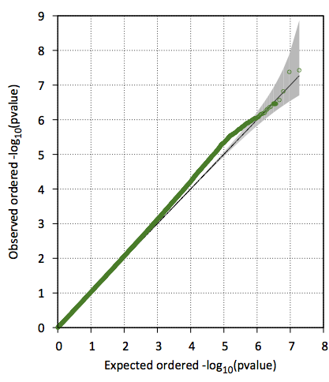
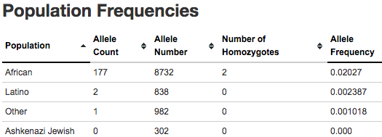
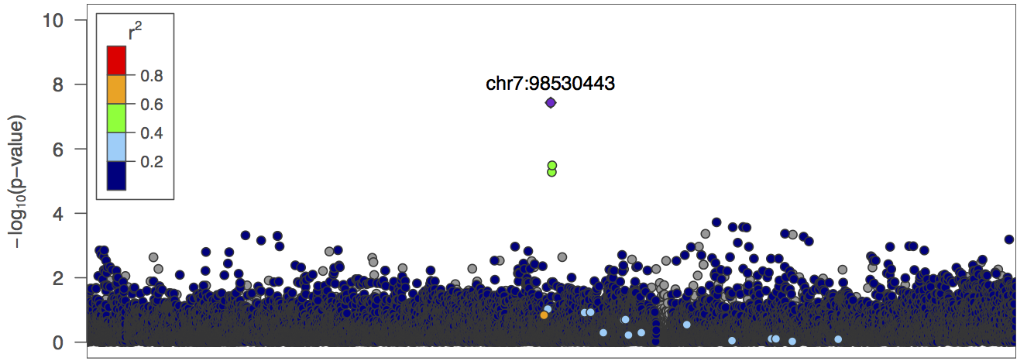
MGI CVD study: AA EOCAD analysis
African-specific allele in known loci: LDLR
Single variant analysis: 2,328 Cases and 2,856 controls (MAF ≥ 0.5%)
Variant | MAF | OR | P-value
rs17242787 | 1.9% | 0.41 | 6.3x10⁻⁷
Novel African-specific locus with genome-wide significance, pending replication
African-specific alleles with suggestive association, pending replication
Variant | MAF | OR | P-value
rs113471477 | 0.8% | 3.6 | 3.7X10⁻⁸
10 African-enriched SNVs with P ≤ 9x10⁻⁷
    MAF range = 0.5 – 5%
    NFE MAF range = 0 – 0.08%
    3 represented well in HRC (AC>100)
    7 with HRC AC range = 0 – 34

Slide 9
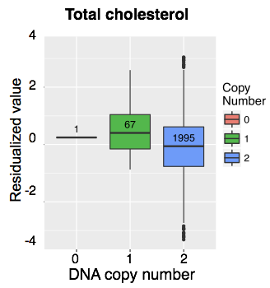
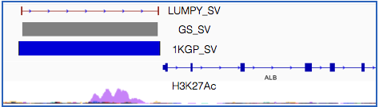
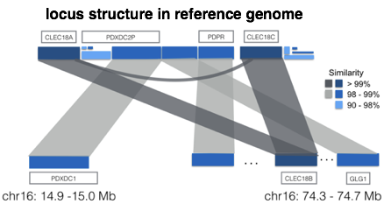
MGI CVD study: Finnish WGS analysis
Polygenic risk score for known CAD loci
Finnish-specific SVs: 4.3kb deletion in the ALB promoter
 | OR per SD | P-value
African Americans (2,328 cases) | 1.15 | 1x10⁻⁶
Finnish Europeans (1,493 cases) | 1.44 | 2x10⁻¹⁶
MAF = 1.7% in Finns; 0.1% in 1000G EUR
P-value (TC) = 6.7x10⁻⁶; P-value (ALB) = 1.6x10⁻¹¹
Finnish SVs: 2,063 WGS (discovery) with ~18,000 WES (replication)
Finnish-specific SVs not tagged by local SNVs
Trait | GW sig | Replicated in exomes | Finnish- enriched | Not Tagged | Obvious gene
VLDL | X | X |  | X | X
HDL | X | NA (intronic)
GP | X | X |  | X | X
TC | X | NA (promoter) | X |  | X
AA | X | X | X | X | X

Slide 10
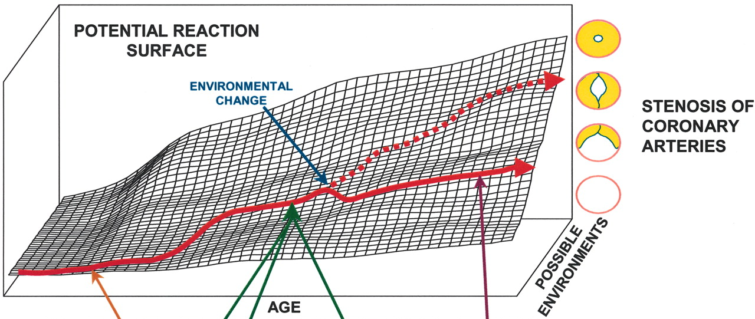
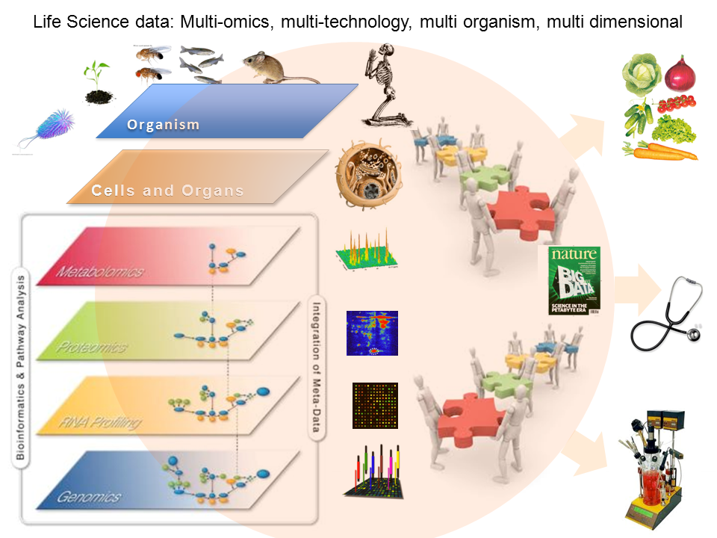
Quality, Deep and Longitudinal Phentyping

Slide 11
Genomic Discovery Samples
Discovery samples
Study | WGS (CCDG+TOPMed) | WGS + Metabolome
ARIC | 4,921+3,983 | 4000
SOL | 4,000+3,978 | 4000
Total | 8,921+7,961 | 8000
Replication samples with metabolomics measurements
Study | Whites | Blacks | Hispanics | Others | Total
ARIC | 1500 | 2500 | 0 | 0 | 4000
Asthma | 1200 | 150 | 530 | 0 | 1880
FHS | 2000 | 0 | 0 | 0 | 2000
JHS | 0 | 3400 | 0 | 0 | 3400
MESA | 418 | 189 | 310 | 80 | 997
SOL | 0 | 0 | 4000 | 0 | 4000
Total | 5118 | 6239 | 4840 | 80 | 16277

Slide 12
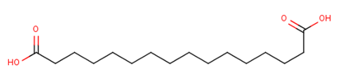
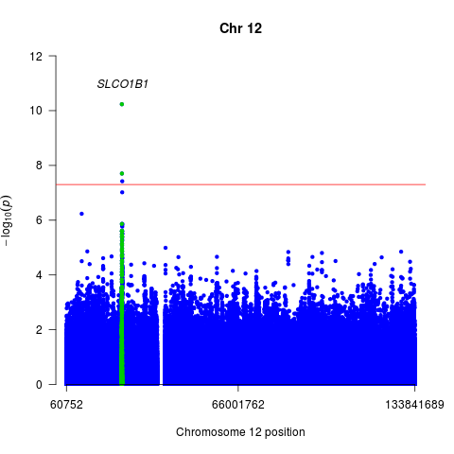
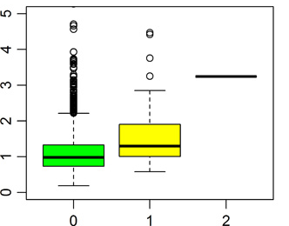
SLCO1B1 -- Hexadecanedioate
SLCO1B1 T5, p=4.81 x 10⁻¹³
SLCO1B1 (691 amino acids)
liver-specific member of the organic anion transporter
LoF variants in SLCO1B1 profound effect on hexadecanedioate levels (P = 5.8 × 10⁻11 in AA)
MAF=0.02 in AA and <0.001 in EA
LOF: c.481+1G>T
1
2
3
4
5
6
7
8
9
10
11
12
13
14
15
Notes:
P-value of 5.8E-11 is from Elena’s WGS results in AA.
P=2.9E-09 in Bing’s LoF paper

Slide 13
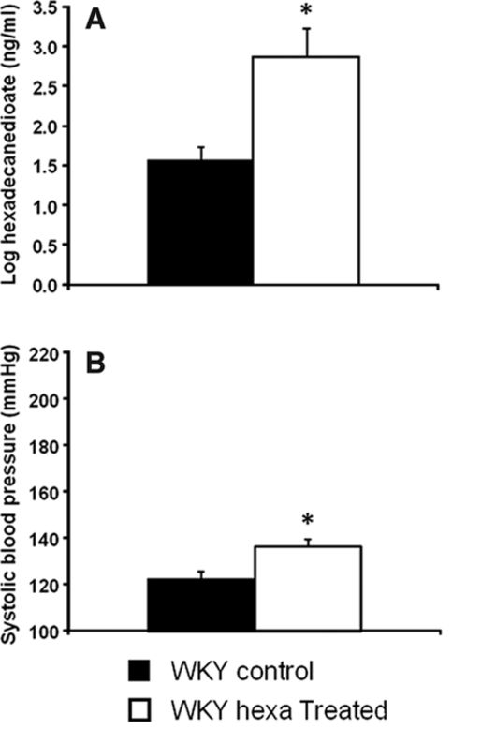
Hexadecadioate & Disease in Afr-Am
High hexadecanedioate levels
Blood Pressure / Hypertension:
OR = 1.22, p = 2.46 x 10⁻⁵
Heart Failure :
HR = 1.12, p = 0.03 among hypertensive patients
All-cause Mortality:
HR = 1.18, p = 3.28 x 10⁻⁶ among hypertensive;
HR = 1.13, p = 4.20 x 10⁻⁵
Rat Feeding
Menni C, et al. Hypertension. 2015
Notes:
High hexadecanedioate levels associated with increased
Risk of developing incident heart failure, beyond the effect of traditional risk factors, i.e. BMI, heart rate, SBP, CHD history, smoking status etc.
Risk of death from any cause
1 sd of hexadecanedioate level is associated with 12% increased risk of developing heart failure (HR=1.12, p=0.03 in hypertensive patients)
1 sd of hexadecanedioate level is associated with 18% increased risk of death (HR=1.18, p=3.28E-06) among hypertensive AAs, HR=1.13, p=4.20E-05 in all AAs.
(follow up till 2014)

