Slide 1
PsychEncode CrossDisorder Capstone #1
Primary Analysis
Adult Disease Case/Control Datasets
  SCZ, BD: BrainGVEX, CMC, BipSeq, LIBD
  ASD: UCLA, Yale
Restricted to:
  Frontal and temporal cortex
  Adult samples only (Yale)
Run Separately for:
  Differential gene expression
  Differential transcript expression
  Differential splicing (PSI)
  Gene co-expression networks
  Isoform co-expression networks
Secondary Analysis
  Explore Significant results (genes, networks) for:
    Developmental Trajectory (BrainSpan, Yale)
    GABA vs Glu Specificity (EpiGABA)
    Presence in disease model (iPSC)
Dataset | Group | Files | Tissue | Library | Stranded | Protocol | Sequencer | Freeze
BrainGVEX | SCZ, BD, CTL | 429 | DLPFC | rRNA-dep | Stranded (reverse) | 100 bp PE | HiSeq 2000 / 2500/ 4000 | 1
Common Mind | SCZ, BD, CTL | 613 | BA9/46 (DLPFC) | rRNA-dep | Un-stranded | 100 bp PE | HiSeq 2000 | 1
UCLA-ASD | ASD, CTL | 253 | BA9/46, BA41, CBL | rRNA-dep | Un-stranded | 50bp Paired End | HiSeq 2000 | 1
Yale-ASD | ASD, CTL | 45 | DLPFC, TC, V1, CBL | rRNA-dep | stranded (reverse) | 100 bp PE | HiSeq 2500 | 1
BipSeq | BD | 69 | BA9/46 (DLPFC) | polyA | Un-stranded | 100 bp PE | HiSeq 2000 | 2
CMC_HBCC | SCZ, BD, CTL | 387 | DLPFC | rRNA-dep | Stranded (reverse) | 100 bp PE | HiSeq 2500 | 2
LIBD | SCZ, CTL | 495 | BA9/46 (DLPFC) | polyA | Un-stranded | 100 bp PE | HiSeq 2000 | 2
BrainSpan | CTL | 606 | many | polyA | Un-stranded | 76bp Single end | GAIIx | 1
EpiGABA | CTL | 4 | OFC (BA11) | rRNA-dep | stranded (reverse) | 50-100bp SE/PE | HiSeq 2000 | 1
iPSC | CTL | 51 | iPSC | ?? | stranded (reverse) | paired end | ?? | 1
TOTAL

Slide 2
Analysis Pipeline
RNA-Seq
Genotype
Read Alignment
(STAR; hg19 with ENSGv75 gene models)
QC and Filtering
(PLINK)
Chicago
Dominic, Tonya
White, Liu
QC and Filtering
(PicardTools)
1kG Imputation
(Beagle)
Read Quantification
(RSEM)
Quantification of Splicing (PSI)
(Spladder, Leafcutter)
Ancestry Calls
Isoform-Level
Analysis
Gene Normalization & Filtering
(>1 TPM in 10+% samples)
QTL Analysis?
(FastQTL)
Intregrate with Other Capstones?
Polygenic Risk Score
(PRSice, PGC Summary Statistics)
Differential Splicing
(Linear mixed-effects model)
Differential Isoform Usage Analysis
Outlier Removal & Covariate Correction
Isoform Co-Expression
Networks
Mt Sinai Hoffman
Yale: Liu, Pochareddy
Mt Sinai Pinto
Gene Co-Expression Network Analysis
(WGCNA)
Differential Gene Expression
(Linear mixed-effects model)
UCSD
Iakoucheva
UCLA
Geschwind
https://github.com/mgandal/PsychEncodeCrossDisorderCapstone
Notes:
Capstone will extend these results by adding:
RNAseq → higher dynamic range, especially for low expressed genes
Isoform level / splicing analyses
Integration with eQTL

Slide 3
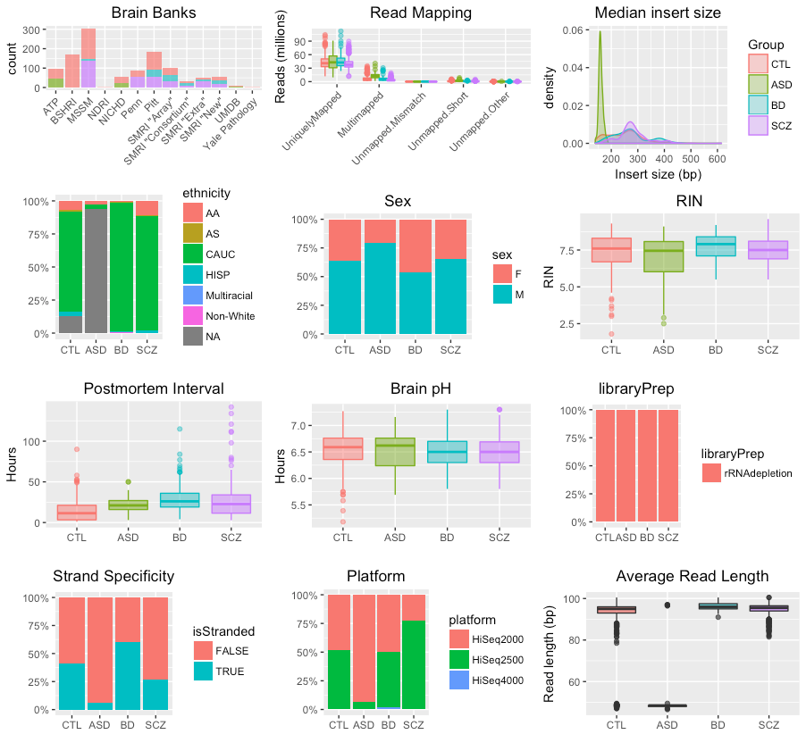
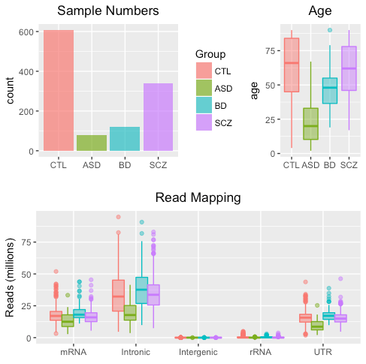
Freeze 1

Slide 4
Covariate Correction

Slide 5
rho
Covariate Correction

Slide 6
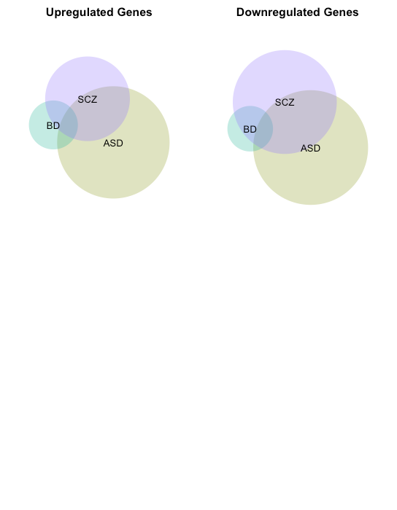
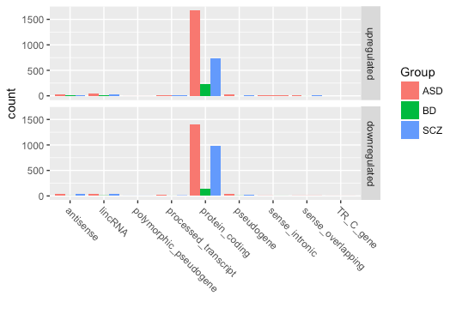
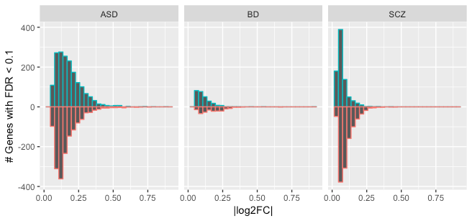
FINAL MODEL
~ Group + age + age.squared +
study + sex + PMI + RIN + RIN.squared + BrainBank + tissue + seqPC1 + … + seqPC16 + seqPC2.squared +
seqPC3.squared +
SV1 + … + SV7

Slide 8
Gene Co-Expression Modules
-> Enriched for Cell-type markers
-> Enriched for Disease GWAS signal
Cell-type Enrichment
GWAS Enrichment

Slide 10
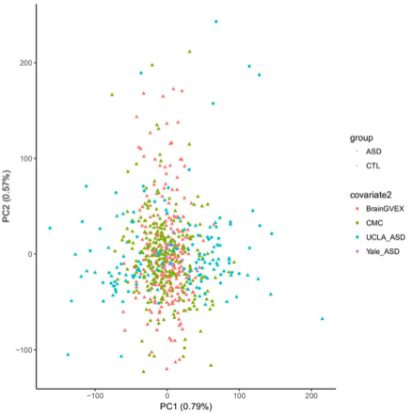
Splicing

