Slide 1
Information theory based measures for quantification of private information leakage and privacy-preserving file formats for functional genomic experiments
Figure pack
GG

Slide 2
Figure 1:

Slide 3
Figure 2

Slide 4
Figure 3: Linking

Slide 5
Figure 4

Slide 6
Figure 5

Slide 7
Figure 6

Slide 8
Figure 7

Slide 9
SI Figure 1

Slide 10
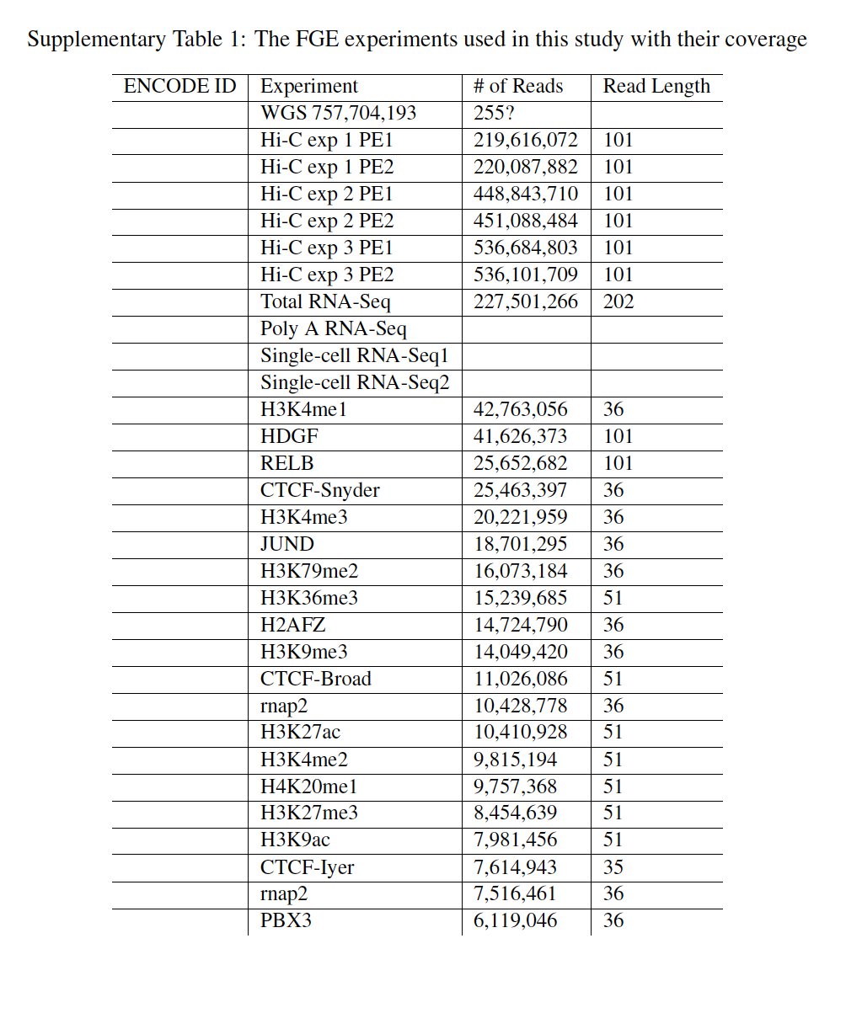
SI Table 1

