Slide 1
Does adding parents to the population affect the linking accuracy?
SNV=[chrom loc alt ref gt]
SNV1=[1 12897 A T 0/1]
x1
x2
P(NA12878 and NA12891) = P(x1)P(x2)
= 0.5P(x1)

Slide 2
How do we know the information we calculate is true information?
Two problems:
SNVs are not independent (due to LD) but adversary may not have the ancestral information of the sample
Real sample size is infinite (# of people in the universe) but we only have a panel of 2504 individuals in 1k genome project

Slide 3
(1) SNVs are not independent (due to LD)
We have shown that LD correlation affects SNVs that are not as informative, hence the difference between the information when we consider dependence vs independence is small

Slide 4
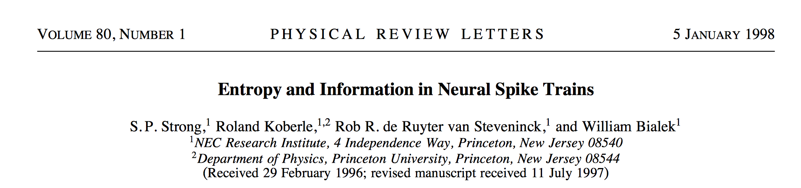
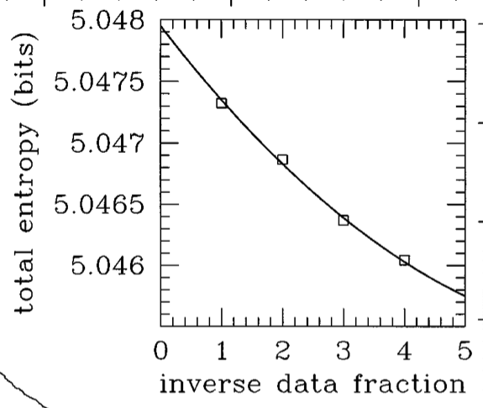
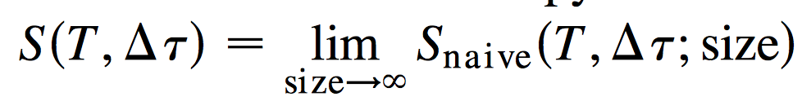
(2) Real sample size is infinite
extrapolation
Sample data in the fraction of 20% → 100%
Find the fit that explains the relationship between data fraction vs information
y-intercept is the information when infinite amount of data
Bootstrapping for more statistically sound calculation
n → ∞

Slide 5
f(x) = a*x^b+c
R-square: 0.9999
Adjusted R-square: 0.9999
a = -6.693e+05
b = 0.5898
c = 6.911e+06

Slide 6
What happens when we start from 1 individual and add an individual one at a time?

Slide 7
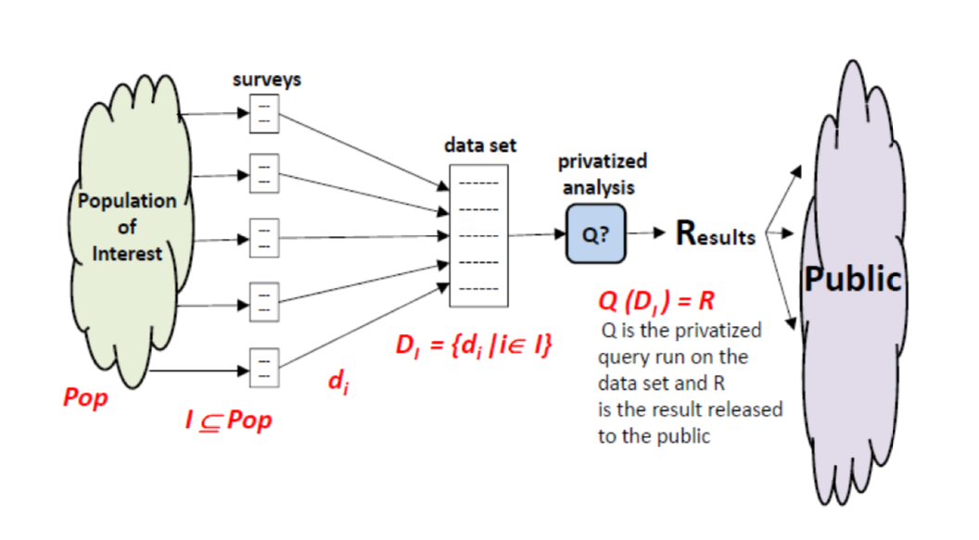
Differential Privacy
Imagine you have two otherwise identical databases, one with your information in it, and one without it. Differential Privacy ensures that the probability that a statistical query will produce a given result is (nearly) the same whether it’s conducted on the first or second database.

Slide 8
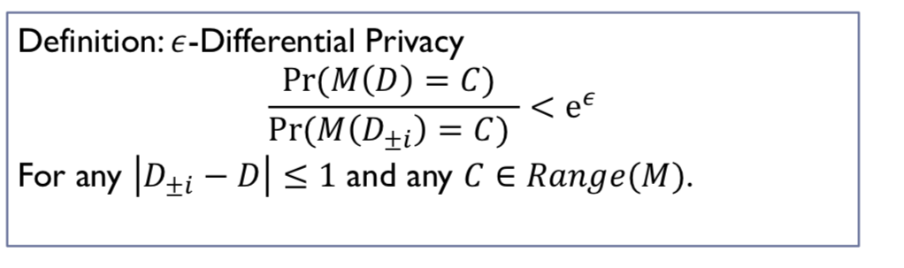
Differential Privacy
The probability that the distorted/noisy result C is nearly the same, whether or not you submit your info
Proposed by Cynthia Dwork in 2006

Slide 9
Differential Privacy
The harm to you is the same regardless of your participation
Automatically immune to linkage attacks
  Netflix data
    Was anonymized but wasn’t differentially private
    Not two records are similar more than 50%
(1) In our case, the only way to make functional genomics data immune to linkage attacks is
not to share “any” variants in the sequences at all!
WHY?

Slide 10
Conclusion: Information does not only depend on the rare SNVs (SNV frequency) but also the unique combination of frequent SNVs. That’s why removing high self-information SNVs does not change the linking accuracy as much!

Slide 11
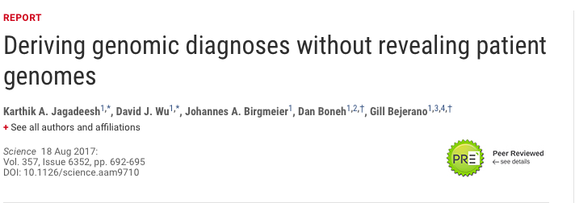
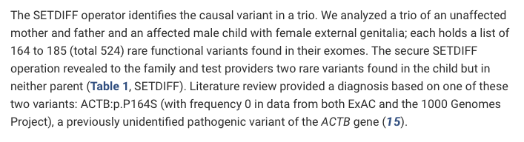
Another discussion point…
It’s clear that we need a few rare SNVs or a larger group of common SNVs to successfully be able to linking attacks
Many of the privacy-preserving computation or encryption methods (such as beacons) focus on releasing only a few variants while keeping the rest private.
Fore example:
However, releasing even a single de-novo variant with 0 frequency in the population make the individual vulnerable to linking attacks

