Slide 1
Paper Lof Update
11/1/17

Slide 2
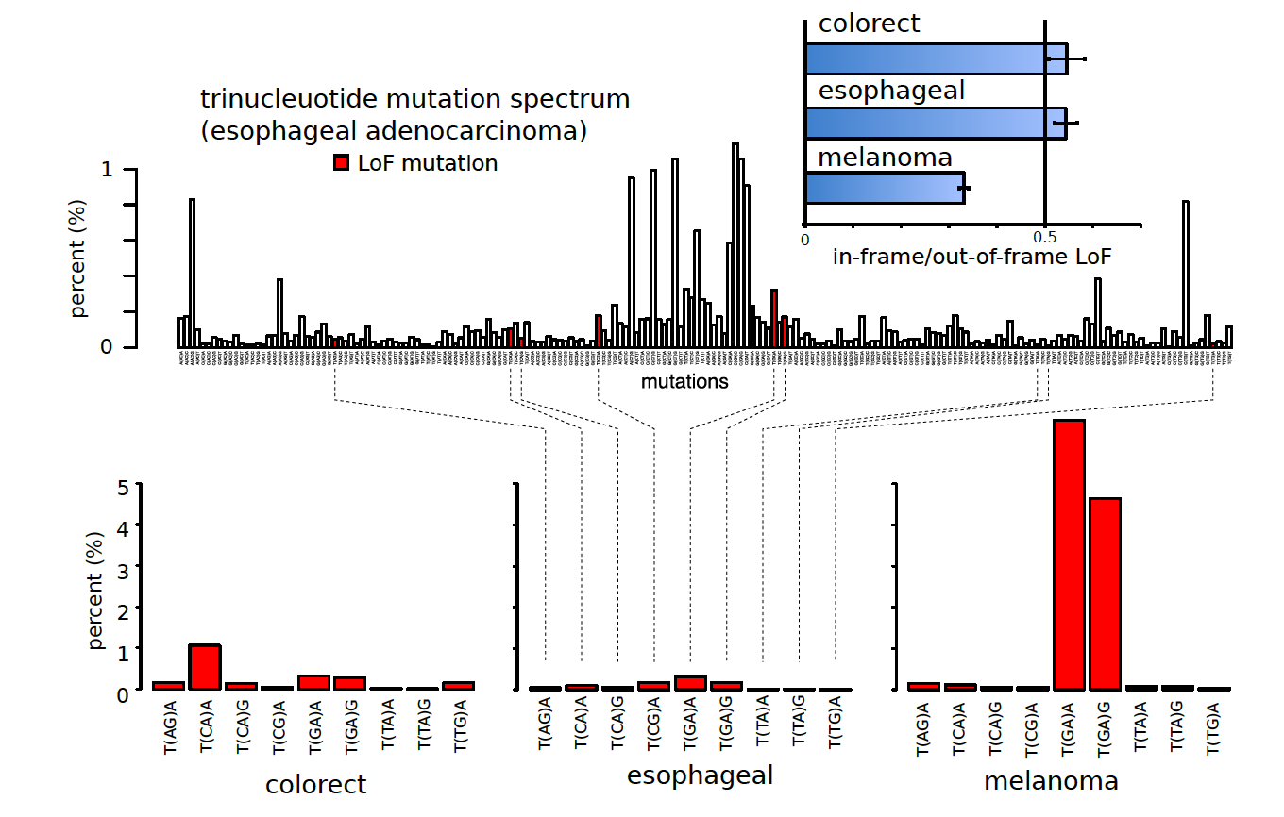

Slide 3
Whole Spectrum middle position

Slide 4
Pendaplets InFrame vs OutFrame

Slide 5
