Slide 1
Passenger mutations in >2500 cancer genomes: Overall molecular functional impact
Mark Gerstein, Yale
Slides freely downloadable
from Lectures.GersteinLab.org
& “tweetable” (via @markgerstein)
See last slide for more info.
No Conflicts for this Talk

Slide 2
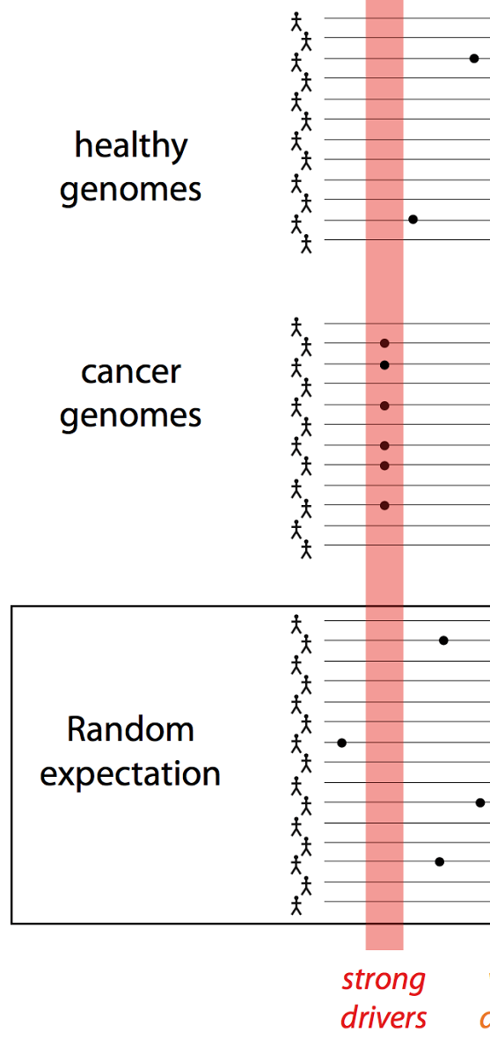
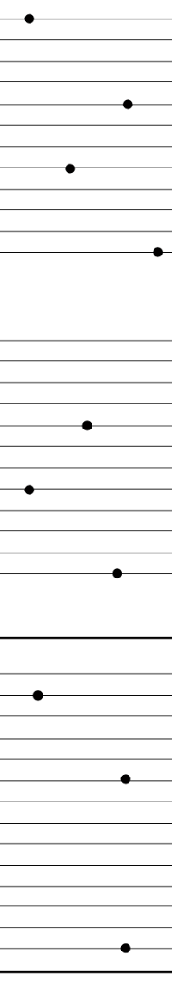
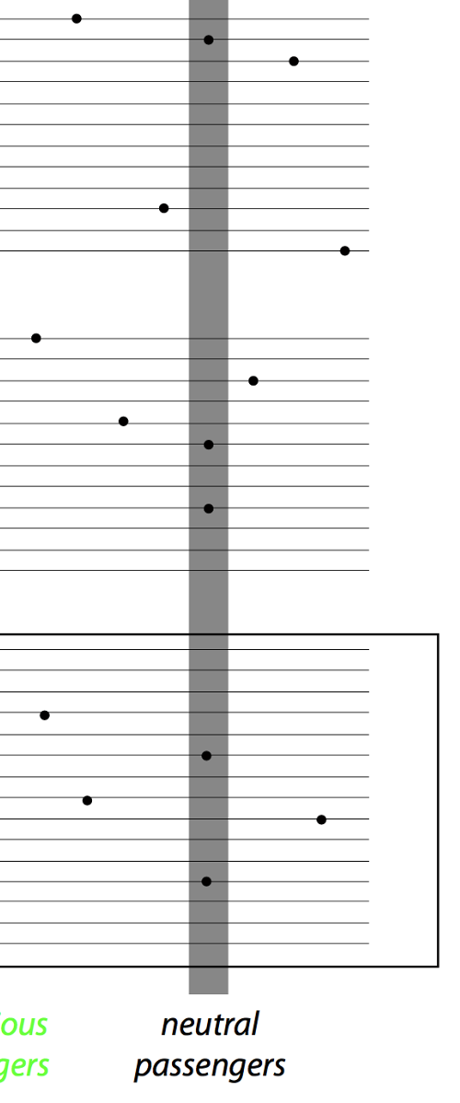
Canonical model of drivers & passengers in cancer
Drivers
  directly confer a selective growth advantage to the tumor cell.
  A typical tumor contains 2-8 drivers.
  identified through signals of positive selection.
  Existing cohorts of ~100s give enough power to identify
Passengers
  Conceptually, a passenger mutation has no direct or indirect effect on tumor progression.
  There are 1000s of passengers in a typical cancer genome.
[Vogelstein Science 2013. 339:1546]

Slide 3
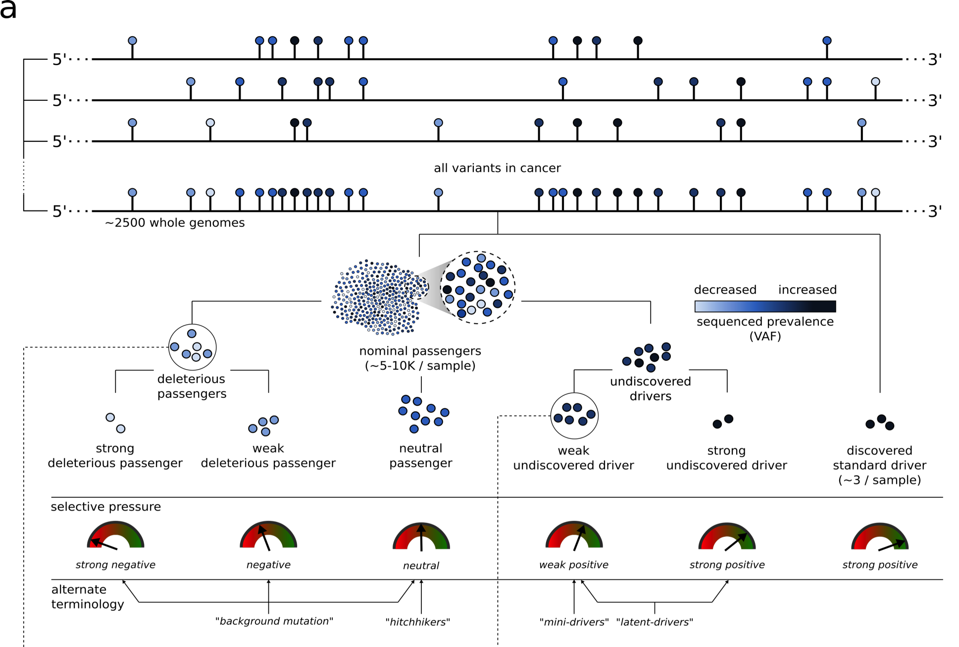
Conceptual extension
of the canonical model of drivers & passengers

Slide 4
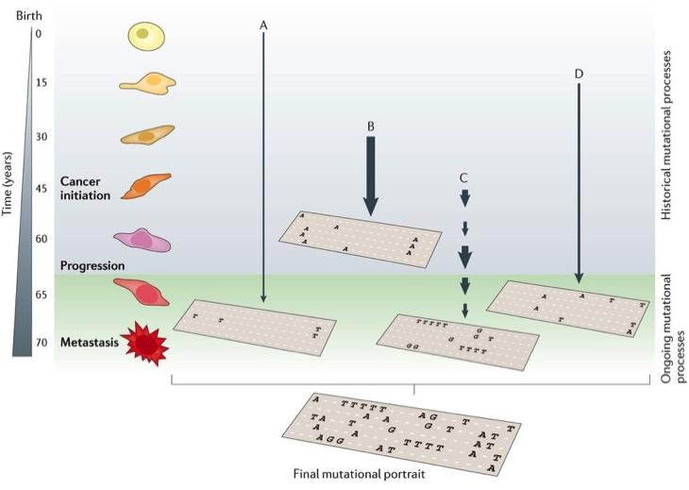
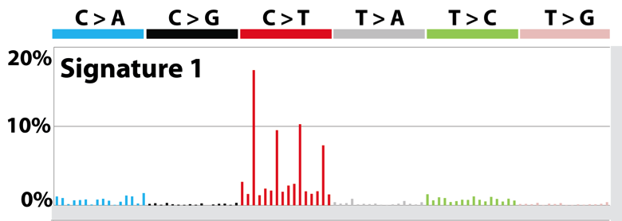
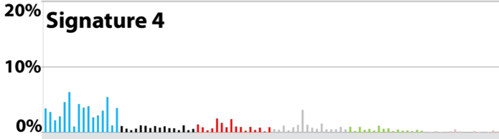
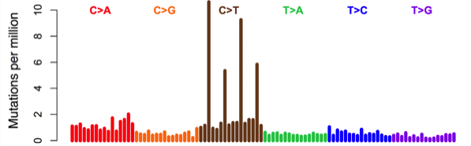
Mutational processes carry context-specific signatures
A[C>T]G
C[C>T]G
S: Mutation signature inferred
M = S × W+ ε
M: Mutation spectrum observed
[T. Helleday, S. Eshtad & S. Nik-Zainal,
Nature Reviews Genetics (’14), L. Alexandrov et al., Nature (‘13) ]
Notes:
Mutation spectrum is further broken down to mutation signatures, which represent mutational processes

Slide 5
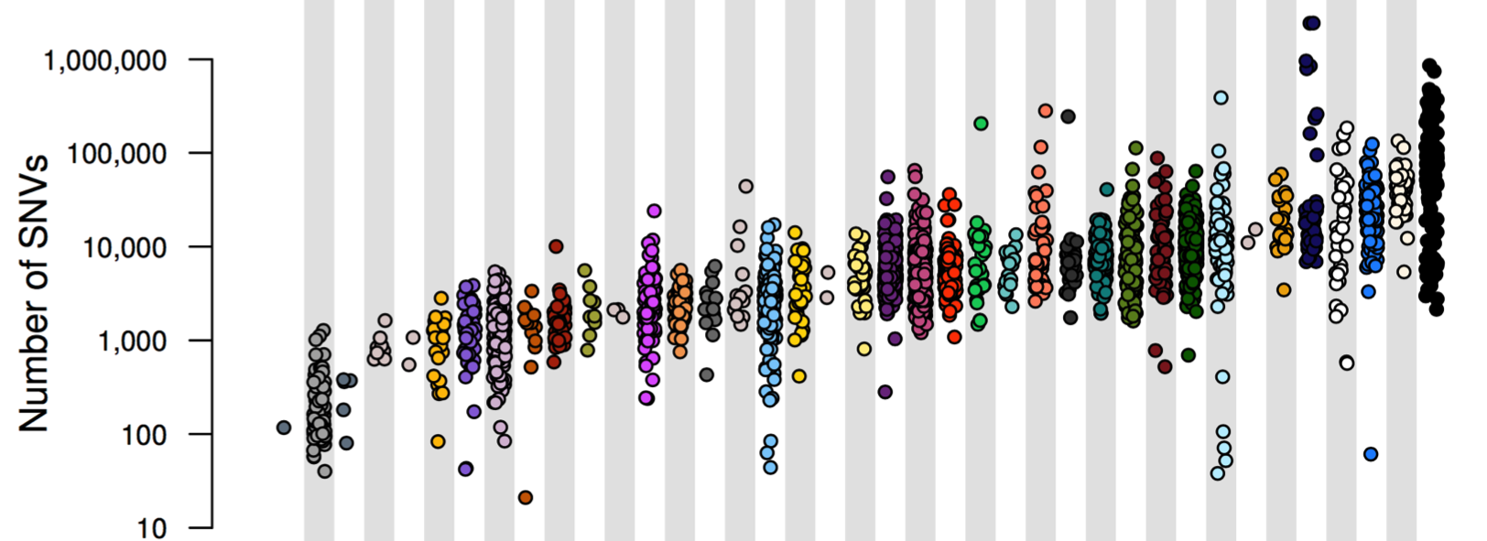
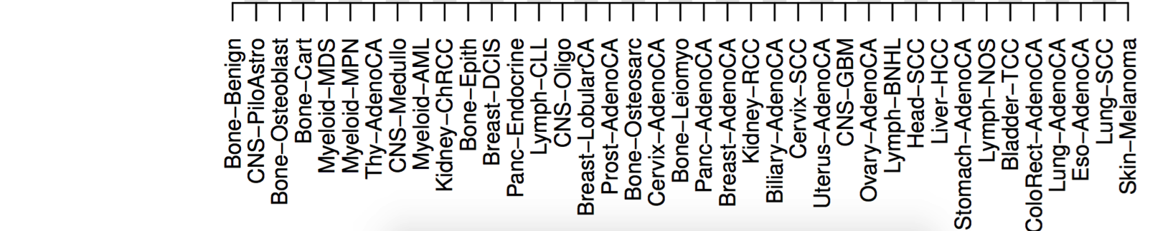
PCAWG : most comprehensive resource for cancer whole genome analysis
Goal of PCAWG:
To understand role of non-coding regions of cancer genomes in cancer progression.
Union of TCGA-ICGC efforts
Jointly analyzing ~2800 whole genome tumor/normal pairs
  > 580 researchers
  16 thematic working groups
  ~30M total somatic SNVs
Adapted from Campbell et. al., bioRxiv (’17)

Slide 6
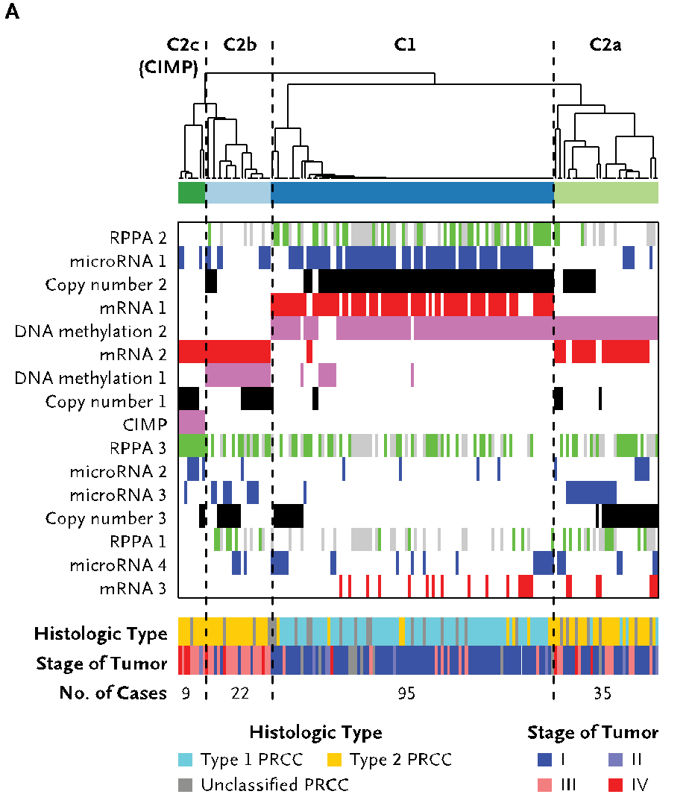
A case study: pRCC
Kidney cancer lifetime risk of 1.6% & the papillary type (pRCC) counts for ~10% of all cases
TCGA project sequenced 161 pRCC exomes & classified them into subtypes
Also, 35 WGS of TN pairs
[Cancer Genome Atlas Research Network N Engl J Med. (‘16) ]

Slide 7
Passenger mutations in >2500 cancer genomes:
Overall molecular functional impact
Introduction
  Background: driver-and-passenger model (w/ conceptual extension) & mutational spectra & signatures
  Data source: PCAWG comprehensive WGS on >2.5K + focus on 35 pRCC WGS
Overall functional impact of variants
  FunSeq entropy-weights multiple features to evaluate the functional impact of SNVs
  Investigating how the fraction of high-impact (non-strong-driver) SNVs scales & how it relates to survival
Differential burdening from various mutational processes
  Diff. burdening of TF sub-networks, results from spectra & signatures differentially affecting binding motifs
  High & low impact mutations assoc. w/ diff. signatures
  Number of mutations in DHSes assoc. w/ specific chromatin mod. mutation
Functional impact & tumor evolution
  Differences in functional impact betw. early & late passenger mutations (eg in TSGs & oncogenes)

Slide 8
Passenger mutations in >2500 cancer genomes:
Overall molecular functional impact
Introduction
  Background: driver-and-passenger model (w/ conceptual extension) & mutational spectra & signatures
  Data source: PCAWG comprehensive WGS on >2.5K + focus on 35 pRCC WGS
Overall functional impact of variants
  FunSeq entropy-weights multiple features to evaluate the functional impact of SNVs
  Investigating how the fraction of high-impact (non-strong-driver) SNVs scales & how it relates to survival
Differential burdening from various mutational processes
  Diff. burdening of TF sub-networks, results from spectra & signatures differentially affecting binding motifs
  High & low impact mutations assoc. w/ diff. signatures
  Number of mutations in DHSes assoc. w/ specific chromatin mod. mutation
Functional impact & tumor evolution
  Differences in functional impact betw. early & late passenger mutations (eg in TSGs & oncogenes)

Slide 9
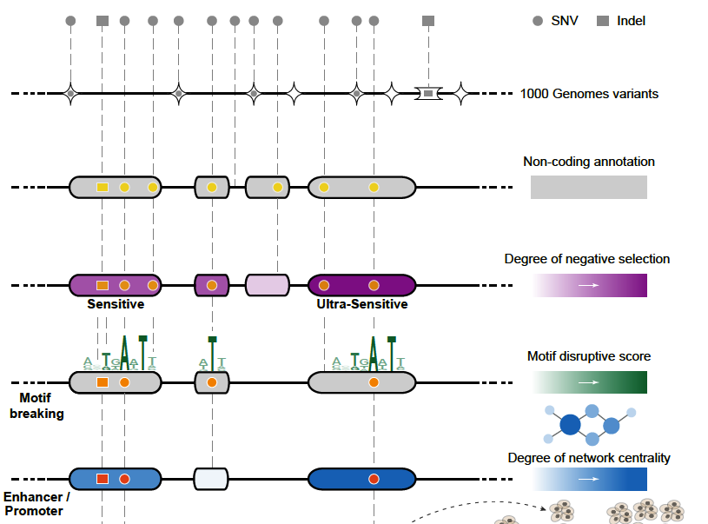
Funseq: a flexible framework to determine
functional impact & use this to prioritize variants
Annotation (tf binding sites open chromatin, ncRNAs) & Chromatin Dynamics
Conservation
(GERP, allele freq.)
Mutational impact (motif breaking, Lof)
Network (centrality position)
[Fu et al., GenomeBiology ('14), , Khurana et al., Science ('13)]

Slide 10
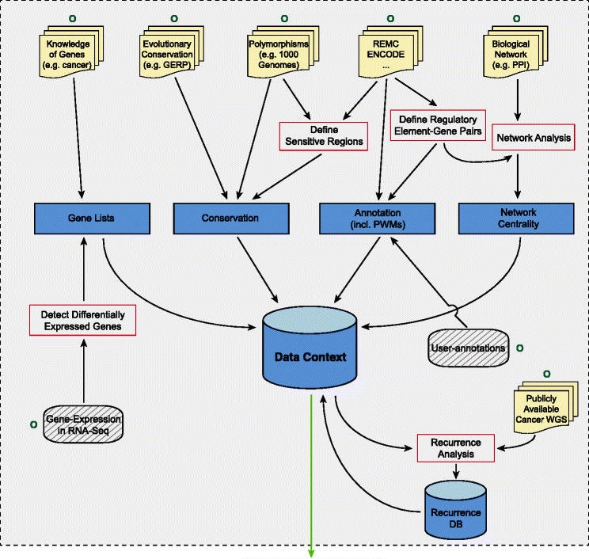

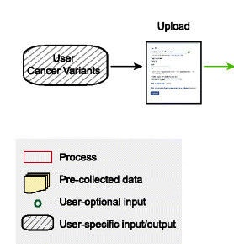
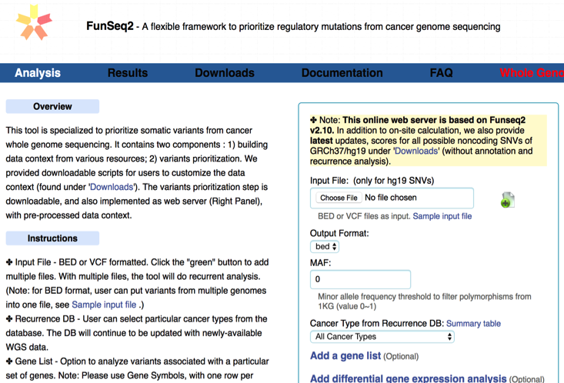
FunSeq.gersteinlab.org
HOT region
Sensitive region
Polymorphisms
Genome
Entropy based method for weighting consistently many genomic features
Practical web server
Submission of variants & pre-computed large data context from uniformly processing large-scale datasets
[Fu et al., GenomeBiology ('14)]

Slide 11
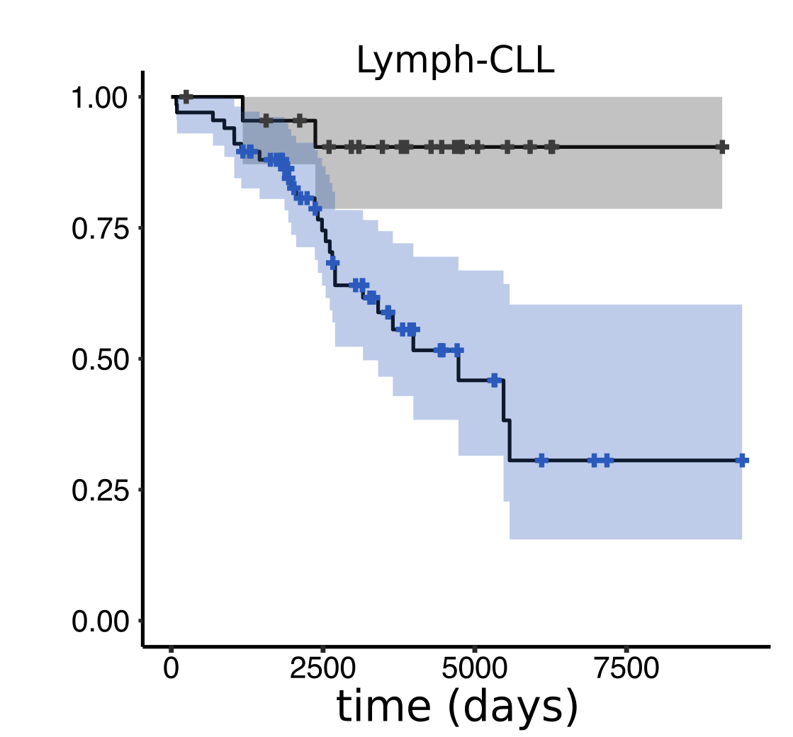
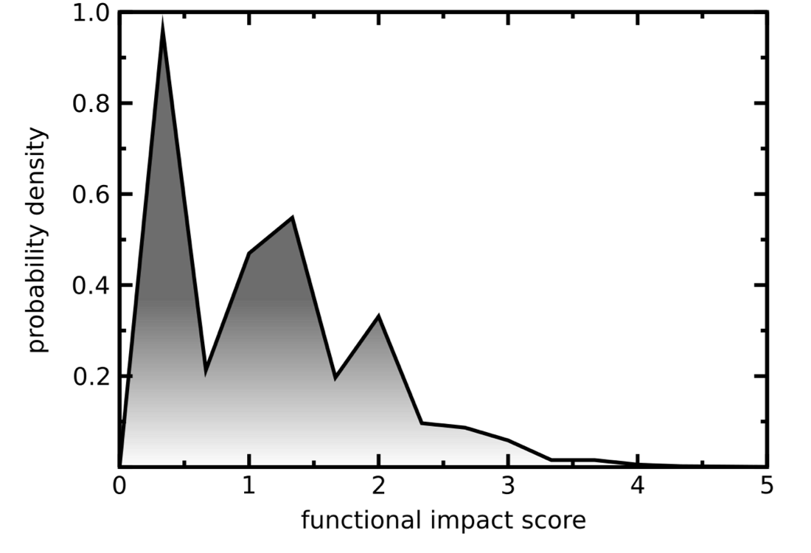
Overall functional impact distribution of
PCAWG mutations
Funseq molecular functional impact of ~30M variants
in >2500 PCAWG samples
Division of PCAWG Lymph-CLL cohort based on average impact of non-driver variants (high v low)

Slide 12
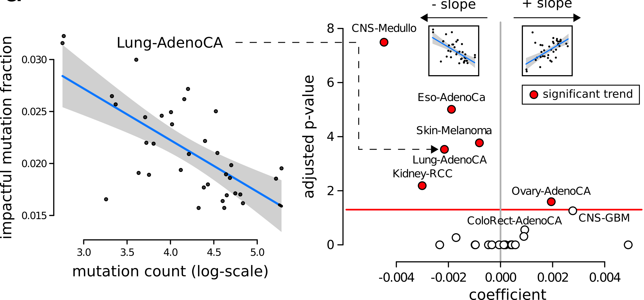
In many PCAWG cohorts, we observe the fraction of impactful “passengers” decreases with increase in total mutation burden.

Slide 13
Passenger mutations in >2500 cancer genomes:
Overall molecular functional impact
Introduction
  Background: driver-and-passenger model (w/ conceptual extension) & mutational spectra & signatures
  Data source: PCAWG comprehensive WGS on >2.5K + focus on 35 pRCC WGS
Overall functional impact of variants
  FunSeq entropy-weights multiple features to evaluate the functional impact of SNVs
  Investigating how the fraction of high-impact (non-strong-driver) SNVs scales & how it relates to survival
Differential burdening from various mutational processes
  Diff. burdening of TF sub-networks, results from spectra & signatures differentially affecting binding motifs
  High & low impact mutations assoc. w/ diff. signatures
  Number of mutations in DHSes assoc. w/ specific chromatin mod. mutation
Functional impact & tumor evolution
  Differences in functional impact betw. early & late passenger mutations (eg in TSGs & oncogenes)

Slide 14
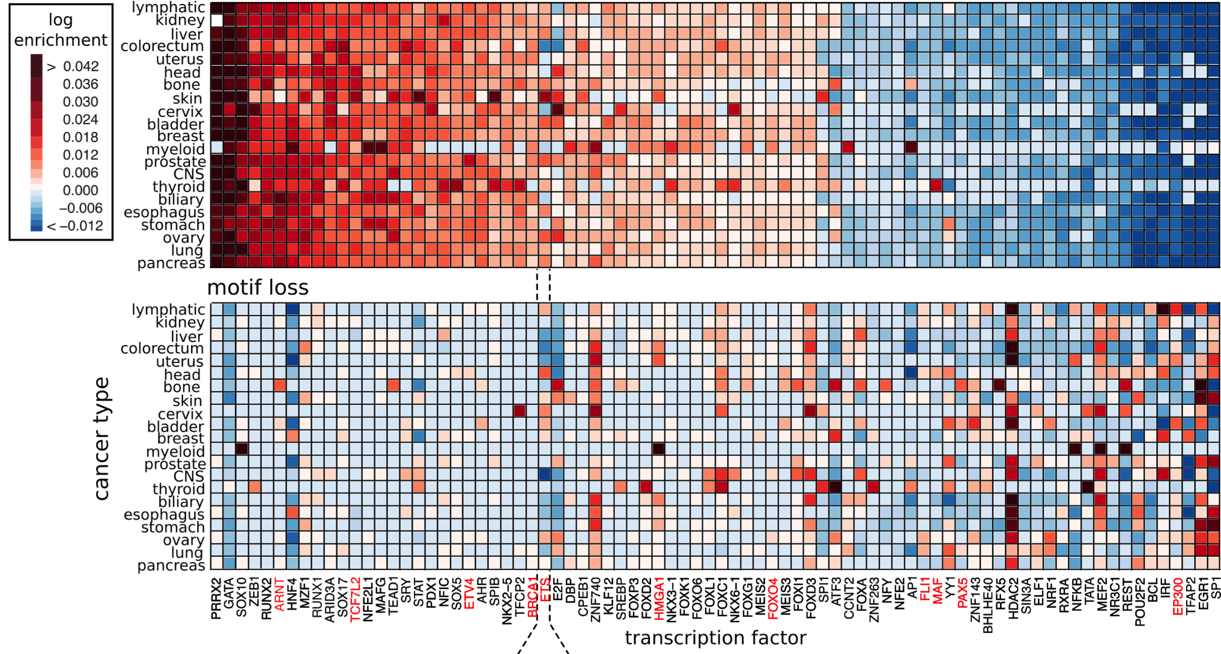
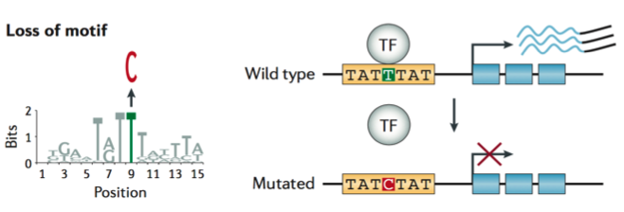
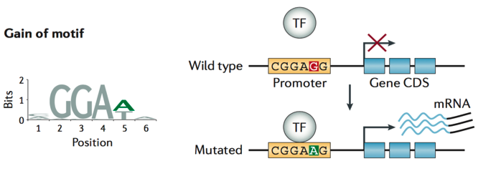
Mutational burdening of TF-subnetworks due to SNVs breaking & creating binding sites
≈ç
LOSS
GAIN
Khurana et. al., Nature Reviews Genetics (’16)
ARNT
EP300

Slide 15
Kidney cancer as an example: differential TF burdening correlates with mutational spectrum
all mutations (N=923,782)
coding LoF: premature stops (N = 525)
noncoding LoF
motif breaks in …
HDAC2 (N=675)
EWSR1 (N=514)
SP1 (N=571)
Notes:
disproportionate functional load on certain TFs in cancers can be related to an underlying mutational spectrum influencing their binding sites.
For instance in Kidney-RCC cohort, mutational spectrum of motif breaking events observed in SP1 (major contribution from C>T and C>A mutation) , HDAC2 (uniform distribution) and EWSR1 (uniform distribution) is very different.

Slide 16
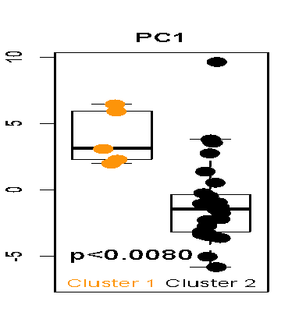
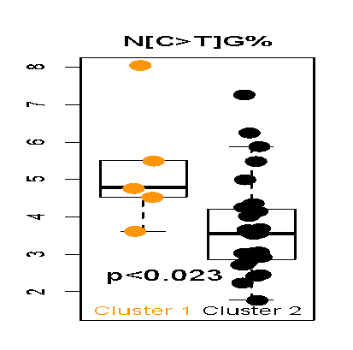
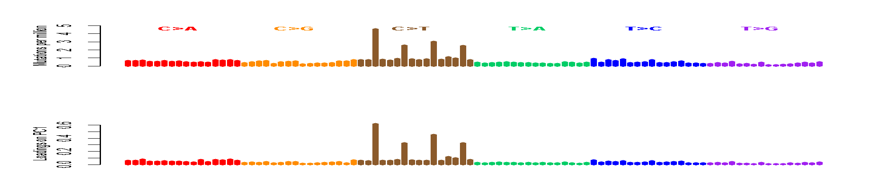
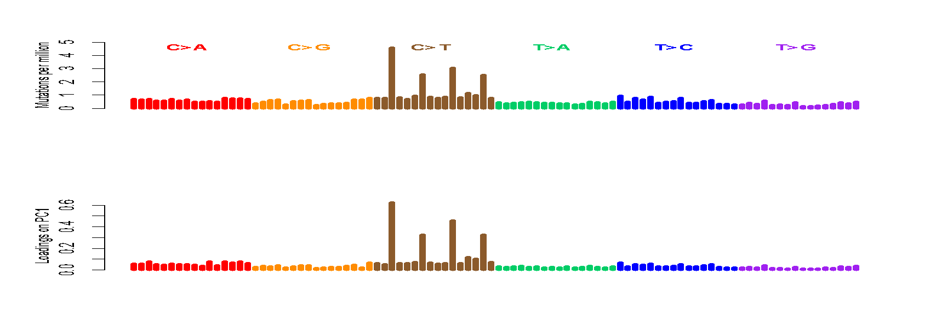
CpGs drive inter-patient variation in pRCC mutational spectra
The loadings on PC1 are mostly [C>T]G
Confirmed by higher C>T% in CpGs in the hypermethylated group (cluster1)
A[C>T]G
G[C>T]G
C[C>T]G
T[C>T]G
[S. Li, B. Shuch and M. Gerstein PLOS Genetics (‘17)]

Slide 17
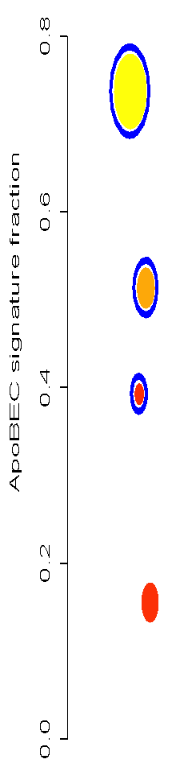
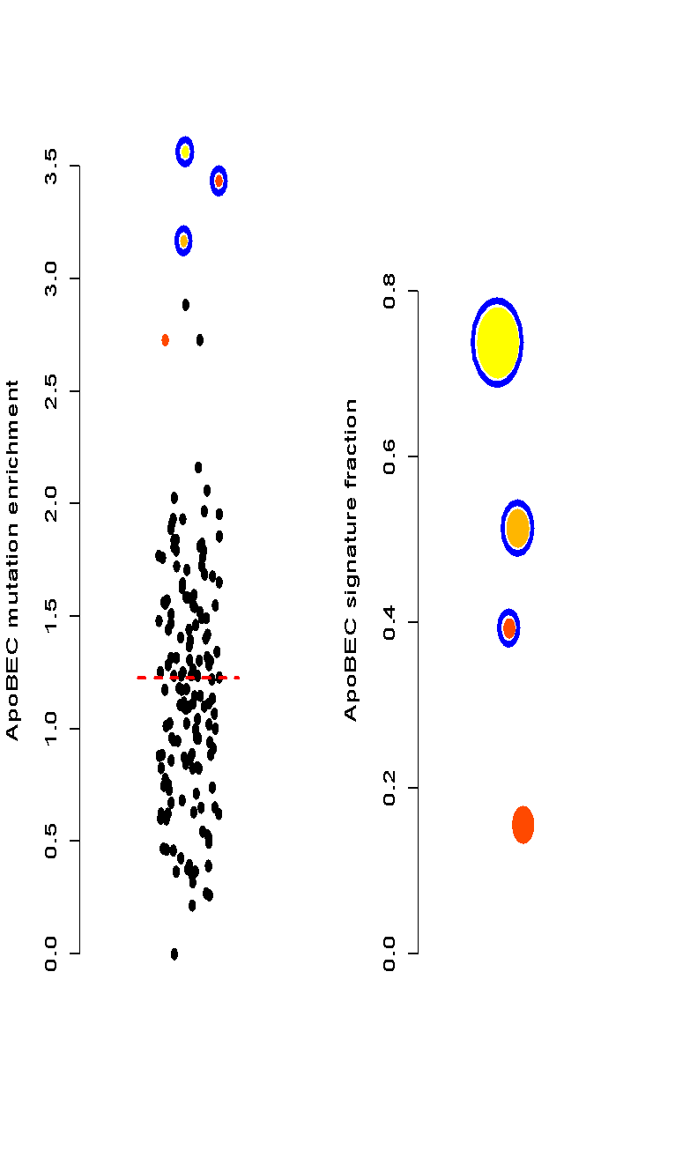

LoF SNVs (premature stops)
enrichment
-log(p-value)
3.6
7.2
22
50
100
150
total mutations
high impact passenger SNVs
ccRCC
pRCC
pRCC
ccRCC
low impact passenger SNVs
Signatures burden the
genome disproportionally
We found 1 pRCC has
ApoBEC signature, but nothing in a larger ccRCC cohort
Signatures in pRCC
[S. Li, B. Shuch and M. Gerstein PLOS Genetics (‘17)]
Notes:
ApoBEC signature is observed in chRCC but never in ccRCC
Three samples that are urothelial cancer (UC) but mislabeled and processed through the pipeline (internal positive controls

Slide 18
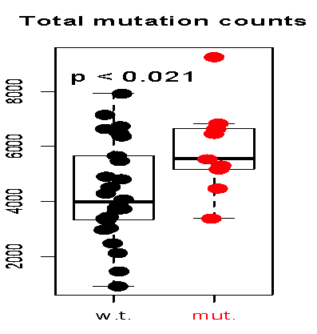
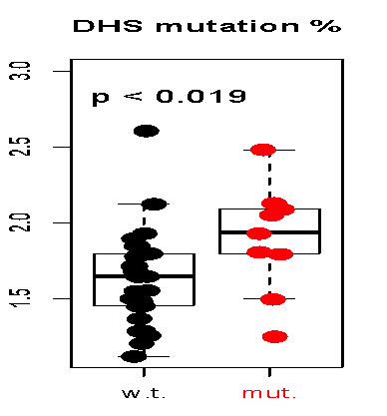
Key mutation affects mutational landscape which, in turn, affects overall burden in pRCC
Chromatin remodeling defect (“mut”) leads to more mutations in open chromatin (raw number & fraction) in those pRCC cases w/ the mutation
[S. Li, B. Shuch and M. Gerstein PLOS Genetics (‘17)]

Slide 19
Passenger mutations in >2500 cancer genomes:
Overall molecular functional impact
Introduction
  Background: driver-and-passenger model (w/ conceptual extension) & mutational spectra & signatures
  Data source: PCAWG comprehensive WGS on >2.5K + focus on 35 pRCC WGS
Overall functional impact of variants
  FunSeq entropy-weights multiple features to evaluate the functional impact of SNVs
  Investigating how the fraction of high-impact (non-strong-driver) SNVs scales & how it relates to survival
Differential burdening from various mutational processes
  Diff. burdening of TF sub-networks, results from spectra & signatures differentially affecting binding motifs
  High & low impact mutations assoc. w/ diff. signatures
  Number of mutations in DHSes assoc. w/ specific chromatin mod. mutation
Functional impact & tumor evolution
  Differences in functional impact betw. early & late passenger mutations (eg in TSGs & oncogenes)

Slide 20
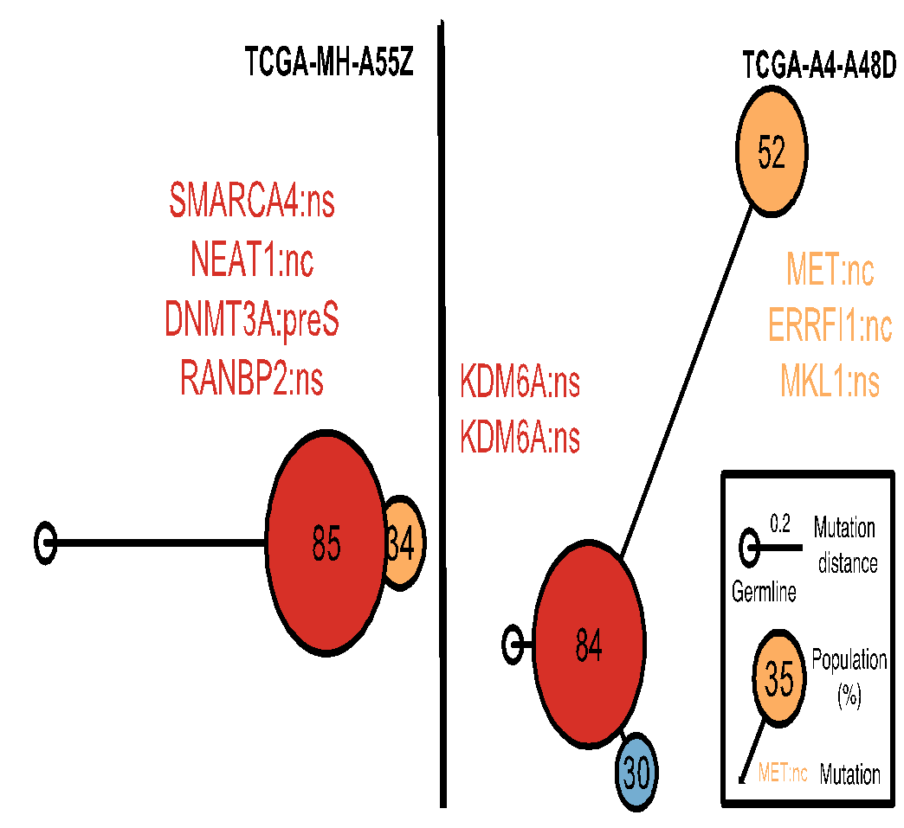
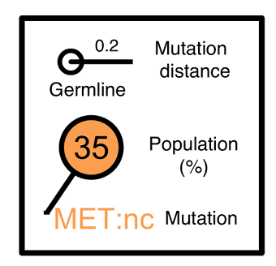
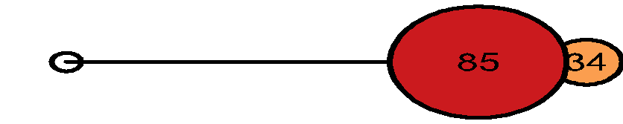
Construct evolutionary trees in pRCC
Infer mutation order and tree structure based on mutation abundance (PhyloWGS, Deshwar et al., 2015)
Some of the key mutations occur in all the clones while others are just in some parts of the tree
MET: noncoding
ERRFI1: noncoding
DNMT3A: premature stop
NEAT1: noncoding
SMARCA4: missense
KDM6A: missense
[S. Li, B. Shuch and M. Gerstein PLOS Genetics (‘17)]

Slide 21
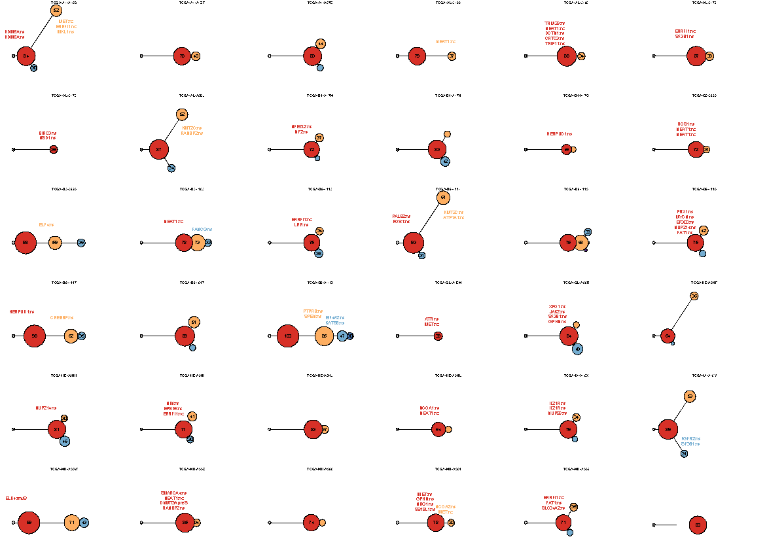
Mutation
distance
Populations
(%)
0.5
Germline
[S. Li, B. Shuch and M. Gerstein PLOS Genetics (‘17)]

Slide 22
Mutation
distance
Populations
(%)
0.5
Germline
[S. Li, B. Shuch and M. Gerstein PLOS Genetics (‘17)]

Slide 23
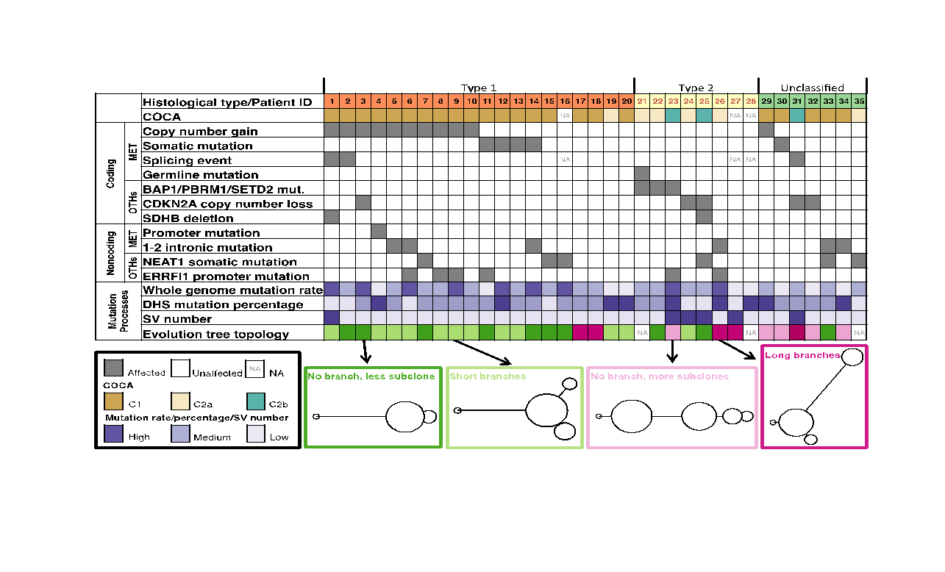
Tree topology correlates with molecular subtypes
[Li et al., PLOS Genetics (‘17)]

Slide 24
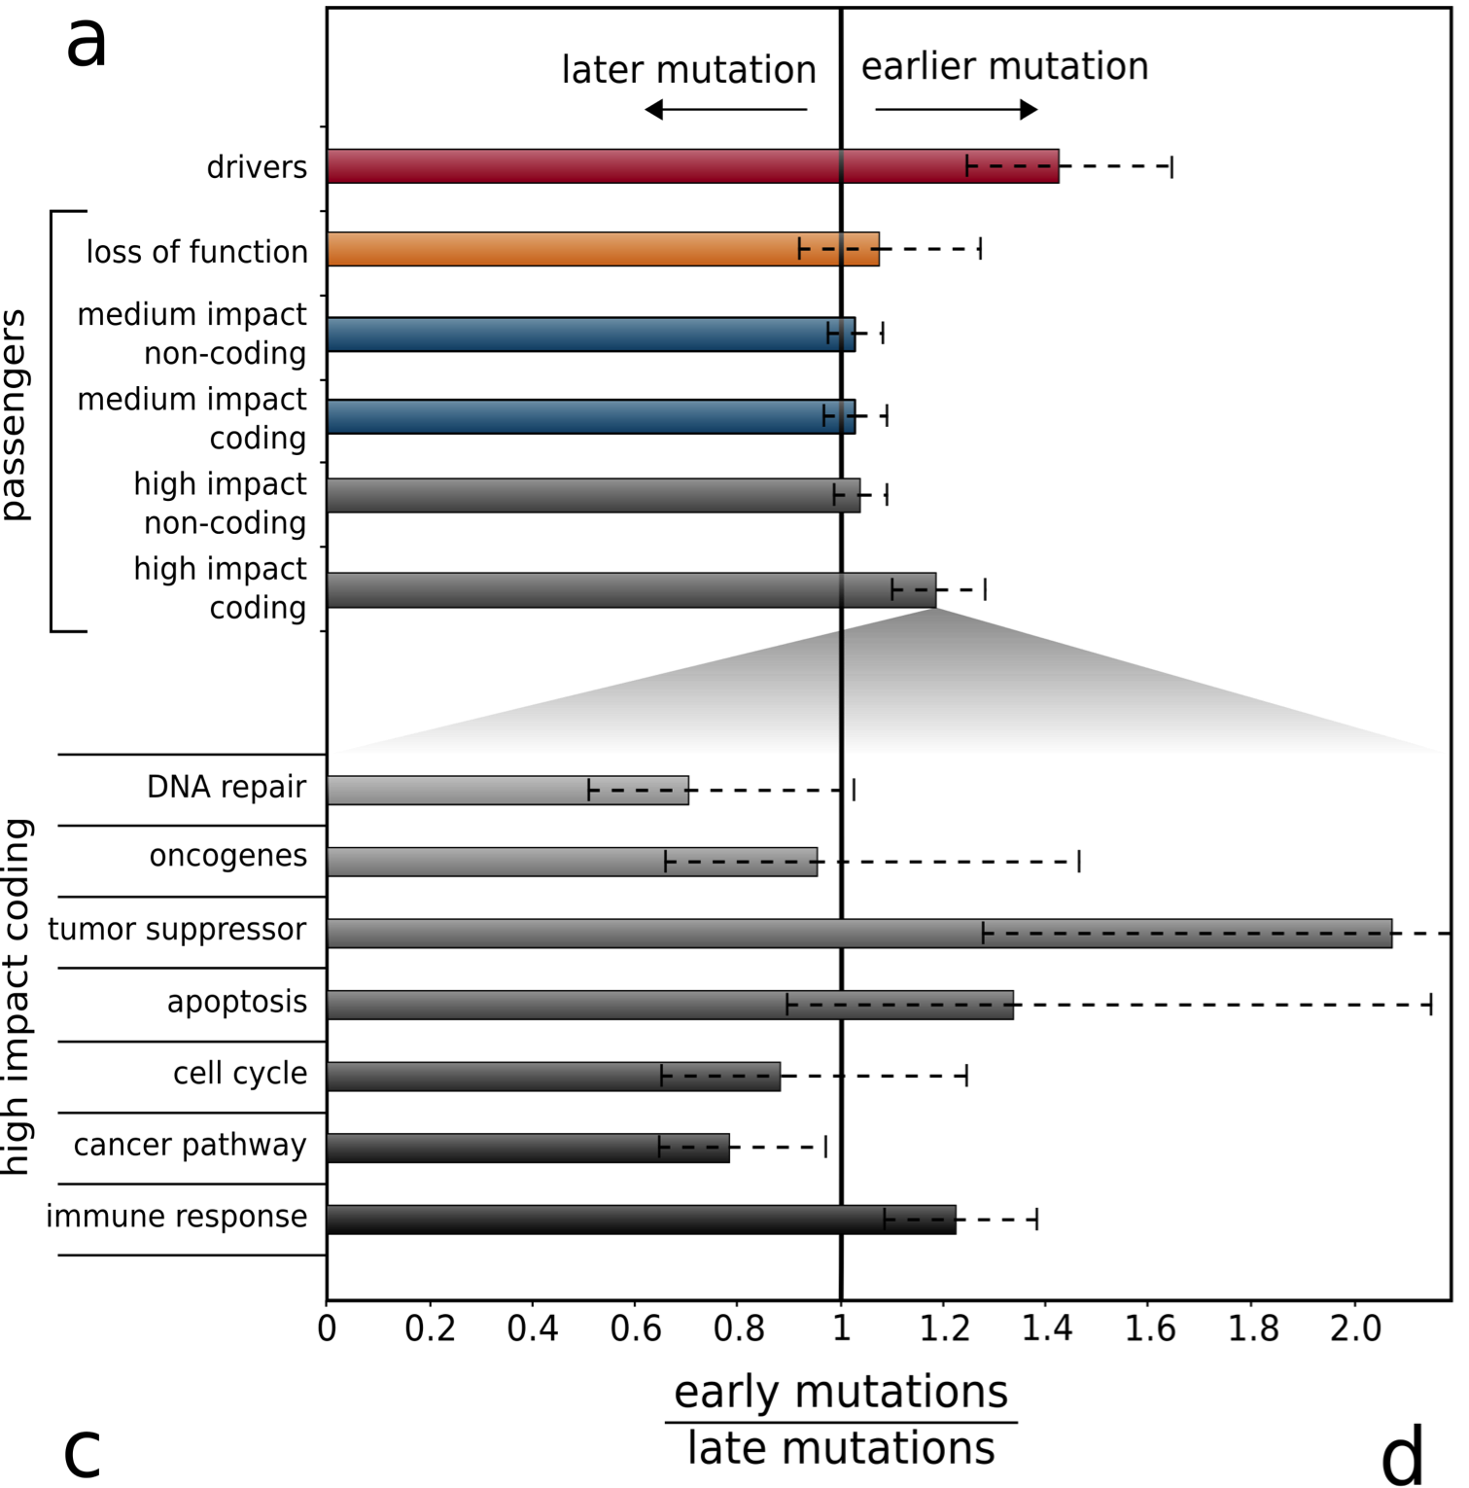
Sub-clonal architecture of mutations in PCAWG
As expected, drivers are enriched in earlier subclones. Overall, no such enrichment among passengers.
High impact passengers are slightly enriched among early subclones.
Particularly, passengers in tumor suppressor (in contrast to oncogenes, which require specific mutations).

Slide 25
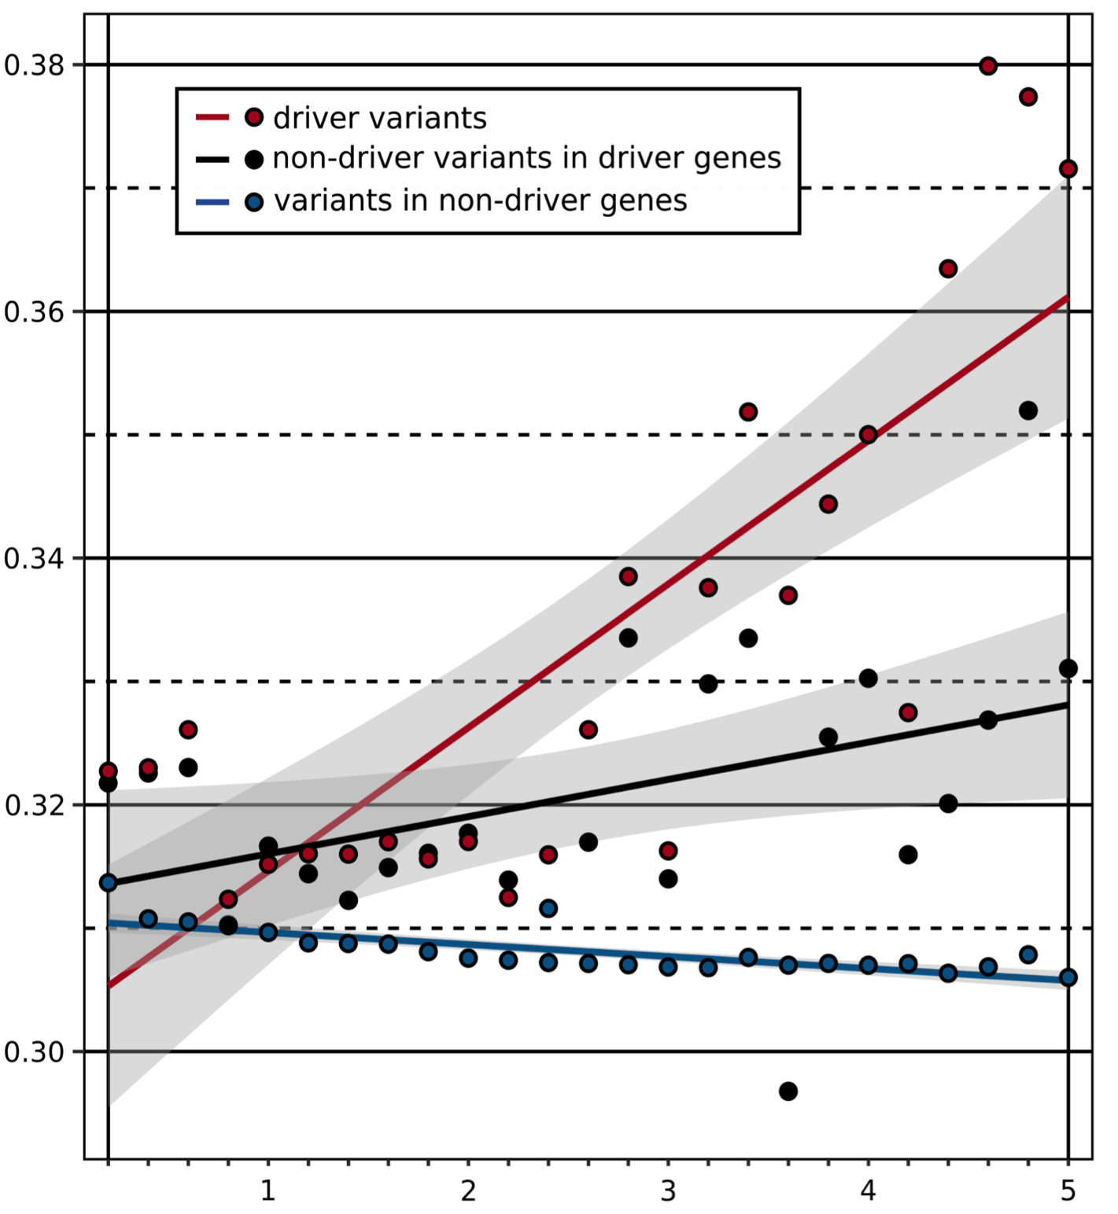
Continuous correlation of functional impact & VAF
Among mutations in driver genes: higher impact mutation
=> spreads to more cells.
Still true after removing all known driver variants from driver genes. (Latent drivers?)
Outside driver genes:
higher impact mutation
=> spreads to fewer cells
(Deleterious passengers?)
Early vs Late (mean VAF)
Functional Impact (GERP score)

Slide 26
Passenger mutations in >2500 cancer genomes:
Overall molecular functional impact
Introduction
  Background: driver-and-passenger model (w/ conceptual extension) & mutational spectra & signatures
  Data source: PCAWG comprehensive WGS on >2.5K + focus on 35 pRCC WGS
Overall functional impact of variants
  FunSeq entropy-weights multiple features to evaluate the functional impact of SNVs
  Investigating how the fraction of high-impact (non-strong-driver) SNVs scales & how it relates to survival
Differential burdening from various mutational processes
  Diff. burdening of TF sub-networks, results from spectra & signatures differentially affecting binding motifs
  High & low impact mutations assoc. w/ diff. signatures
  Number of mutations in DHSes assoc. w/ specific chromatin mod. mutation
Functional impact & tumor evolution
  Differences in functional impact betw. early & late passenger mutations (eg in TSGs & oncogenes)

Slide 27
Passenger mutations in >2500 cancer genomes:
Overall molecular functional impact
Introduction
  Background: driver-and-passenger model (w/ conceptual extension) & mutational spectra & signatures
  Data source: PCAWG comprehensive WGS on >2.5K + focus on 35 pRCC WGS
Overall functional impact of variants
  FunSeq entropy-weights multiple features to evaluate the functional impact of SNVs
  Investigating how the fraction of high-impact (non-strong-driver) SNVs scales & how it relates to survival
Differential burdening from various mutational processes
  Diff. burdening of TF sub-networks, results from spectra & signatures differentially affecting binding motifs
  High & low impact mutations assoc. w/ diff. signatures
  Number of mutations in DHSes assoc. w/ specific chromatin mod. mutation
Functional impact & tumor evolution
  Differences in functional impact betw. early & late passenger mutations (eg in TSGs & oncogenes)

Slide 28
Functional impact in PCAWG (PanCancer.info)
S Kumar, J Warrell, W Meyerson, P McGillivary, L Salichos, S Li,
A Fundichely, E Khurana, C Chan, M Nielsen,C Herrman,
A Harmanci, L Lochovsky,Y Zhang, X Li,
PCAWG Drivers & Functional Interpretation
Group (Gad Getz, Jakob Pedersen, Josh Stuart, Ben Rapheal, Nuria Lopez Bigas, David G. Wheeler), ICGC/TCGA Pan-Cancer Analysis
of Whole Genomes Network
FunSeq.gersteinlab.org
Y Fu, E Khurana, Z Liu,
S Lou, J Bedford, XJ Mu,
KY Yip,
pRCC
S Li,
B Shuch
See gersteinlab.org/jobs !
Hiring Postdocs.
Acknow-ledgements

Slide 29
Info about this talk
General PERMISSIONS
This Presentation is copyright Mark Gerstein, Yale University, 2016.
Please read permissions statement at gersteinlab.org/misc/permissions.html .
Feel free to use slides & images in the talk with PROPER acknowledgement (via citation to relevant papers or link to gersteinlab.org). Paper references in the talk were mostly from Papers.GersteinLab.org.
PHOTOS & IMAGES
For thoughts on the source and permissions of many of the photos and clipped images in this presentation see streams.gerstein.info . In particular, many of the images have particular EXIF tags, such as kwpotppt , that can be easily queried from flickr, viz: flickr.com/photos/mbgmbg/tags/kwpotppt

