Slide 1

Modeling tumor evolution: the tale of a thousand and one tumors
TUMORS

Slide 2

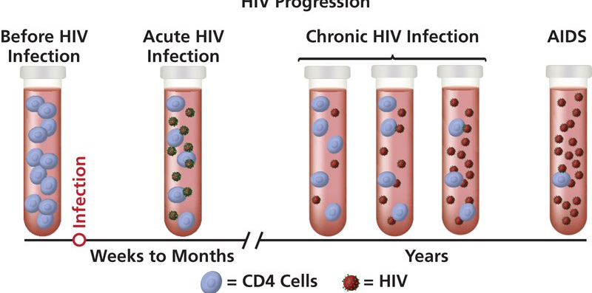
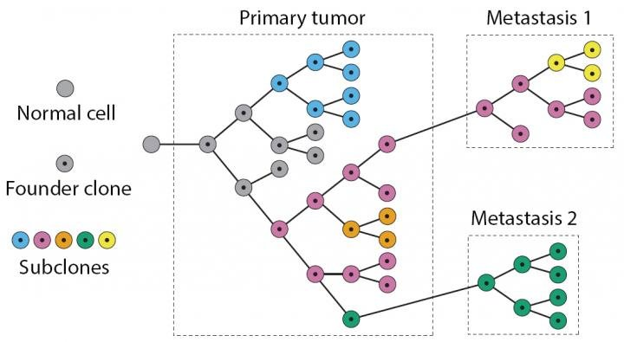


Evolving at different pace
Slow track
Fast track
A
5-10 years
~320 MYA
C
B
~100 MYA
Months to
a few years
~300 MYA

Slide 3

Tumor Evolution
A Thousands Evolutions
994 linear tumor samples
39 cancer types
XXX somatic mutations

Slide 4
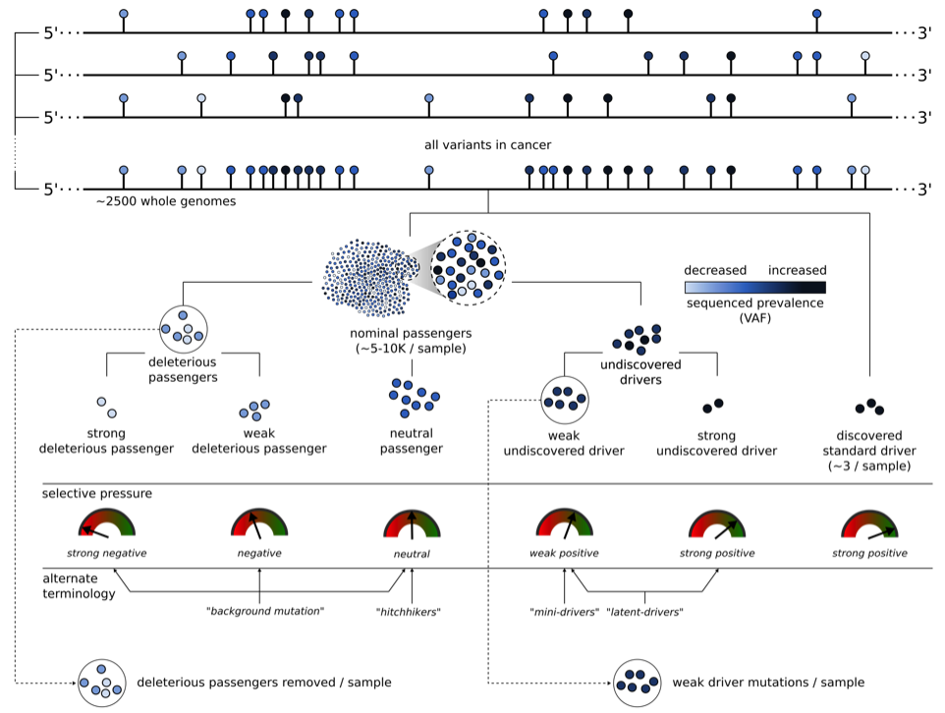
Drivers, passengers and “nominal” passengers (shotgun)
Are weak drivers real?
Can we detect them?
What is their effect?
Sushant et al 2017(?)

Slide 5


Hitchhiking prevalence is increased
No fitness mutation
fitness mutation
0
1
2
3
4
0
1
2
3
4
8/16 = 0.5
12/20 = 0.6
4/16 = 0.25
8/20 = 0.4
8/16 = 0.5
8/20 = 0.4

Slide 6
Hitchhiking prevalence is increased
No fitness mutation
fitness mutation
Hitchhiking mut.
With higher VAF
0
1
2
3
4
0
1
2
3
4
8/16 = 0.5
12/20 = 0.6
4/16 = 0.25
8/20 = 0.4
8/16 = 0.5
8/20 = 0.4

Slide 7
A method for detecting growth rate and the effect of mutations during tumor progression

Slide 8
Growth rate ‘r’ can be calculated independently (using only mutational frequencies) for “hitchhikers”
…And non hitchhikers

Slide 9
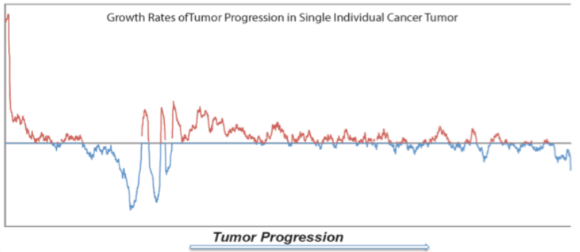
Positive and Negatic Growth rates during a linear tumor growth

Slide 10
Local re-optimization for linear tumors

Slide 11
Simulations I: Predicting growth rate r and mutational effect k without noise

Slide 12
Simulations with noise
A. Biological noise due to replication
K effect
B. Systematic noise due to coverage
r = 3
K = 1.5
50x 100x 150x 200x 250x 300x
50x 100x 150x 200x 250x 300x

Slide 13
Identify selection based on positive or negative growth across 994 linear tumors
Spec.muts: Mutations from specific genes (eg. TP53), types (eg. nonsense) etc.
Positive Growth
Enrichement =
(# spec.muts in positive growth) – (# random in positive growth)
(total spec.muts in 994 tumors)

Slide 14
Selection across Genes and Types:
Strong selection for Promoters, also for introns and LoFs
components of lipoproteins
important for the structure of the epidermis
Dynein has ATPase activity
proteoglycan, with several sugar molecules attached
Phosphoprotein
immunoglobulin lambda-like polypeptides
may play a role in calcium signaling
-log(Pvalue)
tumor suppr. controlling cell proliferation
Fc fragment of IgG binding protein
Fc fragment of IgG binding protein
Associated with autosomal recessive ataxia
cell adhesion molecule, cell proliferation
Ass. with testicular germ cell tumors
negatively regulate lipogenesis
PGE

Slide 15
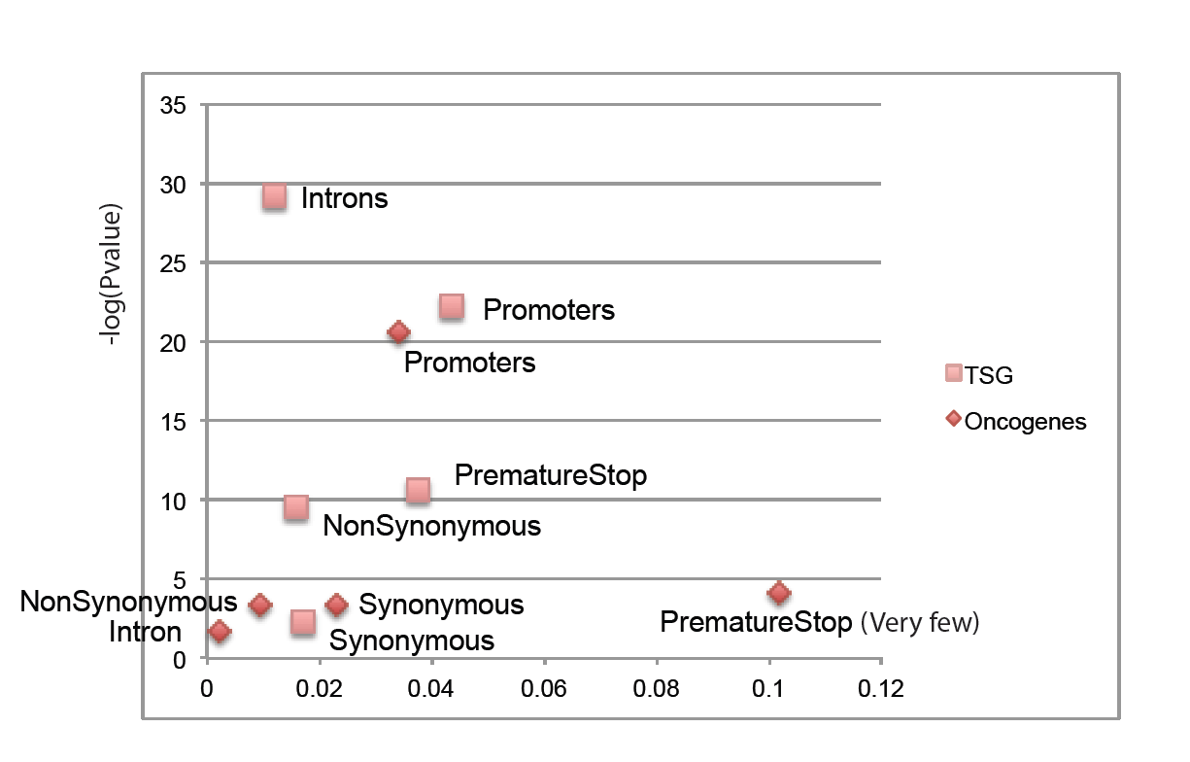
Tumor Genes

Slide 16
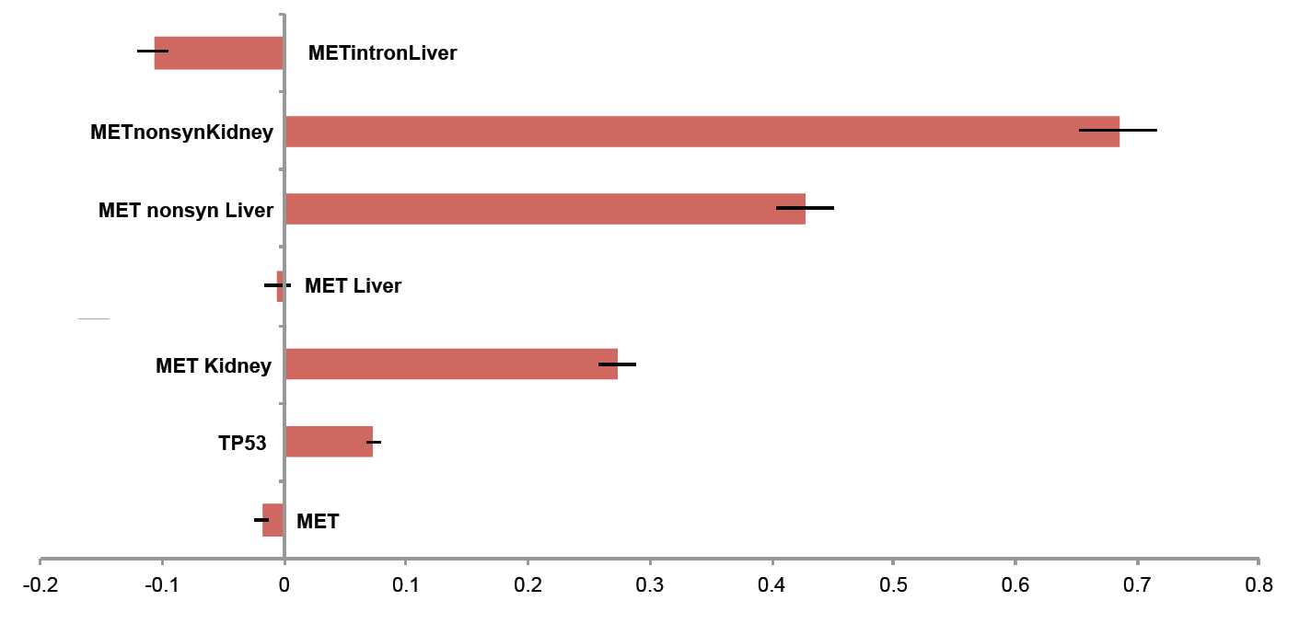
Not All tumor genes appear to be found in positive growth regions:
The MET story

Slide 17
The MET story:
MET is selected in Kidney

Slide 18
The MET story:
But not in Liver?

Slide 19
The MET story:
It is..

Slide 20
The MET story: selection even in introgenic regions

Slide 21
The MET story: selection even in introgenic regions
Beta-catenin (CTNNB1)
-log(Pvalue)
nonsynonymous
Intron
total
Growth effect

Slide 22
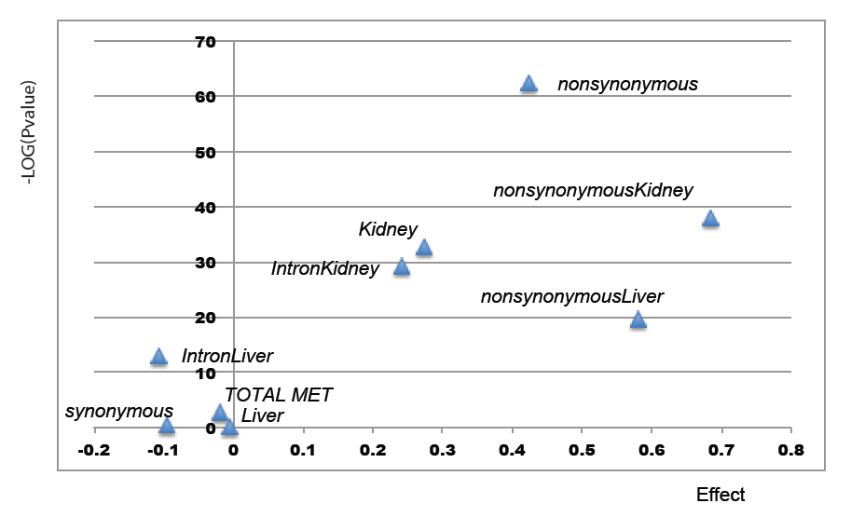
Not All Onco-Gene mutations are Selected: The MET story

Slide 23
Or across different tumors

Slide 24
Calculating growth rates across a (Deep-sequenced) tumor progression I

Slide 25
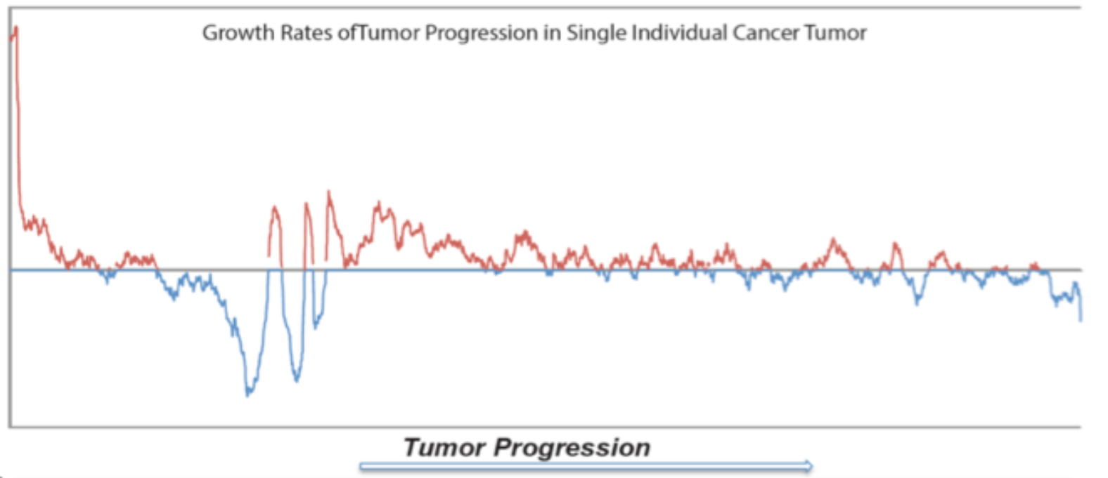
Growth spikes after negative growth correspond to missense oncogenic mutations
A 300x Deep-sequenced AML model tumor

Slide 26
Mapping Oncongenic mutations
FLT3
IDH1
IDH2

Slide 27
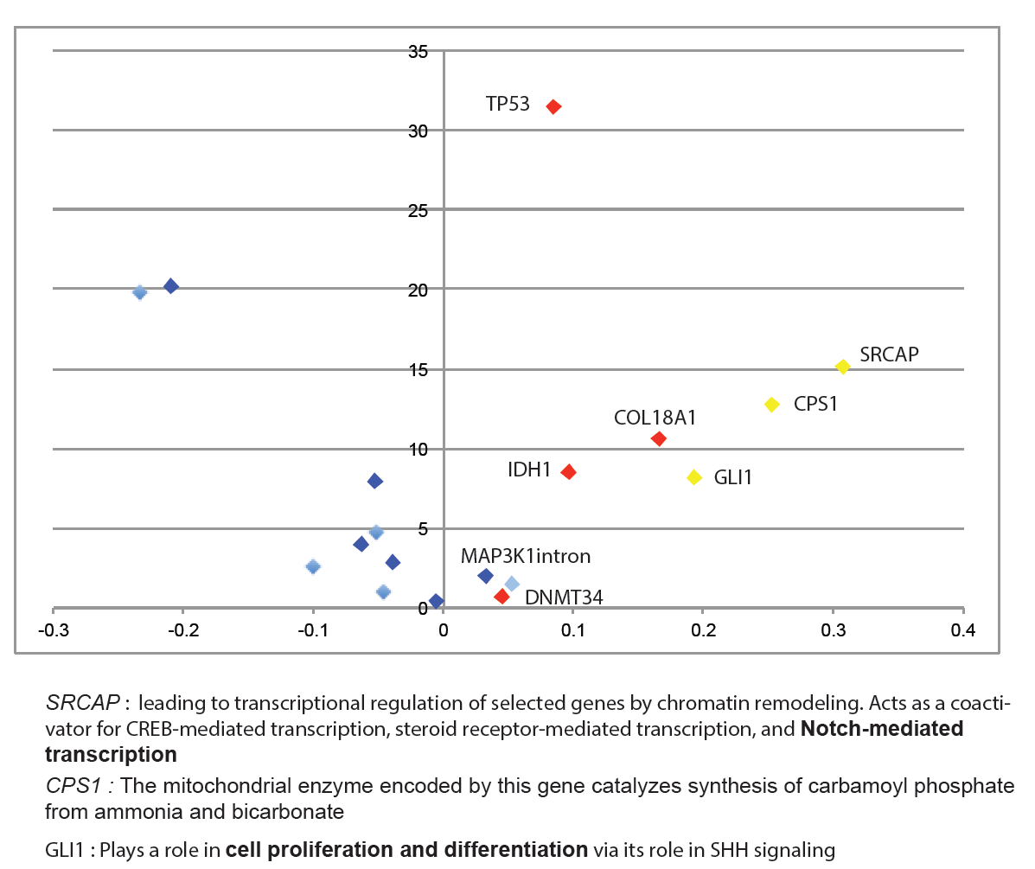
Testing mutated genes for selection using 994 linear tumors
-log(Pvalue)
Positive growth effect

Slide 28
Adding positive selected mutations
CPS1
GLI1
COL18A1
MAP3K1
intron
FLT3
IDH1
IDH2

Slide 29
Adding mutational effect K
CPS1
GLI1
COL18A1
FLT3
MAP3K1
intron
IDH1
IDH2

Slide 30
K using 1000 tumors
1
3
5
2
4
6
IDH2
1
2
3
4
6
5

Slide 31
Estimating K using 1000 tumors
Tumor Suppressor Genes
Oncogenes
TP53
CTNNB1

Slide 32
Summary/ Big picture
Tumors are “real time” evolution experiments
We showed that tumor evolution can be model evolutionarily
  We still need better models and deep-sequencing
We constructed a method that:
  Estimates growth rates during tumor progression
  Is applicable to individual tumors
  Draws information from thousand shallow-sequenced tumors
  Can estimate the effect of a subclone or mutation
Using 994 linear tumors we can detect selection for genomic regions (genes, group of genes, introns, type of mut)
We detected positive selection for intragenic regions, strong selection for promoters
We detected the presence of mutations with weak and strong effect
We suggest novel drivers

Slide 33
Immediate Follow-ups
Publish the method as software
Improve models (allow α% to be selected per gene)
Use the method to Calculate the number of weak drivers and deleterious passengers (Paper ω)
Associate growth rates with changes in signatures (methods ready)
Study the cascade effects of Map Kinases during tumor progression

