Slide 1
Lu, J., Breitwieser, F. P., Thielen, P. & Salzberg, S. L. Bracken: estimating species abundance in metagenomics data. PeerJ Comput. Sci. 3, e104 (2017).
Jclub
DS
31 Oct 2017

Slide 2
Background
Phylotyping vs meta genomics
Many reads correspond to identical regions between two or more genomes.
Affected by asymmetry in the databases
Many more genomes of well studied taxa e.g. Streptococcus
Mycobacterium bovis is over 99.95% identical to Mycobacterium tuberculosis
Bacillus anthracis, Bacillus cereus, and Bacillus thuringiensis are over 99% identical
Escherichia coli and Shigella flexneri are the same species
Alignment-based methods are slow

Slide 3
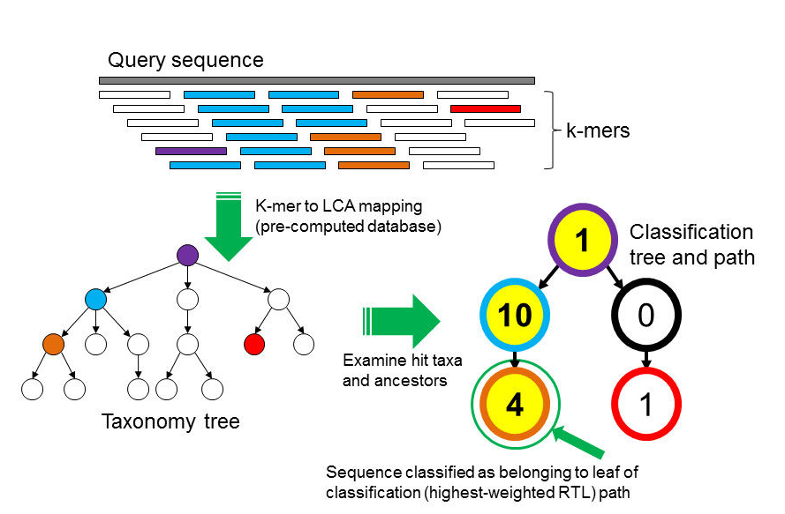
Wood, D. E. & Salzberg, S. L. Kraken: ultrafast metagenomic sequence classification using exact alignments. Genome Biology 15, R46 (2014).
Notes:
Figure 1 The Kraken sequence classification algorithm. To classify a sequence, each k-mer in the sequence is mapped to the lowest common ancestor (LCA) of the genomes that contain that k-mer in a database. The taxa associated with the sequence’s k-mers, as well as the taxa’s ancestors, form a pruned subtree of the general taxonomy tree, which is used for classification. In the classification tree, each node has a weight equal to the number of k-mers in the sequence associated with the node’s taxon. Each root-to-leaf (RTL) path in the classification tree is scored by adding all weights in the path, and the maximal RTL path in the classification tree is the classification path (nodes highlighted in yellow). The leaf of this classification path (the orange, leftmost leaf in the classification tree) is the classification used for the query sequence.

Slide 4
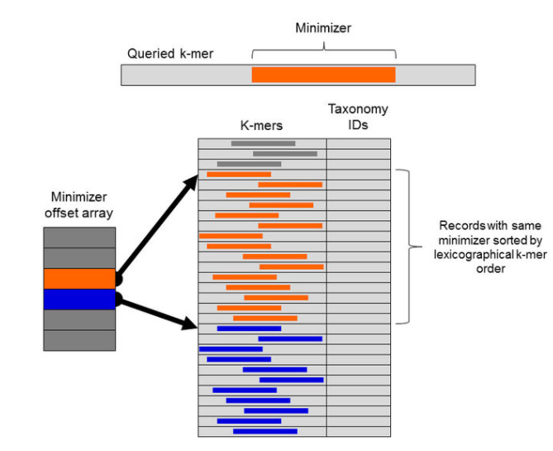
Kraken’s db – 2-step lookup table
Notes:
Figure 5Kraken database structure. Each k-mer to be queried against the database has a specific substring that is its minimizer. To search for a k-mer in the database, the positions in the database that contain k-mers with the same minimizer are examined. These positions are quickly found by examining the minimizer offset array for the start positions of records with the k-mer’s minimizer (orange) and the next possible minimizer (blue). Within a range of records associated with a given minimizer, records are sorted by lexicographical ordering of their k-mers, allowing a query to be completed by using a binary search over this range.

Slide 5
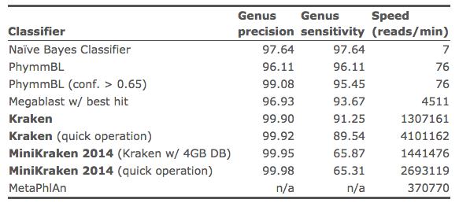

Slide 6
Background
Methods for dealing with multi-mapping
First create db of unique clade-specific marker genes
Assign reads to Lowest Common Ancestor (LCA)
Some method for inferring the most likely assignment for the read
Problems with LCA
Strands reads at higher taxonomic levels
Inaccurate strain or species abundances
Relevance to exceRpt
Will we be asked to validate our reads?
Asthma work was cut to genus
Should we be looking at higher taxonomic levels?

Slide 7
Bayesian Reestimation of Abundance after Classification with KrakEN (Bracken)
uses the taxonomic assignments made by Kraken
+ information about the genomes (uniqueness in the db, number of genomes in the genus)
estimates abundance at the species level, the genus level, or above (not strain)

Slide 8
Bracken algorithm
P(G_{j}|S_{i}) the probability that a read from genome S_{i} is classified by Kraken as the parent genus G_{j}.
P(S_{i}) the probability that a read in the sample belongs to genome S_{i},
the probability that a read classified at genus G_{j} belongs to the genome S_{i}
P(G_{j}) = the probability that a read is classified by Kraken at the genus level G_{j} = 1

Slide 9
Next we consider how to compute P(G_{j}|S_{i}), the probability that a read from genome S_{i} will be classified by Kraken at the parent genus G_{j}.
We estimate this probability for reads of length r by classifying the sequences (genomes) that we used to build the database using that same database, as follows.
For each k-mer in the sequences, Kraken assigns it a taxonomy ID by a fast lookup in its database. To assign a taxonomy ID for a read of length r, Kraken examines all k-mer classifications in that read. For example, for
k = 31 and r = 75, the read will contain 45 k-mers.
Our procedure examines, for each genome in the database, a sliding window of length r across the entire genome.

Slide 10
Calculating P(G_{j}|S_{i})
For each genome S_{i} of length L_{i} we thus generate (L_{i} − r + 1) mappings to taxonomical IDs.
We also calculate the proportion of reads from S_{i} that were assigned to every node from genome S_{i} to the root node of the taxonomy tree.
P(G_{j}|S_{i}) = N_{Gj(Si)} ∕ (L_{i} − r + 1).
N_{Gj(Si)} For node G_{j}, we then count the number of reads from S_{i} that are assigned to it

Slide 11
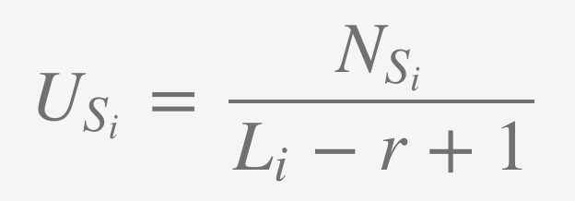
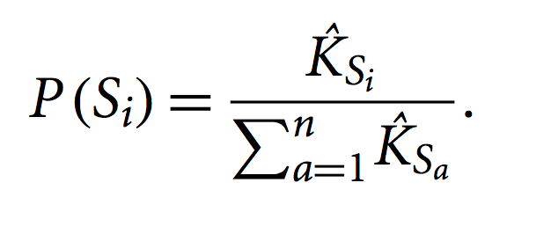
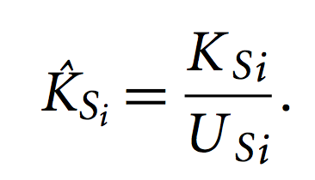
Calculating P(S_{i})
N_{Si} is the number of k-mers of length r that are uniquely assigned to genome S_{i}
Unique kmers
Total kmers of genome, length L_{i}
number of reads KSi from a sample that Kraken actually assigns to Si
All genomes in a genus
Genus Gj contains n genomes

Slide 14
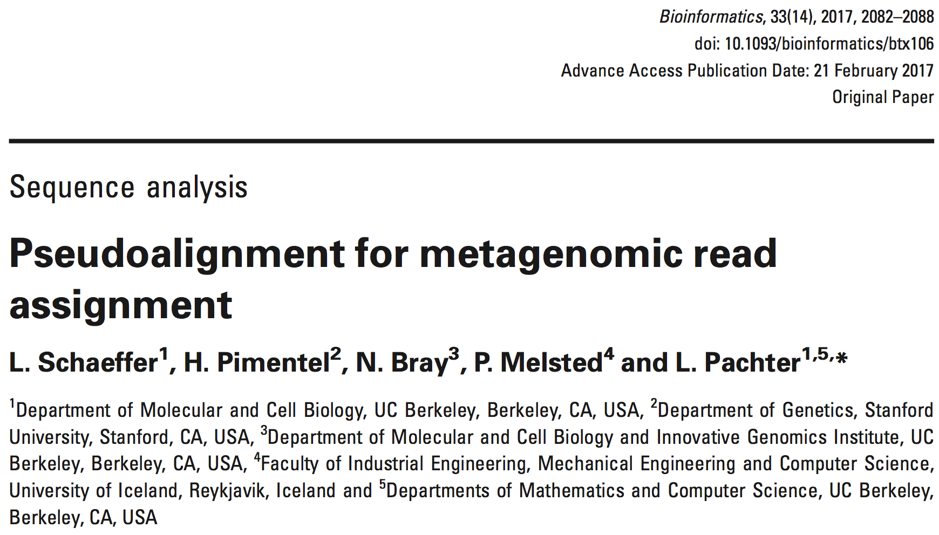
Other methods for this task
Kalliso (first uses MASH to limit size of database, then EM for read assignment)
MetaPhlAn,
ConStrains,
GAAS,
GASiC,
TAEC,
GRAMMy]

Slide 15
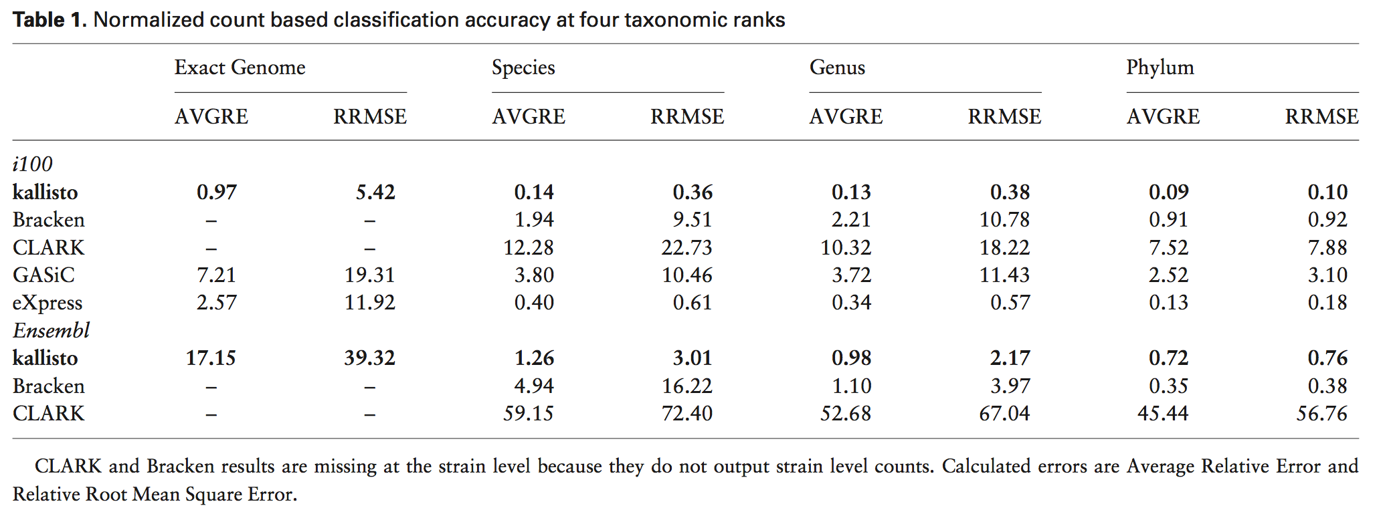
kallisto performance

Slide 16
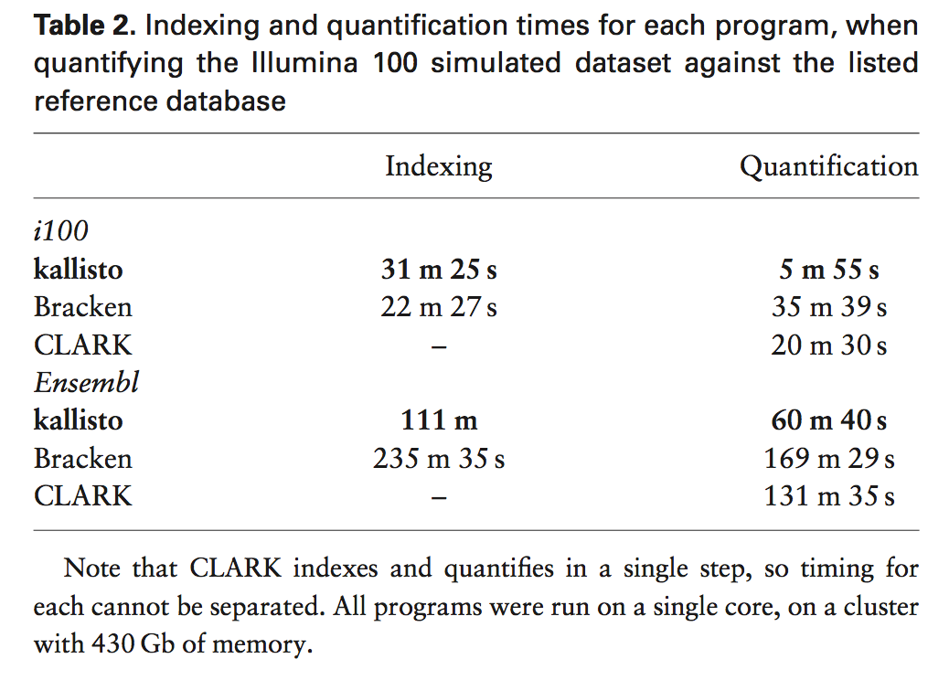

Slide 17
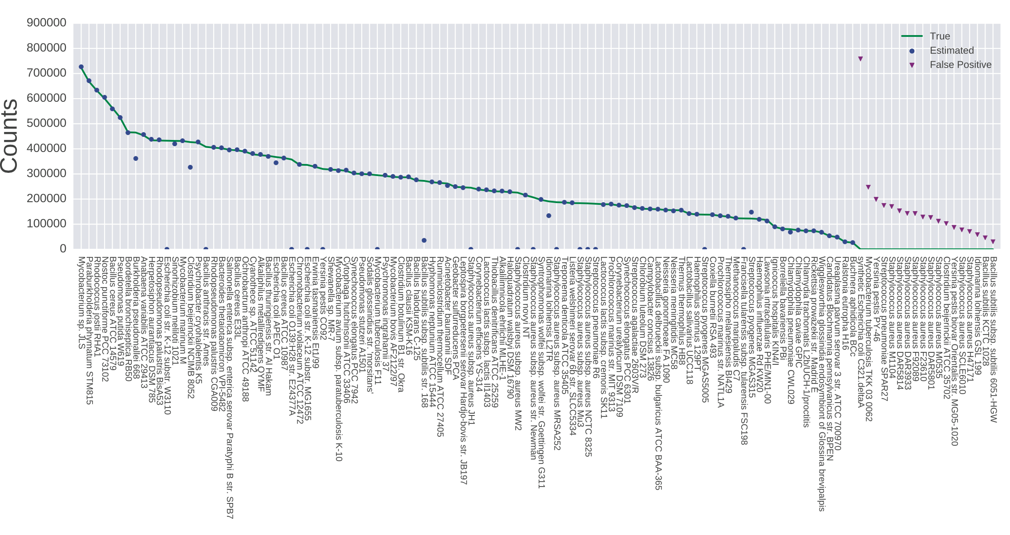

Slide 18
Conclusions
We should use the i100 dataset to benchmark exceRpt for exogenous sequence abundances,
Use that result to determine if we should run the unmapped asthma reads through another tool (probably kalliso)

