Slide 1
Extra slide

Slide 2
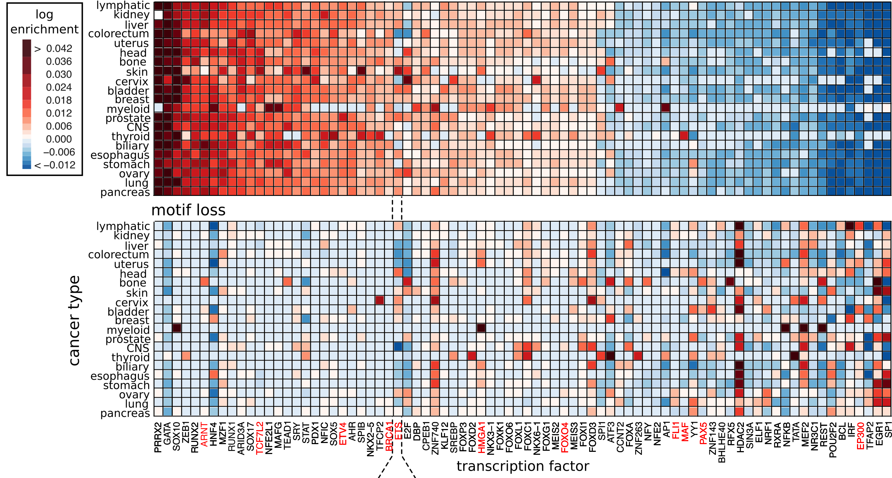
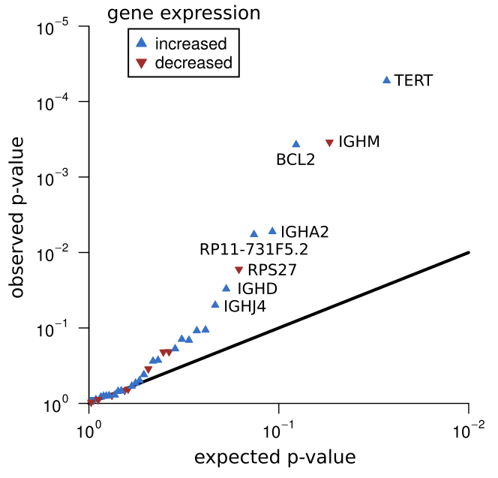
Mutational burdening of TF-subnetworks due to SNVs breaking & creating binding sites
GAIN
LOSS
ETS regulated genes
ARNT
EP300

