Slide 1
Bitcoin block chain
In 2014, the blockchain is over 20 GB in size, growing at an increasing rate
The block size is capped at 1MB, and with 1 block approximately every 10 min
Thus, the blockchain size can grow at most
6*24*365 = 52,560MB or 52 GB per year
At the end of 2016, the size of full bitcoin blockchain reaches 100GB, with about 4500 and 5000 full bitcoin nodes constantly online

Slide 2
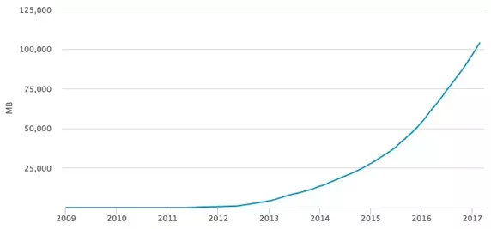

Slide 3
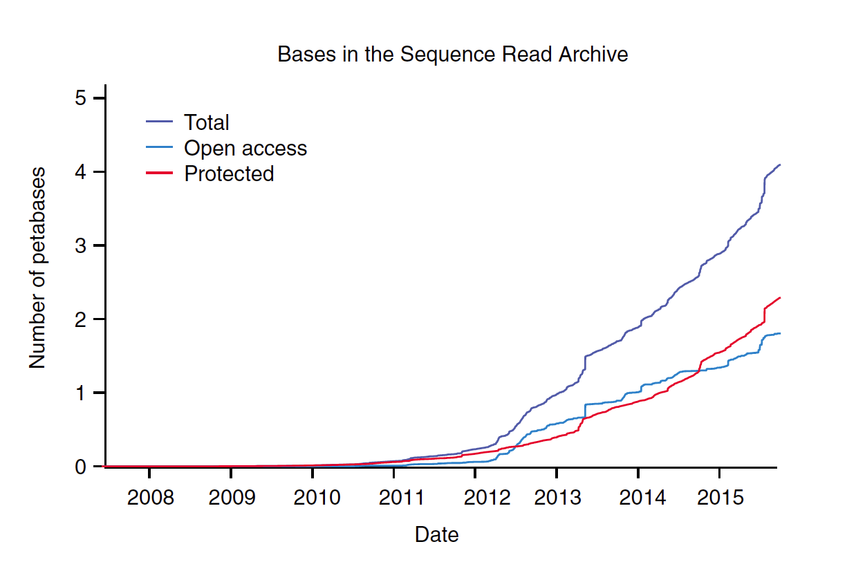

Slide 4
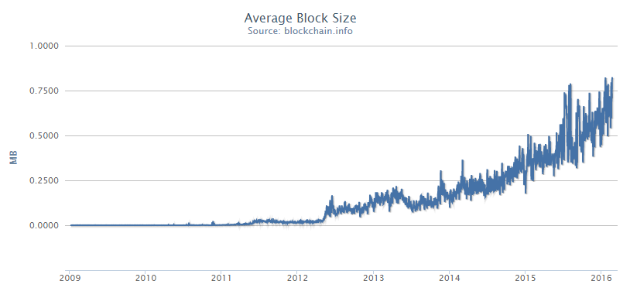

Slide 5
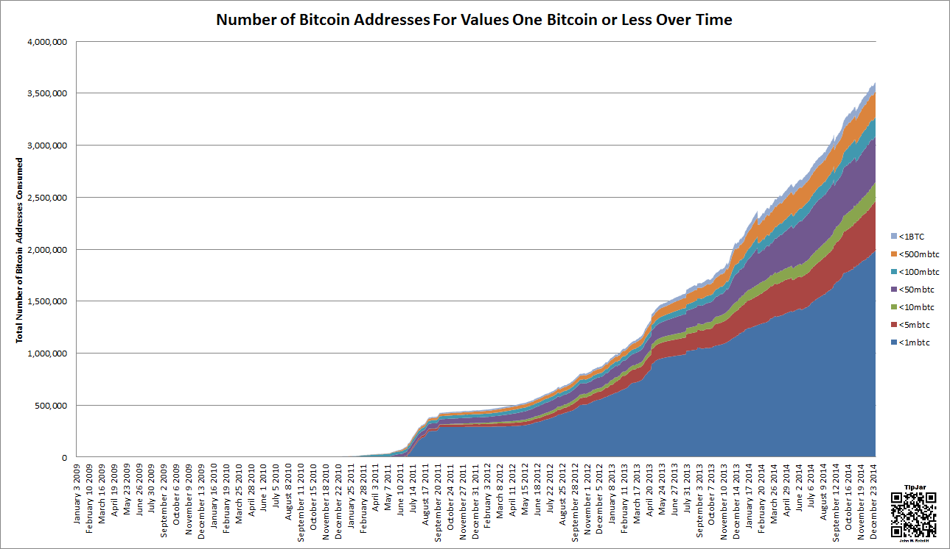

Slide 6
