Slide 1
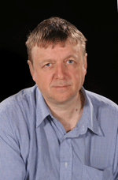
Genetics of Neurodegenerative Diseases
Summarize recent work in neurodegenerative disease
Pleomorphic risk for parkison’s disease at SNCA
innate immune system in Alzheimer's and Parkinson's disease
PU.1 transcription factor (lower expression delays onset of Alzheimer's disease)
Trem2 gene (
MS4A
APP metabolism
Glial repsonse
SNCA and SCARBP GWAS hits in PD and DLB, same gene, different regulationselective vulnerability
pathogenesis of Ataxia (34 loci)
John Hardy
UCL institute of neurology
Notes:
Alpha-synuclein (SNCA) (first PD gene, found to segregate with the disease)

Slide 2
Goal: Advancing human potential and promoting equal opportunity
Education/ Science/ Policy
Technology
CHAN ZUCKERBERG BIOHUB: UCSF/coco cola/stanford
Bring bio/comp people together and talk to each other
CZI support Human Cell Atlas (HCA):
Funding
Platforms (DCP)
Promote collaboration
Collaborate with Broad institute (Eric Lander)
Clout platform, eg. Single cell platform
Knowledge environment: sharing scientific knowledge
Grant and help develop platform for bioRxiv
Meta, knowledge graph

Slide 3
Marg Sutherland
NIND
AMP PD
AMP: Accelerating medicne partnership

Slide 4
Marg Sutherland
NIND
AMP PD
AMP: Accelerating medicne partnership
PD knowledge platform
Incorporating NIH common fund exRNA
Collaborating with Verily
Google genomics data share cloud
AMP-T2D

Slide 5
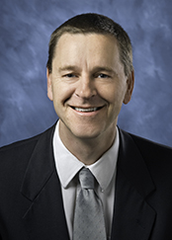
NIH Tissue Chip Initiative & Projects
link
Collaborate with Emulate
iPSC for PD
ALS-Chip as example, 3D model
Clive Svendsen
Cedars-Sinal
Sam Sances
Postdoc fellow
Cedars-Sinal

Slide 6
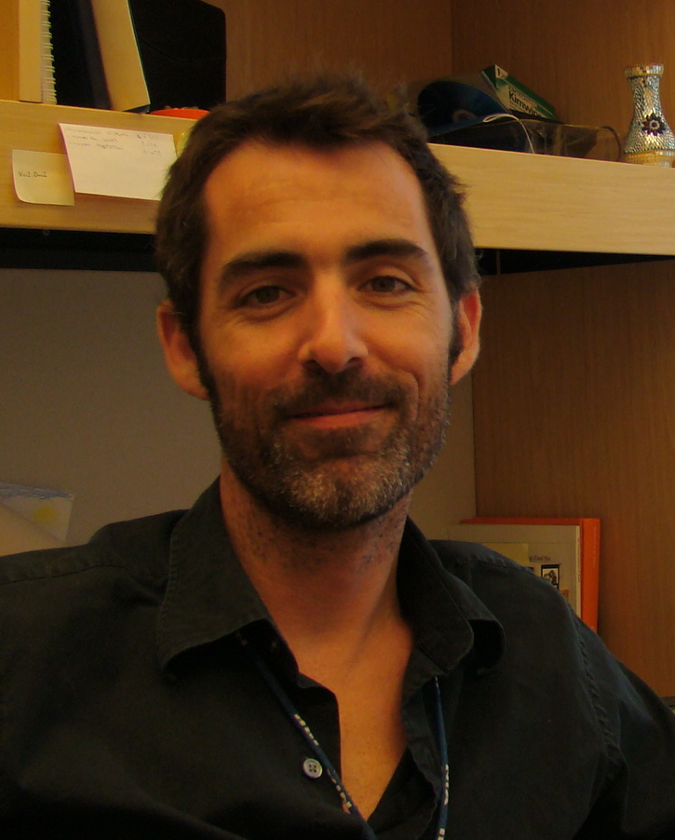
The International PD Genetics Consortium
IPDGC
International Parkinson Disease Genetics Consortium
IPDGC datasets
17545 cases
21678 controls
39223 total
40 IPDGC publications in the last 5 years
Andy Singleton
Laboratory of Neurogenetics
NIA
Whole exome sequencing
1148PD cases and 503 controls
Genome sequence
4200 cases, 600 neuropathologically normal controls
3000 DLB(dementia with Lewy bodies) and 3000 FTD(frontotemporal dementia) (Scholz and Traynor)

Slide 7
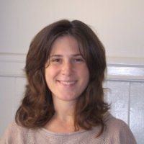
AMP-AD: A community-based approach to systems biology-based AD target discovery
AMP-AD knowledge portal
Sage synapse
Lara Mangravite
Sage Bionetworks
UCSF

Slide 8
AMP-AD: A community-based approach to systems biology-based AD target discovery
AMP-AD knowledge portal
Sage synapse
6890 individuals
RNASeq Sample SWAP
Differential Expression
N = 1026Brain
eQTL N = 1700 (including common mind)
Collaborate
compare with AMP-AD network disease models
Aggregate
nominate target supported by multiple groups
Each group funded to do clinical trials
Evaluate
candidate target14 model organism studies
Lara Mangravite
Sage Bionetworks
UCSF

Slide 9
AMP-AD: A community-based approach to systems biology-based AD target discovery
AMP-AD knowledge portal
Sage synapse
Lara Mangravite
Sage Bionetworks
UCSF

Slide 10
AMP-AD: A community-based approach to systems biology-based AD target discovery
AMP-AD knowledge portal
Sage synapse
Lara Mangravite
Sage Bionetworks
UCSF

Slide 11
AMP-AD: A community-based approach to systems biology-based AD target discovery
AMP-AD knowledge portal
Sage synapse
Lara Mangravite
Sage Bionetworks
UCSF

