Slide 1
Jclub
MTG

Slide 3
Hojoong Kwak
Cornell University
Notes:
Precision Run-on sequencing (PRO-seq) Kwak et al, Science 2013

Slide 4
Hojoong Kwak
Cornell University

Slide 5
Hojoong Kwak
Cornell University

Slide 6
Hojoong Kwak
Cornell University

Slide 7
Hojoong Kwak
Cornell University

Slide 9
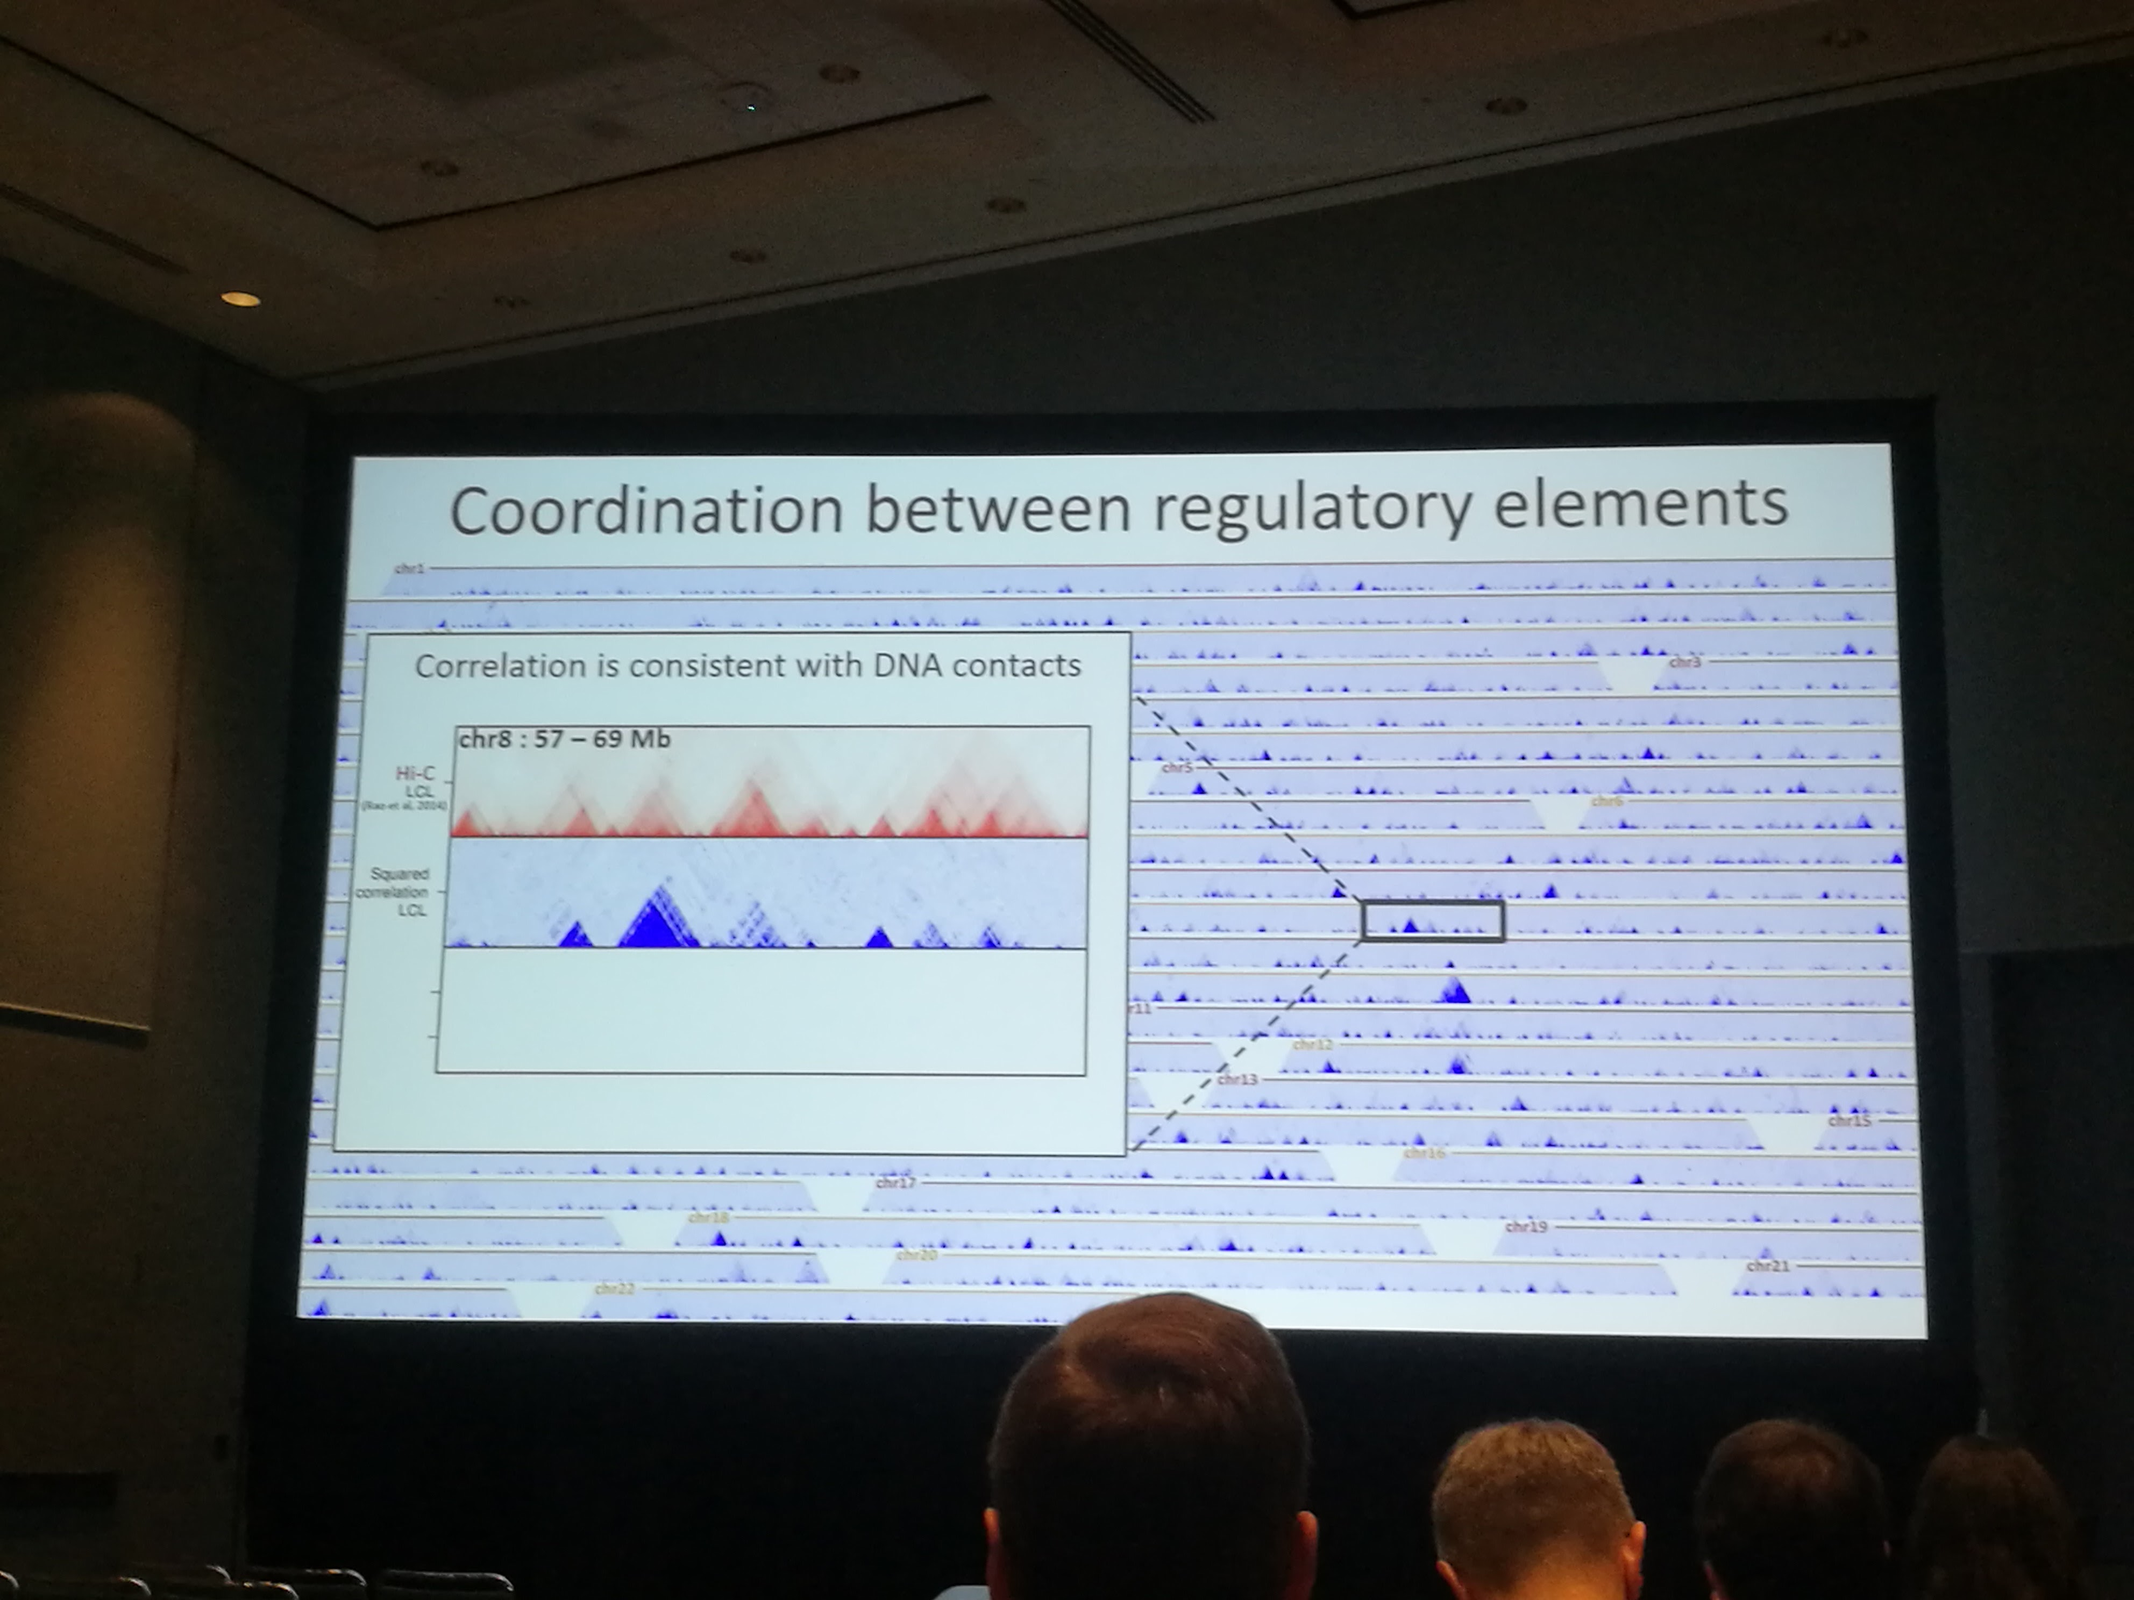

Slide 19
Notes:
asthma

Slide 20
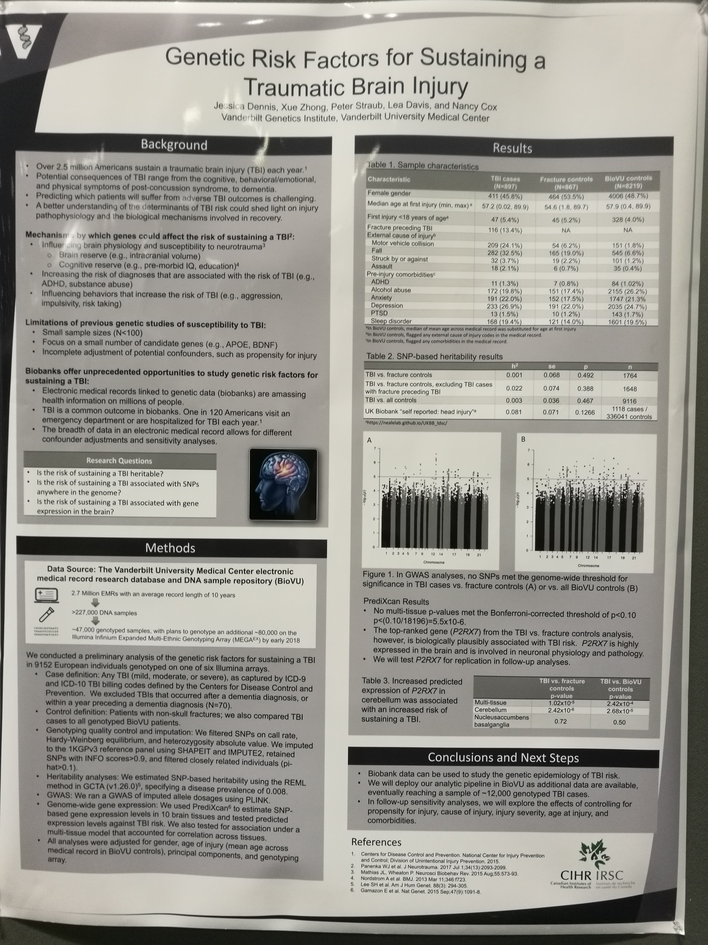

Slide 22
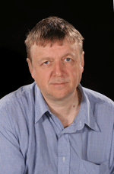
Genetics of Neurodegenerative Diseases
Summarize recent work in neurodegenerative disease
Pleomorphic risk for parkison’s disease at SNCA
innate immune system in Alzheimer's and Parkinson's disease
PU.1 transcription factor (lower expression delays onset of Alzheimer's disease)
Trem2 gene (
MS4A
APP metabolism
Glial repsonse
SNCA and SCARBP GWAS hits in PD and DLB, same gene, different regulationselective vulnerability
pathogenesis of Ataxia (34 loci)
John Hardy
UCL institute of neurology
Notes:
Alpha-synuclein (SNCA) (first PD gene, found to segregate with the disease)

Slide 23
Goal: Advancing human potential and promoting equal opportunity
Education/ Science/ Policy
Technology
CHAN ZUCKERBERG BIOHUB: UCSF/coco cola/stanford
Bring bio/comp people together and talk to each other
CZI support Human Cell Atlas (HCA):
Funding
Platforms (DCP)
Promote collaboration
Collaborate with Broad institute (Eric Lander)
Clout platform, eg. Single cell platform
Knowledge environment: sharing scientific knowledge
Grant and help develop platform for bioRxiv
Meta, knowledge graph

Slide 24
Marg Sutherland
NIND
AMP PD
AMP: Accelerating medicne partnership

Slide 25
Marg Sutherland
NIND
AMP PD
AMP: Accelerating medicne partnership
PD knowledge platform
Incorporating NIH common fund exRNA
Collaborating with Verily
Google genomics data share cloud
AMP-T2D

Slide 26
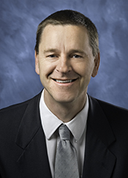
NIH Tissue Chip Initiative & Projects
link
Collaborate with Emulate
iPSC for PD
ALS-Chip as example, 3D model
Clive Svendsen
Cedars-Sinal
Sam Sances
Postdoc fellow
Cedars-Sinal

Slide 27
NIH Tissue Chip Initiative & Projects
link
Collaborate with Emulate
iPSC for PD
ALS-Chip as example, 3D model
Clive Svendsen
Cedars-Sinal
Sam Sances
Postdoc fellow
Cedars-Sinal

Slide 28
NIH Tissue Chip Initiative & Projects
link
Collaborate with Emulate
iPSC for PD
ALS-Chip as example, 3D model
neural network activity assessed through live imaging
Clive Svendsen
Cedars-Sinal
Sam Sances
Postdoc fellow
Cedars-Sinal

Slide 29
NIH Tissue Chip Initiative & Projects
link
Collaborate with Emulate
iPSC for PD
ALS-Chip as example, 3D model
neural network activity assessed through live imaging
Clive Svendsen
Cedars-Sinal
Sam Sances
Postdoc fellow
Cedars-Sinal

Slide 30
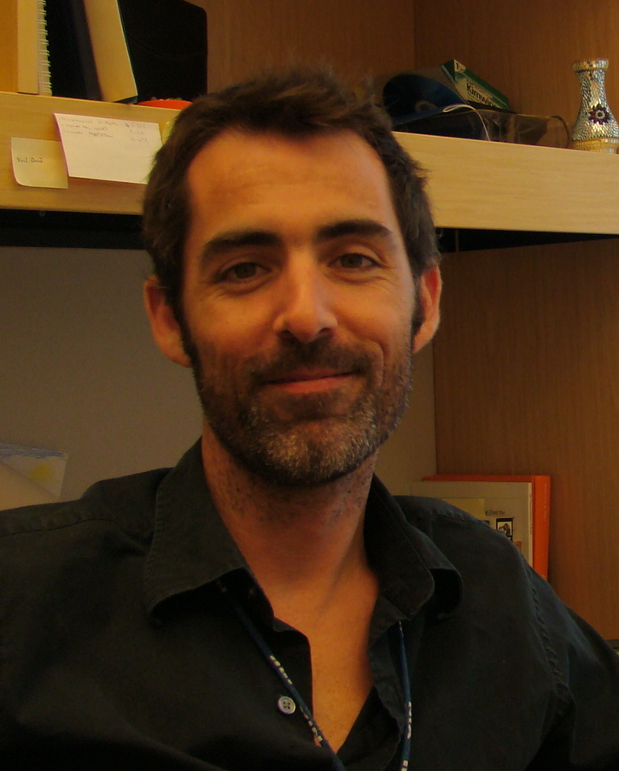
The International PD Genetics Consortium
IPDGC
International Parkinson Disease Genetics Consortium
Andy Singleton
Laboratory of Neurogenetics
NIA

Slide 31
The International PD Genetics Consortium
IPDGC
International Parkinson Disease Genetics Consortium
IPDGC datasets
17545 cases
21678 controls
39223 total
40 IPDGC publications in the last 5 years
Andy Singleton
Laboratory of Neurogenetics
NIA
Whole exome sequencing
1148PD cases and 503 controls
Genome sequence
4200 cases, 600 neuropathologically normal controls
3000 DLB(dementia with Lewy bodies) and 3000 FTD(frontotemporal dementia) (Scholz and Traynor)

Slide 32
The International PD Genetics Consortium
IPDGC
International Parkinson Disease Genetics Consortium
IPDGC datasets
17545 cases
21678 controls
39223 total
40 IPDGC publications in the last 5 years
Expression dataset / eQTL datasets
(NIH, UCL, DZNE)
functional analysis
high content screens
protein-interactions overlay with risk SNP QTL internal data browsers
Loci predicting PD vs control: ROC 0.93-0.96
Whole exome sequencing
1148PD cases and 503 controls
Genome sequence
4200 cases, 600 neuropathologically normal controls
3000 DLB(dementia with Lewy bodies) and 3000 FTD(frontotemporal dementia) (Scholz and Traynor)

Slide 33
High throughput functional prioritization of candidate genes from large-scale sequencing and GWAS studies
Peter Heutink
Exome sequence: look for LOF variants
mitochondria morphology and parkin translocation
start with 27 candidate genes (with LOF variants)
GWAS study show 17 novel loci
TMEM175 in STAT3 pathway
FANTOM6
screening in multiple iPS derived cell types

Slide 34
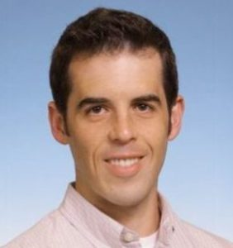
A platform for genetic data sharing and analysis: the AMP-T2D knowledge portaltype-2 diabetes knowledge portal
Hail and LocusZoom support large scale interactive analysis
variant finder: search for variants through filter across different datasets
gene page: customized burden test
Jason Flannick
Massachusetts General Hospital
The Broad Institute
AMP-PD
Notes:
Accelerating medicine partnership

Slide 35
A platform for genetic data sharing and analysis: the AMP-T2D knowledge portaltype-2 diabetes knowledge portal
Hail and LocusZoom support large scale interactive analysis
variant finder: search for variants through filter across different datasets
gene page: customized burden test
Jason Flannick
Massachusetts General Hospital
The Broad Institute
AMP-PD
Notes:
Accelerating medicine partnership

Slide 36
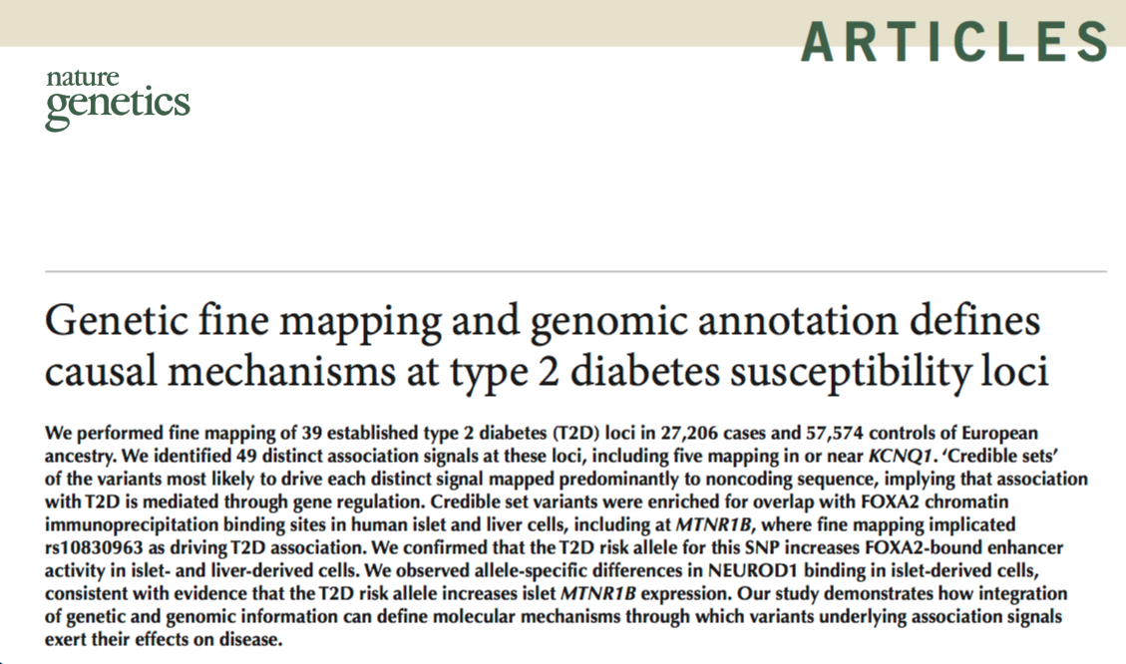
A platform for genetic data sharing and analysis: the AMP-T2D knowledge portaltype-2 diabetes knowledge portal
Hail and LocusZoom support large scale interactive analysis
variant finder: search for variants through filter across different datasets
gene page: customized burden test
Jason Flannick
Massachusetts General Hospital
The Broad Institute
AMP-PD
Notes:
Accelerating medicine partnership

Slide 37
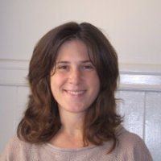
AMP-AD: A community-based approach to systems biology-based AD target discovery
AMP-AD knowledge portal
Sage synapse
Lara Mangravite
Sage Bionetworks
UCSF

Slide 38
AMP-AD: A community-based approach to systems biology-based AD target discovery
AMP-AD knowledge portal
Sage synapse
Lara Mangravite
Sage Bionetworks
UCSF

Slide 39
AMP-AD: A community-based approach to systems biology-based AD target discovery
AMP-AD knowledge portal
Sage synapse
6890 individuals
RNASeq Sample SWAP
Differential Expression
N = 1026Brain
eQTL N = 1700 (including common mind)
Collaborate
compare with AMP-AD network disease models
Aggregate
nominate target supported by multiple groups
Each group funded to do clinical trials
Evaluate
candidate target14 model organism studies
Lara Mangravite
Sage Bionetworks
UCSF

Slide 40
AMP-AD: A community-based approach to systems biology-based AD target discovery
AMP-AD knowledge portal
Sage synapse
Lara Mangravite
Sage Bionetworks
UCSF

Slide 41
AMP-AD: A community-based approach to systems biology-based AD target discovery
AMP-AD knowledge portal
Sage synapse
Lara Mangravite
Sage Bionetworks
UCSF

Slide 42
AMP-AD: A community-based approach to systems biology-based AD target discovery
AMP-AD knowledge portal
Sage synapse
Lara Mangravite
Sage Bionetworks
UCSF

Slide 43
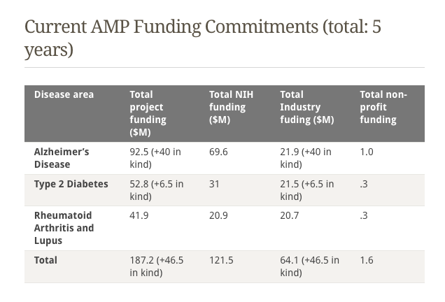

Slide 44
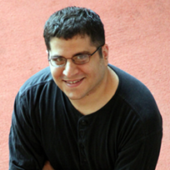
Computational Approaches for Interpreting Non-coding Genetic Variants
Epigenetic:
ChromHMM, Chromimpute (Epigenomic imputation)
Functional Assay
MPRA: sharpr-STARR
Conservation states provide complementary genome annotation
ConsHMM
Encode each position in 3 category: match in human genome/ not match/ does not align
Jason Ernst
UCLA

Slide 45
The end

Slide 46
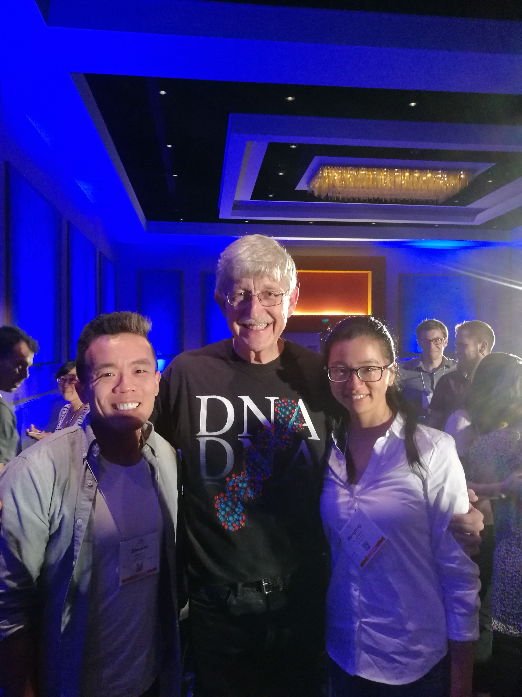
The end

