Slide 1
Statistical properties of weak non-neutral effects in cancer using additive variance
10/23/17

Slide 2
Additive variance model
Additive variance model detects aggregate effects of many variants on a phenotype, whose individual effect sizes may be too weak to achieve significance individually
Model can only detect that an aggregate effect exists: does not identify particular variants as significant
We adapt this model from GWAS analysis to detect non-neutral weak effects in cancer

Slide 3
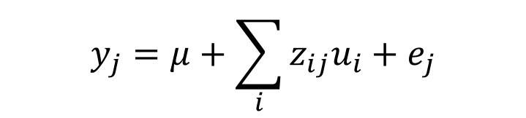


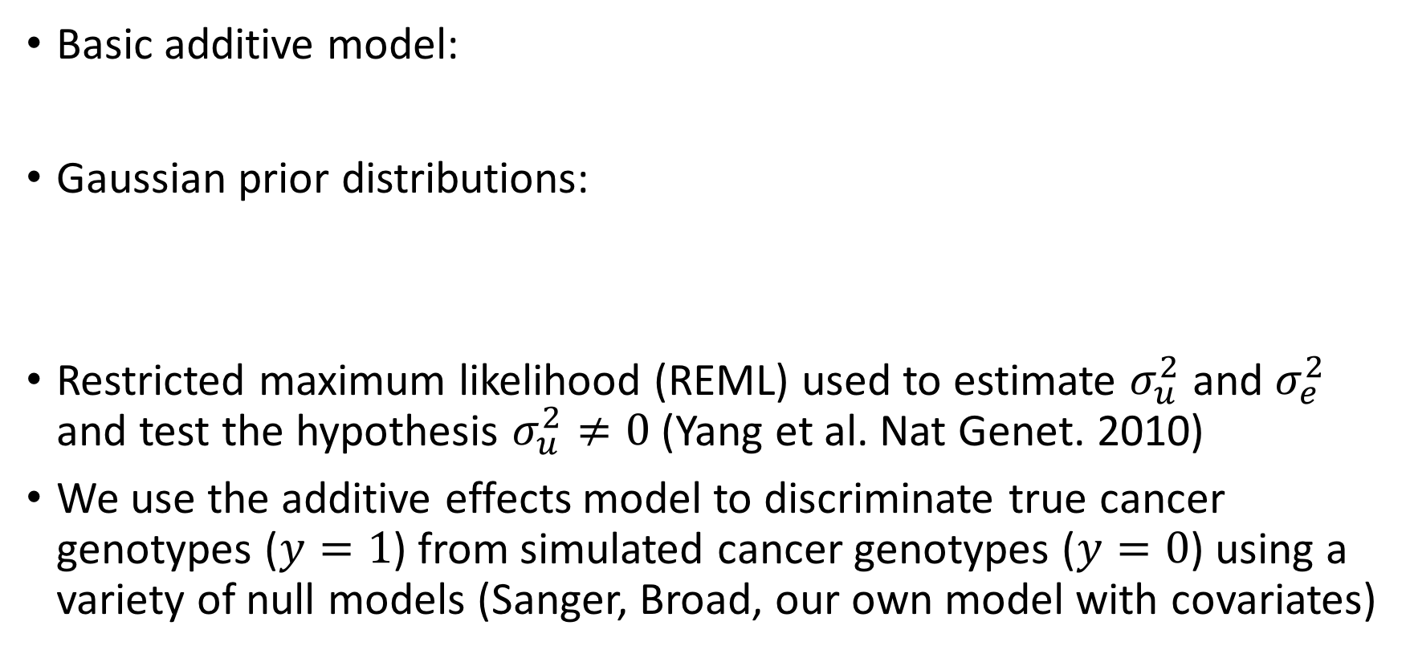
Additive variance model
$$y_{j}=μ+\sum_{i}{z_{ij}u_{i}+e_{j}}$$
$y_{j}$ = phenotype of patient $j$
$μ$ = mean phenotype
$z_{ij}$ = normalized (z-score) dosage of SNV $i$ in sample $j$
$u_{i}$ = effect of SNV $i$
$e_{j}$ = residual for patient $j$
Basic additive model:
Gaussian prior distributions:
Restricted maximum likelihood (REML) used to estimate $σ_{u}^{2}$ and $σ_{e}^{2}$ and test the hypothesis $σ_{u}^{2}≠0$ (Yang et al. Nat Genet. 2010)
We use the additive effects model to discriminate true cancer genotypes ($y=1$) from simulated cancer genotypes ($y=0$) using a variety of null models (Sanger, Broad, our own model with covariates)
$$u_{i}∼N\left(0,σ_{\text{u}}^{2}\right)$$
$$e_{j}∼N(0,σ_{\text{e}}^{2})$$

Slide 4
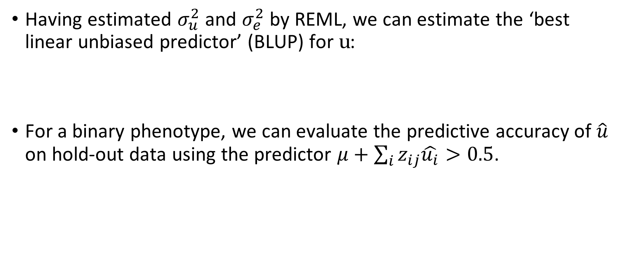

Additive variance model: Predictive form
Having estimated $σ_{u}^{2}$ and $σ_{e}^{2}$ by REML, we can estimate the ‘best linear unbiased predictor’ (BLUP) for $\text{u}$:
For a binary phenotype, we can evaluate the predictive accuracy of $\hat{u}$ on hold-out data using the predictor $μ+\sum_{i}{z_{ij}\hat{u_{i}}>0.5}$.
$$\hat{\text{u}}=\text{argma}{\text{x}}_{\text{u}}\left(P\left(\text{u}\text{|}\text{y}\right)\right)$$

Slide 5
Analysis of weak effect distributions
We investigate net properties of weak effects using a version of the additive variance model recast as a predictive model (using the Best Linear Unbiased Predictor, BLUP)
We make 10 splits of the data into equal-sized test and training partitions for each cohort, and train separate models on each
We compare models trained on various categories of mutations
  Coding
  Promoters
  Other non-coding
  CGC genes only

Slide 6

Comparison of predictive power for cancer phenotype
Coding + non-coding
All promoters
Cancer gene promoters
Predictive accuracy
p=1.2e-19
p=8.2e-13
p=0.0075
Additive variance ($σ_{A}^{2}$)
Blue: Cohort means; Red: 10 X test/train splits for each cohort;
p-value: Binomial-test against null hypothesis that predictive_accuracy=0.5
NB: Half of the data only used for training, which is expected to lower predictive accuracy and increase variance on the $σ_{A}^{2}$ estimate

Slide 7
Statistics of positive and negative effects
We find a mixture of positive and negative BLUP coefficients across models
Proportion of positive coefficients
Cohort | Breast | CNS | Kidney | Ovary | Pancreas | Prostate | Skin
Coding+ncd
Promoters
CGC promot. | 0.48 | 0.43 | 0.49 | 0.51 | 0.46 | 0.42 | 0.32

Slide 8
CGC promoters are more predictive than others only in certain tumor types
Breast
Kidney
Pan-cancer
Predictive accuracy
Predictive accuracy
*
Prostate
n.s.
603 CGC promoters
Random subsets of 603 promoters
*

Slide 9
Summary
Statistics of BLUP predictor may be used to investigate net properties of weak non-neutral effects
We find a mixture of positive and negative effects across all models tested, and a dependency on tumor type for the predictive ability of various mutation classes
Analyses subject to assumptions of background models

Slide 10
Extra slides

Slide 11
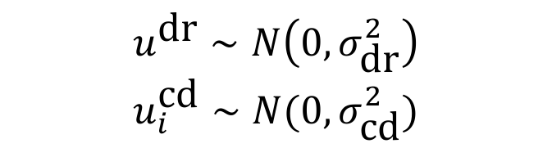
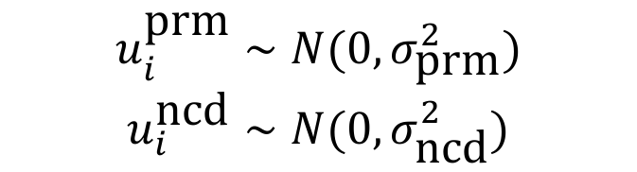
Additive variance model: alternative forms
Combined model with separate terms for different mutation classes:
$$y_{j}=μ+\sum_{i}{z_{ij}^{\text{cd}}u_{i}^{\text{cd}}+}\sum_{i}{z_{ij}^{\text{prm}}u_{i}^{\text{prm}}+}\sum_{i}{z_{ij}^{\text{n}\text{cd}}u_{i}^{\text{n}\text{cd}}+e_{j}}$$
(1)
$$y_{j}=μ+z_{j}^{\text{dr}}u^{\text{dr}}+\sum_{i}{z_{ij}^{\text{cd}}u_{i}^{\text{cd}}+}\sum_{i}{z_{ij}^{\text{prm}}u_{i}^{\text{prm}}+}\sum_{i}{z_{ij}^{\text{n}\text{cd}}u_{i}^{\text{n}\text{cd}}+e_{j}}$$
(2)
$$u^{\text{dr}}∼N\left(0,σ_{\text{dr}}^{2}\right)$$
$$u_{i}^{\text{cd}}∼N(0,σ_{\text{cd}}^{2})$$
$$u_{i}^{\text{prm}}∼N(0,σ_{\text{prm}}^{2})$$
$$u_{i}^{\text{ncd}}∼N(0,σ_{\text{n}\text{cd}}^{2})$$

Slide 12
Additive variance breakdown, model comparison
Broad null model
 | Coding | Prom | Oth. ncd | Total
Pan-canc | 0.2127 | 0.008 | 0.1959 | 0.4165
Per SNV | 0.0049 | 0.0023 | 0.0002
Our null model (w/ covariates)
 | Coding | Prom | Oth. ncd | Total
Pan-canc | 0.2171 | 0.0265 | 0.1586 | 0.4022
Per SNV | 0.0048 | 0.0007 | 0.0001
Model with separate drivers term
 | PCAWG drivers | Ours | Broad | Sanger
Pan-canc | 0.4981 | 0.564 | 0.5736 | 0.5741

Slide 13
Q-values across cohorts / mutation classes
Mutation class q-vals (Broad null)
Full model vs drivers q-vals
 | Coding | Prom | Oth. ncd
Breast | 4.2e-9 | 0.1345 | 0.1301
CNS | 0.0304 | 0.0402 | 0.0396
Kidney | 0.0344 | 0.525 | 0.0854
Liver | 2.7e-8 | 0.029 | 0.0001
Ovary | 3.5e-5 | 0.5 | 0.0255
Pancreas | ~0 | 0.032 | 0.0304
Prostate | 0.0673 | 0.0845 | 0.0024
 | Ours | Broad | Sanger
Breast | 0.0217 | 0.0334 | 0.0875
CNS | 0.4737 | 0.0839 | 0.0953
Kidney | 0.2125 | 0.2841 | 0.0001
Liver | 0.0123 | 0.0001 | 0.1718
Ovary | 0.0212 | 0.0098 | 0.0149
Pancreas | 0.0554 | 0.036 | 0.5
Prostate | 0.021 | 0.0127 | 4.5e-5

