Slide 1
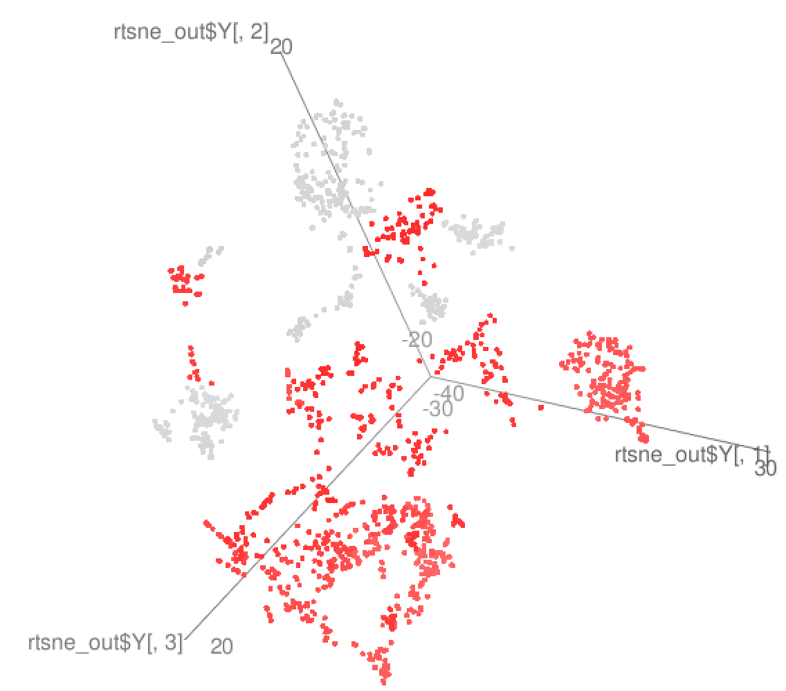
932 single cells from Sestan Lab
Gene expression data from Mingfeng Li
Neuronal signature gene expression correlation (Lake, Science 16’)
PNAS 15’, n=466
Non-neuronal signature gene expression correlation (PNAS 15’)
Nenad, n=932

