Slide 1

Modeling tumor evolution: the tale of a thousand and one tumors
TUMORS

Slide 2

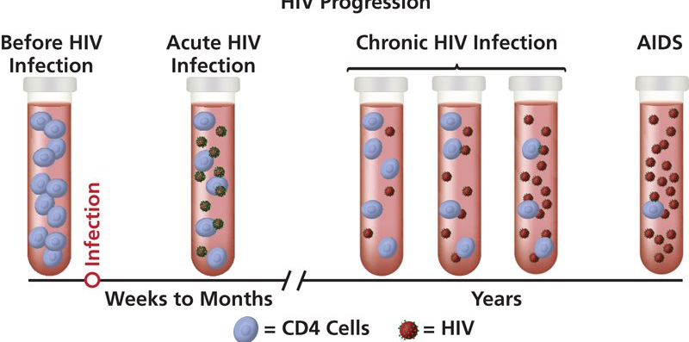
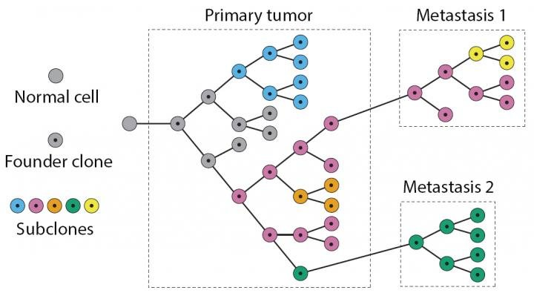


Evolving at different pace
Slow track
Fast track
A
5-10 years
~320 MYA
C
B
~100 MYA
Months to
a few years
~300 MYA

Slide 3

Tumor Evolution
A Thousands Evolutions
994 linear tumor samples
39 cancer types
XXX somatic mutations

Slide 4
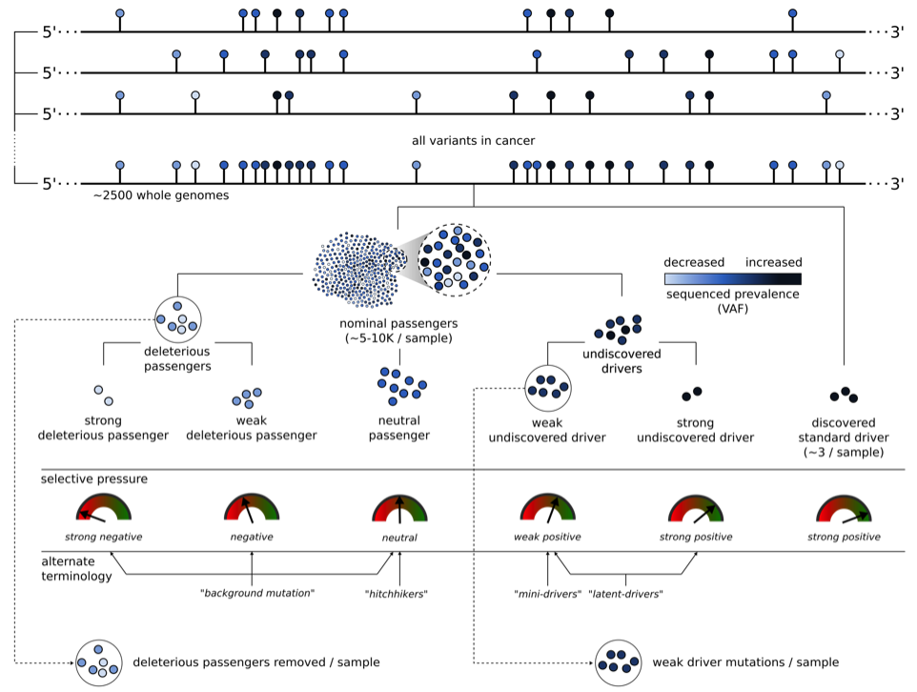
Drivers, passengers and “nominal” passengers (shotgun)
Are weak drivers real?
Can we detect them?
What is their effect?
Sushant et al 2017(?)

Slide 5


Hitchhiking prevalence is increased
No fitness mutation
fitness mutation
0
1
2
3
4
0
1
2
3
4
8/16 = 0.5
12/20 = 0.6
4/16 = 0.25
8/20 = 0.4
8/16 = 0.5
8/20 = 0.4

Slide 6
A method for detecting growth rate and the effect of mutations during tumor progression
Key observation:
  Hichthiking mutations are generational mutations

Slide 7
Estimating the frequency of “hitchchickers”

Slide 8
Growth rate ‘r’ can be calculated independently for “hitchhikers”

Slide 9
…And non hitchhikers

Slide 10
Re-optimizing locally for linear tumors

Slide 11
Simulations I: Predicting growth rate r and mutational effect k without noise

Slide 12
Simulations II: introducing noise
A. Biological noise
K effect
B. Systematic noise due to coverage
r = 3
K = 1.5
50 100 150 200 250 300
50 100 150 200 250 300

Slide 13


Simulations III: From low to high sequencing coverage
$$r$$
$$k$$
50 100 150 200 250 300
50 100 150 200 250 300
Sequencing Coverage

Slide 14
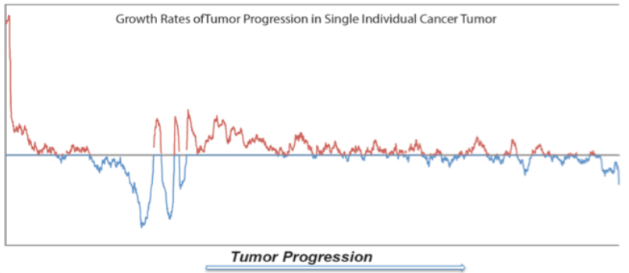
Identify selection based on positive or negative growth across 994 linear tumors
(# spec.muts in positive growth) – (# random in positive growth)
Positive Growth Effect =
(total spec.muts in 994 tumors)
Spec.muts: Mutations from specific genes (eg. TP53), types (eg. nonsense) etc.

Slide 15
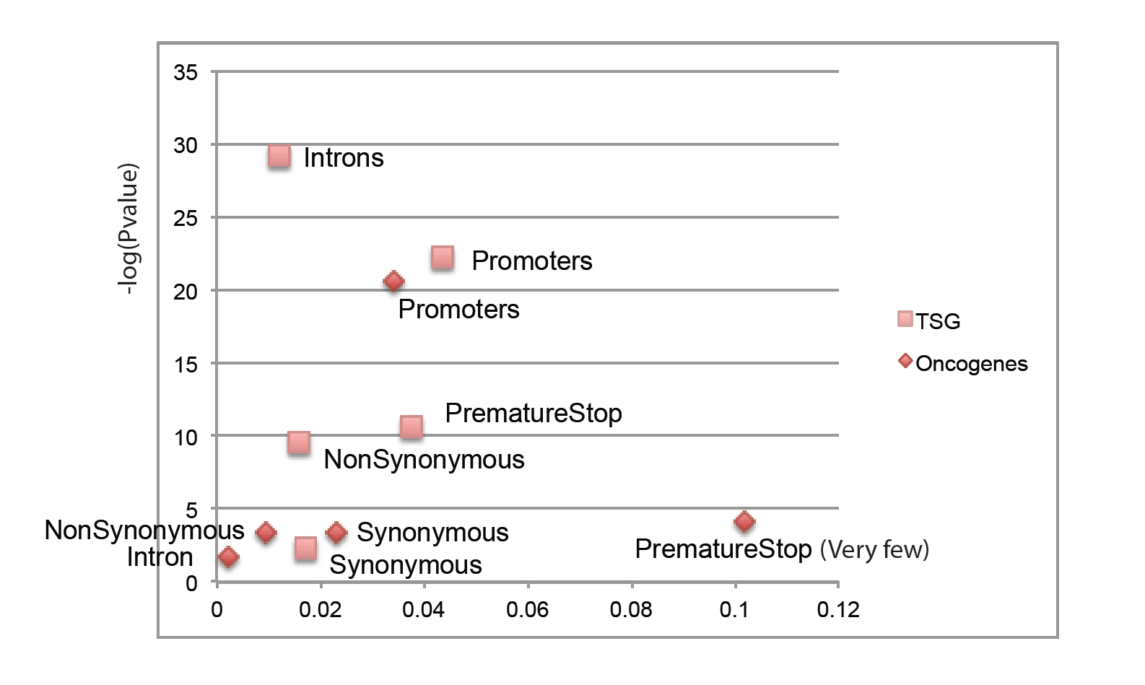
Selection across Genes and Types:
Strong selection for Promoters, also for introns and LoFs
Growth
Effect
Highly mutated genes (PCAWG)
TSG - Oncogenes
TSG/Onco vs normal Genes
-log(Pvalue)
Effect
Effect

Slide 16
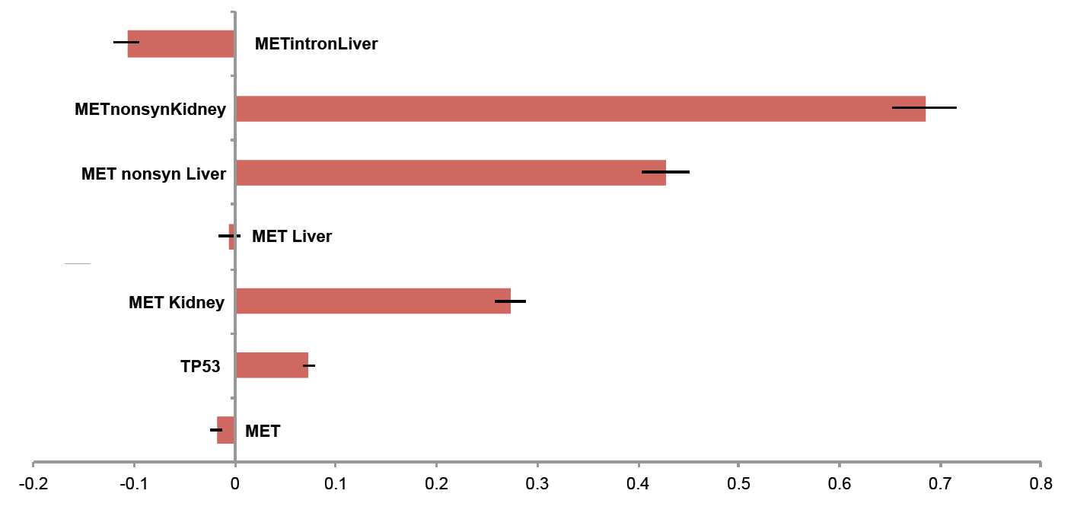
Not All OncoGene mutations appear to be under selection: The MET story

Slide 17
The MET story:
MET is selected in Kidney

Slide 18
The MET story:
But not in Liver?

Slide 19
The MET story:
It is..

Slide 20
The MET story:
Strong selection even in introgenic region

Slide 21
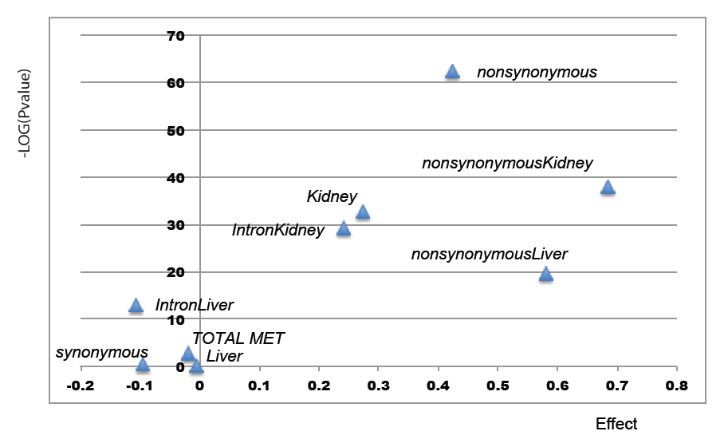
Not All Onco-Gene mutations are Selected: The MET story

Slide 22
Or across different tumors

Slide 23
Calculating growth rates across a (Deep-sequenced) tumor progression I

Slide 24
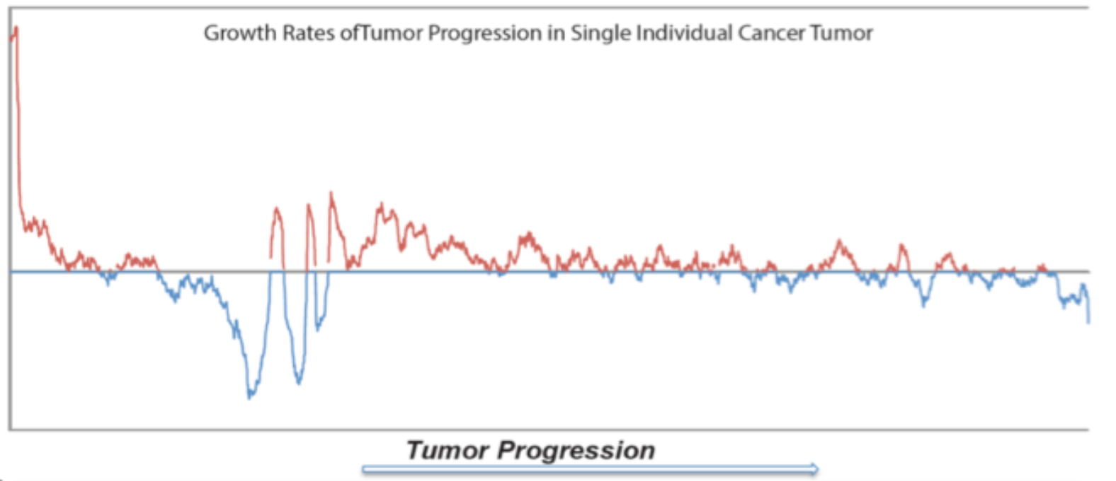
Some growth Peaks correspond to missense oncogenic mutations
A 300x Deep sequenced AML tumor

Slide 25
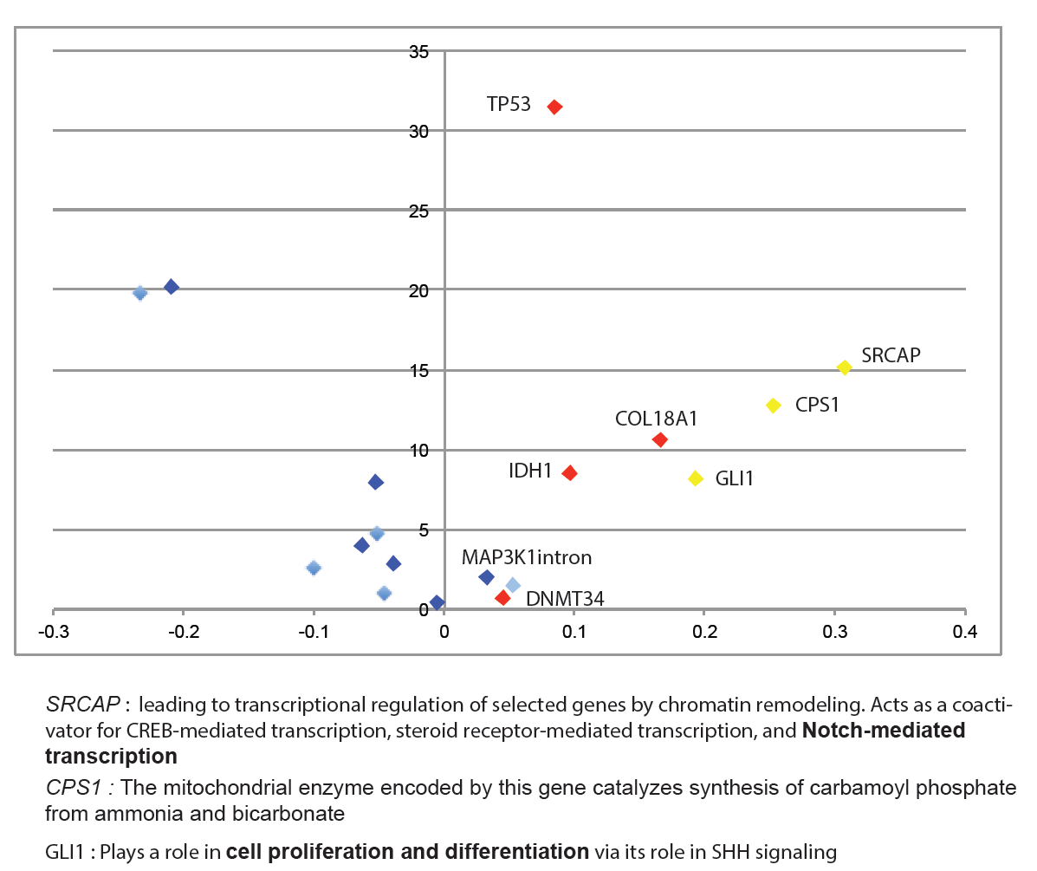
What about the other peaks?

Slide 26
What about the other peaks?
FLT3
IDH1
IDH2

Slide 27
Adding positive selected mutations
CPS1
GLI1
COL18A1
MAP3K1
intron
FLT3
IDH1
IDH2

Slide 28
Optimizing for parameter K:
The war of weak drivers: MET vs TP53

Slide 29
Summary
Tumors are “real time” evolution experiments
We constructed a method that:
  Estimates growth rates during tumor progression
  Is applicable to individual tumors
  Can estimate the effect of a subclone or mutation
Using 994 linear tumors we can detect selection for genomic regions (genes, group of genes, introns, type of mut)
We detected positive selection for intragenic regions, strong selection for promoters
We detected the presence of mutations with weak and strong effect
We suggest novel drivers

Slide 30
Immediate Follow-ups
Publish the method as software
Use the method to Calculate the number of weak drivers and deleterious passengers (Paper ω)
Associate growth rates with changes in signatures (methods ready)
Study the cascade effects of Map Kinases during tumor progression

