Slide 1
PsychENCODE Capstone 4 figures
Gerstein Lab
Yale University
10/19/2017

Slide 2
PsychENCODE Capstone #4
Developing a Brain Genomics Resource via Integrating CommonMind, ENCODE, GTEx, and Roadmap

Slide 3
PsychENCODE Capstone 4 flowchart
ChIP-seq
RNA-seq
Genotype
ChIP-seq
pipeline
RNA-seq
pipeline
Imputation
pipeline
Enhancers
Expression, bigwig
Genotype dosage
Expression normalization
Covariates calculation
Brain Specific enhancers
Differential expression analysis, PCA
eQTL
pipeline
Integrated analysis

Slide 4
Capstone #4 – talk outline
Resource
  Brain enhancers, eQTLs, expression modules, networks &c
Transcriptome analysis
  Spectral analysis of gene expression, unique brain expression patterns
  Non-coding transcription & retro-element activity, not atypical
Integrative network models
  Relating perturbations in gene expression to variants

Slide 5
Datasets
Datasets | Disease status | # samples | Brain region | Data Type
ENCODE/Roadmap | CTL |  | Multiple regions | ChIP-seq, RNA-seq
BrainSpan | CTL | 606 | 16 regions | ChIP-seq, RNA-seq, genotype
CommonMind | SCZ, BD, CTL | 613 | DFC | RNA-seq, genotype
GTEx | CTL | 92 | DFC | RNA-seq, genotype
BrainGVEX | SCZ, BD,C TL | 429 | DFC | RNA-seq, genotype
UCLA-ASD | ASD, CTL | 253 | DFC, CBC | ChIP-seq, RNA-seq, genotype
Yale-ASD | ASD, CTL | 45 | DFC, TC, V1, CBL | ChIP-seq, RNA-seq, genotype
CNON | SCZ, CTL | 63 | Olfactory Neuroepithelium | ChIP-seq
EpiGABA | CTL | 4 | OFC (BA11) | RNA-seq, genotype, ERRBS, Methylation
iPSC | CTL | 51 | iPSC | ChIP-seq, RNA-seq, WGS
TOTAL |  | ~2156
PsychENCODE

Slide 6
JW, MTG, PE

Slide 7
SL, DC, PE, MTG,KM

Slide 8
Characteristic Statistics for the Brain
(Preliminary!)
 | Total
Enhancers^{[1]} | 2.3M
Genes^{[2]} | 23K
lncRNAs and pseudogenes^{[2]} | 33.2K
cis-eQTLs^{[2]} | 26.4M
Gene expression modules^{[2]} | 117
Differentially included exons^{[3]} | 2.5K
Active in Brain regions | Brain Specific
332.5K (14.5%) | 130.2K (5.7%)
17.6K (76.4%) | 386 (1.6%)
14K (42.2%) | 814 (2.4%)
3.25M (12.3%) | 1.02M (3.9%)
59 (50.4%) | 6 (5.1%)
- | 420 (16.4%)
Other tissue active (mean) | Other tissue specific (mean)
274.1K (11.9%) | 83.5K (3.6%)
16.9K (73.5%) | 25.9 (0.1%)
10K (30.1%) | 136.7 (0.4%)
599K (2.3%) | 189K (0.73%)
26.3 (22.4%) | 3.3 (2.8%)
- | 142 (5.5%)
JW, DW,SL, Suhn,JP
[1] Roadmap Epigenomics Consortium. Integrative analysis of 111 reference human epigenomes. Nature, 2015.
[2] The GTEx Consortium. The Genotype-Tissue Expression (GTEx) pilot analysis: Multitissue gene regulation in humans. Science, 2015.
[3] Melé et.al. The human transcriptome across tissues and individuals. Science, 2015.
Notes:
1323 total rnaseq data/data is ready

Slide 9
Capstone #4 – talk outline
Resource
  Brain enhancers, eQTLs, expression modules, networks &c
Transcriptome analysis
  Spectral analysis of gene expression, unique brain expression patterns
  Non-coding transcription & retro-element activity, not atypical
Integrative network models
  Relating perturbations in gene expression to variants

Slide 10
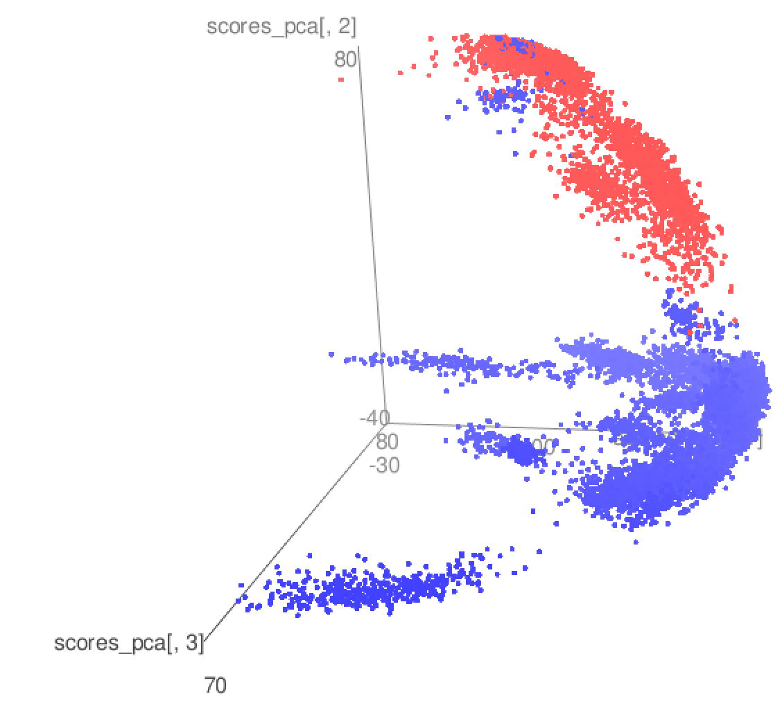
PCA of GTEX, GVEX, Brainspan, CMC, ASD
Brain samples
Other tissue samples in GTEx
DW, FN
Notes:
DW – can you merge 9 & 10 if easy

Slide 11
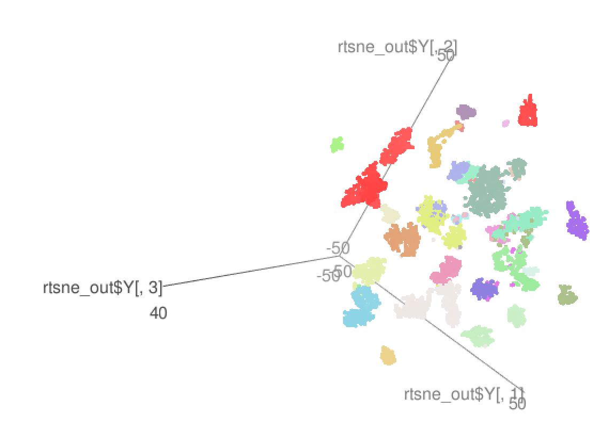
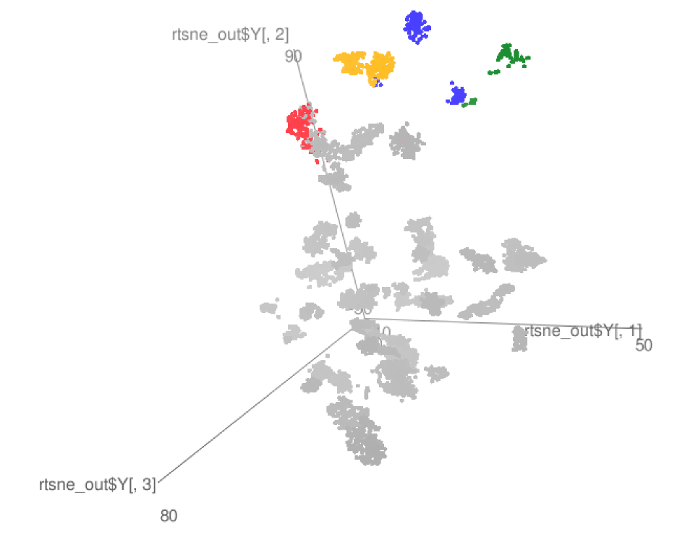
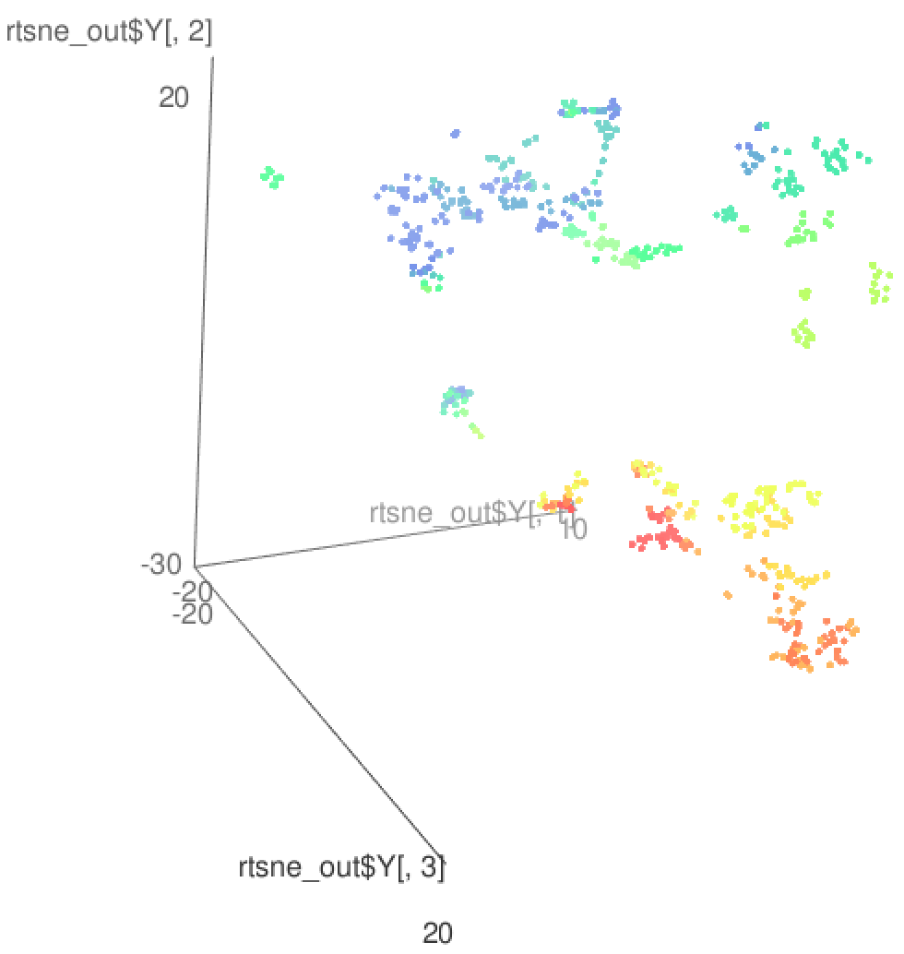
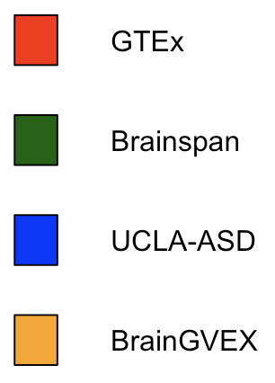
tSNE local clustering
Birth->
GTEx
GTEx + some PEC
Brainspan
DW, FN

Slide 12
RCA
Brain samples
Create a reference expression panel
  Select ~1,400 genes with tissue specific expression
  Calculating the median expression of all reference genes for all reference tissues
For each sample, we project the gene expression values to the reference panel
Finally we perform a PCA analysis using the projected values
Cerebellum samples
DW, FN

Slide 13
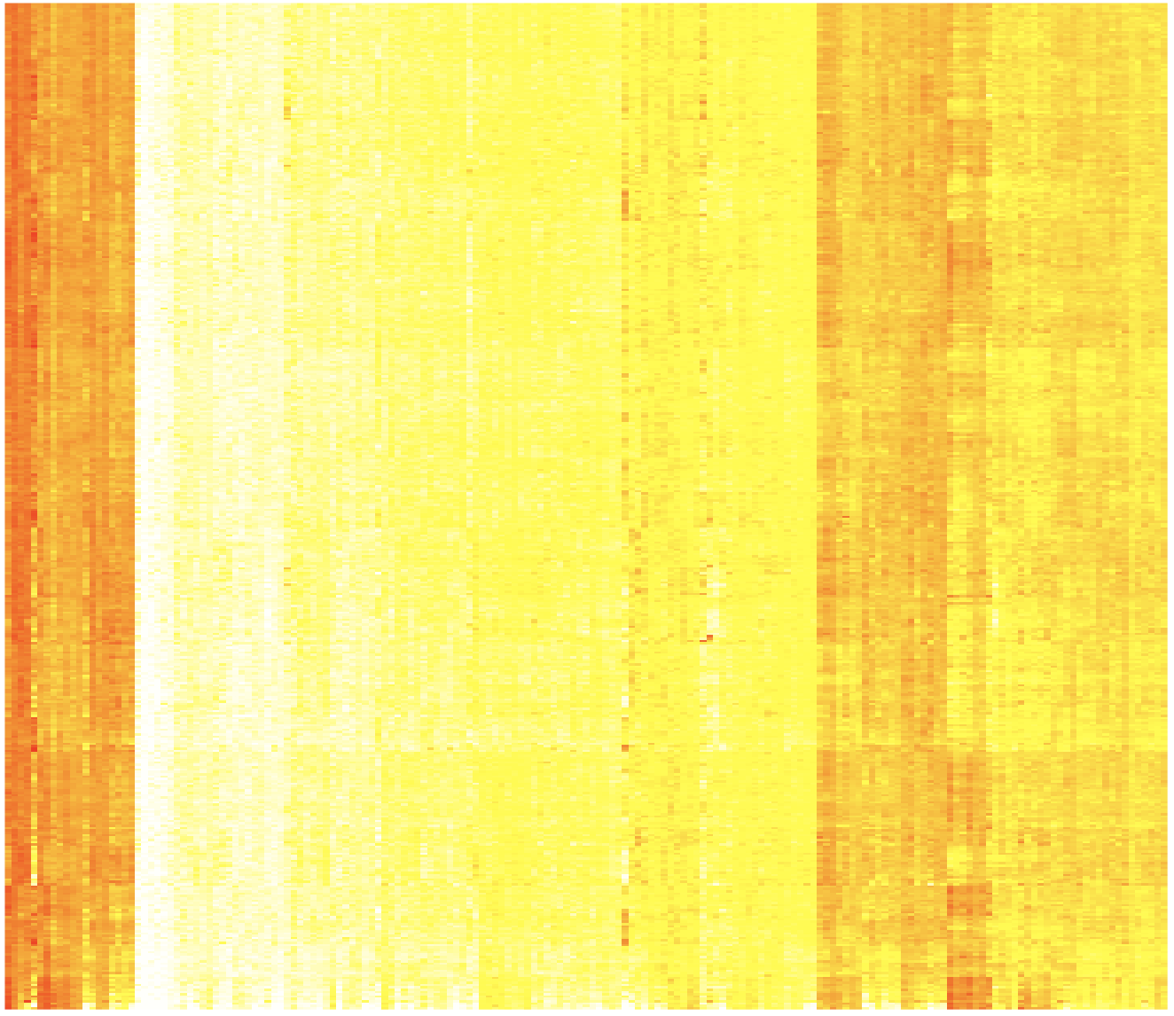
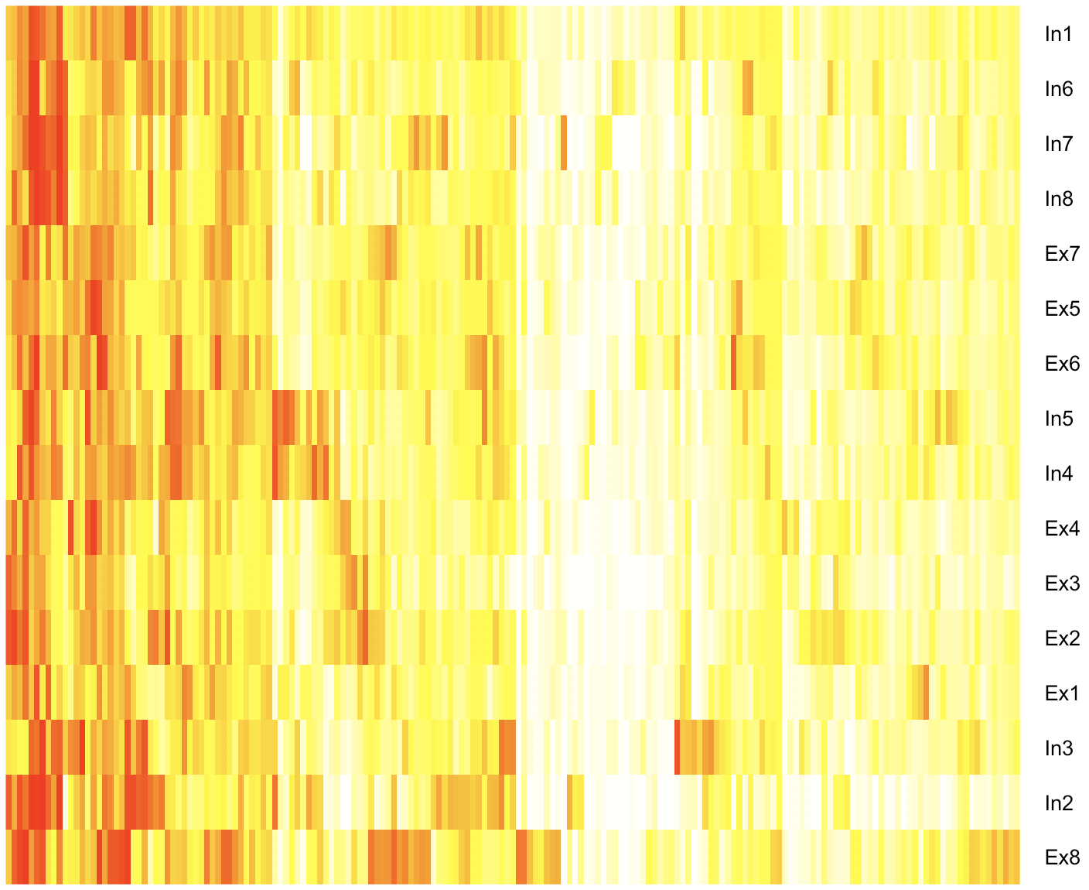
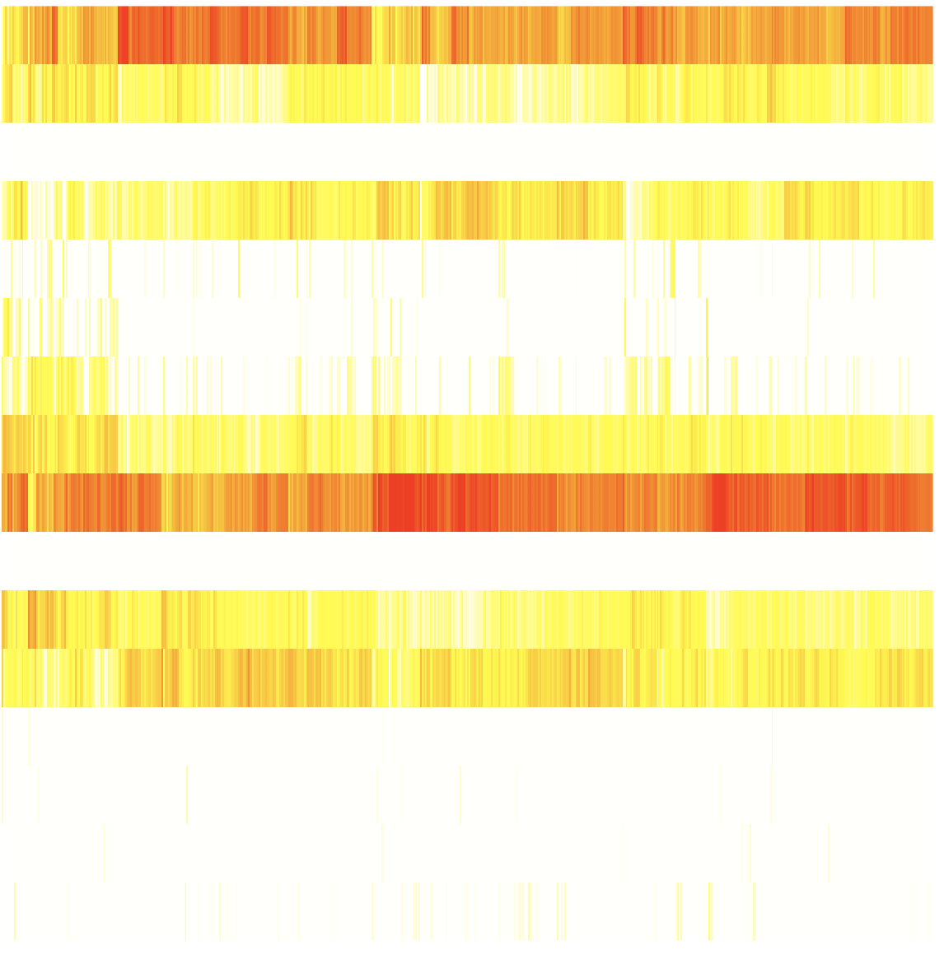
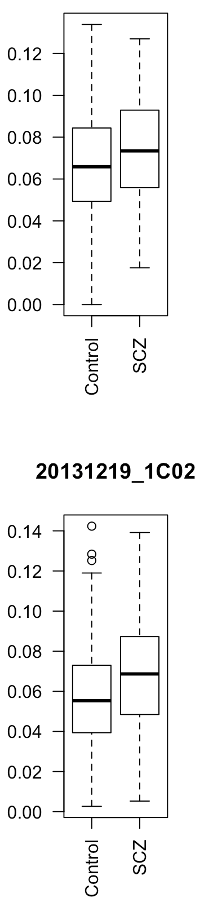
CMC
X
= W *
Y
16 neuronal cell types
Inhibitory (In) and Excitatory (Ex) neuronal single cell types,
Lake et. al, Science. ’16
Samples
182 biomarker genes
182 biomarker genes
X – gene expression matrix of 182 neuronal cell type biomarker genes across brain cortex tissue; Y – avg. gene expression matrix of 182 biomarker genes across 16 neuronal cell types; W – neuronal cell type contribution coefficient matrix by deconvolution using non-negative least square
GVEX
DW, FN
Excitatory (Ex) neuronal type 2
Single cell contribution coeffs for SCZ, BP, CTL brain cortex tissues
p<6e-3
p<2e-8

Slide 14
Capstone #4 – talk outline
Resource
  Brain enhancers, eQTLs, expression modules, networks &c
Transcriptome analysis
  Spectral analysis of gene expression, unique brain expression patterns
  Non-coding transcription & retro-element activity, not atypical
Integrative network models
  Relating perturbations in gene expression to variants

Slide 15
Transcriptome diversity, outside of genes
FN
Notes:
FN – to discuss slide 14- is this genes + noncoding… what’s 9K?

Slide 16
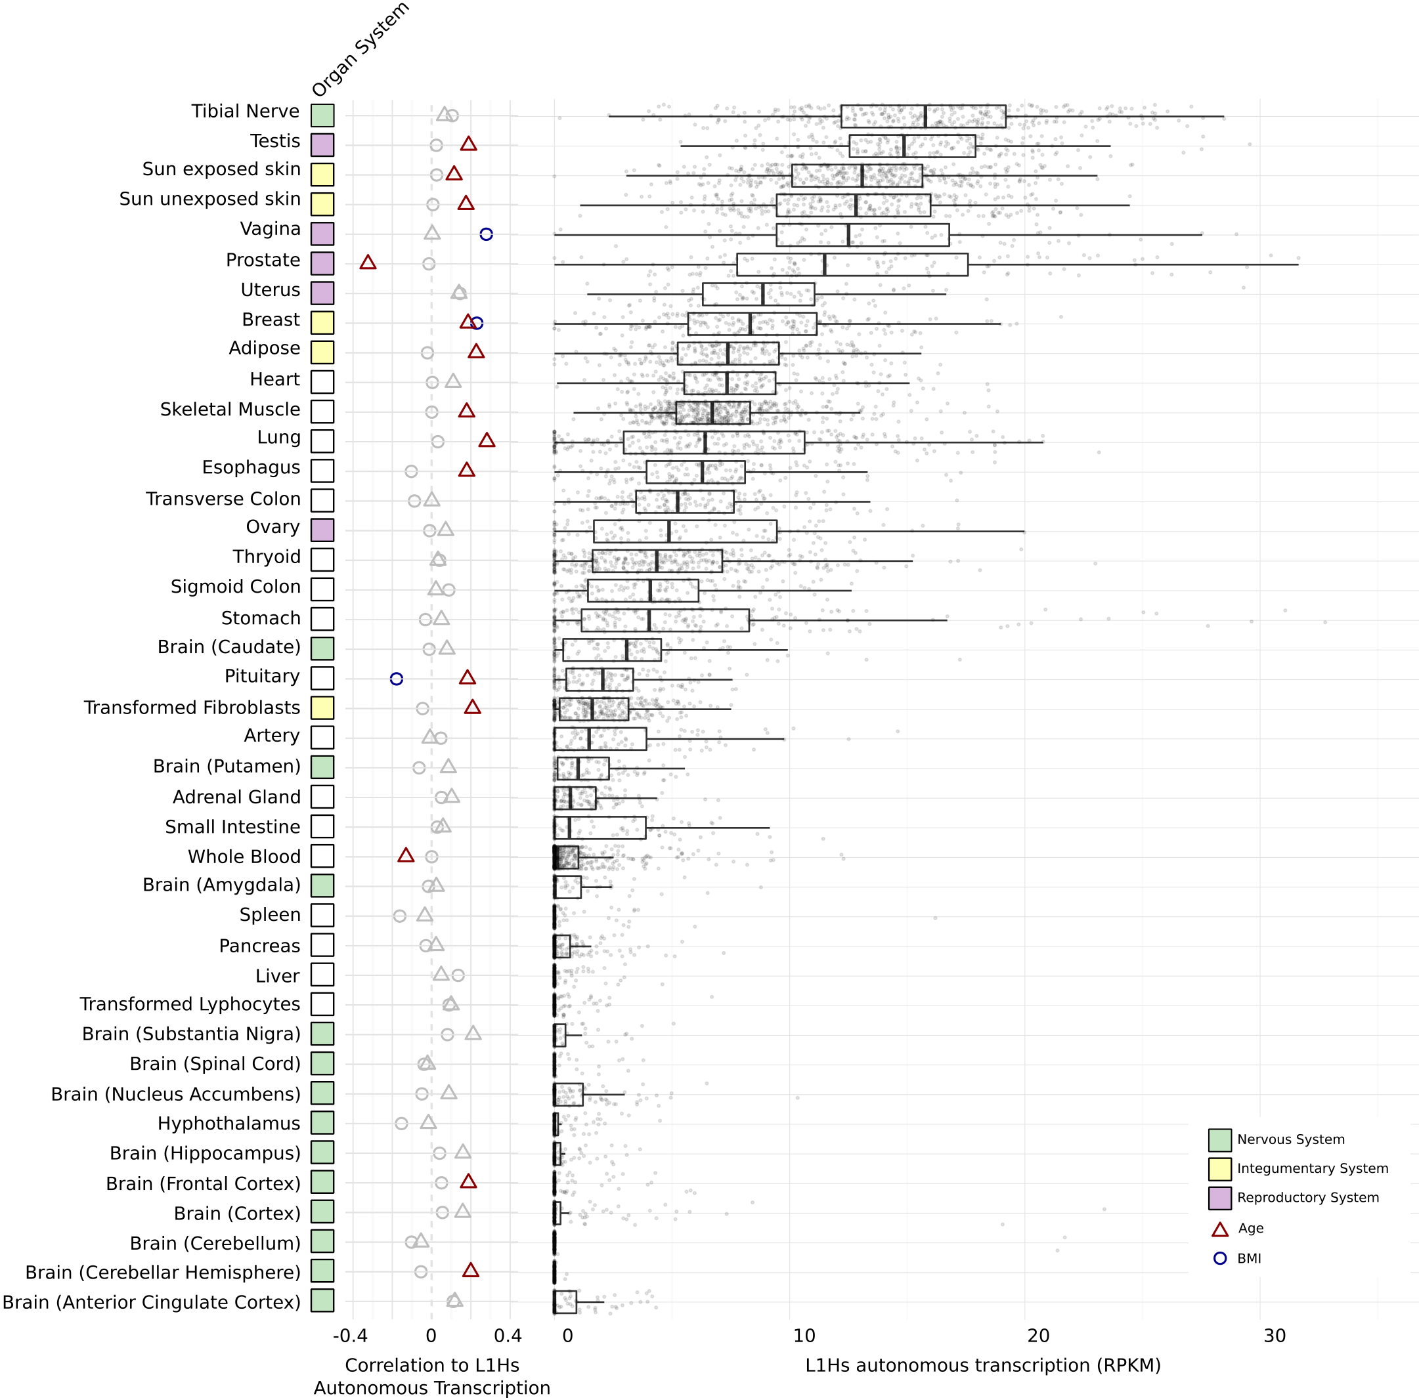
LINE-1 activity in the human brain
LINE-1 has been shown to be active in the human brain
  Creating somatic mosaicism across neurons (Muotri et. al.)
  Suggesting that LINE-1 might contribute to neuronal plasticity
We used RNA-seq data to uncover the activity of LINE-1 elements in brain regions
However, ~30% of the human genome is derived from LINE-1 elements.
  We developed Methods to decouple pervasive transcription from autonomous LINE-1 transcription.
Brain
FN

Slide 17
Capstone #4 – talk outline
Resource
  Brain enhancers, eQTLs, expression modules, networks &c
Transcriptome analysis
  Spectral analysis of gene expression, unique brain expression patterns
  Non-coding transcription & retro-element activity, not atypical
Integrative network models
  Relating perturbations in gene expression to variants

Slide 18
Enhancer 1
Enhancer 2
Enhancer 3
eQTLs for brain gene (E_{l,i} is l^{th} eQTL’s genotype at i^{th} sample)
TF 1
TF 2
Enhancers linking to brain gene
TF 3
Brain gene promoter
Transcription Factors (TFs) with TFBSs (T_{k,i} is k^{th} TF expression at i^{th} sample)
G_{i} is the brain gene expression at i^{th} sample
TF 4
Promoter
Brain gene
TFBS affected by eQTLs
Integrative modeling
Regulatory network
TF 1
…
TF 4
Network structure analysis
Brain gene
Regulatory logic
Regulatory circuit
Contributions of TFs, eQTLs, interactions
of TFs and eQTLs
Input type | TF1 | 0 | 0 | 1 | 1
 | TF4 | 0 | 1 | 0 | 1
Output | Brain gene | 0 | 1 | 1 | 1
activation
DW, JW, PE, JP, SL
repression

Slide 19
Example: enhancer regulatory network for CDNF (Cerebral Dopamine Neurotrophic Factor)
TFs having binding sites on CDNF enhancers
SPIB
BRCA1
SOX5
NFE2L1
MAFG
SPIB ⍺₁=0.18
BRCA1 ⍺₂= 0.053
SOX5 ⍺₃= -0.072
NFE2L1 ⍺₄= 0.051
MAFG ⍺₅= -0.389
rs72782895 β₁= 0.066
rs67337311 β₂= -0.025
rs35342583 β₃= -0.032
using CMC SCZ & CTRL gene expression and genotype data
G=CDNF
rs35342583
rs67337311
rs72782895
eQTLs breaking TFBSs

Slide 20
PsychENCODE Capstone #4
Developing a Brain Genomics Resource via Integrating CommonMind, ENCODE, GTEx, and Roadmap
Shuang Liu
Daifeng Wang
Fabio Navarro
Declan Clarke
Jonathan Warrell
Prashant Emani
Mengting Gu
Jonathan Park
Aparna Nathan
Mark Gerstein
James Knowles
Pamela Sklar
Hoffman, Gabriel
Andrew Jaffe
Suhn Kyong Rhie
Peggy Farnham
Kevin White
Dominic Fitzgerald
Zhiping Weng
Eugenio Mattei
Nenad Sestan (BrainSpan)
Notes:
SL – slide 1 – did we forget anyone ?

