Slide 1
Utilizing the existence of NA12878
?
Gamze Gürsoy

Slide 2


So far in the Gerstein Lab…
ENCODEC
Privaseq3
EN-TEx

Slide 3

From Personal Genomics to Genome Privacy
Personal Genomics
Genome of an Individual
  Sequencing, analysis, interpretation
  Soon will become part of medical practice
  NCI: prevent, diagnose, and treat disease through personalized medicine
Privacy risk
  Identity tracing
    Link between unknown genome to a panel of individual through quasi-identifiers
  Attribute Disclosure Attacks
    Known DNA sample to private data such as HIV status or drug abuse
  Completion Techniques
    Impute sensitive information from partial genomic data (e.g. bipolar disorder risk)
Image L: http://calorierestrictiondietplan.com/customizing-a-cr-way-lifestyle-for-your-genome/
Image R: https://www.genome.gov/27561246/privacy-in-genomics/

Slide 4
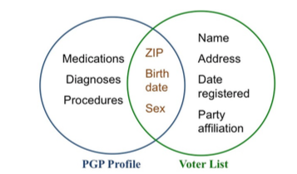
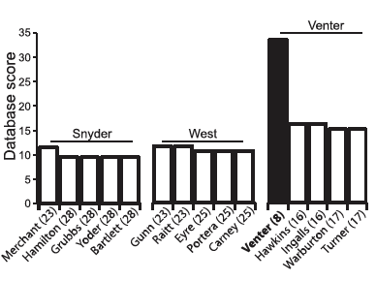
Genome Privacy traditionally focuses on DNA variants
Detecting whether an individual with known genotypes in a complex DNA mixture
  Homer et. al, 2008
          Distance between genotype and dataset
  Im et. al, 2012
          Regression coefficients of GWAS summary statistics can reveal person’s participation
  Homer et. al, 2008
Identification attacks by cross-referencing independent datasets
  Sweeney at al, 2013
          Cross-reference PGP profile with public voter list data
  Gymrek et al, 2013
          Cross-reference Y-STRs with recreational genetic genealogy database
  Sweeney et. al, 2013
  Gymrek et. al, 2013

Slide 5
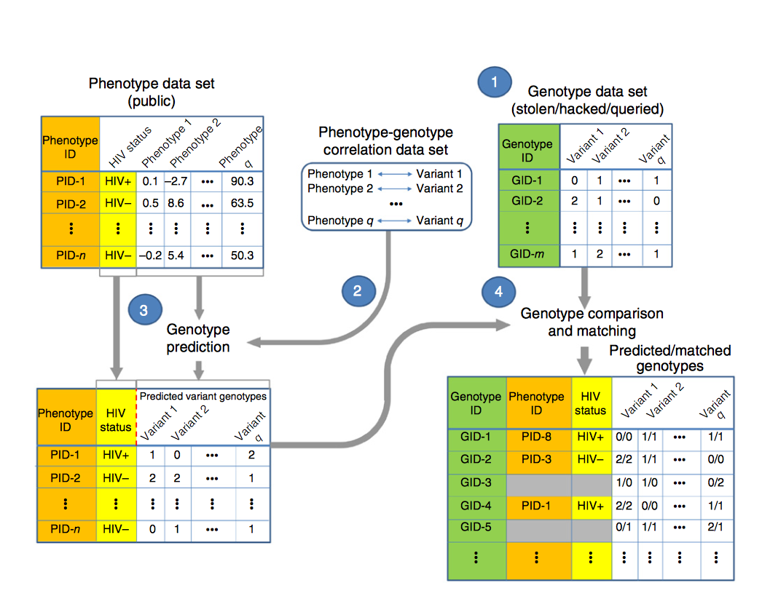
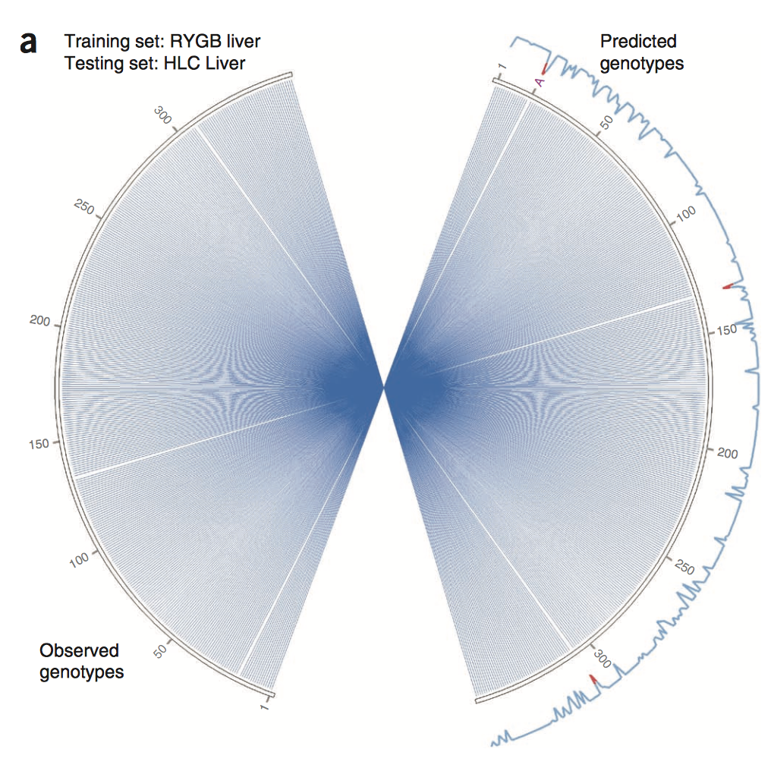
Functional genomics era increases the number of quasi-identifiers
RNA-Seq is of particular interest
  Big consortia like ENCODE, TCGA, GTEx provide a wealth of functional genomics data, which particularly belong to individuals
  Schadt et. al, 2012
    SNP genotypes can be predicted from RNA-Seq expression data using known eQTLs
  Harmanci and Gerstein, 2016
    eQTLs and extreme expression levels can be used to do linking attacks
  Schadt et. al, 2012
  Harmanci and Gerstein, 2016
ChIP-Seq and Hi-C signal tracks can also leak genotype information
  Harmanci and Gerstein, 2017

Slide 6
Functional genomics era attacks focus on phenotype-genotype relationship
BUT, nobody is talking about the “elephant in the room”
All the functional genomics data comes with a great deal of sequencing data
How much information, for example, RNA-Seq reads or ChIP-Seq reads contain?
Is that information enough to identify individuals?
Is it safe to share the fastq/bam files from these experiments?
HeLa genome is locked, but we have access to its ChIP-Seq reads!
Image: http://berkeleysciencereview.com/article/good-bad-hela/

Slide 7
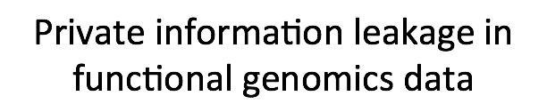
Quantification and Linking

Slide 8
Datasets
ChIP-Seq
Experiment | # of Reads | Read Length
H3K4me1 | 42,763,056 | 36
HDGF | 41,626,373 | 101
RELB | 25,652,682 | 101
CTCF-Snyder | 25,463,397 | 36
H3K4me3 | 20,221,959 | 36
JUND | 18,701,295 | 36
H3K79me2 | 16,073,184 | 36
H3K36me3 | 15,239,685 | 51
H2AFZ | 14,724,790 | 36
H3K9me3 | 14,049,420 | 36
CTCF-Broad | 11,026,086 | 51
rnap2 | 10,428,778 | 36
H3K27ac | 10,410,928 | 51
H3K4me2 | 9,815,194 | 51
H4K20me1 | 9,757,368 | 51
H3K27me3 | 8,454,639 | 51
H3K9ac | 7,981,456 | 51
CTCF-Iyer | 7,614,943 | 35
rnap2 | 7,516,461 | 36
PBX3 | 6,119,046 | 36
Individual: NA12878
Gold Standard: 1000 Genome genotypes
Control: WGS, # of reads= 757,704,193, read length = 250 bp
Experiment | # of Reads | Read Length
Hi-C exp 1 PE1 | 219,616,072 | 101
Hi-C exp 1 PE2 | 220,087,882 | 101
Hi-C exp 2 PE1 | 448,843,710 | 101
Hi-C exp 2 PE2 | 451,088,484 | 101
Hi-C exp 3 PE1 | 536,684,803 | 101
Hi-C exp 3 PE2 | 536,101,709 | 101
RNA-Seq | 227,501,266 | 202

Slide 9
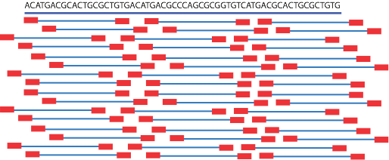
Approach

Slide 10
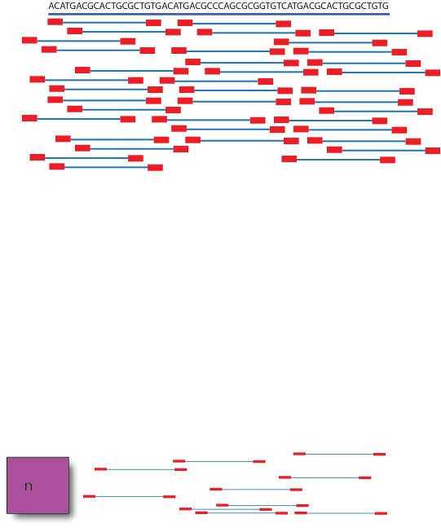
Approach
1kG panel
Genotyping
(GATK pipeline)
Information quantification
Linking

Slide 11
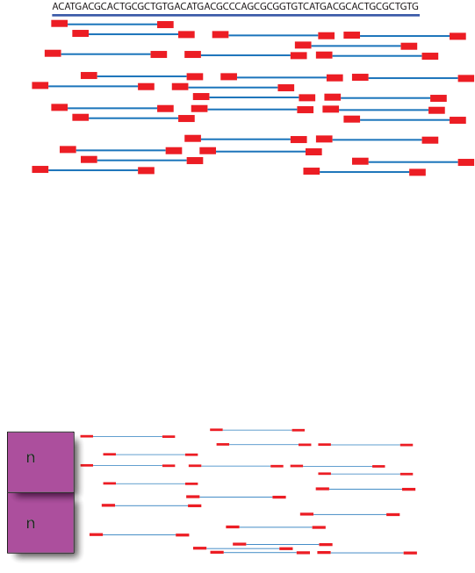
Approach
1kG panel
Genotyping
(GATK pipeline)
Information quantification
Linking

Slide 12
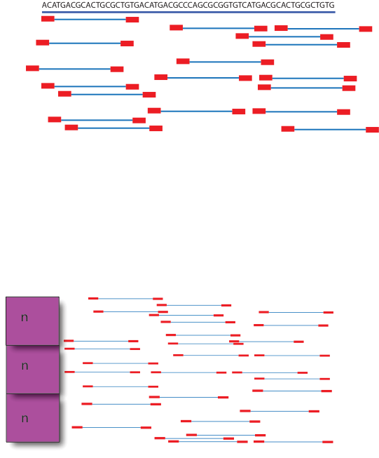
Approach
1kG panel
Genotyping
(GATK pipeline)
Information quantification
Linking

Slide 13
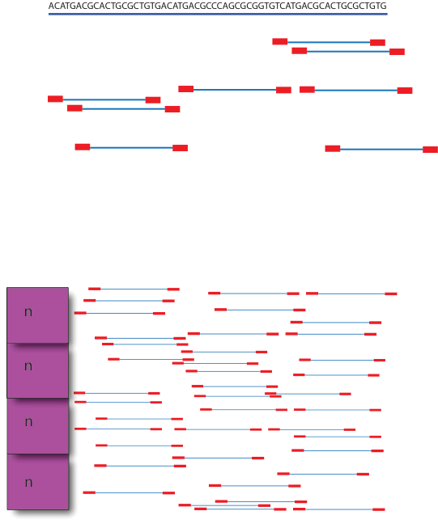
Approach
1kG panel
Genotyping
(GATK pipeline)
Information quantification
Linking

Slide 14
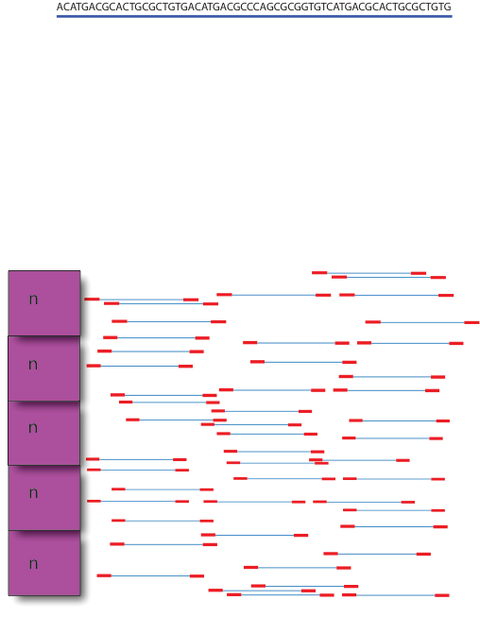
Approach
5n = total number of reads in the experiment
1kG panel
Genotyping
(GATK pipeline)
Information quantification
Linking

Slide 15
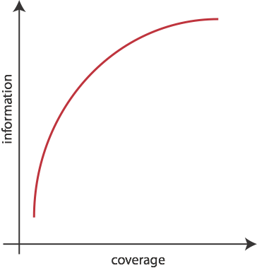
Approach
1kG panel
Genotyping
(GATK pipeline)
Information quantification
Linking

Slide 16
For WGS/Hi-C/ChIP-Seq Analysis
For RNA-Seq

Slide 17
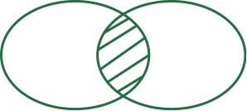



What is “information”?
Let S^{GS}(NA12878) be the set of SNVs determined by 1k genome (gold standard)
Let S^{FGE} be the noisy set of SNVs called using the reads from any functional genomic experiment
S^{FGE}
S^{GS}(NA12878)
h(S^{FGE})
h(S^{GS})
f(si) : number of individuals with SNV si
nT : total number of individuals in the population
pointwise mutual information (pmi)
Further normalization with the gold standard
%of the gold standard information = pmi(S^{FGE};NA12878) / S^{GS}(NA12878)

Slide 18
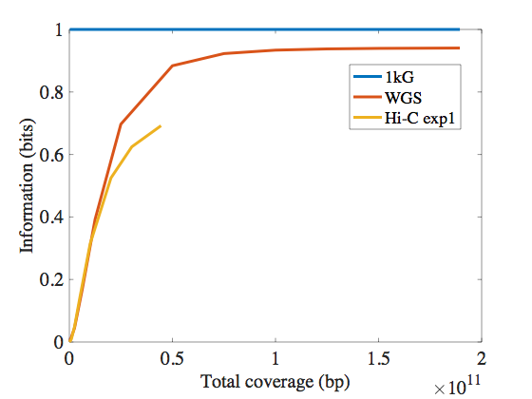
How much information a typical Hi-C experiment contain?
However, this is just one experiment out of 18 that was used to create the whole Hi-C library. Can we get more information by adding these experiments together?

Slide 19
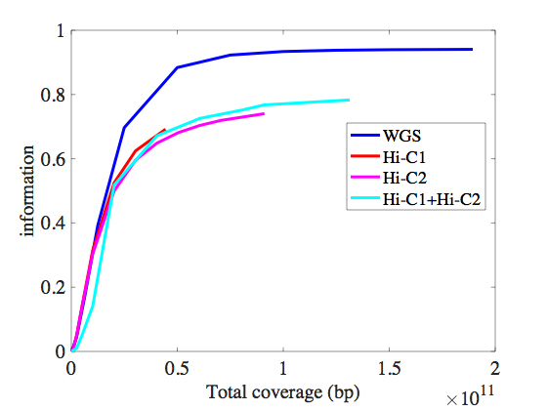
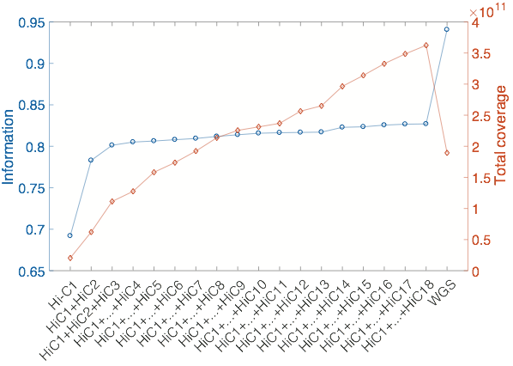
Putting Hi-C experiments together does not change the outcome

Slide 20
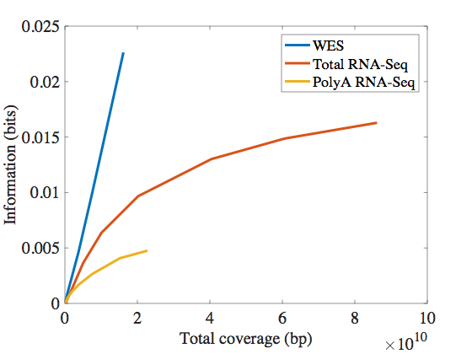
How much information a typical RNA-Seq experiment contain?

Slide 21
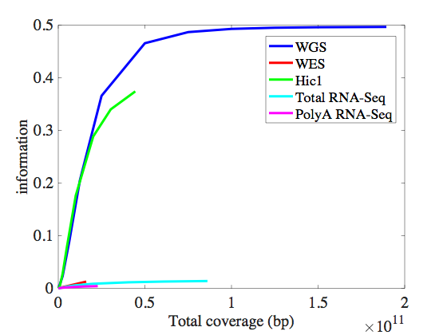
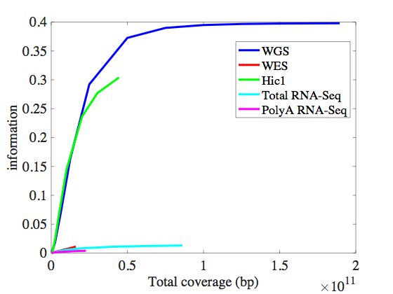
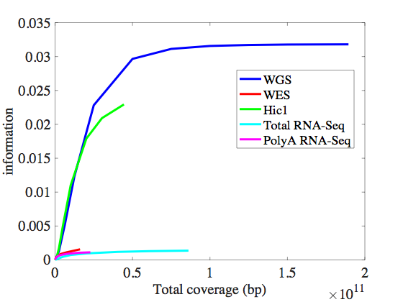
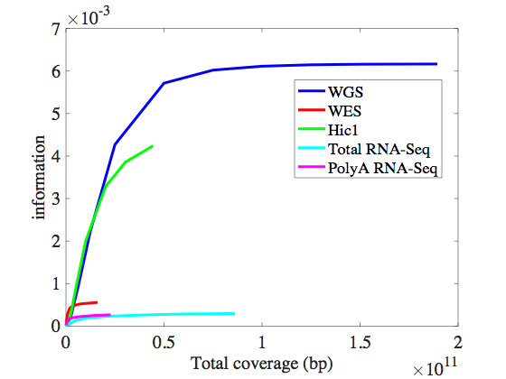
Hi-C reveals more information at transcript and coding regions compared to RNA-Seq
Transcript
Protein-coding
Exon
CDS

Slide 22
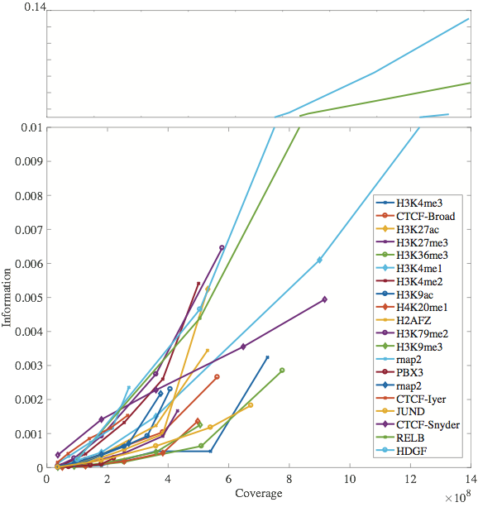
How much information ChIP-Seq contain?
Seems like both ChIP-Seq and RNA-Seq leak only a small proportion of private information.
Now, the question becomes “does this leakage enough to link the individuals to a panel of genotypes?

Slide 23
Linking attack with the publicly available fastq files
Panel of genotypes
HIV Status
 | g1
+
gi
gn
pmi(S;individual1)
individual1
0/1
1/1
0/0
-
Exp^{k}
{S}
individuali
0/0
1/1
1/1
pmi(S;individuali)
pmi(S;individualm)
individualm
0/1
0/0
1/1
-

Slide 24
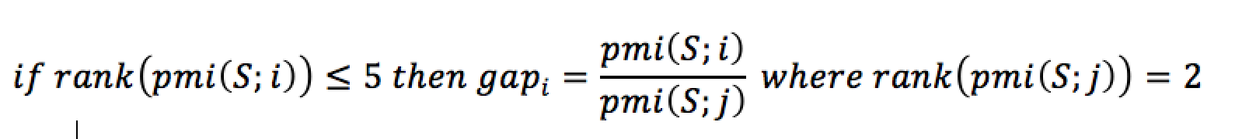

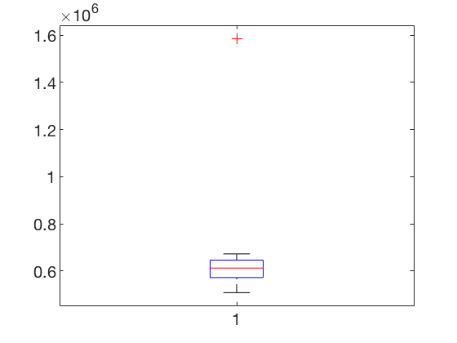




Quantification of Linking Accuracy
1. Amount of information we have for the target individual +
2. Amount of information we have for other individuals in the panel -
Rank of all the pmi(S;i) values, where S is the set of genotypes called from experiment, and i is the genotypes of individual i in the panel.
Calculate gapi for each individual as
Individual i
Individual i is extremely vulnerable
Individual i is vulnerable
Individual i can be vulnerable with auxiliary information
Individual i cannot be identified
pmi
gapi

Slide 25
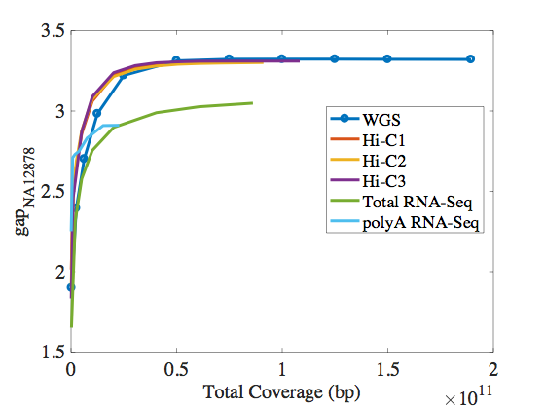
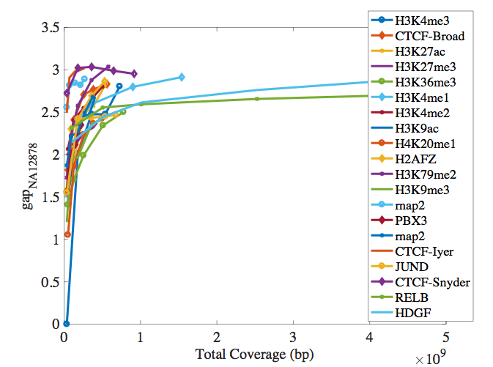
ChIP-Seq reveals way less information compared to other assays. However, it provides comparable linking accuracy to WGS and Hi-C!

Slide 26
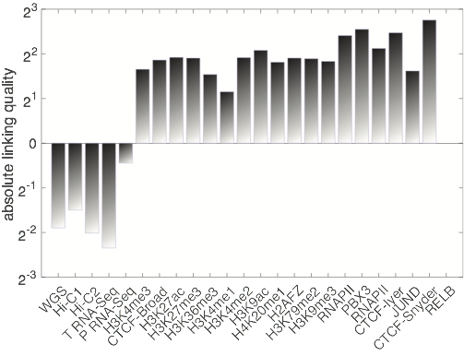
ChIP-Seq reveals way less information compared to other assays. However, it provides highest linking accuracy!
A better comparison can be made by normalizing the gap by the coverage
absolute linking quality (exp^{k}) = log2 [ max(gap)/{coverage at max(gap)} ]
coverage = total coverage / haploid genome size

Slide 27
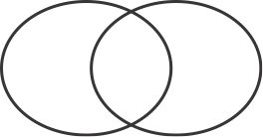
Genotyping Accuracy
For a high quality linking, we needed
  1. High information overlap with the target individual
  2. Less information overlap with the rest of the panel
X
Y
npmi(x;y) = pmi(x;y)/h(x,y)
{
h(x|y)
pmi(x;y)
h(y|x)
If npmi(x;y) = -1, x and y never occurring together
npmi(x;y) = 0, x and y are independent
npmi(x;y) = 1, x and y are completely co-occuring
h(x,y)
Normalized point wise mutual information - npmi(x;y)
If X is the genotype set called from experiment, Y is the gold standard, then npmi(x;y) can be used as a metric for genotyping accuracy.
Not only missed genotypes (h(y|x)) but also the noise (or the False Positives or h(x|y)) will affect this metric.

Slide 28
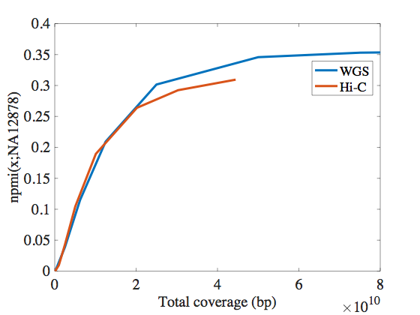
The difference between npmi of Hi-C and WGS is smaller compared to difference between pmi
}
}

Slide 29
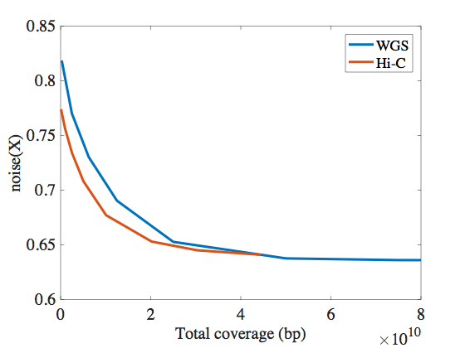
Variant calling from Hi-C is less noisy compared to WGS?
X
Y
h(x|y)
pmi(x;y)
h(y|x)
noise(X)=h(x|y)/h(x)
Self information of X that does not overlap with self information of Y
Self information of X
Yes! At low coverages …
Still somewhat better at high coverages

Slide 30
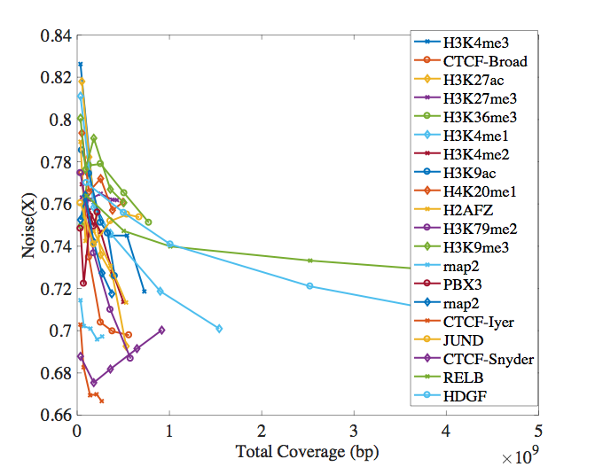
Variant calling from ChIP-Seq is comparable to Hi-C and WGS in terms of noise - maybe a bit more noisy

Slide 31
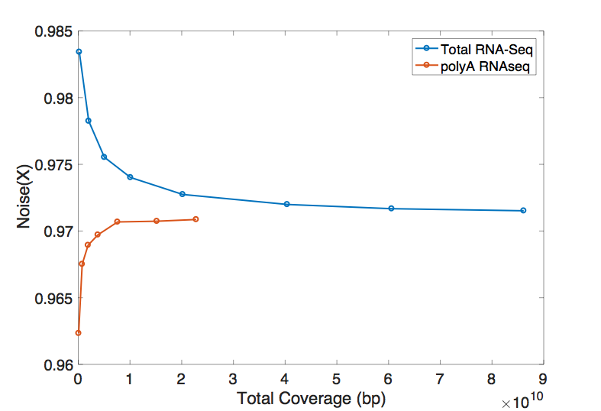
Variant calling from RNA-Seq has the highest amount of noise
Potential Reasons:
Split Reads
RNA editing

Slide 32


Imputation of more SNVs
Use IMPUTE2 and 1000genomes panel to impute new SNVs using LD blocks
Imputed SNVs are further filtered based on <0.3 certainty threshold
pmi score is adjusted

Slide 33
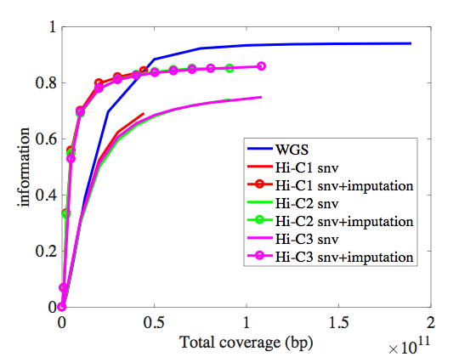
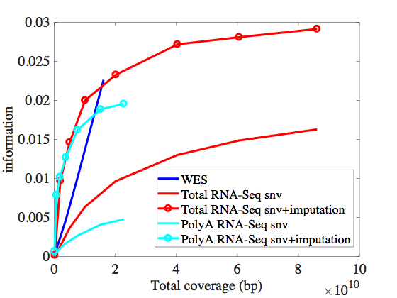
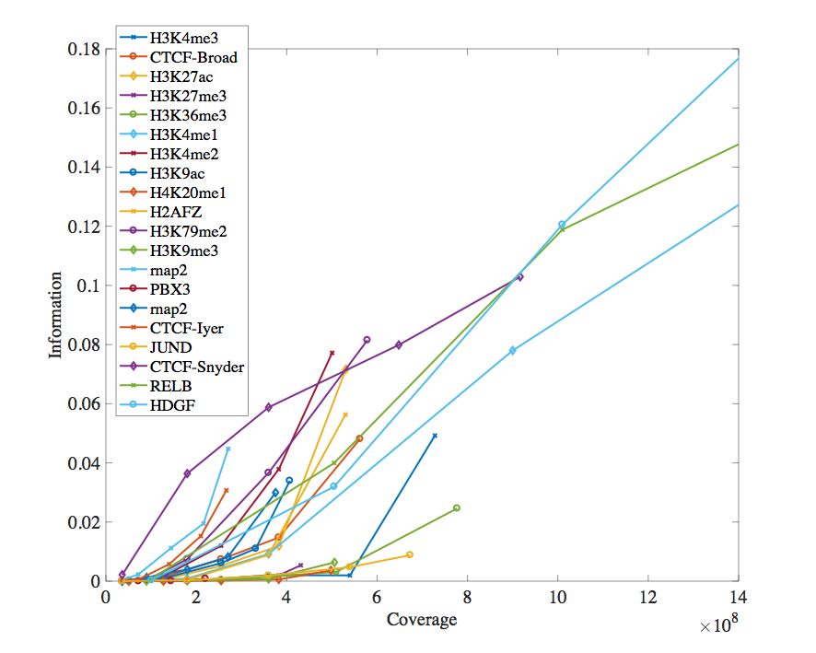
Imputation substantially increases the information
ChIP-Seq before imputation
ChIP-Seq after imputation

Slide 34
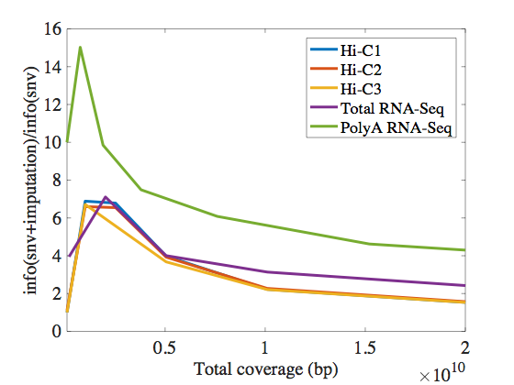
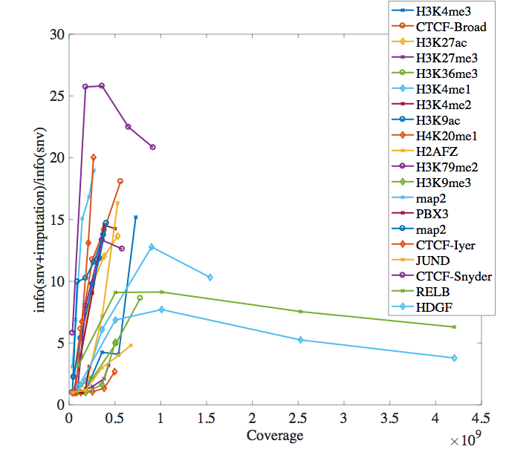
More information can be imputed from ChIP-Seq&RNA-Seq compared to Hi-C
3’
5’
- Having more depth in a concentrated area vs. having shallow depth but sampling the genome in many LD blocks
- More room for imputation - data is sparse

Slide 35
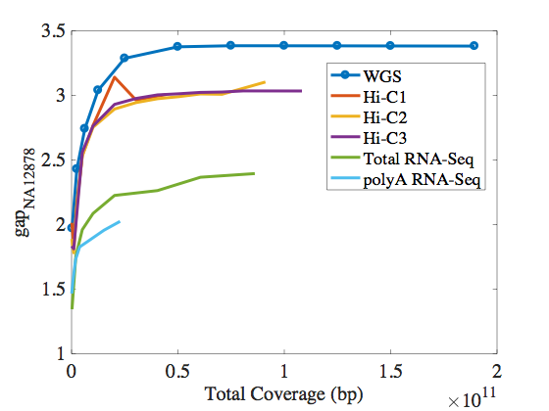
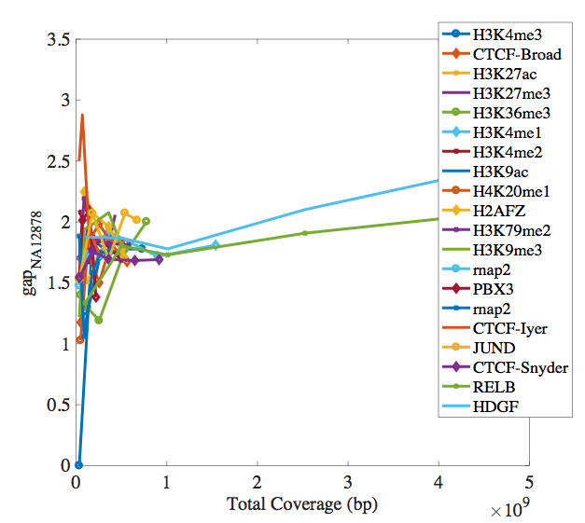
However, imputation decreases linking accuracy
Hi-C&RNA-Seq before imputation
Hi-C&RNA-Seq after imputation
Because we impute SNVs that have high MAFs in the population and end up having common SNVs to the individuals in the panel
ChIP-Seq before imputation
ChIP-Seq after imputation

Slide 36
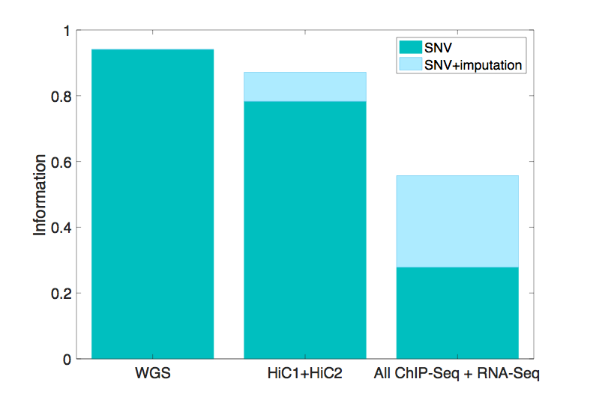
We can further put all ChIP-Seq together and gain a wealth of information about the individual

Slide 37
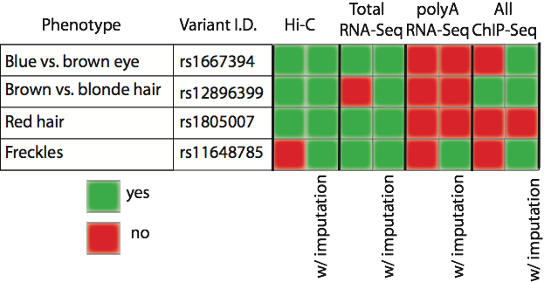
Phenotypes can be inferred using noisy&incomplete sequencing data from RNA-Seq and ChIP-Seq

Slide 38

Given properties of an experiment with sequencing product, can we predict approximately how much information will be leaked without calling variants?
As the total coverage increases, leaked information increases - trivial but is it linear?
Can depth of the coverage alone predict the leaked information?
Every experiments comes with biases (i.e transcription factor binding site distribution, non-coding genome, just protein coding genome, etc)
  Can we quantify the bias? Does that help us to quantify the leaked information?
                If y is the leaked information, is there an f? If so, what are x?

Slide 39


Lander-Waterman Statistics
Lander-Waterman Equation
d=NxL/G
N = number of reads
L = length of the reads
G = haploid genome length
Depth of coverage, d
Breadth of coverage, b
Since G >> L, end effects are ignored
Left-hand ends of the fragments are independently distributed with uniform distribution over [0, G]
Any left hand falls in an interval (x , x+L) with a probability of N/(G-1), G is large, so N/G
Number of fragments that fall in to this interval has a binomial distribution with a mean of NxL/G = d
Since N>>L, this distribution approximates to Poisson with a mean and std of d

Slide 40
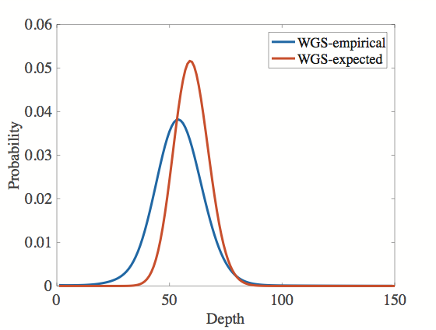
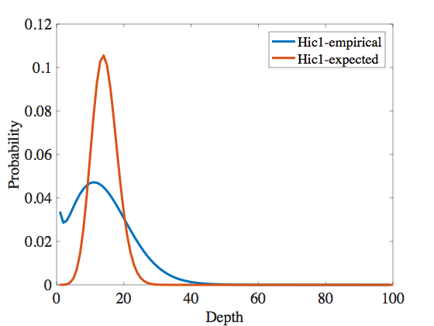

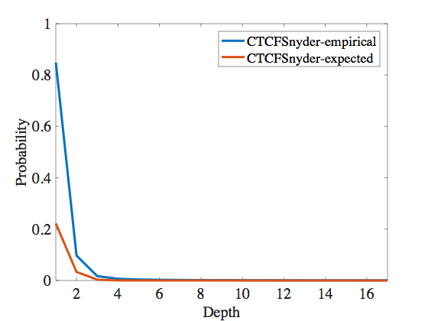
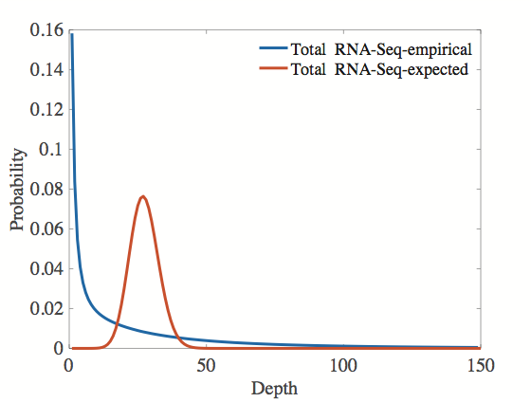
Lander-Waterman statistics can be used to estimate the bias
Expected distributions are derived using mean = NL/G for each experiment
Bias ~ divergence from Poisson
Kullback–Leibler divergence
DKL is the expectation of the logarithmic difference between the depth distribution of an experiment and its expected Poissonian behavior if it were to be a WGS experiment
DKL
WGS | 0.235717159
Hi-C | 0.447761206
RNA-Seq | 1.725381274
CTCFSnyder | 0.296116866

Slide 41
A Theoretical Framework
Lander-Waterman Equation
d=NxL/G
N = number of reads
L = length of the reads
G = haploid genome length
Depth of coverage, d
Breadth of coverage, b
X
Y
{
h(x|y)
pmi(x;y)
h(y|x)
y = nmpi(X;NA12878) (genotyping accuracy)
x1=breadth of the coverage
x2=depth of the coverage
x3=DKL (divergence from expected distribution)
h(x,y)
npmi(x;y) = pmi(x;y)/h(x,y)

Slide 42
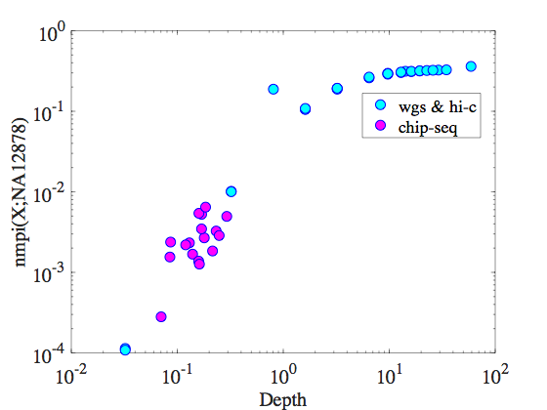
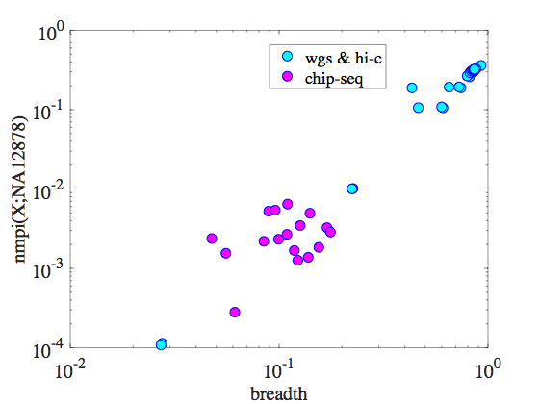
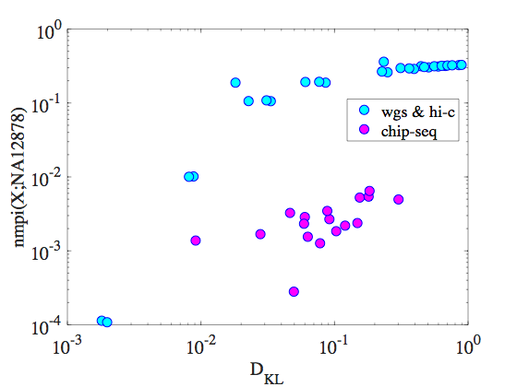


Nonlinear relationship between the features and npmi
Regression Learning
  19 different learners (linear regression, different trees, SVM with different kernels, Gaussian process regression)
  Best fit = Gaussian Process Regression with exponential kernel

Slide 43
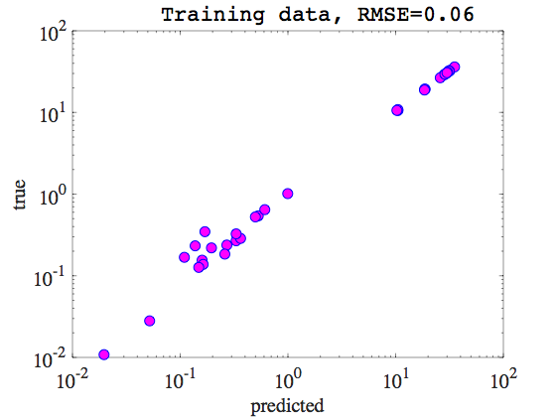
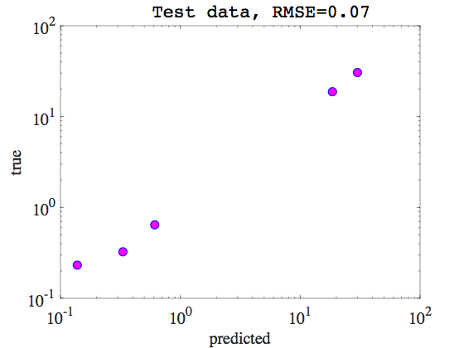
Regression Learning
  Total of 45 data points (values range between 0 and 35)
    40 is used for training, 5 is for test (randomly sampled)
    5-fold cross validation during training

Slide 44
A few points to consider in the future
We can simulate more data points to increase the sample size for the learner
Definition of bias can be changed and it might help to build a better predicter
negative
bias
positive
bias
Try to predict the information content of a different kind of functional genomics data such as ATAC-Seq or Faire-Seq

Slide 45



How can we secure this data?
Privacy preserving file format
Option 1: MRF Format - For RNA-Seq
Problems:
  Indels can be inferred from the split reads
Individual is extremely vulnerable

Slide 46
How can we secure this data?
Privacy preserving file format
Option 2: MRF Format Re-visited
        As it turns out STARR prints deletions differently than split reads in a bam file
A
B
C
Splice junction read
A
TS1
TE1
B
TS2
TE2
C
Reference
genome
Chr n: +/- : TS1—TE1:TS2—TE2

Slide 47
How can we secure this data?
Privacy preserving file format
Option 2: MRF Format Re-visited
        As it turns out STARR prints deletions differently than split reads in a bam file
A
B
C
Deletions
A
B
C
Reference
genome
S1
S1+N
        N: read length
Chr n: +/- : S1—S1+N

Slide 48
How can we secure this data?
Privacy preserving file format
Option 2: MRF Format Re-visited
        As it turns out aligners prints indels differently than split reads in a bam file
A
B
C
Insertions
A
B
C
Reference
genome
S1
S1+N
        N: read length
Chr n: +/- : S1—S1+N

Slide 49
How can we secure this data?
Privacy preserving file format
Option 3: GMZ Format (MRF+privateKey)
Objectives:
  Keep the public data light (small file size)
  Keep the private data light
  Minimize the information leakage
  Maximize the utility
Privacy in traditional data science sense…
Bob
Internet
Alice
Privacy preserving mapping

Slide 50

Privacy in traditional data science sense…
increase utility
decrease privacy risk

Slide 51
How can we secure this data?
Privacy preserving file format
Option 3: GMZ Format (MRF+private-key)
plaintext
Alice
Bob
plaintext
chipher
chiphertext
Alice
Bob

Slide 52
How can we secure this data?
Privacy preserving file format
Option 3: GMZ Format (MRF+private-key)
plaintext
chipher
chiphertext
Alice
Bob
m = plaintext
c = chipper text
Ek = encryption chipper, k is a cyrptographic key
Dk = Ek⁻¹ = decryption chipper
c = Ek(m)
Dk(c) = Dk(Ek(m)) = m
KGB ciphertext found in a hollow nickel in Brooklyn in 1953

Slide 53
How can we secure this data?
Privacy preserving file format
Option 3: GMZ Format (MRF+private-key)
An example encryption technique: Vernam Chipper (one-time pad)
Information-theoretically secure - impossible to crack
  Used to store highly sensitive data - NSA uses one-time pad
Based on exclusive-or (XOR, ⊕)
  x⊕y is true when exactly one of x and y is true
  x⊕y is false when x and y are both true or both false
c = m ⊕ k and m = c ⊕ k
Dk(Ek(m)) = c ⊕ k
= (m ⊕ k) ⊕ k
        = m ⊕ (k ⊕ k)
        = m ⊕ 0
        = m

Slide 54
How can we secure this data?
An example encryption technique: Vernam Chipper (one-time pad)
k = sum of numerical values of alphabet
(A=0, B=1, C=2, …, Z=26 -> k=26)
Let’s say Alice wants to say “HELLO” to Bob
H E L L O message
7 (H) 4 (E) 11 (L) 11 (L) 14 (O) message
+ 23 (X) 12 (M) 2 (C) 10 (K) 11 (L) key
= 30 16 13 21 25 message + key
= 4 (E) 16 (Q) 13 (N) 21 (V) 25 (Z) (message + key) mod 26
E Q N V Z → ciphertext
Bob converts chipher text “EQNVZ”
E Q N V Z ciphertext
4 (E) 16 (Q) 13 (N) 21 (V) 25 (Z) ciphertext
- 23 (X) 12 (M) 2 (C) 10 (K) 11 (L) key
= -19 4 11 11 14 ciphertext – key
= 7 (H) 4 (E) 11 (L) 11 (L) 14 (O) ciphertext – key (mod 26)
H E L L O → message
Problem: Key has to be same size as the message
For a 2GB bam file, we need to create 2GB of key file
We might as well lock the bam file
BUT

Slide 55





How can we secure this data?
Privacy preserving file format
Option 3: GMZ Format (MRF+private-key)
MRF
~400 MB
private-key
~10 MB
X
X
=
BAM file
~1—2 MB

Slide 56
Summary
There is information leakage even in low coverage functional genomics data
  Enough to identify individual in a panel
  Sensitive phenotype information can be inferred from the leaked information
We have developed an information theoretic framework to quantify the information leakage
We can predict the leaked information by using the depth, breadth and the bias of the sequencing experiment
We have improved our existing privacy preserving file formats to prevent the private information leakage

Slide 57

Future Directions
Working on a linking attack using gene expression extremity + loss of function mutation from 1000genomes
Accurate genotyping/somatic mutation load using Hi-C data for samples we don't have WGS data - especially for tissue samples from one individual or cells in different developmental stages from same donor
  EN-TEx data can be utilized
Private information leakage in functional genomics data in terms of SVs. I ran CNVnator on Hi-C data for deletions (NA12878)
  Which in turn can lead to SV calling from Hi-C data (deletions and using diagonal for tandem repeats)
  Might also lead to better understanding of SV mechanism with the underlying 3D genome architecture

Slide 58
Acknowledgments
Mark
NA12878
Arif
Fabio
Sarah
Lilly
Joel
Timur
Sushant
Prashant
Jing
Donghoon
Jason

