Slide 1
Prioritizing somatic variants: approaches for identifying key variants through recurrence, coding & noncoding functional impact
Mark Gerstein, Yale
Slides freely downloadable from Lectures.GersteinLab.org
& “tweetable” (via @markgerstein). See last slide for more info.

Slide 2
Prioritizing somatic variants: approaches for identifying key variants through recurrence, coding & noncoding functional impact
Introduction
The need to identify key variants for precision and personalized medicine
Growth in cancer genome variant data
Mining data to prioritize variants in the search for cancer drivers
Functional impact in coding regions
- Annotation of Loss-of-Function Transcripts (ALoFT)
- LOF annotation as a complex problem
- Identifying deleterious somatic LoF variants
- Biomolecular frustration as a localized metric
- Evaluating localized frustration changes (∆F)
- Differential ∆F profiles in oncogenes vs. TSGs
Functional impact in non-coding regions
FunSeq integrates evidence on variants
Recurrence-based driver identification
Replication timing
Topologically associating domains (TADs)
- Identifying TADs at multiple resolutions
- TAD boundaries as demarcators
LARVA: burden testing on non-coding annotations
- Correcting for over-dispersion in mutation counts
- Applications to different cancer types
MOAT for somatic mutation modeling
- Basics of MOAT formalism
- FunSeq integration
Dealing with lower power
Realistic application to papillary Renal Cell Carcinoma (pRCC)
- Achieving statistical power
- Variants in MET & noncoding hotspots

Slide 3
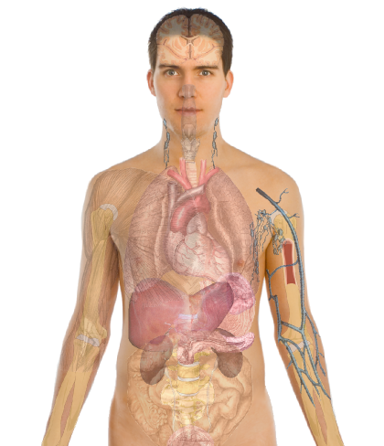
Personal Genomics as a Gateway into Biology
Personal genomes will soon become a commonplace part of medical research & eventually treatment (esp. for cancer). They will provide a primary connection for biological science to the general public.
normal
tumor

Slide 4
Personal Genomics as a Gateway into Biology
Personal genomes will soon become a commonplace part of medical research & eventually treatment (esp. for cancer). They will provide a primary connection for biological science to the general public.

Slide 6
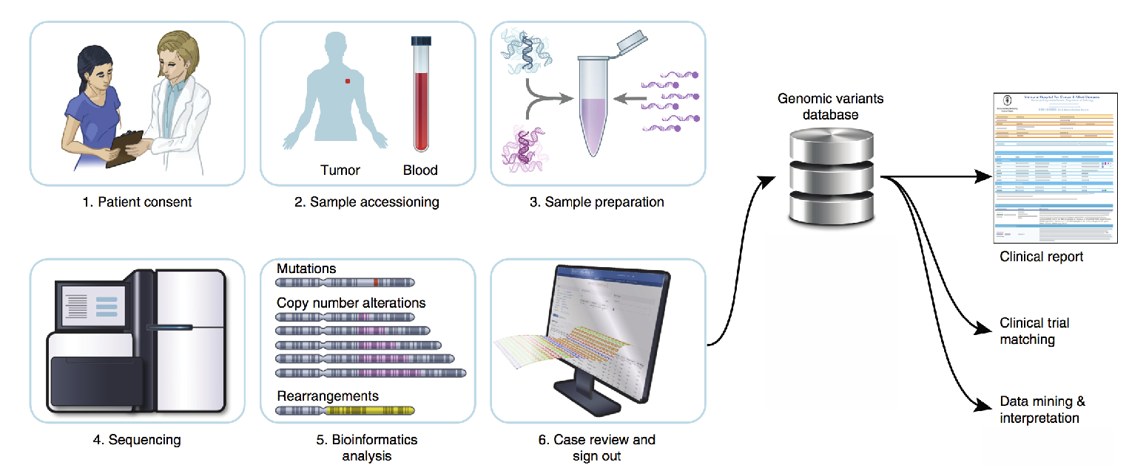
Key variants will increasingly play essential roles in precision medicine
Database of variants
1. General
diagnosis
2. Sample extraction
3. Sample preparation
Clinical report
Trial
matching
Refined
diagnosis
(ex: sub-
cancer type)
4. Sequencing
5. Analysis
6. Review
Modified from A. Zehir et al, Nat. Med (2017)

Slide 7
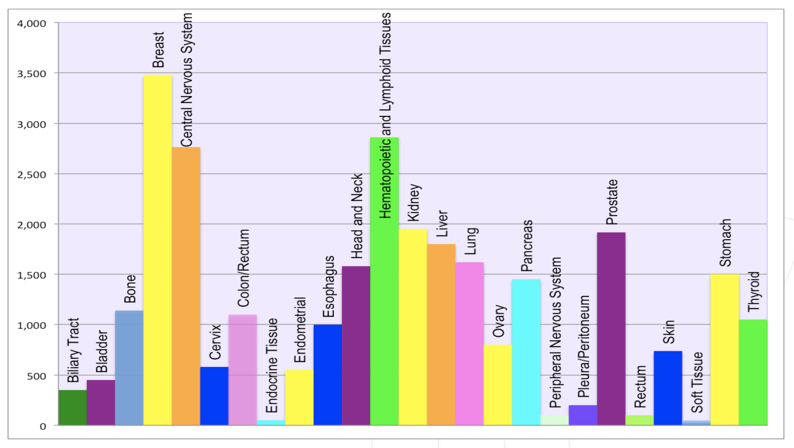
~30,000 tumor genomes from 90 ICGC project commitments
Tumor Genomes
Genomes by Cancer Type
2008 2009 2010 2011 2012 2013 2014 2015
Modified from H. Nahal , 12th Scientific ICGC Workshop (Sept 2016)

Slide 8
Growth of ICGC datasets
Hardeep Nahal , 12th Scientific
ICGC Workshop (Sept 2016)

Slide 10
Canonical model of drivers and passengers in cancer
Drivers
Driver mutations directly confer a selective growth advantage to the tumor cell.
A typical tumor contains 2-8 drivers.
Drivers are identified through signals of positive selection.
Passengers
Conceptually, a passenger mutation has no direct or indirect effect on tumor progression.
There are thousands of passengers in a typical cancer genome.

Slide 11
Refined model of drivers and passengers in cancer

Slide 12
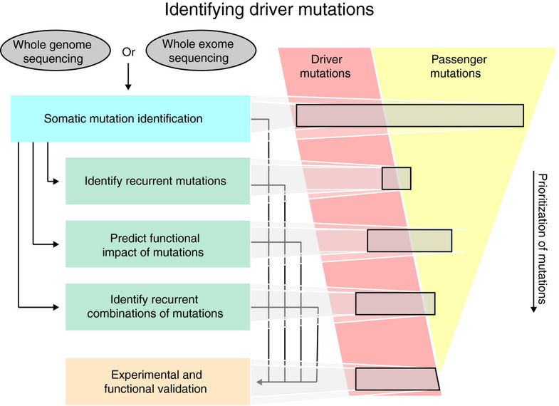
Identifying select driver variants from the large pool of candidate variants
Prioritizing key variants identifies drivers to better enable more precise diagnostics and targeted therapies
SNVs Amplifications Fusions
Number of patients in matched clinical trials identified on the basis of actionable variants in different genes
# patients in a targeted clinical trial
Top: Raphael, et al., Genome Med. (2014)
Bottom: Modified from Zehir et al, Nat. Med (2017)

Slide 13
Prioritizing somatic variants: approaches for identifying key variants through recurrence, coding & noncoding functional impact
Introduction
The need to identify key variants for precision and personalized medicine
Growth in cancer genome variant data
Mining data to prioritize variants in the search for cancer drivers
Functional impact in coding regions
- Annotation of Loss-of-Function Transcripts (ALoFT)
- LOF annotation as a complex problem
- Identifying deleterious somatic LoF variants
- Biomolecular frustration as a localized metric
- Evaluating localized frustration changes (∆F)
- Differential ∆F profiles in oncogenes vs. TSGs
Functional impact in non-coding regions
FunSeq integrates evidence on variants
Recurrence-based driver identification
Replication timing
LARVA: burden testing on non-coding annotations
- Correcting for over-dispersion in mutation counts
- Applications to different cancer types
Topologically associating domains (TADs)
- Identifying TADs at multiple resolutions
- TAD boundaries as demarcators
MOAT for somatic mutation modeling
- Basics of MOAT formalism
- FunSeq integration
Dealing with lower power
Realistic application to papillary Renal Cell Carcinoma (pRCC)
- Achieving statistical power
- Variants in MET & noncoding hotspots

Slide 14
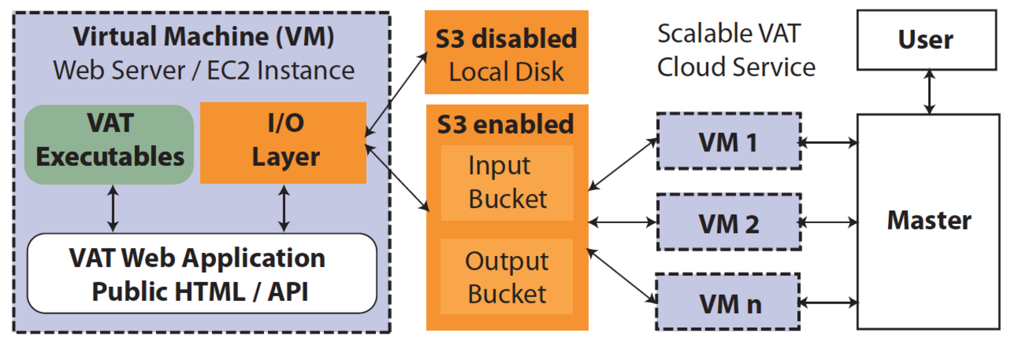
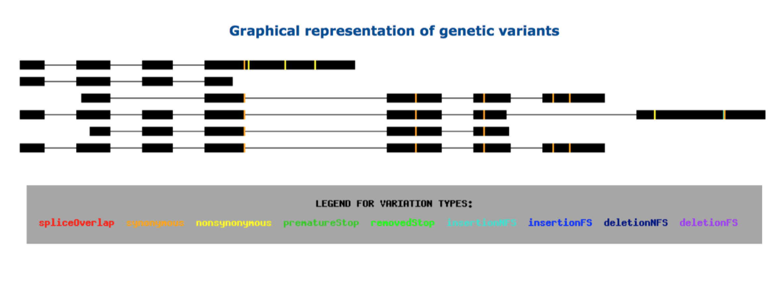
vat.gersteinlab.org
Variant Annotation Tool (VAT)
VCF Input
Output:
Annotated VCFs
Graphical representations of functional impact on transcripts
Access:
Webserver
AWS cloud instance
Source freely available
CLOUD APPLICATION
Habegger L.*, Balasubramanian S.*, et al. Bioinformatics, 2012
Notes:
‹#›
Big data challenge, graphical interface is important

Slide 15
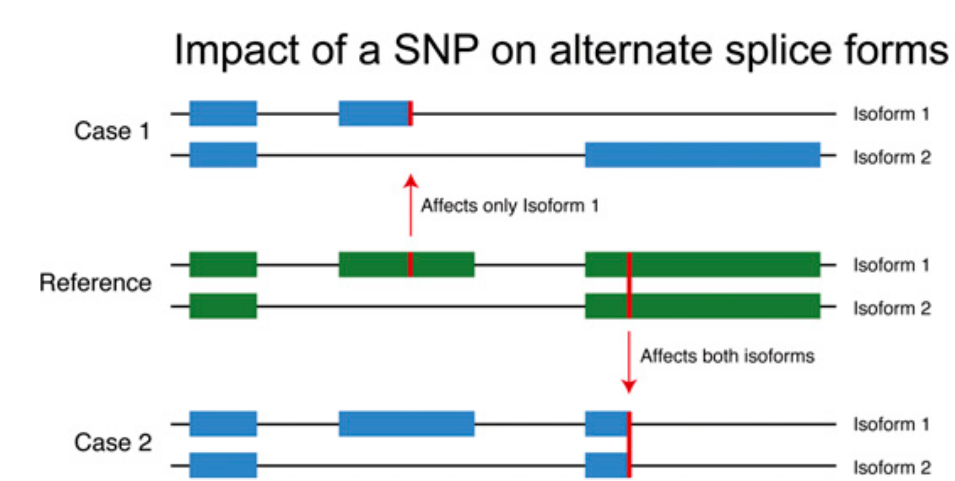
Complexities in LOF annotation
Transcript isoforms,
distance to stop,
functional domains,
protein folding,
etc.
Balasubramanian S. et al., Genes Dev., ’11
Balasubramanian S.*, Fu Y.* et al., NComms., ’17

Slide 16
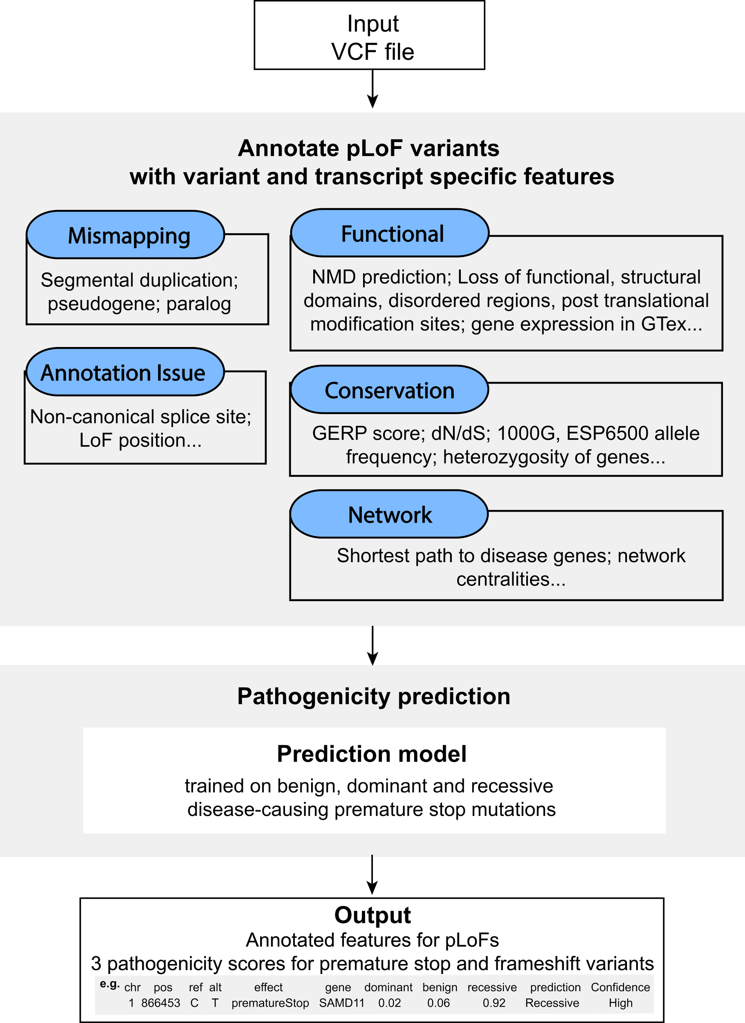
Annotation of Loss-of-Function Transcripts (ALoFT)
VCF Input
Output:
Impact score: benign or deleterious.
Confidence level.
Annotated VCF.
Access:
Software package: aloft.gersteinlab.org
Gitub: github.com/gersteinlab/aloft
Balasubramanian S.*, Fu Y.* et al., NComms., ’17

Slide 17
LoF position distribution varies by cohort
Balasubramanian S.*, Fu Y.* et al., NComms., ’17

Slide 18
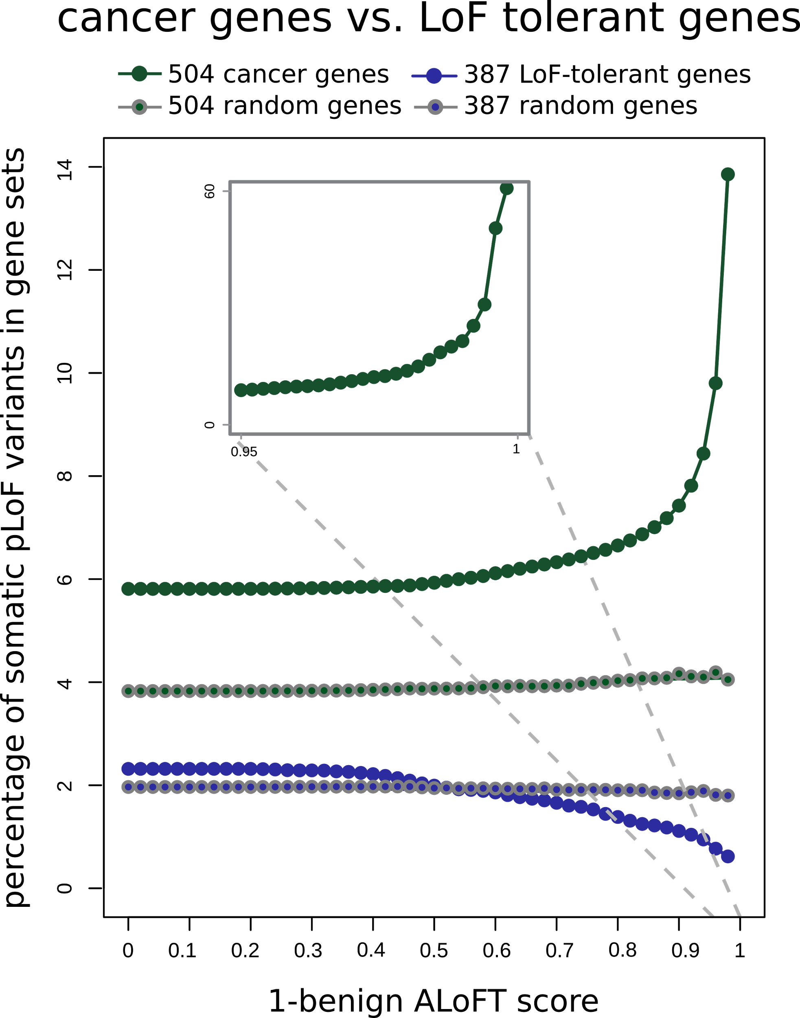
ALoFT identifies deleterious
somatic LoF variants
LoF tolerant genes:
LoF in the 1KG cohort.
Depleted in deleterious LoFs.
Cancer genes:
COSMIC consensus.
Enriched in deleterious LoFs.
Balasubramanian S.*, Fu Y.* et al., NComms., ’17

Slide 19
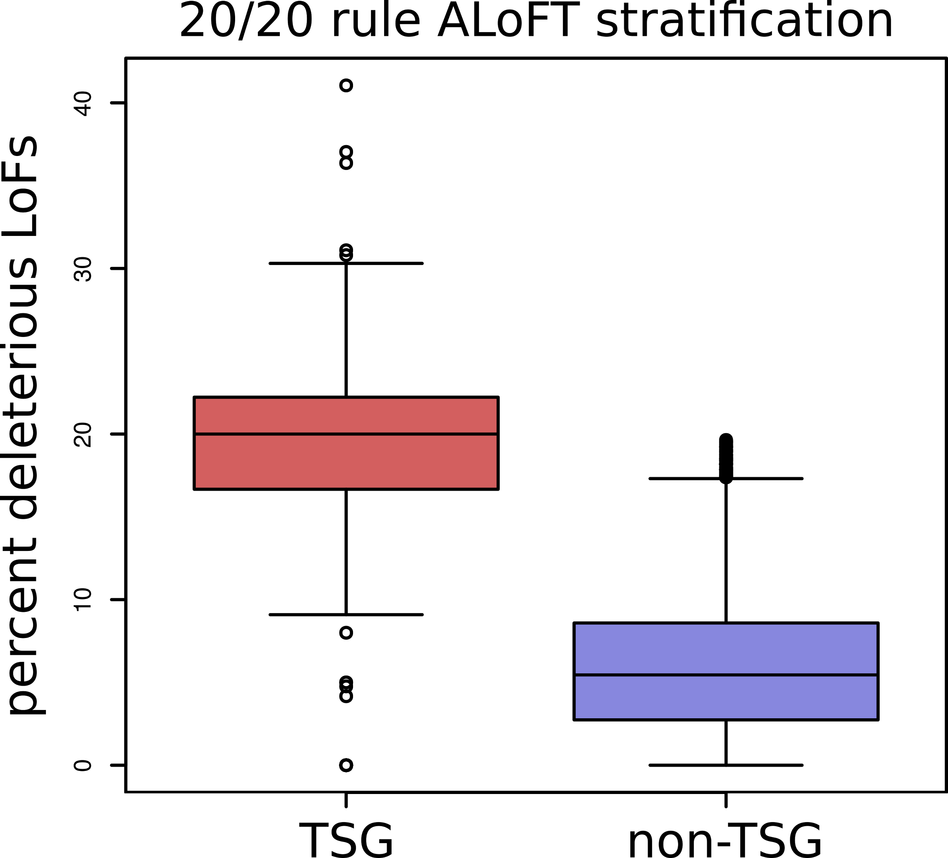
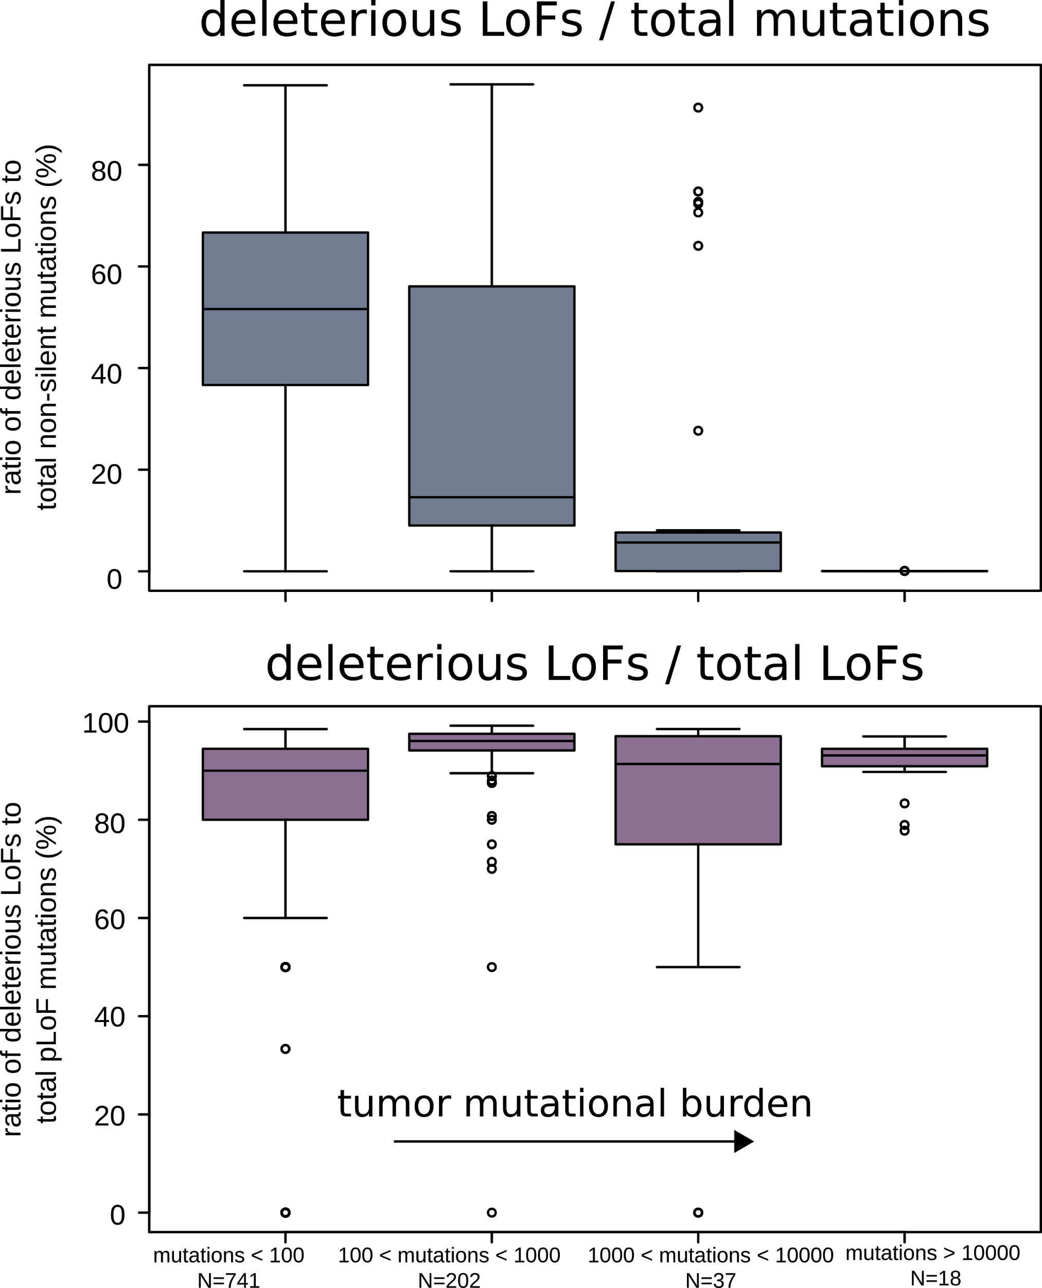
ALoFT refines cancer mutation classification
Vogelstein et al. 2013: if >20% of mutations in a gene are inactivating → tumor suppressor gene (TSG).
ALoFT further refines 20/20 rule predictions.
Balasubramanian S.*, Fu Y.* et al., NComms., ’17

Slide 20
Prioritizing somatic variants: approaches for identifying key variants through recurrence, coding & noncoding functional impact
Introduction
The need to identify key variants for precision and personalized medicine
Growth in cancer genome variant data
Mining data to prioritize variants in the search for cancer drivers
Functional impact in coding regions
- Annotation of Loss-of-Function Transcripts (ALoFT)
- LOF annotation as a complex problem
- Identifying deleterious somatic LoF variants
- Biomolecular frustration as a localized metric
- Evaluating localized frustration changes (∆F)
- Differential ∆F profiles in oncogenes vs. TSGs
Functional impact in non-coding regions
FunSeq integrates evidence on variants
Recurrence-based driver identification
Replication timing
LARVA: burden testing on non-coding annotations
- Correcting for over-dispersion in mutation counts
- Applications to different cancer types
Topologically associating domains (TADs)
- Identifying TADs at multiple resolutions
- TAD boundaries as demarcators
MOAT for somatic mutation modeling
- Basics of MOAT formalism
- FunSeq integration
Dealing with lower power
Realistic application to papillary Renal Cell Carcinoma (pRCC)
- Achieving statistical power
- Variants in MET & noncoding hotspots

Slide 21
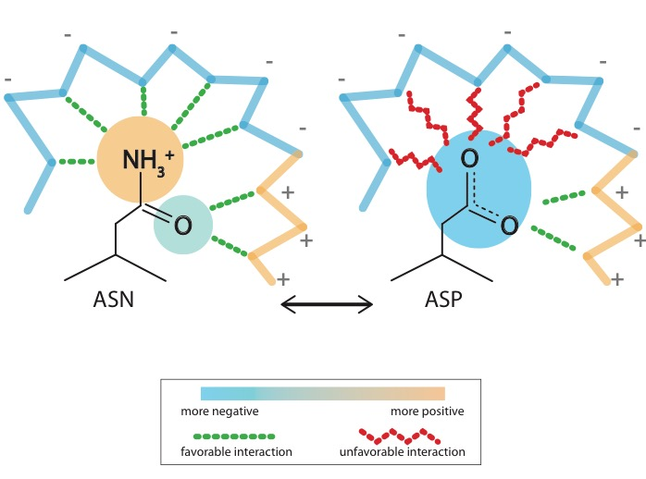
Schematic illustration of localized frustration
[Ferreiro et al., PNAS (’07)]

Slide 22
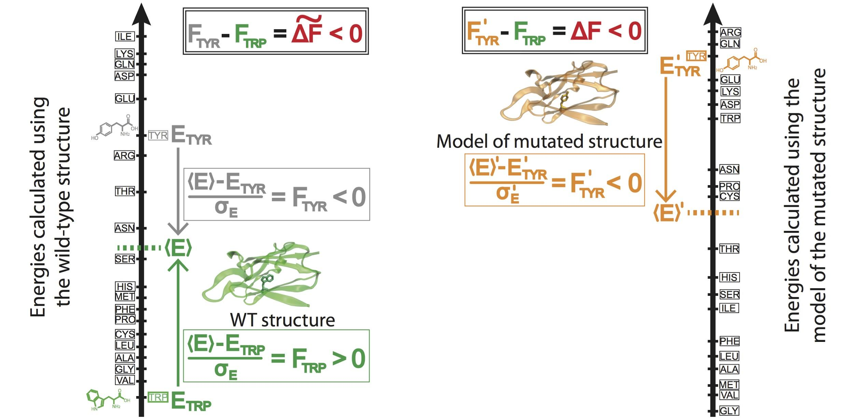
Workflow for evaluating localized frustration changes (∆F)
[Kumar et al. NAR (in 2016)
Notes:
An example illustrating the case in which ∆F < 0. The ∆F associated with an SNV is negative if the SNV introduces a destabilizing effect. Shown here is the result of changing residue ID 31 in plastocyanin (pdb ID 3CVD) from the wild-type residue (Trp) to a mutated residue (Tyr). Left) The protein in its wild-type form (in green), in which the tryptophan residue at position 31 is substantially more energetically favorable relative to the mean energy ⟨E⟩ that would result from having any of the possible 20 amino acids at that position. This disparity is designated by (⟨E⟩ - E_{nat})/σ_{E} = F_{nat} > 0. Right) The entire protein structure is then modeled to generate the mutated structure after the SNV W31Y is introduced, thereby changing the relative energetic distributions for the different amino acids. The new mean and standard deviation associated with the energies of the modeled structure are designated by ⟨E⟩’ and σ_{E}’, respectively. In this case, the SNV that introduces 31Y results in an energy that is higher than the mean energy of all possible 20 amino acids at that position. This disparity is designated by (⟨E⟩’ - E_{mut})/σ_{E}’ = F_{mut} < 0. Taken together, the negative value associated with the disparity between the F_{mut} and F_{nat} values (F_{mut} - F_{nat} = ∆F < 0) indicates that the this SNV is locally unfavorable.

Slide 23
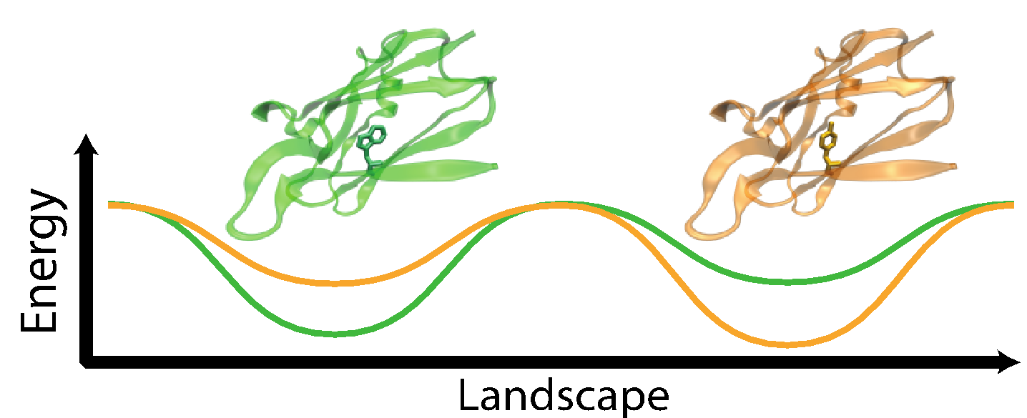
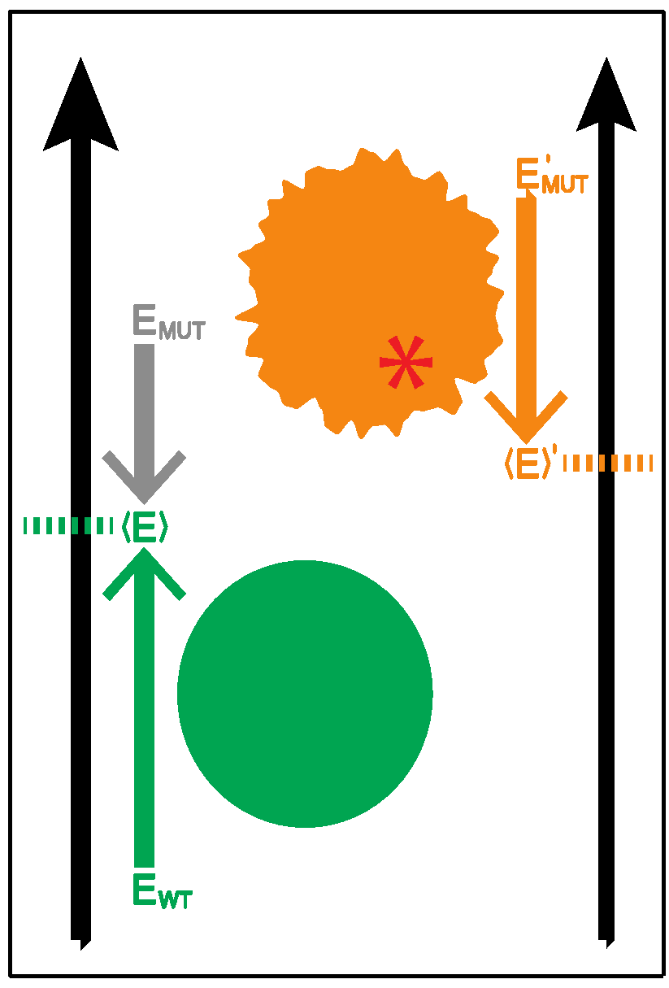
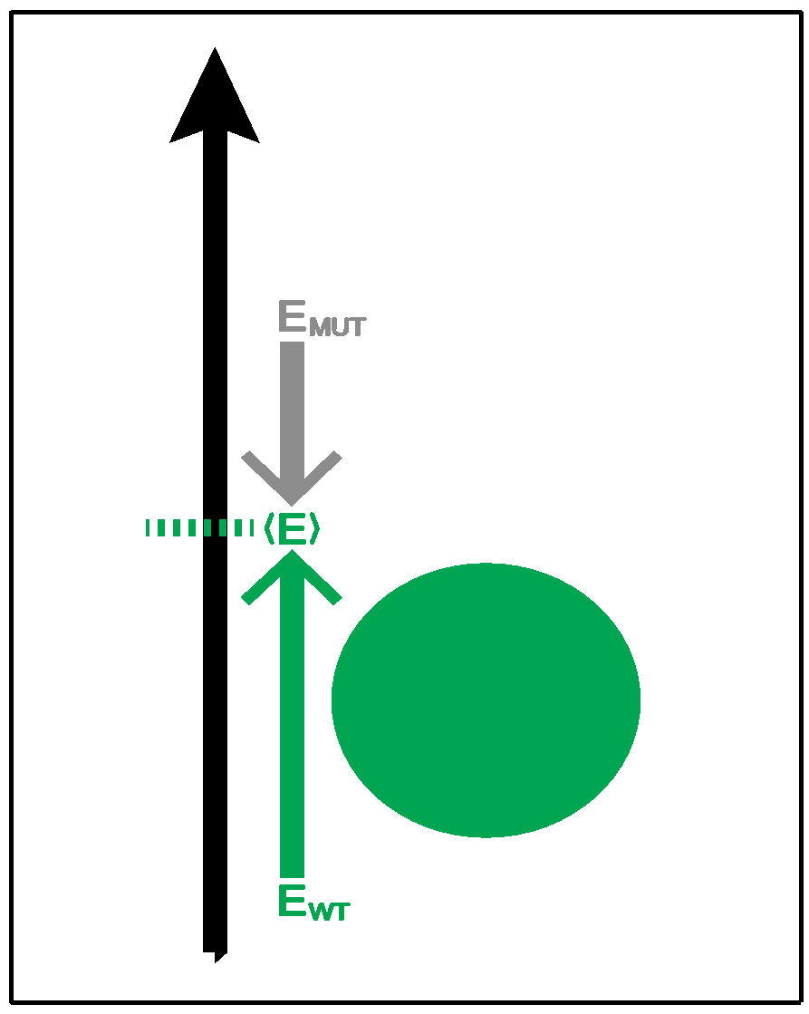
Complexity of the second order frustration calculation
MD-assisted free energy calculation (∆G)
Second order frustration calculation (∆F)
Time
First order frustration calculation (F)
Accuracy

Slide 24
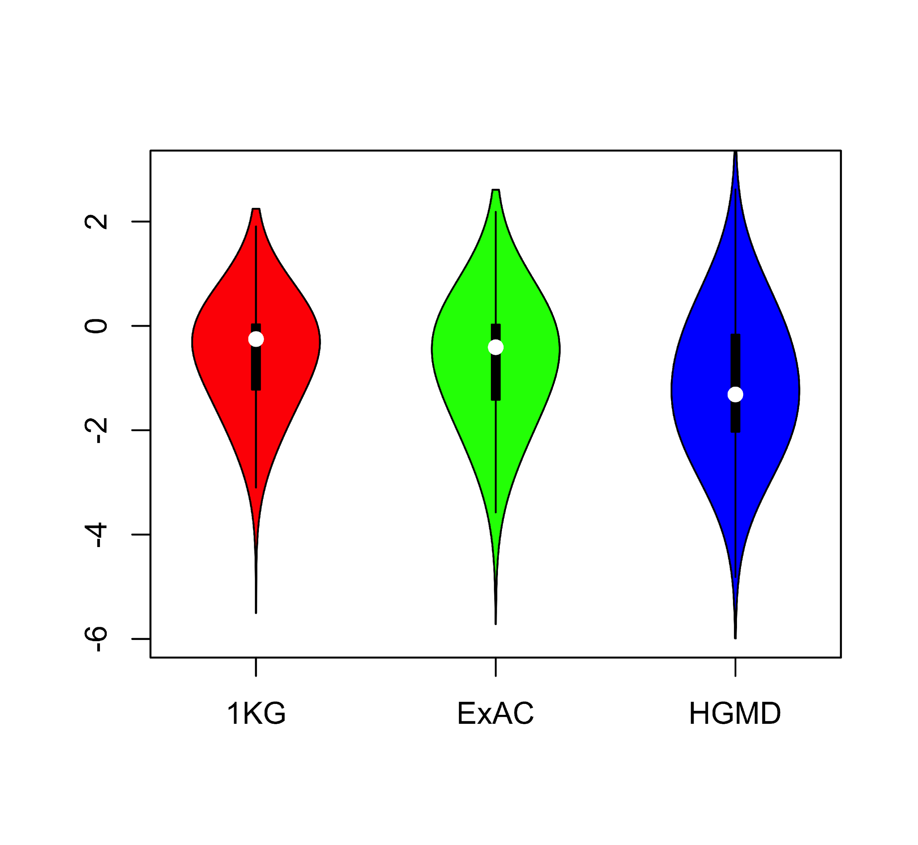
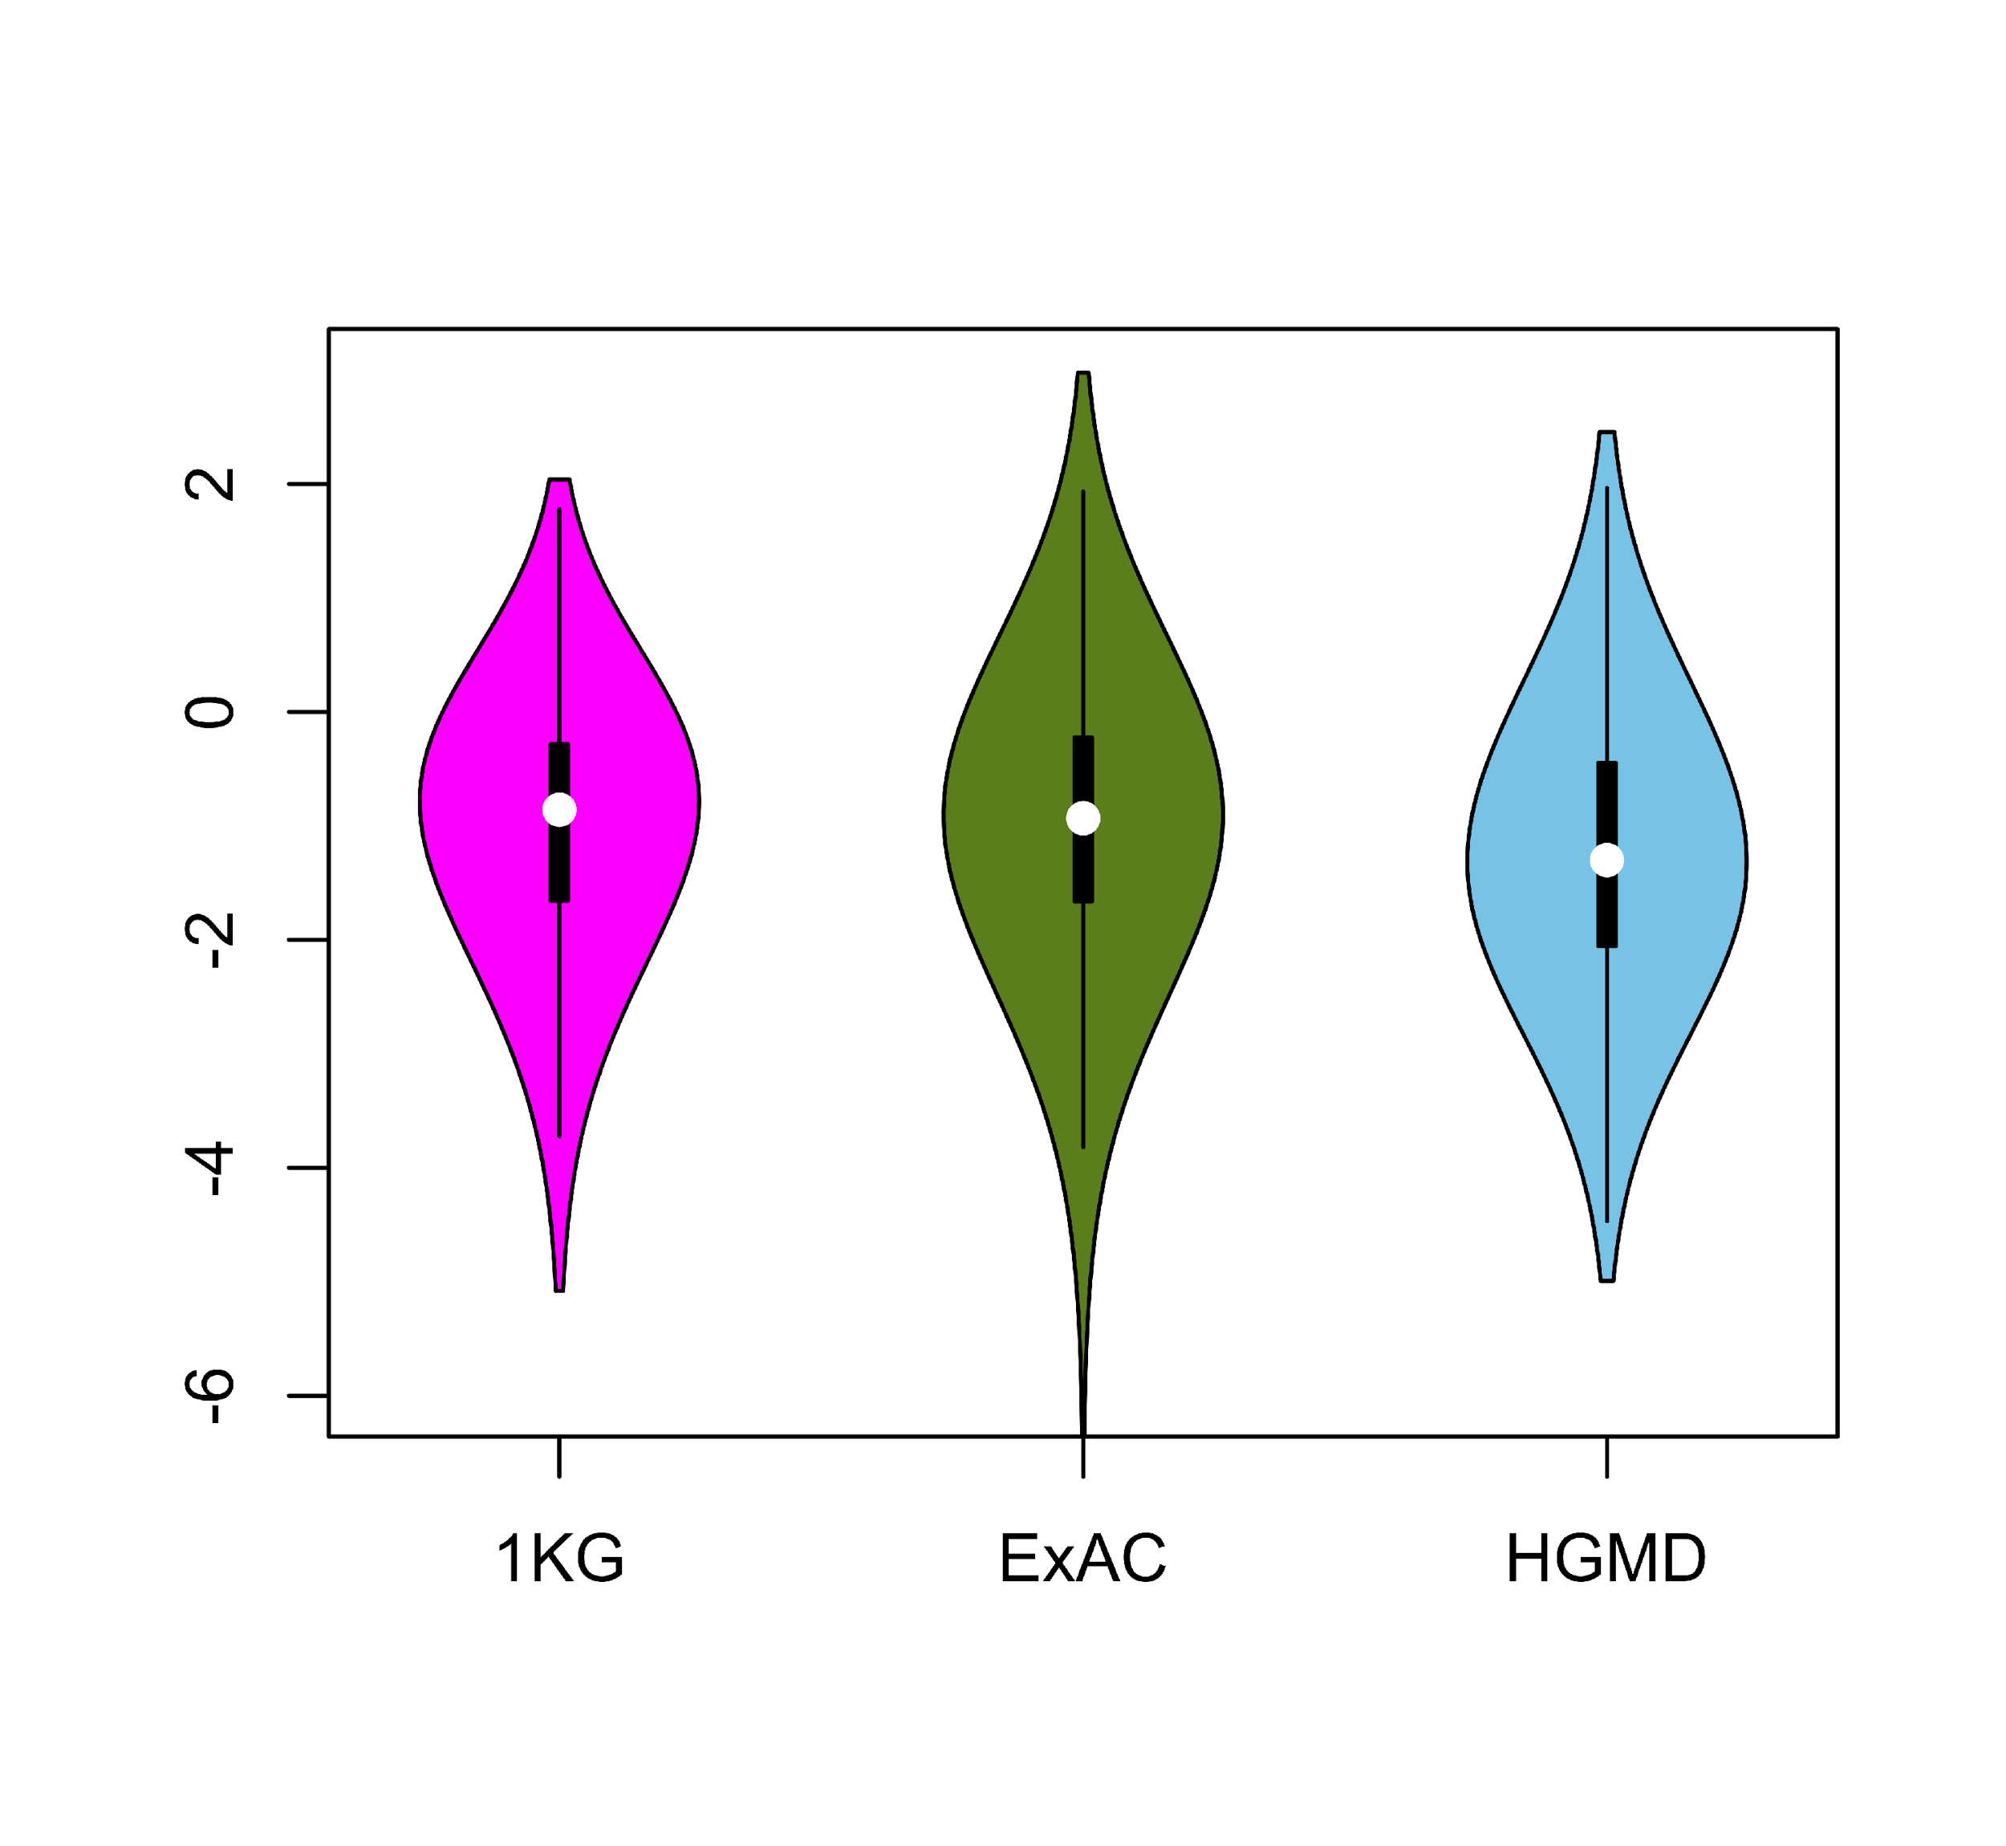
Comparing ∆F values across different SNV categories: disease v normal
Loss of frustration
Gain of frustration
[Kumar et al. NAR (in press); biorxiv 052027]
Core residues
Surface residues
Normal mutations (1000G) tend to unfavorably frustrate (less frustrated) surface more than core, but for disease mutations (HGMD) no trend & greater changes
Notes:
We observed that benign SNVs lead to greater disruptions within minimally frustrated surface residues compared to core residues in the native structure, and this trend is observed when using both ExAC and 1KG (Figure A & B). However, SNVs from HGMD that impact minimally frustrated core residues induce stronger perturbations than benign SNVs influencing minimally frustrated core residues (Figure C). This suggest that the mechanistic difference between benign and disease SNVs can be attributed to their impact on the local environment of core residues. Within the core, disease-associated SNVs result in more severe perturbations to local interactions relative to those introduced by benign SNVs. These local disruptions are propagated throughout the core and, in turn, drive the deleteriousness of various disease-associated SNVs.

Slide 25
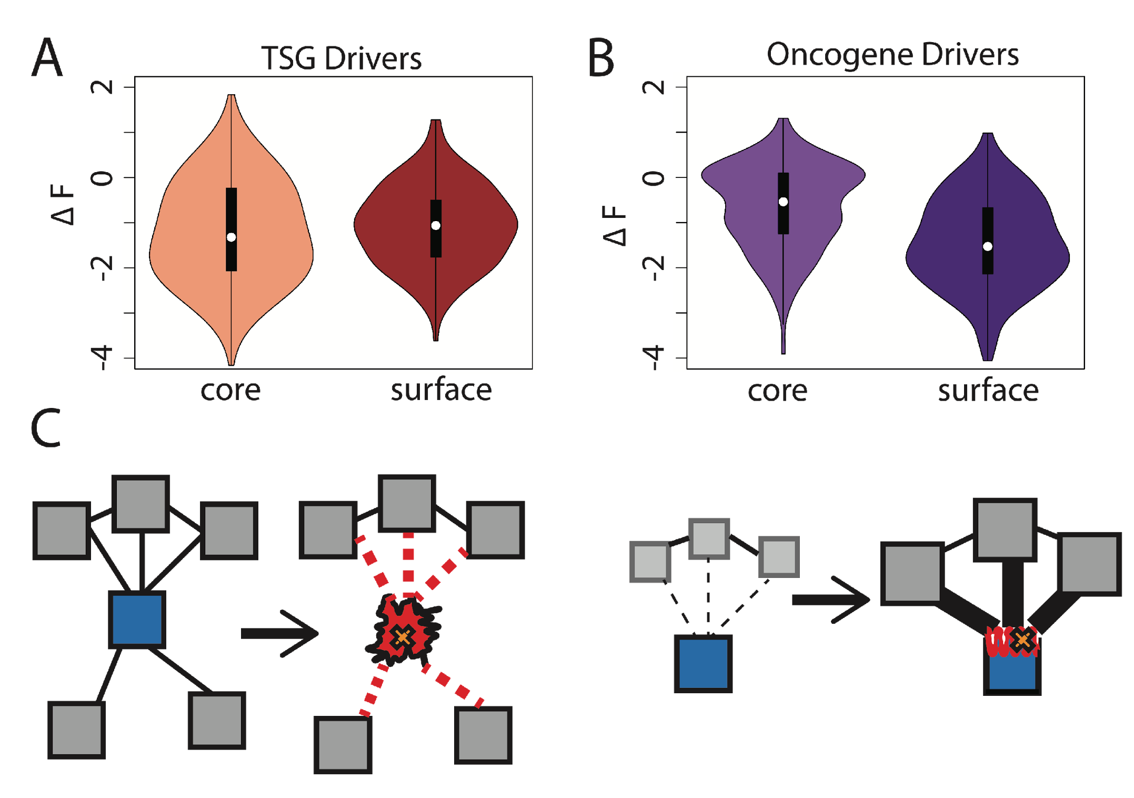
Comparison between ∆F distributions: TSGs v. oncogenes
[Kumar et al. NAR (in press); biorxiv 052027]
SNVs in TSGs change frustration more in core than the surface, whereas those associated with oncogenes manifest the opposite pattern. This is consistent with differences in LOF v GOF mechanisms.
Notes:
we observe that somatic SNVs associated with TSGs change the frustration more in core than the surface, whereas those associated with oncogenes manifest the opposite pattern. This is consistent with LOF and GOF mechanism proposed for TSG and oncogene driven cancer progression.

Slide 26
Prioritizing somatic variants: approaches for identifying key variants through recurrence, coding & noncoding functional impact
Introduction
The need to identify key variants for precision and personalized medicine
Growth in cancer genome variant data
Mining data to prioritize variants in the search for cancer drivers
Functional impact in coding regions
- Annotation of Loss-of-Function Transcripts (ALoFT)
- LOF annotation as a complex problem
- Identifying deleterious somatic LoF variants
- Biomolecular frustration as a localized metric
- Evaluating localized frustration changes (∆F)
- Differential ∆F profiles in oncogenes vs. TSGs
Functional impact in non-coding regions
FunSeq integrates evidence on variants
Recurrence-based driver identification
Replication timing
LARVA: burden testing on non-coding annotations
- Correcting for over-dispersion in mutation counts
- Applications to different cancer types
Topologically associating domains (TADs)
- Identifying TADs at multiple resolutions
- TAD boundaries as demarcators
MOAT for somatic mutation modeling
- Basics of MOAT formalism
- FunSeq integration
Dealing with lower power
Realistic application to papillary Renal Cell Carcinoma (pRCC)
- Achieving statistical power
- Variants in MET & noncoding hotspots

Slide 27
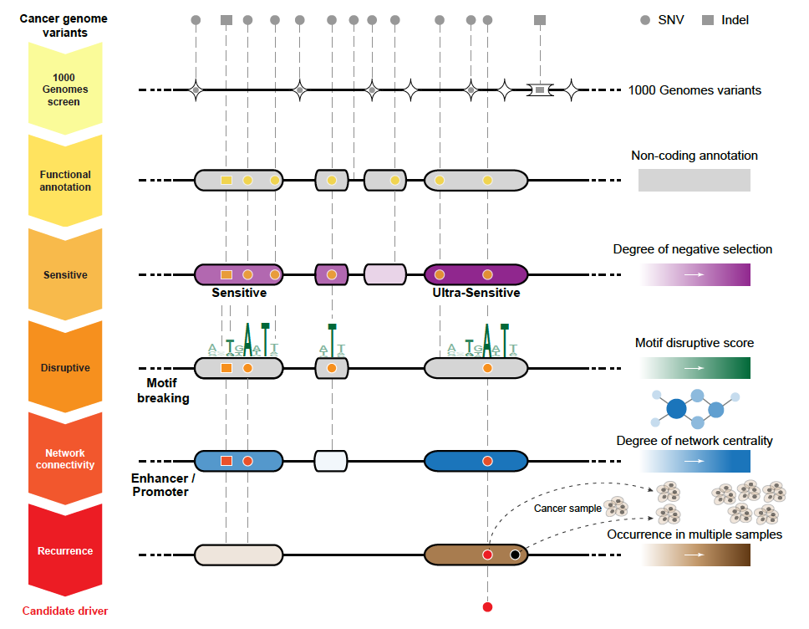
Funseq: a flexible framework to prioritize non-coding variants integrating various resources.
Annotation (TF binding sites open chromatin, ncRNAs)
Conservation
(GERP)
Mutational impact (motif breaking, Lof)
Network (centrality position)
Chromatin dynamics
[Khurana et al., Science (‘13)]
[Fu et al., GenomeBiology ('14),
Khurana et al., Science ('13)]

Slide 28
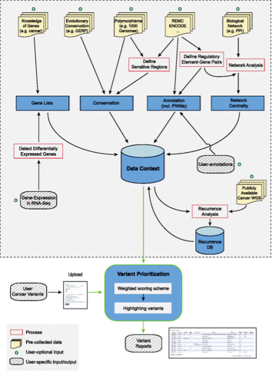
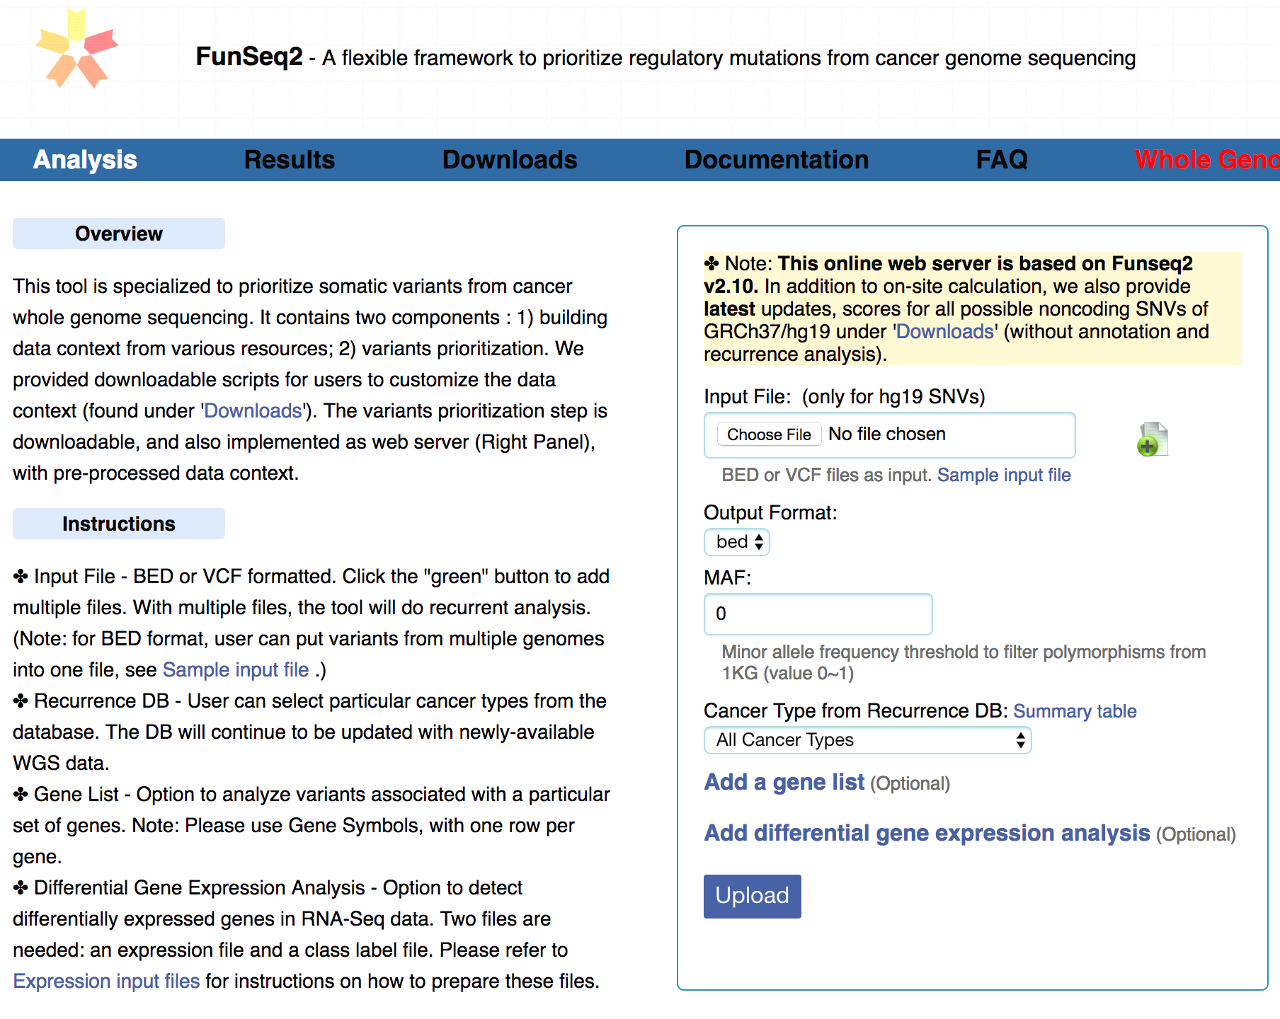
HOT region
Sensitive region
Polymorphisms
Genome
Practical web server
Submission of variants & pre-computed large Data context from uniformly processing large-scale datasets
Entropy based method for weighting consistently many genomic features
FunSeq.gersteinlab.org

Slide 29
Prioritizing somatic variants: approaches for identifying key variants through recurrence, coding & noncoding functional impact
Introduction
The need to identify key variants for precision and personalized medicine
Growth in cancer genome variant data
Mining data to prioritize variants in the search for cancer drivers
Functional impact in coding regions
- Annotation of Loss-of-Function Transcripts (ALoFT)
- LOF annotation as a complex problem
- Identifying deleterious somatic LoF variants
- Biomolecular frustration as a localized metric
- Evaluating localized frustration changes (∆F)
- Differential ∆F profiles in oncogenes vs. TSGs
Functional impact in non-coding regions
FunSeq integrates evidence on variants
Recurrence-based driver identification
Replication timing
LARVA: burden testing on non-coding annotations
- Correcting for over-dispersion in mutation counts
- Applications to different cancer types
Topologically associating domains (TADs)
- Identifying TADs at multiple resolutions
- TAD boundaries as demarcators
MOAT for somatic mutation modeling
- Basics of MOAT formalism
- FunSeq integration
Dealing with lower power
Realistic application to papillary Renal Cell Carcinoma (pRCC)
- Achieving statistical power
- Variants in MET & noncoding hotspots

Slide 30
Mutation recurrence
Cancer Type 1
Cancer Type 2
Cancer Type 3

Slide 31
Mutation recurrence
Cancer Type 1
Cancer Type 2
Cancer Type 3
Early replicated regions
Late replicated regions

Slide 32
Noncoding annotations
Cancer Type 1
Cancer Type 2
Cancer Type 3
Early replicated regions
Late replicated regions

Slide 33
Noncoding annotations
Cancer Type 1
Cancer Type 2
Cancer Type 3
Early replicated regions
Late replicated regions

Slide 34
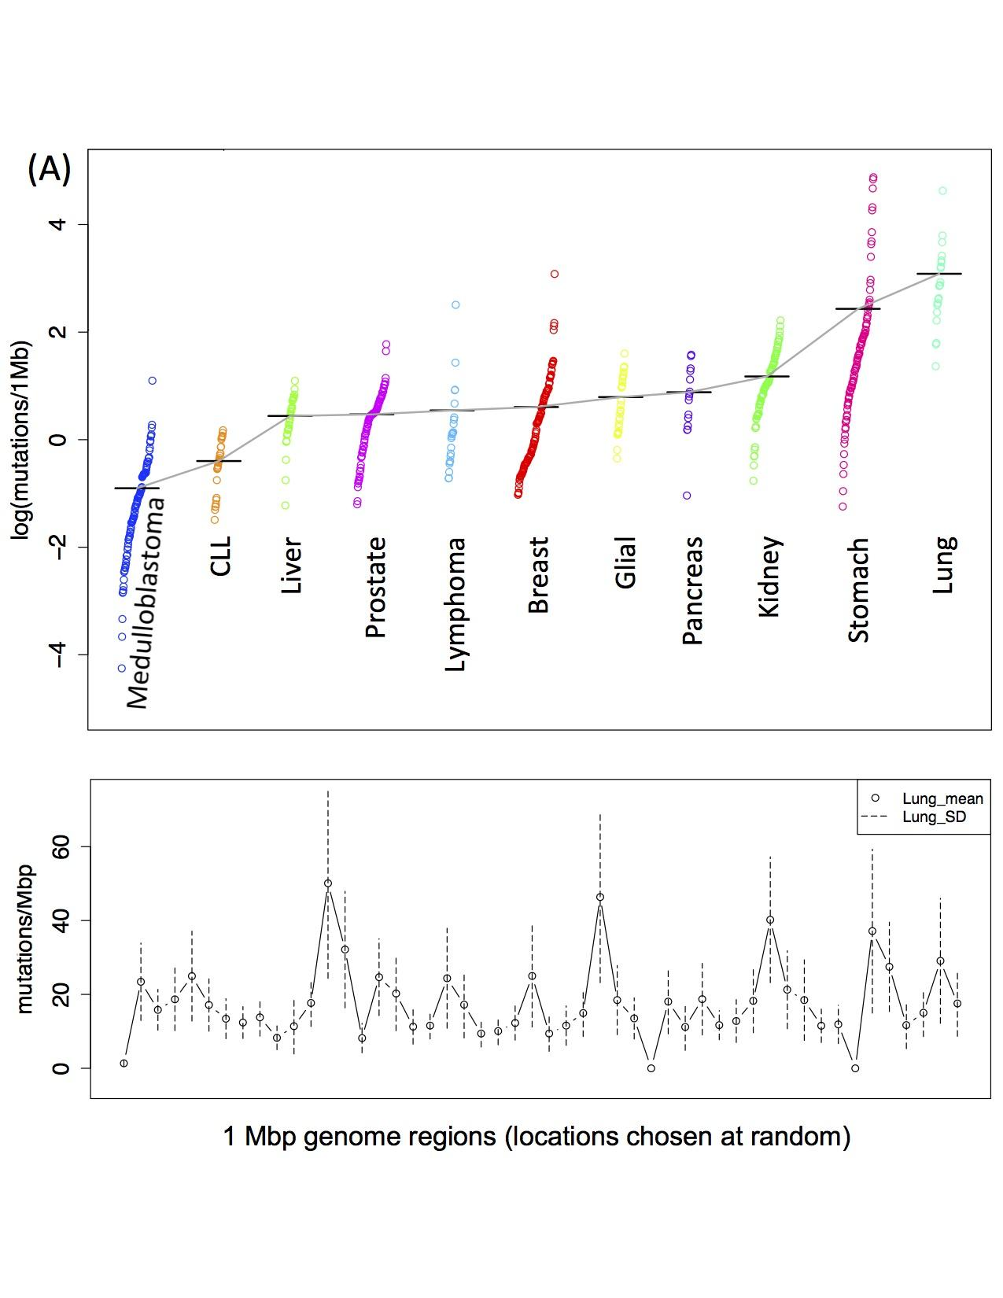
Cancer Somatic Mutational Heterogeneity, across cancer types, samples & regions
[Lochovsky et al. NAR (’15)]

Slide 35
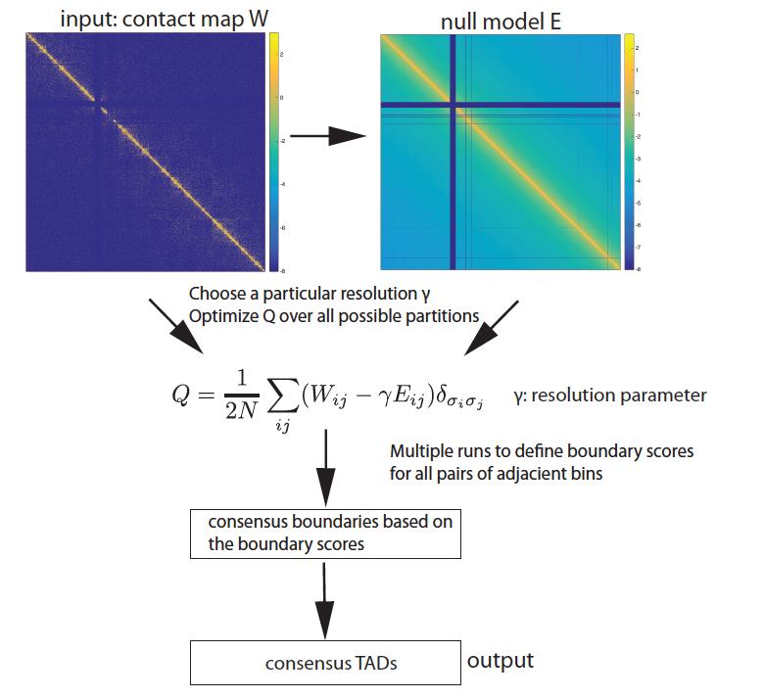
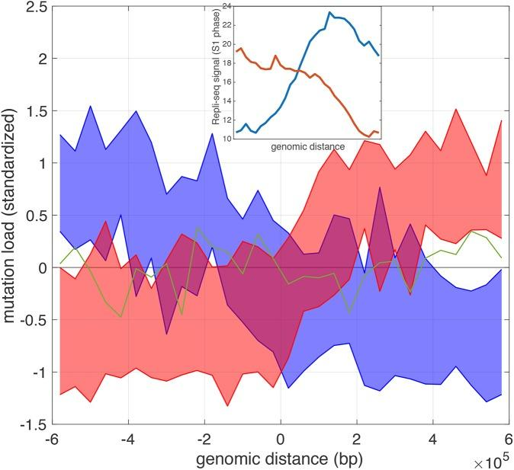
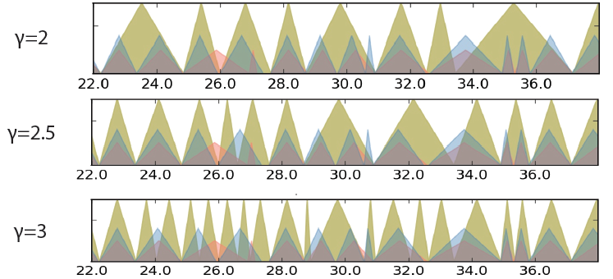
mrTADFinder: Identifying TADs in multiple resolutions
[Yan et al., PLOS Comp. Bio. 2017; bioRxiv 097345]
genomic distance from the TAD boundary
Mutation burden and DNA replication timing

Slide 36
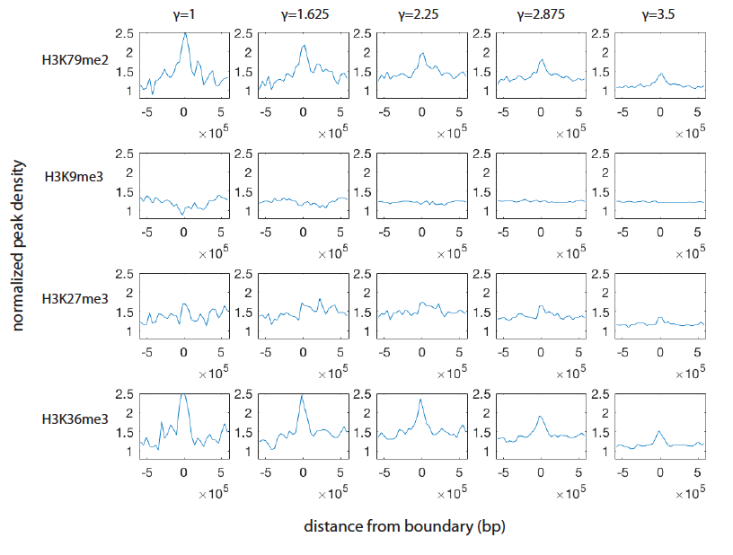
mrTADFinder: Identifying TADs in multiple resolutions
[Yan et al., PLOS Comp. Bio. 2017; bioRxiv 097345]
Enrichment of histone features at different resolution

Slide 37
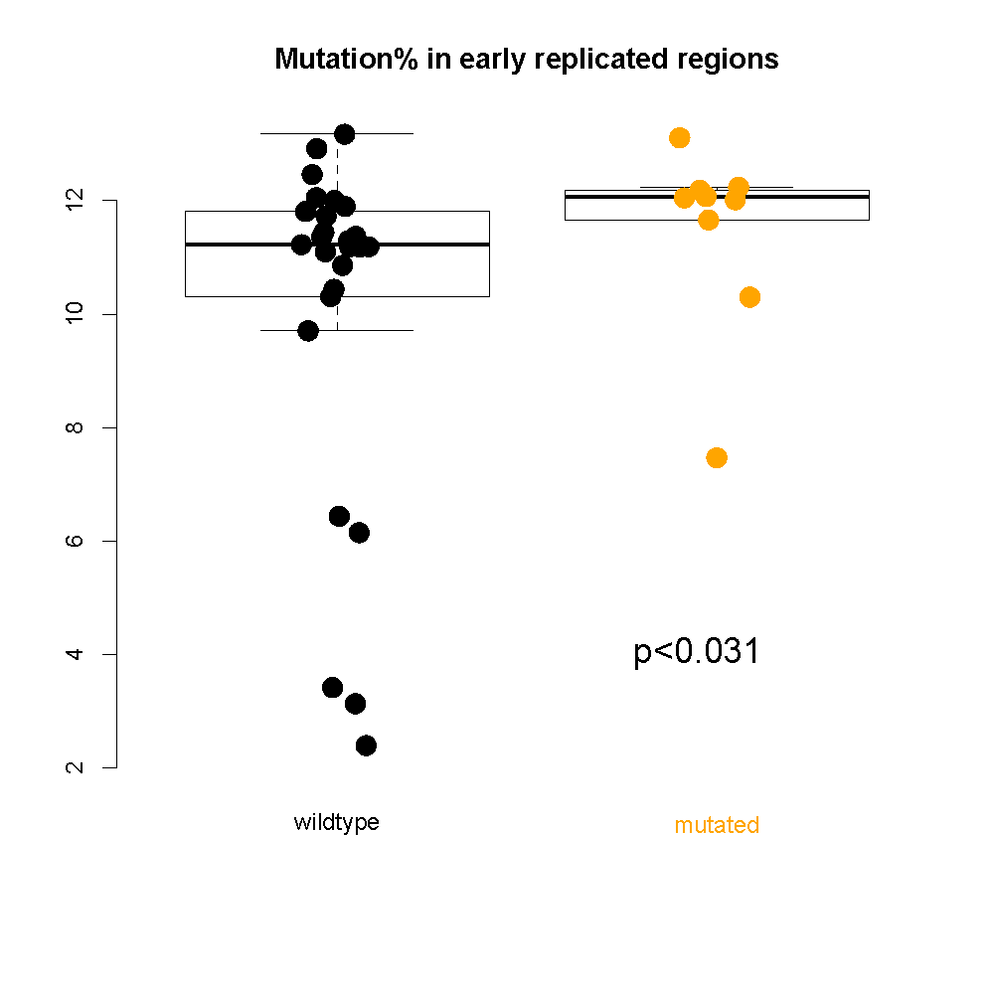
Repli-seq signal(S1 phase)
genomic distance from the TAD boundary
Chromatin remodeling failure leads to more mutations in early-replicating regions
genomic distance from the TAD boundary
[Yan et al., PLOS Comp. Bio. (‘17); S. Li et al., PLOS Genetics (‘17)] ]

Slide 38
Cancer Somatic Mutation Modeling
PARAMETRIC MODELS
Suppose there are k genome elements. For element i, define:
n_{i}: total number of nucleotides
x_{i}: the number of mutations within the element
p: the mutation rate
R_{i}: the covariate rank of the element
Non-parametric model is useful when covariate data is missing for the studied annotations
Also sidesteps issue of properly identifying and modeling every relevant covariate (possibly hundreds)
NON-PARAMETRIC MODELS
Model 1: Constant Background Mutation Rate (Model from Previous Work)
Assume constant background mutation rate in local regions.
Model 3a: Random Permutation of Input Annotations
Model 2a: Varying Mutation Rate
with Single Covariate Correction
Shuffle annotations within local region to assess background mutation rate.
Model 3b: Random Permutation of Input Variants
Shuffle variants within local region to assess background mutation rate.
Model 2b: Varying Mutation Rate
with Multiple Covariate Correction
[Lochovsky et al. under review]
[Lochovsky et al. NAR (’15)]

Slide 39
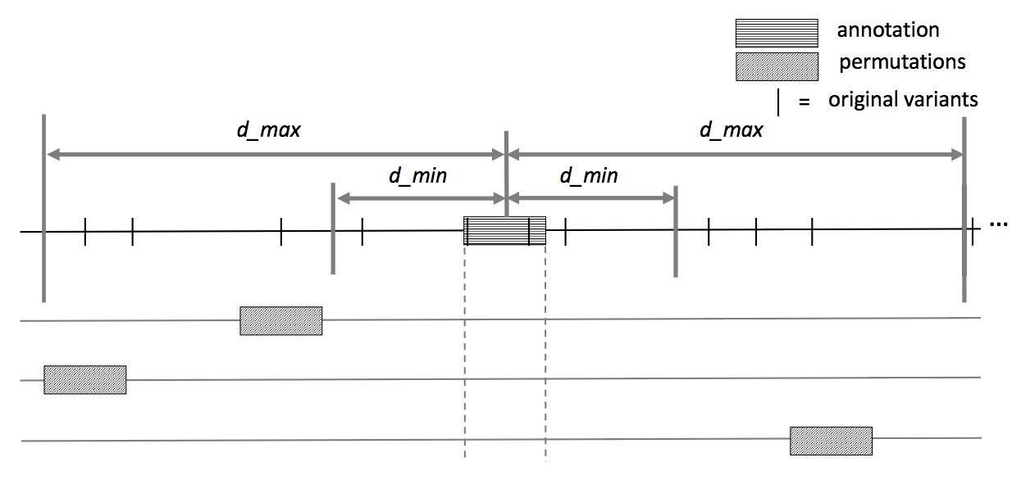
MOAT-a: Annotation-based permutation
Notes:
Formally, this method incorporates the annotation length l, the number of random bins we’re going to place in the surrounding genome, n, and two parameters that determine the boundaries of the local genome in which we place random bins, d_min and d_max. d_max has to be small enough that the background mutation rate is roughly constant, while d_min exists to ensure that, if there’s some transitionary region between the mutation rate of a and the mutation rate of the surrounding genome, that the signal from a won’t bleed into our analysis of the local genome context.

Slide 40
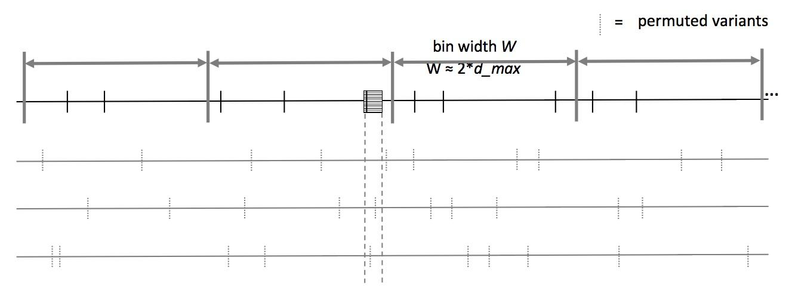
MOAT-v: Variant-based Permutation
Notes:
The second version of MOAT operates on the idea of variant-based permutation. We place bins over the entire genome that each represent a local genome context, shuffle the variants in each bin, and track permuted variant counts for the annotation we’re studying.

Slide 41
MOAT-v: Variant-based Permutation
For each bin, repeat n times:
Iterate through intersecting variants: pick a new location in the bin that has the same trinucleotide context in the reference genome as the original variant location
Pick with uniform probability, excluding the original variant location as a possible new location
new variant
original variant
alt
T
T
ref
CTTCAAGTTCTCAACTCCTGTCAATATCCCTTCCCCTCAACTTGACAATC
*
*
*
*
* = candidates for variant’s new location
Notes:
When we move the variants’ to new locations, we want to preserve the trinucleotide context of the variant, which includes the nucleotide where the variant occurs, and the two neighboring nucleotides on either side. To do this, we index every trinucleotide in the reference genome within the variant’s bin, and select one of these new locations with uniform probability, excluding the original variant site. With this, we maintain the mutation frequencies of the trinucleotides in each bin, and it ensures that the trinucleotide mutation rates are consistent in our permutations.

Slide 42
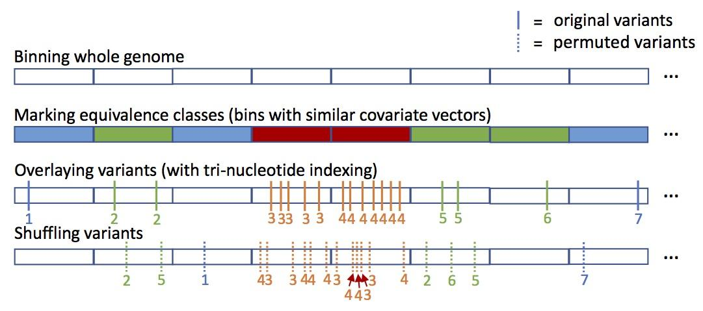
MOAT-s
A somatic variant simulator
Given a set of input variants, shuffle to new locations, taking genome structure into account

Slide 43
Funseq2 Integration
Funseq2¹ integration with MOAT
Computational method developed in the Gerstein lab
Assesses the functional impact of whole genome sequence variants
Uses a vast range of coding and noncoding annotations to prioritize variants most likely to be associated with cancer
MOAT identifies input variants with significantly elevated Funseq scores
Computations performed alongside mutation burden analysis
Works with MOAT-a and MOAT-v
1. Fu, Y. et al. FunSeq2: a framework for prioritizing noncoding regulatory variants in cancer. Genome biology 15, 480 (2014).
Notes:
Just as mutation burden is intended to help find the important stuff in cancer, we can also prioritize important parts of the genome with a functional impact analysis.

Slide 44
Funseq2 Integration
Run Funseq2 over the whole genome
Produce signal track that is the maximum score at each position
Calculate an annotation signal by summing the intersecting variants’ scores
Use the same procedure on permuted data
These are background scores to determine if the observed score is significantly elevated
80
80
50
20
20
50
+
30
20
= 50
0
40

Slide 45
Funseq2 Integration
Compiled list of annotations with significantly elevated Funseq2 scores
TSSes, promoters, enhancers
Results comparable to the elevated mutation burden analysis
MOAT implementation is generalizable to any whole genome signal track
e.g. can plug in a GERP score or K27 acetylation file
Negligible effect on runtime
Parallelization scalability preserved
Notes:
Seems that the list for Funseq2 is longer than for mutation burden → higher false positive rate?

Slide 46
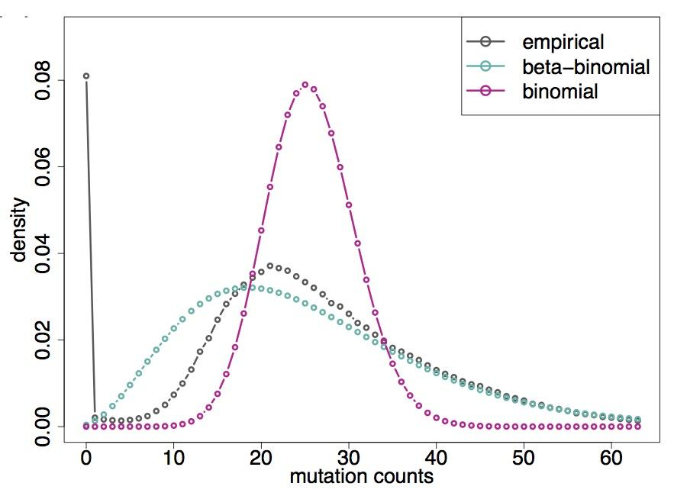
LARVA Model Comparison
Comparison of mutation count frequency implied by the binomial model (model 1) and the beta-binomial model (model 2) relative to the empirical distribution
The beta-binomial distribution is significantly better, especially for accurately modeling the over-dispersion of the empirical distribution
[Lochovsky et al. NAR (’15)]

Slide 49
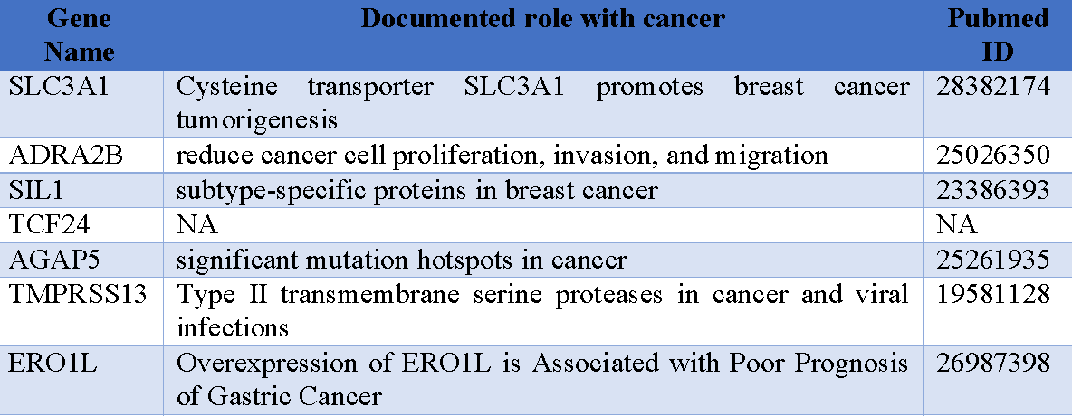
MOAT Results: recapitulates LARVA with excellent GPU-driven runtime scalability
We demonstrate computational efficiency of MOAT’s NVIDIA™ CUDA™ version, with respect to the number of permutations, is dramatically enhanced compared to the CPU version.
.
Number of permutations | Fold speedup of CUDA version
1k | 14x
10k | 100x
100k | 256x
.
.
MOAT’s high mutation burden elements recapitulates LARVA’s results and published noncoding cancer-associated elements.

Slide 50
Prioritizing somatic variants: approaches for identifying key variants through recurrence, coding & noncoding functional impact
Introduction
The need to identify key variants for precision and personalized medicine
Growth in cancer genome variant data
Mining data to prioritize variants in the search for cancer drivers
Functional impact in coding regions
- Annotation of Loss-of-Function Transcripts (ALoFT)
- LOF annotation as a complex problem
- Identifying deleterious somatic LoF variants
- Biomolecular frustration as a localized metric
- Evaluating localized frustration changes (∆F)
- Differential ∆F profiles in oncogenes vs. TSGs
Functional impact in non-coding regions
FunSeq integrates evidence on variants
Recurrence-based driver identification
Replication timing
LARVA: burden testing on non-coding annotations
- Correcting for over-dispersion in mutation counts
- Applications to different cancer types
Topologically associating domains (TADs)
- Identifying TADs at multiple resolutions
- TAD boundaries as demarcators
MOAT for somatic mutation modeling
- Basics of MOAT formalism
- FunSeq integration
Dealing with lower power
Realistic application to papillary Renal Cell Carcinoma (pRCC)
- Achieving statistical power
- Variants in MET & noncoding hotspots

Slide 51
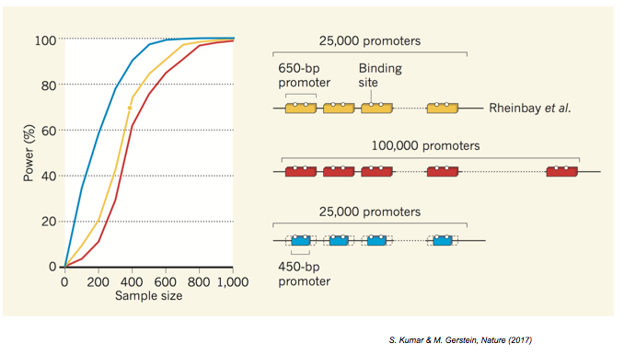
Power a big hurdle in driver discovery
Better annotation or large number of samples could help.

Slide 52
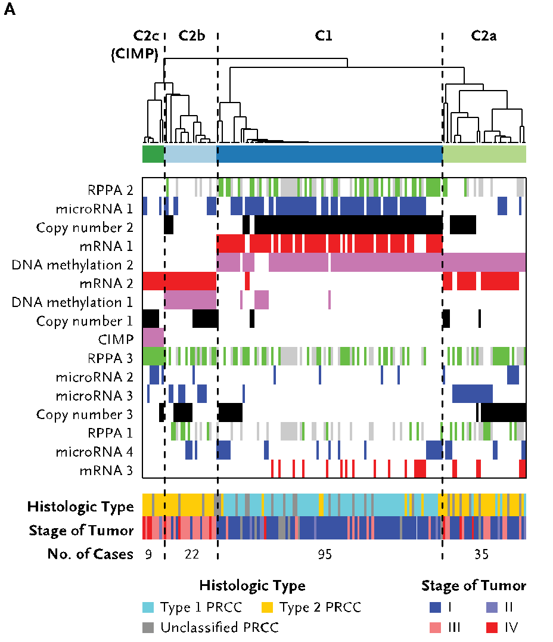
An Underpowered Real Case Study: pRCC
Kidney cancer life time risk: 1.6% the papillary type (pRCC) counts for about 10% of all cases
TCGA project sequenced 161 whole exome of pRCC and conducted molecular subtype
Yet researchers cannot pin down the cause for a significant portion of cases
[Cancer Genome Atlas Research Network N Engl J Med. (‘16) ]

Slide 53
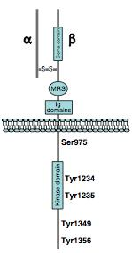
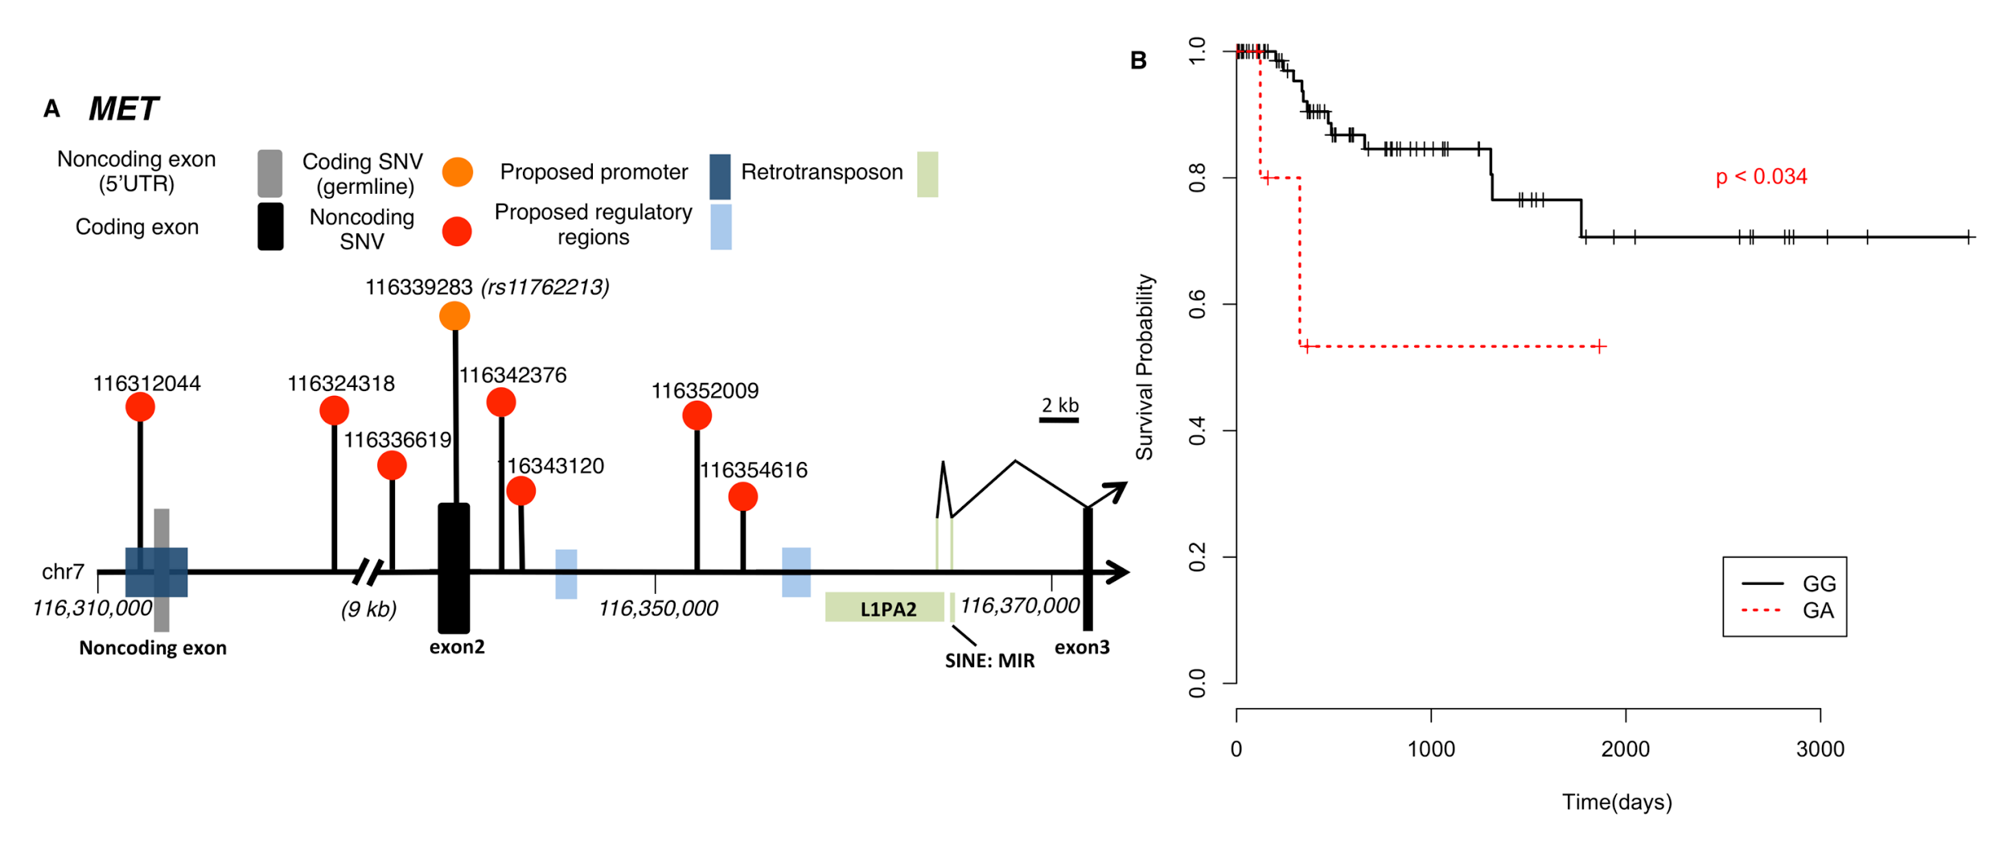
Our Findings on the Tyrosine Kinase MET
MET is the long known driver in pRCC, we
Found rs11762213 predicts survival in type 2 patients
Illustrated the mechanism of an alternative splicing event
A noncoding hotspot in MET
Lack of SV and breakpoint disrupting MET
[A. Gentile, L. Trusolino and PM. Comoglio, Cancer and Metastasis Reviews (‘08)
S. Li, B. Shuch and M. Gerstein PLOS Genetics (‘17)]

Slide 54
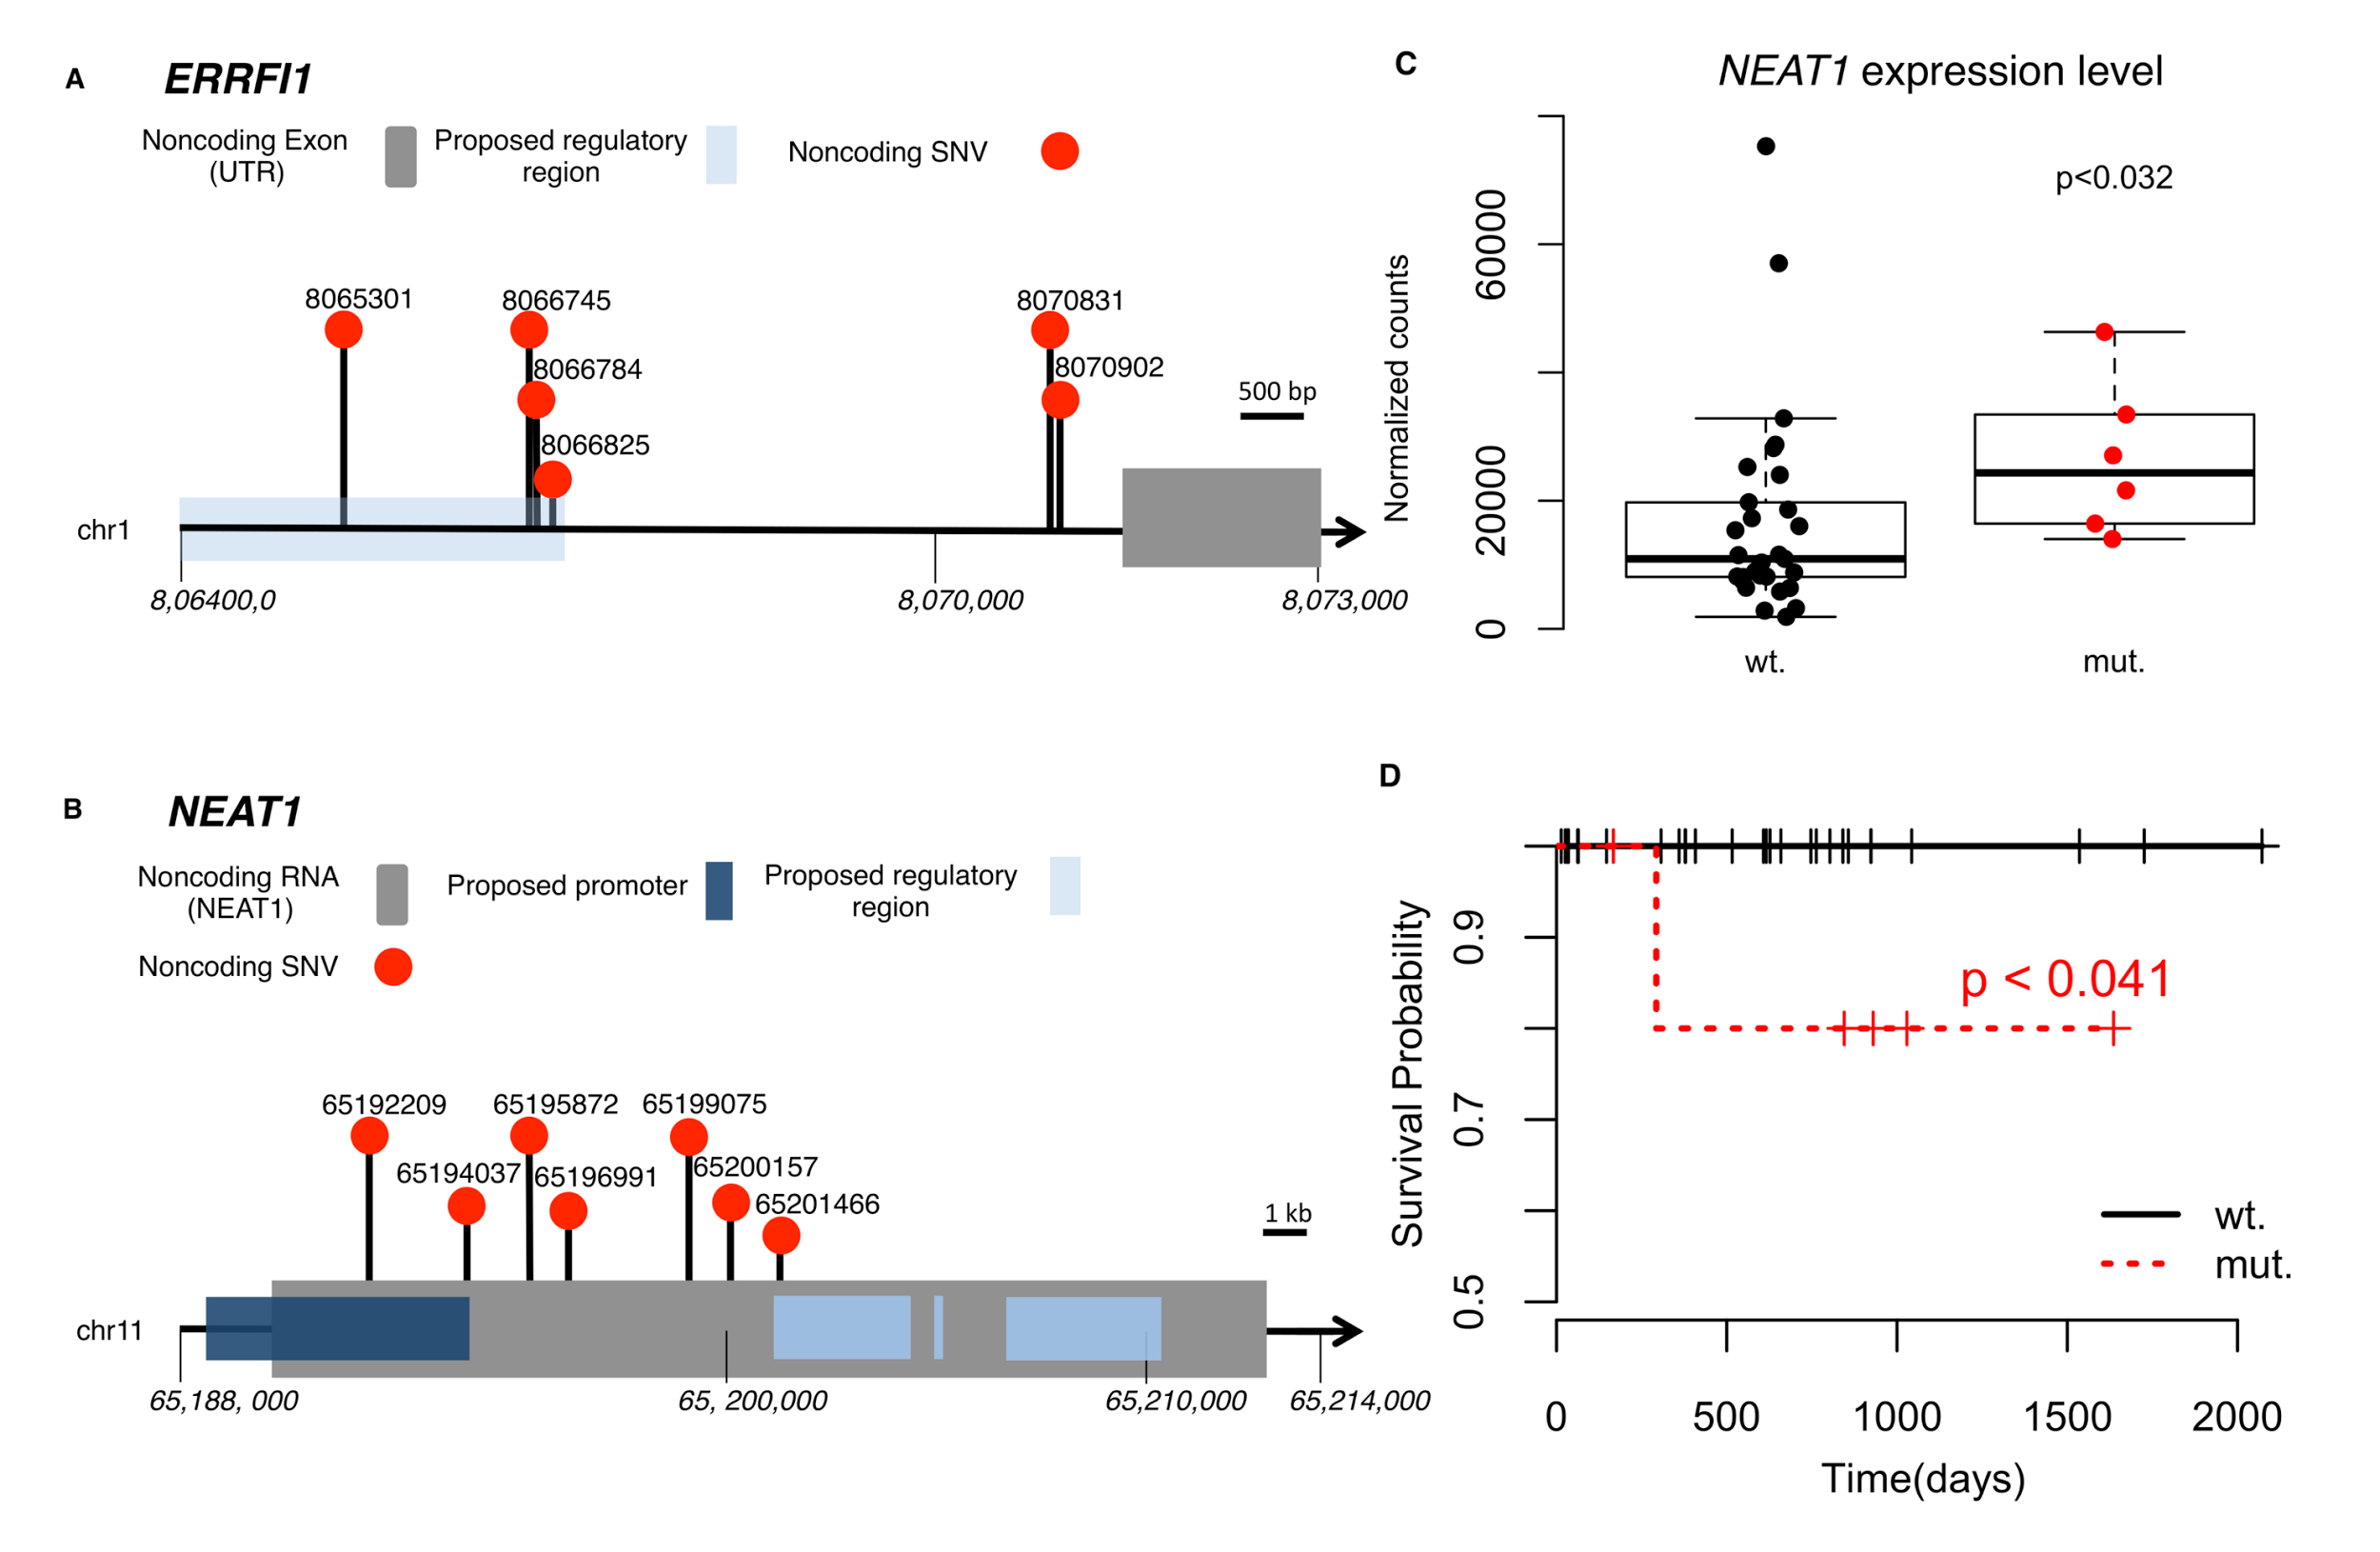
Beyond MET: Two Noncoding Hotspots
[S. Li, B. Shuch and M. Gerstein PLOS Genetics (‘17)]

Slide 55
Cancer drivers: Significance & identification
Yates et al, NRG (2012)

Slide 56
Construct Evolutionary Trees in pRCC
Infer mutation order and tree structure based on mutation abundance (PhyloWGS, Deshwar et al., 2015)
MET: noncoding
ERRFI1: noncoding
DNMT3A: premature stop
NEAT1: noncoding
SMARCA4: missense
KDM6A: missense
[S. Li, B. Shuch and M. Gerstein PLOS Genetics (‘17)]

Slide 57
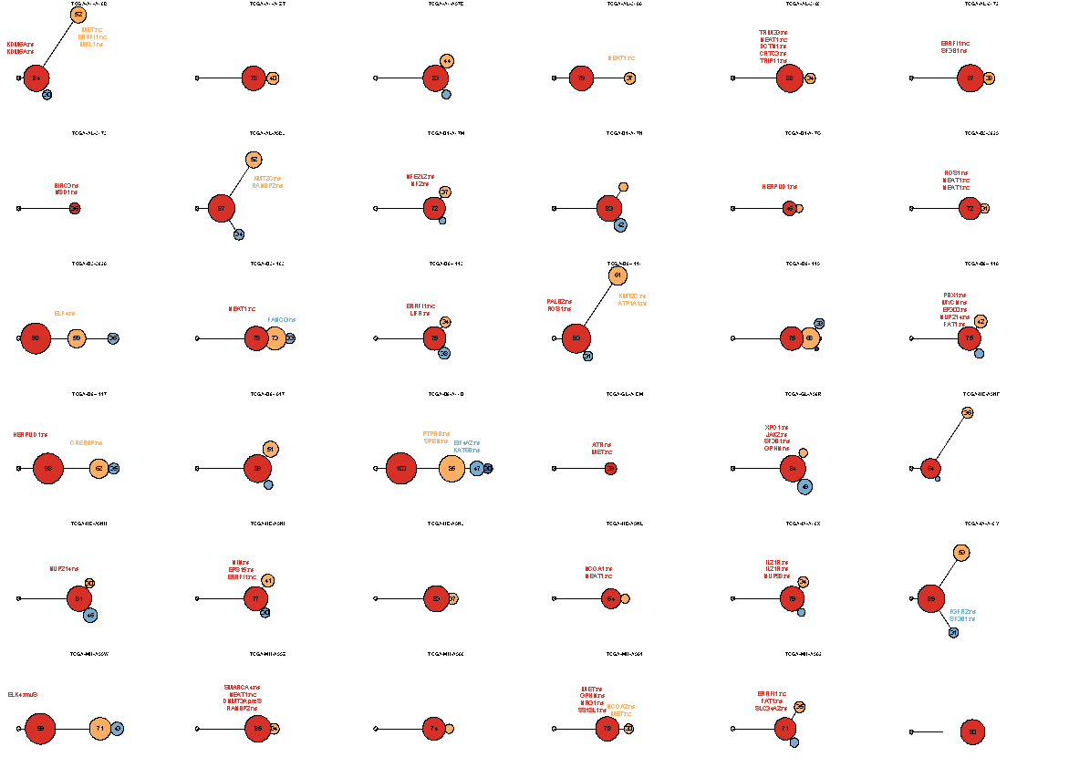
Mutation
distance
Populations
(%)
0.5
Germline
[S. Li, B. Shuch and M. Gerstein PLOS Genetics (‘17)]

Slide 58
Mutation
distance
Populations
(%)
0.5
Germline
[S. Li, B. Shuch and M. Gerstein PLOS Genetics (‘17)]

Slide 59
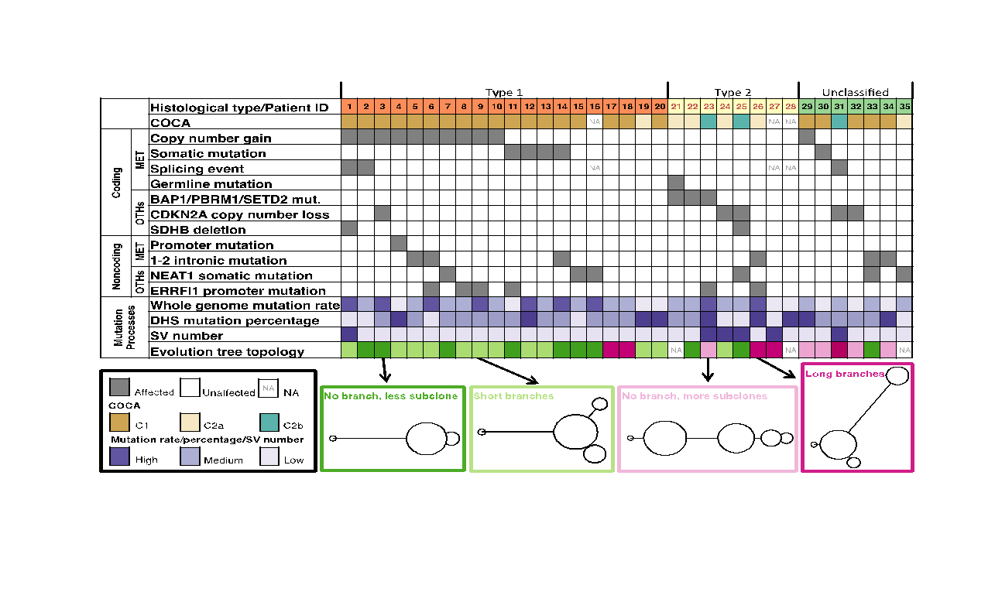
Tree Topology Correlates with Molecular Subtypes
[S. Li, B. Shuch and M. Gerstein PLOS Genetics (‘17)]

Slide 60
Acknowledgments
VAT.gersteinlab.org
L Habegger, S Balasubramanian, DZ Chen, E Khurana, A Sboner, A Harmanci, J Rozowsky, D Clarke, M Snyder
github.com/gersteinlab/Frustration
S Kumar, D Clarke
github.com/gersteinlab/ALoFT
S Balasubramanian, Y Fu, M Pawashe, P McGillivray, M Jin, J Liu, KJ Karczewski, DG MacArthur
FunSeq2.gersteinlab.org
Y Fu, Z Liu, S Lou, J Bedford, XJ Mu, KY Yip, E Khurana
LARVA.gersteinlab.org
L Lochovsky, J Zhang, Y Fu, E Khurana
MOAT.gersteinlab.org
L Lochovsky, J Zhang
github.com/gersteinlab/MrTADfinder
KK Yan, S Lou
[[URL for pRCC?]]
?????.gersteinlab.org
S Li, BM Shuch

Slide 61
Extra slides

Slide 62
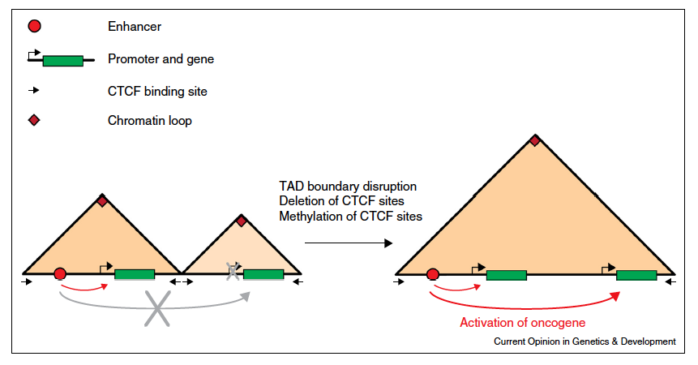
Local TAD boundary disruption activates oncogene
Example: IDH mutant gliomas
Flavahan et al. Bernstein Nature 2016
Example: T-ALL Hnisz
et al. Young Nature 2016
Valton and Dekker Curr. Opin. Genetics and Development 2016

Slide 63
Network modularity
degree of i
adjacency matrix
whether or not
i, j are in the
same module
number of edges
expected number of edges between i and j

Slide 64
Network modularity
Optimization problem
adjacency matrix
degree of i
whether or not
i, j are in the
same module
number of edges
expected number of edges between i and j

Slide 65
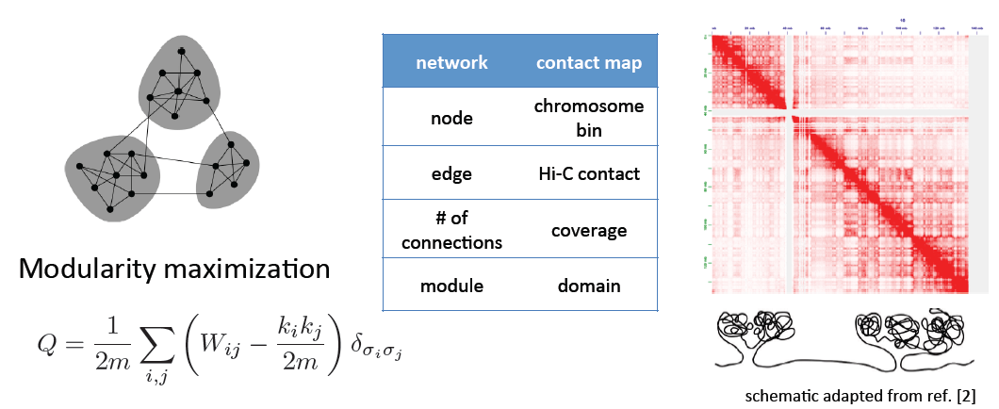
Identifying TADs in multiple resolutions
[Yan et al., PLOS Comp. Bio. (in revision, ‘17); bioRxiv 097345]

Slide 66
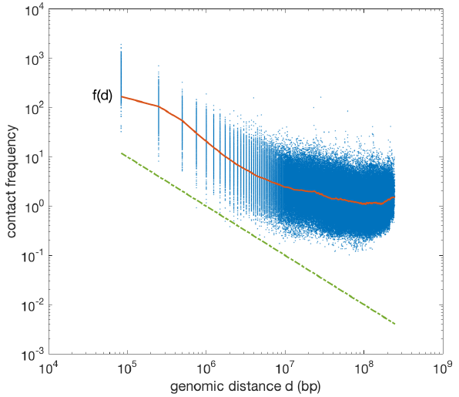
Identifying TADs in multiple resolutions
[Yan et al., PLOS Comp. Bio. (in revision, ‘17); bioRxiv 097345]

Slide 67
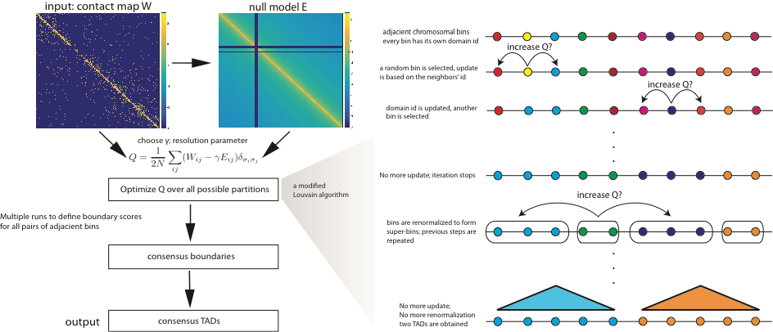
Identifying TADs in multiple resolutions
[Yan et al., PLOS Comp. Bio. (in revision, ‘17); bioRxiv 097345]

Slide 68
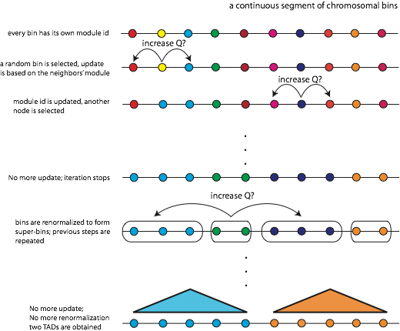
Identifying TADs in multiple resolutions
[Yan et al., PLOS Comp. Bio. (in revision, ‘17); bioRxiv 097345]
a modified Louvain algorithm

Slide 69
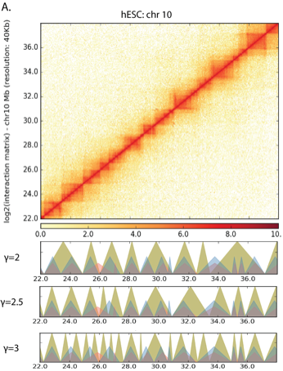
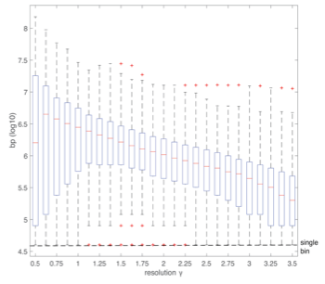
Identifying TADs in multiple resolutions
[Yan et al., PLOS Comp. Bio. (in revision, ‘17); bioRxiv 097345]

Slide 70
Features of Multi-resolution TADs
Specific TFs & HMs associated with TAD boundaries at different scales
Assoc. strong enough to build a predictor
HOT regions at boundaries

Slide 71
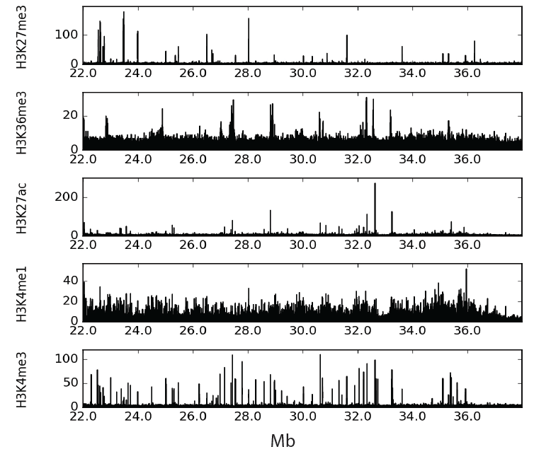
Enrichment of histone features at different resolution
[Yan et al., PLOS Comp. Bio. (in revision, ‘17); bioRxiv 097345]
‹#›

Slide 72
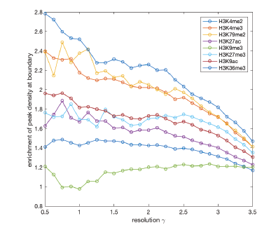
Enrichment of histone features at different resolution
[Yan et al., PLOS Comp. Bio. (in revision, ‘17); bioRxiv 097345]
characteristic length scale

Slide 73
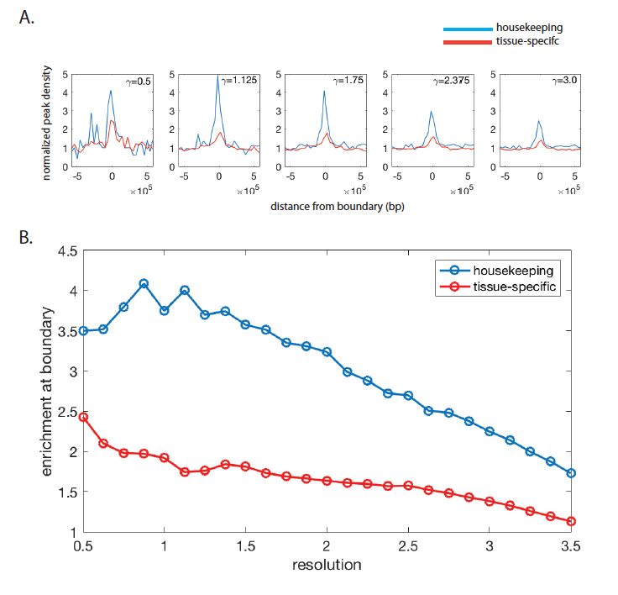
House-keeping vs tissue-specific genes
[Yan et al., PLOS Comp. Bio. (in revision, ‘17); bioRxiv 097345]

Slide 74
Enrichment of TF binding sites near boundaries
Question:
Causes or Consequences?
[Yan et al., PLOS Comp. Bio. (in revision, ‘17); bioRxiv 097345]

Slide 75
Predicting TAD boundaries using TFs binding pattern
Classification problem:
[Yan et al., PLOS Comp. Bio. (in revision, ‘17); bioRxiv 097345]
model performance

Slide 76
Predicting TAD boundaries using chromatin features
Which transcription factors play a role in border formation?
[Yan et al., PLOS Comp. Bio. (in revision, ‘17); bioRxiv 097345]
contribution of individual factors

Slide 77
Finding "Conserved” Sites in the Human Population: Negative selection in non-coding elements based on Production ENCODE & 1000G Phase 1
Broad categories of regulatory regions under negative selection
Related to:
ENCODE, Nature, 2012
Ward & Kellis, Science, 2012
Mu et al, NAR, 2011
(Non-coding RNA)
(DNase I hypersensitive sites)
(TFSS: Sequence-specific TFs)
(Transcription factor binding sites)
Depletion of Common Variants in the Human Population
[Khurana et al., Science (‘13)]

Slide 78
Differential selective constraints among specific sub-categories
Sub-categorization possible because of better statistics from 1000G phase 1 v pilot
[Khurana et al., Science (‘13)]

Slide 79
Defining Sensitive non-coding Regions
~0.4% genomic coverage (~ top 25)
~0.02% genomic coverage (top 5)
Start 677 high-resolution non-coding categories; Rank & find those under strongest selection
Sub-categorization possible because of better statistics from 1000G phase 1 v pilot
[Khurana et al., Science (‘13)]

Slide 80
Identification of non-coding candidate drivers amongst somatic variants: Scheme
[Khurana et al., Science (‘13)]

Slide 81
Flowchart for 1 Prostate Cancer
Genome (from Berger et al. '11)
[Khurana et al., Science (‘13)]

Slide 82
Feature weight
- Weighted with mutation patterns in natural polymorphisms
(features frequently observed weight less)
- entropy based method
HOT region
Sensitive region
Polymorphisms
Genome
[Fu et al., GenomeBiology ('14)]

Slide 83
Feature weight
- Weighted with mutation patterns in natural polymorphisms
(features frequently observed weight less)
- entropy based method
HOT region
Sensitive region
Polymorphisms
Genome
[Fu et al., GenomeBiology ('14)]

Slide 84
Feature weight
- Weighted with mutation patterns in natural polymorphisms
(features frequently observed weight less)
- entropy based method
HOT region
Sensitive region
Polymorphisms
Genome
Feature weight:
p = probability of the feature overlapping natural polymorphisms
For a variant:
[Fu et al., GenomeBiology ('14)]

Slide 85
Mutations downloaded from COSMIC
Somatic variants in 33 cancer types
Data taken from TCGA (data from 10,489 tumor samples shown)
Yi et al, NRG (2017)

