Slide 1
ASHG slides
Passenger mutations in 2500 cancer genomes: Overall molecular functional impact and consequences

Slide 2
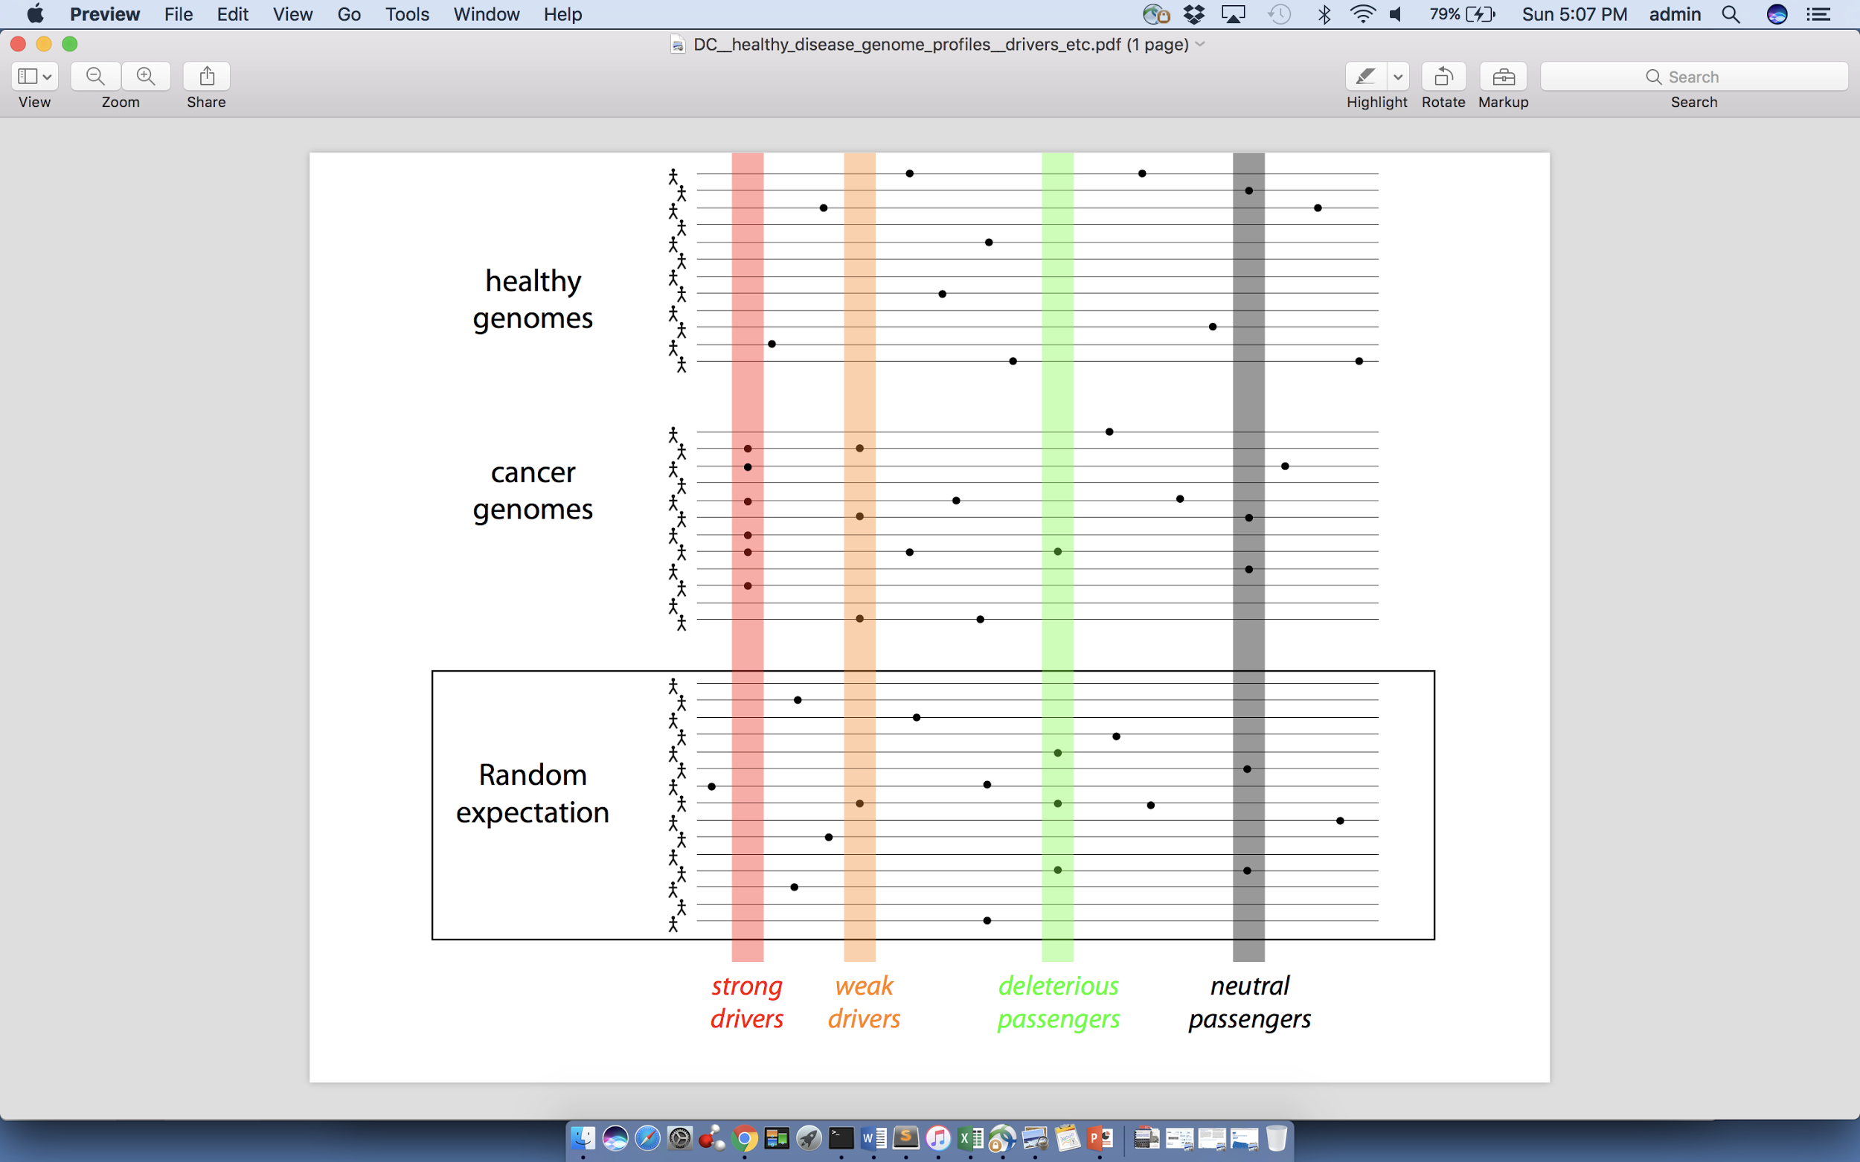
Canonical model of drivers and passengers in cancer
Drivers
  Driver mutations directly confer a selective growth advantage to the tumor cell.
  A typical tumor contains 2-8 drivers.
  Drivers are identified through signals of positive selection.
Passengers
  Conceptually, a passenger mutation has no direct or indirect effect on tumor progression.
  There are thousands of passengers in a typical cancer genome.

Slide 3
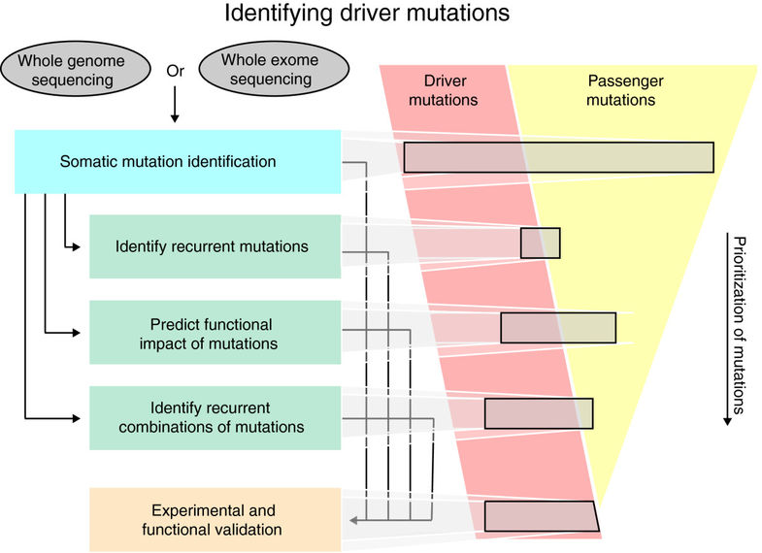
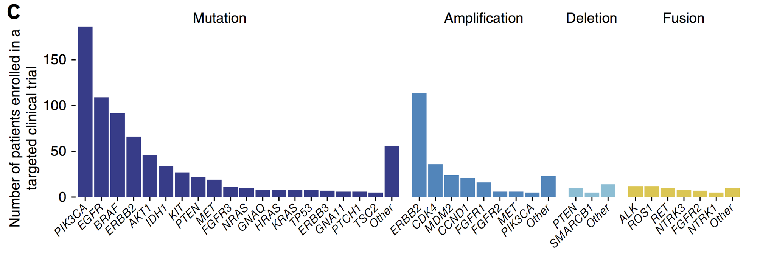
Prioritizing key variants identifies drivers to better enable more precise diagnostics and targeted therapies
Identifying select driver variants from the large pool of candidate variants
Number of patients in matched clinical trials identified on the basis of actionable variants (revealed by MSK-IMPACT) in different genes
Raphael, et al., Genome Med. (2014)
A. Zehir et al, Nat. Med (2017)

Slide 4
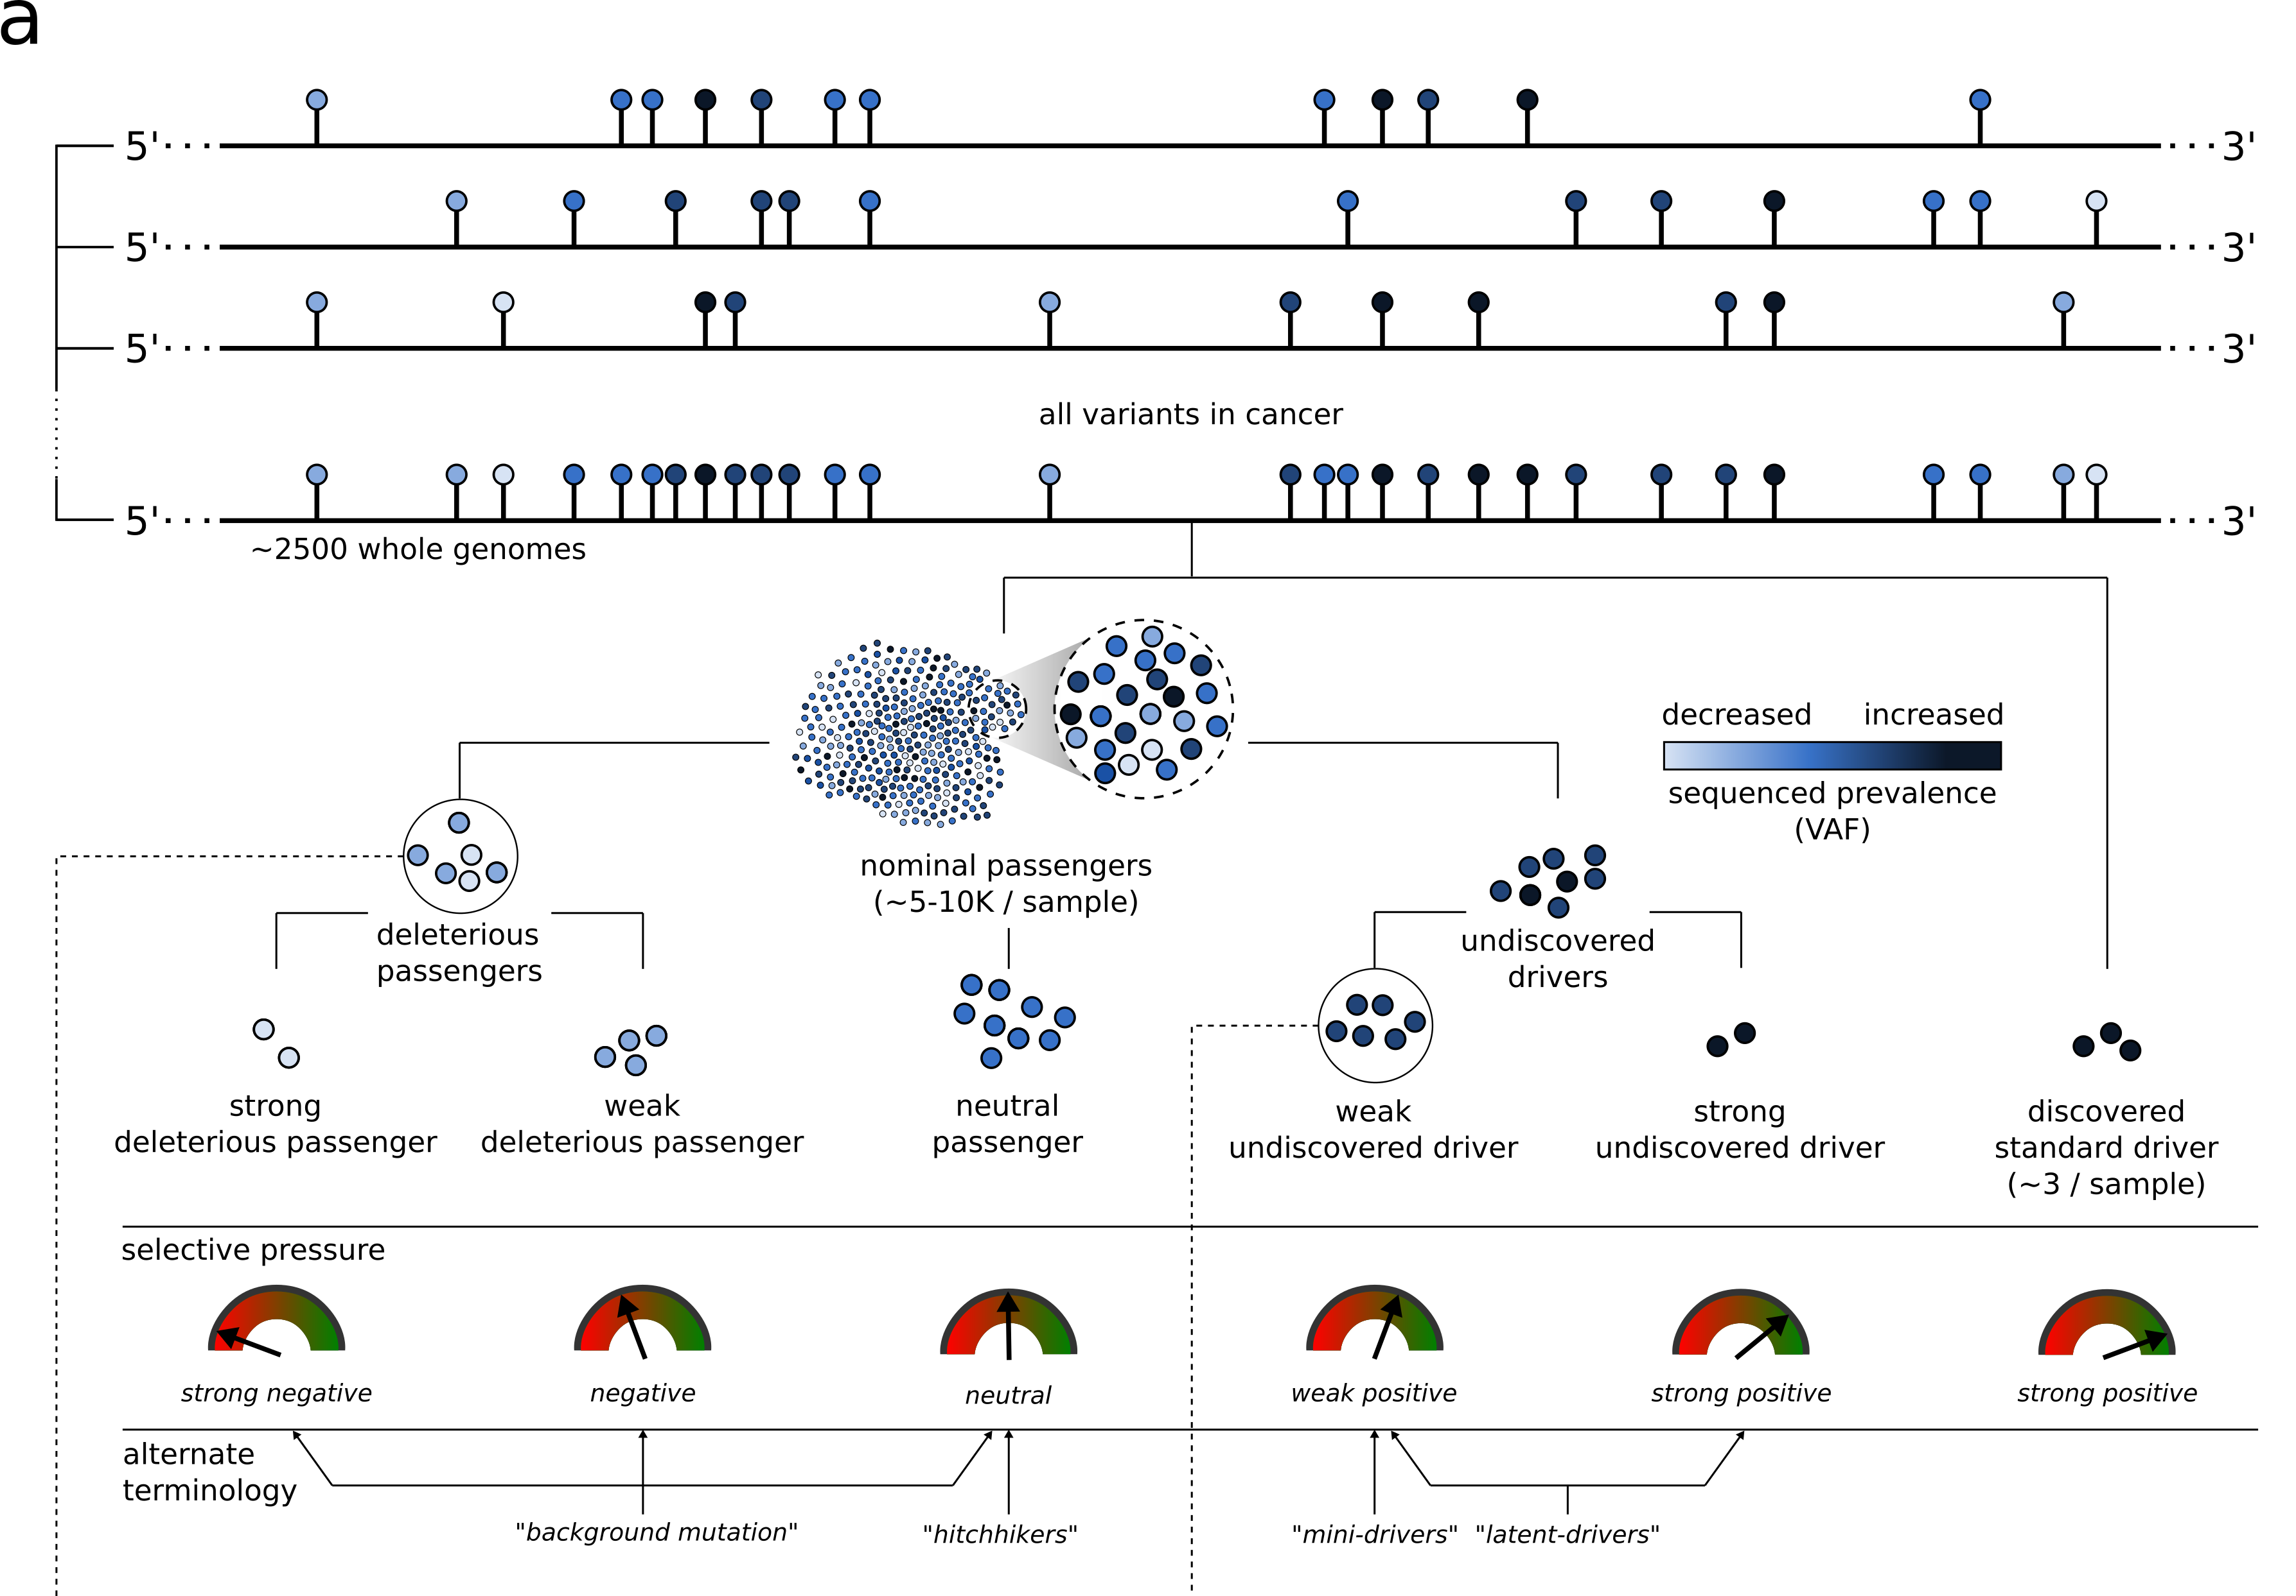
Conceptual extension of the canonical model of drivers and passengers

Slide 5
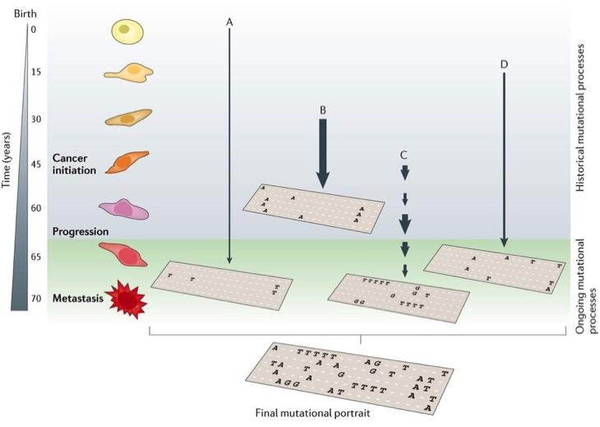
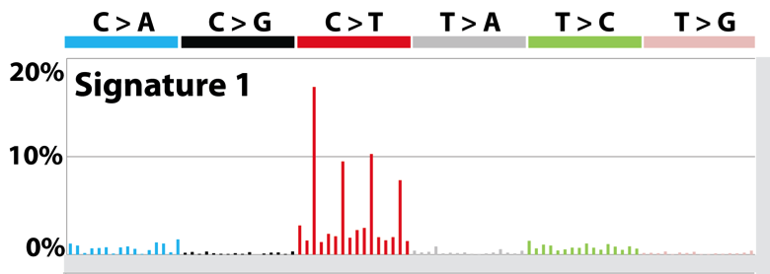
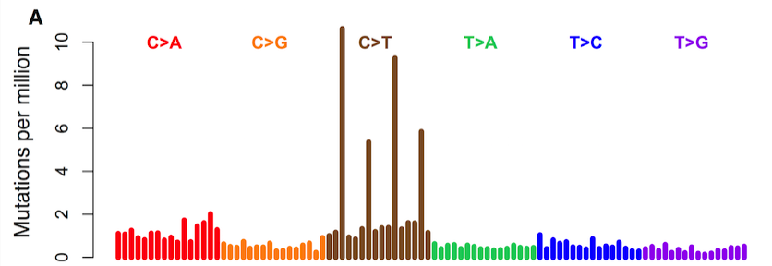
Mutational processes carries context-specific signatures
Mutation signature inferred
Mutation spectrum observed
[T. Helleday, S. Eshtad & S. Nik-Zainal, Nature Reviews Genetics (’14),
L. Alexandrov et al., Nature (‘13) ]
Notes:
Mutation spectrum is further broken down to mutation signatures, which represent mutational processes

Slide 6
A case study: kidney cancer
Kidney cancer life time risk 1.6%; the papillary type (pRCC) counts
for about 10%
TCGA project sequenced 35
whole genomes of pRCC
  Researchers cannot pin down
  the cause for a significant
  portion of cases
[Cancer Genome Atlas Research Network N Engl J Med. (‘16) ]

Slide 7
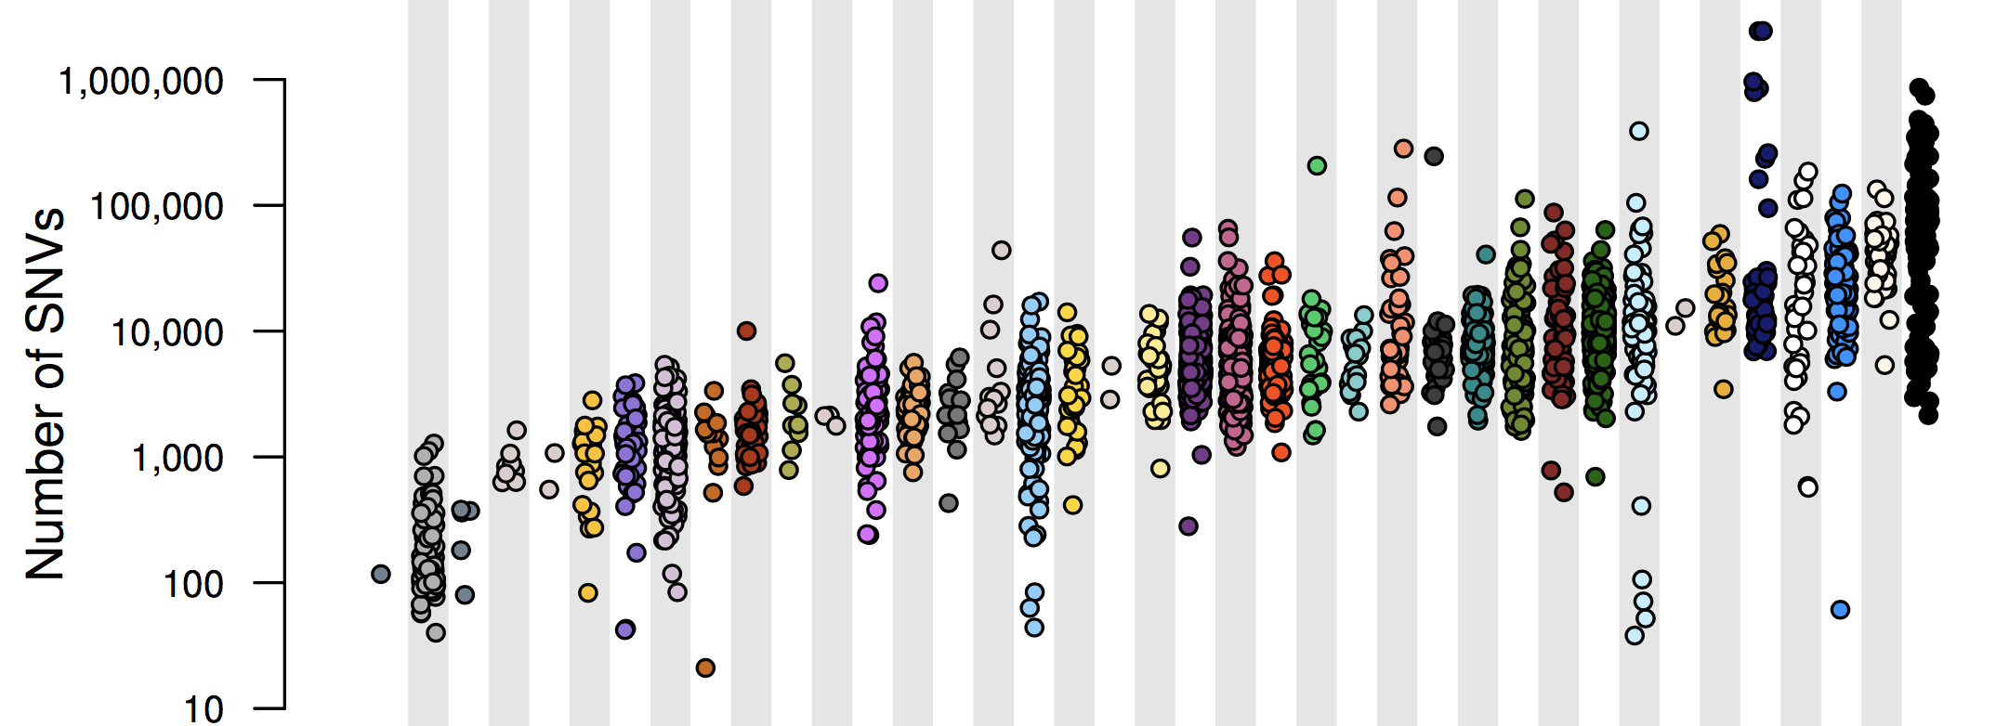
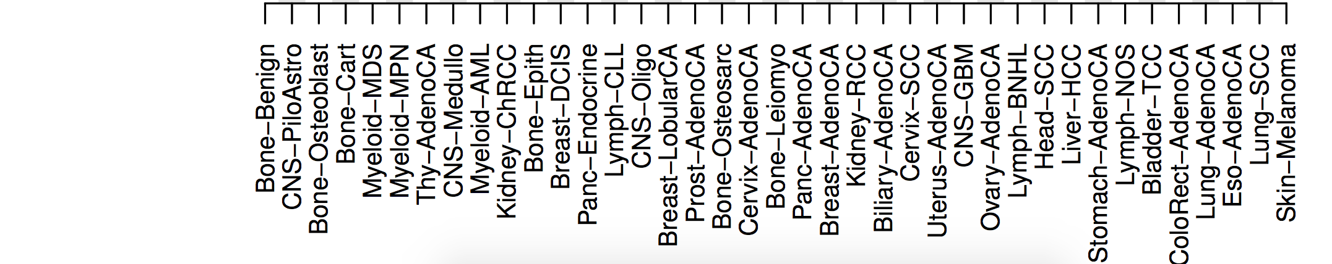
PCAWG : most comprehensive resource for cancer whole genome analysis
Goal of PCAWG:
To understand role of non-coding regions of cancer genomes in cancer progression.
Jointly analyzing ~2800 whole genome tumor/normal pairs
  > 580 researchers
  16 thematic working groups

Slide 8
Functional impact
Summarize funseq

Slide 9
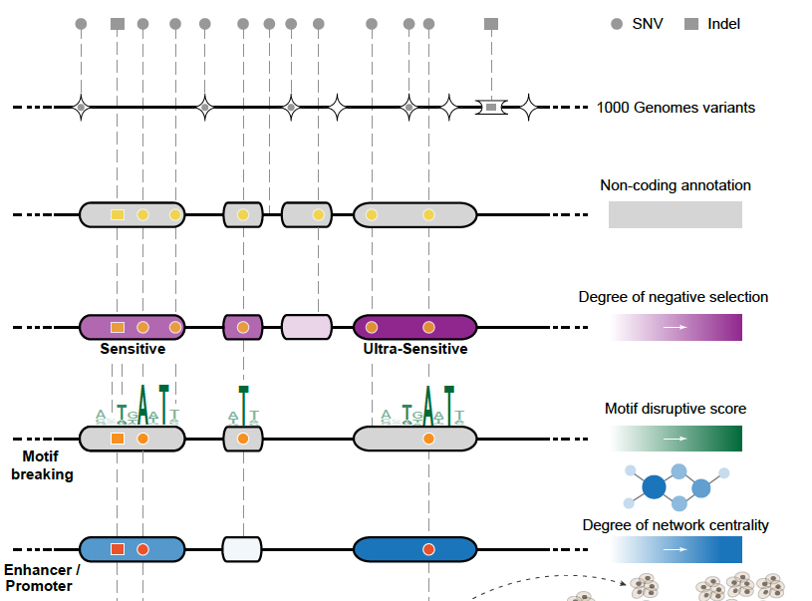
Funseq: a flexible framework to prioritize non-coding variants integrating various resources.
Annotation (tf binding sites open chromatin, ncRNAs)
Conservation
Mutational impact (motif breaking, Lof)
Network (centrality position)
Chromatin dynamics
[Fu et al., GenomeBiology ('14), , Khurana et al., Science ('13)]
[Khurana et al., Science (‘13)]

Slide 10
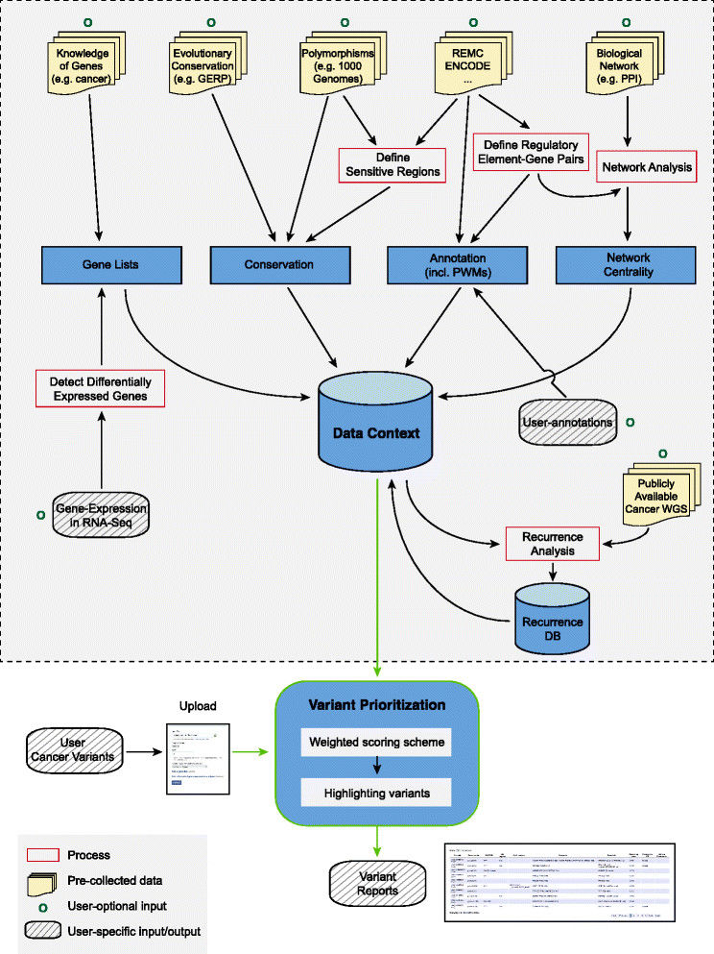
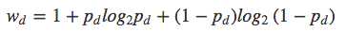
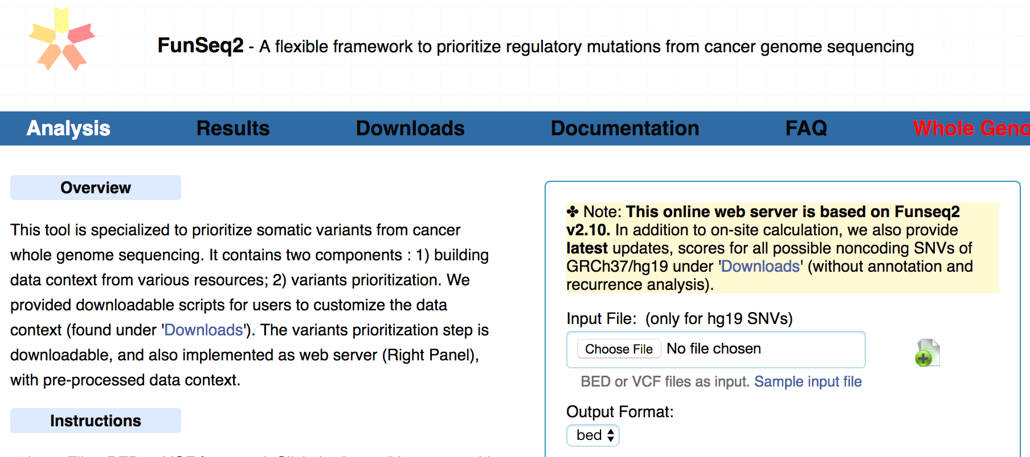
HOT region
Sensitive region
Polymorphisms
Genome
Practical web
Submission of variants & pre-computed large Data context from uniformly processing large-scale datasets
Entropy based method for weighting consistently many genomic features
FunSeq.gersteinlab.org

Slide 11
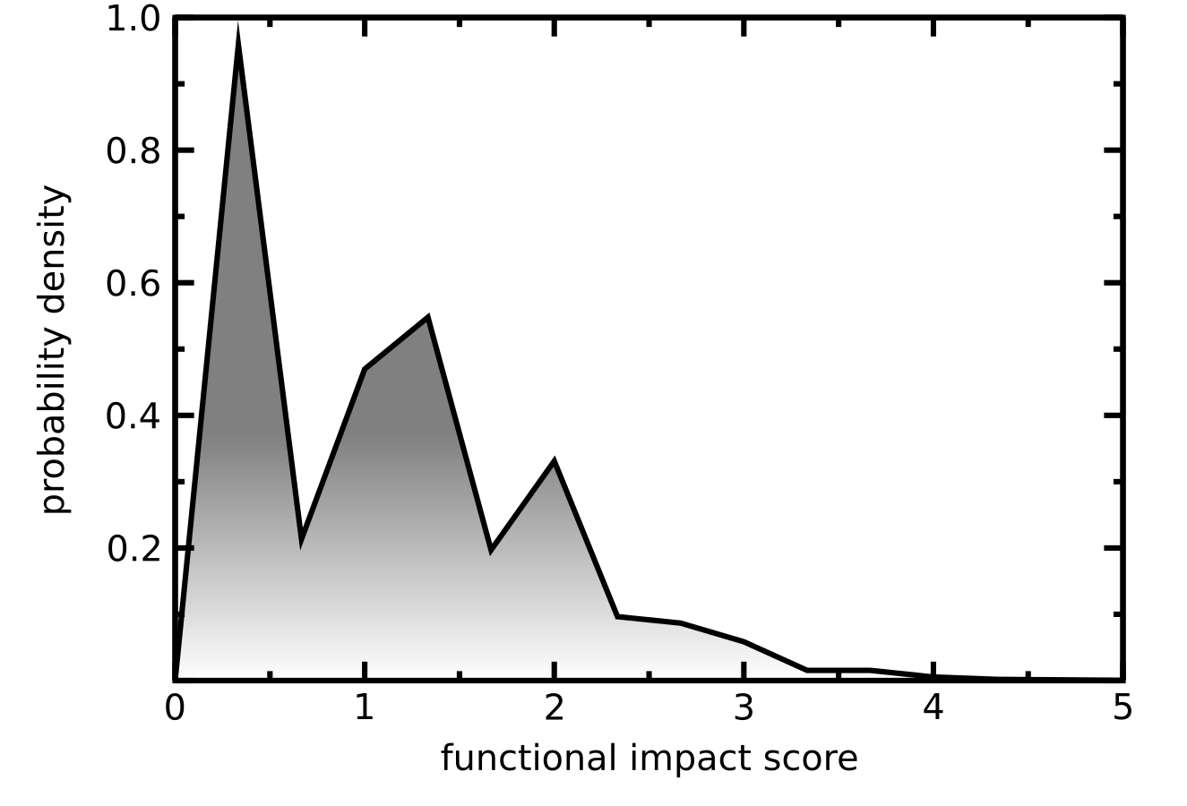
Functional impact distribution of PCAWG non-coding mutations
Funseq based molecular functional impact of variants in > 2500 PCAWG samples
Multimodal non-coding functional impact score distribution
    High impact score region presumably enriched with potential driver mutations.
    Low impact region corresponds to true passengers.

Slide 12
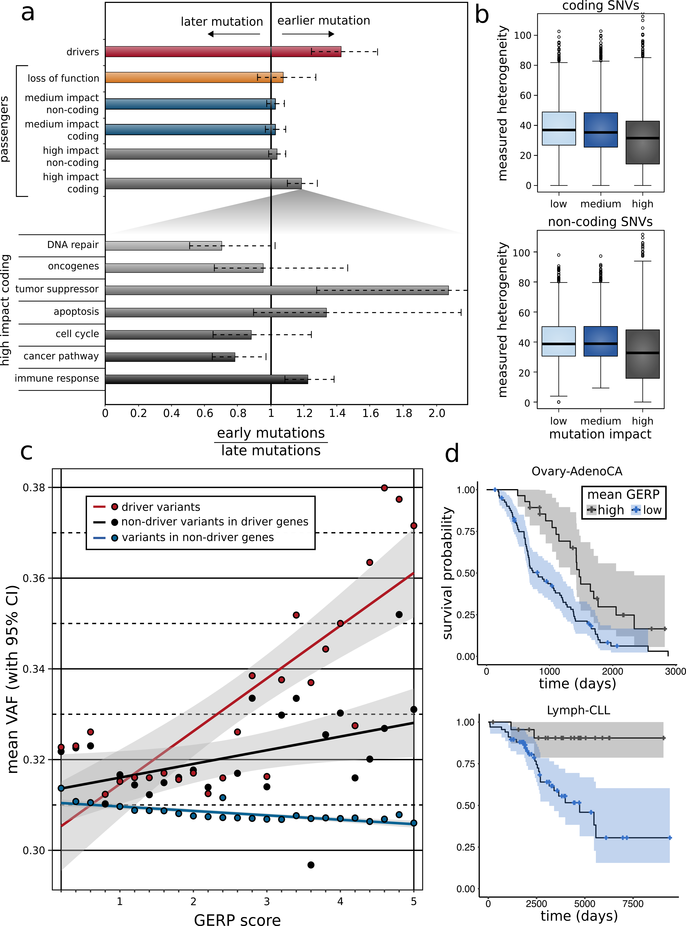
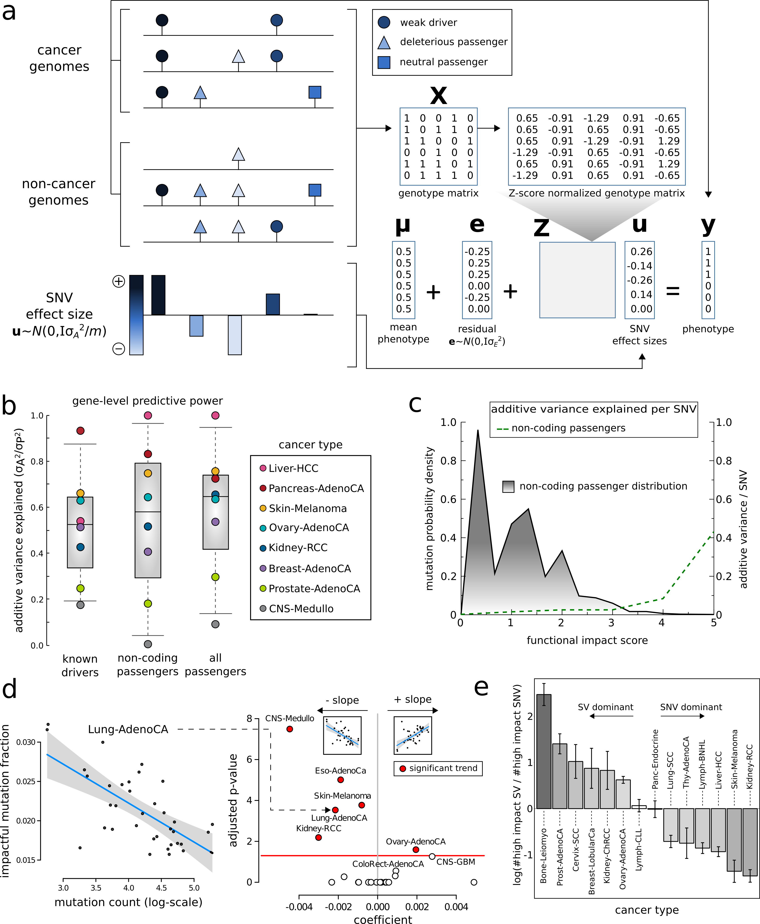
Fraction of high impact nominal passengers in PCAWG
In many PCAWG cohorts, we observe that fraction of impactful passengers decreases with increase in total mutation burden.

Slide 13
Differential burdening and intermediate peak can be attributed to mutational processes or selection

Slide 14
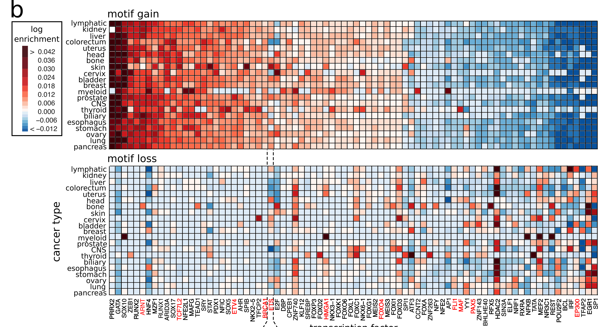
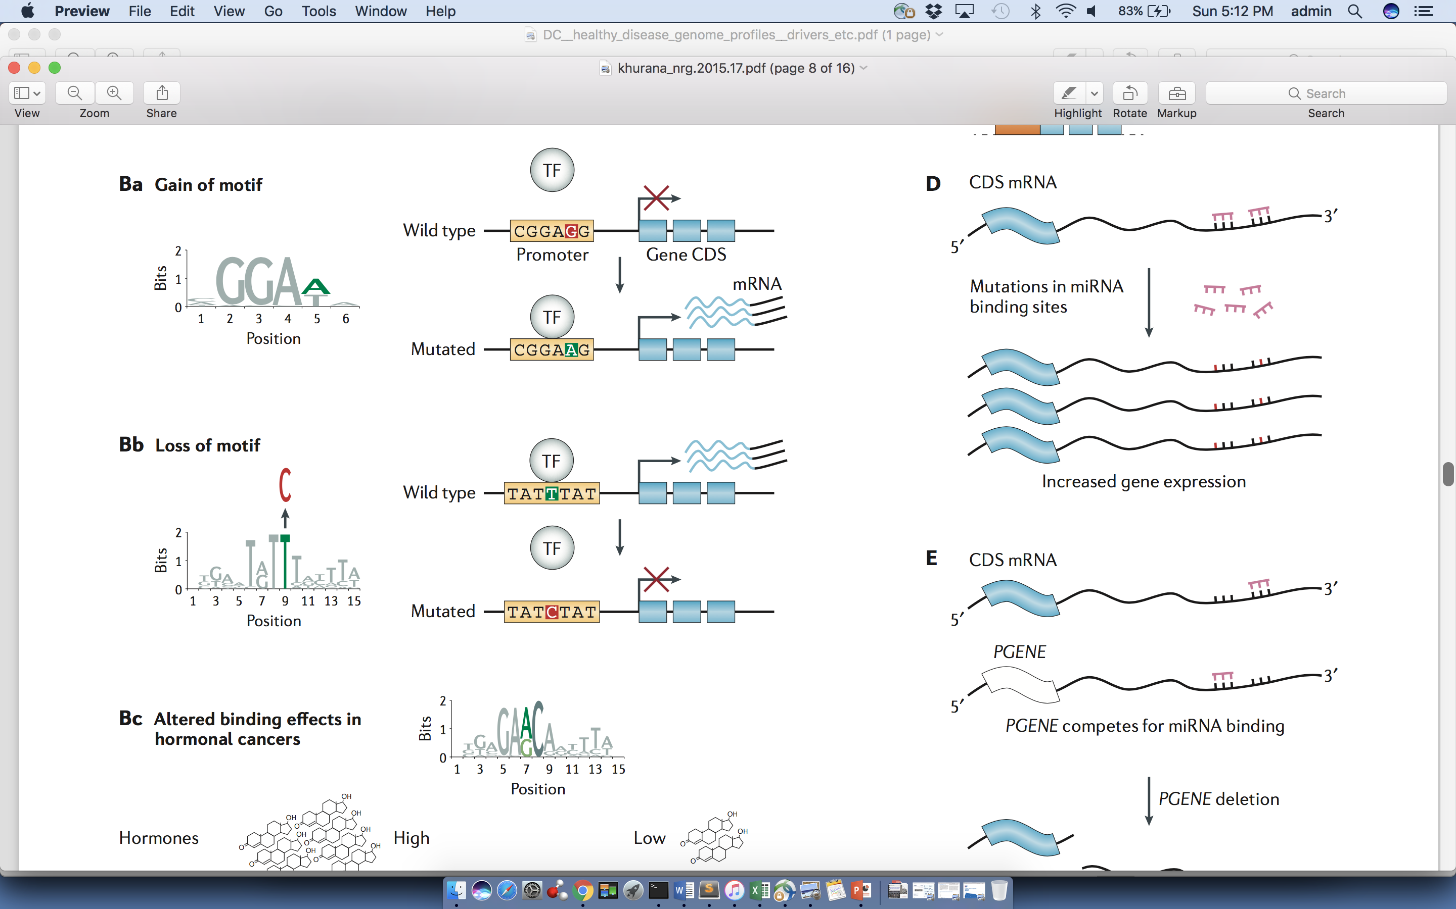
Passengers burdening of TF binding landscape
≈ç
Khurana et. al., Nature Reviews Genetics (’16)

Slide 15
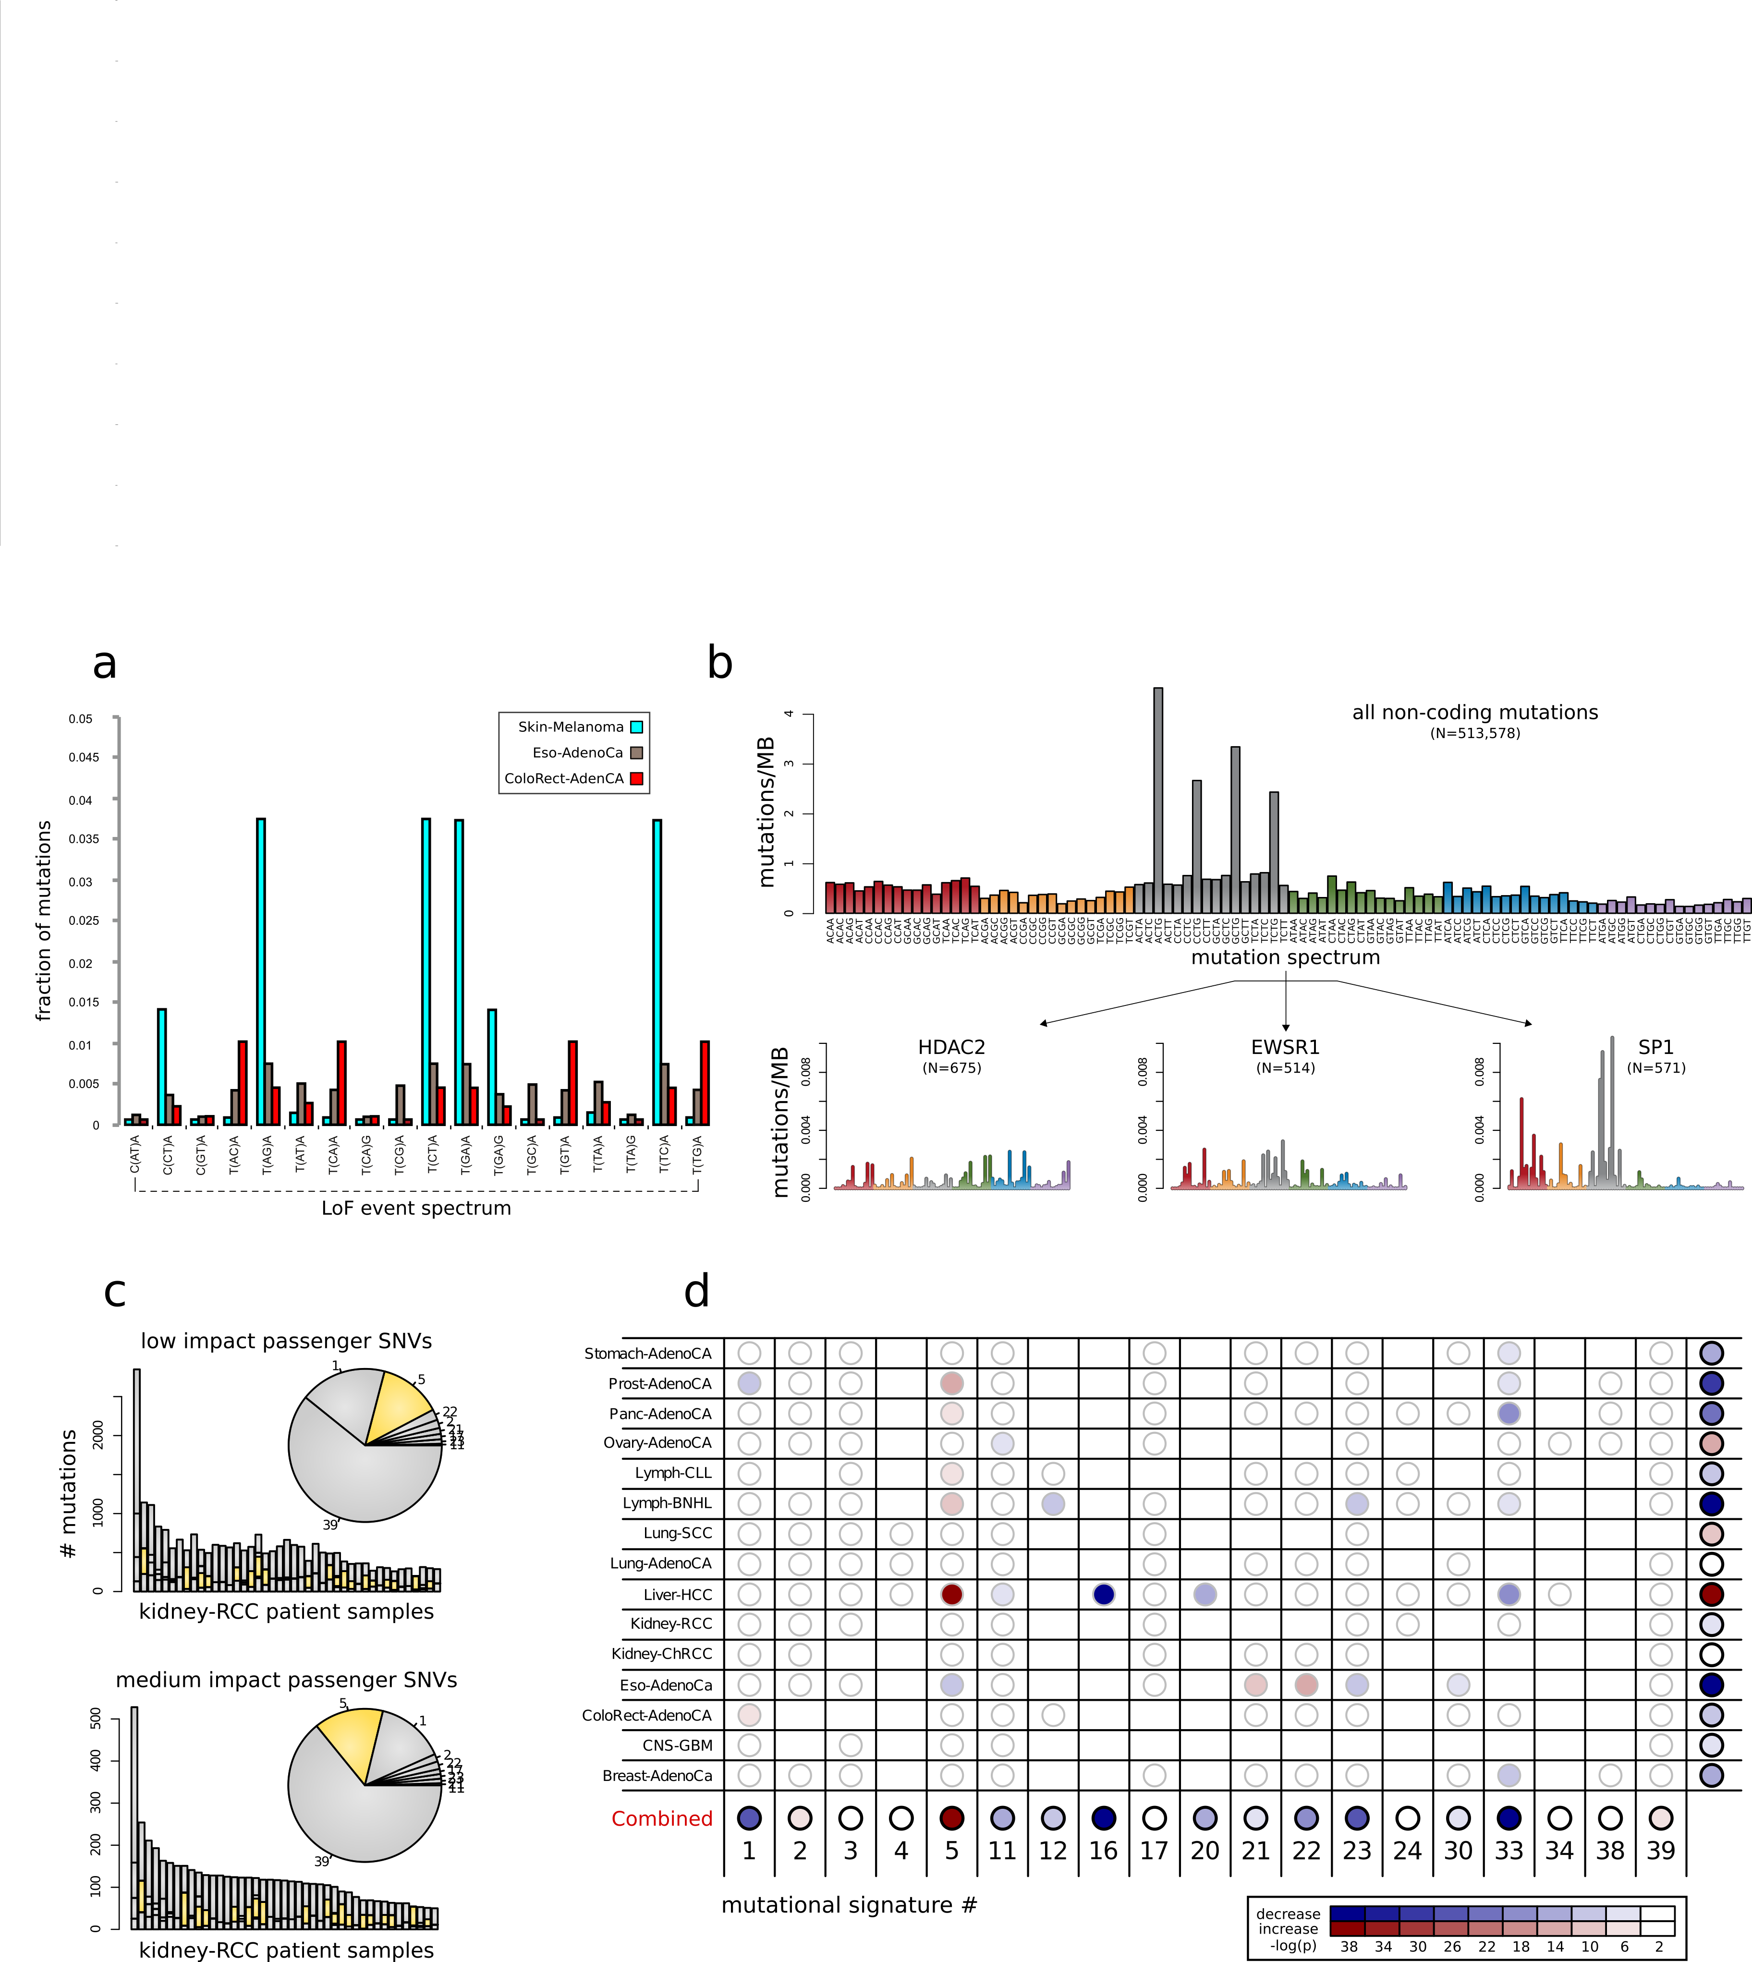
Kidney cancer as an example: differential TF burdening correlates with mutation spectrum
Motif loss

Slide 16
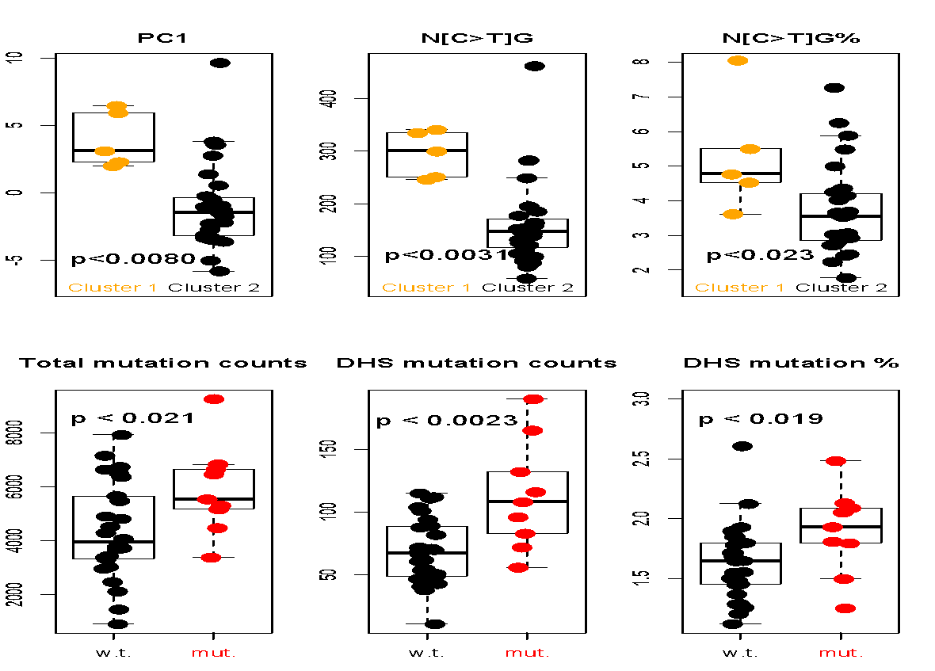
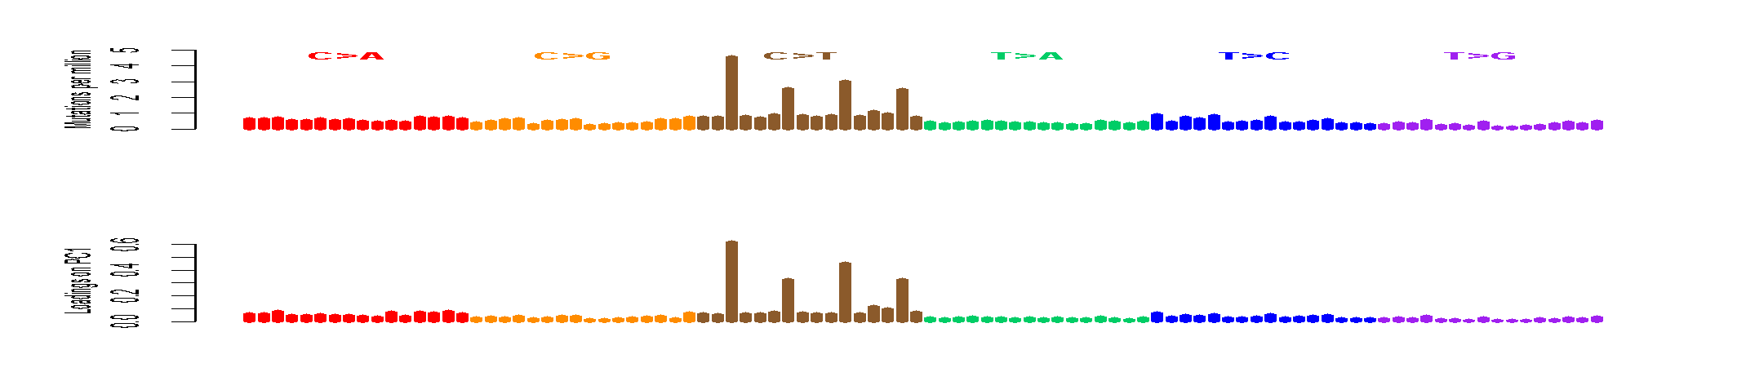
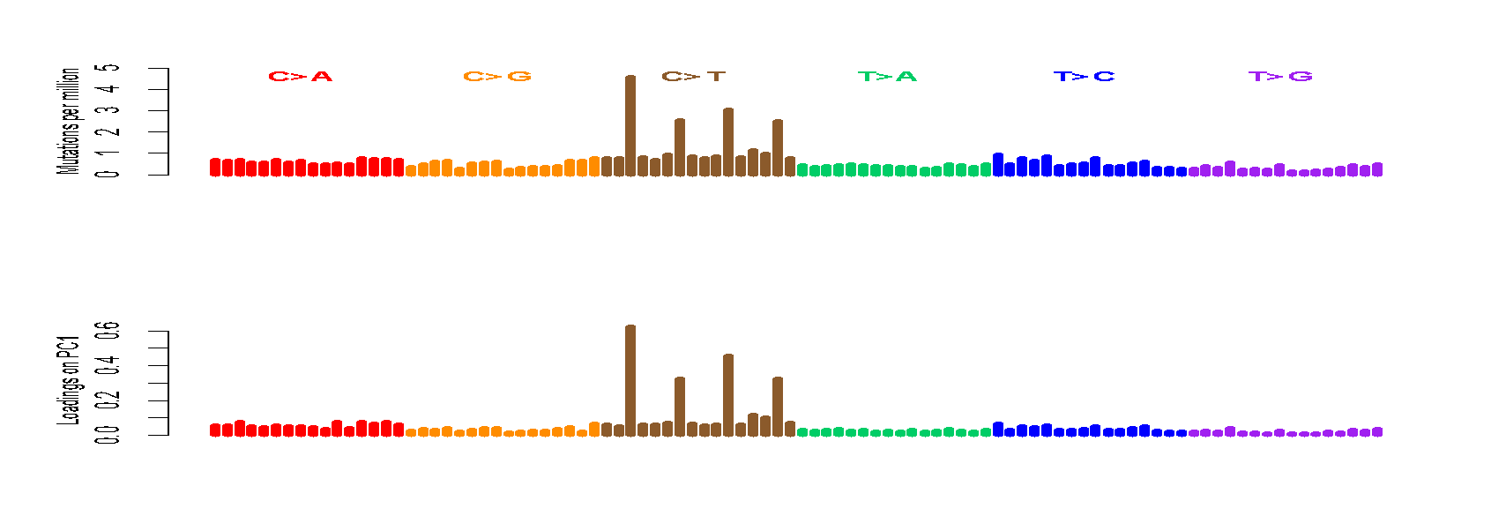
CpGs drive inter-patient variation
The loadings on PC1 are mostly [C>T]G
Confirmed by higher C>T% in CpGs in the hypermethylated group (cluster1)
A[C>T]G
G[C>T]G
C[C>T]G
T[C>T]G
[S. Li, B. Shuch and M. Gerstein PLOS Genetics (‘17)]

Slide 17
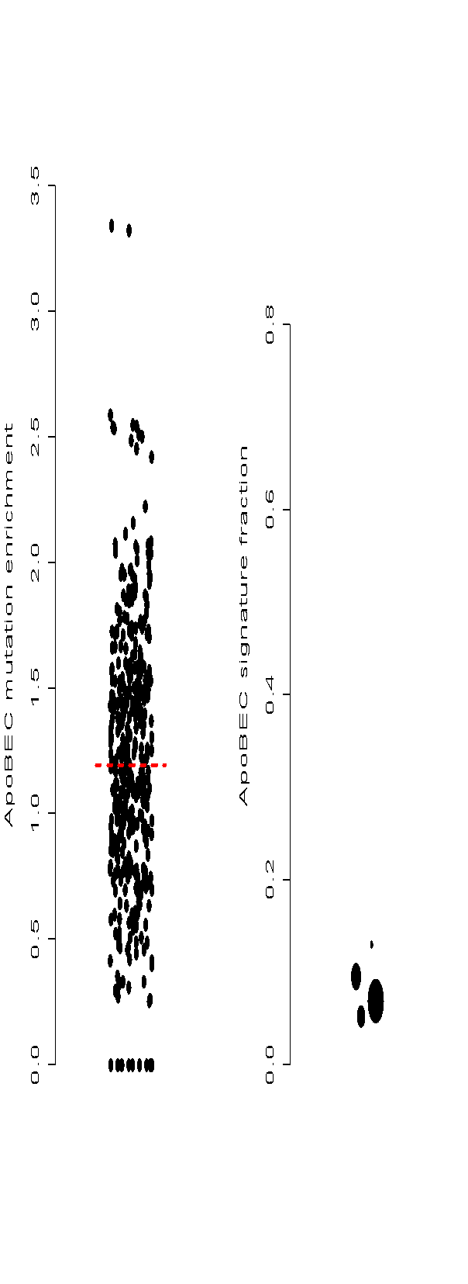

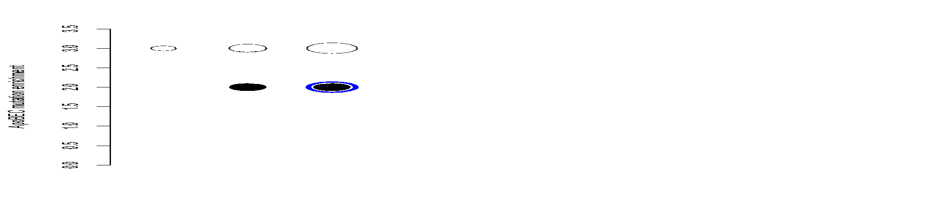

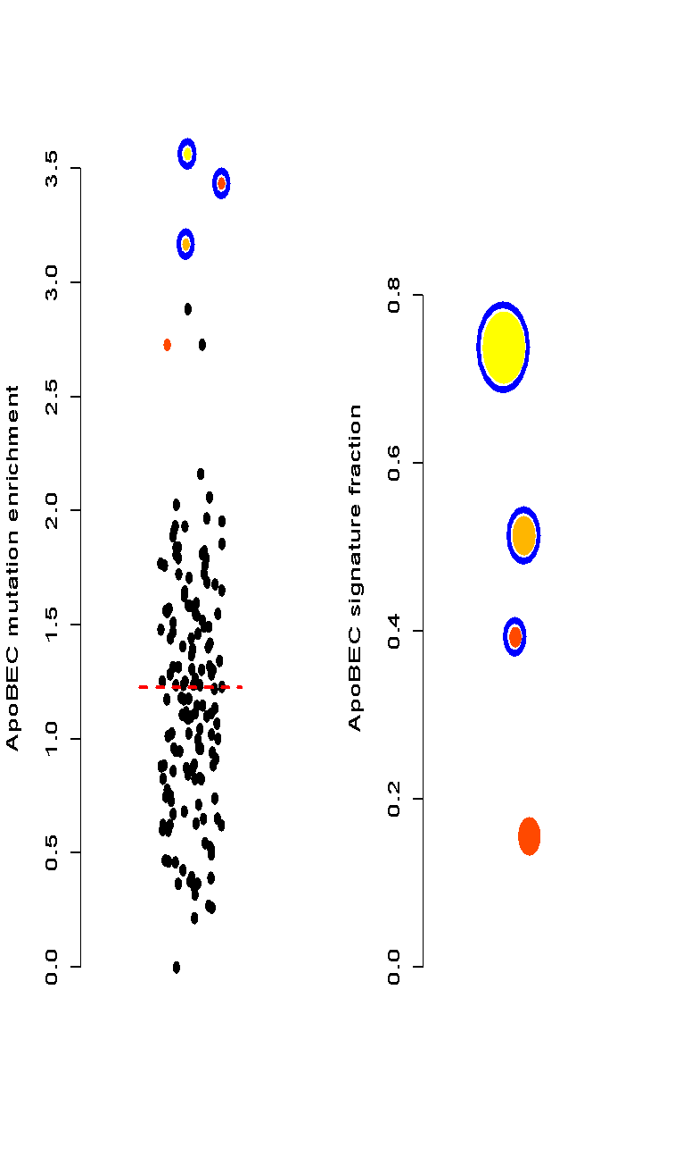

Signatures in pRCC
Signatures burden the
genome disporpotionally
We found one pRCC has
ApoBEC signature, but not
in a larger ccRCC corhort
enrichment
-log(p-value)
3.6
7.2
22
50
100
150
RCC samples
total mutations
UC samples
pRCC
ccRCC
[S. Li, B. Shuch and M. Gerstein PLOS Genetics (‘17)]
Notes:
ApoBEC signature is observed in chRCC but never in ccRCC
Three samples that are urothelial cancer (UC) but mislabeled and processed through the pipeline (internal positive controls

Slide 18

Mutational landscape affects overall burden
Chromatin remodeling defect leads to more mutations in open chromatin
Mismatch repair failure raises the fraction of impactful non-coding mutations
[S. Li, B. Shuch and M. Gerstein PLOS Genetics (‘17)]

Slide 19
Early v late mutations in PCAWG

Slide 20

Sub-clonal architecture of nominal passengers in PCAWG
Overall enrichment and of nominal passenger variants among TSGs and depletion among oncogenes.

Slide 21
Correlating functional impact and prevalence of nominal passengers in PCAWG
Nominal passengers disrupting more conserved positions tend to have lower VAFs.

Slide 22
Additive variance to quantify aggregated effect of nominal passengers in PCAWG

Slide 23

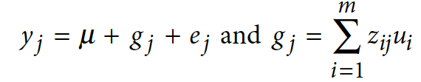


Additive effects model to quantify cumulative effect of nominal passengers in PCAWG
Model for the effect of an individual SNP on a phenotype
Extension to model the combined effects of multiple SNPs

Slide 24
Additive variance for multiple cancer cohorts in PCAWG
Significant additive variance explained by nominal passengers in PCAWG.

