Slide 1
RBFOX2, BS₁
RBFOX2, BS_{n}
rare
common

Slide 3
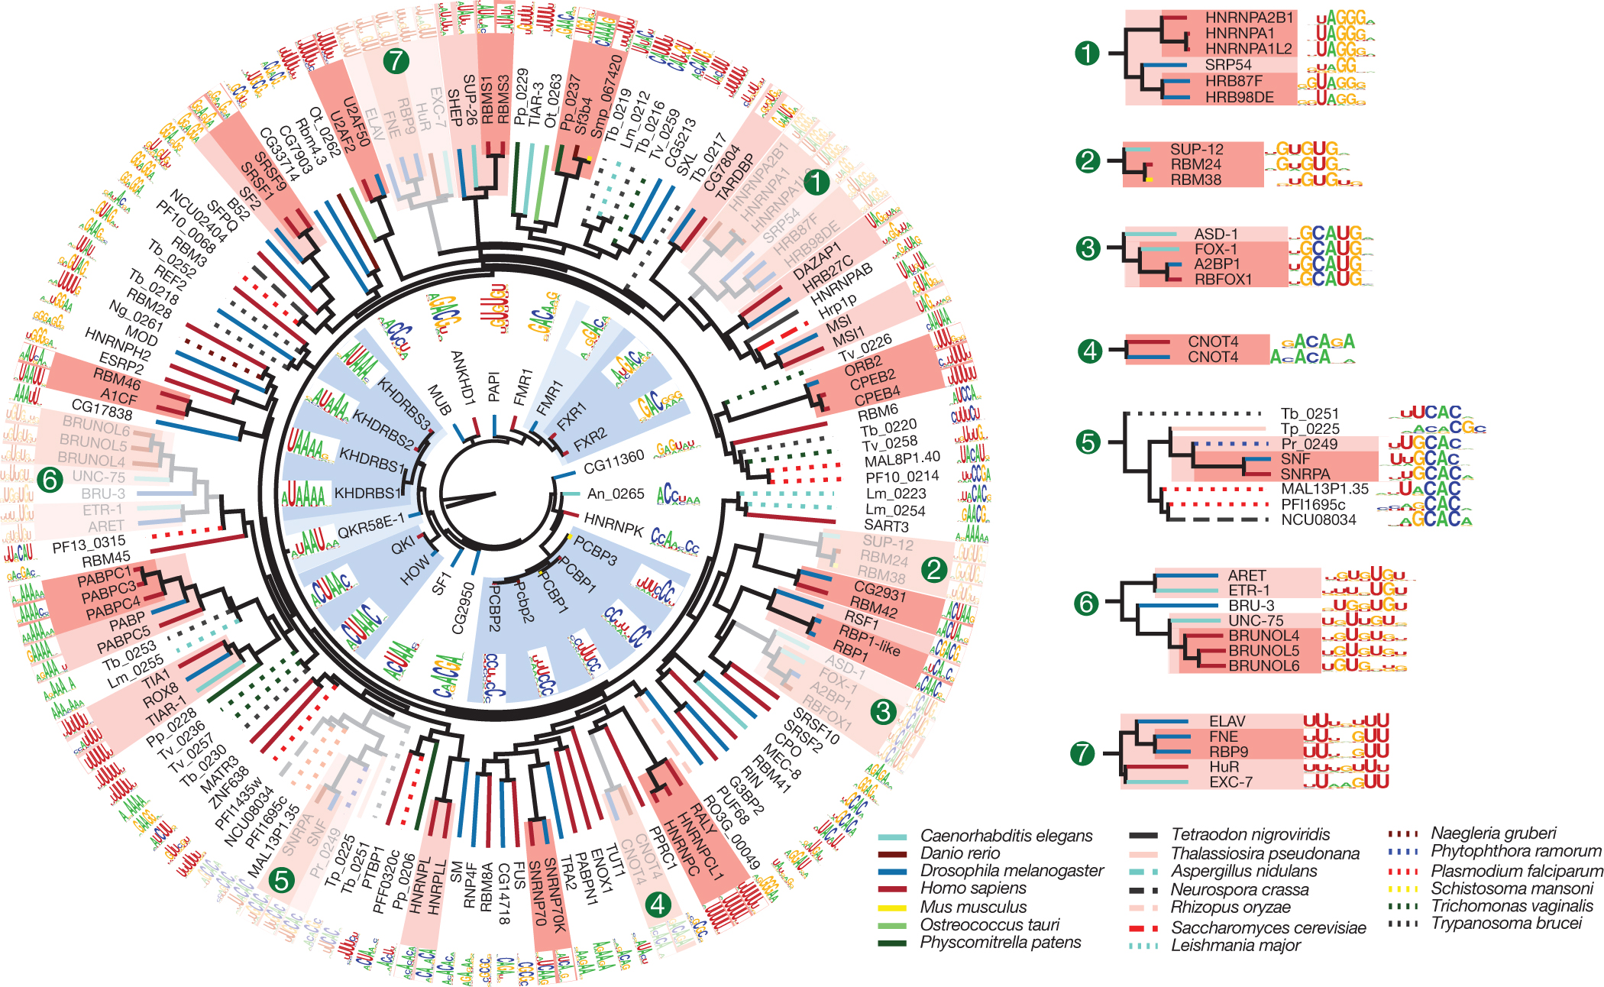
Common variants
Mutation of interest
Observed
Average
Correction
Entropy
Score
Rare variants
Binding motif
4/5
0.8
0.62
1.25
0.98
1.23
2/3
0.67
0.62
1.08
1.01
1.08
1/3
0.33
0.45
0.73
0.90
0.81
overlap
Peak #
1
1
3
1
Motif
DScore
Motif Score
1.12
P=0.03
0.95

