Slide 1
Logic
Data larger
Key is prioritizing
How to do this ?
Key aspect is driver v pass.

Slide 2
Logic
Data larger
Key is prioritizing
How to do this ?
Key aspect is driver v pass.

Slide 3
Mutations downloaded from COSMIC
Somatic variants in 33 cancer types
Data taken from TCGA (data from 10,489 tumor samples shown)
Yi et al, NRG (2017)

Slide 4
~2/3 of variants are non-synonymous SNVs
The variants reported here are not exclusive to driver events
dominated by SNVs: kidney clear-cell carcinoma, glioblastoma multiforme, hepatocellular carcinoma, acute myeloid leukaemia, colorectal carcinoma and endometrial carcinoma
dominated by CNVs: most serous ovarian and breast carcinomas and many lung and head and neck squamous cell carcinomas
Outlier w/fewer non-synonymous SNVs and more frame-shifts: THCA (thyroid carcinoma)
Yi et al, NRG (2017)

Slide 5
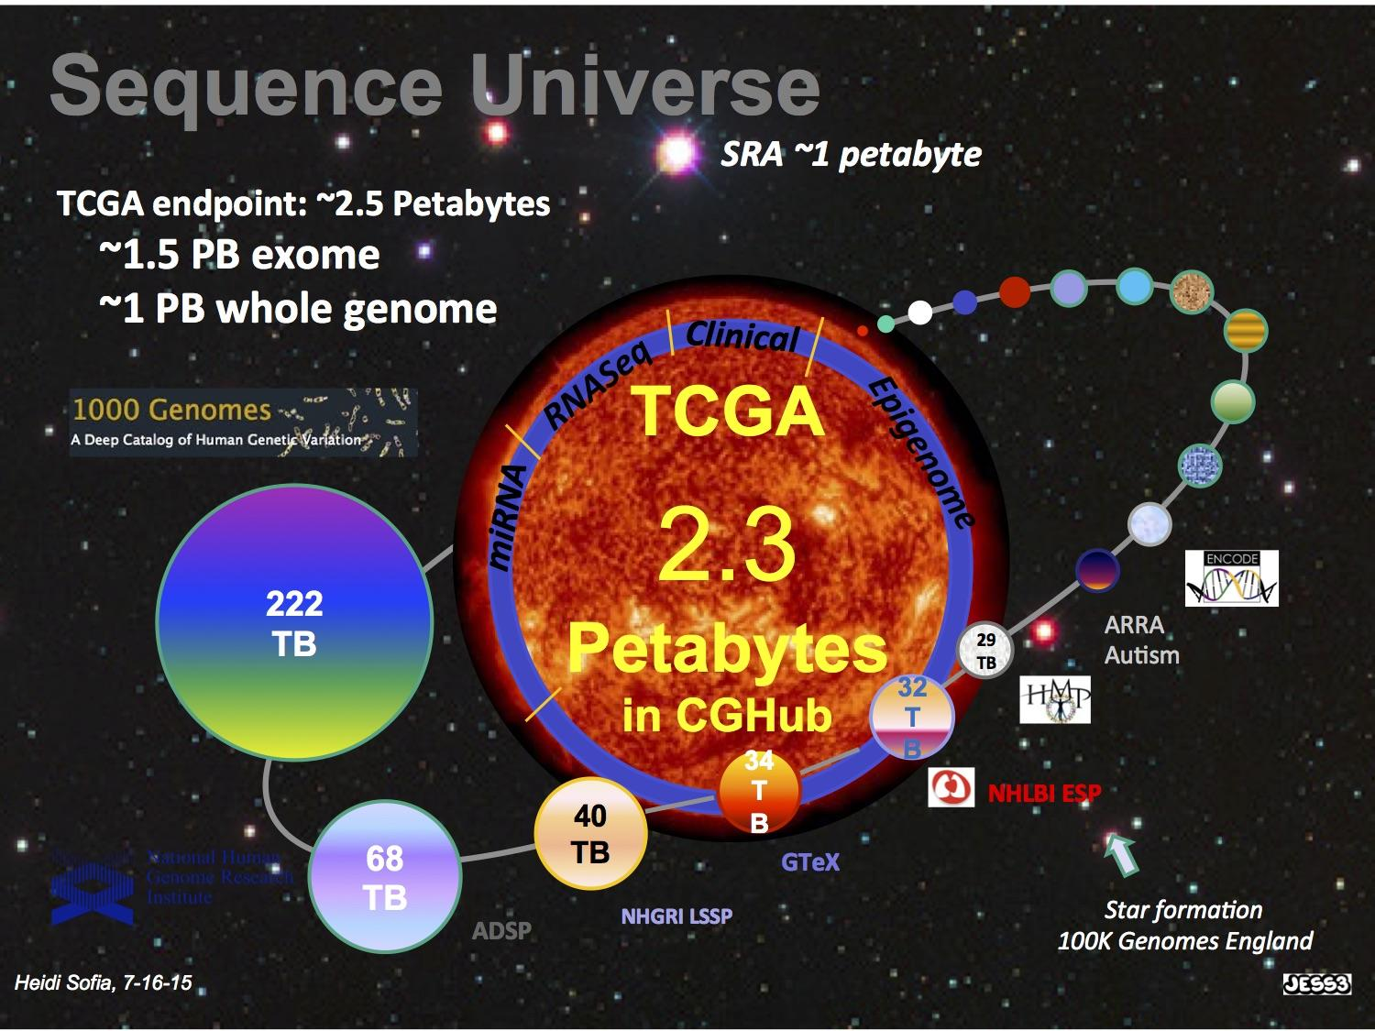

Slide 6
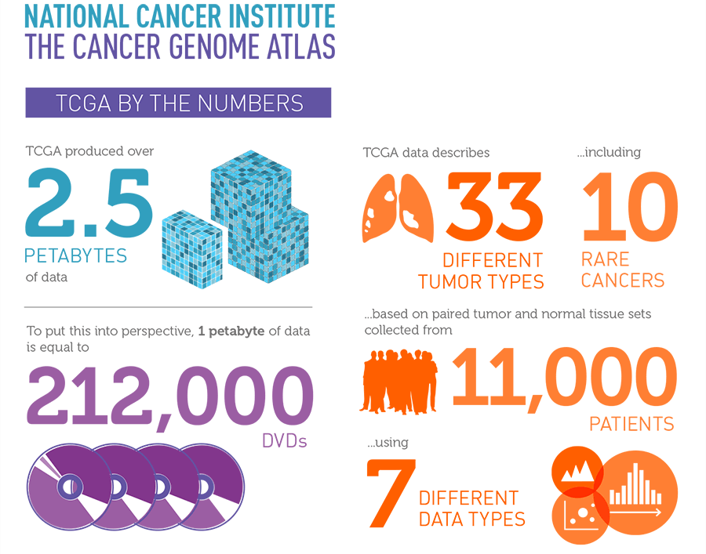
cancergenome.nih.gov

Slide 7
Logic
Data larger
Key is prioritizing
How to do this ?
Key aspect is driver v pass.

Slide 8
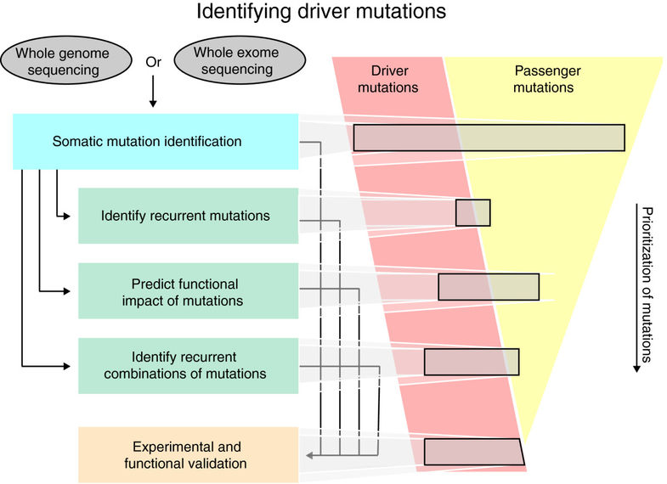
Raphael BJ, et al., Genome Med. (2014)

Slide 9
Logic
Data larger
Key is prioritizing
How to do this ?
Key aspect is driver v pass.

Slide 10
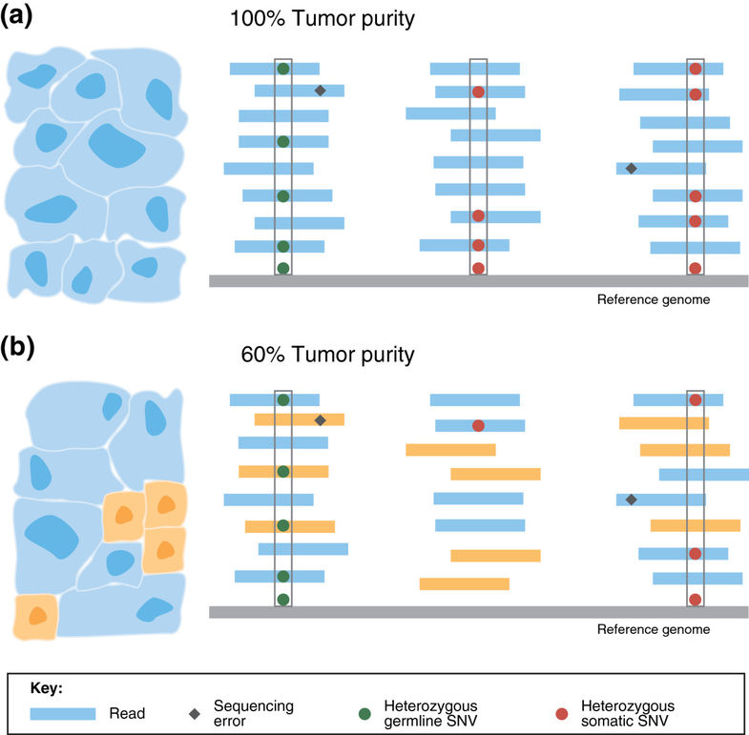
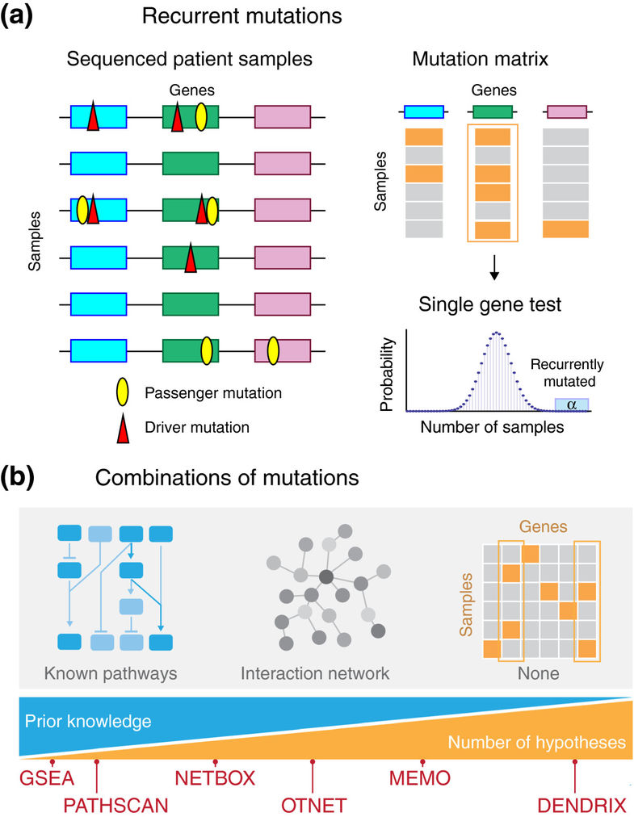
Raphael BJ, et al., Genome Med. (2014)

Slide 11
Misc.

Slide 12
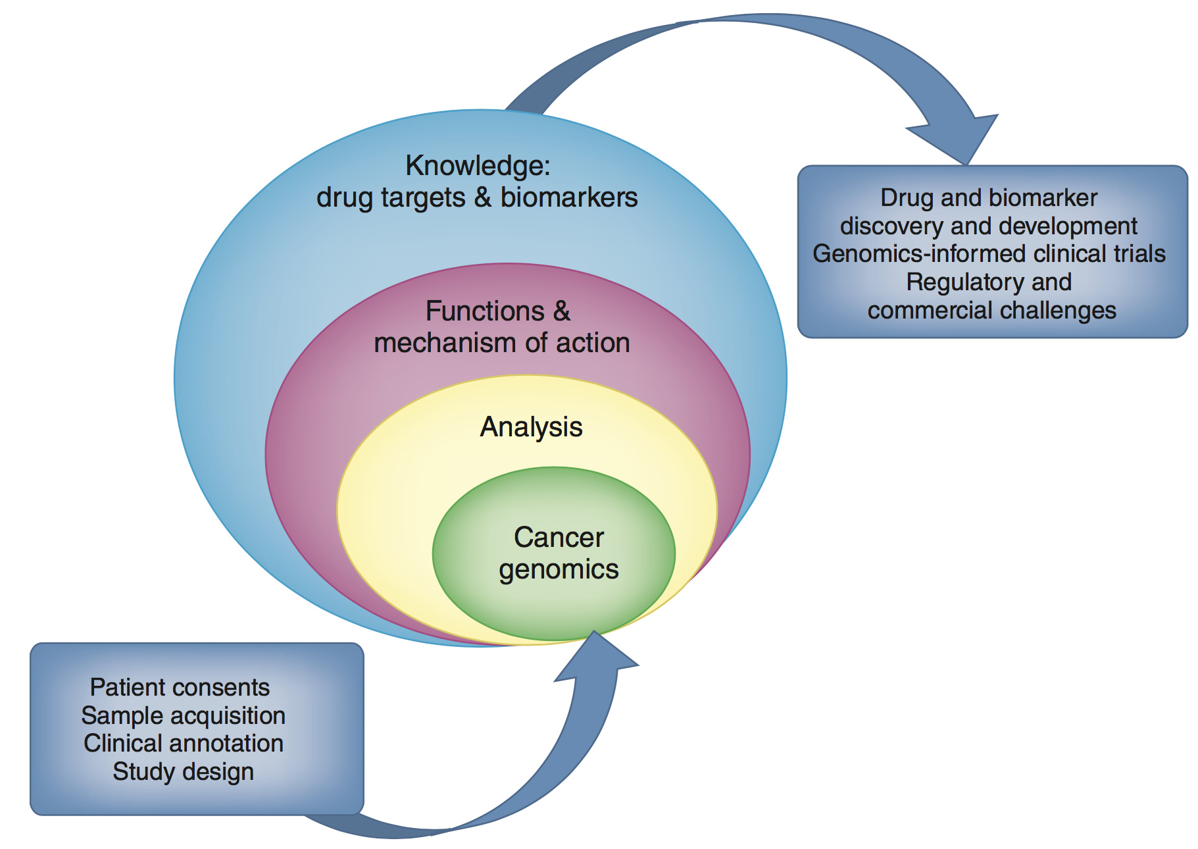
Chin, L et al., Nat Med (2011)

Slide 13
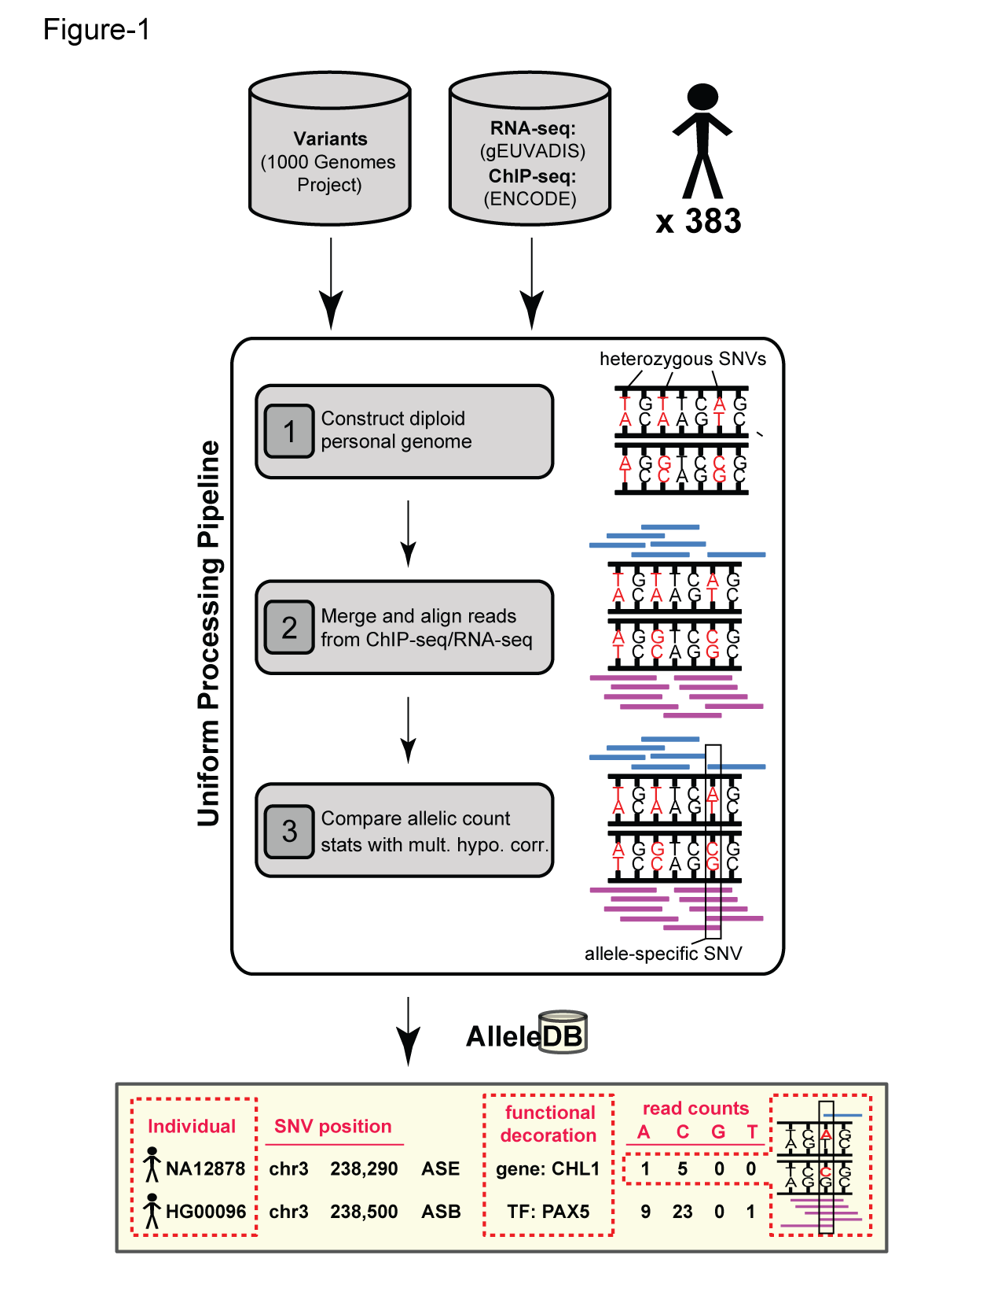
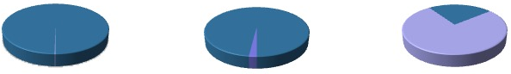
Human Genetic Variation
Population of
2,504 peoples
A Cancer Genome
A Typical Genome
Origin of Variants
Class of Variants
 | Coding | Non-coding
Germ-line | 22K | 4.1 – 5M
Somatic | ~50 | 5K
SNP | 3.5 – 4.3M
Indel | 550 – 625K
SV | 2.1 – 2.5K (20Mb)
Total | 4.1 – 5M
SNP | 84.7M
Indel | 3.6M
SV | 60K
Total | 88.3M
Prevalence of Variants
Common
Common
Passenger
Driver (~0.1%)
Rare* (1-4%)
Rare (~75%)
* Variants with allele frequency < 0.5% are considered as rare variants in 1000 genomes project.
The 1000 Genomes Project Consortium, Nature. 2015. 526:68-74
Khurana E. et al. Nat. Rev. Genet. 2016. 17:93-108

Slide 14

(Finding the key mutations in ~3M Germline variants &
~5K Somatic Variants in a Tumor Sample)
Cancer drivers: Significance & identification

Slide 15
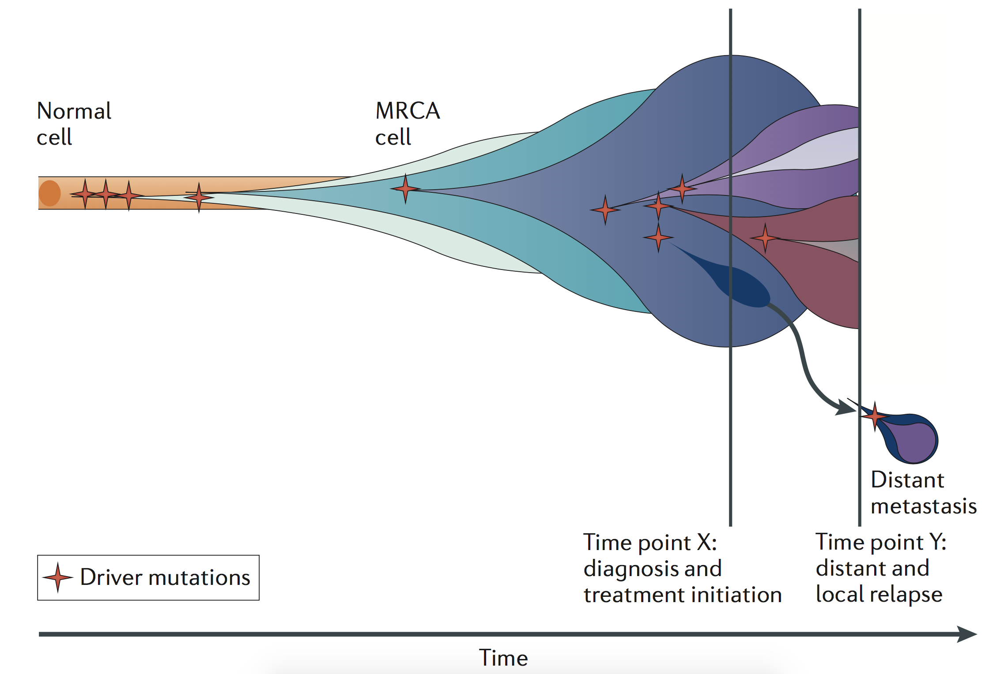
Cancer drivers: Significance & identification
Yates et al, NRG (2012)

Slide 16
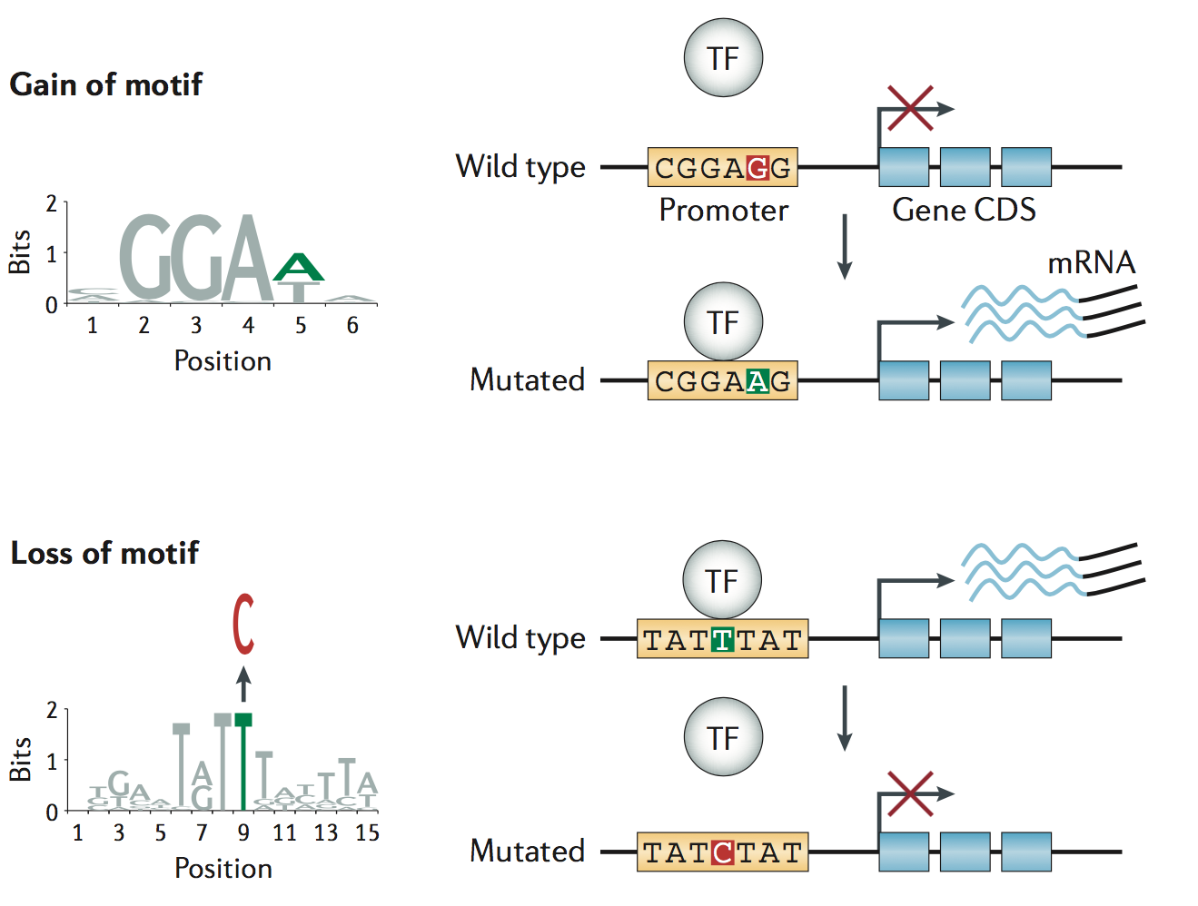
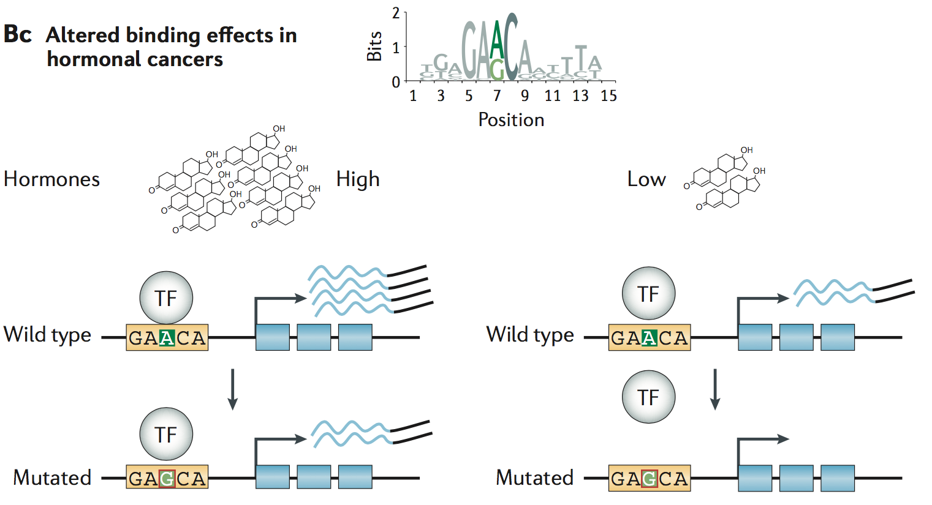
Cancer drivers: Significance & identification: functional annotations
≈ç
Khurana et al, NRG (2016)

