Slide 1
ASHG slides
Passenger mutations in 2500 cancer genomes: Overall molecular functional impact and consequences

Slide 2
Finding drivers (summarize)

Slide 3
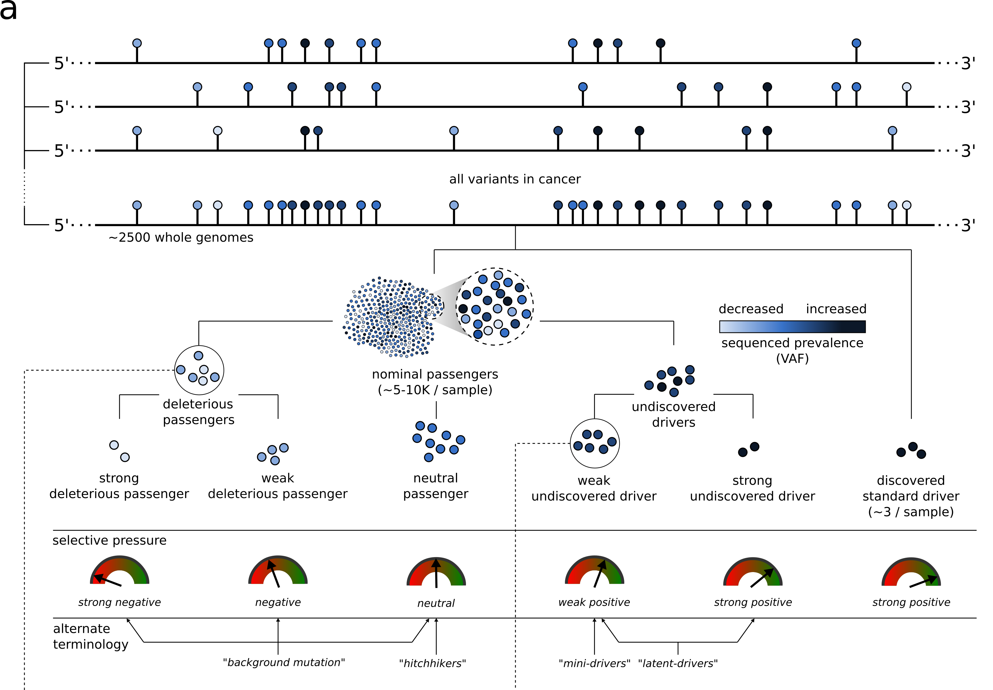
Conceptual extension of the canonical model of drivers and passengers

Slide 4
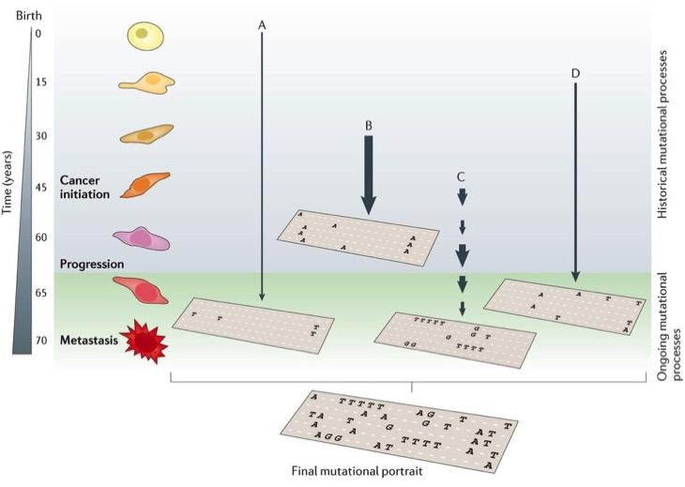
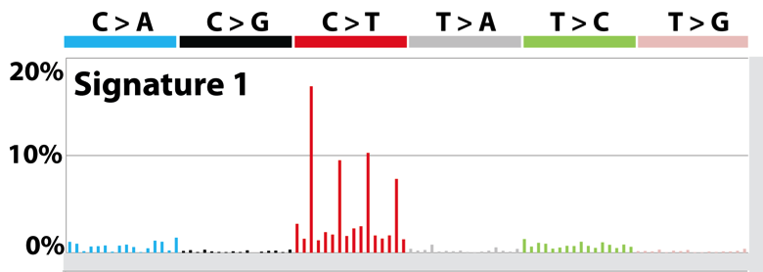
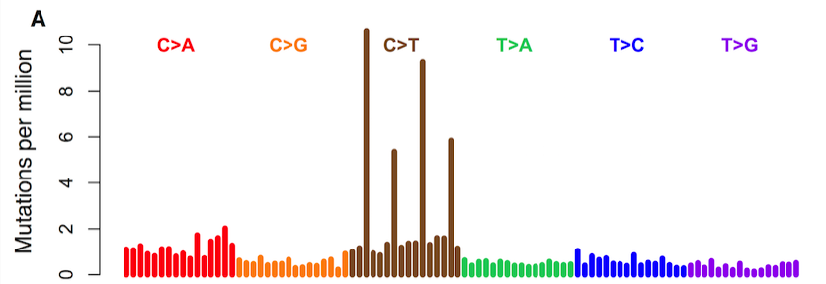
Mutational Context and Signatures
Mutation spectrum is further broken down to mutation signatures, which represent mutational processes
Mutation signature inferred
Mutation spectrum observed

Slide 5
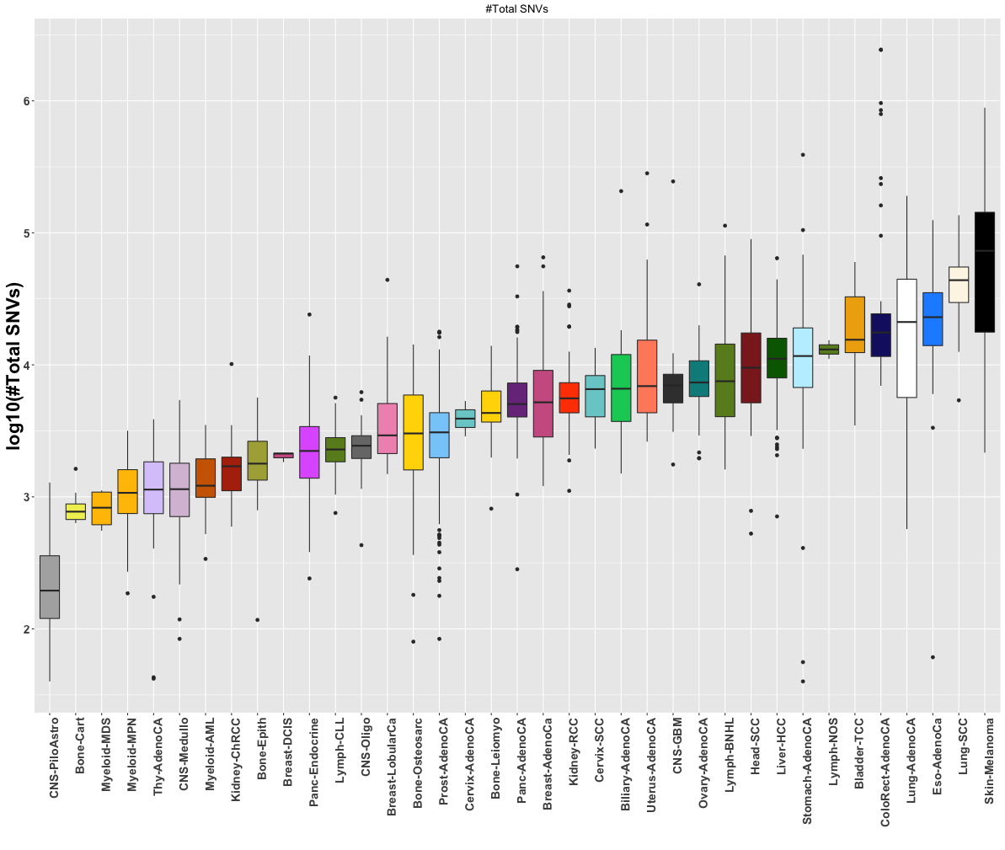
Suggest to remove this

Slide 6
pRCC : ~10% of all kidney cancers
Kidney cancer life time risk: 1.6%; the papillary type (pRCC) counts for about 10% of all cases
TCGA project sequenced 35 whole genomes of pRCC
  Researchers cannot pin down the cause for a significant portion of cases

Slide 7
Functional impact
Summarize funseq

Slide 8
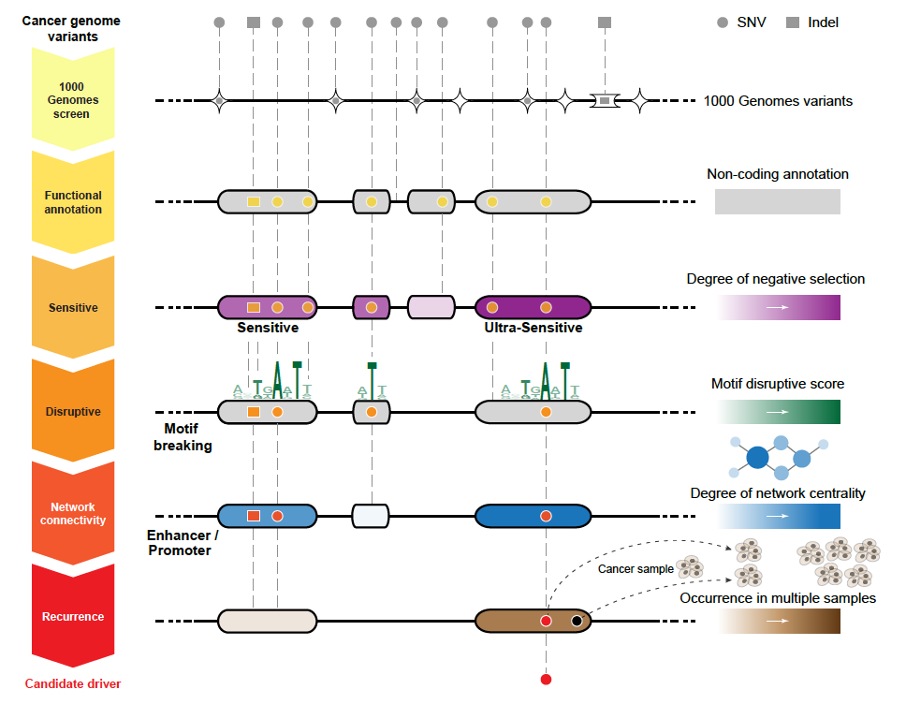
FunSeq2.gersteinlab.org
[Fu et al., GenomeBiology ('14)]

Slide 9
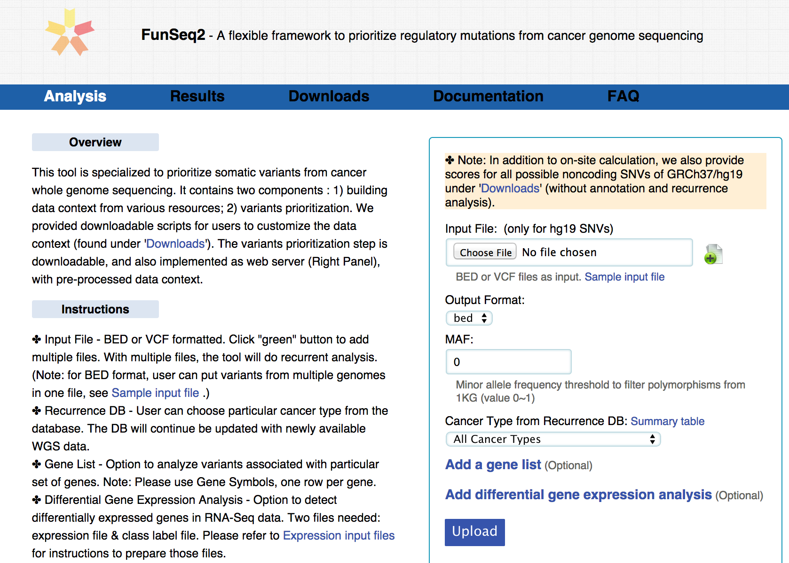
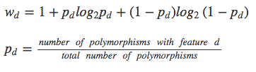
Feature weight
- Weighted with mutation patterns in natural polymorphisms
(features frequently observed weight less)
- entropy based method
Discrete features:

Slide 10
Overall functional impact

Slide 11
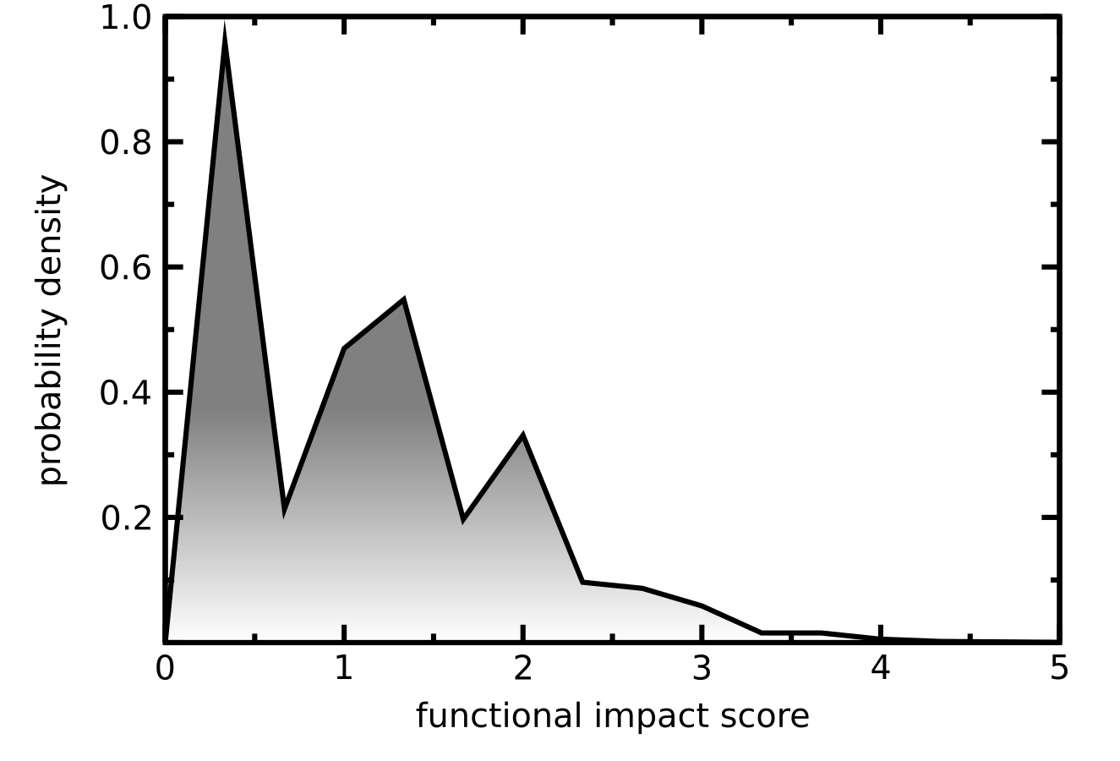
Functional impact distribution of PCAWG non-coding mutations
Funseq based molecular functional impact of variants in > 2500 PCAWG samples
Multimodal non-coding functional impact score distribution
    High impact score region presumably enriched with potential driver mutations.
    Low impact region corresponds to true passengers.

Slide 12
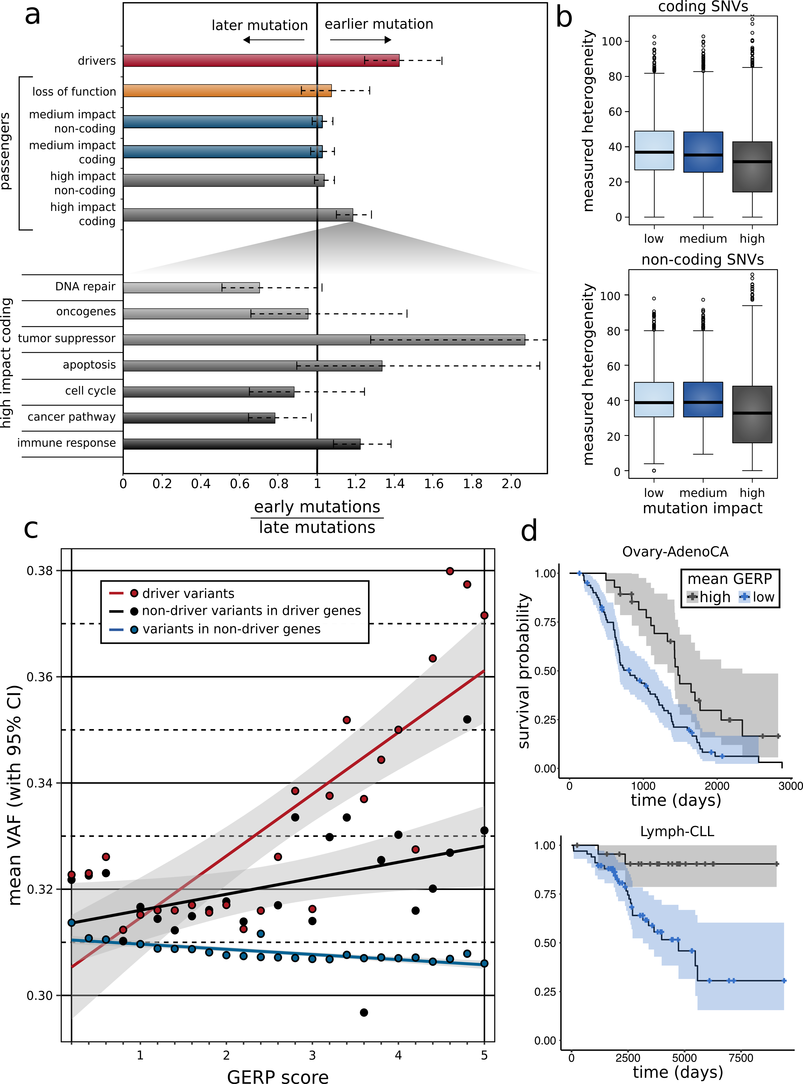
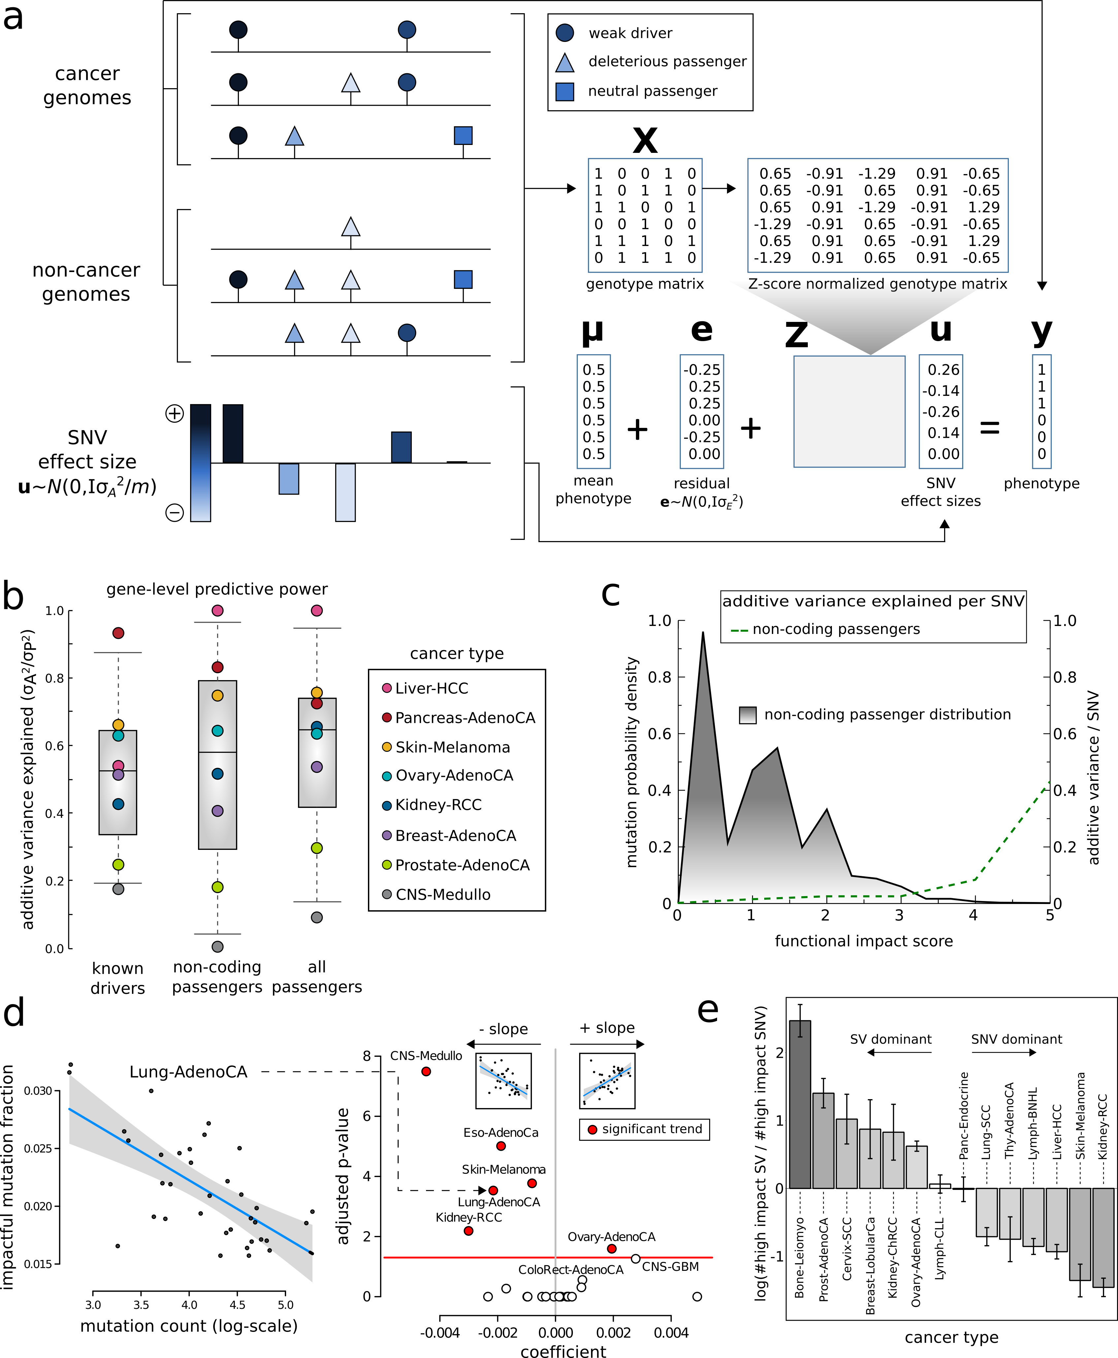
Fraction of high impact nominal passengers in PCAWG
In many PCAWG cohorts, we observe that fraction of impactful passengers decreases with increase in total mutation burden.

Slide 13
Differential burdening and intermediate peak can be attributed to mutational processes or selection

Slide 14
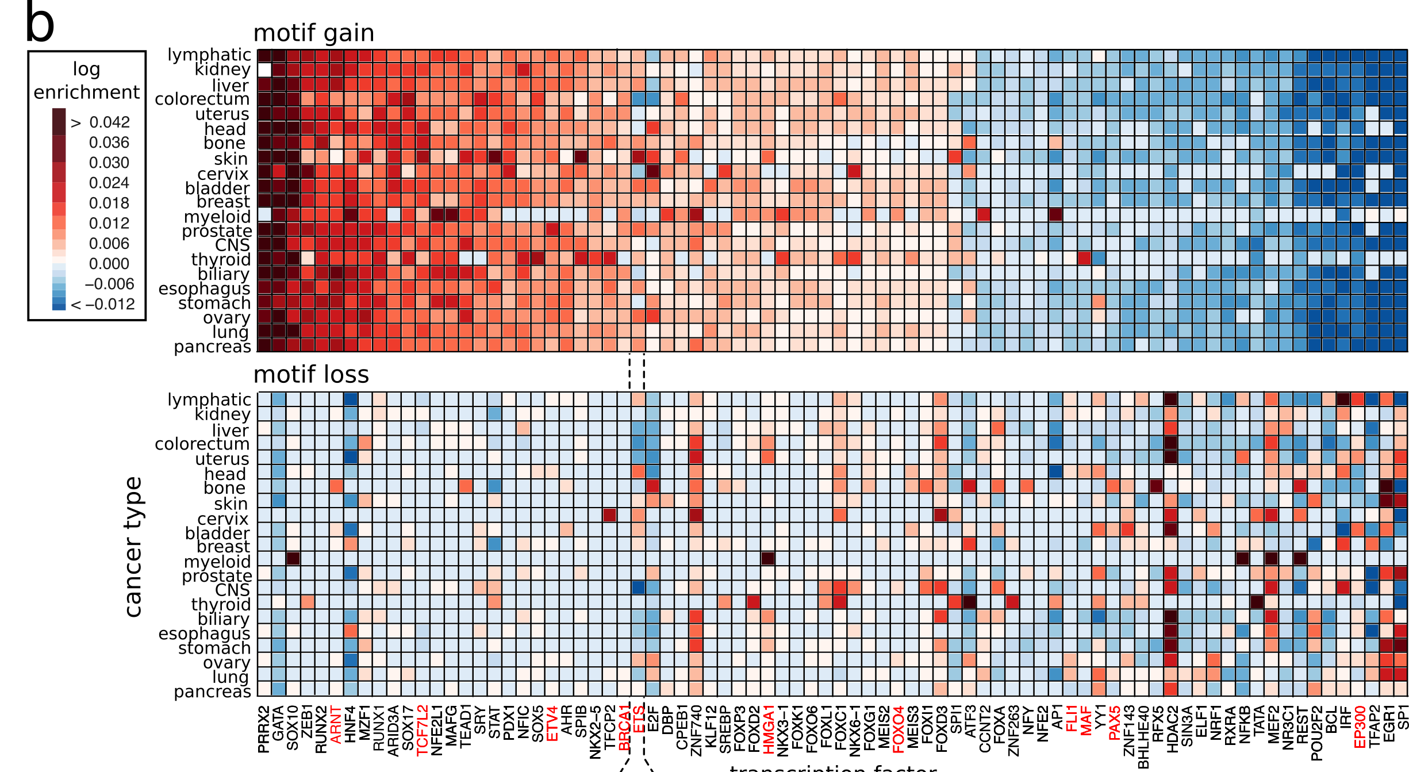
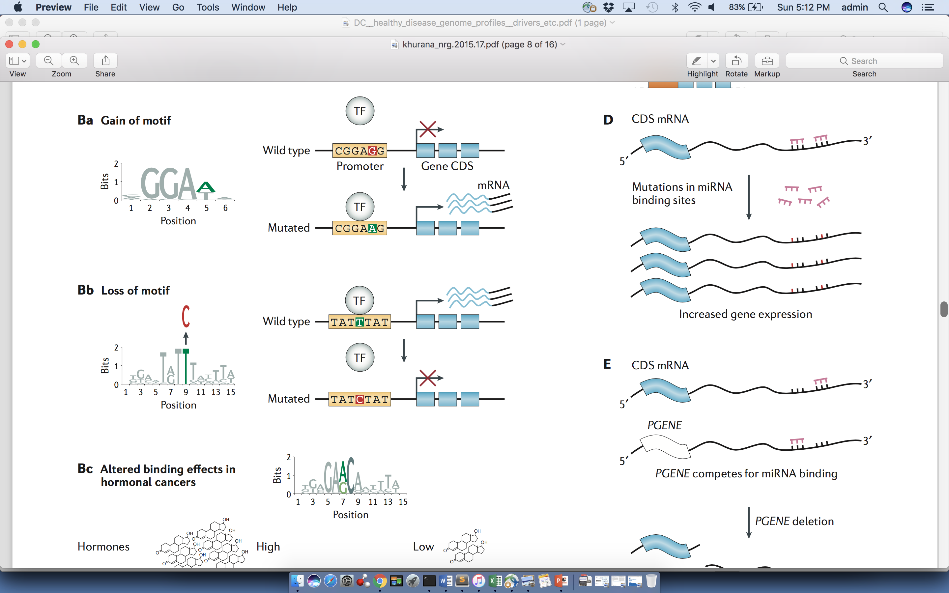
Passengers burdening of TF binding landscape
≈ç

Slide 15
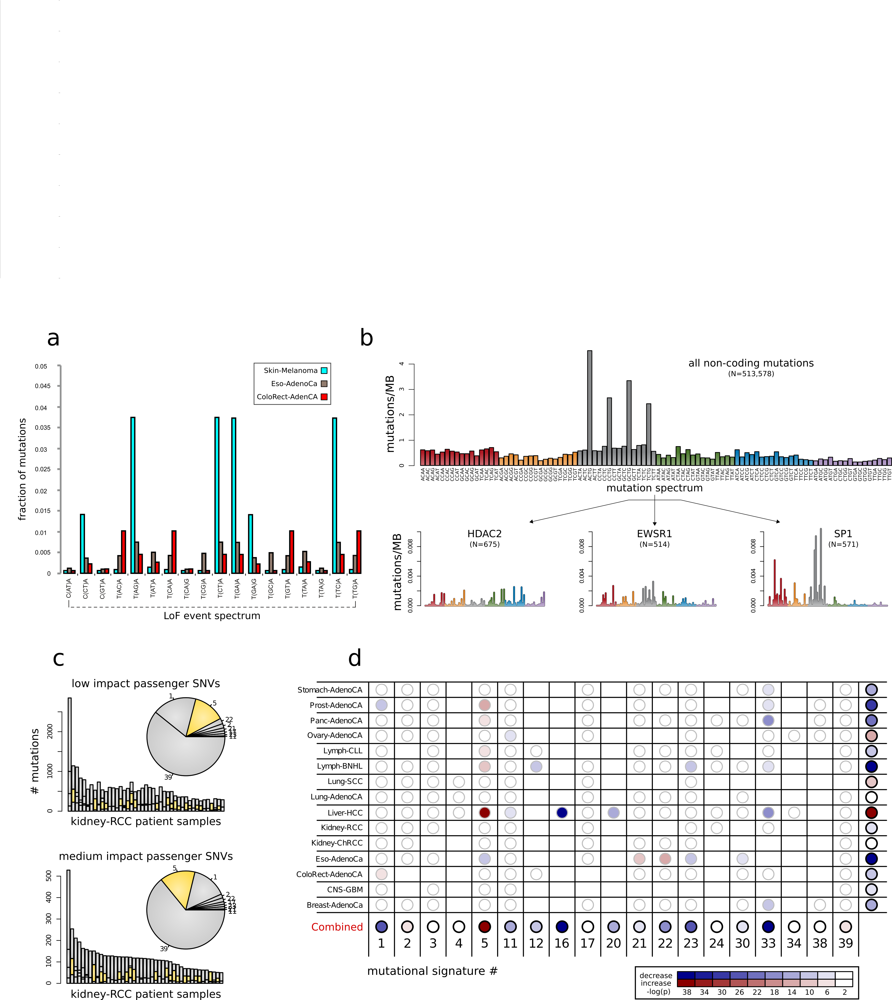
Correlating differential mutation burden with underlying mutation spectrum
Moved before signature

Slide 16
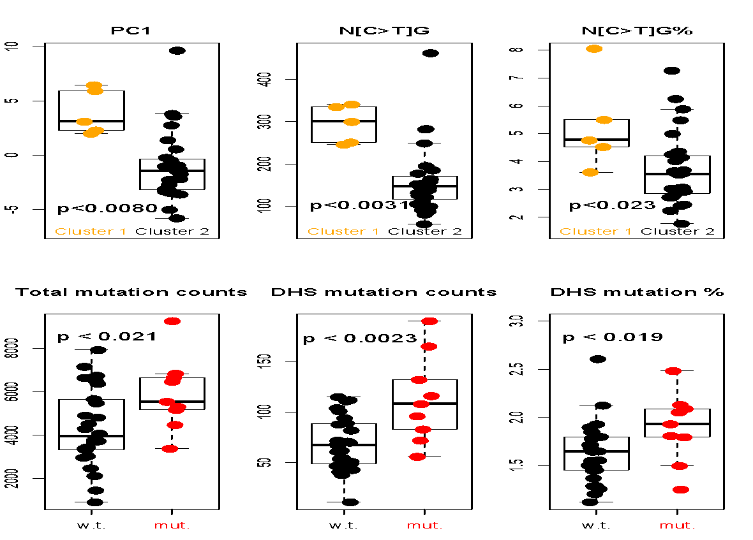
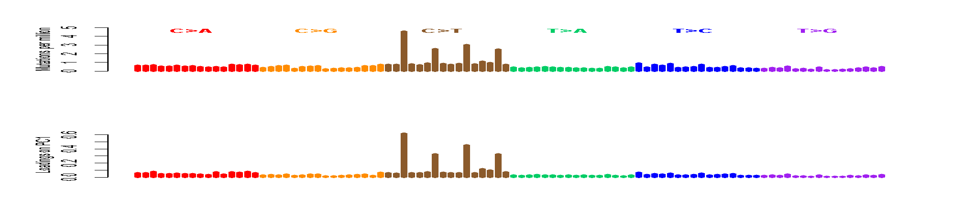
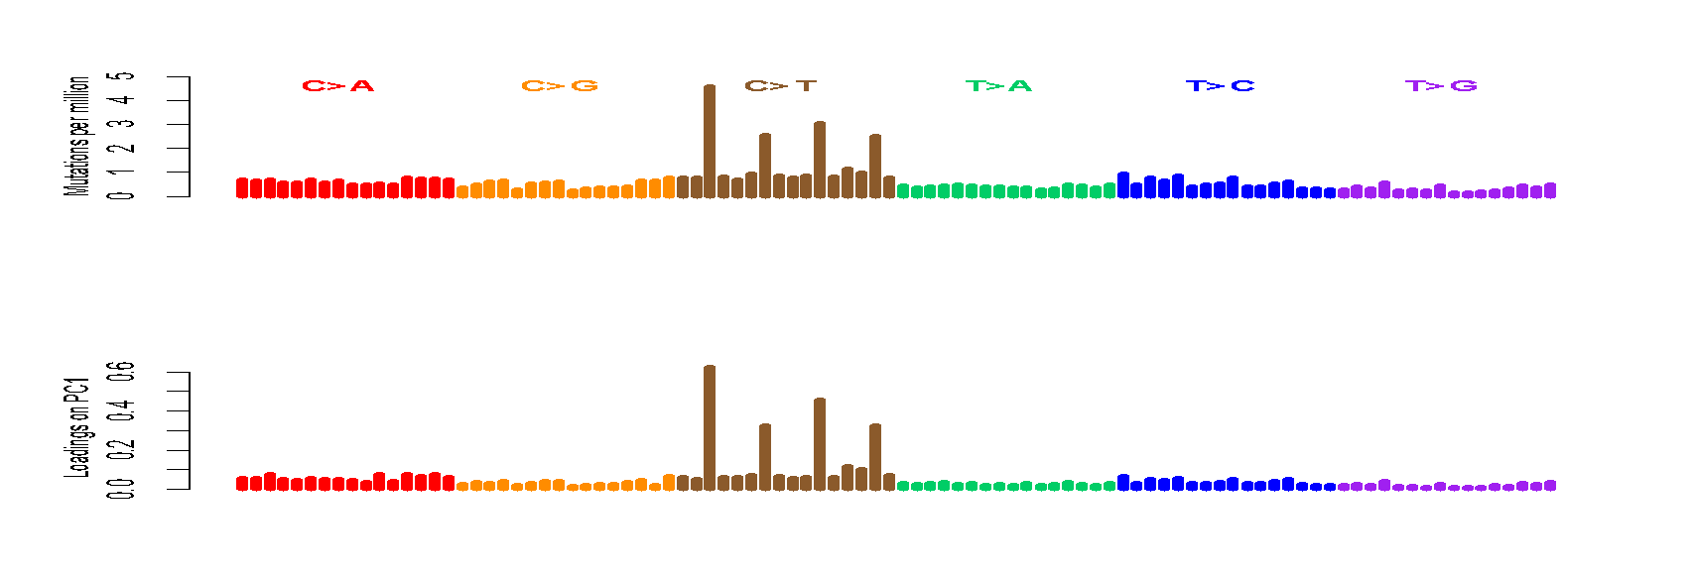
Now focusing kidney….CpGs Drive inter-patient variation
The Loading on PC1 is mostly [C>T]G
Confirmed by higher C>T% in CpGs in the hypermethylated group (cluster1)
A[C>T]G
G[C>T]G
C[C>T]G
T[C>T]G
S. Li, B. Shuch and M. Gerstein PLOS Genetics 2017

Slide 17
Let’s look at mutational process in pRCC closely

Slide 18
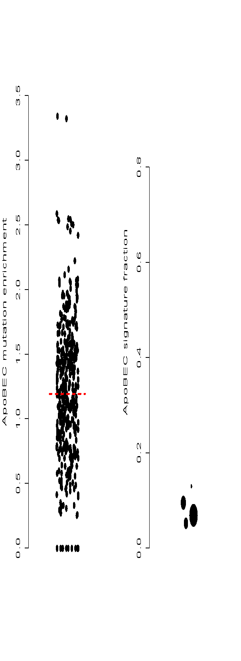


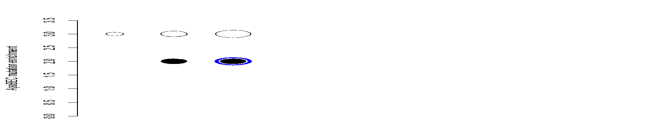
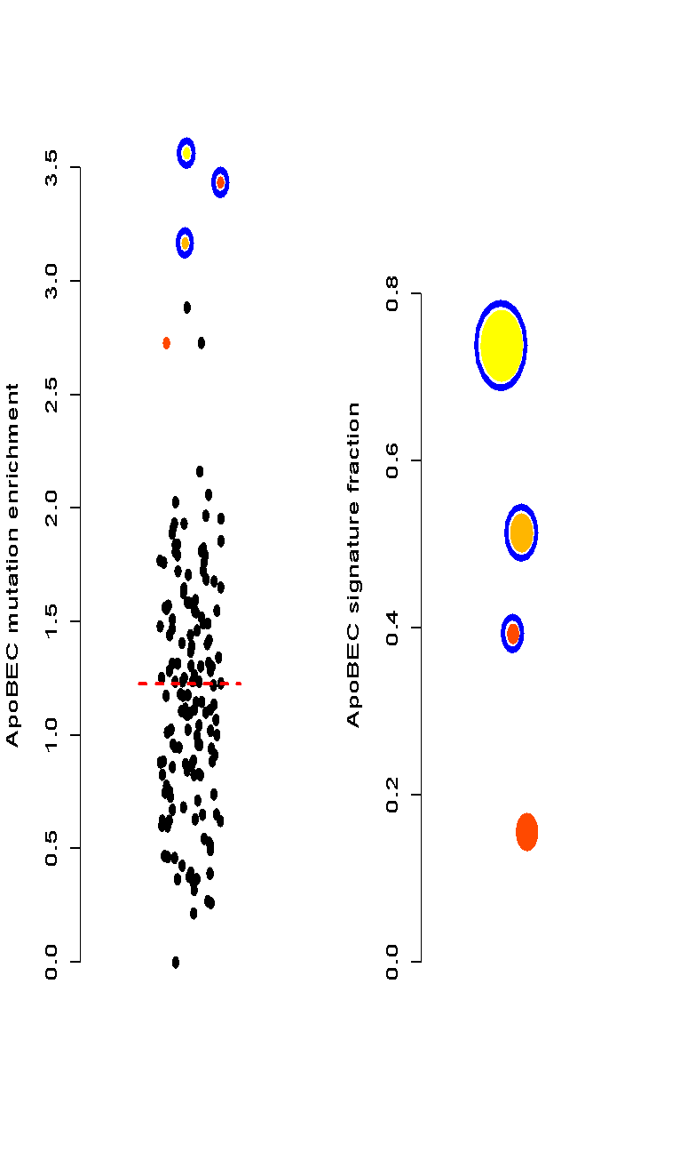

Discover ApoBEC Signature
enrichment
-log(p-value)
3.6
7.2
22
50
100
150
ApoBEC signature is observed
in chRCC but never in ccRCC.
We found a pRCC has ApoBEC
signature
Three samples that are urothelial
cancer (UC) but mislabeled
and processed through the
pipeline (internal positive controls)
RCC samples
total mutations
UC samples
pRCC & UC
ccRCC
S. Li, B. Shuch and M. Gerstein PLOS Genetics 2017

Slide 19

Chromatin remodeling failure changes mutational landscape
Samples with CR defect accumulate more mutations in open chromatin/early replicated regions; Interactions between mutational landscape and driver mutations.
S. Li, B. Shuch and M. Gerstein PLOS Genetics 2017

Slide 20
Mutational landscape change affects overall burden
Cancer

Slide 21
Early v late mutations in PCAWG

Slide 22

Sub-clonal architecture of nominal passengers in PCAWG
Overall enrichment and of nominal passenger variants among TSGs and depletion among oncogenes.

Slide 23
Correlating functional impact and prevalence of nominal passengers in PCAWG
Nominal passengers disrupting more conserved positions tend to have lower VAFs.

Slide 24
Additive variance to quantify aggregated effect of nominal passengers in PCAWG

Slide 25

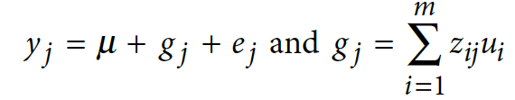


need better transition
Additive effects model to quantify cumulative effect of nominal passengers in PCAWG
Model for the effect of an individual SNP on a phenotype
Extension to model the combined effects of multiple SNPs
where: y=phenotype; x_ij is the ’genetic dosage’ of the i’th SNP in individual j, taking values {0,1}; a_i is the fixed effect size of SNP i, and e_j is the residual effect
where: z_ij is a ‘normalized genetic dosage’, i.e. the z-score of x_ij; u_i is the effect
size of SNP i treated as a random variable; g_j is the combined effect of all SNPs for individual j

Slide 26
Additive variance for multiple cancer cohorts in PCAWG

