Slide 1
ASHG slides

Slide 2
Cancer Genomics intro

Slide 3
Lots of mutations
PCAWG rich resource to look at variations in cancer

Slide 4
PCAWG : most comprehensive resource for cancer whole genome analysis
Goal of PCAWG:
To understand role of non-coding regions of cancer genomes in cancer progression.
Looking beyond single nucleotide variants in cancer genome
    Large structural variations
    Somatic copy number aberrations
    Extending know mutational signature repertoire
    Mapping cancer evolution history by analyzing clonal architecture
Jointly analyzing ~2800 whole genome tumor/normal pairs
  > 580 researchers
  16 thematic working groups
  > 130 research project

Slide 5
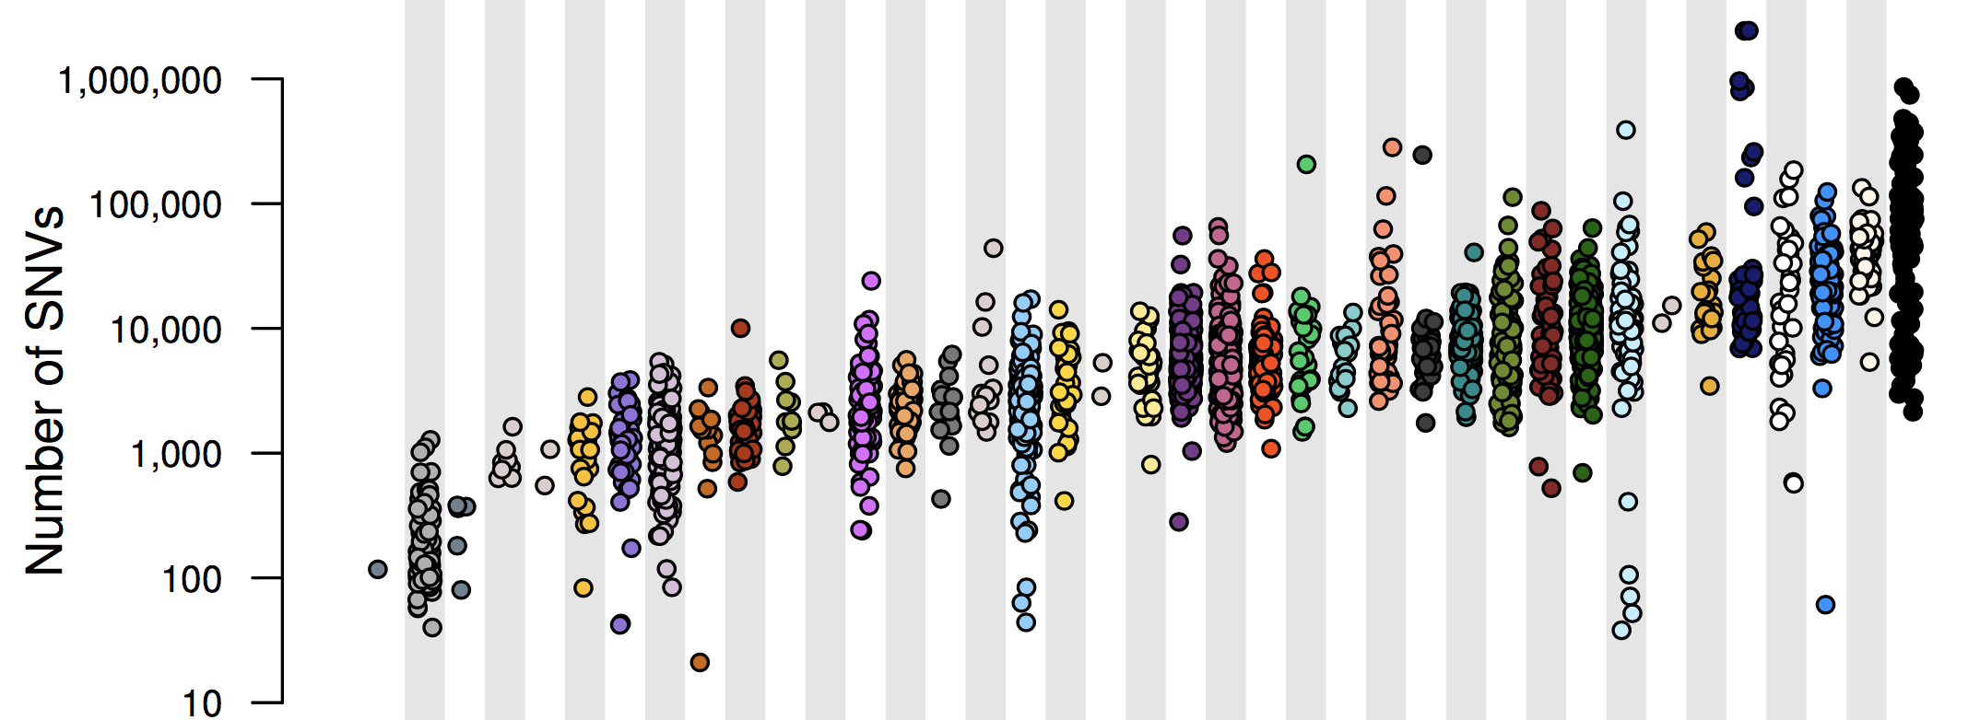
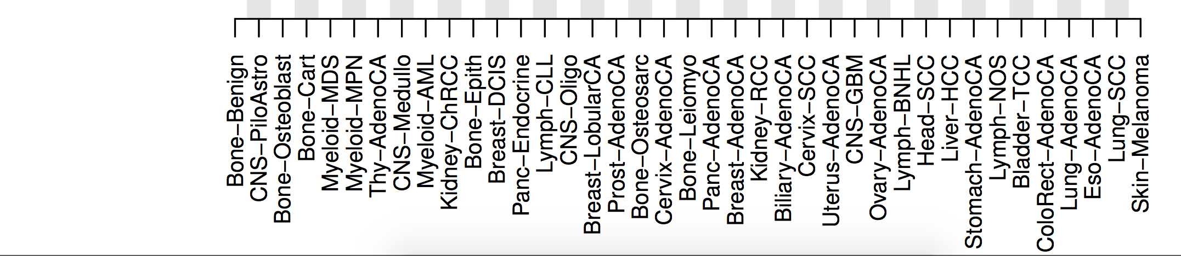
Adapted from Campbell et al, bioRxiv (2017)

Slide 6
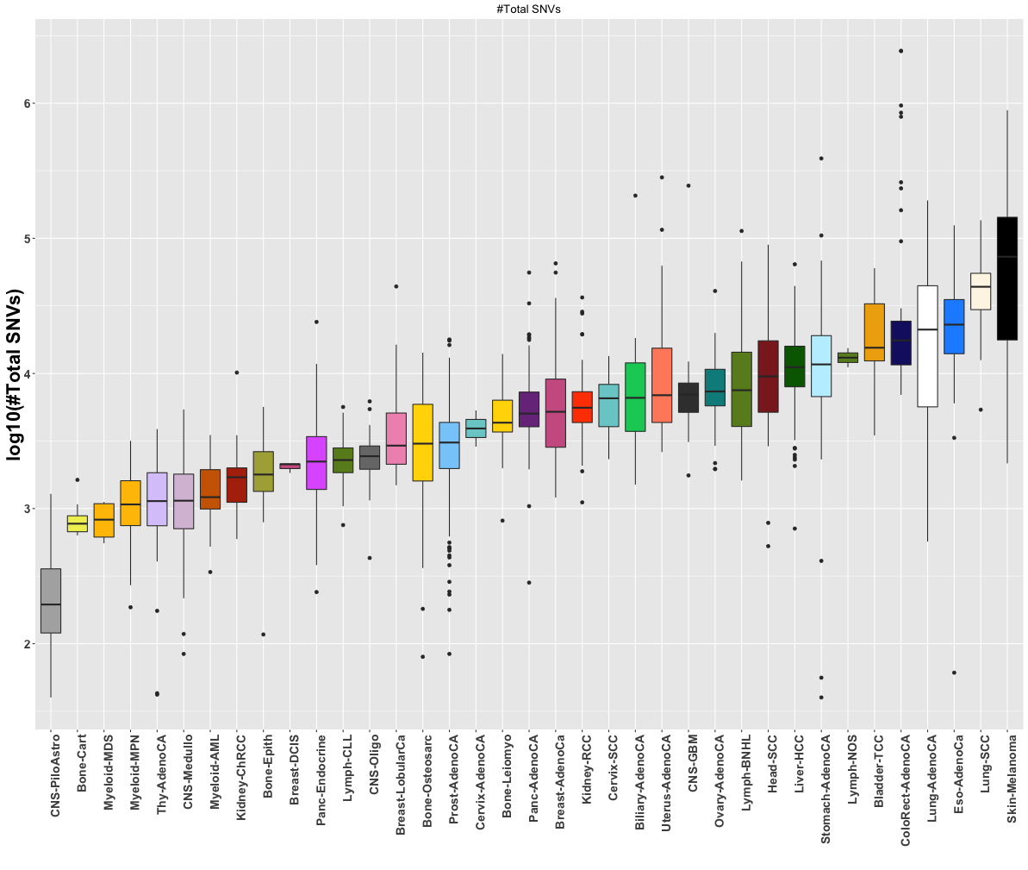
Suggest to remove this

Slide 7
pRCC : ~10% of all kidney cancers
Kidney cancer life time risk: 1.6%; the papillary type (pRCC) counts for about 10% of all cases
TCGA project sequenced 35 whole genomes of pRCC
  Researchers cannot pin down the cause for a significant portion of cases

Slide 8
Functional impact
Summarize funseq

Slide 9
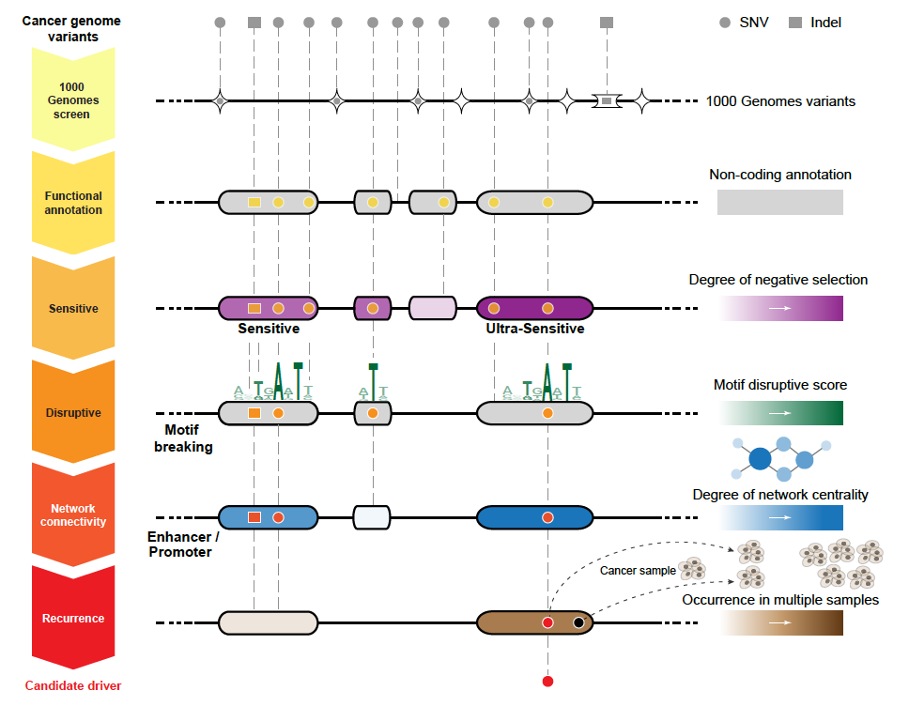
FunSeq2.gersteinlab.org
[Fu et al., GenomeBiology ('14)]

Slide 10
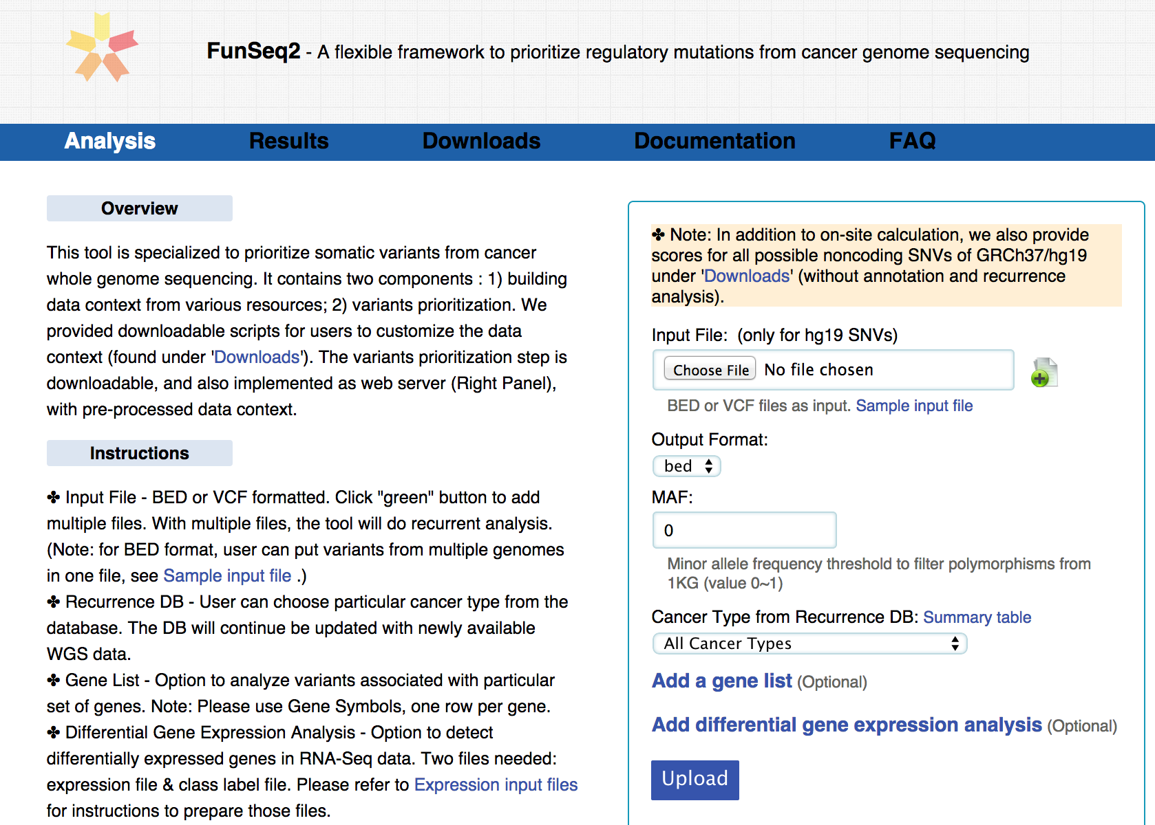
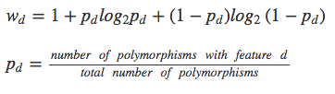
Feature weight
- Weighted with mutation patterns in natural polymorphisms
(features frequently observed weight less)
- entropy based method
Discrete features:

Slide 11
Finding drivers (summarize)

Slide 12
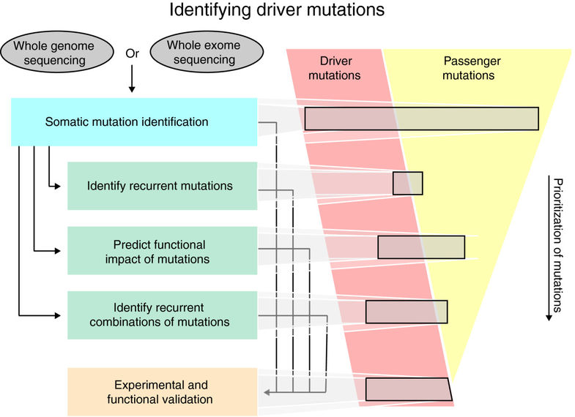
PCAWG efforts at Identifying Drivers
Drivers (~2-4 SNVs) confer a selective growth advantage to cancer cells
Passengers have no effect tumor progression
PCAWG is working to comprehensively discover drivers (esp. in non-coding regions) via recurrence analyses & functional impact
Raphael BJ, et al., Genome Med. (2014)

Slide 13
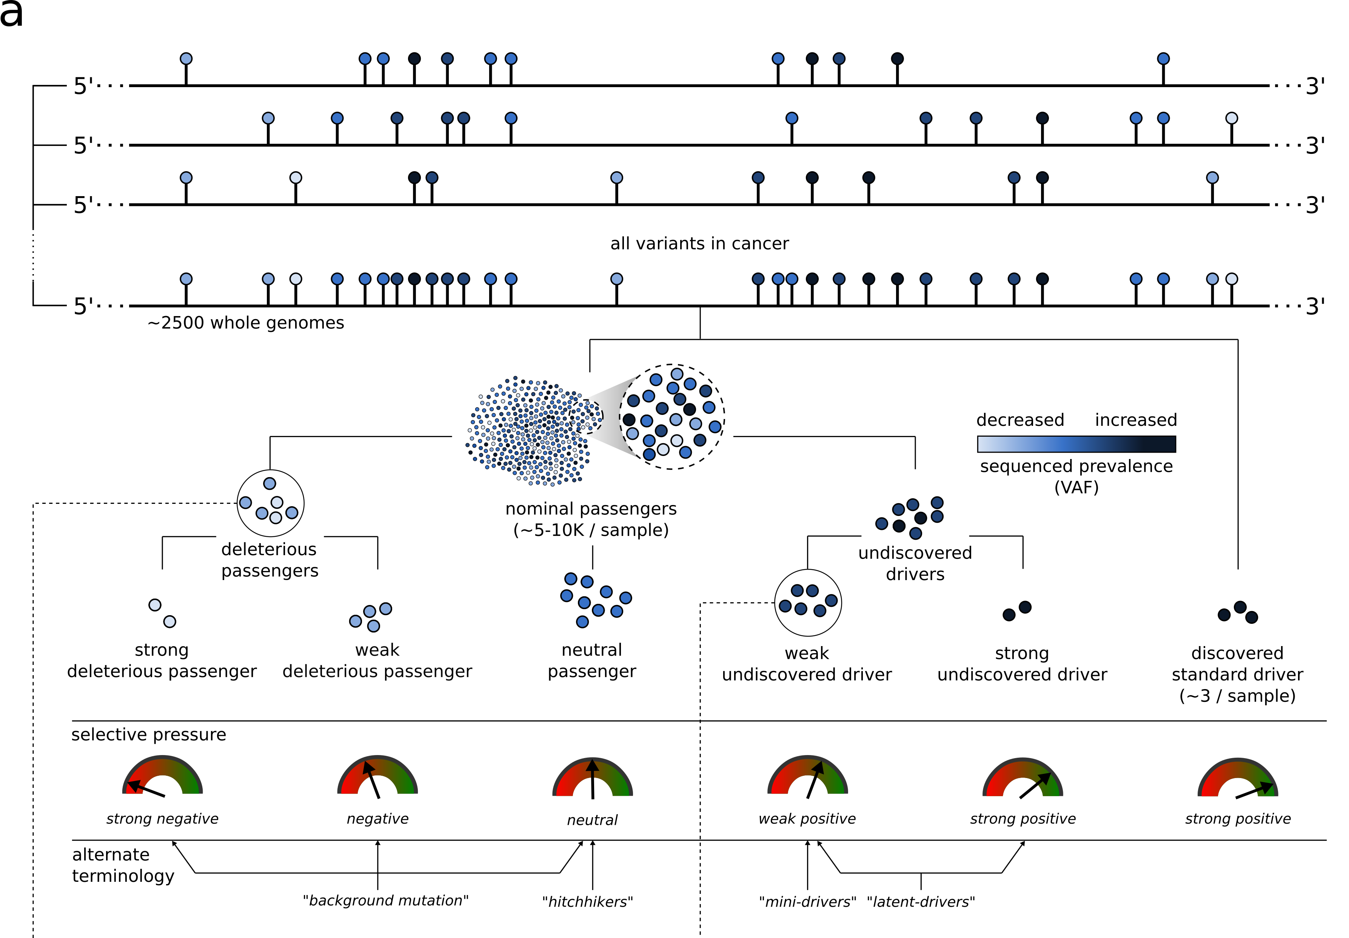
Conceptual extension of the canonical model of drivers and passengers

Slide 14
Overall functional impact

Slide 15
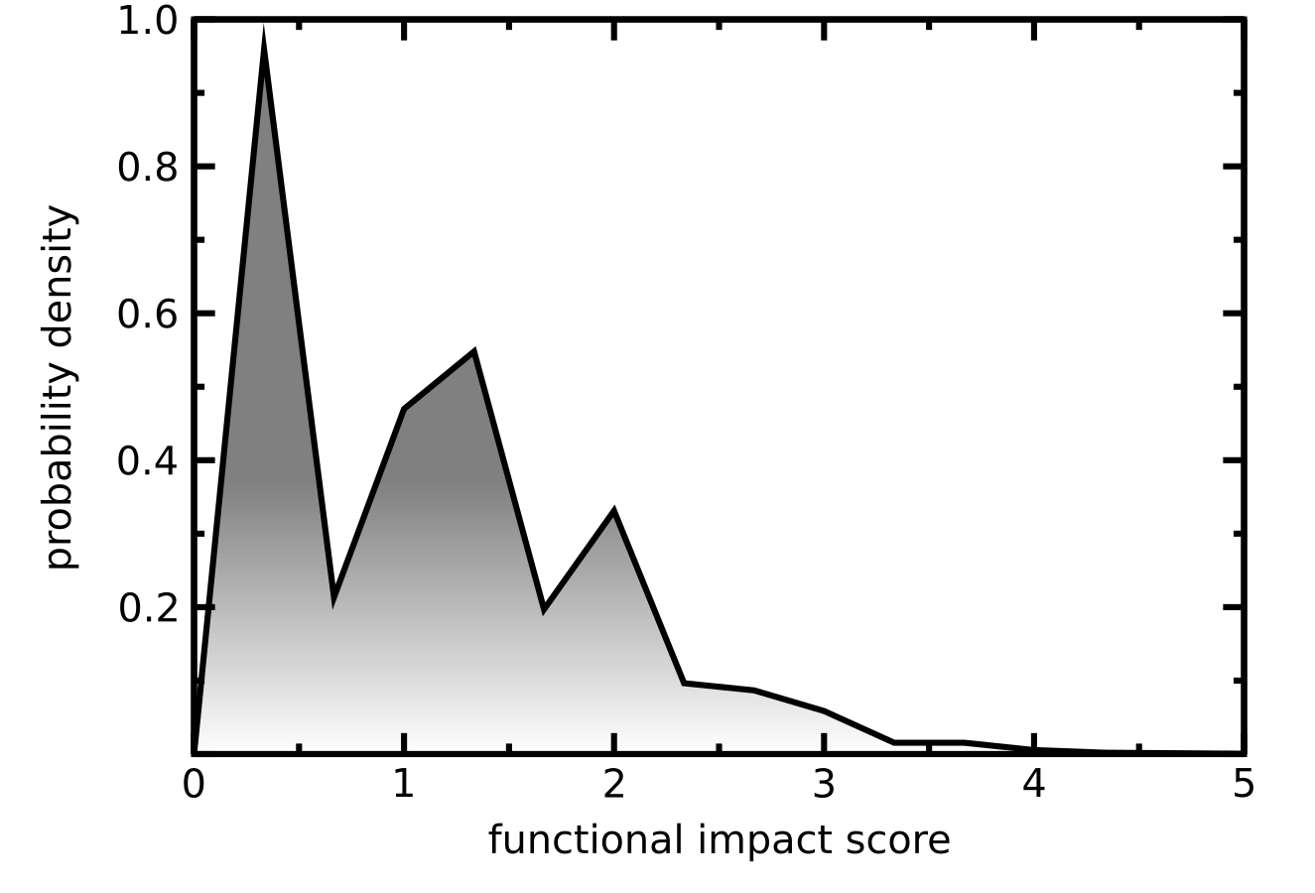
Functional impact distribution of PCAWG non-coding mutations
Funseq based molecular functional impact of variants in > 2500 PCAWG samples
Multimodal non-coding functional impact score distribution
    High impact score region presumably enriched with potential driver mutations.
    Low impact region corresponds to true passengers.

Slide 16
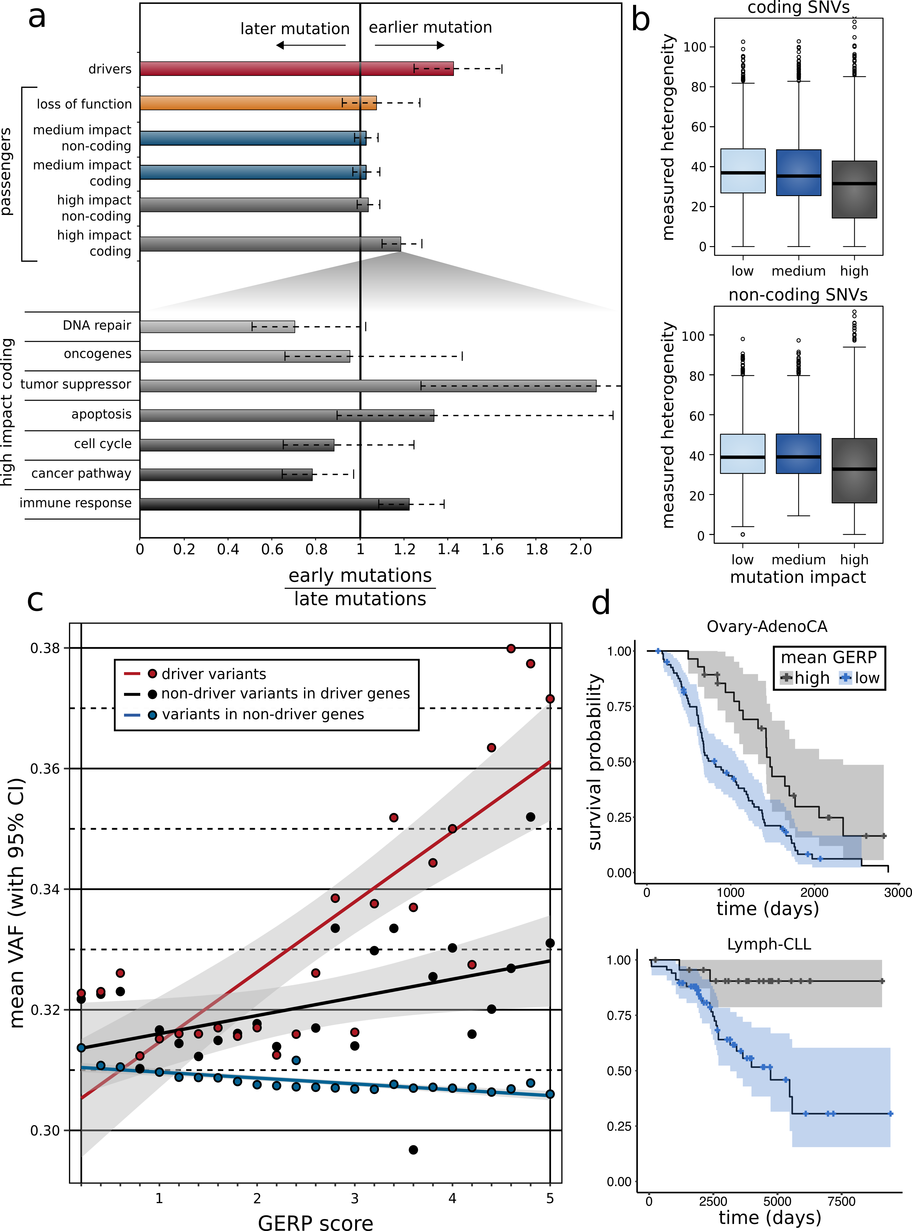
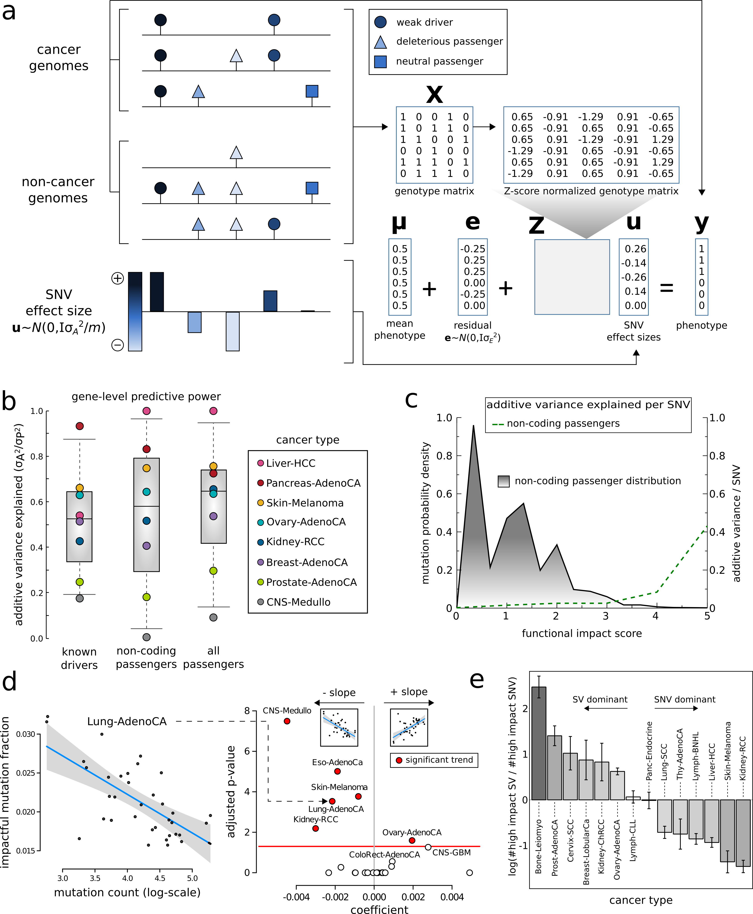
Fraction of high impact nominal passengers in PCAWG
In many PCAWG cohorts, we observe that fraction of impactful passengers decreases with increase in total mutation burden.

Slide 17
Differential burdening and intermediate peak can be attributed to mutational processes or selection

Slide 18
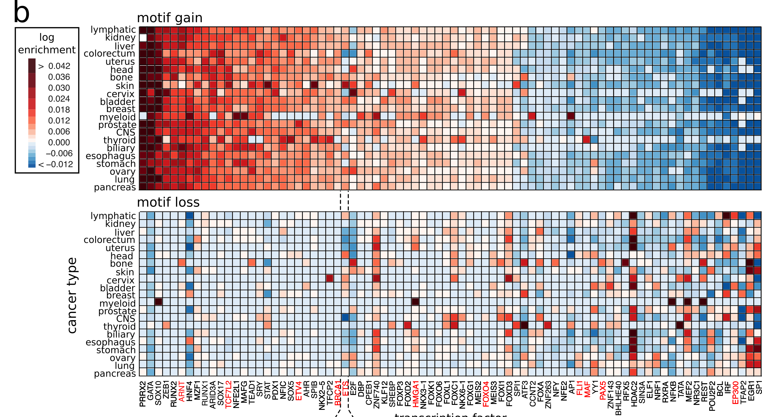
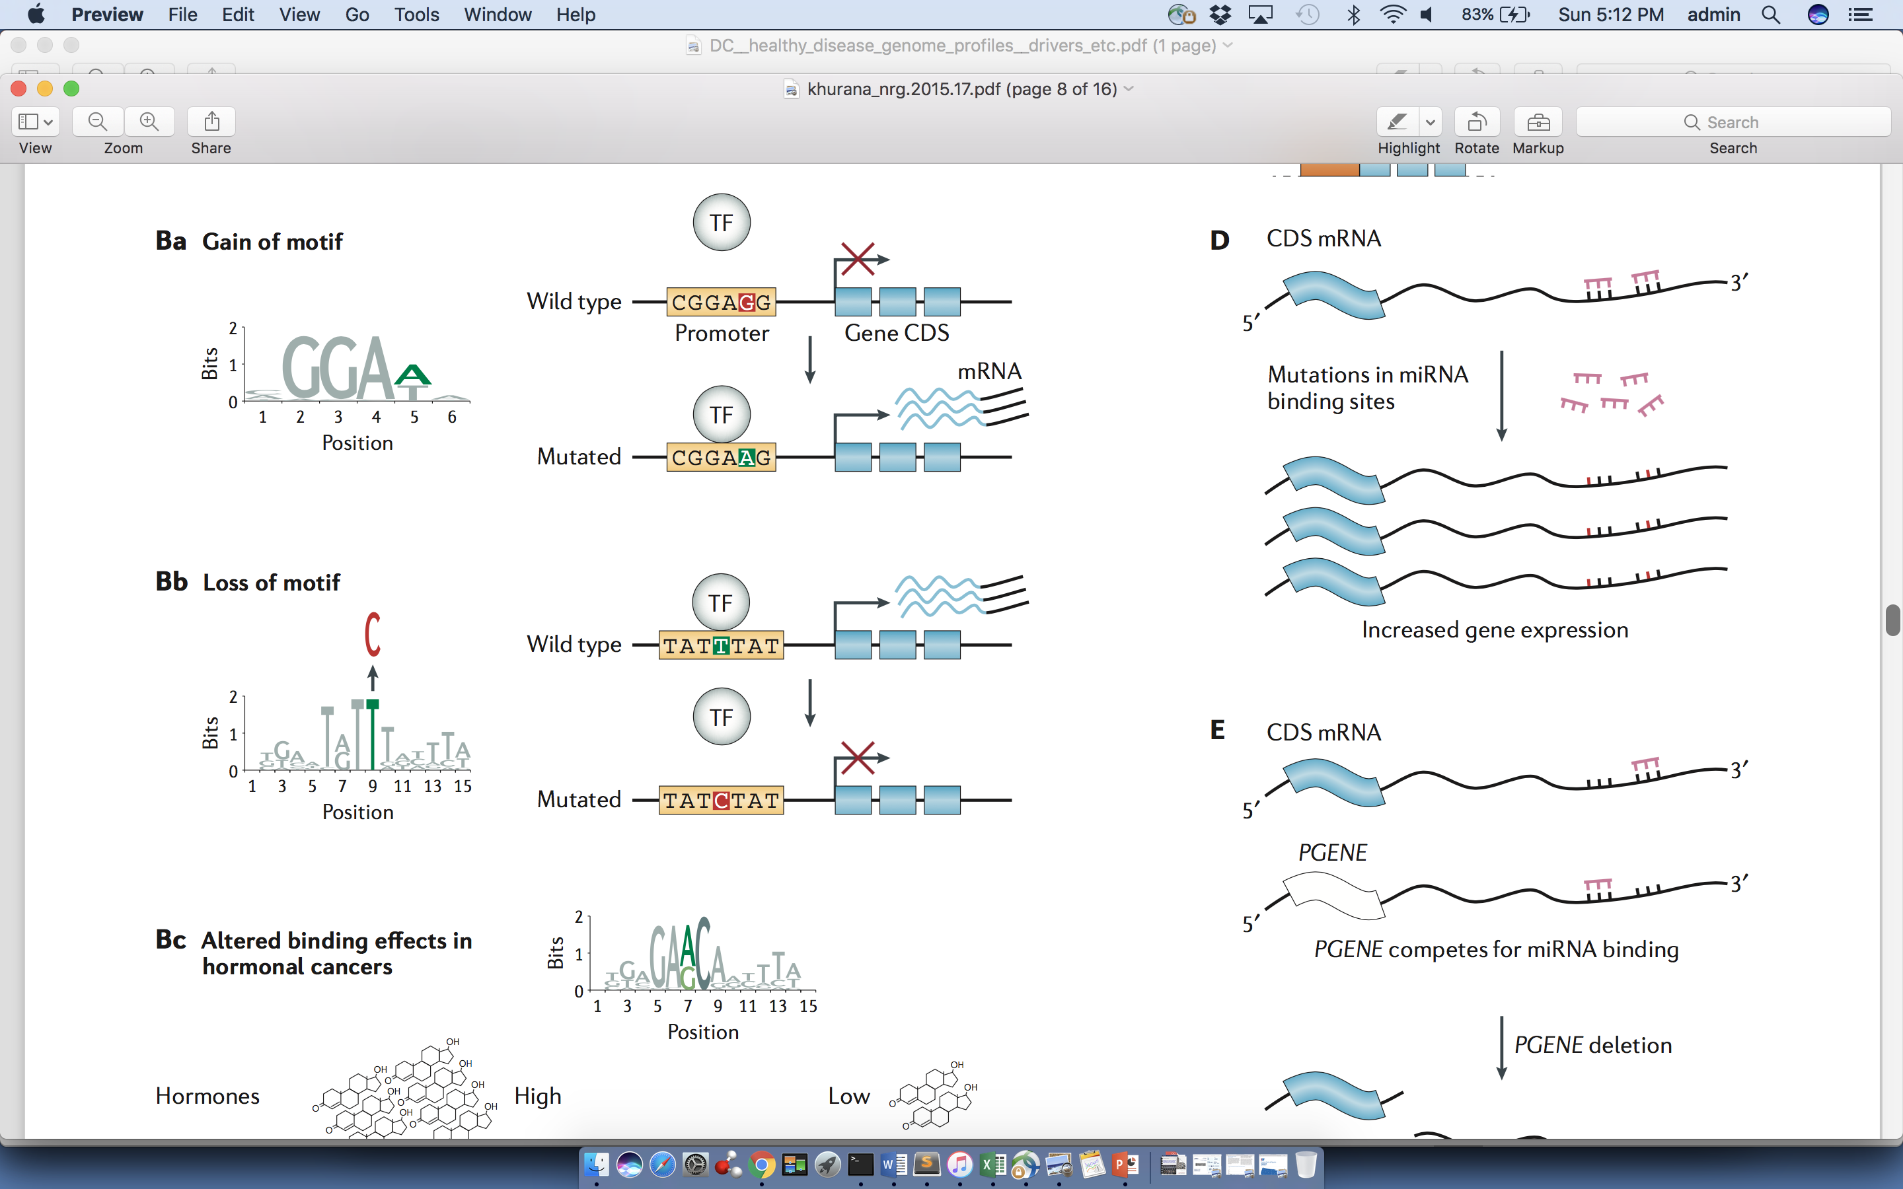
Passengers burdening of TF binding landscape
≈ç

Slide 19
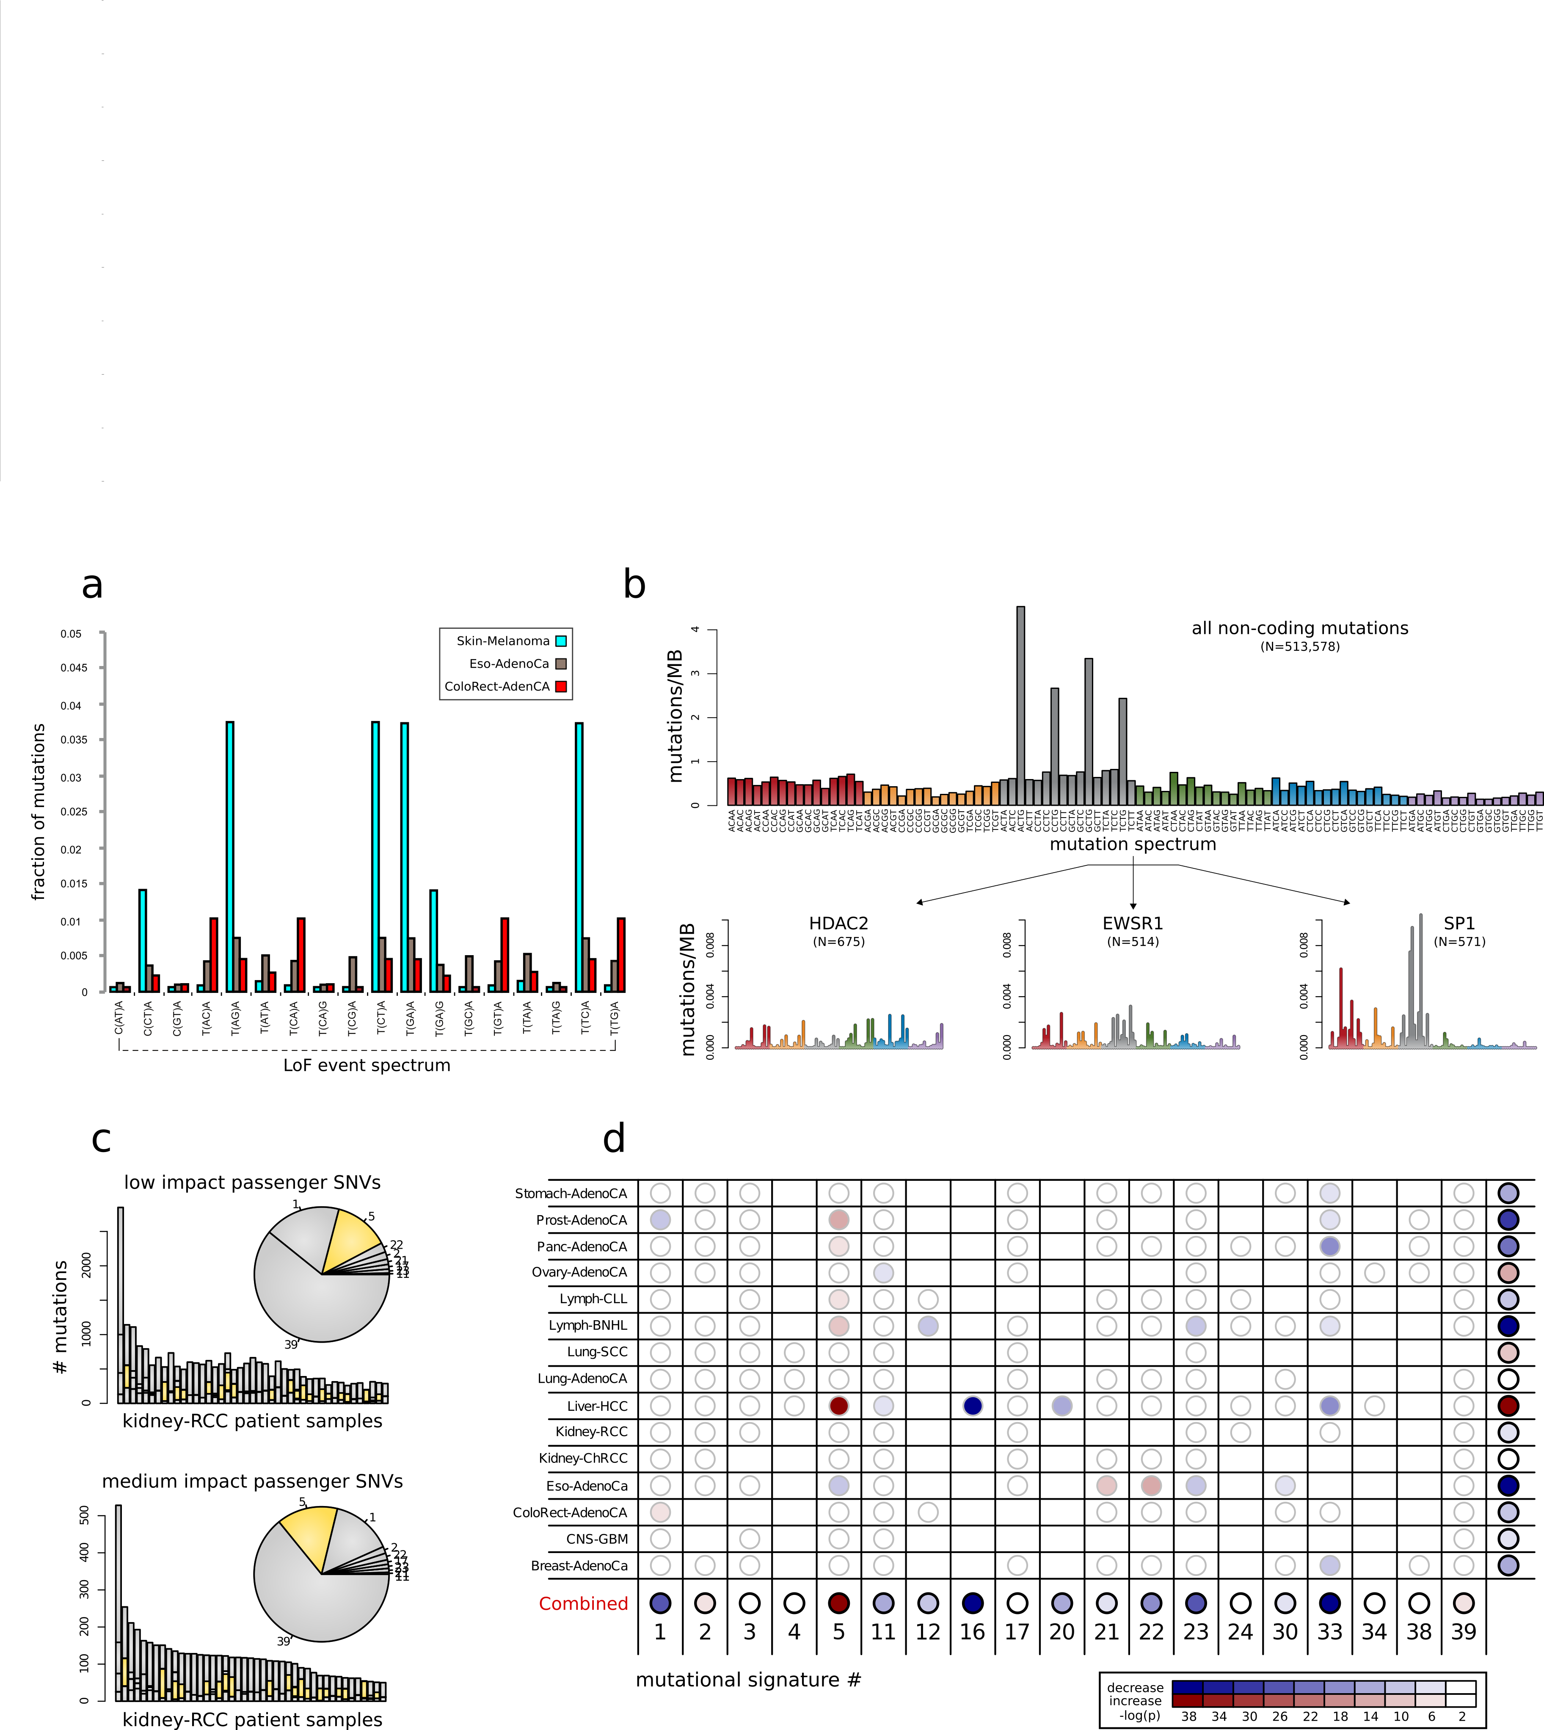
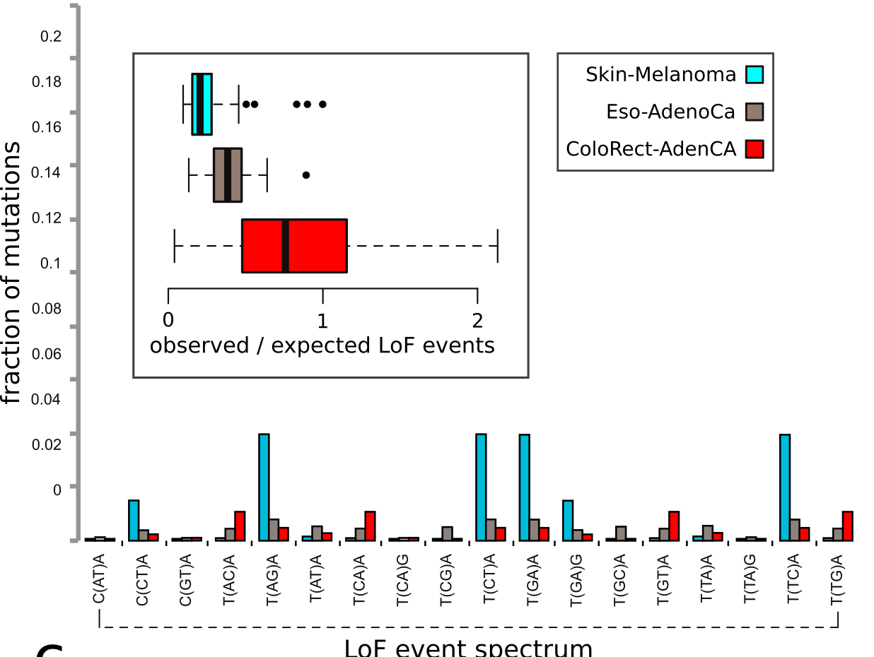
Correlating differential mutation burden with underlying mutation spectrum
Moved before signature

Slide 20
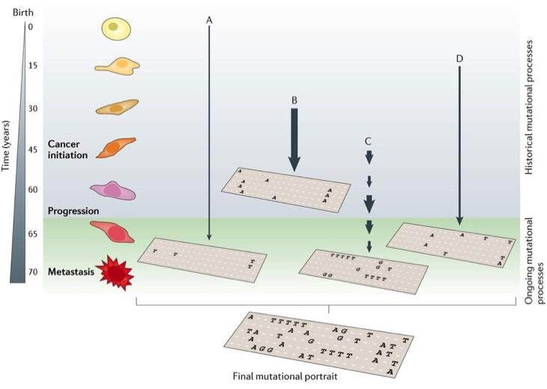
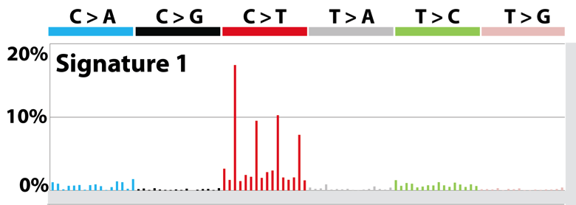
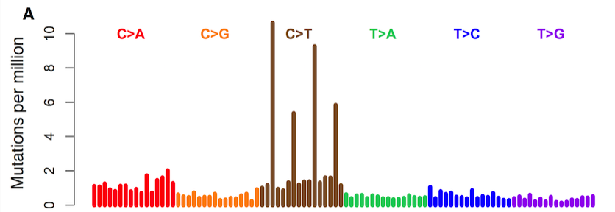
Mutational Context and Signatures
Mutation spectrum is further broken down to mutation signatures, which represent mutational processes
Mutation signature inferred
Mutation spectrum observed

Slide 21
De-convoluting functional impact and mutational signature
Differential functional impact explained by differences in signature contribution.

Slide 22
Let’s look at mutational process in pRCC closely

Slide 23
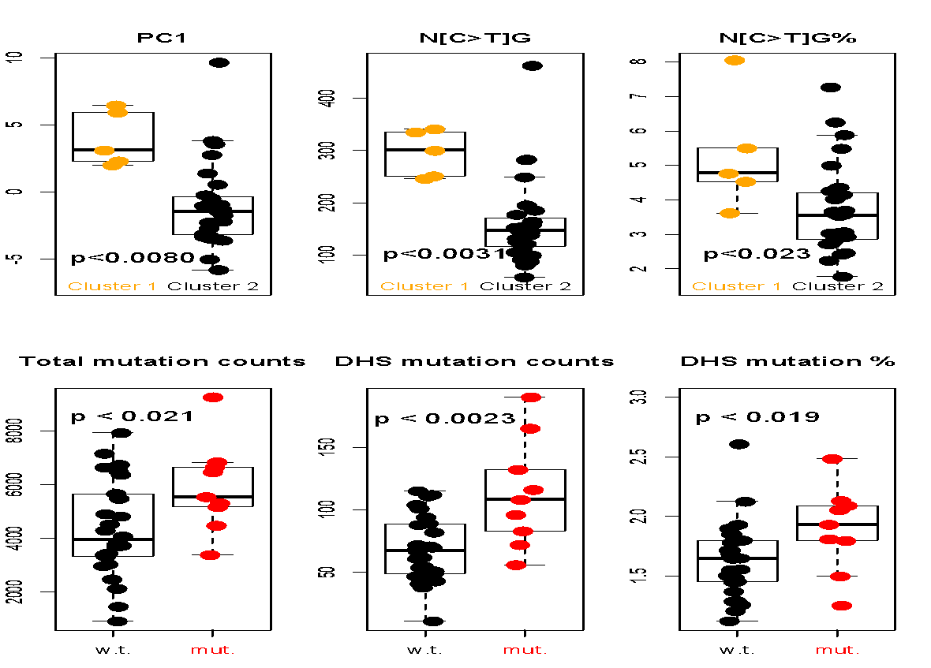
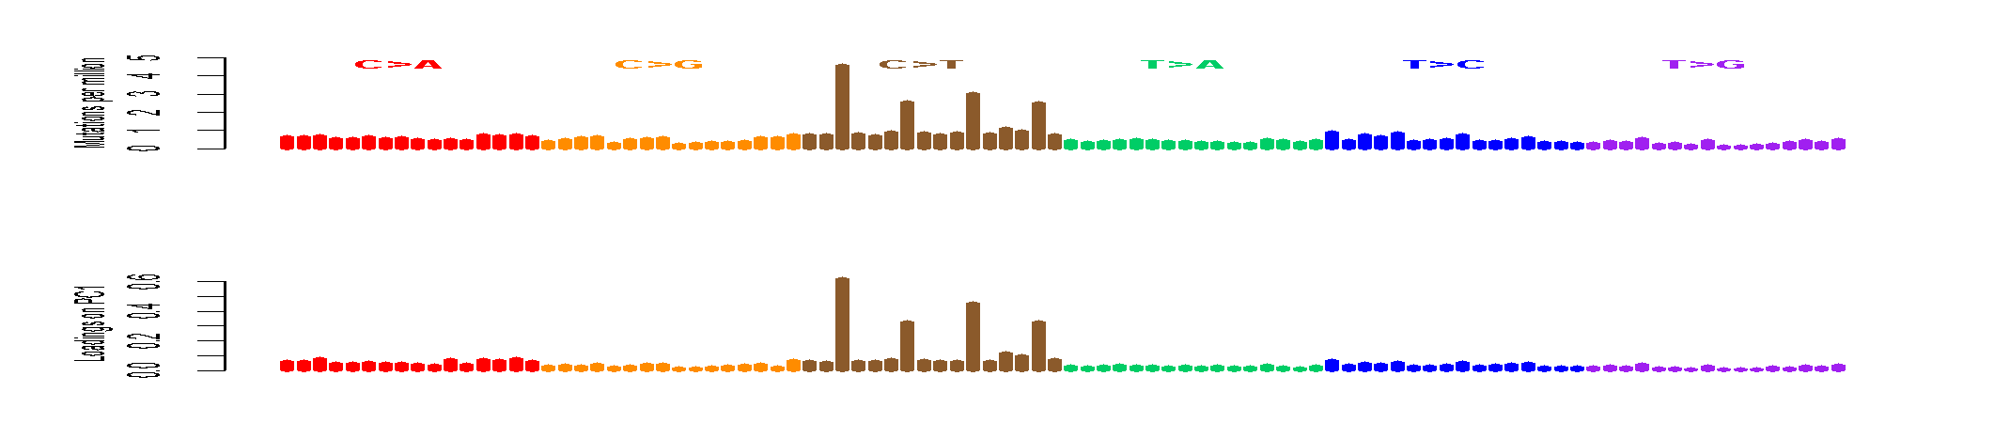
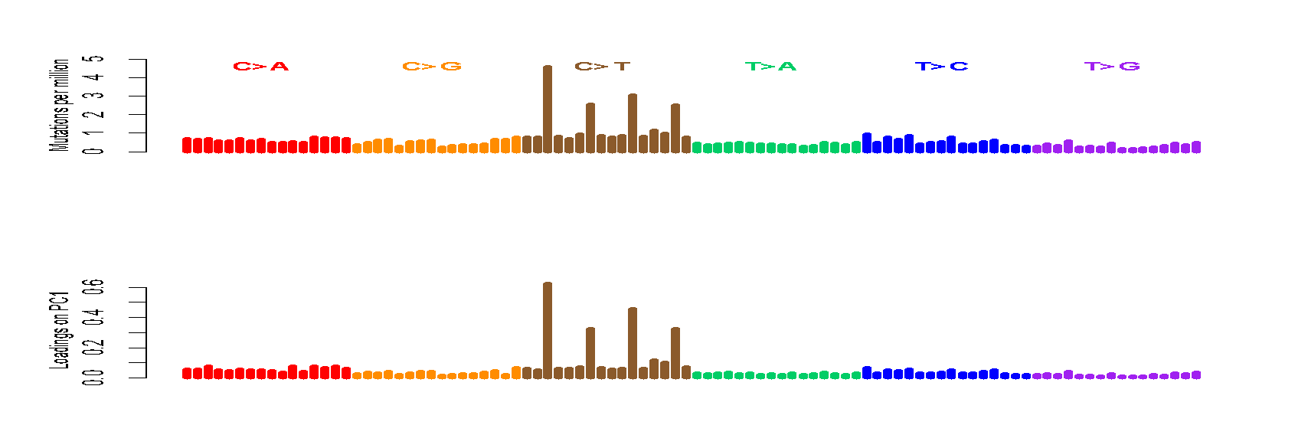
Now focusing kidney….CpGs Drive inter-patient variation
The Loading on PC1 is mostly [C>T]G
Confirmed by higher C>T% in CpGs in the hypermethylated group (cluster1)
A[C>T]G
G[C>T]G
C[C>T]G
T[C>T]G
S. Li, B. Shuch and M. Gerstein PLOS Genetics 2017

Slide 24
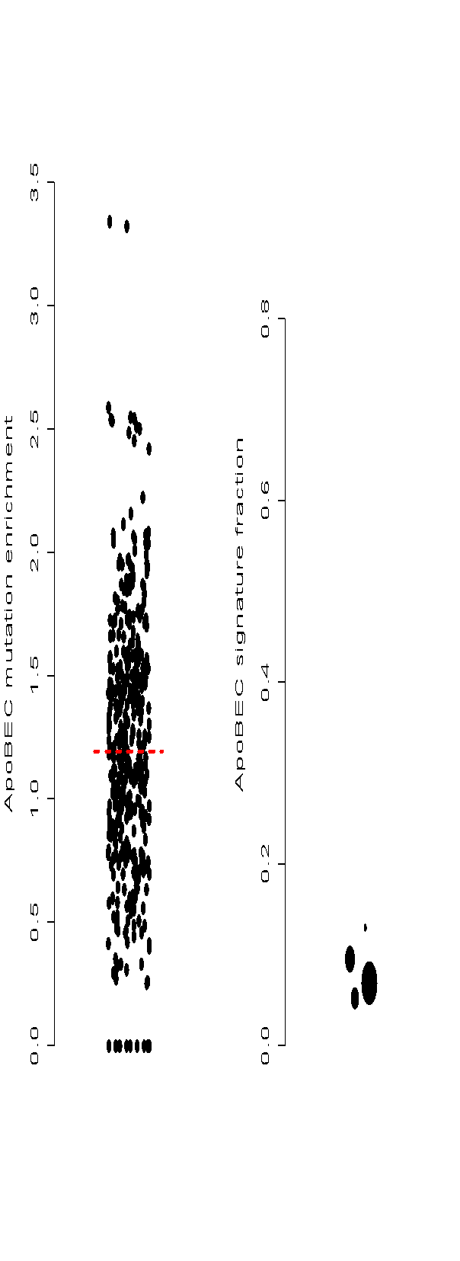


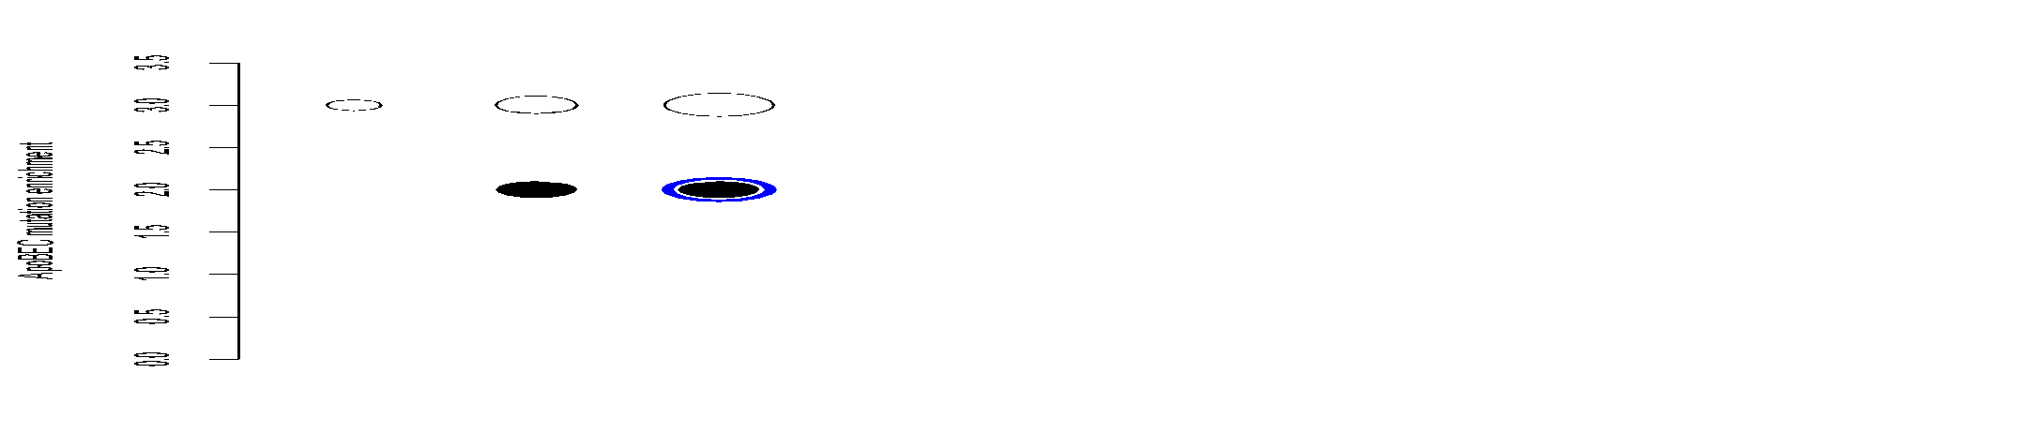
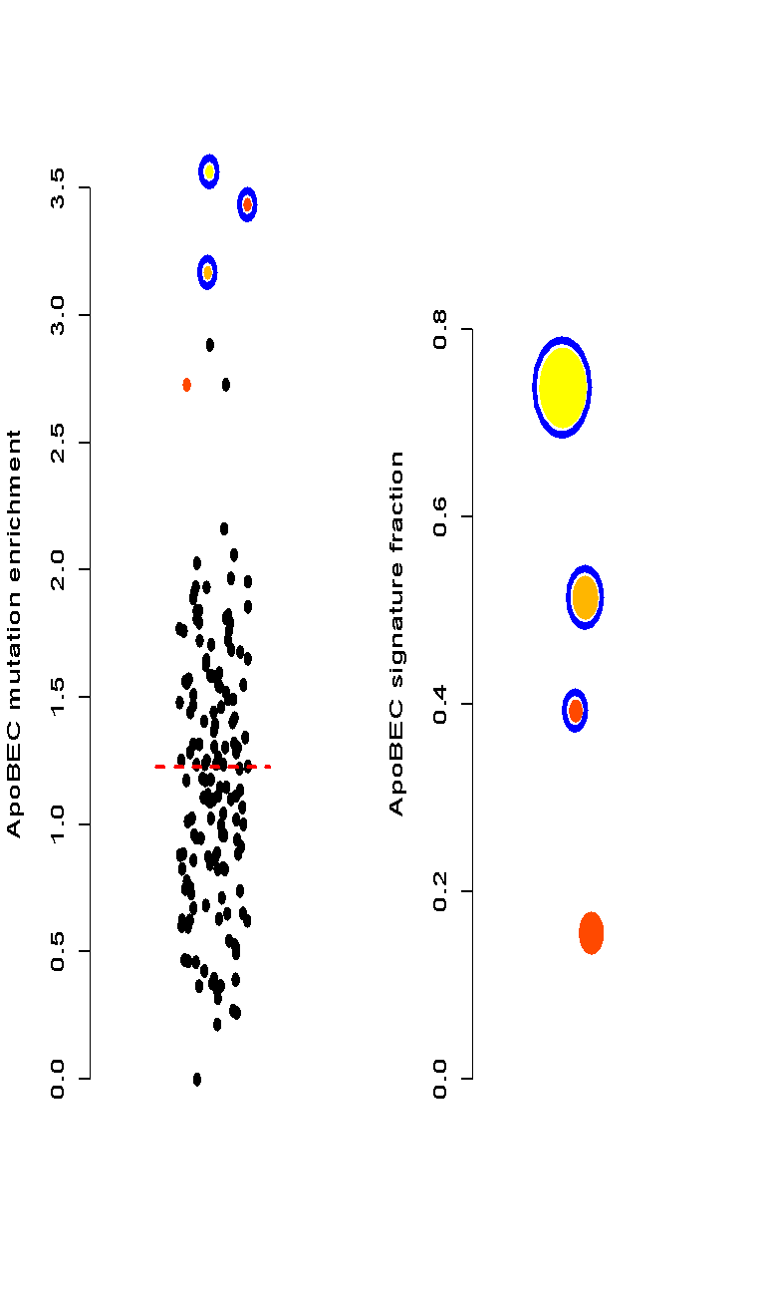

Discover ApoBEC Signature
enrichment
-log(p-value)
3.6
7.2
22
50
100
150
ApoBEC signature is observed
in chRCC but never in ccRCC.
We found a pRCC has ApoBEC
signature
Three samples that are urothelial
cancer (UC) but mislabeled
and processed through the
pipeline (internal positive controls)
RCC samples
total mutations
UC samples
pRCC & UC
ccRCC
S. Li, B. Shuch and M. Gerstein PLOS Genetics 2017

Slide 25

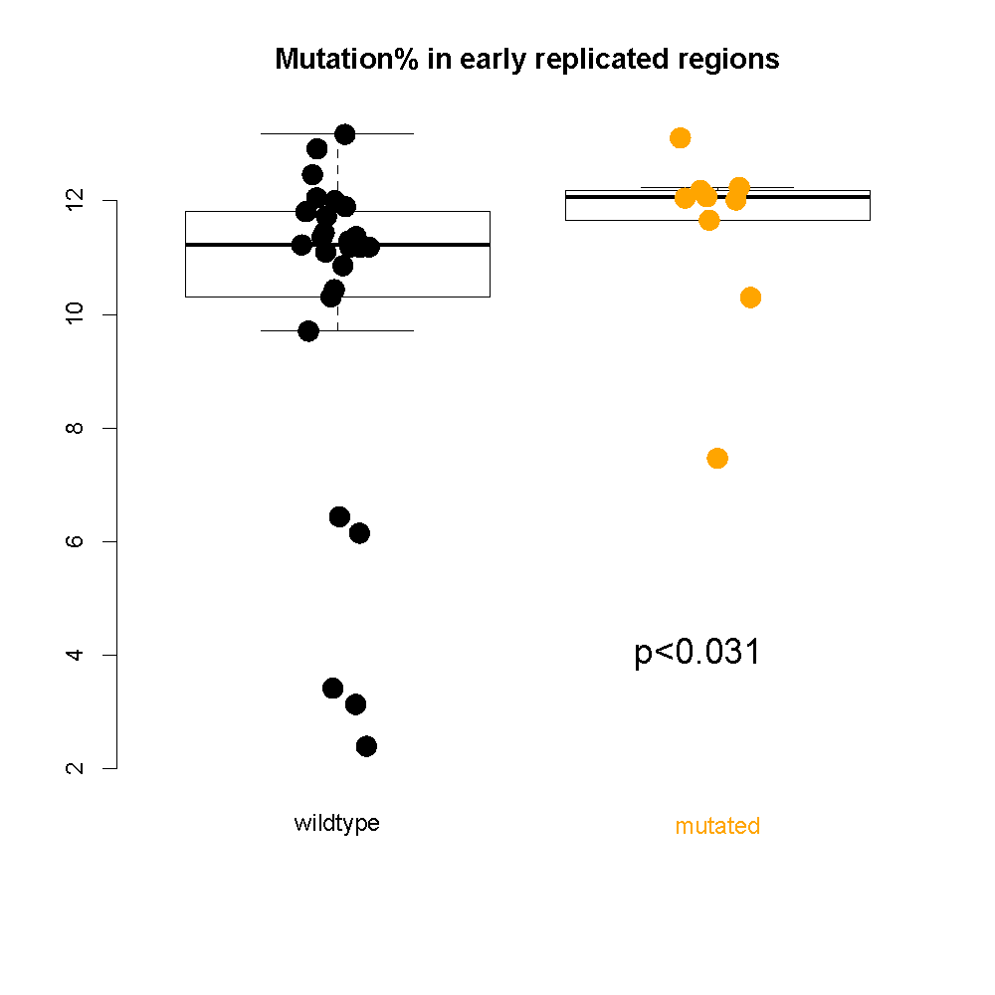
Chromatin remodeling failure changes mutational landscape
Samples with CR defect accumulate more mutations in open chromatin/early replicated regions; Interactions between mutational landscape and driver mutations.
S. Li, B. Shuch and M. Gerstein PLOS Genetics 2017

Slide 26
Mutational landscape change affects overall burden
Cancer

Slide 27
Early v late mutations in PCAWG

Slide 28

Sub-clonal architecture of nominal passengers in PCAWG
Overall enrichment and of nominal passenger variants among TSGs and depletion among oncogenes.

Slide 29
Correlating functional impact and prevalence of nominal passengers in PCAWG
Nominal passengers disrupting more conserved positions tend to have lower VAFs.

Slide 30
Additive variance to quantify aggregated effect of nominal passengers in PCAWG

Slide 31

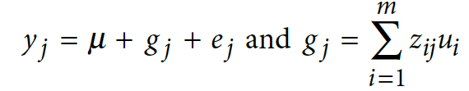


need better transition
Additive effects model to quantify cumulative effect of nominal passengers in PCAWG
Model for the effect of an individual SNP on a phenotype
Extension to model the combined effects of multiple SNPs
where: y=phenotype; x_ij is the ’genetic dosage’ of the i’th SNP in individual j, taking values {0,1}; a_i is the fixed effect size of SNP i, and e_j is the residual effect
where: z_ij is a ‘normalized genetic dosage’, i.e. the z-score of x_ij; u_i is the effect
size of SNP i treated as a random variable; g_j is the combined effect of all SNPs for individual j

Slide 32
Additive variance for multiple cancer cohorts in PCAWG

