Slide 1
ENCodec: a companion encyclopedia in ENCODE for cancer research
Jing Zhang
Gerstein Lab
MB&B, Yale

Slide 2
Outline
Introduction to EN-codec resource
Multi-level integration from ENCODE benefits mutation burden analysis
  Raw signal level integration
  Annotation level integration
Interpreting transcriptional level regulatory changes through network rewiring analysis
  Quantification of regulatory changes
  Effect of highly rewired TFs in cancer
Integrating regulatory networks with tumor expression profiles identifies key regulators in cancer
  Identification of key regulators that driver T/N differential expression
  Investigating the cooperation pattern between key regulators
Variant prioritization scheme and small scale validations

Slide 3
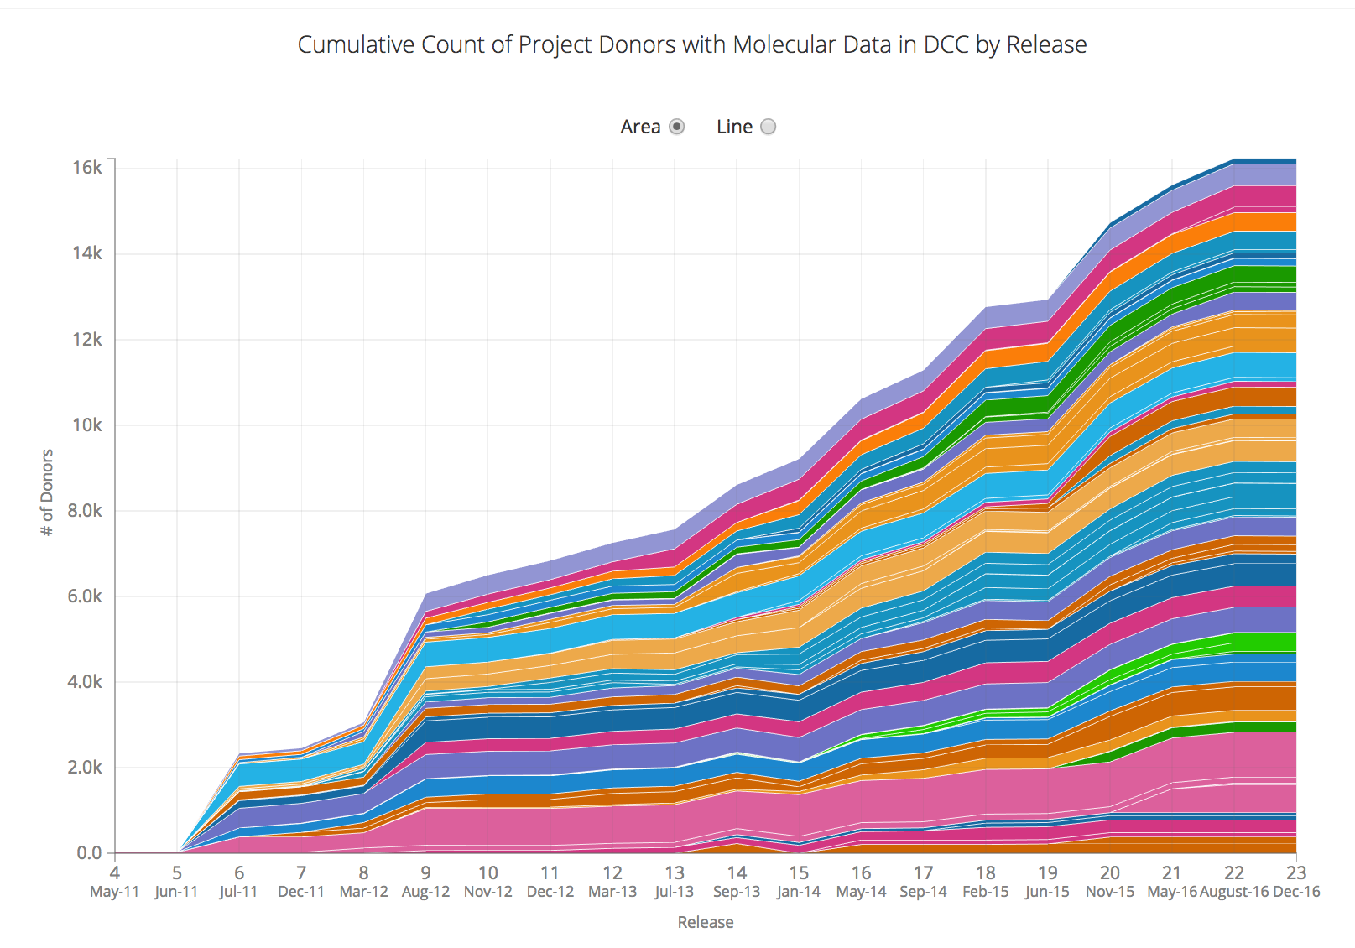
Efforts to interpret cancer genomes
Tens of thousands of patient data released
Thousands of whole genome sequencing
Millions of mutations
Tens of thousands of tumor and/or normal expression profiling
Tens of thousands of patient survival data
…
Our understanding of the genome
Focused on hundreds of cancer associated genes
Annotation of 20k genes, 1-2% of genome
Limited knowledge of non-coding regulatory regions
…
How to interpret the “dark” part of cancer genomes?
http://ncg.kcl.ac.uk/ncg4/statistics.php

Slide 4
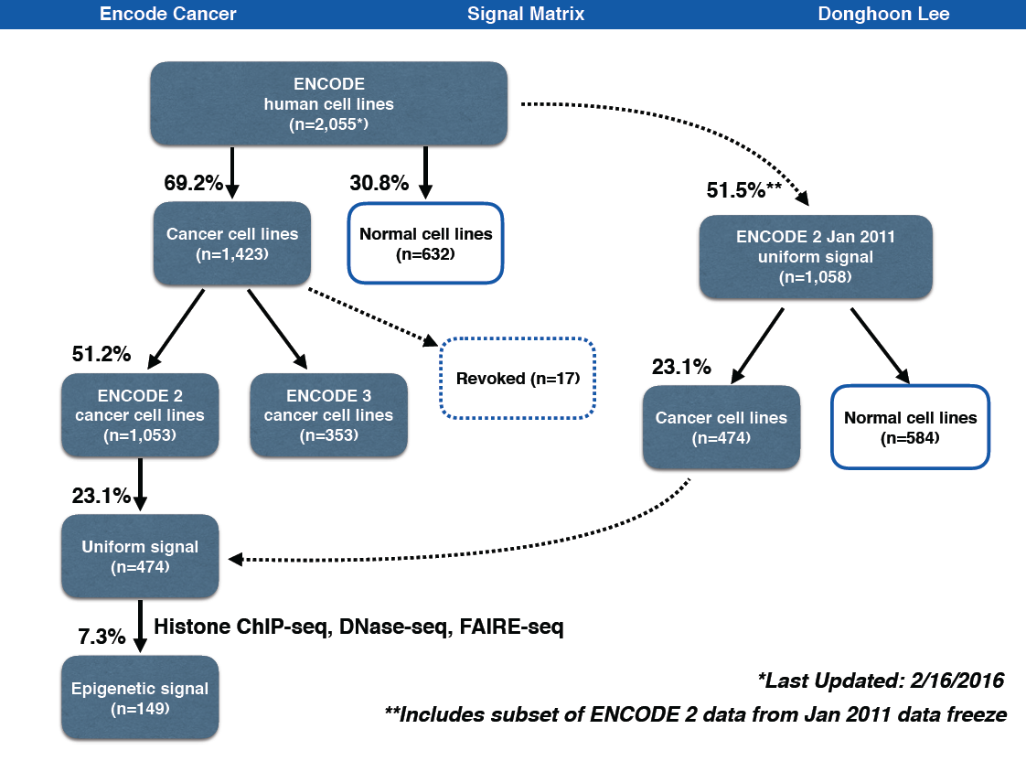
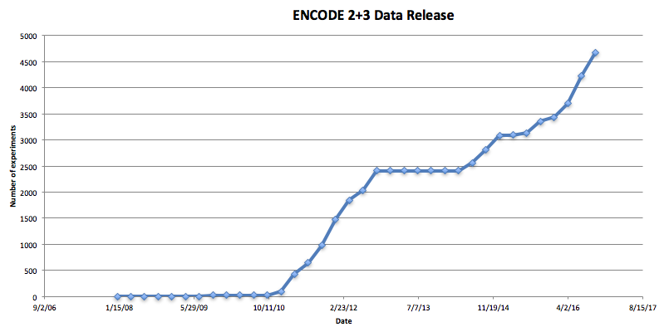
The majority of ENCODE cell lines are cancerous
Broad spectrum of cell types
Dataset almost doubled in ENCODE3 as compared with ENCODE2
~69% of cell types in ENCODE are cancerous
Several top tier cell lines are enriched with various types of assays
Many new experimental assays in top tier cell lines to help genome functional characterization

Slide 5
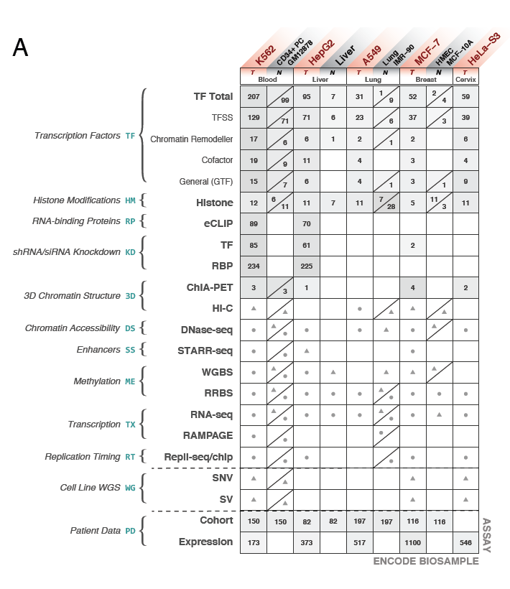
En-Codec: a companion encyclopedia in ENCODE for cancer research
Data enriched cell types
Cell_Type | Biosample type | Total assays
K562 | immortalized cell line | 680
HepG2 | immortalized cell line | 356
GM12878 | immortalized cell line | 281
K562 RNAi | immortalized cell line | 276
HepG2 RNAi | immortalized cell line | 230
MCF-7 | immortalized cell line | 162
HEK293 | immortalized cell line | 153
H1-hESC | stem cell | 131
HeLa-S3 | immortalized cell line | 129
SK-N-SH | immortalized cell line | 79
A549 | immortalized cell line | 78
endothelial cell of umbilical vein | primary cell | 59
keratinocyte | primary cell | 53
HCT116 | immortalized cell line | 49
IMR-90 | primary cell | 46
fibroblast of lung | primary cell | 42
A549 ethanol | immortalized cell line | 40
liver | tissue | 37
foreskin fibroblast | primary cell | 31
mammary epithelial cell | primary cell | 31

Slide 6
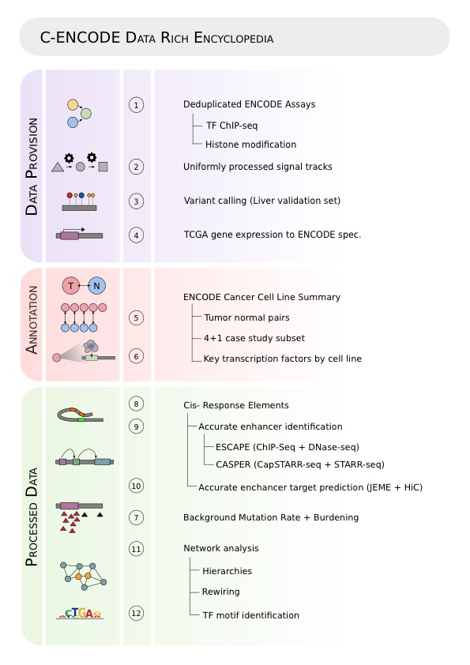
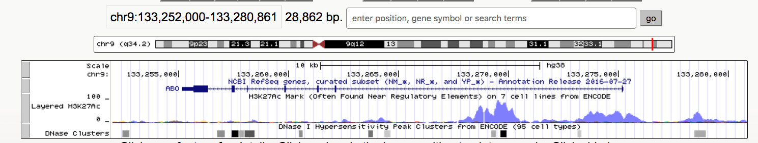
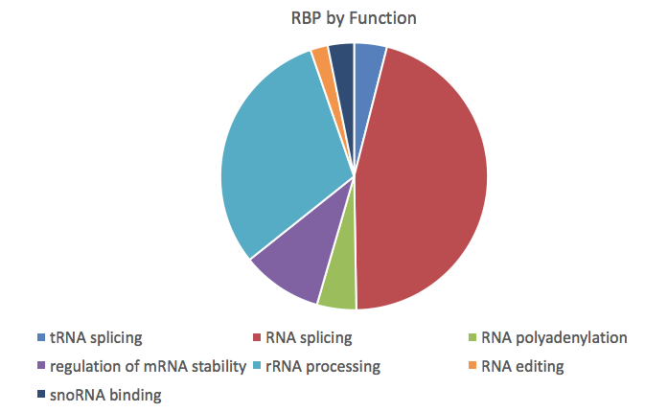
En-Codec: Structure of the resource
Cancer | Abbr. | Tumor | Normal
Breast | BRCA | MCF-7 | MCF-10A
Liver | LIHC | HepG2 | Liver
Lung | LUAD | A549 | IMR-90
Blood | CML[ CLL/AML] | K562 | GM12878
Cervix | CESC | HeLa-S3 | NA

Slide 7
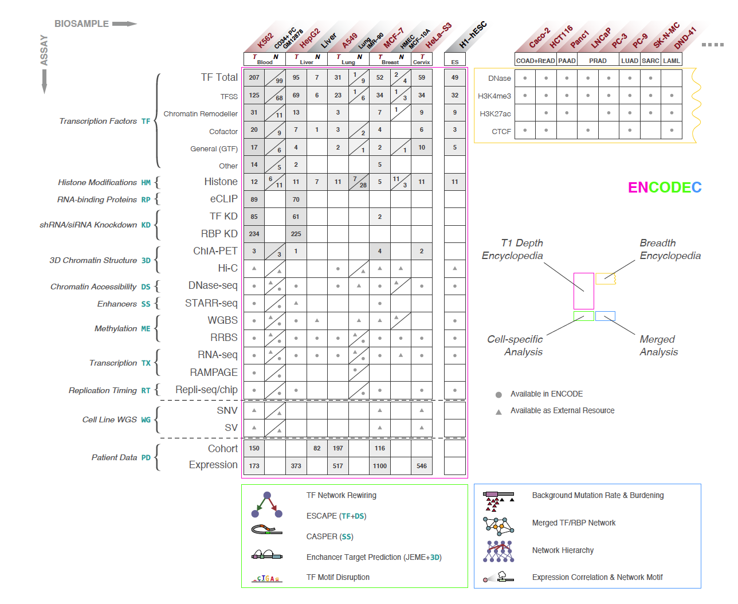

Slide 8
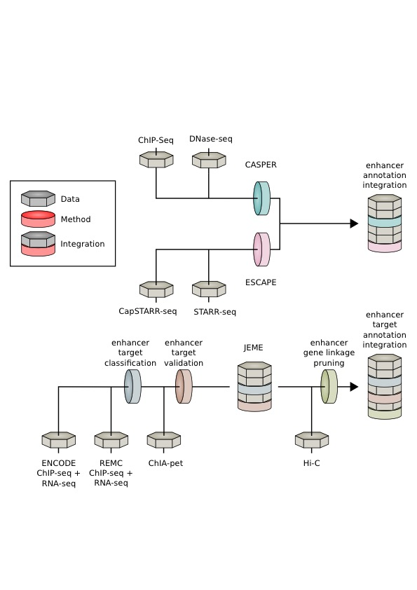
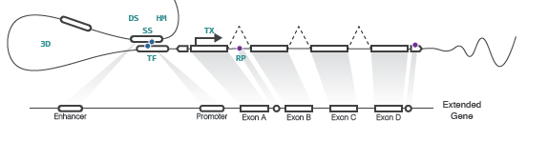
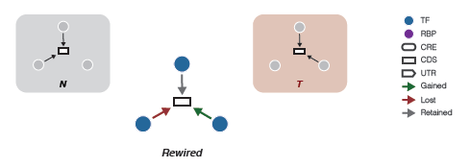
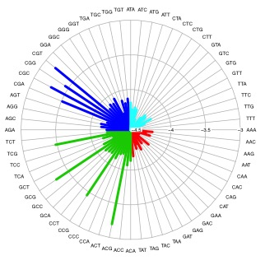
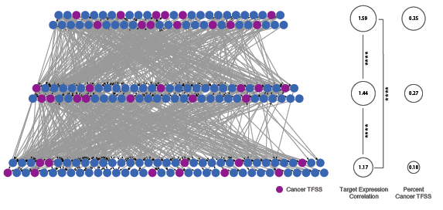
En-Codec: a cancer encyclopedia resource from ENCODE
Enhancer & target prediction
Extended gene neighborhood
Regulatory Network
Network rewiring
Network hierarchy
BMR
Regulation power

Slide 9
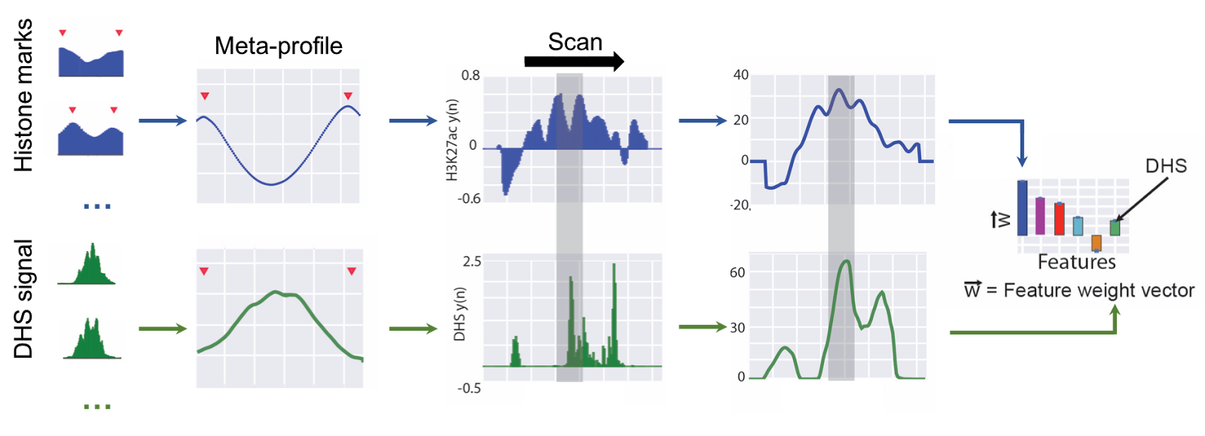
ESCAPE+CASPER: integrative approach for enhancer prediction
intersection
High confidence enhancers in different cell types

Slide 10
Outline
Introduction to EN-codec resource
Multi-level integration from ENCODE benefits mutation burden analysis
  Raw signal level integration
  Annotation level integration
Interpreting transcriptional level regulatory changes through network rewiring analysis
  Quantification of regulatory changes
  Effect of highly rewired TFs in cancer
Integrating regulatory networks with tumor expression profiles identifies key regulators in cancer
  Identification of key regulators that driver T/N differential expression
  Investigating the cooperation pattern between key regulators
Variant prioritization scheme and small scale validations

Slide 11
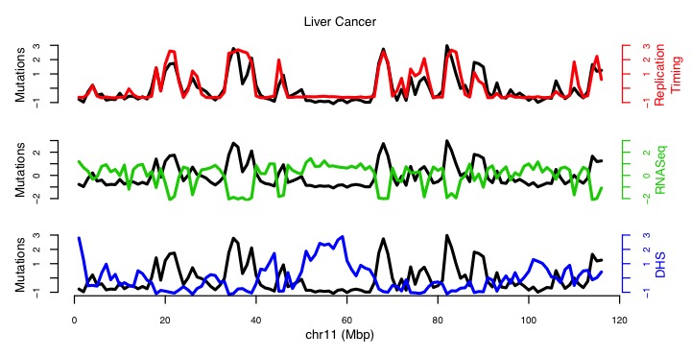
Multi-level data integration better enables recurrent variant analysis
How to evaluate the somatic mutation burden in cancer?
Background mutation rate (BMR) modeling
mutational heterogeneity control
Internal effects
External effects

Slide 12
  Raw signal level integration enables accurate BMR modeling
Many features are correlated with BMR
 | Bin | All | Mutated
GCT | 1Mb | 3000 | 15

Slide 13

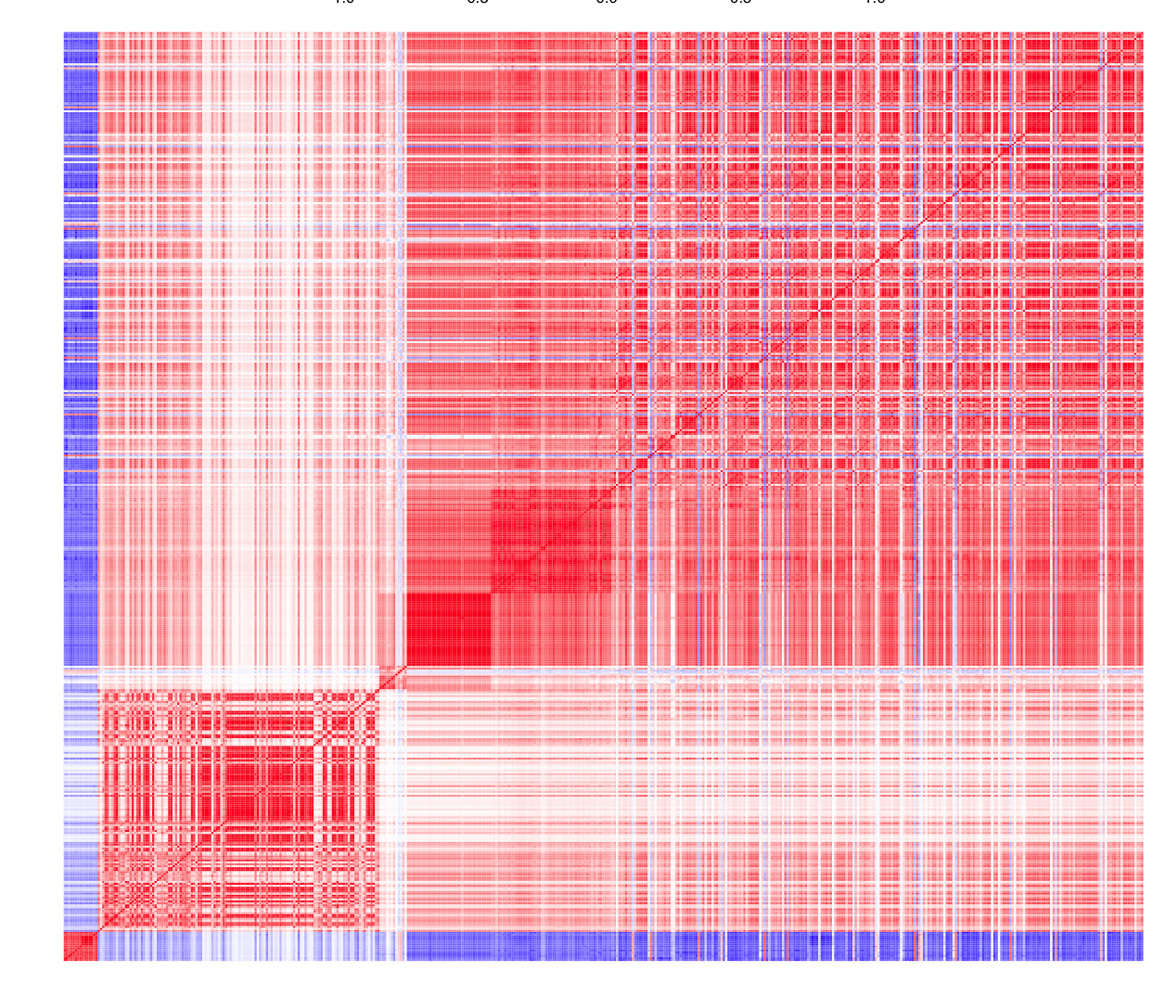
Performance in four different cancer types
Correlation Heatmap of 1mb bins of features

Slide 14
How to improve BMR estimation accuracy
  Use matched tissue data
  Combine more features
  Detect overdispersion and correct if necessary

Slide 15
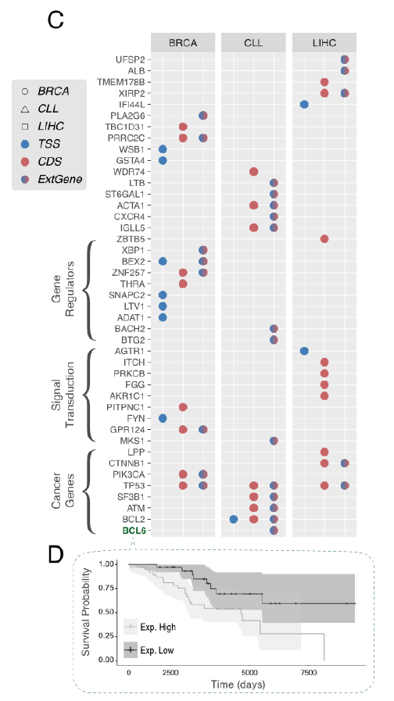
Annotation level integration in mutation burden analysis
Extended gene neighborhood
Picks up distributed mutation signals from multiple regions
Benefits variant impact interpretation
Discovers genes (BCL6) with prognostic value but missed by CDS analysis

Slide 16
Outline
Introduction to EN-codec resource
Multi-level integration from ENCODE benefits mutation burden analysis
  Raw signal level integration
  Annotation level integration
Interpreting transcriptional level regulatory changes through network rewiring analysis
  Quantification of regulatory changes
  Effect of highly rewired TFs in cancer
Integrating regulatory networks with tumor expression profiles identifies key regulators in cancer
  Identification of key regulators that driver T/N differential expression
  Investigating the cooperation pattern between key regulators
Variant prioritization scheme and small scale validations

Slide 17
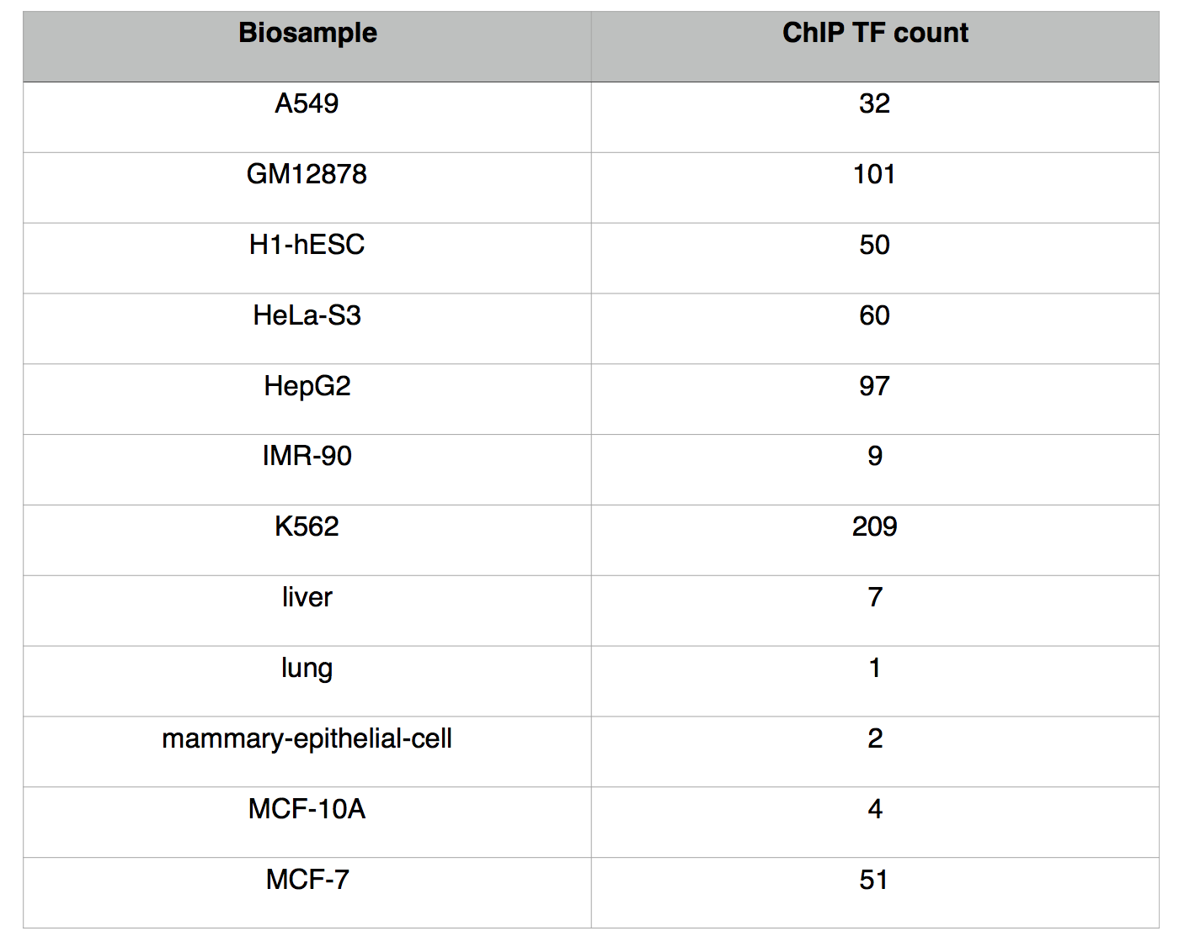
Cell Types specific network analysis helps to pinpoint regulation changes

Slide 18
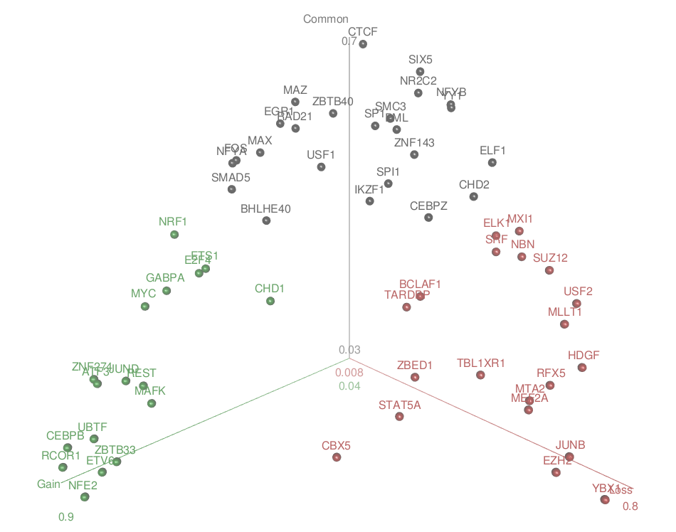
TF network rewiring schematic
Kmeans clustering of TFs according to percentage of gain/loss edges
NFE2 and RCOR1 were identified as one of the strongest member of gained group,
CTCF was identified as a member of common group
YBX1 was identified as a member of loss group

Slide 19
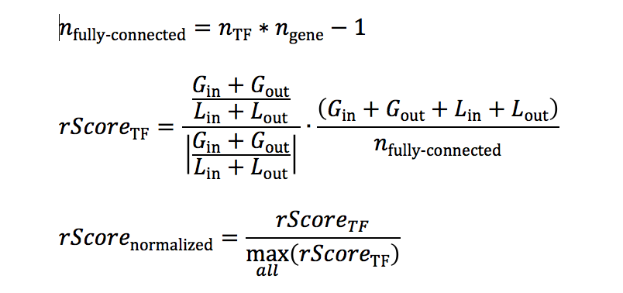
Direct Rewiring Index:
potential of loss and gain edges when transiting from tumor to normal cells
Gene community based Rewiring score:
Difference of linkages to different gene communities in T/N cells

Slide 20
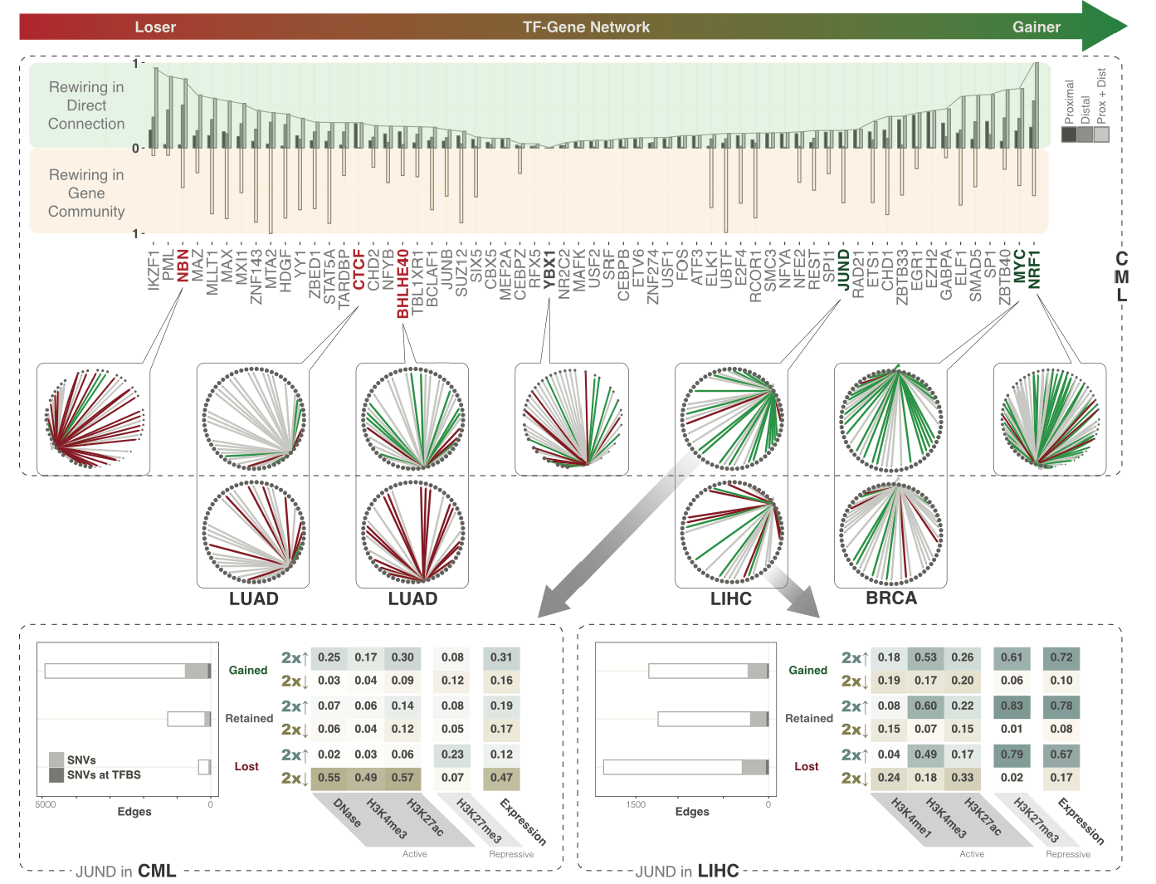
Direct Rewiring index
Gene community based
rewiring index

Slide 21
Outline
Introduction to EN-codec resource
Multi-level integration from ENCODE benefits mutation burden analysis
  Raw signal level integration
  Annotation level integration
Interpreting transcriptional level regulatory changes through network rewiring analysis
  Quantification of regulatory changes
  Effect of highly rewired TFs in cancer
Integrating regulatory networks with tumor expression profiles identifies key regulators in cancer
  Identification of key regulators that driver T/N differential expression
  Investigating the cooperation pattern between key regulators
Variant prioritization scheme and small scale validations

Slide 22
Pinpoint Key Regulators through generalized network analysis
Top tier TFs are slightly enriched with more cancer associated TFs
Top tier TFs demonstrates stronger regulation power in cancer genomes

Slide 23
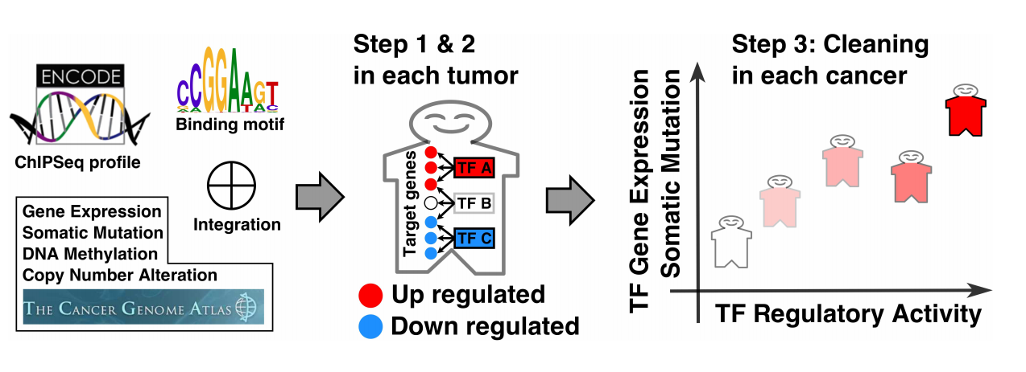
Pinpoint Key Regulators through generalized network analysis
TF regulation Score
Gene Expression
Modeling regulation potential of regulator-gene pair
regulation score, not the expression level of TF1 to gene 1
Run a regression on each patient
Do model selection for TFs using forward selection
Use t value of the final model to measure significance
Summarize the percentage of patients with significant correlation

Slide 24
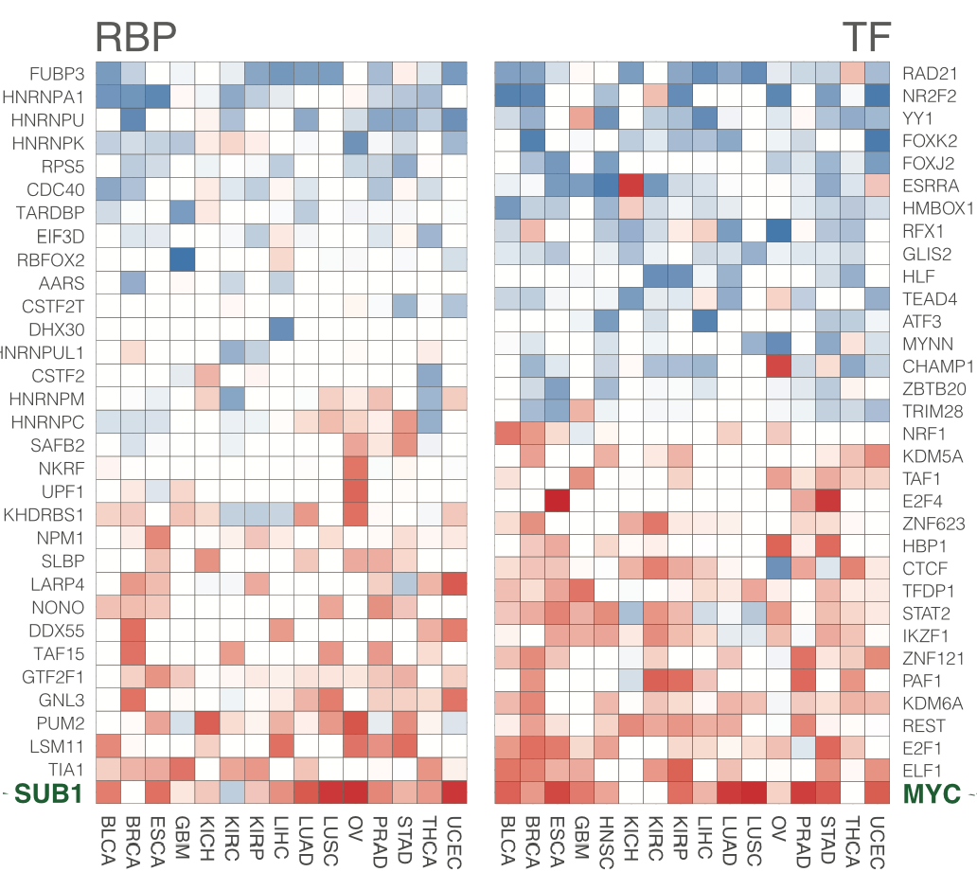
Enriched with down-regulated targets
RBP regulation score
3’ UTR
Enriched with up-regulated targets

Slide 25
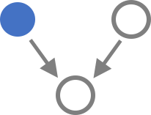
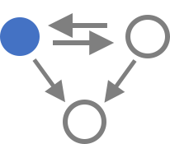
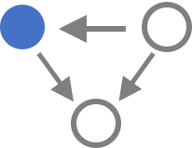
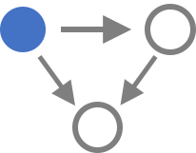
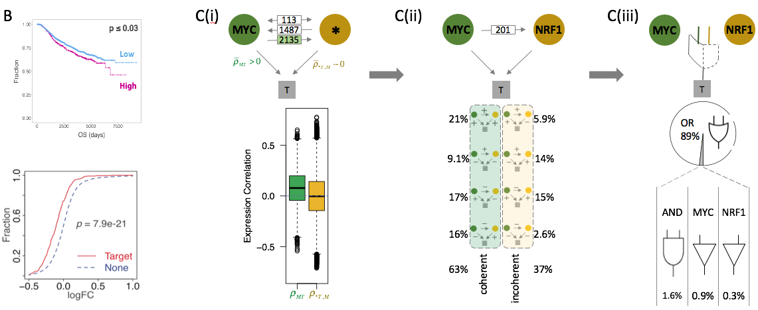
Investigating How MYC work with others regulators
Other TF | 212 | 2 | 14 | 38
Triplet | 10574 | 113 | 1487 | 2135

Slide 26
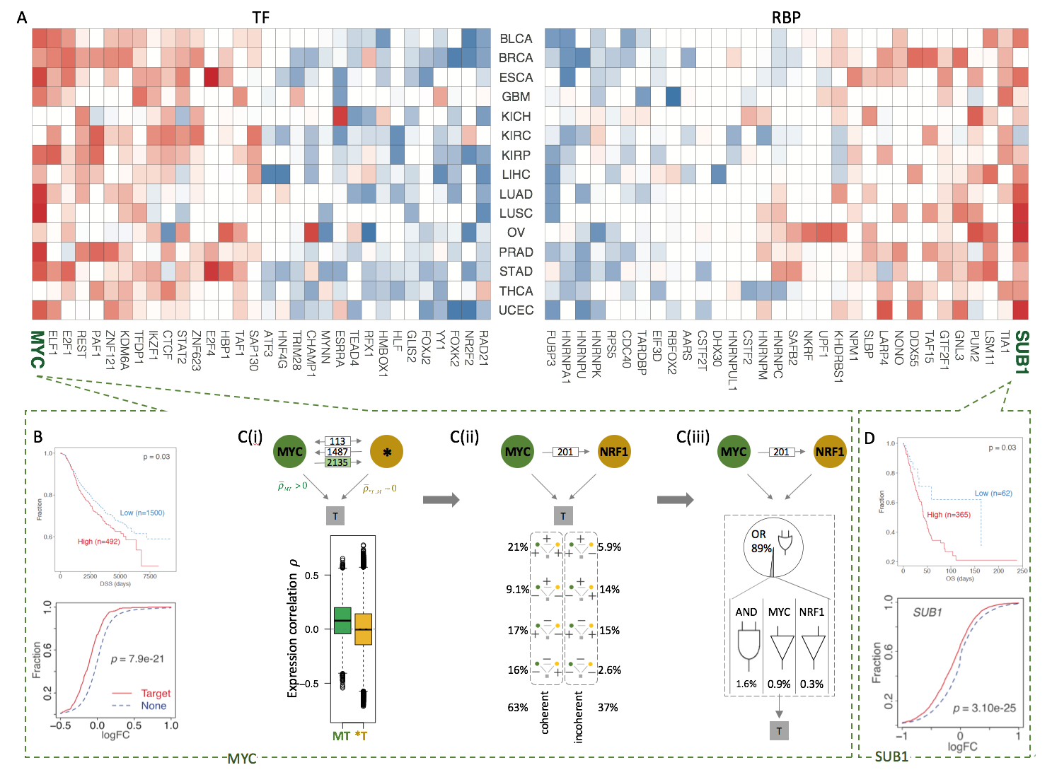

Slide 27
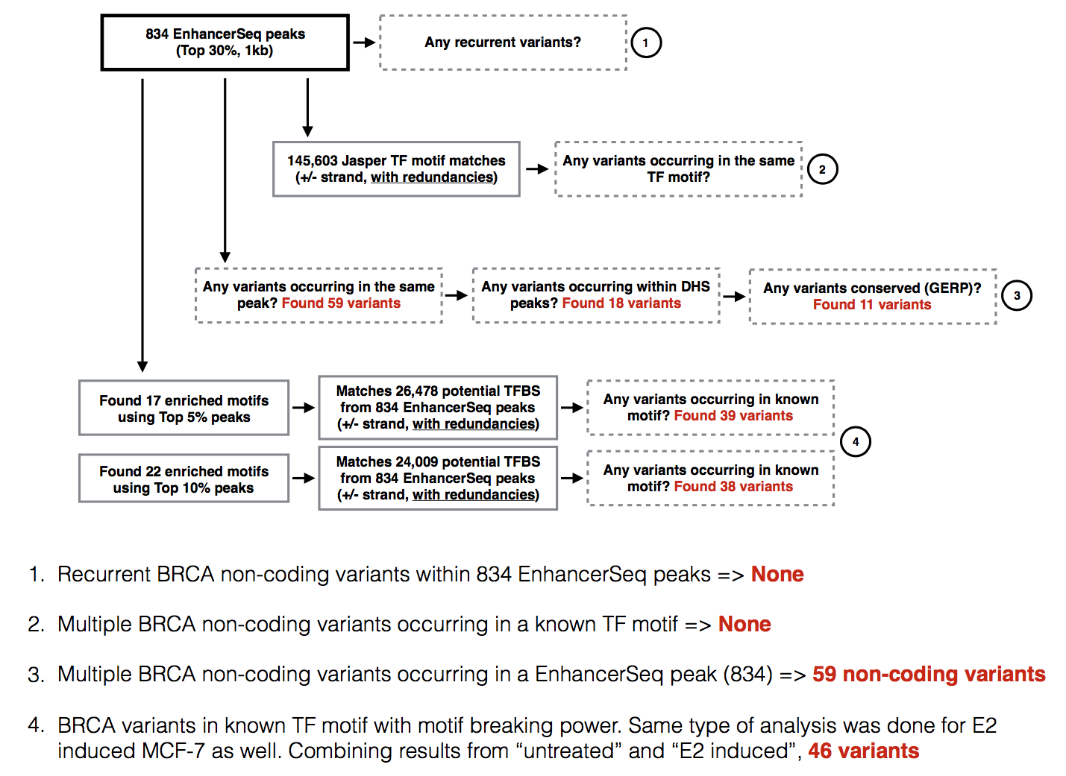
Variant prioritization
Variant Validation
SAMPLE | CHR | POS | REF | ALT | TEST_START | TEST_END
Sample01 | chr16 | 85604242 | C | G | 85603992 | 85604491
Sample02 | chr21 | 27541982 | G | A | 27541732 | 27542231
Sample03 | chr8 | 21541726 | A | G | 21541476 | 21541975
Sample04 | chr17 | 38474408 | C | G | 38474158 | 38474657
Sample05 | chr20 | 43971343 | G | C | 43971093 | 43971592
Sample06 | chr7 | 1598567 | C | T | 1598317 | 1598816
Sample07 | chr20 | 58563412 | C | T | 58563162 | 58563661
Sample08 | chr7 | 150759483 | C | G | 150759233 | 150759732
Sample09 | chr7 | 5596005 | T | G | 5595755 | 5596254
Sample10 | chr6 | 134700462 | G | T | 134700212 | 134700711

Slide 28
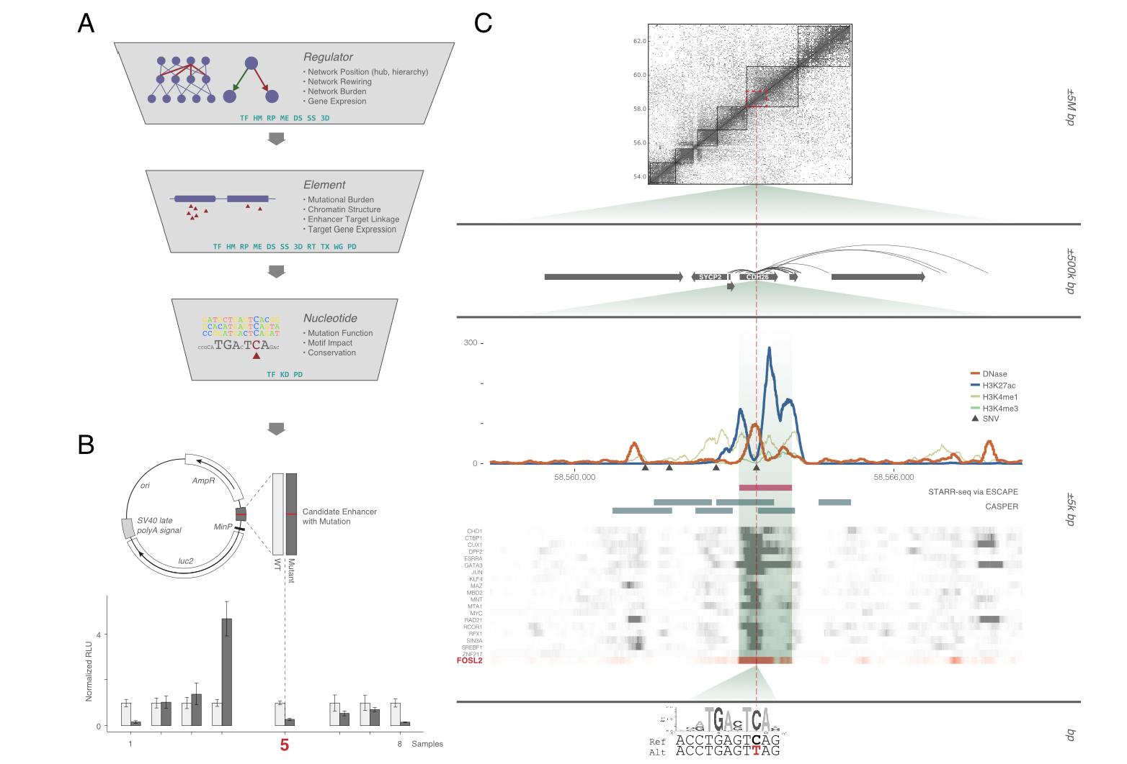

Slide 29
Summary of resource in ENCodec for cancer research
Raw Data | Signal tracks from de-duplicated ChIP-seq, Dnase-seq, Repli-seq, RNA-seq, WGBS data
 | Germline/somatic variant calls from liver cancer patients
 | SNV/SV calls for several top tier cell lines
 | Annotation of TFs and RBPs
 | Tumor-normal pairs of cell types of many cancer types
Annotation | Cell type specific promoter usage
 | Enhancer predictions and gene linkages
 | TF & RBP network – cell type specific and generalized
 | Extended gene neighborhood
Software | Motiftool: motif gain/loss events events
 | NIMBus: mutation burden analysis tool
 | ESCAPE + Casper: enhancer prediction based on ChIP-seq, Dnase-seq and STARR-seq
 | JEME: enhancer target prediction
 | Vinas: variant impact on cancer genome analysis tool
Analysis-release | Network hierarchies
 | Estimated BMR in various cancer types
 | TF rewiring status
 | TF/RBP regulation power in T/N cell types
 | regulatory status changes per gene
 | burdened elements

Slide 30


Acknowledgement
Mark Gerstein
Donghoon Lee
Lucas Lochovsky, Jason Liu, Yanlin Feng
Joel Rozowsky, Shaoke Lou – ChIP-seq
Arif Harmanci, Mengting Gu, Koon-Kiu Yan, Anurag Sethi – Enhancer
William Meyerson, Patrick Mcgillivray, Xiaotong Li – Survival analysis and T/N pairing
Gamze Gursoy, Daifeng Wang – loregic
Variation group!
Kevin White Lab

Slide 31
Discussion

Slide 32
Ultimate question: a cancer cell is going through a more differentiated way or un-differentiated
K562
Differentiated direction:
1
Un-Differentiated direction:
2
3
4
5
6
7
H1
GM12878

Slide 33
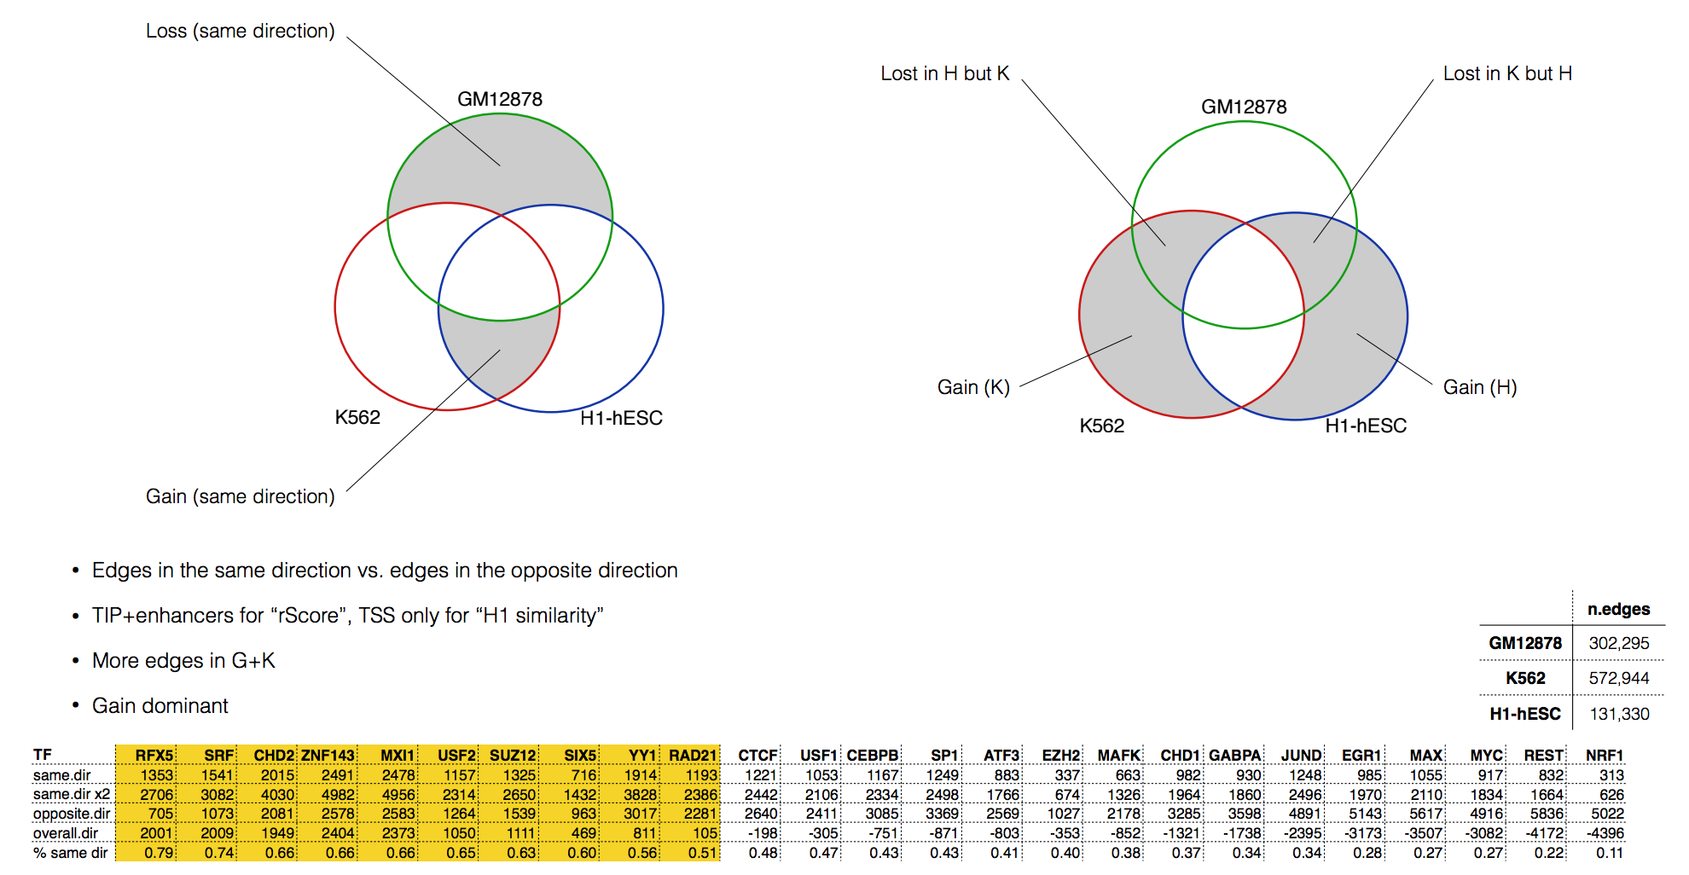

Slide 34
