Slide 1
Analysis methods for RNA chemical probing
Michael Rutenberg Schoenberg
jclub
9 Oct 2017

Slide 2
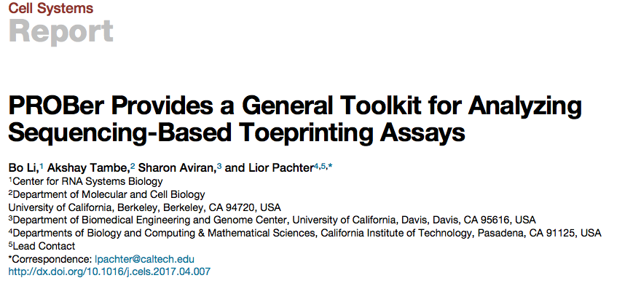
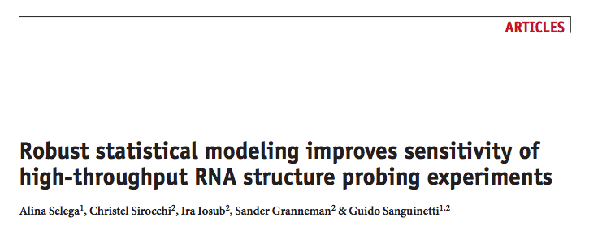

Slide 3

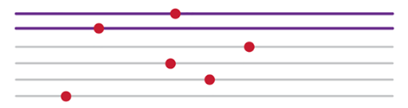
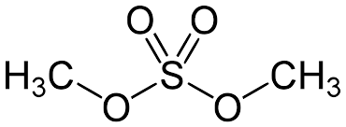
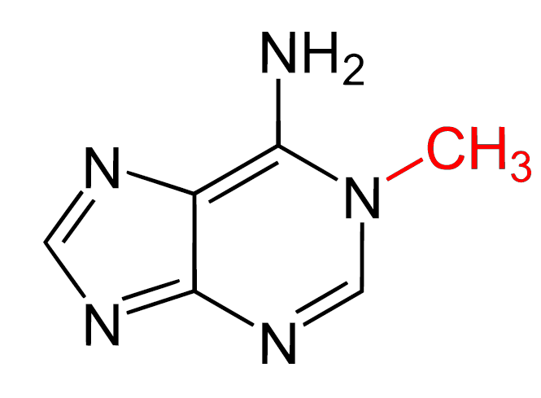

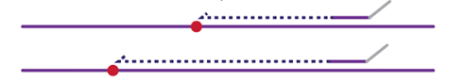
Chemical probing of RNA
Chemically modify RNA
  Usually unstructured nucleotides are modifiable
Read out with reverse transcriptase
Stops & Mutations
Chemically modify RNA
DMS
Read out with Reverse Transcriptase
1-methyladenine
Stops
Mutations
(SHAPE-MaP)
mutation
Reviewed in Kubota et al Nat Chem Biol 2016
Siegfried et al. Nat Methods 2014
Notes:
DMS – methylates the Watson-Crick face of A,C
1M7 (SHAPE reagent) – acylate flexible 2’ OH in the ribose sugar
Hi, I’m Michael – I try to do experiments and actually do computational analysis in the Simon and Gerstein labs.
Let’s say that you like RNA and you want to find nucleotides that have a funky property. You might design (or use) a chemical that reacts specifically with it. This is chemical probing. To see if your special property is there, you need
But is the funky property there? That requires statistical anlaysis, and that’s what I do.

Slide 4
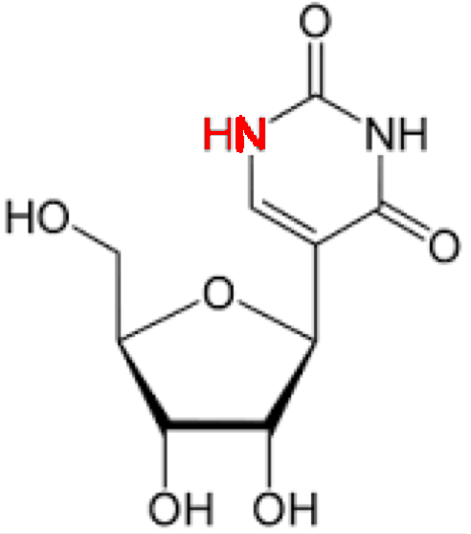
Chemical probing reveals diverse RNA properties at nucleotide resolution
Protein-RNA interactions
Structural context
∆SHAPE
SHAPE
DMS
Other reagents
Smola et al. Biochemistry 2015
Smola et al. PNAS 2016
Weeks, Weissman, Rouskin, Bevilacqua,
Assmann, other groups
Nucleotide modifications
CMC + reversal: pseudoU
NaIO₄: 2’-O-methylation
Cyanoethylation: Inosine
Carlile et al. Nature 2014
Dai et al. Nat Meth 2017
Zhu et al. RNA 2017
Reviewed in Kubota et al. Nat Chem Biol 2016

Slide 5
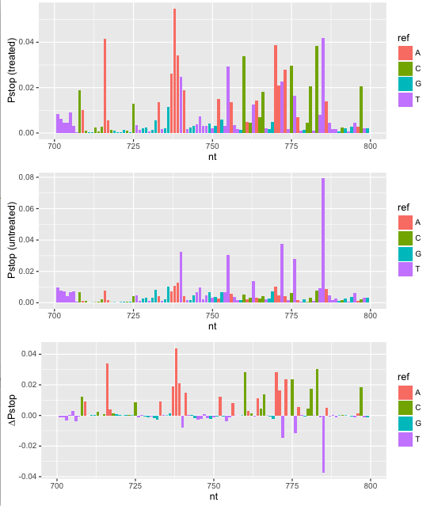
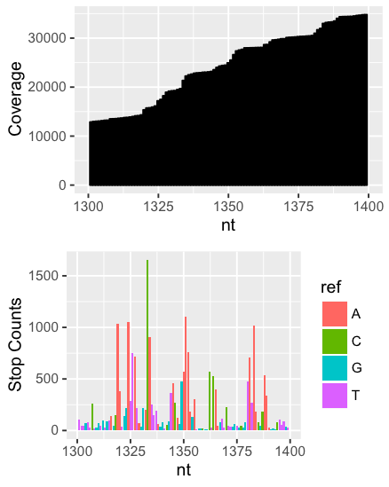
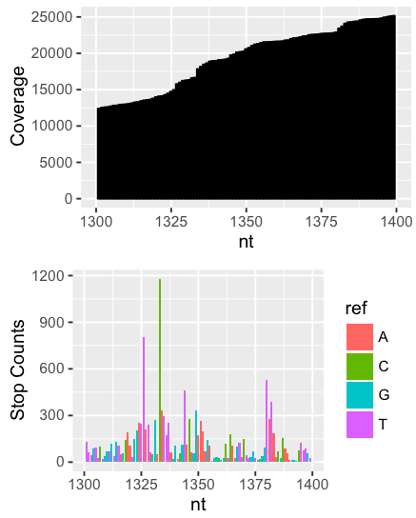
Naïve inference of chemical probing reactivity
i∈nucleotides; N total
P_{stop}(i) = stops(i)/coverage(i)
P_{stop-treatment}(i) = P_{stop}(treated) - P_{stop}(control)/(1-P_{stop}(control))
DMS-Seq data for Xist RNA
A and C should be modified
Treated
Control
Combined
Fang, Moss et al. PLoS Genet. 2015, Aviran and Pachter 2011
Notes:
Fang, Moss et al. PLoS Genet. 2015

Slide 6
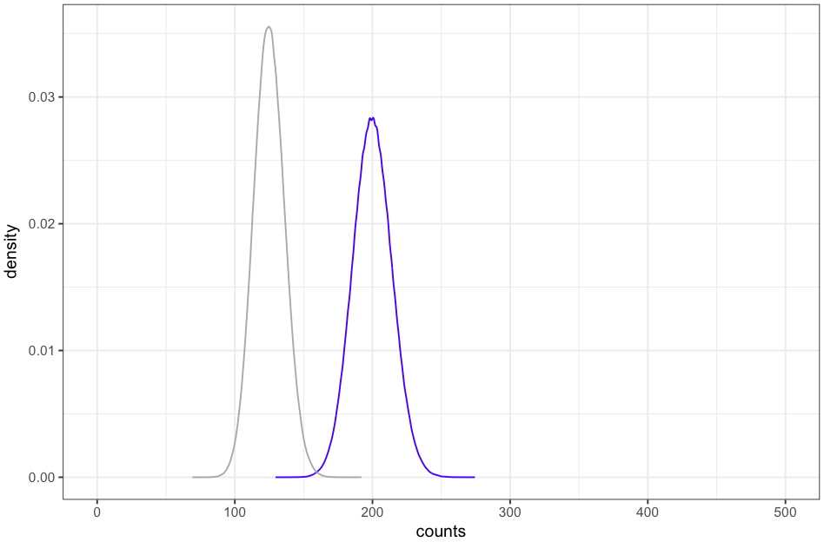
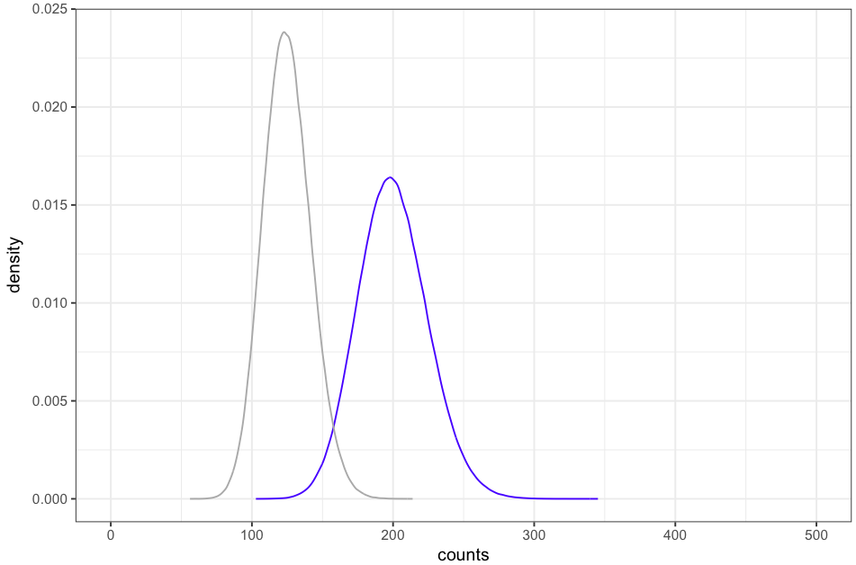
Modeling methods
Compare distributions of treated vs. control at the count level (me)
Estimate best value for probability of stopping due to treatment (reactivity), given experimental biases
Uniform statistical process
Overdispersed
treated
vs.
control

Slide 8
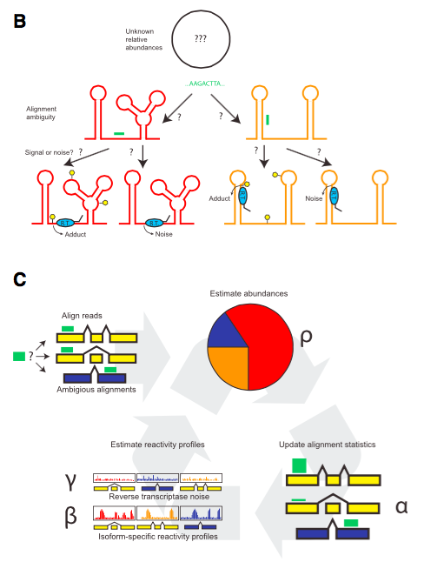

Slide 9
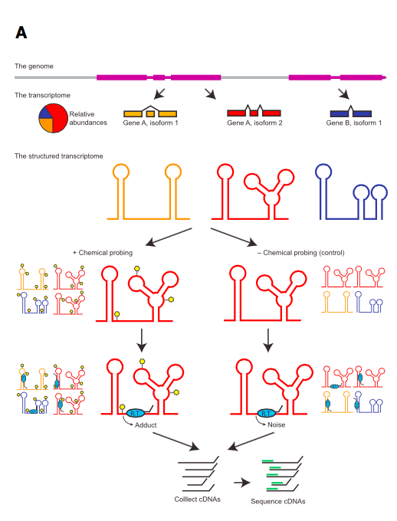
Basic idea:
Reads map ambiguously to different transcripts.
To determine stop rates at each nucleotide, it is better to jointly estimate stop rate and transcript abundance.
Li et al. Cell Systems 2017

Slide 10
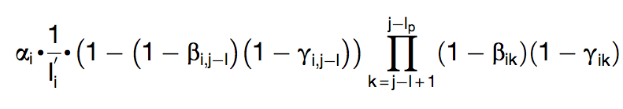
Generative model
i – transcripts
k – position within transcript
α_{i} – rate of production of reads from transcript, given abundance & length
β_{ik} – probability of dropoff due to chemical treatment at nucleotide k in transcript i
γ_{ik} – background probability of dropoff at nucleotide k in transcript i
I_{i} – number of priming sites for transcript i
j – priming site within transcript
Prob(read) =
Probaility of stopping at nucleotide
Probability of not stopping beforehand

Slide 11
Parameter estimation
β_{ik} – probability of dropoff due to chemical treatment at nucleotide k in transcript i
γ_{ik} – background probability of dropoff at nucleotide k in transcript I
β, γ are each fit with prior beta distributions to prevent overfitting with low sequencing coverage.

Slide 12
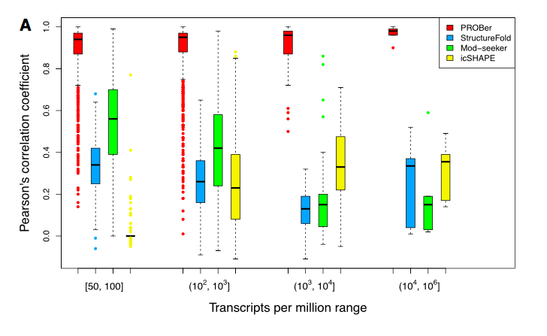
PROBer produces more robust estimates on simulated reads
Correlations of stop rates (due to chemical treatment) in simulated replicates of RNA chemical probing data.
Robustness of PROBer is primarily due to .

Slide 13
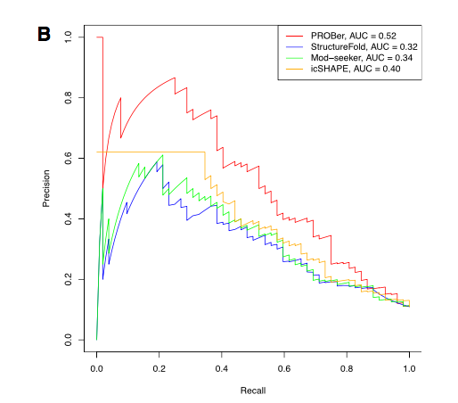
PROBer is better at identifying true positive reactive bases in
DMS-Seq reacts with unstructured A and C bases
Positives: single-stranded + >= 2 Angstroms² of solvent accessible surface area on modifiable N atom
Negatives: double-stranded nucleotides
Excluded: single-stranded nucleotides with less solvent accessible surface area
A. thaliana 18S rRNA

Slide 14
PROBer performance on RNA structure prediction
PROBer (mostly) improves performance of RNA secondary structure prediction for yeast rRNAs.

Slide 15
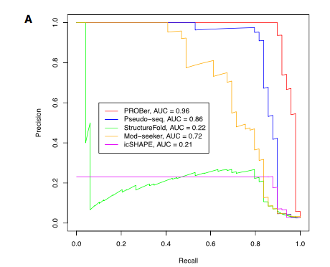
PROBer improves identification of pseudouridine residues in Pseudo-Seq
CMC, another chemical probing reagent, is specific for pseudouridine

Slide 16
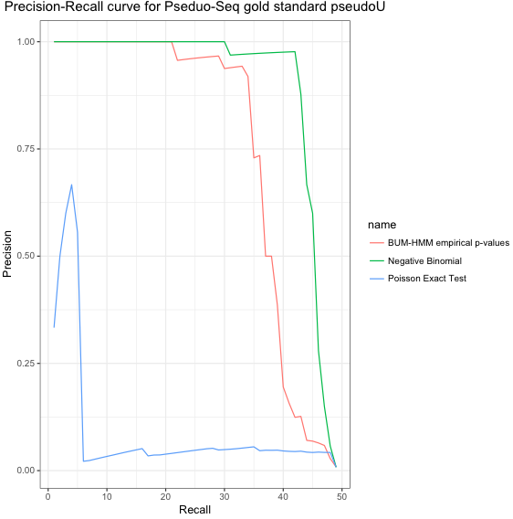
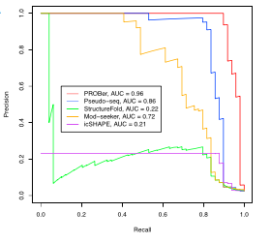
Results: CMC vs. NT (WT): Gold standard RNAs
49 ψ residues in canonical yeast ncRNAs (18S, 5S, 25S, U2)
Ψ vs. non-ψ
Minor note: BUM-HMM performs much better when other ncRNAs besides 18S are added
Similar to PROBer curve
Ψ vs. U
Li et al. Cell Systems 2017

Slide 17
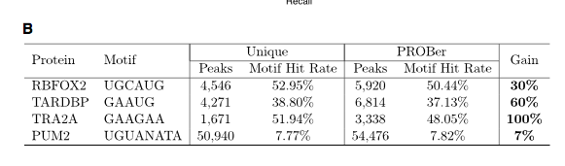
CLIP data
Using expectation maximization instead of filtering out non-unique reads leads to discovery of more peaks with little motif loss.

Slide 18
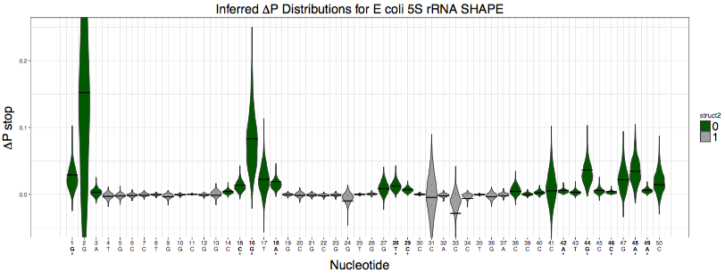
Questions for me
I first model counts, then infer reactivity distributions. Should I incorporate a prior on reactivity?

Slide 19
Questions for me
Should I instead model the distribution of reactivity directly?

Slide 20
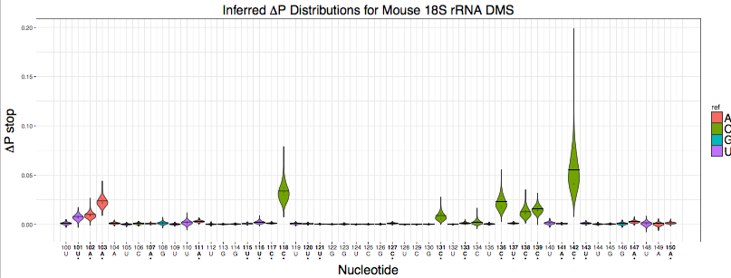
E. coli 5S rRNA SHAPE nucleotide reactivity distributions

