Slide 1
Personal Genomics: Managing Exponential Data Scaling through Prioritizing High-impact Variants
Mark Gerstein, Yale
Slides freely downloadable from Lectures.GersteinLab.org
& “tweetable” (via @markgerstein). See last slide for more info.

Slide 2
Personal Genomics: Managing Exponential Data Scaling through Prioritizing High-impact Variants
Introduction
The exponential scaling of data generation & processing
The landscape of variants in personal genomes suggests finding a few key ones
Evaluating the Impact of Non-coding Variants with Annotation
Annotating non-coding regions on different scales with MUSIC
Prioritizing rare variants with “sensitive sites” (human-conserved)
Prioritizing in terms of network connectivity (eg hubs)
Prioritizing using AlleleDB in terms of allelic elements
Having observed difference in molecular activity in many contexts
Putting it together in Workflows
Using Larva to do burden testing on non-coding annotation
Need to correct for over-dispersion mutation counts
Parameterized according to replication timing
Using FunSeq to integrate evidence on variants
Systematically weighting all the features
suggesting non-coding drivers
Prioritzing rare germline variants
Postscript: Analysis of the Evolution of a Consortium
Differences in “modularity” for members & users
Key role for brokers

Slide 3
Personal Genomics: Managing Exponential Data Scaling through Prioritizing High-impact Variants
Introduction
The exponential scaling of data generation & processing
The landscape of variants in personal genomes suggests finding a few key ones
Evaluating the Impact of Non-coding Variants with Annotation
Annotating non-coding regions on different scales with MUSIC
Prioritizing rare variants with “sensitive sites” (human-conserved)
Prioritizing in terms of network connectivity (eg hubs)
Prioritizing using AlleleDB in terms of allelic elements
Having observed difference in molecular activity in many contexts
Putting it together in Workflows
Using Larva to do burden testing on non-coding annotation
Need to correct for over-dispersion mutation counts
Parameterized according to replication timing
Using FunSeq to integrate evidence on variants
Systematically weighting all the features
suggesting non-coding drivers
Prioritzing rare germline variants
Postscript: Analysis of the Evolution of a Consortium
Differences in “modularity” for members & users
Key role for brokers

Slide 4
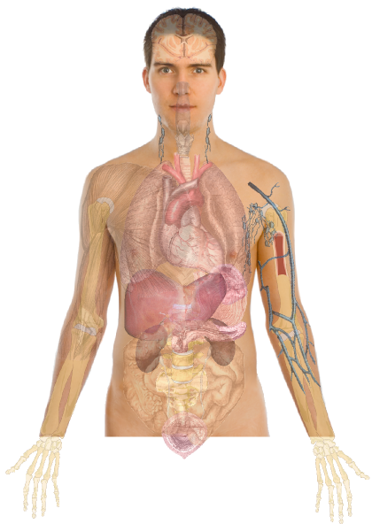
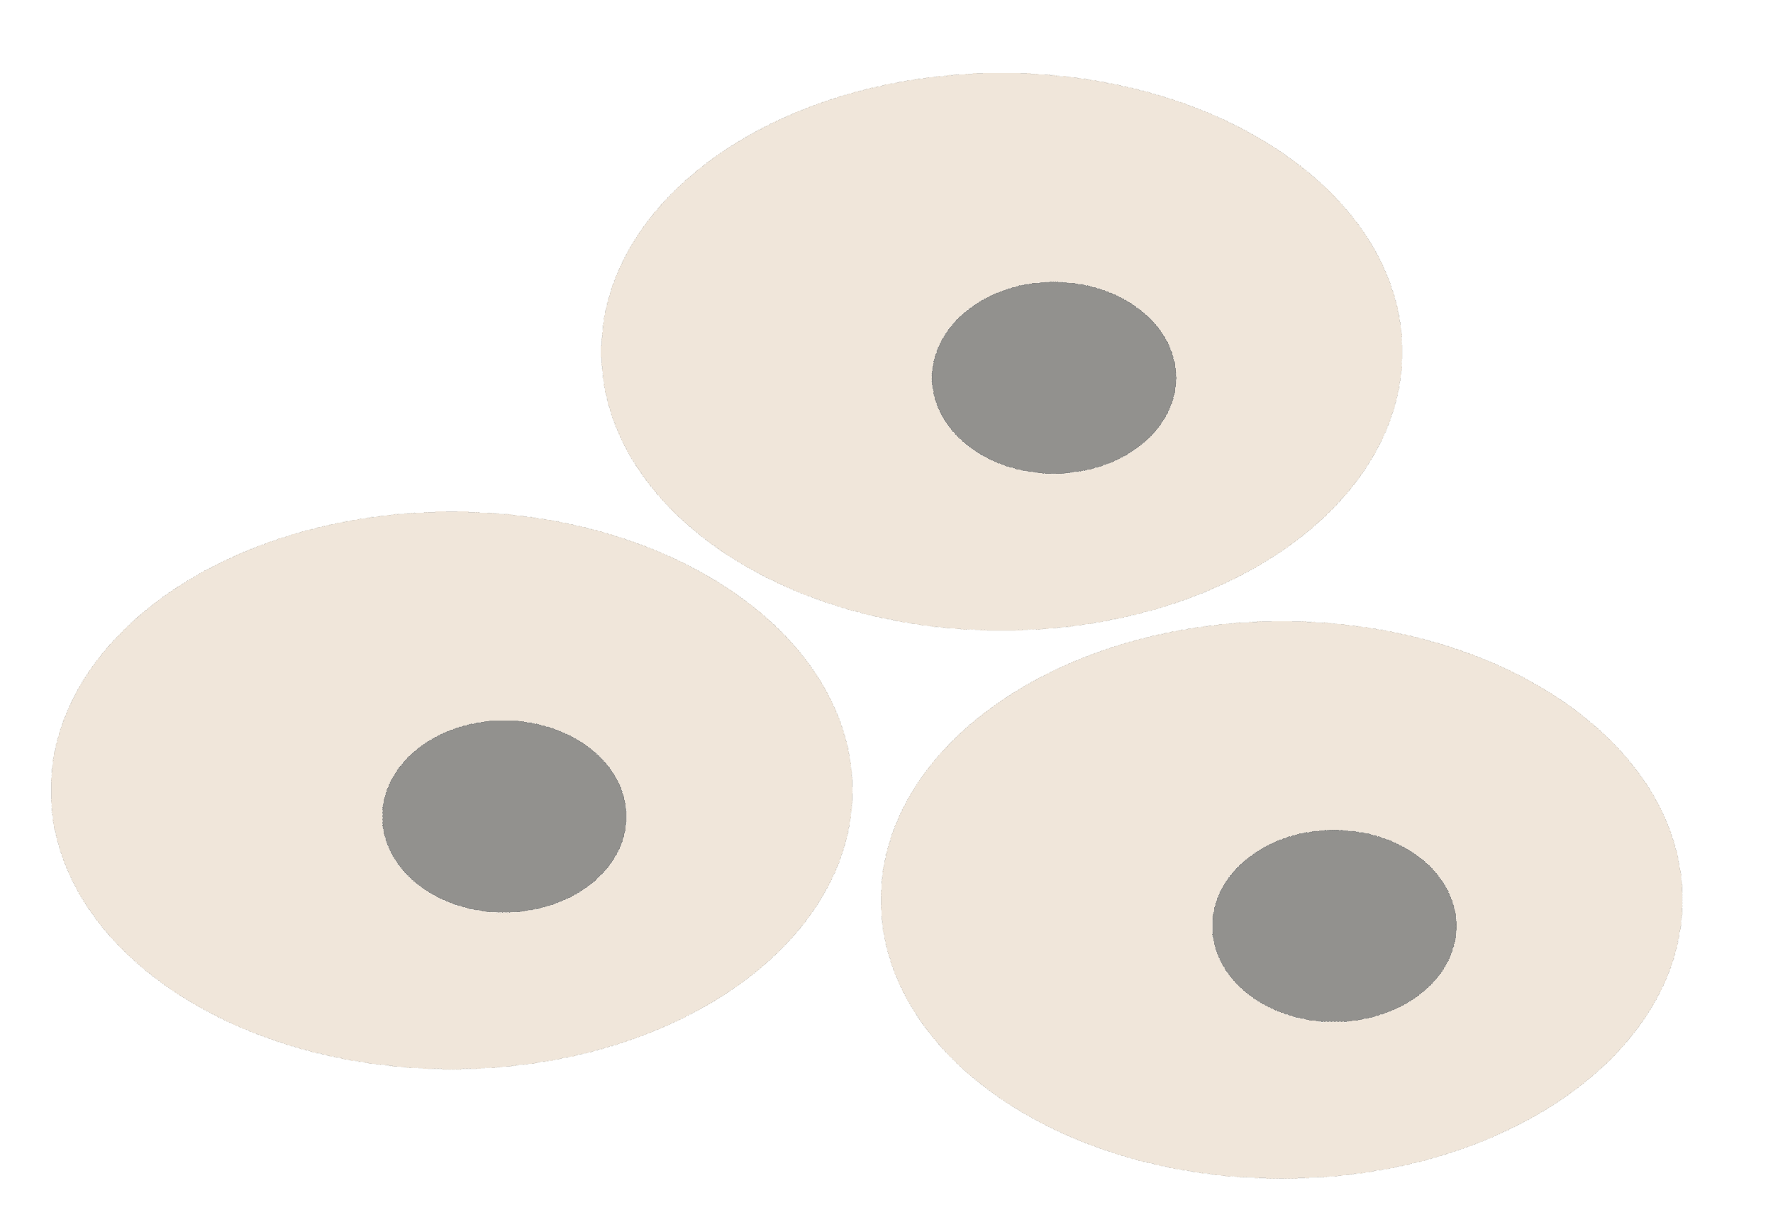
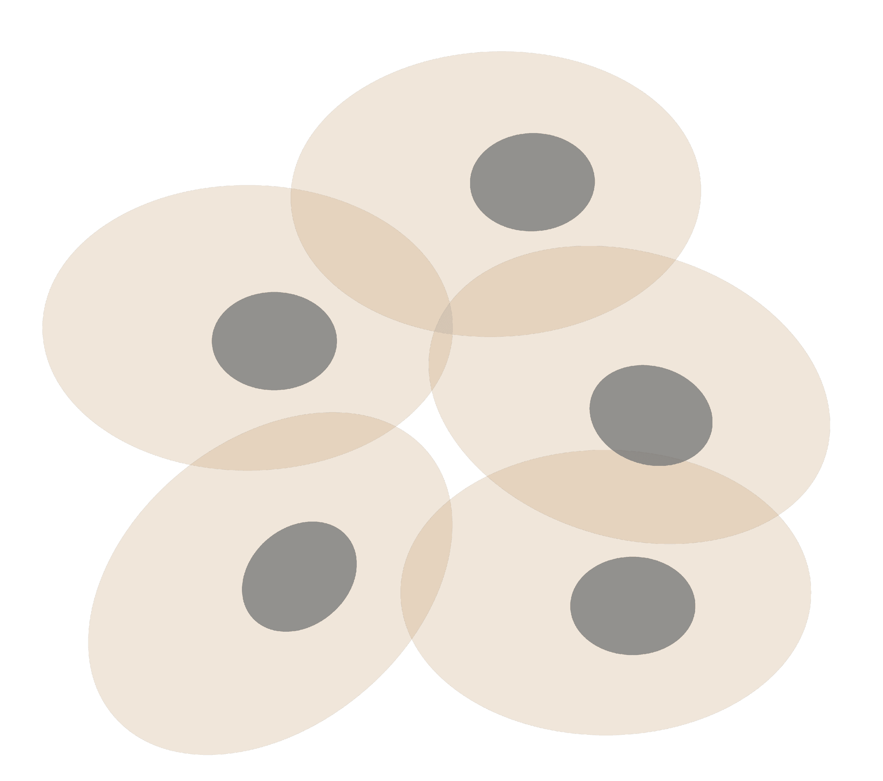
Personal Genomics as a Gateway into Biology
Personal genomes soon will become a commonplace part of medical research & eventually treatment (esp. for cancer). They will provide a primary connection for biological science to the general public.
normal
tumor

Slide 5
Personal Genomics as a Gateway into Biology
Personal genomes soon will become a commonplace part of medical research & eventually treatment (esp. for cancer). They will provide a primary connection for biological science to the general public.

Slide 8
Logic
Data larger
Key is prioritizing
How to do this ?
Key aspect is driver v pass.

Slide 9
Human Genetic Variation
A Cancer Genome
A Typical Genome
Population of 2,504 peoples
Origin of Variants
Class of Variants
 | Coding | Non-coding
Germ-line | 22K | 4.1 – 5M
Somatic | ~50 | 5K
SNP | 3.5 – 4.3M
Indel | 550 – 625K
SV | 2.1 – 2.5K (20Mb)
Total | 4.1 – 5M
SNP | 84.7M
Indel | 3.6M
SV | 60K
Total | 88.3M
Prevalence of Variants
Common
Passenger
Common
Driver (~0.1%)
Rare* (1-4%)
Rare (~75%)
* Variants with allele frequency < 0.5% are considered as rare variants in 1000 genomes project.
The 1000 Genomes Project Consortium, Nature. 2015. 526:68-74 Khurana E. et al. Nat. Rev. Genet. 2016. 17:93-108

Slide 10
(Finding the key mutations in ~3M Germline variants & ~5K Somatic Variants in a Tumor Sample)
Cancer drivers: Significance & identification

Slide 11
Finding Key Variants Germline
CAN YOU FIND THE PANDA?
Common variants
Can be associated with phenotype (ie disease) via a Genome-wide Association Study (GWAS), which tests whether the frequency of alleles differs between cases & controls.
Usually their functional effect is weaker.
Many are non-coding
Issue of LD in identifying the actual causal variant.
Rare variants
Associations are usually underpowered due to low frequencies.
They often have larger functional impact
Can be collapsed in the same element to gain statistical power (burden tests).
In some cases, causal variants can be identified through tracing inheritance of Mendelian subtypes of diseases in large families.
McCarthy, M. et al. Nat. Rev. Genet. 2008. 9, 356-369, Zuk, O. et al. PNSA. 2014. Vol. 11, no. 4, MacArthur DG et al. Nature 2014. 508:469-476

Slide 12
Association of Variants with Diseases
Common
Variants
Healthy
Rare or
Somatic
Variants
Pooled
Variants
High
Function
Impact
Diseased
Burden Test
GWAS Positive

Slide 13
Finding Key Variants Somatic
CAN YOU FIND THE PANDA?
Overall
Often these can be conceptualized as very rare variants
A challenge to identify somatic mutations contributing to cancer is to find driver mutations & distinguish them from passengers.
Drivers
Driver mutation is a mutation that directly or indirectly confers a selective growth advantage to the cell in which it occurs.
A typical tumor contains 2-8 drivers; the remaining mutations are passengers.
Passengers
Conceptually, a passenger mutation has no direct or indirect effect on the selective growth advantage of the cell in which it occurred.
Vogelstein B. Science 2013. 339(6127):1546-1558

Slide 14
Cancer drivers: Significance & identification
frequency-based approaches

Slide 15
Cancer drivers: Significance & identification: functional annotations
≈ç
Khurana et al, NRG (2016)

Slide 16
Personal Genomics: Managing Exponential Data Scaling through Prioritizing High-impact Variants
Introduction
The exponential scaling of data generation & processing
The landscape of variants in personal genomes suggests finding a few key ones
Evaluating the Impact of Non-coding Variants with Annotation
Annotating non-coding regions on different scales with MUSIC
Prioritizing rare variants with “sensitive sites” (human-conserved)
Prioritizing in terms of network connectivity (eg hubs)
Prioritizing using AlleleDB in terms of allelic elements
Having observed difference in molecular activity in many contexts
Putting it together in Workflows
Using Larva to do burden testing on non-coding annotation
Need to correct for over-dispersion mutation counts
Parameterized according to replication timing
Using FunSeq to integrate evidence on variants
Systematically weighting all the features
suggesting non-coding drivers
Prioritzing rare germline variants
Postscript: Analysis of the Evolution of a Consortium
Differences in “modularity” for members & users
Key role for brokers

Slide 17
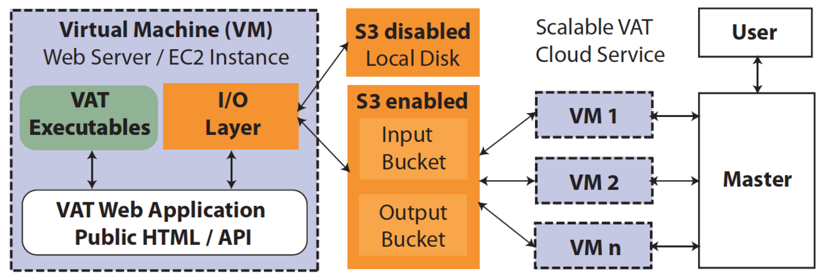
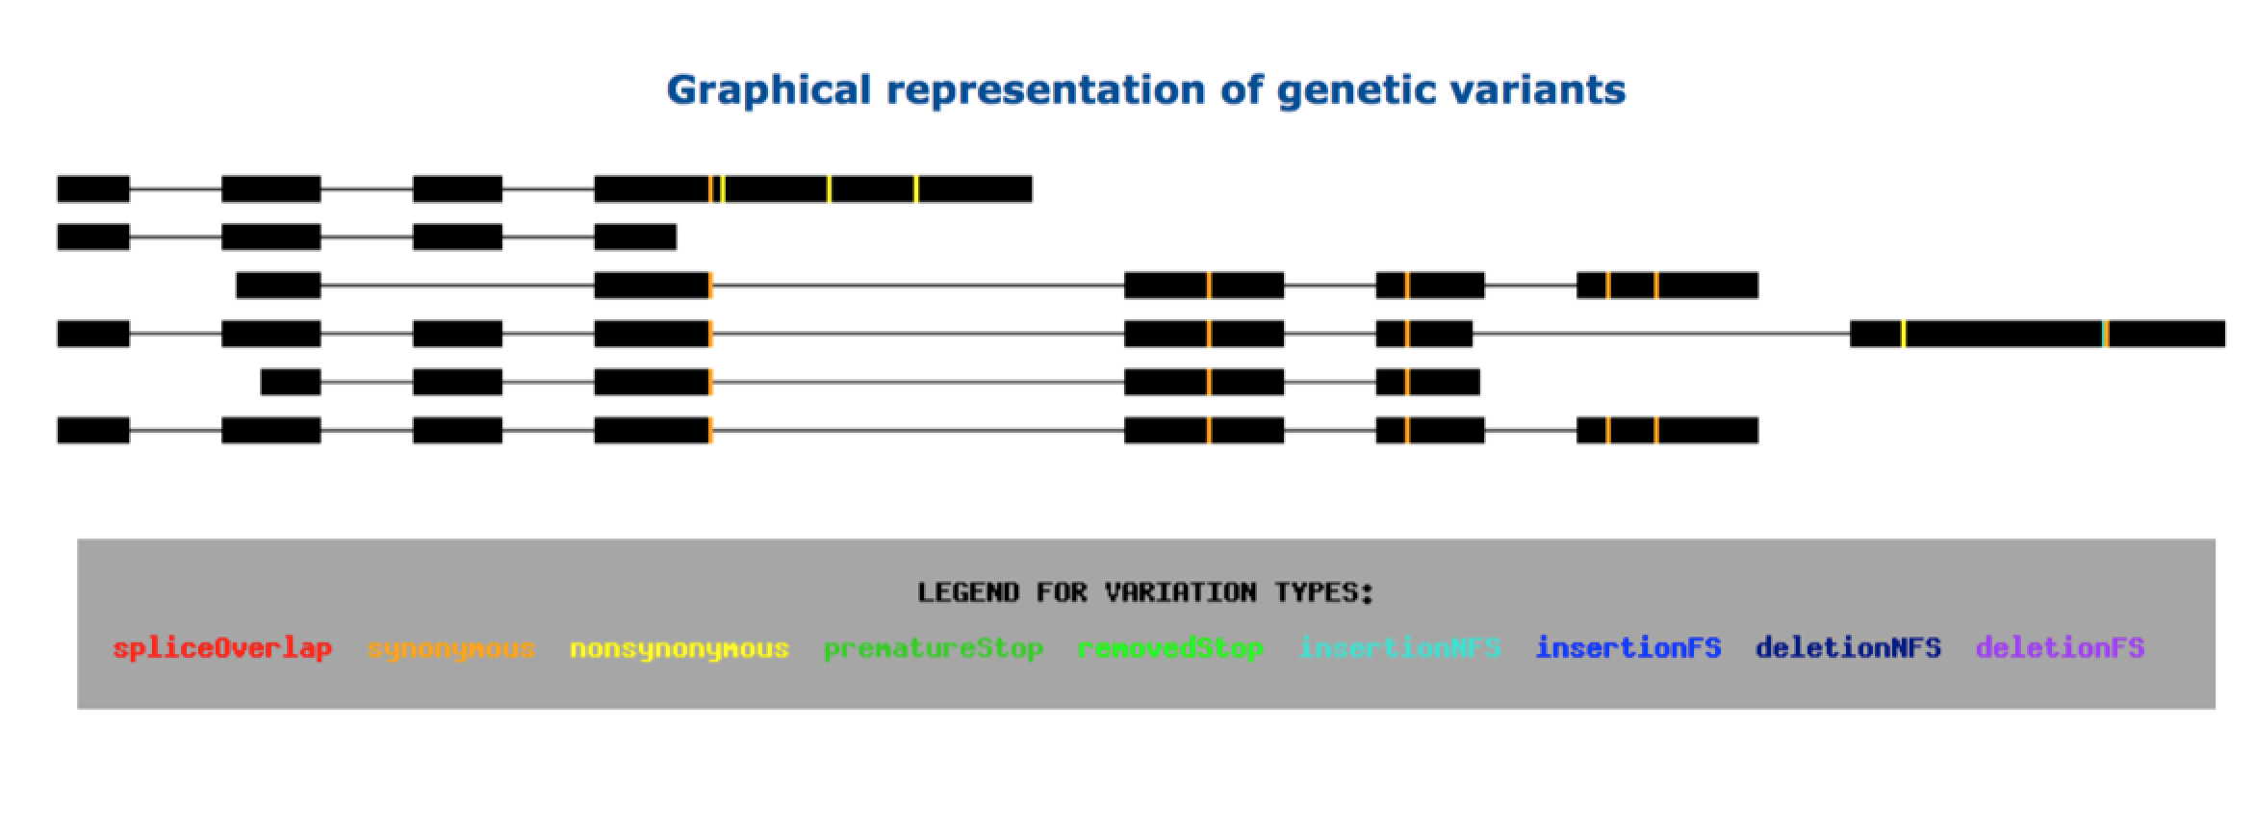
vat.gersteinlab.org
Variant Annotation Tool (VAT)
VCF Input
Output:
Annotated VCFs
Graphical representations of functional impact on transcripts
Access:
Webserver
AWS cloud instance
Source freely available
CLOUD APPLICATION
Habegger L.*, Balasubramanian S.*, et al. Bioinformatics, 2012
Notes:
‹#›
Big data challenge, graphical interface is important

Slide 18
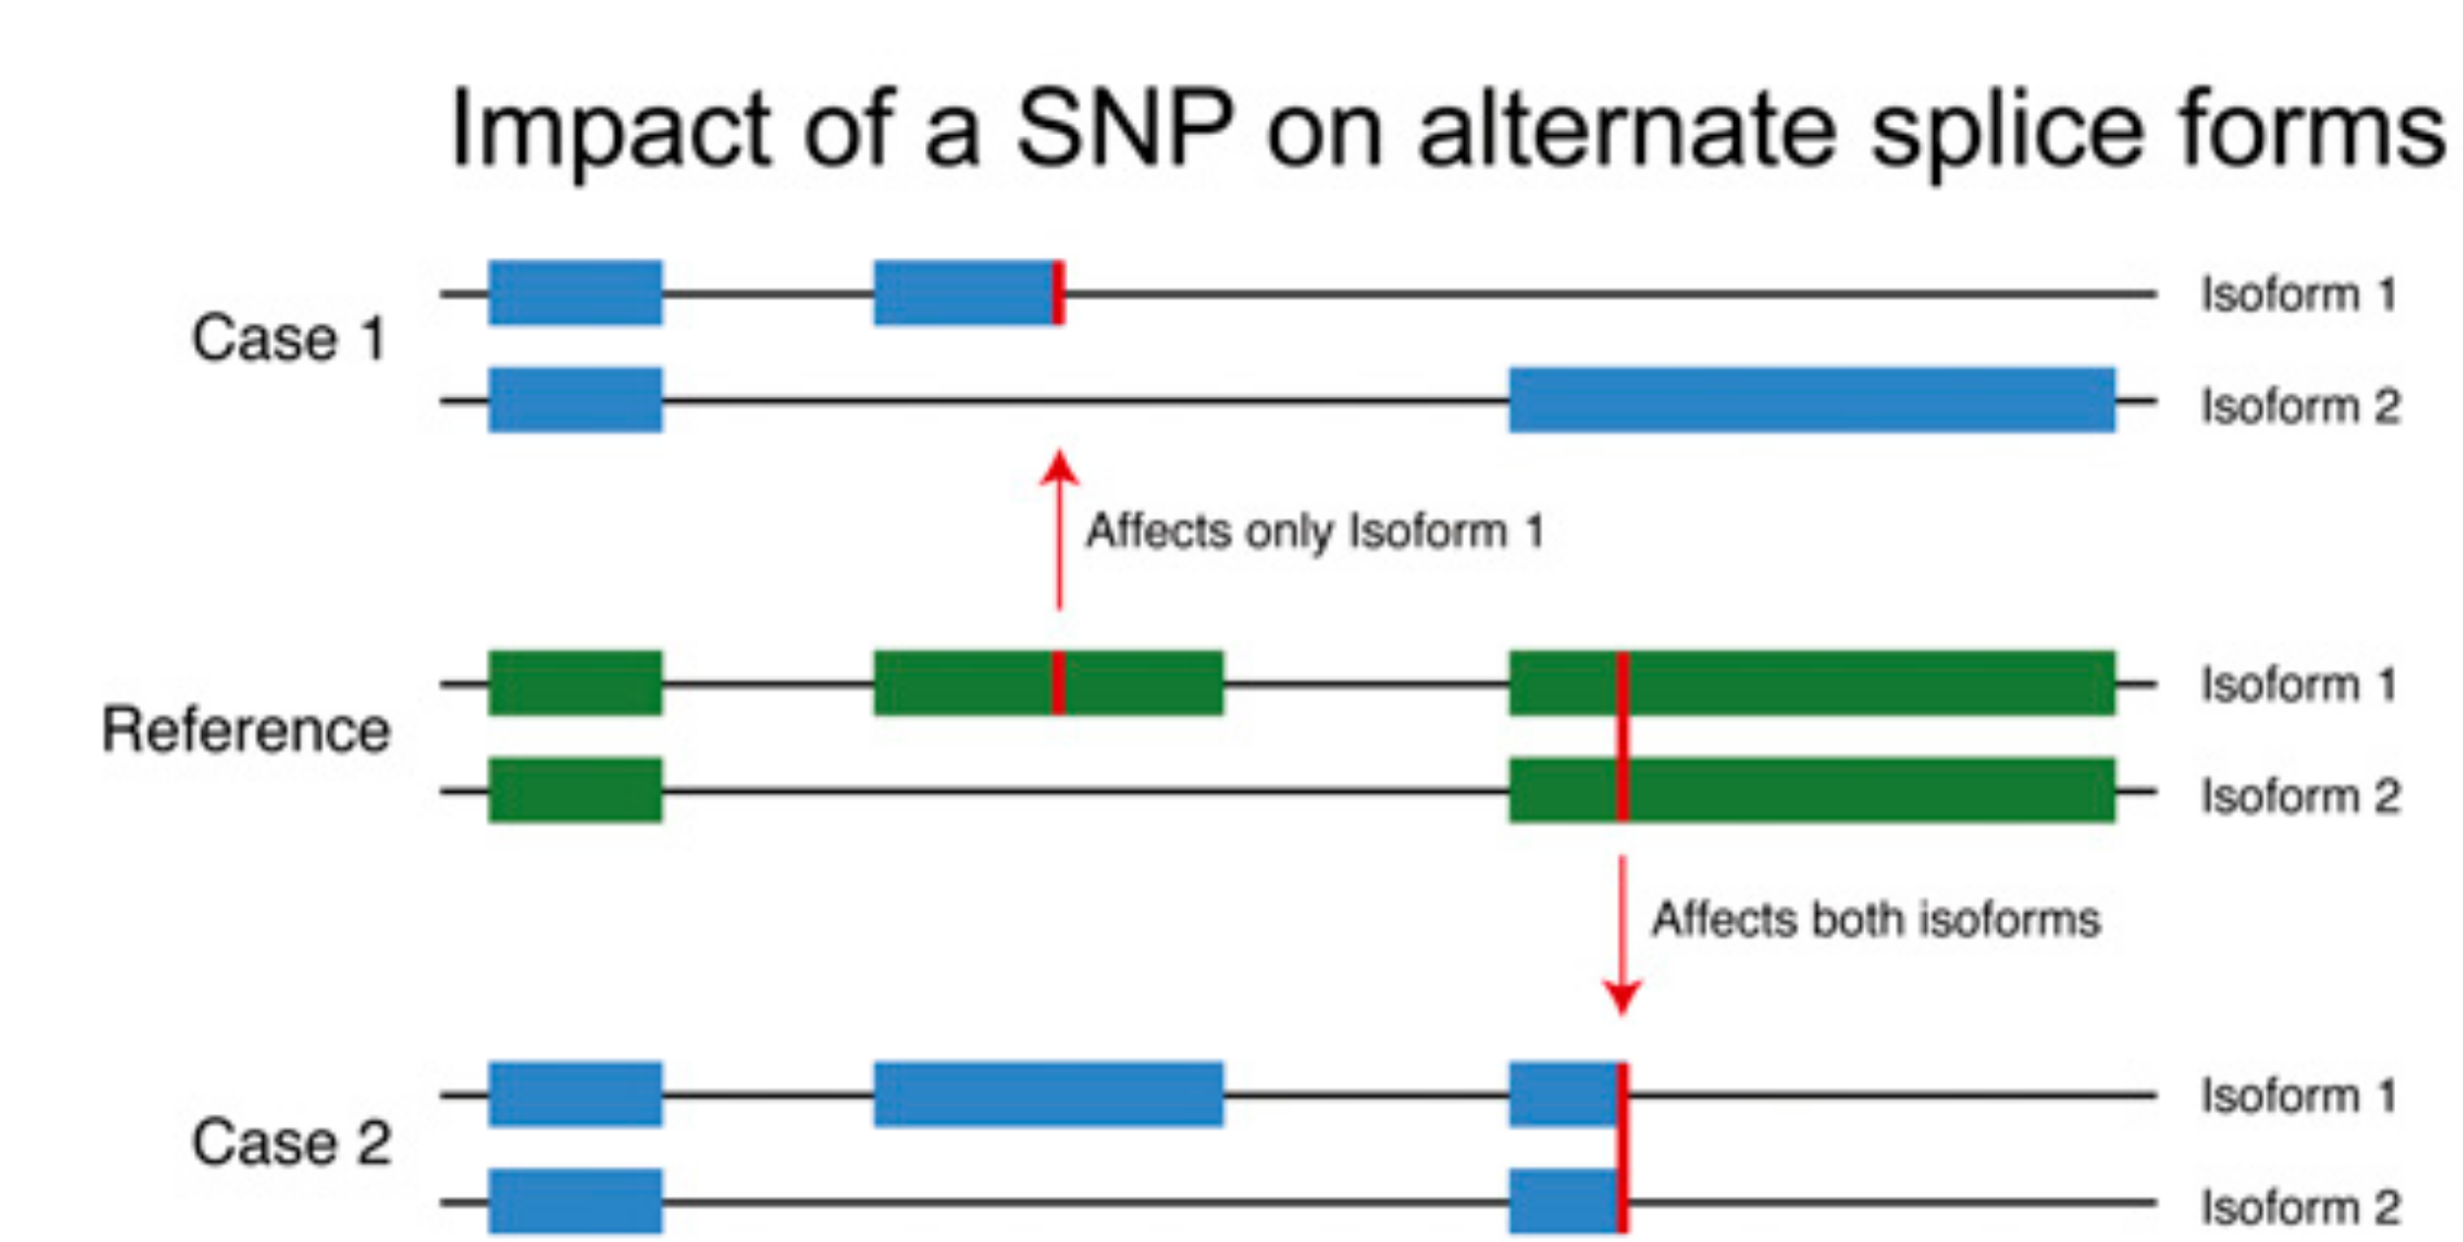
Complexities in LOF annotation
Transcript isoforms,
distance to stop,
functional domains,
protein folding,
etc.
Balasubramanian S. et al., Genes Dev., ’11
Balasubramanian S.*, Fu Y.* et al., NComms., ’17

Slide 19
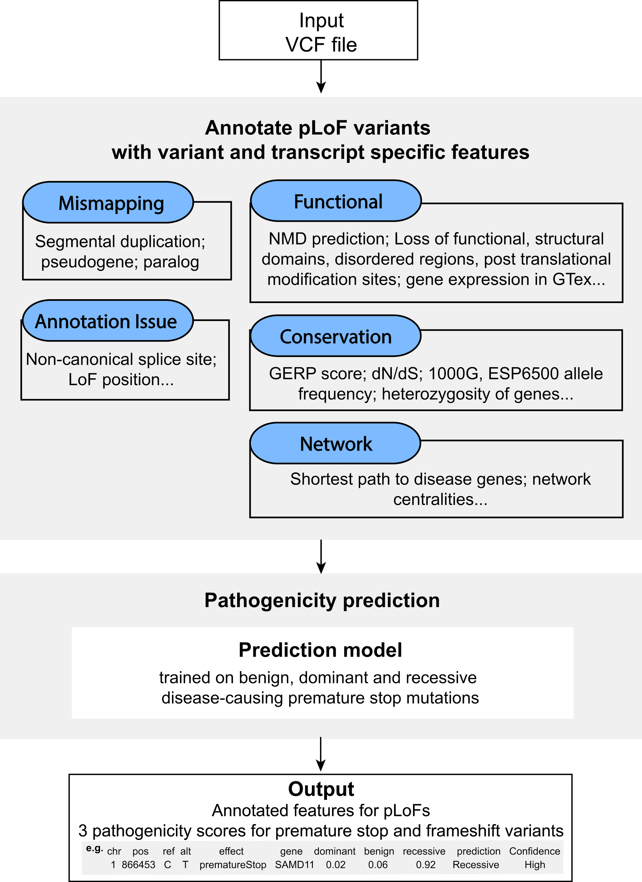
Annotation of Loss-of-Function Transcripts (ALoFT)
VCF Input
Output:
Impact score: benign or deleterious.
Confidence level.
Annotated VCF.
Access:
Software package: aloft.gersteinlab.org
Gitub: github.com/gersteinlab/aloft
Balasubramanian S.*, Fu Y.* et al., NComms., ’17

Slide 20
LoF position distribution varies by cohort
Balasubramanian S.*, Fu Y.* et al., NComms., ’17

Slide 21
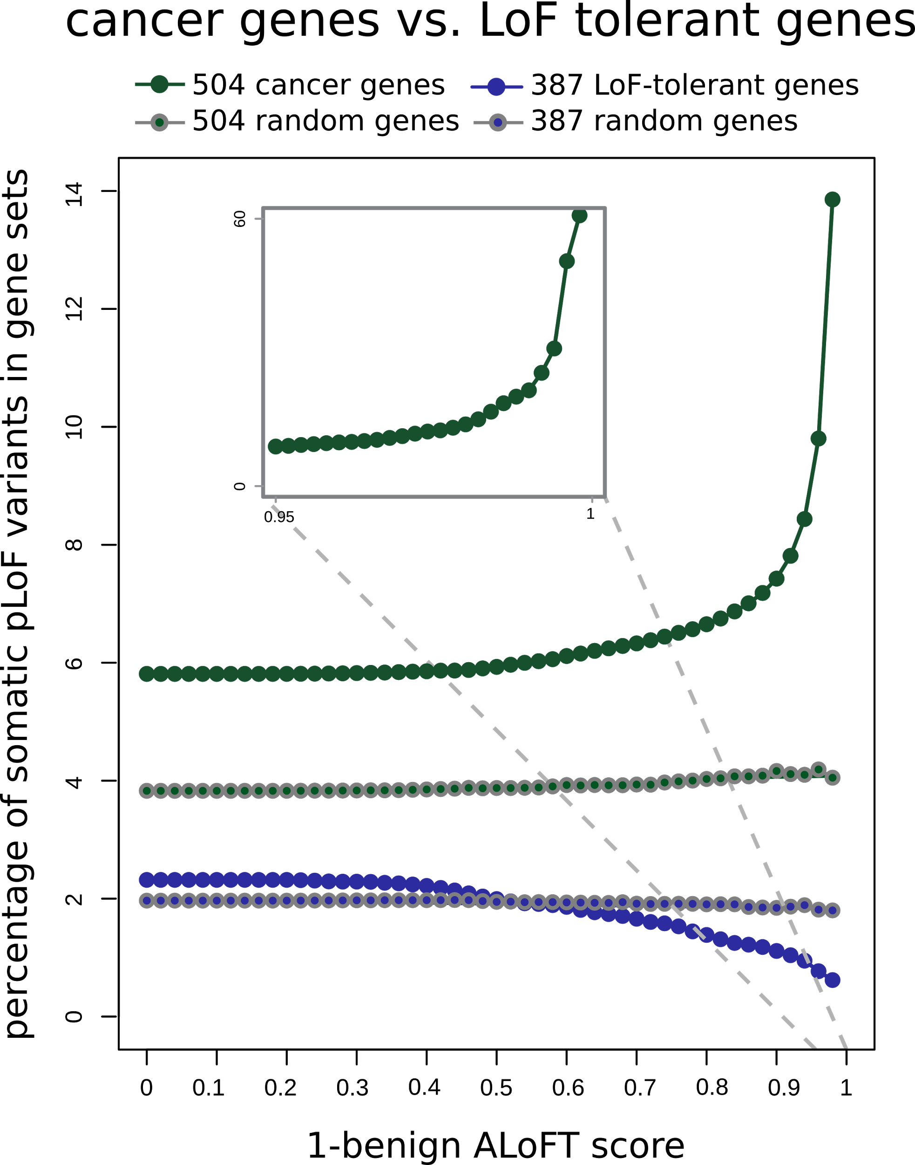
ALoFT identifies deleterious
somatic LoF variants
LoF tolerant genes:
LoF in the 1KG cohort.
Depleted in deleterious LoFs.
Cancer genes:
COSMIC consensus.
Enriched in deleterious LoFs.
Balasubramanian S.*, Fu Y.* et al., NComms., ’17

Slide 22
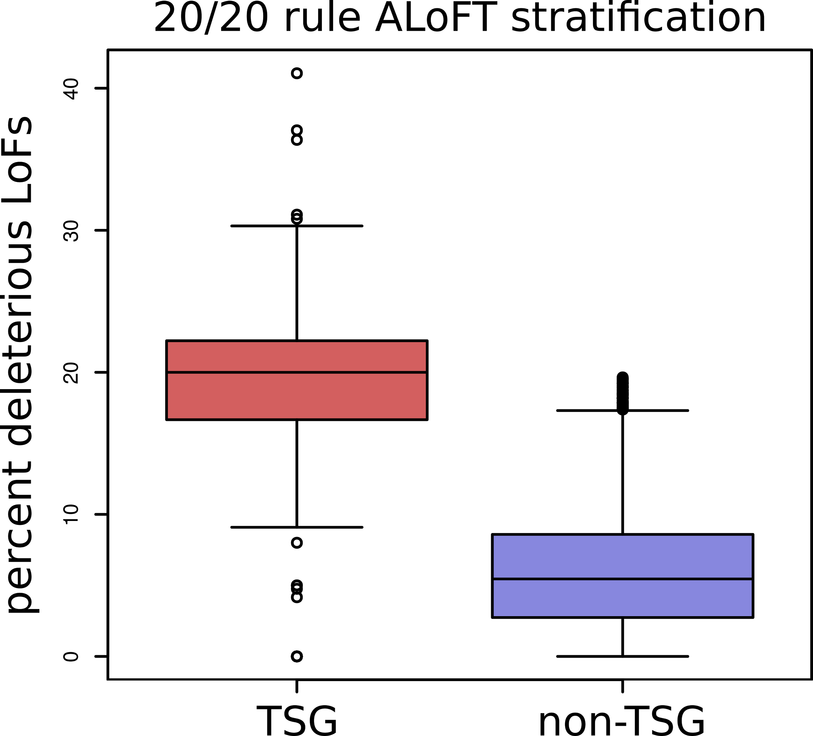
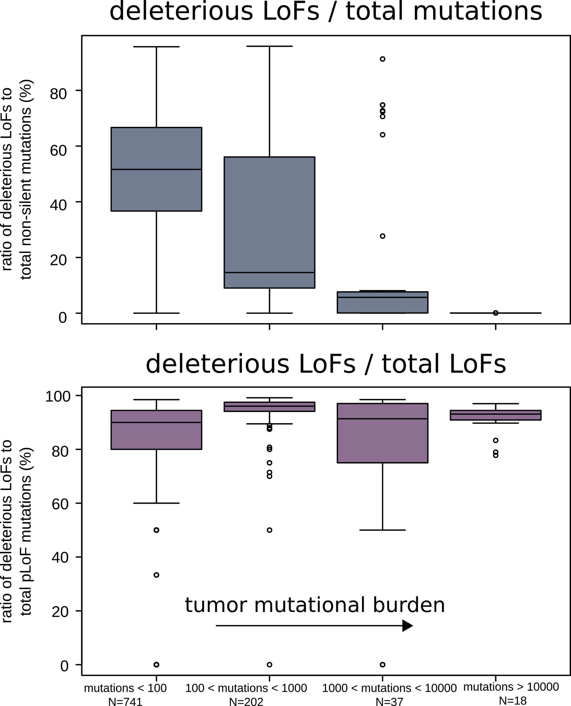
ALoFT refines cancer mutation classification
Vogelstein et al. 2013: if >20% of mutations in a gene are inactivating → tumor suppressor gene (TSG).
ALoFT further refines 20/20 rule predictions.
Balasubramanian S.*, Fu Y.* et al., NComms., ’17

Slide 23
Personal Genomics: Managing Exponential Data Scaling through Prioritizing High-impact Variants
Introduction
The exponential scaling of data generation & processing
The landscape of variants in personal genomes suggests finding a few key ones
Evaluating the Impact of Non-coding Variants with Annotation
Annotating non-coding regions on different scales with MUSIC
Prioritizing rare variants with “sensitive sites” (human-conserved)
Prioritizing in terms of network connectivity (eg hubs)
Prioritizing using AlleleDB in terms of allelic elements
Having observed difference in molecular activity in many contexts
Putting it together in Workflows
Using Larva to do burden testing on non-coding annotation
Need to correct for over-dispersion mutation counts
Parameterized according to replication timing
Using FunSeq to integrate evidence on variants
Systematically weighting all the features
suggesting non-coding drivers
Prioritzing rare germline variants
Postscript: Analysis of the Evolution of a Consortium
Differences in “modularity” for members & users
Key role for brokers

Slide 24
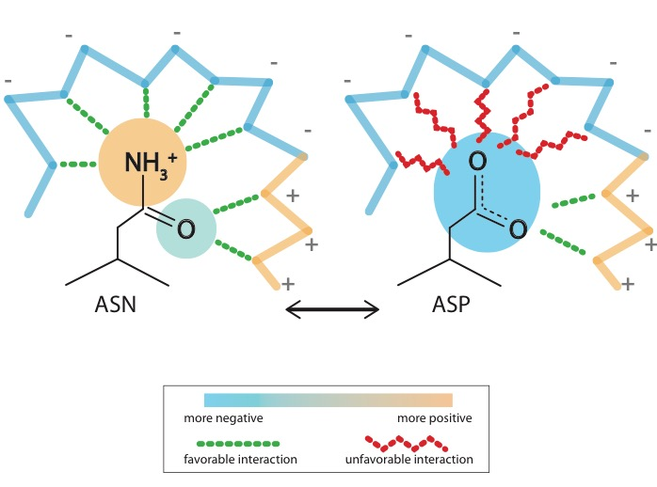
Schematic illustration of localized frustration
[Ferreiro et al., PNAS (’07)]

Slide 25
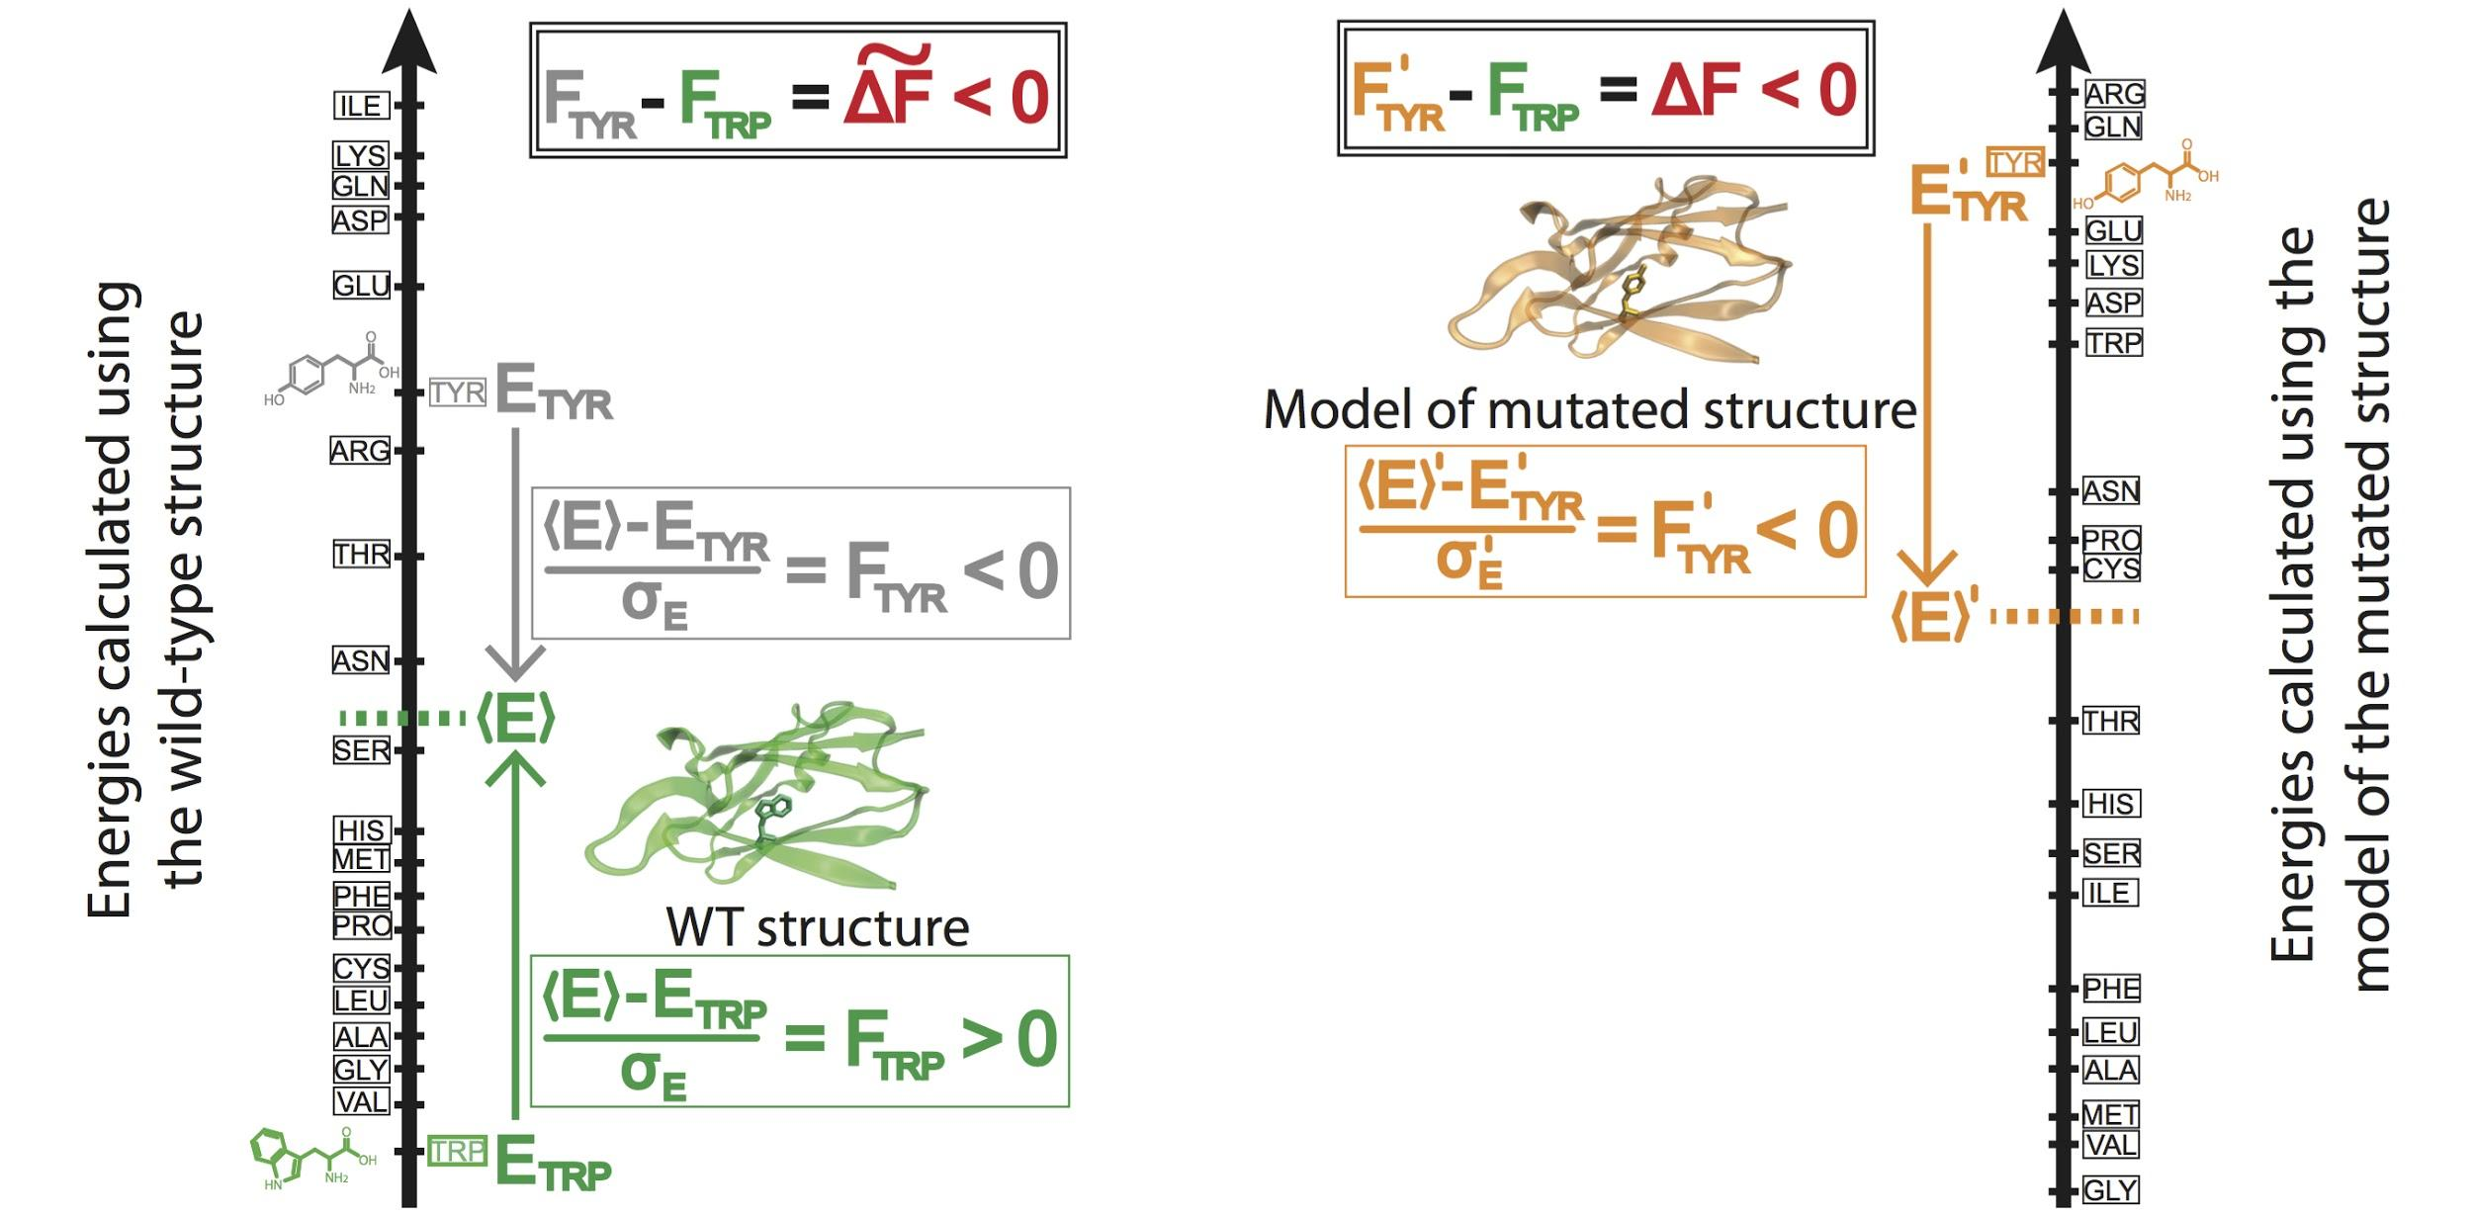
Workflow for evaluating localized frustration changes (∆F)
[Kumar et al. NAR (in press); biorxiv 052027]
Notes:
An example illustrating the case in which ∆F < 0. The ∆F associated with an SNV is negative if the SNV introduces a destabilizing effect. Shown here is the result of changing residue ID 31 in plastocyanin (pdb ID 3CVD) from the wild-type residue (Trp) to a mutated residue (Tyr). Left) The protein in its wild-type form (in green), in which the tryptophan residue at position 31 is substantially more energetically favorable relative to the mean energy ⟨E⟩ that would result from having any of the possible 20 amino acids at that position. This disparity is designated by (⟨E⟩ - E_{nat})/σ_{E} = F_{nat} > 0. Right) The entire protein structure is then modeled to generate the mutated structure after the SNV W31Y is introduced, thereby changing the relative energetic distributions for the different amino acids. The new mean and standard deviation associated with the energies of the modeled structure are designated by ⟨E⟩’ and σ_{E}’, respectively. In this case, the SNV that introduces 31Y results in an energy that is higher than the mean energy of all possible 20 amino acids at that position. This disparity is designated by (⟨E⟩’ - E_{mut})/σ_{E}’ = F_{mut} < 0. Taken together, the negative value associated with the disparity between the F_{mut} and F_{nat} values (F_{mut} - F_{nat} = ∆F < 0) indicates that the this SNV is locally unfavorable.

Slide 26
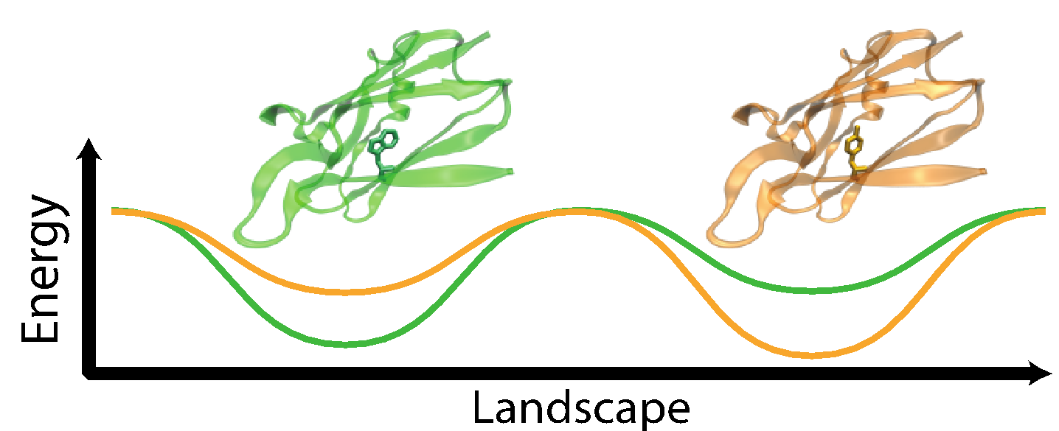
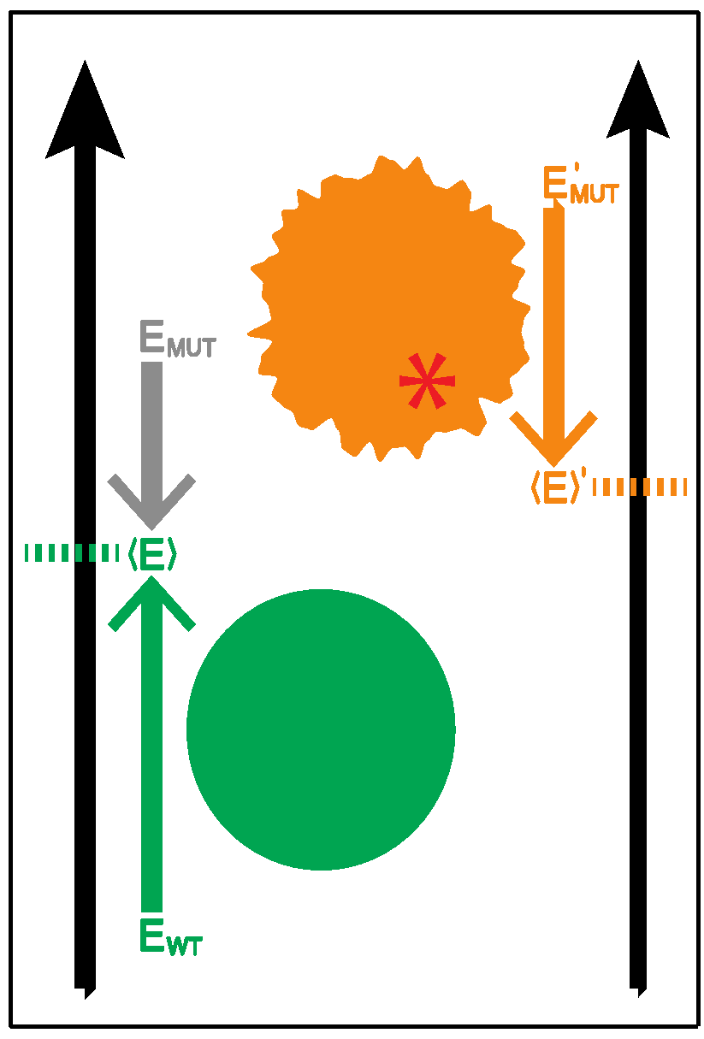
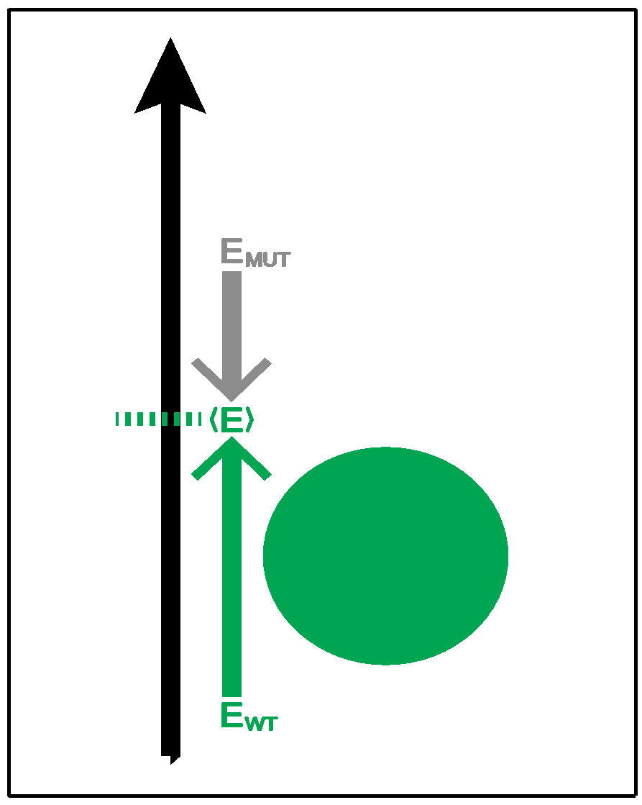
Complexity of the second order frustration calculation
MD-assisted free energy calculation (∆G)
Second order frustration calculation (∆F)
Time
First order frustration calculation (F)
Accuracy

Slide 27
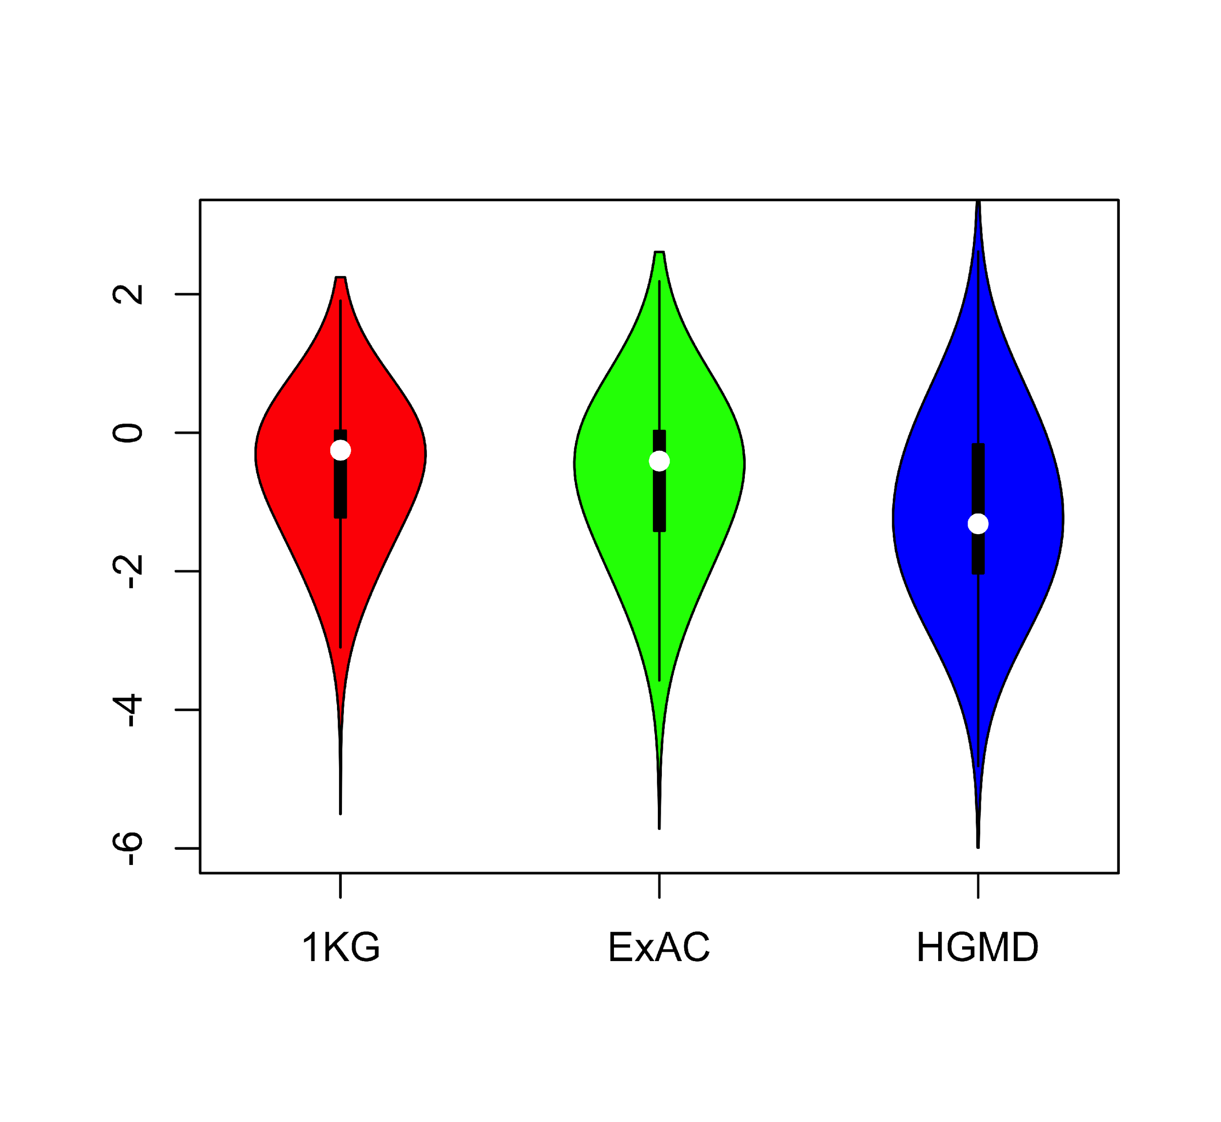
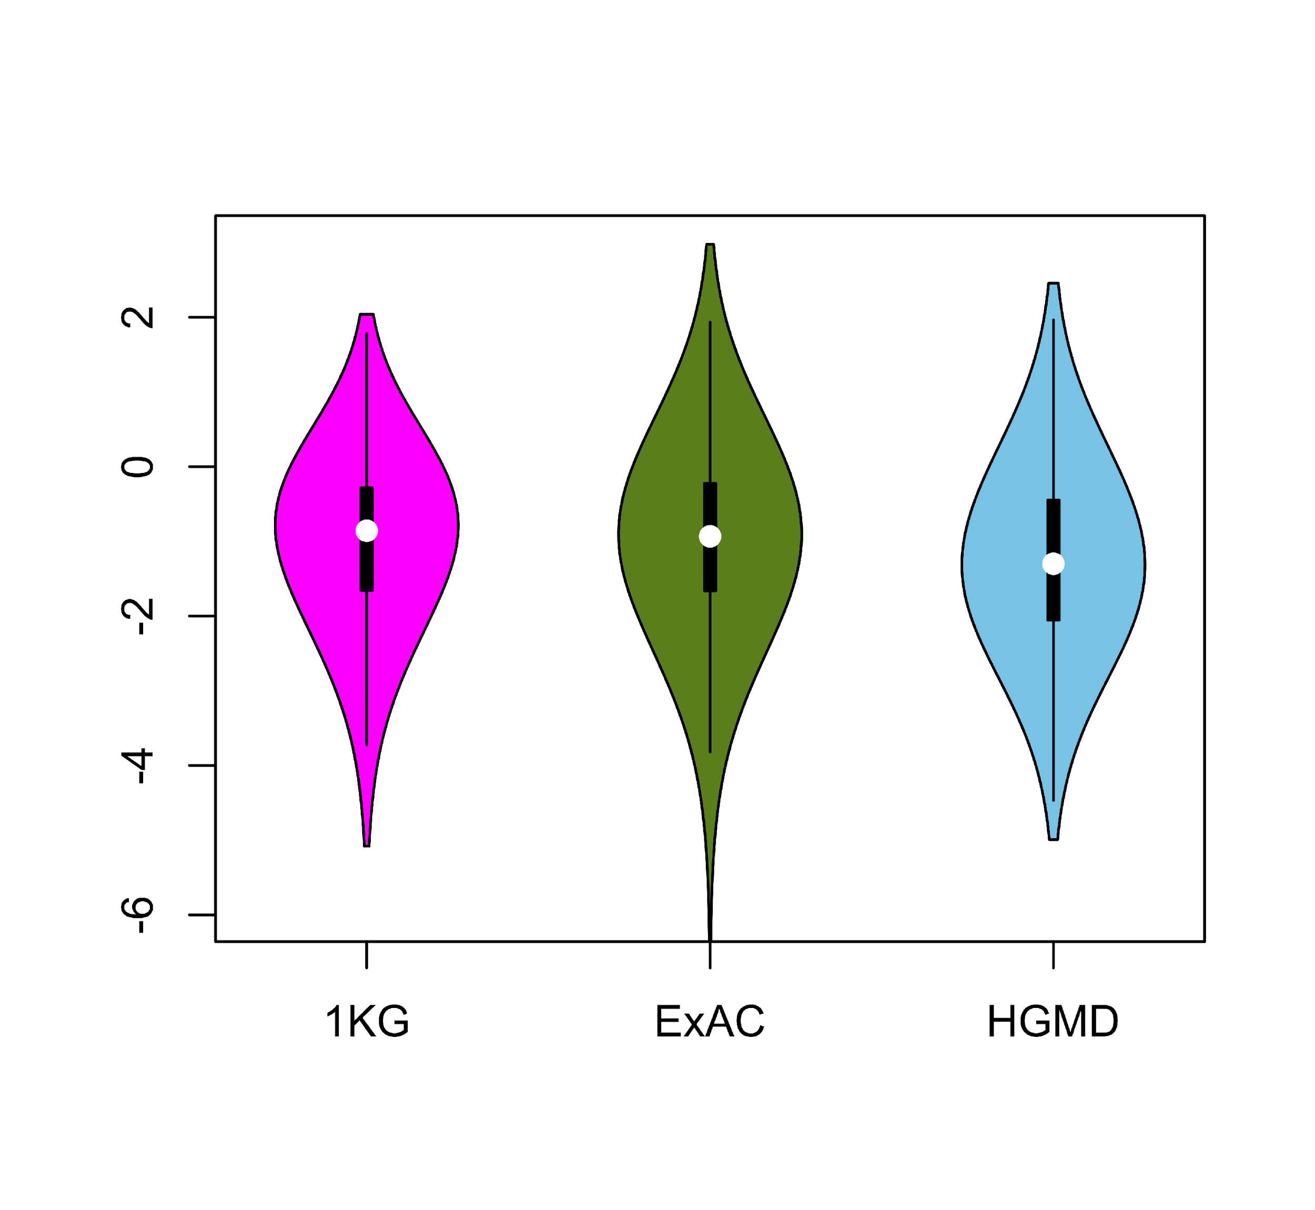
Comparing ∆F values across different SNV categories: disease v normal
Loss of frustration
Gain of frustration
[Kumar et al. NAR (in press); biorxiv 052027]
Core residues
Surface residues
Normal mutations (1000G) tend to unfavorably frustrate (less frustrated) surface more than core, but for disease mutations (HGMD) no trend & greater changes
Notes:
We observed that benign SNVs lead to greater disruptions within minimally frustrated surface residues compared to core residues in the native structure, and this trend is observed when using both ExAC and 1KG (Figure A & B). However, SNVs from HGMD that impact minimally frustrated core residues induce stronger perturbations than benign SNVs influencing minimally frustrated core residues (Figure C). This suggest that the mechanistic difference between benign and disease SNVs can be attributed to their impact on the local environment of core residues. Within the core, disease-associated SNVs result in more severe perturbations to local interactions relative to those introduced by benign SNVs. These local disruptions are propagated throughout the core and, in turn, drive the deleteriousness of various disease-associated SNVs.

Slide 28
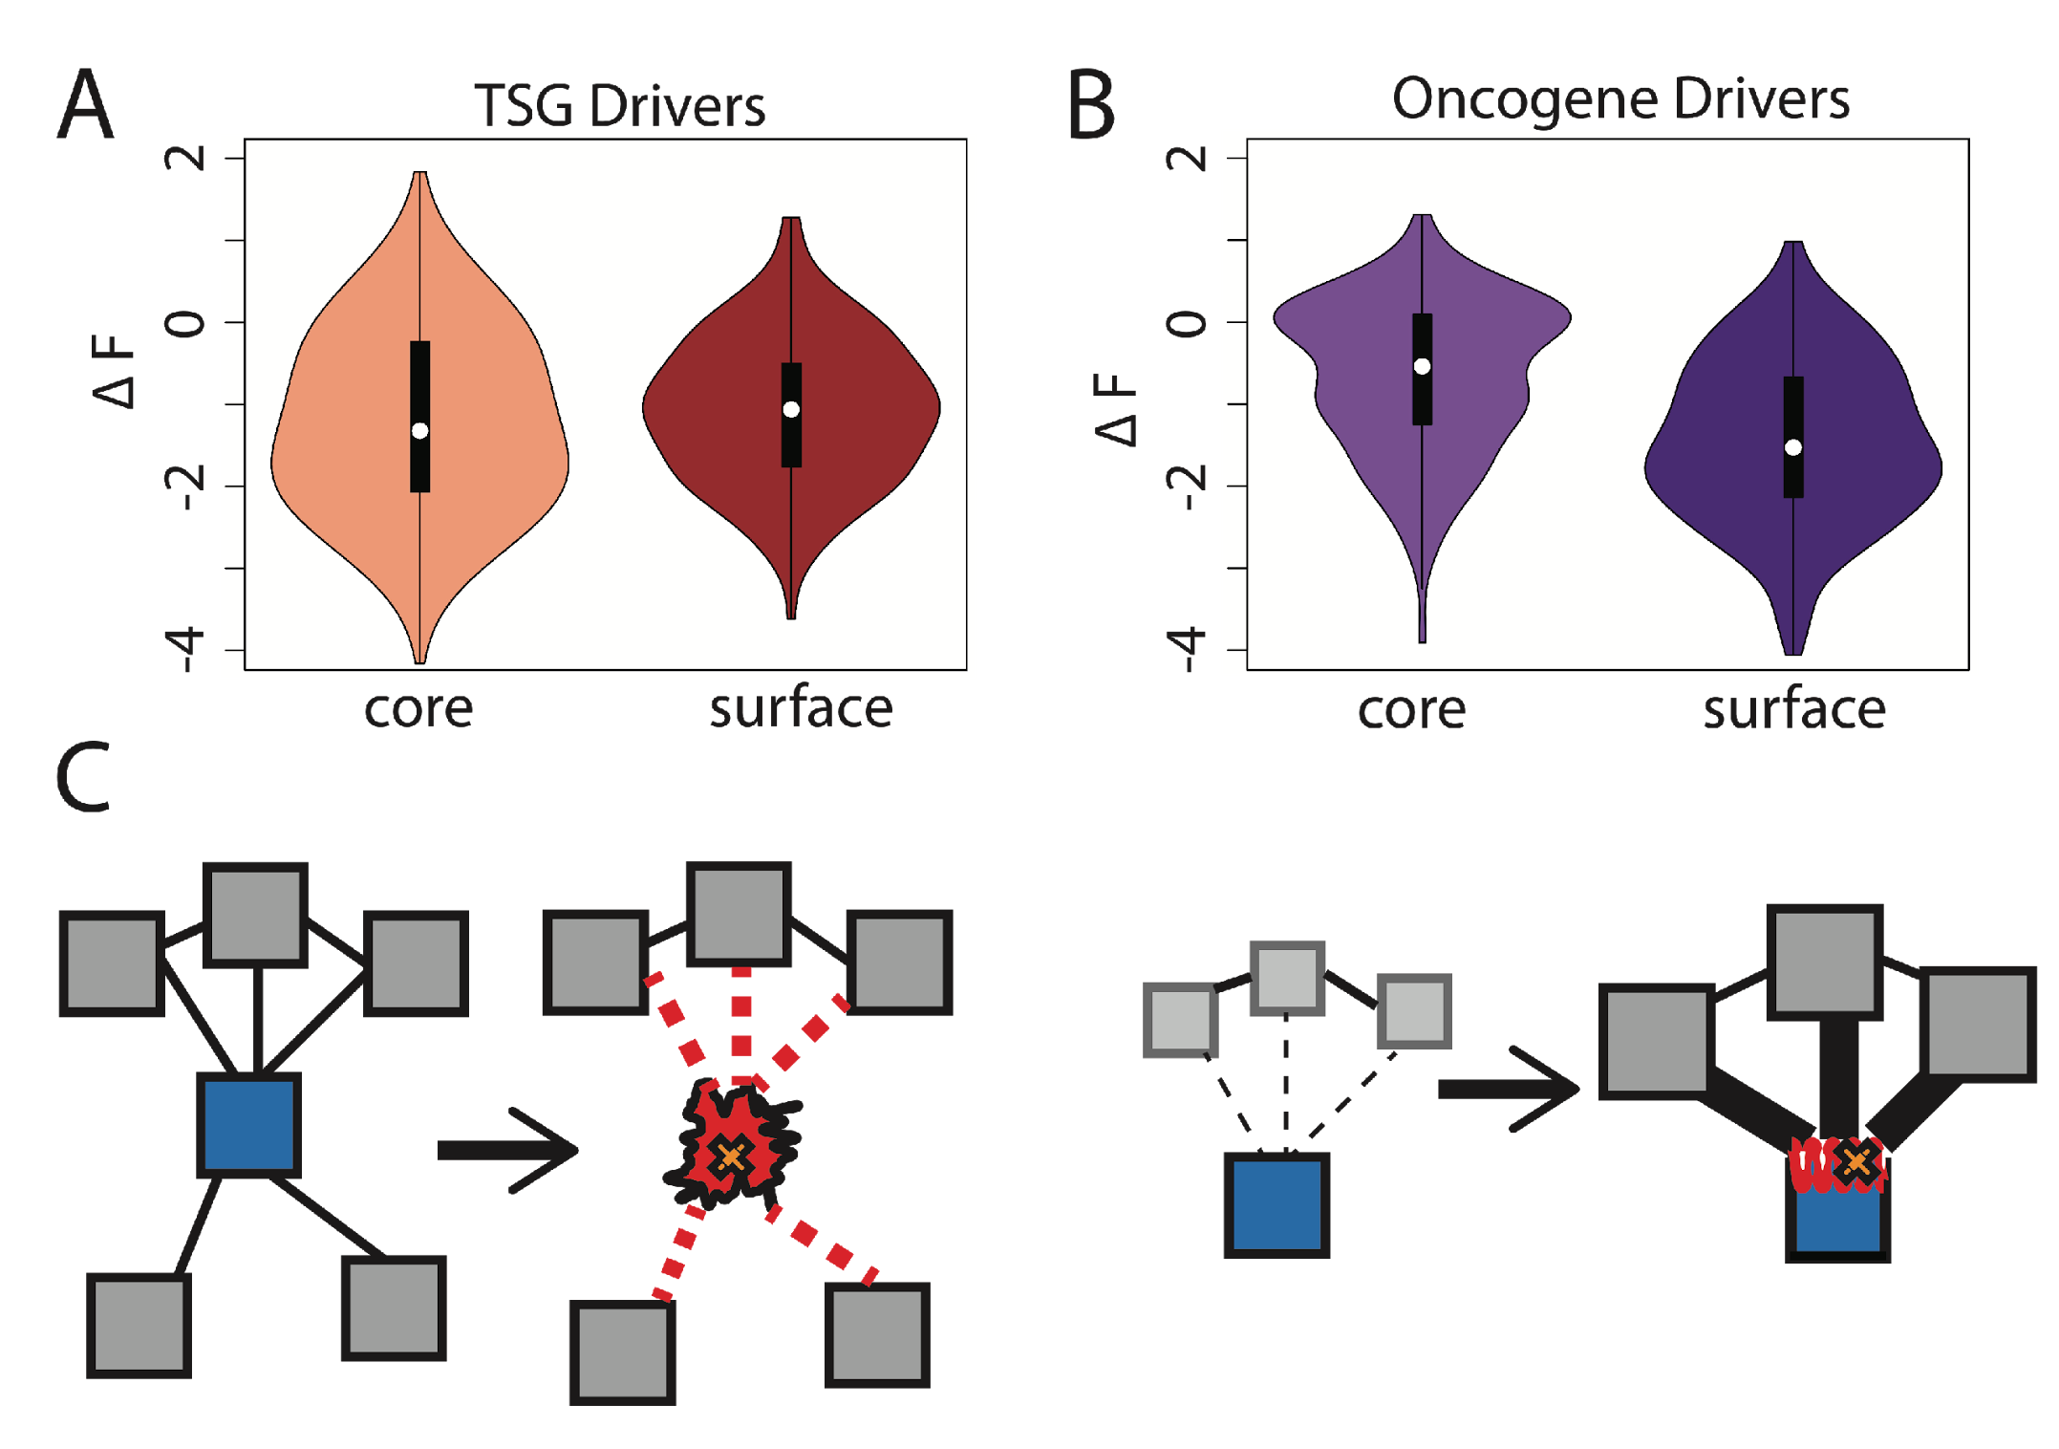
Comparison between ∆F distributions: TSGs v. oncogenes
[Kumar et al. NAR (in press); biorxiv 052027]
SNVs in TSGs change frustration more in core than the surface, whereas those associated with oncogenes manifest the opposite pattern. This is consistent with differences in LOF v GOF mechanisms.
Notes:
we observe that somatic SNVs associated with TSGs change the frustration more in core than the surface, whereas those associated with oncogenes manifest the opposite pattern. This is consistent with LOF and GOF mechanism proposed for TSG and oncogene driven cancer progression.

Slide 29
Personal Genomics: Managing Exponential Data Scaling through Prioritizing High-impact Variants
Introduction
The exponential scaling of data generation & processing
The landscape of variants in personal genomes suggests finding a few key ones
Evaluating the Impact of Non-coding Variants with Annotation
Annotating non-coding regions on different scales with MUSIC
Prioritizing rare variants with “sensitive sites” (human-conserved)
Prioritizing in terms of network connectivity (eg hubs)
Prioritizing using AlleleDB in terms of allelic elements
Having observed difference in molecular activity in many contexts
Putting it together in Workflows
Using Larva to do burden testing on non-coding annotation
Need to correct for over-dispersion mutation counts
Parameterized according to replication timing
Using FunSeq to integrate evidence on variants
Systematically weighting all the features
suggesting non-coding drivers
Prioritzing rare germline variants
Postscript: Analysis of the Evolution of a Consortium
Differences in “modularity” for members & users
Key role for brokers

Slide 30
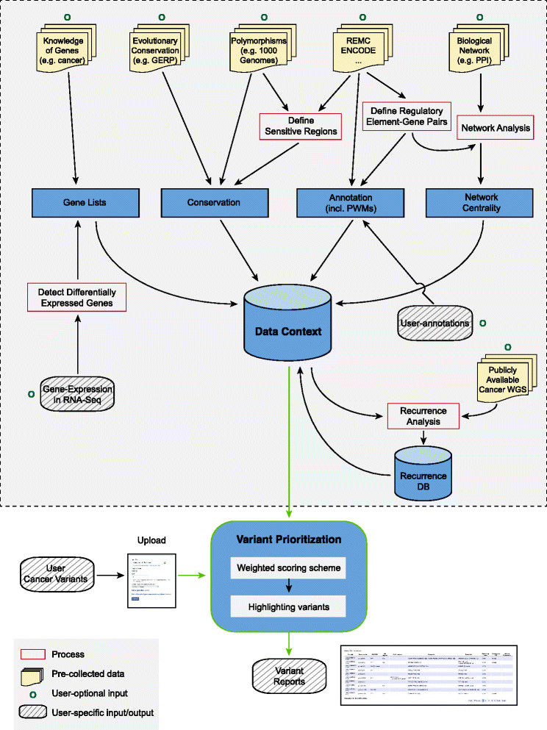
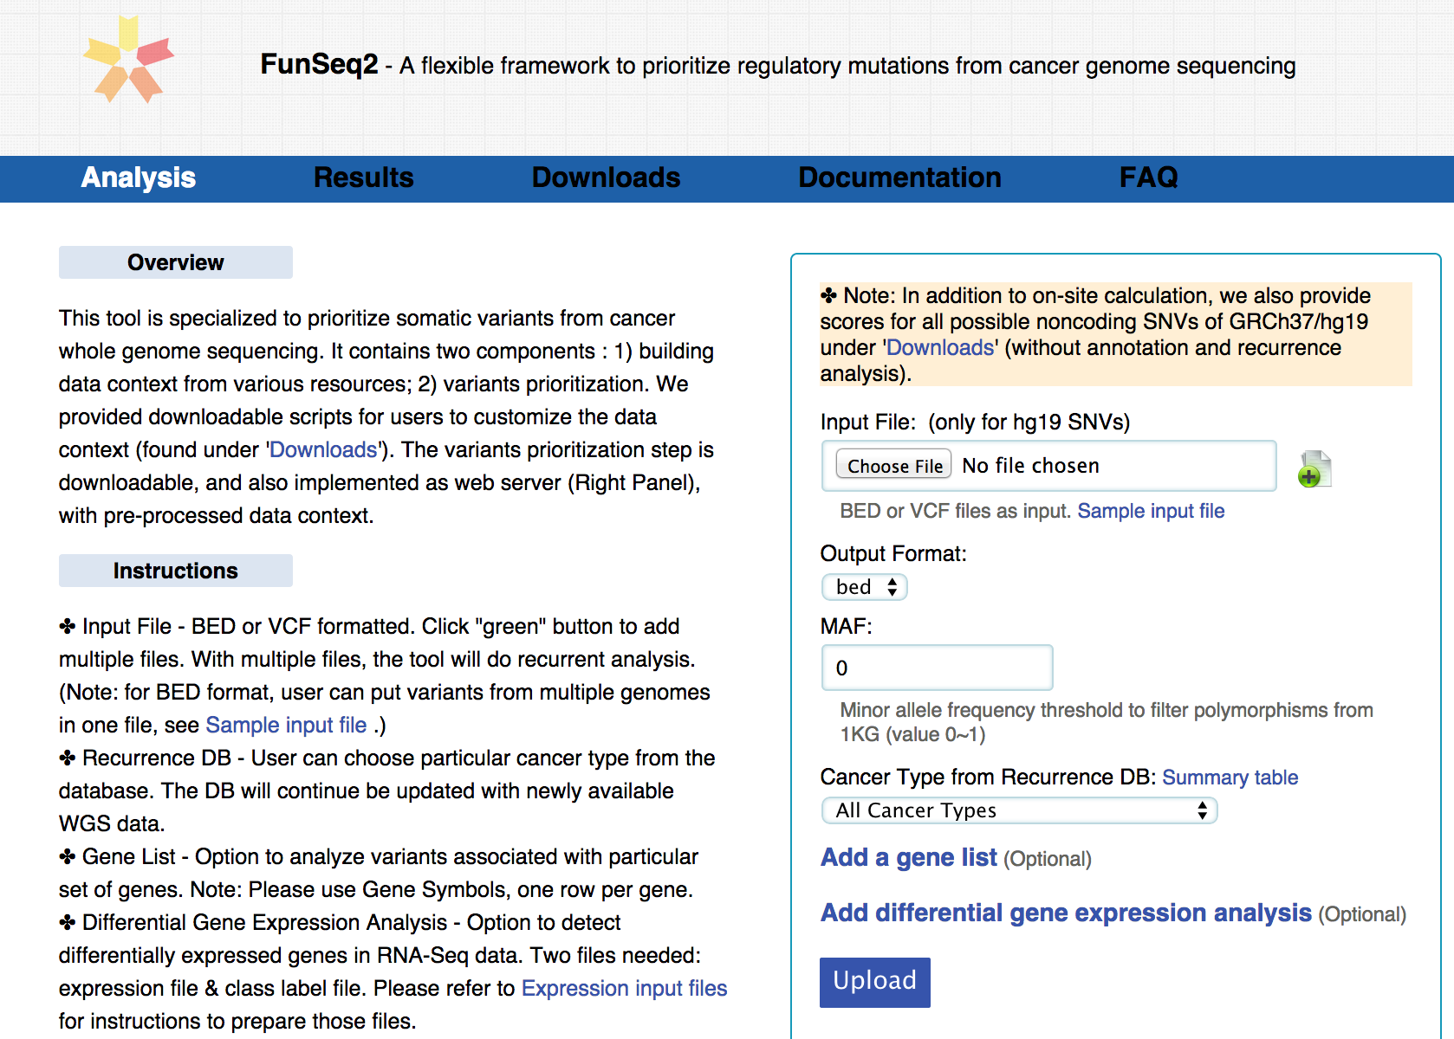
FunSeq2.gersteinlab.org
[Fu et al., GenomeBiology ('14)]

Slide 31
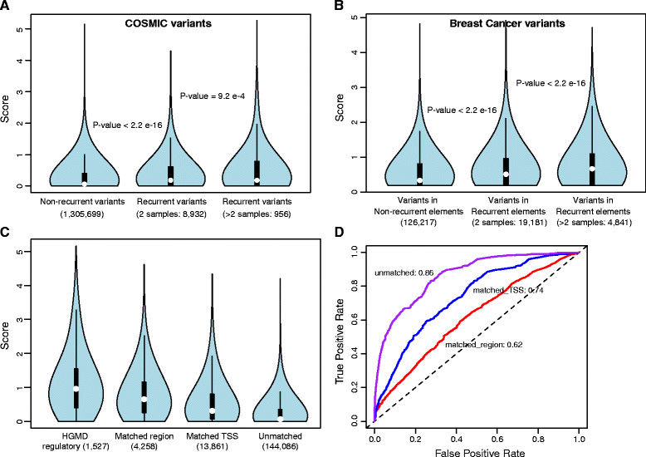
Feature weight
- Weighted with mutation patterns in natural polymorphisms
(features frequently observed weight less)
- entropy based method
Discrete features:
Continuous features:

Slide 32
Personal Genomics: Managing Exponential Data Scaling through Prioritizing High-impact Variants
Introduction
The exponential scaling of data generation & processing
The landscape of variants in personal genomes suggests finding a few key ones
Evaluating the Impact of Non-coding Variants with Annotation
Annotating non-coding regions on different scales with MUSIC
Prioritizing rare variants with “sensitive sites” (human-conserved)
Prioritizing in terms of network connectivity (eg hubs)
Prioritizing using AlleleDB in terms of allelic elements
Having observed difference in molecular activity in many contexts
Putting it together in Workflows
Using Larva to do burden testing on non-coding annotation
Need to correct for over-dispersion mutation counts
Parameterized according to replication timing
Using FunSeq to integrate evidence on variants
Systematically weighting all the features
suggesting non-coding drivers
Prioritzing rare germline variants
Postscript: Analysis of the Evolution of a Consortium
Differences in “modularity” for members & users
Key role for brokers

Slide 33
Mutation recurrence
Cancer Type 1
Cancer Type 2
Cancer Type 3

Slide 34
Mutation recurrence
Cancer Type 1
Cancer Type 2
Cancer Type 3
Early replicated regions
Late replicated regions

Slide 35
Noncoding annotations
Cancer Type 1
Cancer Type 2
Cancer Type 3
Early replicated regions
Late replicated regions

Slide 36
Noncoding annotations
Cancer Type 1
Cancer Type 2
Cancer Type 3
Early replicated regions
Late replicated regions

Slide 37
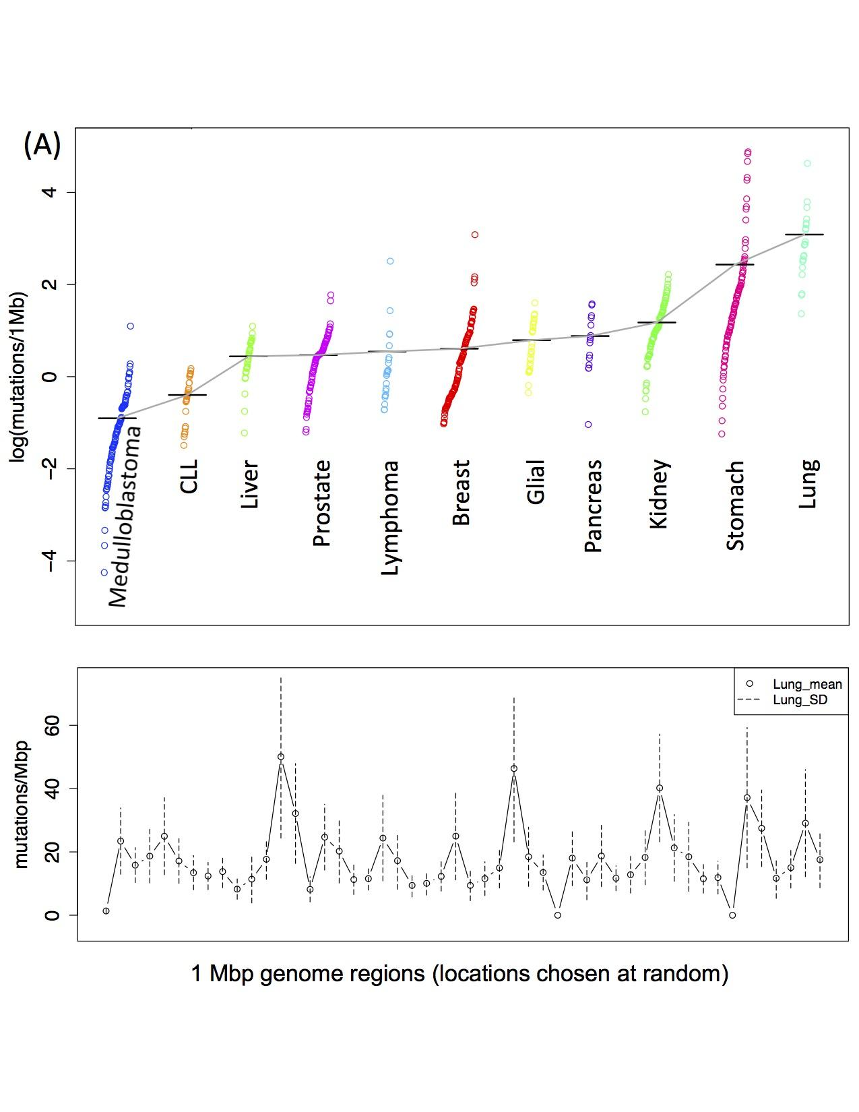
Cancer Somatic Mutational Heterogeneity, across cancer types, samples & regions
[Lochovsky et al. NAR (’15)]

Slide 38
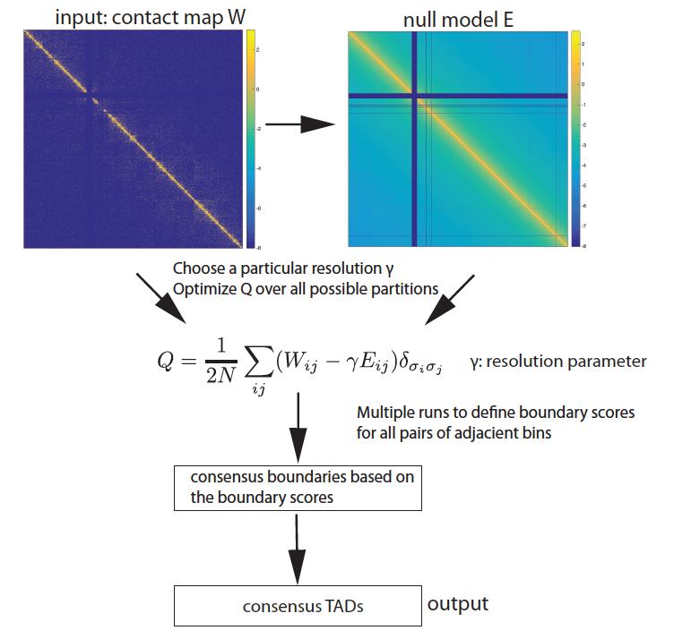
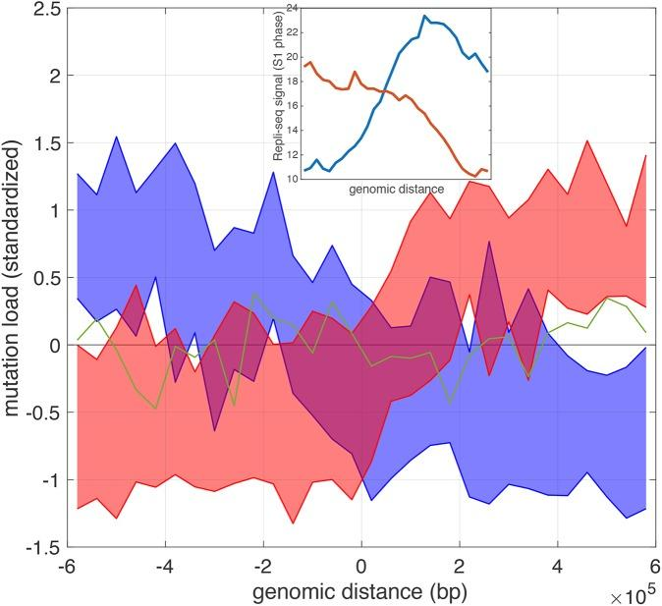
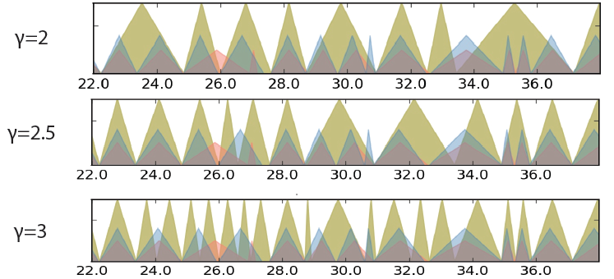
Identifying TADs in multiple resolutions
[Yan et al., PLOS Comp. Bio. 2017; bioRxiv 097345]
Mutation burden and DNA replication timing on TAD boundary

Slide 39
Characterizing TADs at Multiple Scales
Using modularity for identification
Developing an appropriate null expectation
Numerically solve for
in equations

Slide 40
Multi-scale Element Annotation & Variant Prioritization
FunSeq Software Tool for Variant Prioritization
Systematically weighting all the features, for non-coding prioritization

Slide 41
LARVA Implementation
http://larva.gersteinlab.org/
Freely downloadable C++ program
Verified compilation and correct execution on Linux
A Docker image is also available to download
Runs on any operating system supported by Docker
Running time on transcription factor binding sites (a worst case input size) is ~80 min
Running time scales linearly with the number of annotations in the input

Slide 42
Personal Genomics: Managing Exponential Data Scaling through Prioritizing High-impact Variants
Introduction
The exponential scaling of data generation & processing
The landscape of variants in personal genomes suggests finding a few key ones
Evaluating the Impact of Non-coding Variants with Annotation
Annotating non-coding regions on different scales with MUSIC
Prioritizing rare variants with “sensitive sites” (human-conserved)
Prioritizing in terms of network connectivity (eg hubs)
Prioritizing using AlleleDB in terms of allelic elements
Having observed difference in molecular activity in many contexts
Putting it together in Workflows
Using Larva to do burden testing on non-coding annotation
Need to correct for over-dispersion mutation counts
Parameterized according to replication timing
Using FunSeq to integrate evidence on variants
Systematically weighting all the features
suggesting non-coding drivers
Prioritzing rare germline variants
Postscript: Analysis of the Evolution of a Consortium
Differences in “modularity” for members & users
Key role for brokers

Slide 43
Cancer Somatic Mutation Modeling
PARAMETRIC MODELS
Suppose there are k genome elements. For element i, define:
n_{i}: total number of nucleotides
x_{i}: the number of mutations within the element
p: the mutation rate
R_{i}: the covariate rank of the element
Non-parametric model is useful when covariate data is missing for the studied annotations
Also sidesteps issue of properly identifying and modeling every relevant covariate (possibly hundreds)
NON-PARAMETRIC MODELS
Model 1: Constant Background Mutation Rate (Model from Previous Work)
Assume constant background mutation rate in local regions.
Model 3a: Random Permutation of Input Annotations
Model 2a: Varying Mutation Rate
with Single Covariate Correction
Shuffle annotations within local region to assess background mutation rate.
Model 3b: Random Permutation of Input Variants
Shuffle variants within local region to assess background mutation rate.
Model 2b: Varying Mutation Rate
with Multiple Covariate Correction
[Lochovsky et al. under review]
[Lochovsky et al. NAR (’15)]

Slide 44
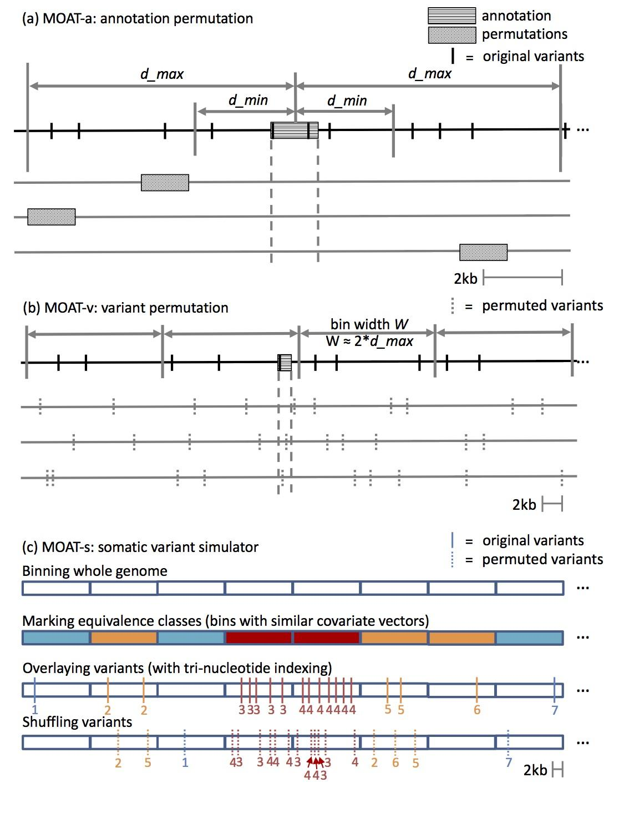
MOAT schematic

Slide 45
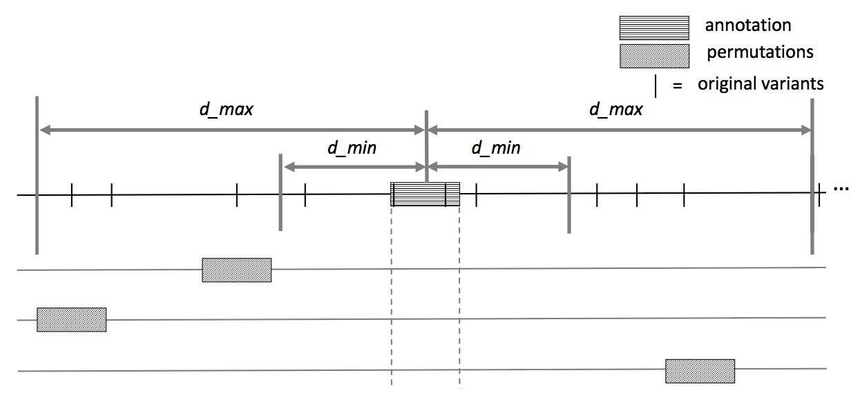
MOAT-a: Annotation-based permutation
Notes:
Formally, this method incorporates the annotation length l, the number of random bins we’re going to place in the surrounding genome, n, and two parameters that determine the boundaries of the local genome in which we place random bins, d_min and d_max. d_max has to be small enough that the background mutation rate is roughly constant, while d_min exists to ensure that, if there’s some transitionary region between the mutation rate of a and the mutation rate of the surrounding genome, that the signal from a won’t bleed into our analysis of the local genome context.

Slide 46
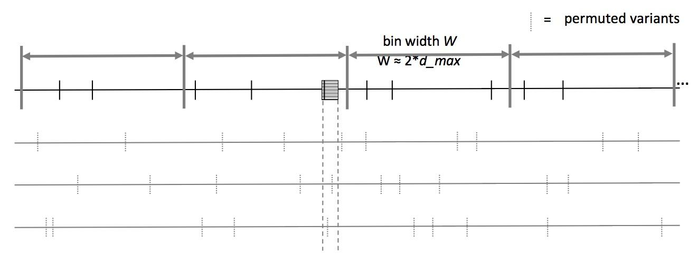
MOAT-v: Variant-based Permutation
Notes:
The second version of MOAT operates on the idea of variant-based permutation. We place bins over the entire genome that each represent a local genome context, shuffle the variants in each bin, and track permuted variant counts for the annotation we’re studying.

Slide 47
MOAT-v: Variant-based Permutation
For each bin, repeat n times:
Iterate through intersecting variants: pick a new location in the bin that has the same trinucleotide context in the reference genome as the original variant location
Pick with uniform probability, excluding the original variant location as a possible new location
new variant
original variant
alt
T
T
ref
CTTCAAGTTCTCAACTCCTGTCAATATCCCTTCCCCTCAACTTGACAATC
*
*
*
*
* = candidates for variant’s new location
Notes:
When we move the variants’ to new locations, we want to preserve the trinucleotide context of the variant, which includes the nucleotide where the variant occurs, and the two neighboring nucleotides on either side. To do this, we index every trinucleotide in the reference genome within the variant’s bin, and select one of these new locations with uniform probability, excluding the original variant site. With this, we maintain the mutation frequencies of the trinucleotides in each bin, and it ensures that the trinucleotide mutation rates are consistent in our permutations.

Slide 48
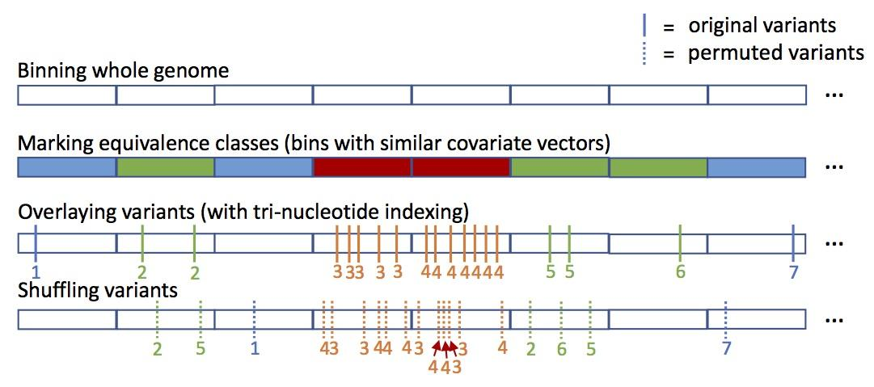
MOAT-s
A somatic variant simulator
Given a set of input variants, shuffle to new locations, taking genome structure into account

Slide 49
Funseq2 Integration
Funseq2¹ integration with MOAT
Computational method developed in the Gerstein lab
Assesses the functional impact of whole genome sequence variants
Uses a vast range of coding and noncoding annotations to prioritize variants most likely to be associated with cancer
MOAT identifies input variants with significantly elevated Funseq scores
Computations performed alongside mutation burden analysis
Works with MOAT-a and MOAT-v
1. Fu, Y. et al. FunSeq2: a framework for prioritizing noncoding regulatory variants in cancer. Genome biology 15, 480 (2014).
Notes:
Just as mutation burden is intended to help find the important stuff in cancer, we can also prioritize important parts of the genome with a functional impact analysis.

Slide 50
Funseq2 Integration
Run Funseq2 over the whole genome
Produce signal track that is the maximum score at each position
Calculate an annotation signal by summing the intersecting variants’ scores
Use the same procedure on permuted data
These are background scores to determine if the observed score is significantly elevated
80
80
50
20
20
50
+
30
20
= 50
0
40

Slide 51
Funseq2 Integration
Compiled list of annotations with significantly elevated Funseq2 scores
TSSes, promoters, enhancers
Results comparable to the elevated mutation burden analysis
MOAT implementation is generalizable to any whole genome signal track
e.g. can plug in a GERP score or K27 acetylation file
Negligible effect on runtime
Parallelization scalability preserved
Notes:
Seems that the list for Funseq2 is longer than for mutation burden → higher false positive rate?

Slide 52
Personal Genomics: Managing Exponential Data Scaling through Prioritizing High-impact Variants
Introduction
The exponential scaling of data generation & processing
The landscape of variants in personal genomes suggests finding a few key ones
Evaluating the Impact of Non-coding Variants with Annotation
Annotating non-coding regions on different scales with MUSIC
Prioritizing rare variants with “sensitive sites” (human-conserved)
Prioritizing in terms of network connectivity (eg hubs)
Prioritizing using AlleleDB in terms of allelic elements
Having observed difference in molecular activity in many contexts
Putting it together in Workflows
Using Larva to do burden testing on non-coding annotation
Need to correct for over-dispersion mutation counts
Parameterized according to replication timing
Using FunSeq to integrate evidence on variants
Systematically weighting all the features
suggesting non-coding drivers
Prioritzing rare germline variants
Postscript: Analysis of the Evolution of a Consortium
Differences in “modularity” for members & users
Key role for brokers

Slide 53
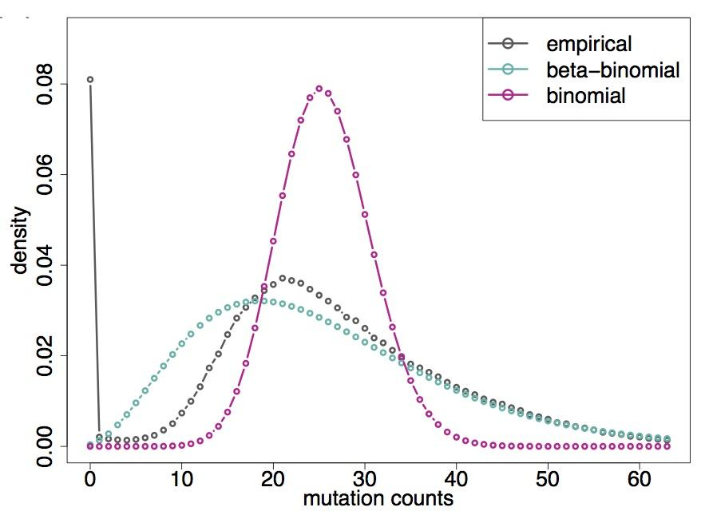
LARVA Model Comparison
Comparison of mutation count frequency implied by the binomial model (model 1) and the beta-binomial model (model 2) relative to the empirical distribution
The beta-binomial distribution is significantly better, especially for accurately modeling the over-dispersion of the empirical distribution
[Lochovsky et al. NAR (’15)]

Slide 56
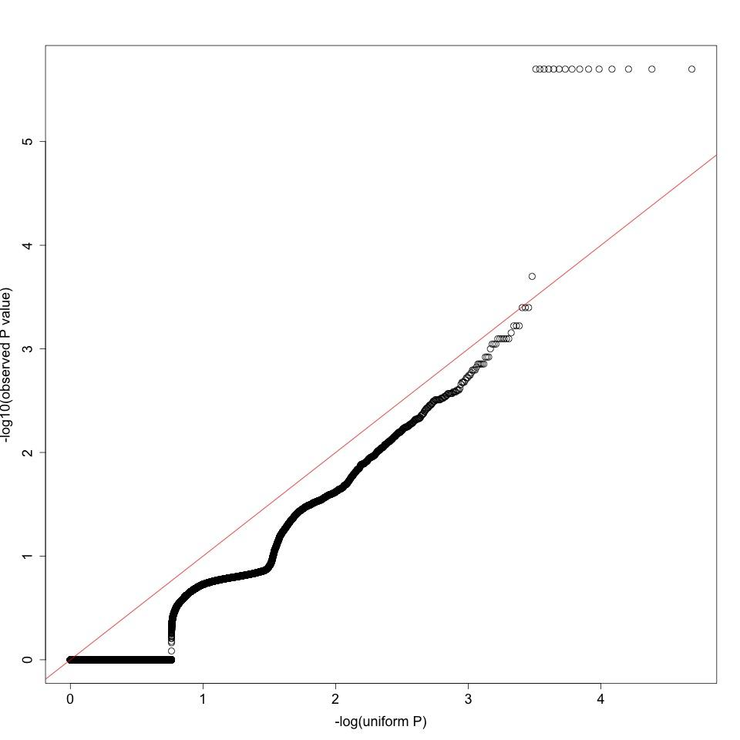
MOAT-a p-value Uniformity QQ-plot

Slide 57
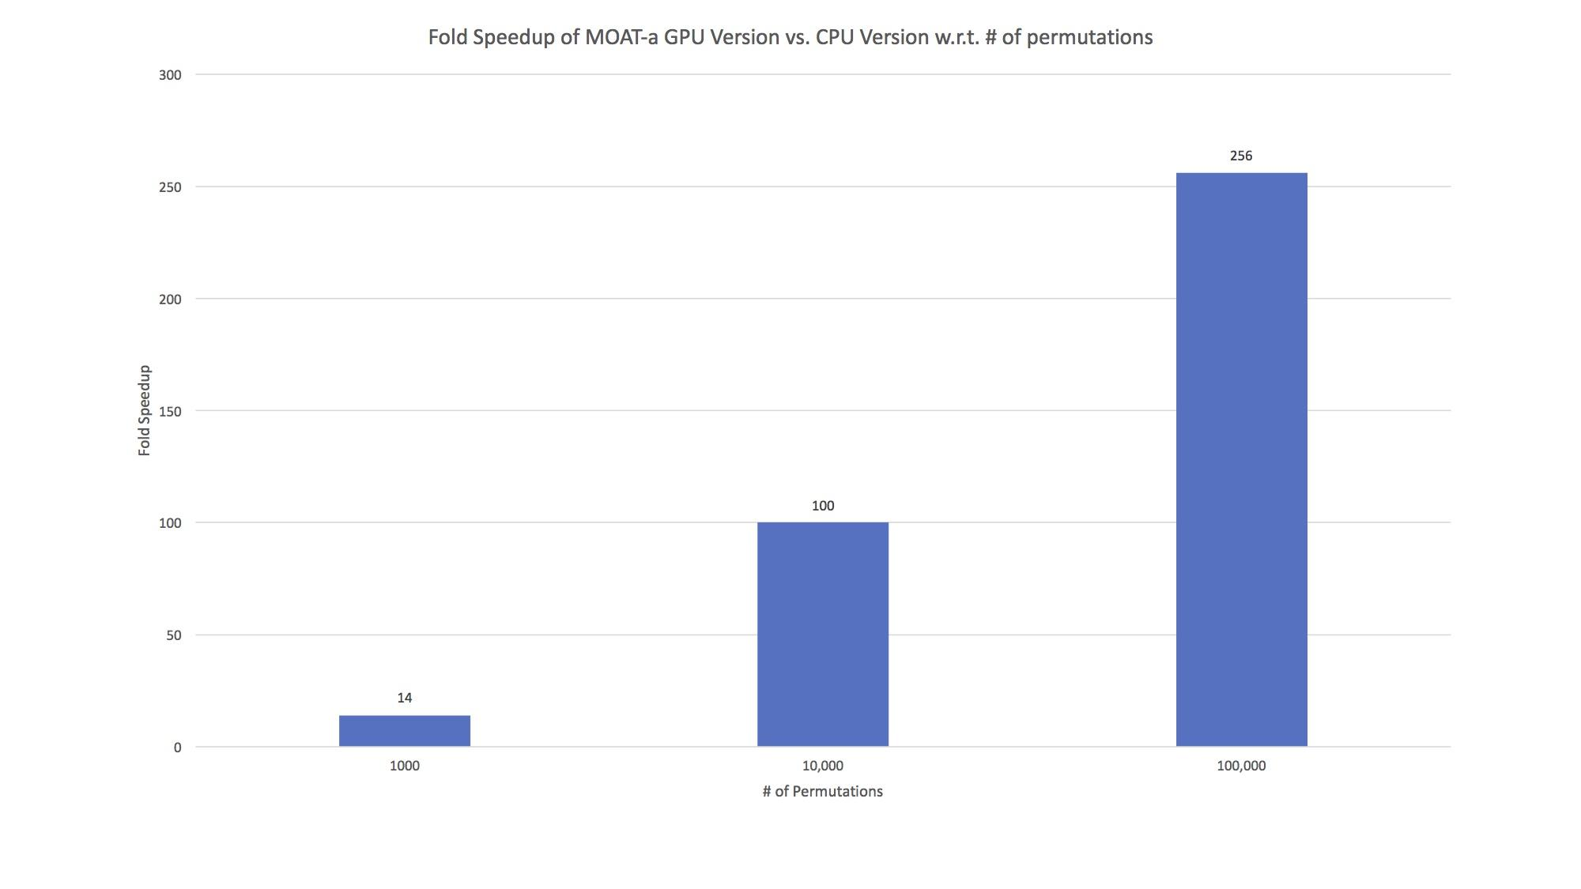
Timed on an input dataset of ~7000 variants and ~13,000 annotations on an Nvidia™ Geforce™ GTX 600-series GPU.

Slide 58
Personal Genomics: Managing Exponential Data Scaling through Prioritizing High-impact Variants
Introduction
The exponential scaling of data generation & processing
The landscape of variants in personal genomes suggests finding a few key ones
Evaluating the Impact of Non-coding Variants with Annotation
Annotating non-coding regions on different scales with MUSIC
Prioritizing rare variants with “sensitive sites” (human-conserved)
Prioritizing in terms of network connectivity (eg hubs)
Prioritizing using AlleleDB in terms of allelic elements
Having observed difference in molecular activity in many contexts
Putting it together in Workflows
Using Larva to do burden testing on non-coding annotation
Need to correct for over-dispersion mutation counts
Parameterized according to replication timing
Using FunSeq to integrate evidence on variants
Systematically weighting all the features
suggesting non-coding drivers
Prioritzing rare germline variants
Postscript: Analysis of the Evolution of a Consortium
Differences in “modularity” for members & users
Key role for brokers

Slide 59
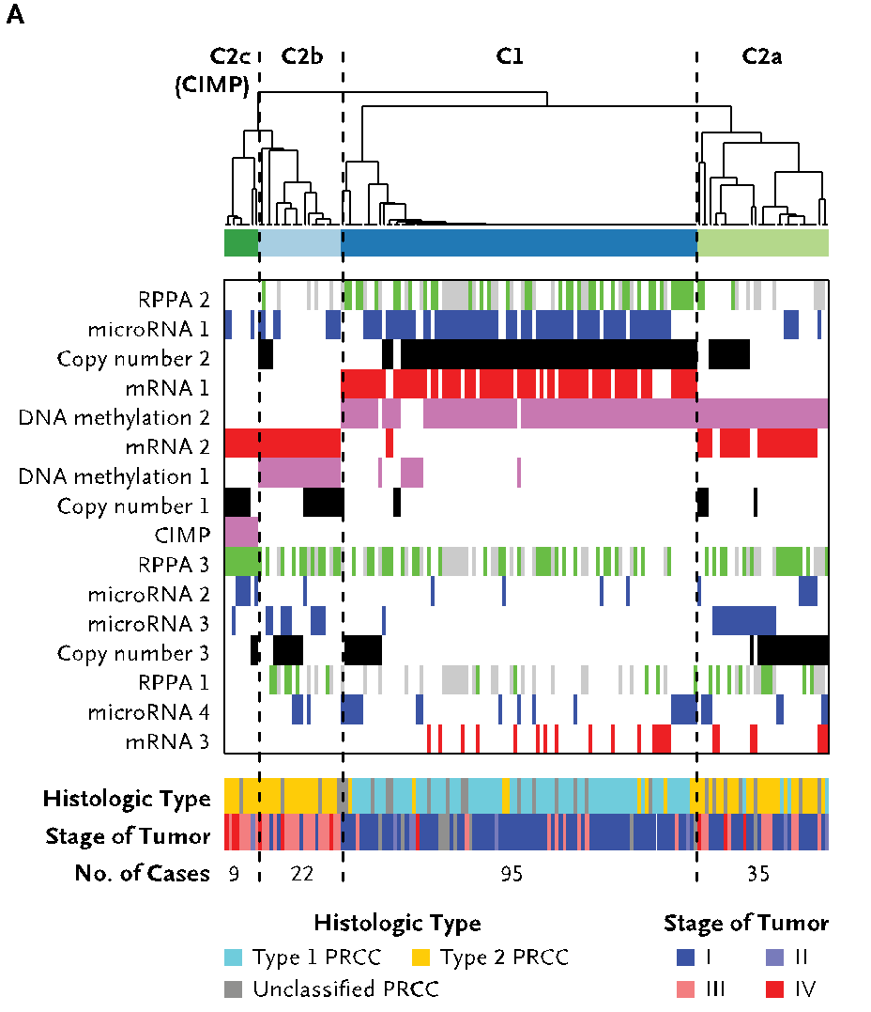
pRCC: ~10% of All Kidney Cancers
Kidney cancer life time risk: 1.6%；the papillary type (pRCC) counts for about 10% of all cases
TCGA project sequenced 161 whole exome of pRCC and conducted molecular subtype
Yet researchers cannot pin down the cause for a significant portion of cases
Cancer Genome Atlas Research Network N Engl J Med. 2016

Slide 60
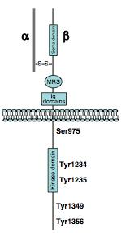
The Tyrosine Kinase MET
MET is a tyrosine kinase and the receptor for HGF
Type I pRCCs show significantly higher MET activation
MET is abnormally activated via
Single nucleotide mutation that lock MET in the activate conformation
An alternative splicing isoform expression
Duplication
A. Gentile, L. Trusolino and PM. Comoglio, Cancer and Metastasis Reviews 2008

Slide 61
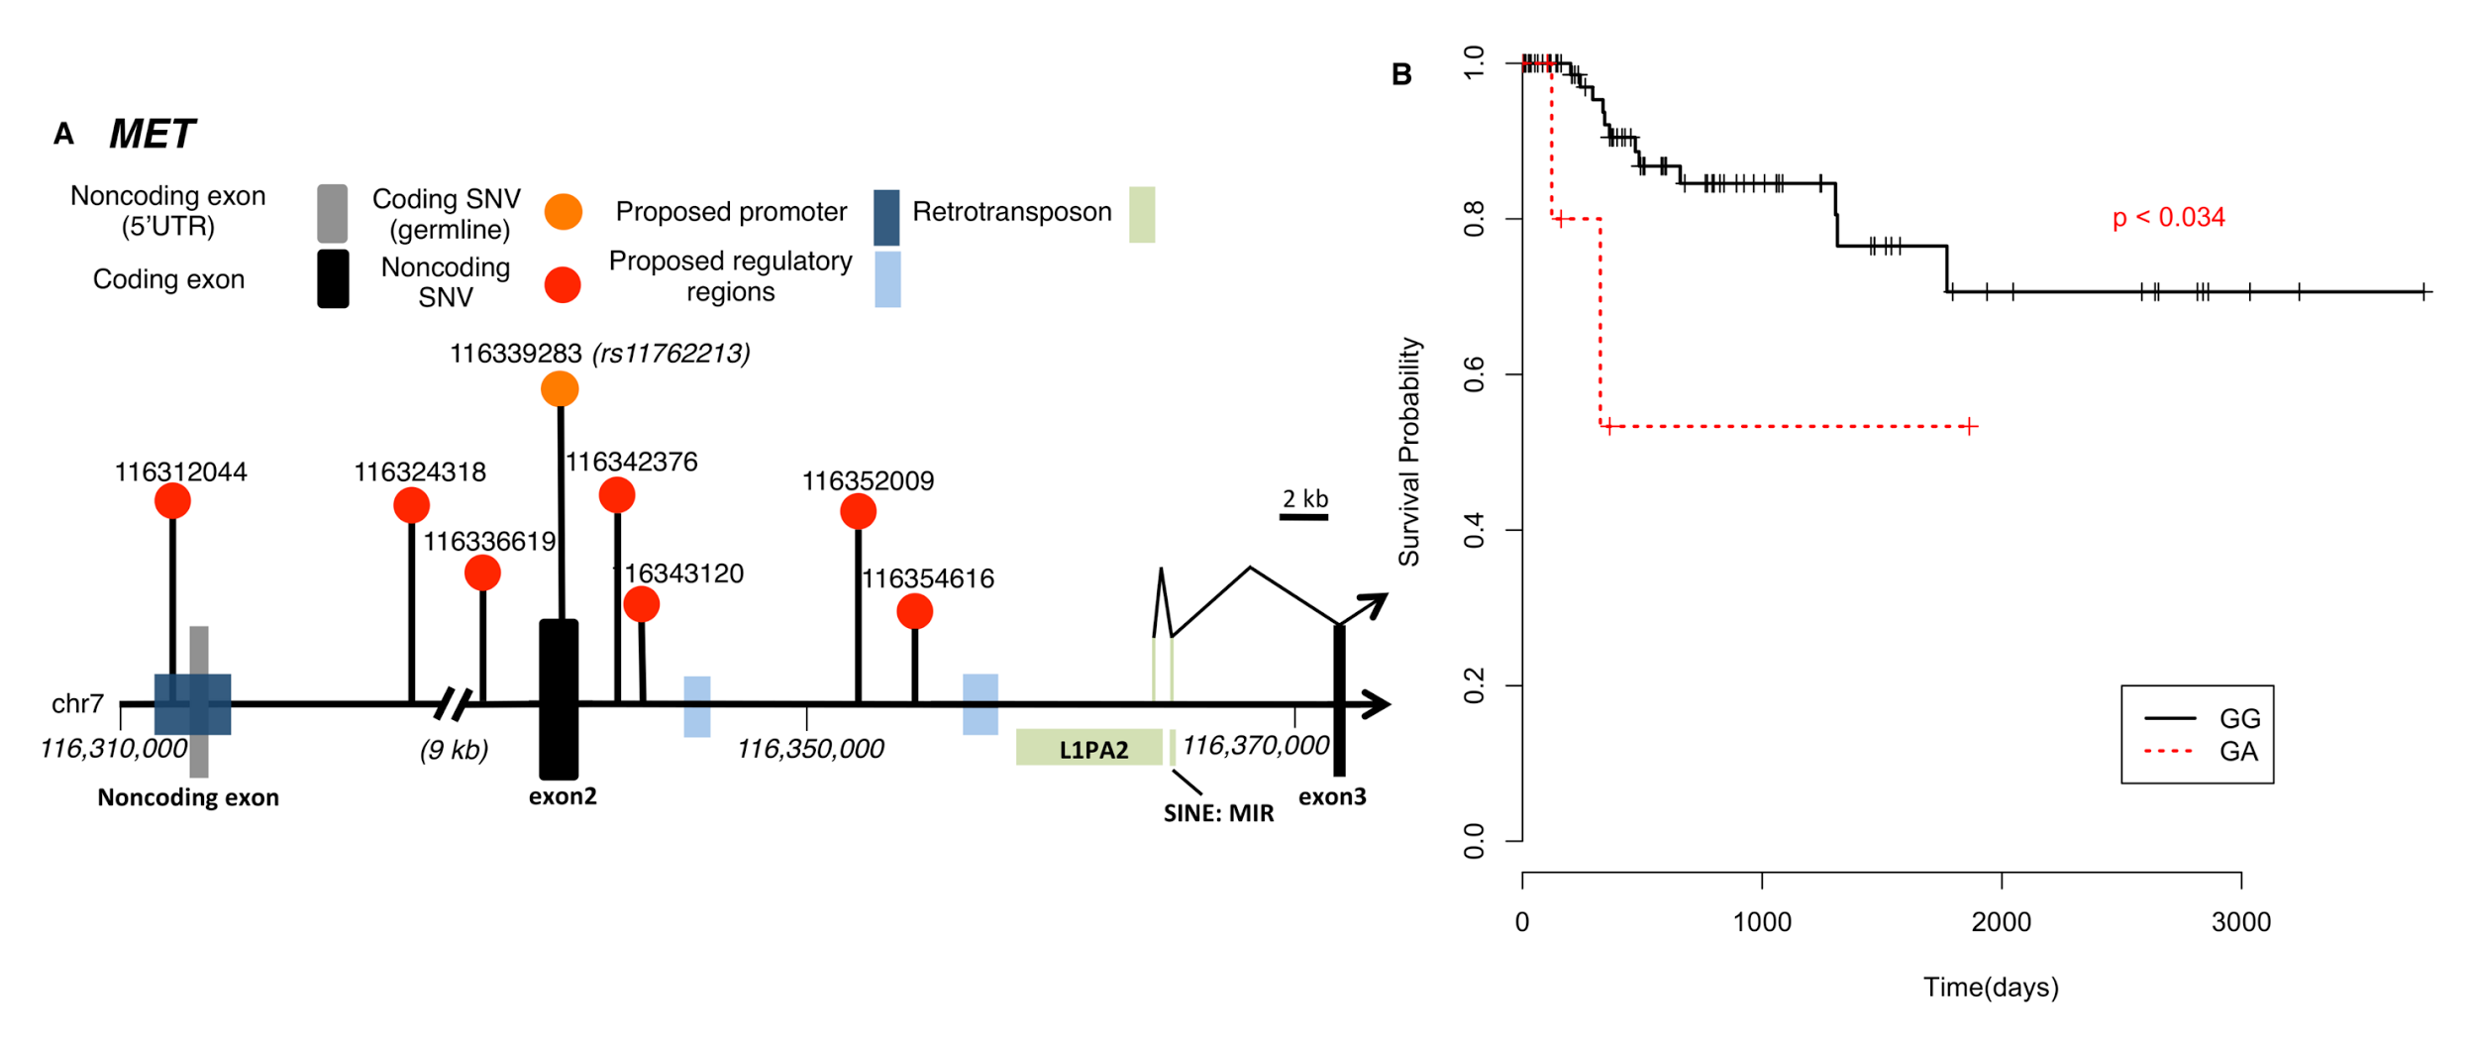
Key Findings in MET
MET is the long-known driver in pRCC, we
Found rs11762213 predicts survival in type 2 patients
Illustrated the mechanism of an alternative splicing event
A noncoding hotspot in MET
Lack of SV and breakpoint disrupting MET
S. Li, B. Shuch and M. Gerstein PLOS Genetics 2017

Slide 62
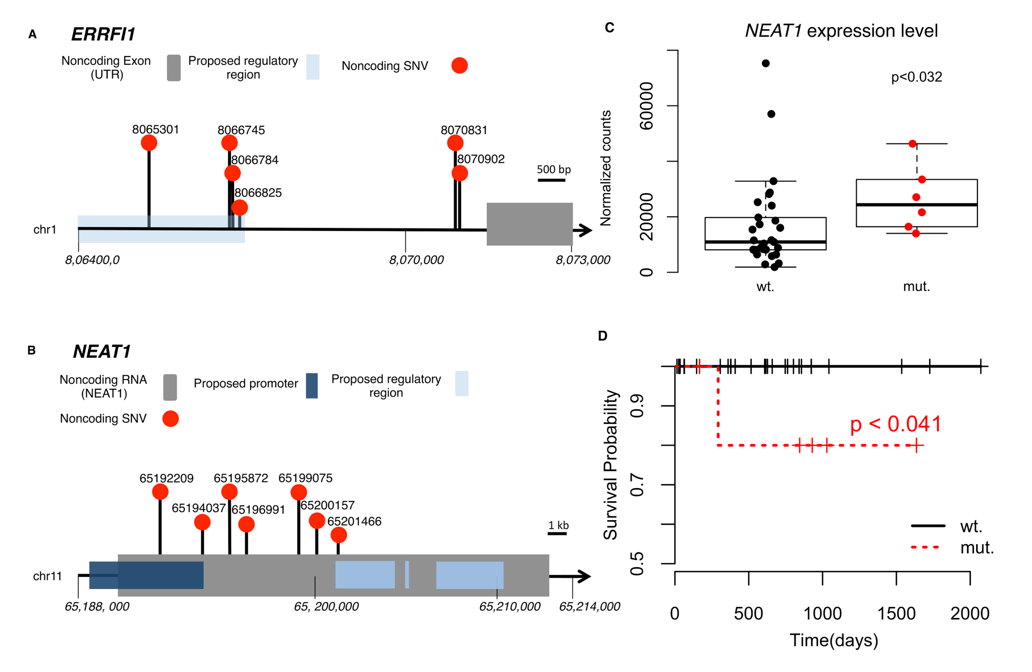
Beyond MET: Two Noncoding Hotspots
S. Li, B. Shuch and M. Gerstein PLOS Genetics 2017

Slide 63
Construct Evolutionary Trees in pRCC
Infer mutation order and tree structure based on mutation abundance (PhyloWGS, Deshwar et al., 2015)
MET: noncoding
ERRFI1: noncoding
DNMT3A: premature stop
NEAT1: noncoding
SMARCA4: missense
KDM6A: missense
S. Li, B. Shuch and M. Gerstein PLOS Genetics 2017

Slide 64
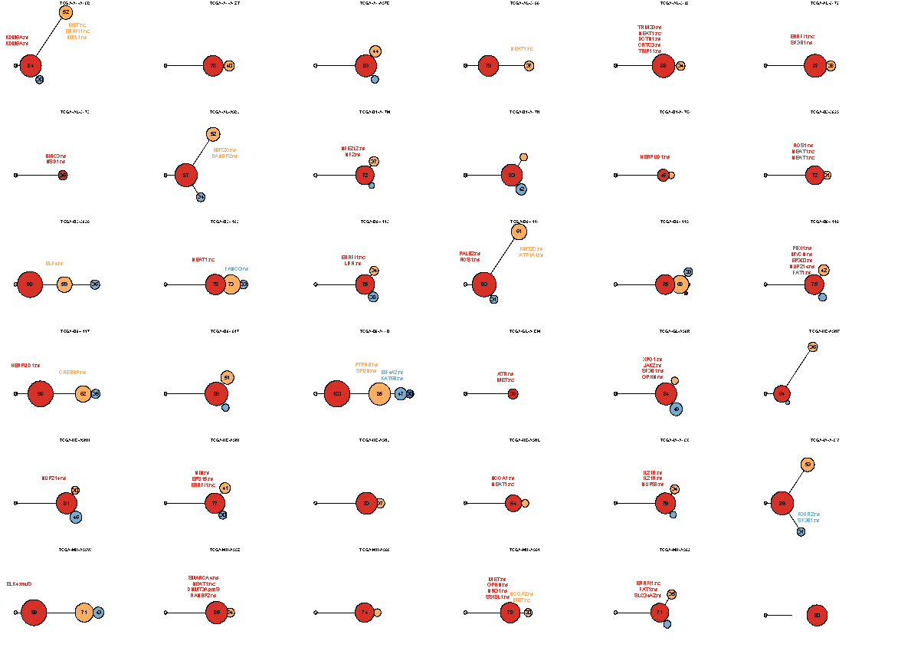
Mutation
distance
Populations
(%)
0.5
Germline
S. Li, B. Shuch and M. Gerstein PLOS Genetics 2017

Slide 65
Mutation
distance
Populations
(%)
0.5
Germline
S. Li, B. Shuch and M. Gerstein PLOS Genetics 2017

Slide 66
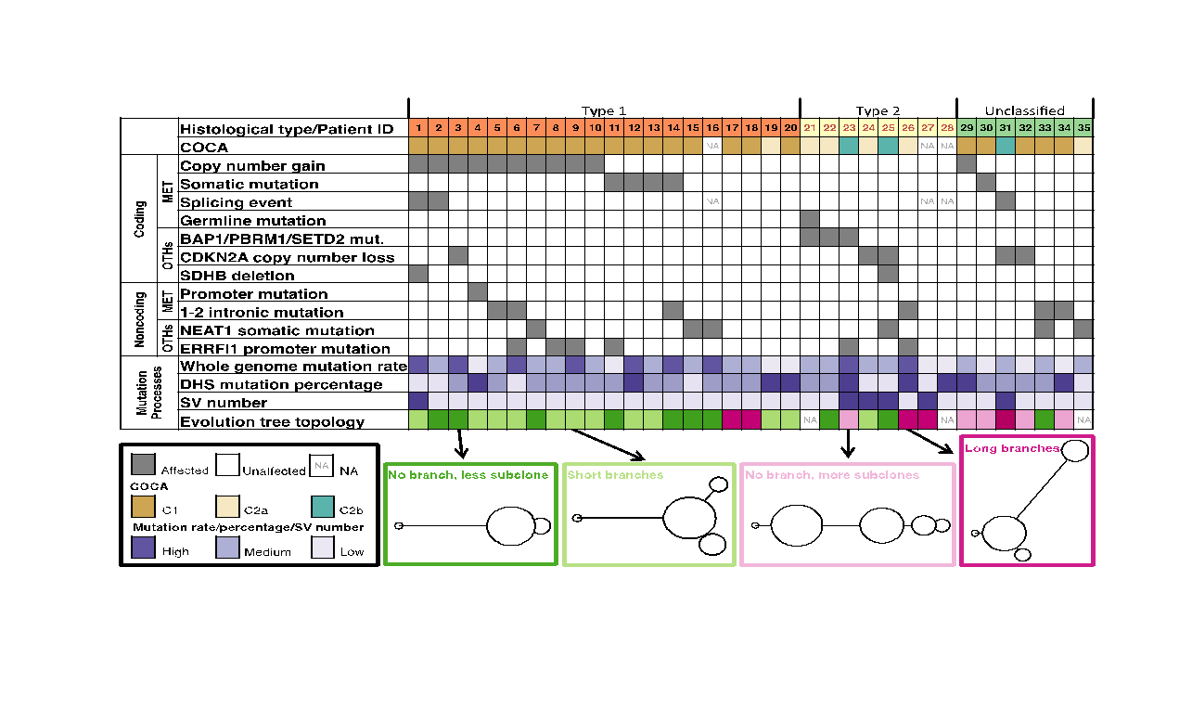
Tree Topology Correlates with Molecular Subtypes
S. Li, B. Shuch and M. Gerstein PLOS Genetics 2017

Slide 67
Personal Genomics: Managing Exponential Data Scaling through Prioritizing High-impact Variants
Introduction
The exponential scaling of data generation & processing
The landscape of variants in personal genomes suggests finding a few key ones
Evaluating the Impact of Non-coding Variants with Annotation
Annotating non-coding regions on different scales with MUSIC
Prioritizing rare variants with “sensitive sites” (human-conserved)
Prioritizing in terms of network connectivity (eg hubs)
Prioritizing using AlleleDB in terms of allelic elements
Having observed difference in molecular activity in many contexts
Putting it together in Workflows
Using Larva to do burden testing on non-coding annotation
Need to correct for over-dispersion mutation counts
Parameterized according to replication timing
Using FunSeq to integrate evidence on variants
Systematically weighting all the features
suggesting non-coding drivers
Prioritzing rare germline variants
Postscript: Analysis of the Evolution of a Consortium
Differences in “modularity” for members & users
Key role for brokers

Slide 68
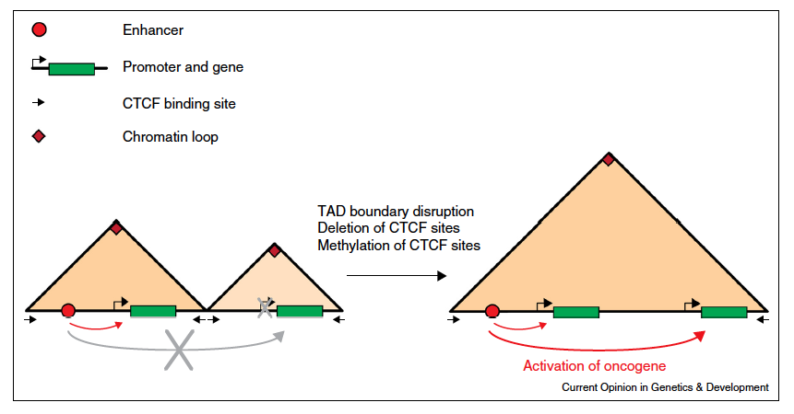
Local TAD boundary disruption activates oncogene
Example: IDH mutant gliomas
Flavahan et al. Bernstein Nature 2016
Example: T-ALL Hnisz
et al. Young Nature 2016
Valton and Dekker Curr. Opin. Genetics and Development 2016

Slide 69
Network modularity
degree of i
adjacency matrix
whether or not
i, j are in the
same module
number of edges
expected number of edges between i and j

Slide 70
Network modularity
Optimization problem
adjacency matrix
degree of i
whether or not
i, j are in the
same module
number of edges
expected number of edges between i and j

Slide 71
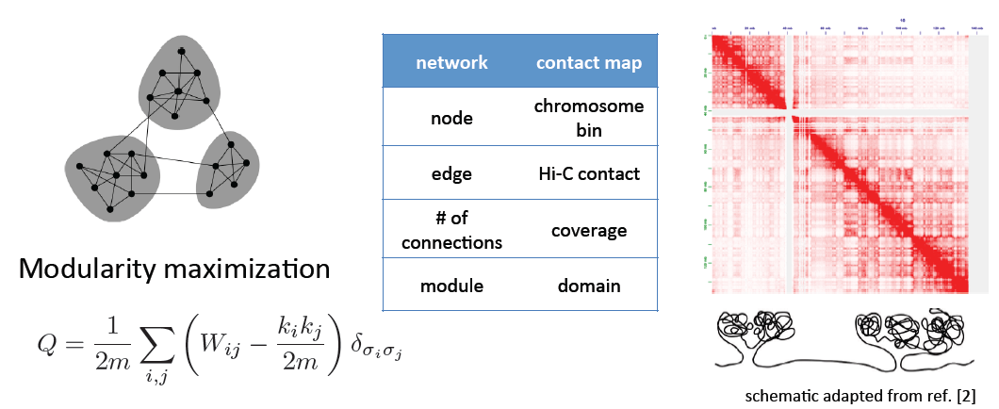
Identifying TADs in multiple resolutions
[Yan et al., PLOS Comp. Bio. (in revision, ‘17); bioRxiv 097345]

Slide 72
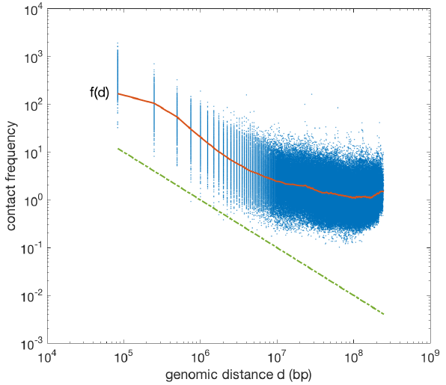
Identifying TADs in multiple resolutions
[Yan et al., PLOS Comp. Bio. (in revision, ‘17); bioRxiv 097345]

Slide 73
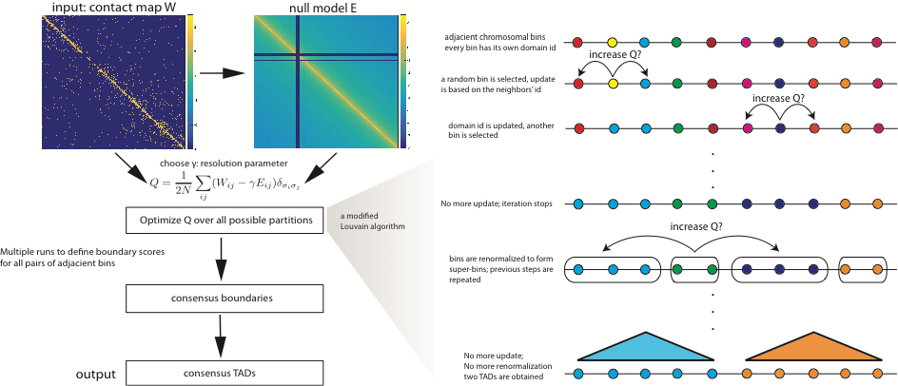
Identifying TADs in multiple resolutions
[Yan et al., PLOS Comp. Bio. (in revision, ‘17); bioRxiv 097345]

Slide 74
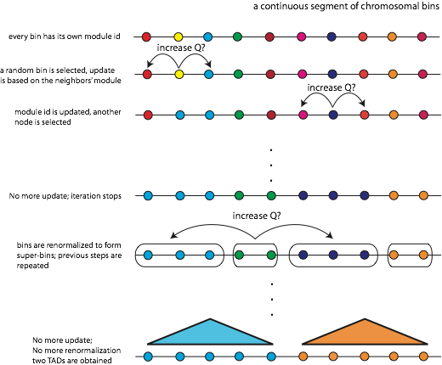
Identifying TADs in multiple resolutions
[Yan et al., PLOS Comp. Bio. (in revision, ‘17); bioRxiv 097345]
a modified Louvain algorithm

Slide 75
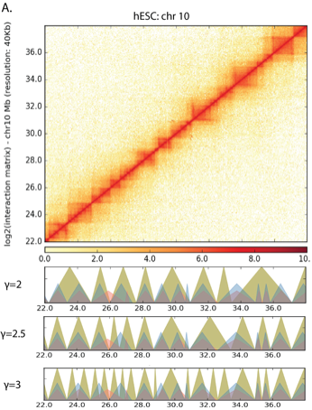
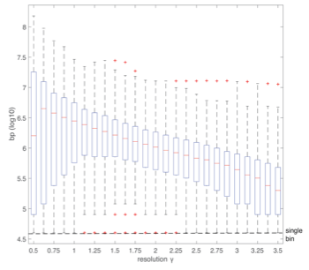
Identifying TADs in multiple resolutions
[Yan et al., PLOS Comp. Bio. (in revision, ‘17); bioRxiv 097345]

Slide 76
Features of Multi-resolution TADs
Specific TFs & HMs associated with TAD boundaries at different scales
Assoc. strong enough to build a predictor
HOT regions at boundaries

Slide 77
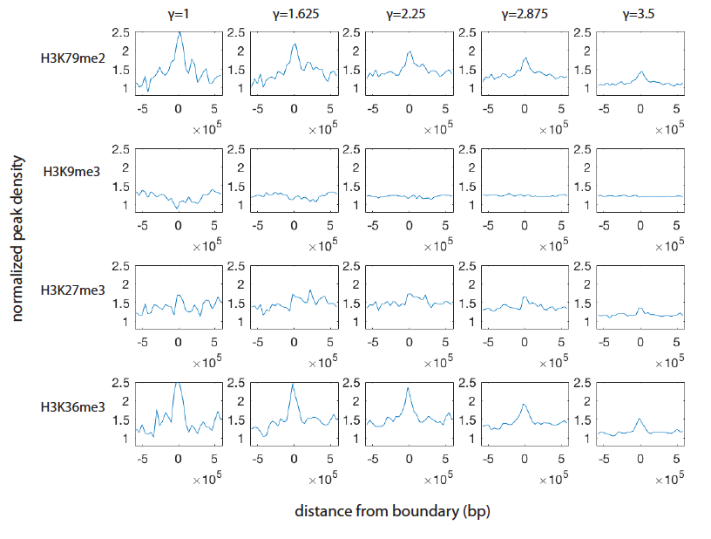
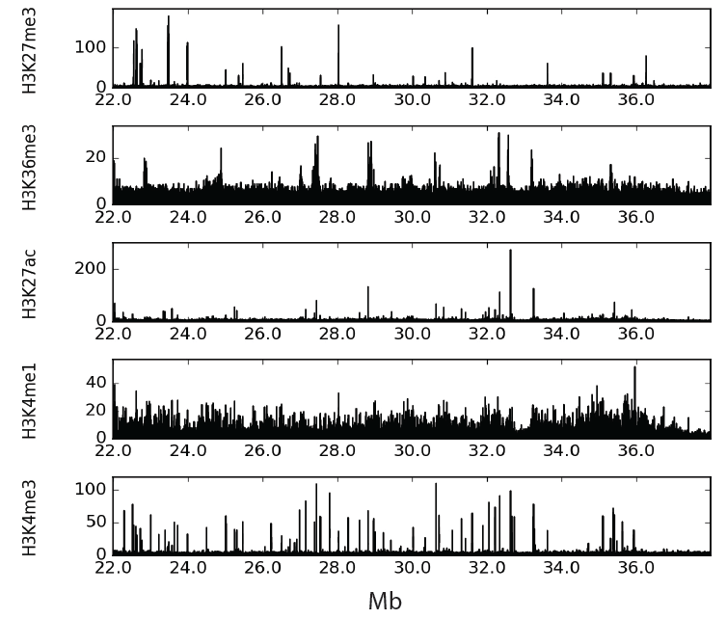
Enrichment of histone features at different resolution
[Yan et al., PLOS Comp. Bio. (in revision, ‘17); bioRxiv 097345]
‹#›

Slide 78
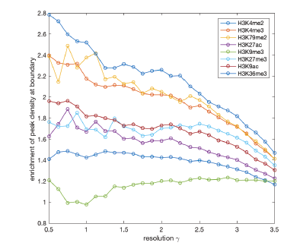
Enrichment of histone features at different resolution
[Yan et al., PLOS Comp. Bio. (in revision, ‘17); bioRxiv 097345]
characteristic length scale

Slide 79
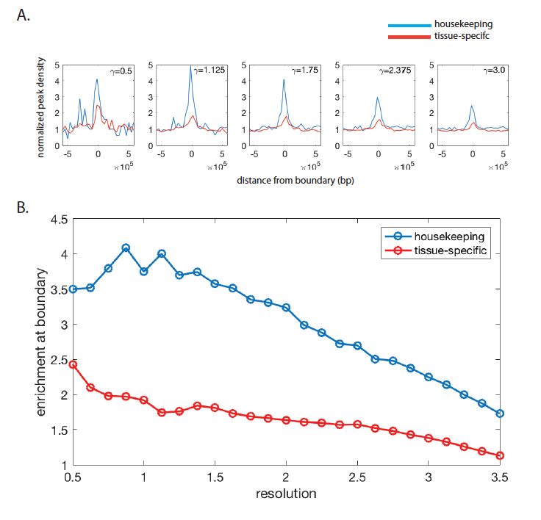
House-keeping vs tissue-specific genes
[Yan et al., PLOS Comp. Bio. (in revision, ‘17); bioRxiv 097345]

Slide 80
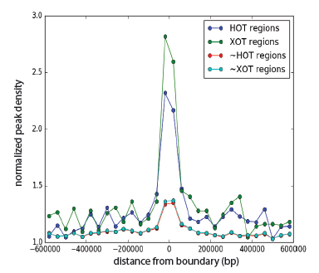
Enrichment of TF binding sites near boundaries
Question:
Causes or Consequences?
[Yan et al., PLOS Comp. Bio. (in revision, ‘17); bioRxiv 097345]

Slide 81
Predicting TAD boundaries using TFs binding pattern
Classification problem:
[Yan et al., PLOS Comp. Bio. (in revision, ‘17); bioRxiv 097345]
model performance

Slide 82
Predicting TAD boundaries using chromatin features
Which transcription factors play a role in border formation?
[Yan et al., PLOS Comp. Bio. (in revision, ‘17); bioRxiv 097345]
contribution of individual factors

Slide 83
Finding "Conserved” Sites in the Human Population: Negative selection in non-coding elements based on Production ENCODE & 1000G Phase 1
Broad categories of regulatory regions under negative selection
Related to:
ENCODE, Nature, 2012
Ward & Kellis, Science, 2012
Mu et al, NAR, 2011
(Non-coding RNA)
(DNase I hypersensitive sites)
(TFSS: Sequence-specific TFs)
(Transcription factor binding sites)
Depletion of Common Variants in the Human Population
[Khurana et al., Science (‘13)]

Slide 84
Differential selective constraints among specific sub-categories
Sub-categorization possible because of better statistics from 1000G phase 1 v pilot
[Khurana et al., Science (‘13)]

Slide 85
Defining Sensitive non-coding Regions
~0.4% genomic coverage (~ top 25)
~0.02% genomic coverage (top 5)
Start 677 high-resolution non-coding categories; Rank & find those under strongest selection
Sub-categorization possible because of better statistics from 1000G phase 1 v pilot
[Khurana et al., Science (‘13)]

Slide 86
Identification of non-coding candidate drivers amongst somatic variants: Scheme
[Khurana et al., Science (‘13)]

Slide 87
Flowchart for 1 Prostate Cancer
Genome (from Berger et al. '11)
[Khurana et al., Science (‘13)]

Slide 88
Feature weight
- Weighted with mutation patterns in natural polymorphisms
(features frequently observed weight less)
- entropy based method
HOT region
Sensitive region
Polymorphisms
Genome
[Fu et al., GenomeBiology ('14)]

Slide 89
Feature weight
- Weighted with mutation patterns in natural polymorphisms
(features frequently observed weight less)
- entropy based method
HOT region
Sensitive region
Polymorphisms
Genome
[Fu et al., GenomeBiology ('14)]

Slide 90
Feature weight
- Weighted with mutation patterns in natural polymorphisms
(features frequently observed weight less)
- entropy based method
HOT region
Sensitive region
Polymorphisms
Genome
Feature weight:
p = probability of the feature overlapping natural polymorphisms
For a variant:
[Fu et al., GenomeBiology ('14)]

