Slide 1
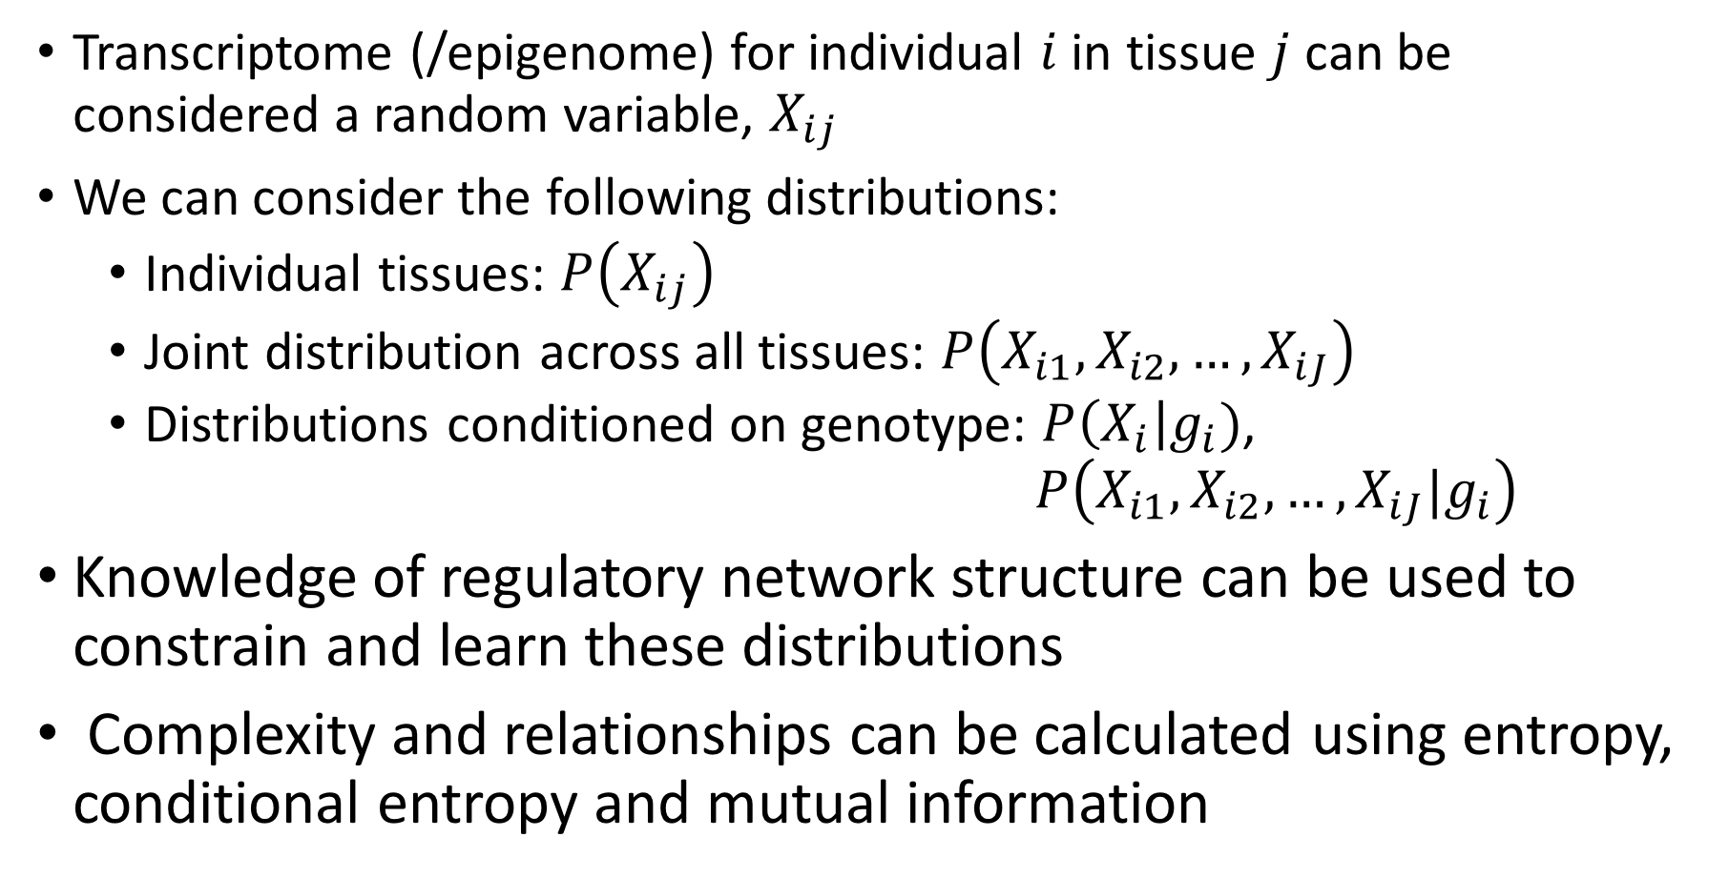
Comparing transcriptome / epigenome complexity across tissues
Transcriptome (/epigenome) for individual $i$ in tissue $j$ can be considered a random variable, $X_{ij}$
We can consider the following distributions:
  Individual tissues: $P\left(X_{ij}\right)$
  Joint distribution across all tissues: $P\left(X_{i1},X_{i2},…,X_{iJ}\right)$
  Distributions conditioned on genotype: $P\left(X_{i}\right|g_{i})$, $P\left(X_{i1},X_{i2},…,X_{iJ}|g_{i}\right)$
Knowledge of regulatory network structure can be used to constrain and learn these distributions
Complexity and relationships can be calculated using entropy, conditional entropy and mutual information

Slide 2
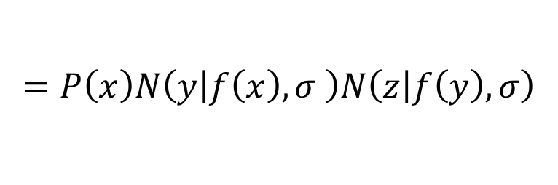



Using regulatory relationships to constrain probabilistic model
For simple networks (e.g. tree structured), local directed models can be directly combined to generate a probabilistic model (e.g. a Bayesian Network):
$$x$$
$$y$$
$$z$$
$$P\left(x,y,z\right)=P\left(x\right)P\left(y | x\right)P\left(z | y\right)$$
$$=P\left(x\right)N\left(y | f\left(x\right),σ \right)N\left(z | f\left(y\right),σ\right)$$

Slide 3



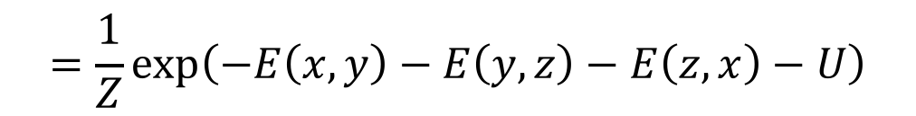
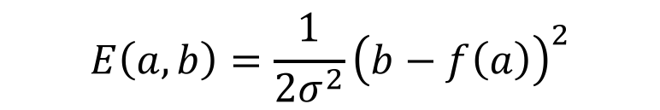
Using regulatory relationships to constrain probabilistic model
If network contains loops, must be considered undirected overall (=> Markov Random Field), although we can still use the local directed structure to parameterize the potentials:
$$z$$
$$x$$
$$y$$
$$P\left(x,y,z\right)=\frac{1}{Z}φ\left(x,y\right)φ\left(y,z\right)φ(z,x)$$
$$=\frac{1}{Z}\exp\left(−E\left(x,y\right)−E\left(y,z\right)−E\left(z,x\right)−U\right)$$
$$E\left(a,b\right)=\frac{1}{{2σ}^{2}}{\left(b−f\left(a\right)\right)}^{2}$$
where:

Slide 4
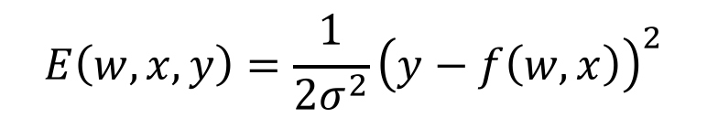

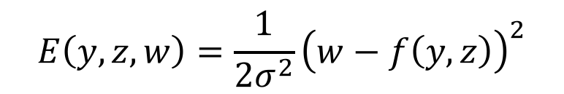
Using regulatory relationships to constrain probabilistic model
For multiple inputs, we can use ‘factor graph’ notation:
$$w$$
$$z$$
$$x$$
$$y$$
$$E\left(w,x,y\right)=\frac{1}{{2σ}^{2}}{\left(y−f\left(w,x\right)\right)}^{2}$$
$$E\left(y,z,w\right)=\frac{1}{2σ^{2}}{\left(w−f\left(y,z\right)\right)}^{2}$$

Slide 5




Cross-tissue Markov network model
Tissue indicators:
$$t_{j}∈\{0,1\}$$
Module activations (/PEER factors):
$$a_{m}∈ℝ$$
Expression levels / Enhancer activities / Chromatin states:
$$x_{n}∈ℝ$$
SNP dosages:
$$g_{k}∈\{0,1,2\}$$

Slide 6

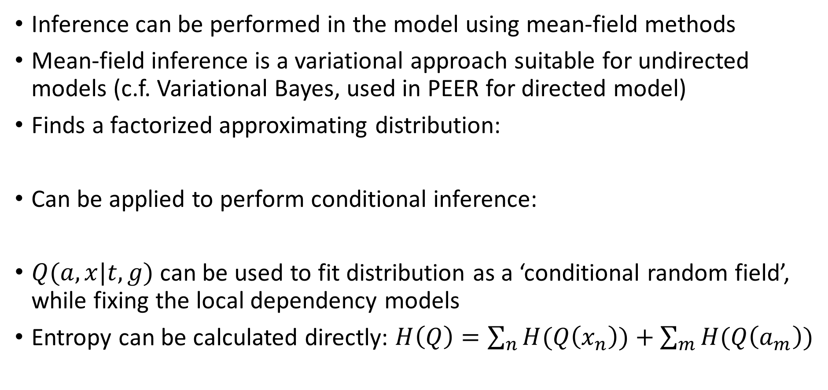
Inference and training
Inference can be performed in the model using mean-field methods
Mean-field inference is a variational approach suitable for undirected models (c.f. Variational Bayes, used in PEER for directed model)
Finds a factorized approximating distribution:
Can be applied to perform conditional inference:
$Q(a,x|t,g)$ can be used to fit distribution as a ‘conditional random field’, while fixing the local dependency models
Entropy can be calculated directly: $H\left(Q\right)=\sum_{n}{H(Q\left(x_{n}\right))+\sum_{m}{H(Q\left(a_{m}\right))}}$
$$Q^{∗}={\text{argmin}}_{Q}(KL\left(Q|P\right))$$
$$Q(a,x|t,g)={\text{argmin}}_{Q}(KL\left(Q|P(a,x|t,g)\right))$$

Slide 7

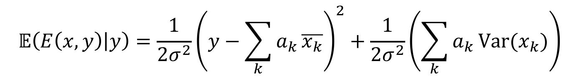
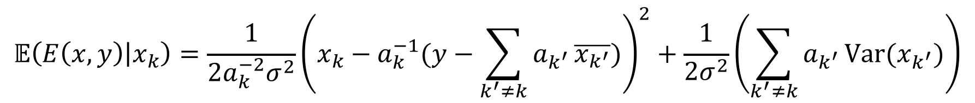

Inference and training
Mean-field updates have the general form:
For local dependency model $E=\frac{1}{{2σ}^{2}}{\left(y−\sum_{k}{a_{k}}x_{k}\right)}^{2}$ with Gaussian factorization of $Q$, updates preserve Gaussian form:
$$Q(x_{i})=\frac{1}{Z_{i}}\exp\left(\sum_{φ}{𝔼(−E_{φ}(x)|x_{i})}\right)$$
$$𝔼\left(E\left(x,y\right) | y\right)=\frac{1}{{2σ}^{2}}{\left(y−\sum_{k}{a_{k}}\overline{x_{k}}\right)}^{2}+\frac{1}{{2σ}^{2}}\left(\sum_{k}{a_{k}}\text{Var}(x_{k})\right)$$
$$𝔼\left(E\left(x,y\right) | x_{k}\right)=\frac{1}{{2a_{k}^{−2}σ}^{2}}{\left(x_{k}−a_{k}^{−1}(y−\sum_{k^{′}≠k}{a_{k^{′}}}\overline{x_{k^{′}}})\right)}^{2}+\frac{1}{{2σ}^{2}}\left(\sum_{k^{′}≠k}{a_{k^{′}}}\text{Var}(x_{k^{′}})\right)$$

Slide 8



Comparing tissue entropies
Entropies can be compared across groups of tissues
$$H(P\left(X_{1},X_{2},…,X_{J}\right))$$
Brain
MI
Other
$$H(P\left(X_{1},X_{2},…,X_{B}\right))$$
$$H(P\left(X_{B+1},X_{B+2},…,X_{J}\right))$$

Slide 9







Comparing tissue entropies
Entropies/Mutual Information can also be compared between brain regions
$$H(P\left(X_{1}\right))$$
Cerebellum
$$I(X_{1};X_{2})$$
$$I(X_{1};X_{3})$$
$$I(X_{1};{X_{2};X}_{3})$$
PFC
Hippo-
campus
$$H(P\left(X_{2}\right))$$
$$I(X_{2};X_{3})$$
$$H(P\left(X_{3}\right))$$

Slide 10

Comparing tissue entropies
In principal, model is predictive, and can can be used to estimate expected transcriptome/modules given genotype and a particular tissue
Can also compare the complexity of particular tissue models conditioned on particular genomes / subsets of genomes (e.g. cases versus controls)
Can use a similar MI approach to look at similarities between conditions
$$H(X_{1}|g_{1}∧g_{2}∧…)$$
Autism
Schz.
Bipol.

