Slide 1
RADAR: an RNA binDing protein regulatory network resource for cAncer Research
Figure Mockup
Workflow walkthrough

Slide 2
A
C
B

Slide 3
(A)
(B)
Length of peaks
# of 1kg variants
(C)
(D)
(E)

Slide 8
C
RBP Specific Annotations
A
B
Length of Genomic Elements
D
Rare DAF Comparison

Slide 11
A
Noncoding
B
Coding
C
D

Slide 12
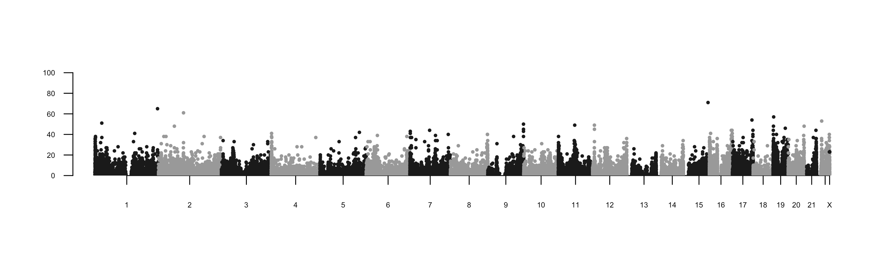
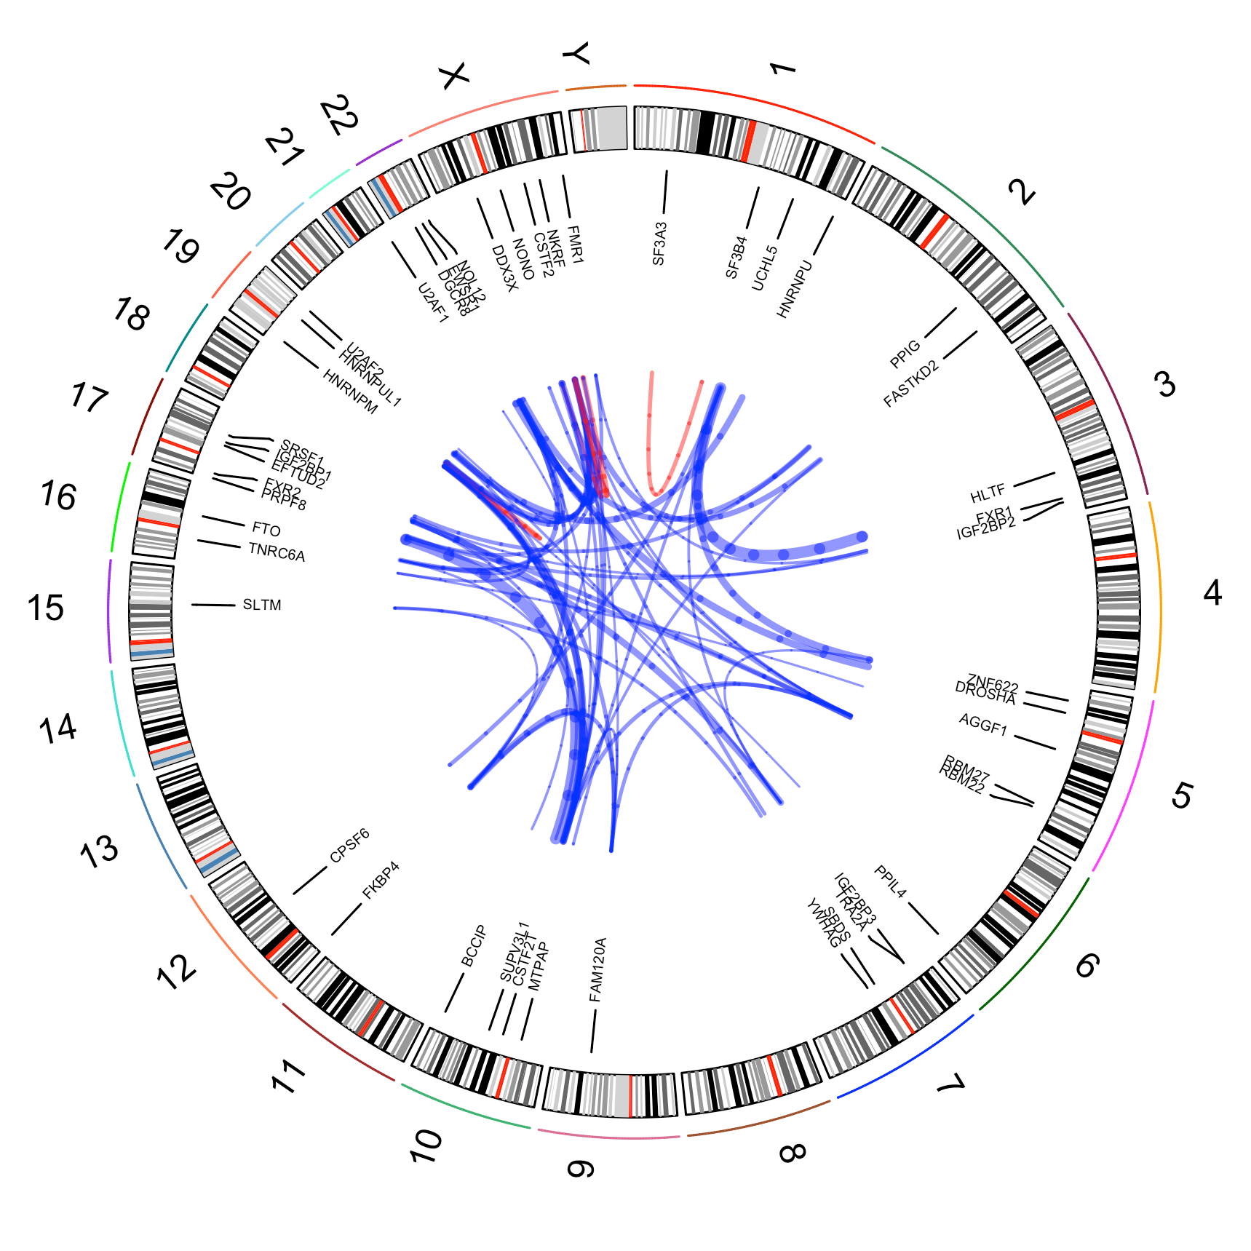
A
B
C
D
E
Co-binding Schematic of SF3 and U2 families
U2AF1
U2 snRNP
SF3B4
U2AF2
SF3A3
A
YYYYRYYYYRRYY
AG
Branch
point
Pyrimidine-rich
region
3’ Exon
0
0.2
0.4
0.6
0.8
1

Slide 13
A
Co-binding Schematic of SF3 and U2 families
B
C
D
E
U2AF1
U2 snRNP
SF3B4
U2AF2
SF3A3
A
YYYYRYYYYRRYY
AG
Branch
point
Pyrimidine-rich
region
3’ Exon
0
0.2
0.4
0.6
0.8
1

Slide 15
U2AF1
U2 snRNP
SF3B4
U2AF2
SF3A3
A
YYYYRYYYYRRYY
AG
Branch
point
Pyrimidine-rich
region
3’ Exon
Co-binding Schematic of SF3 and U2 families
U2AF1
U2 snRNP
SF3B4
U2AF2
SF3A3
A
YYYYRYYYYRRYY
AG
Branch
point
Pyrimidine-rich
region
3’ Exon

Slide 16
Splicing Regulator
HNRNPU
Splicing Complex
U2 snRNP
U2AF2
U2AF1
HNRNPUL1
SF3A3
SF3B4
branch point
AG
Coding
5’ UTR
3’ UTR
5’ Cap
Poly(A) Tail
Intron
Ribosome Interaction
FMR1
Cleavage
60S Ribosome
FXR1
CSTF2
CSTF2T
FXR2

Slide 17
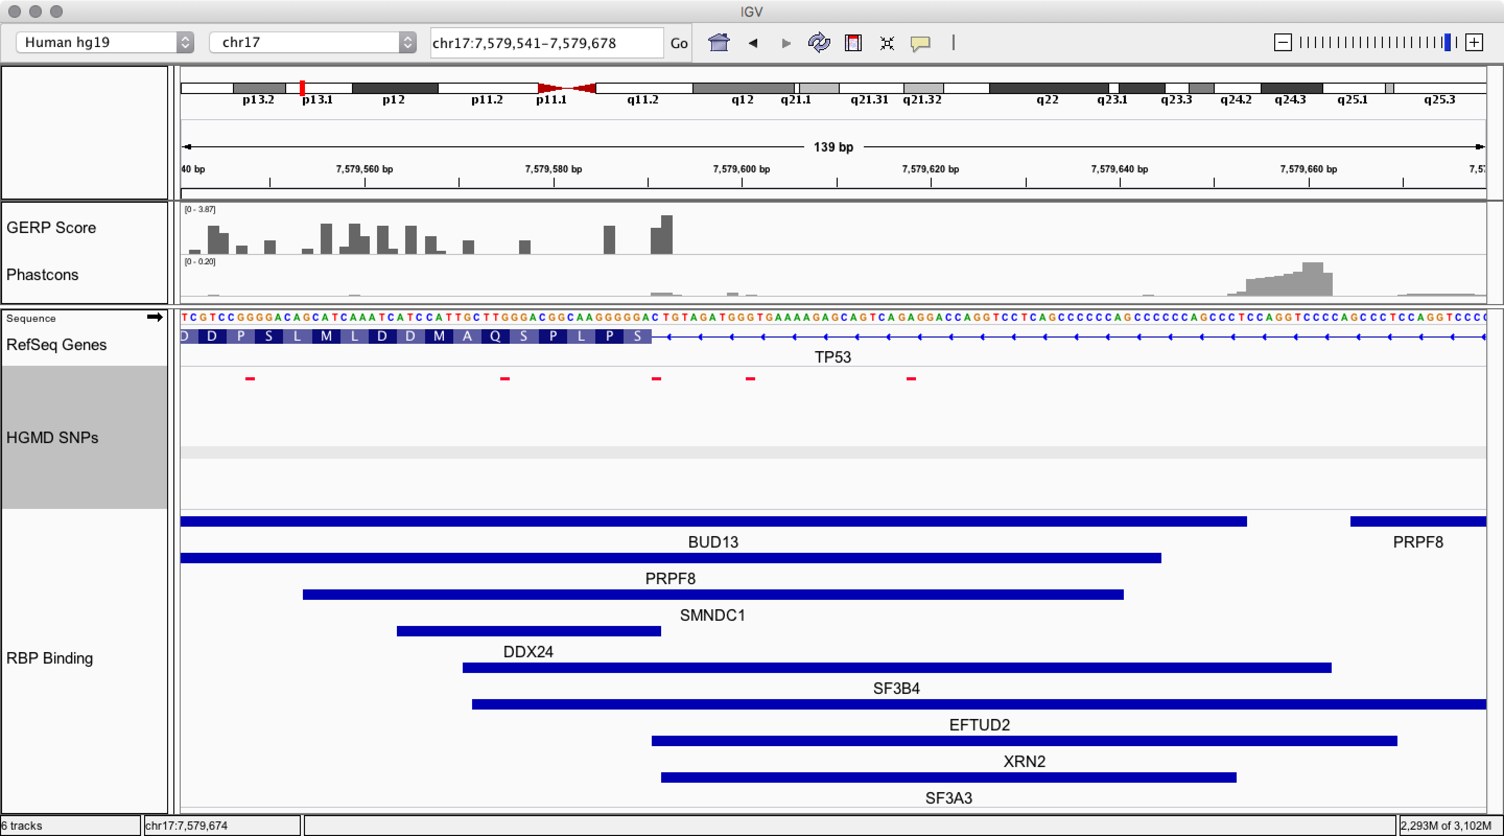
B
HGMD Variants
C
HGMD Nearby Intron Variants
A
mean
Binding profiles
median
QC
Binding Annotation
Network Construction
Motif Scanning
SNPs
D
Rare DAF%
Features, e.g. GC
Background Correction
chr17 : 7,579,618
A>T
28 bp
Annotation score
Hot score
Motif score
Breaks SF3B4 Motif
Rscore

Slide 18
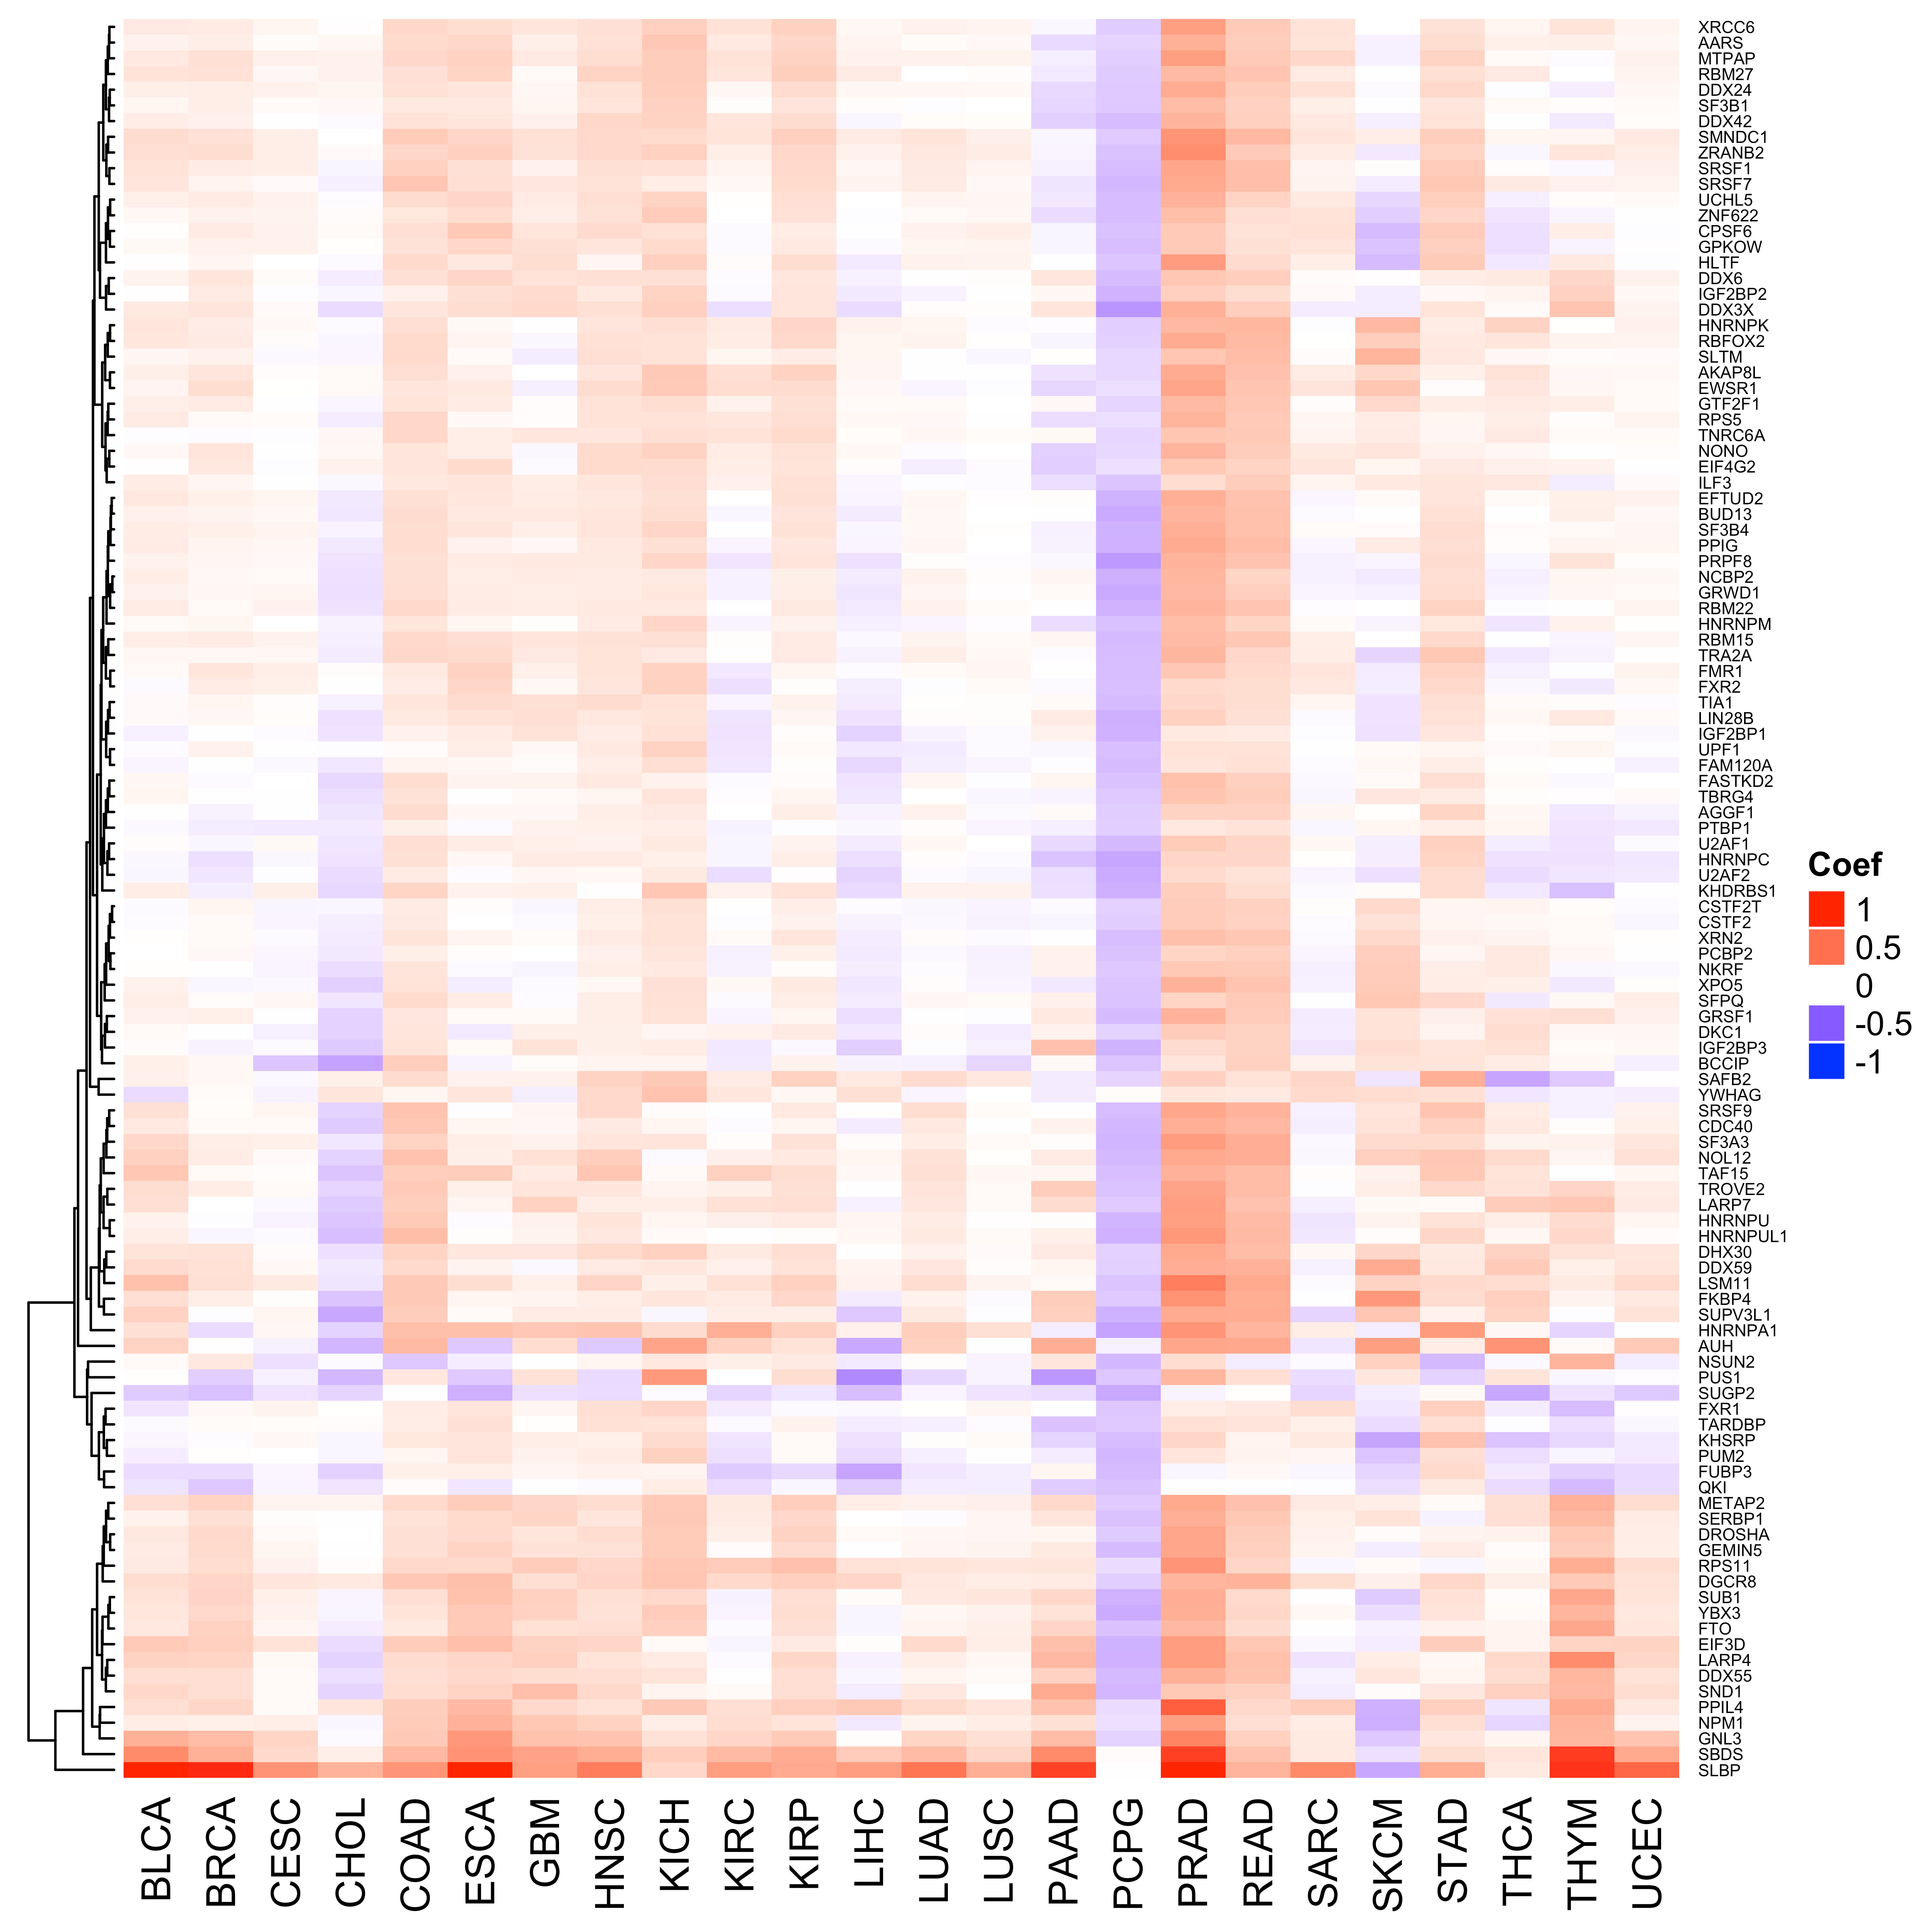
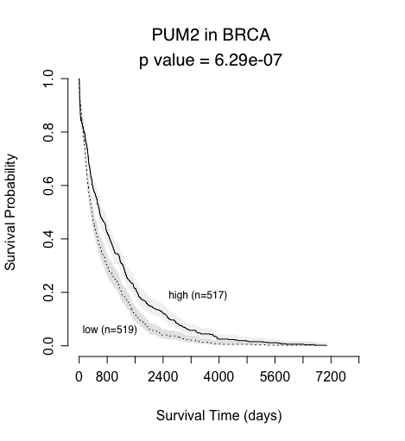
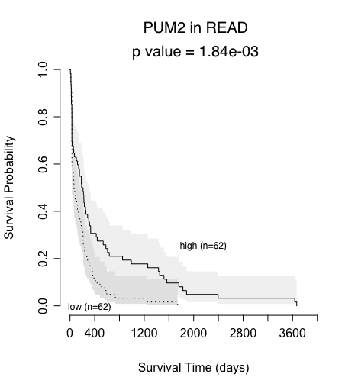
A
1 kb
B
1 kb
5’ UTR
exon
intron
exon
3’UTR
1 kb
1 kb
RBP₁
RBP₂
RBP₃
RBP_{k}
G₁
G₂
G₃
G_{n-1}
G_{n}
RBP₃
RBP₂
RBP2
G₃
G₁
G₂
G_{n-1}
G_{n}
RBP₁
 |  |  |  | … |  |  | Significance
 | G₁ | G₂ | G₃ | … | G_{n-1} | G_{n}
RBP₁ | 1 | 1 | 1 | … | 0 | 0
RBP₂ | 1 | 1 | 0 | … | 0 | 1
RBP₃ | 1 | 0 | 1 | … | 1 | 0
RBP_{k} | 0 | 0 | 0 | … | 1 | 1
C
****
**

Slide 19
Walkthrough of RADAR
Supplemental Information

Slide 20
Motivation of RADAR
Annotation
  Targets of RBPs (regulatory network)
  Classification of peaks or variants: CDS, 3’ UTR, 5’UTR, 3’ Extended, 5’ extended, nearby Intron, other
Prioritization of RBPs
  RBP Activity prediction (logistic regression)
  RBP as prognostic marker
Variant Scoring
  FunSeq2-like entropy-based scoring system for variants specific to RBP binding regions
    Discrete Score (Annotation Score)
    Motif Score
    Recurrence Score

Slide 21
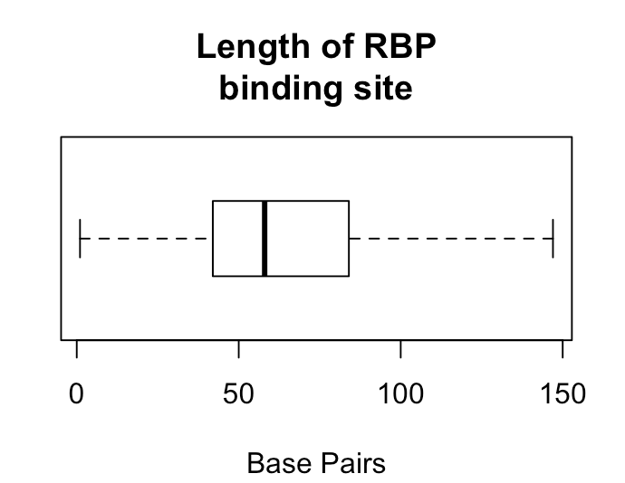
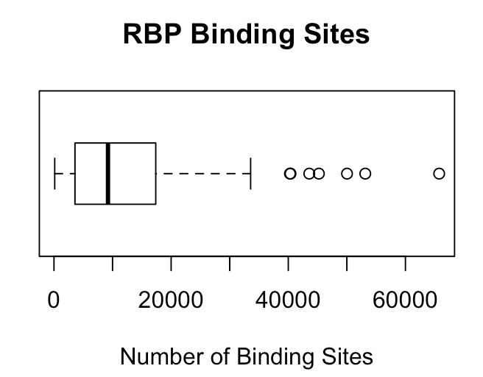
Binding profiles
Binding profiles
eCLIP ENCODE | HepG2 | K562
# RBPs | 70 | 89
# Replicates | 140 | 178
QC
Binding Annotation
Network Construction
Motif Scanning
SNPs
QC
1. Merge RBPs across cell type, taking the union of binding sites
Rare DAF%
K562, RBFOX2
HepG2, RBFOX2
Features, e.g. GC
merged, RBFOX2
2. Only select peaks that have a quality check score of 1000
Background Correction
Annotation score
Hot score
Motif score
Rscore

Slide 22
Nearby intron
Binding profiles
Binding Annotation
1 kb
1 kb
5’ UTR
exon
intron
exon
3’UTR
RBFOX2
QC
RBFOX2
Exon
RBFOX2
Nearby
intron
Binding Annotation
Network Construction
Motif Scanning
SNPs
1. De novo motif discovery using DREME (MEME Suite)
Motif Scanning
Example: RBFOX2, well known motif: TGCATG
Rare DAF%
DREME Result
Features, e.g. GC
Background Correction
Annotation score
Hot score
Motif score
Of the 112 RBP, motifs found for 108 RBPs
Motif with best p-value kept
Rscore

Slide 23
Network Construction
1 kb
1 kb
Binding profiles
5’ UTR
exon
intron
exon
3’UTR
1 kb
1 kb
QC
RBP₁
RBP₂
Binding Annotation
Network Construction
Motif Scanning
RBP₃
RBP_{k}
SNPs
G₁
G₂
G₃
G_{n-1}
G_{n}
RBP₃
RBP₂
RBP2
Rare DAF%
G_{n-1}
G_{n}
G₃
G₁
G₂
Features, e.g. GC
RBP₁
 |  |  |  | … |  |  | Significance
 | G₁ | G₂ | G₃ | … | G_{n-1} | G_{n}
RBP₁ | 1 | 1 | 1 | … | 0 | 0
RBP₂ | 1 | 1 | 0 | … | 0 | 1
RBP₃ | 1 | 0 | 1 | … | 1 | 0
RBP_{k} | 0 | 0 | 0 | … | 1 | 1
Background Correction
****
Annotation score
Hot score
Motif score
Rscore
**

Slide 24
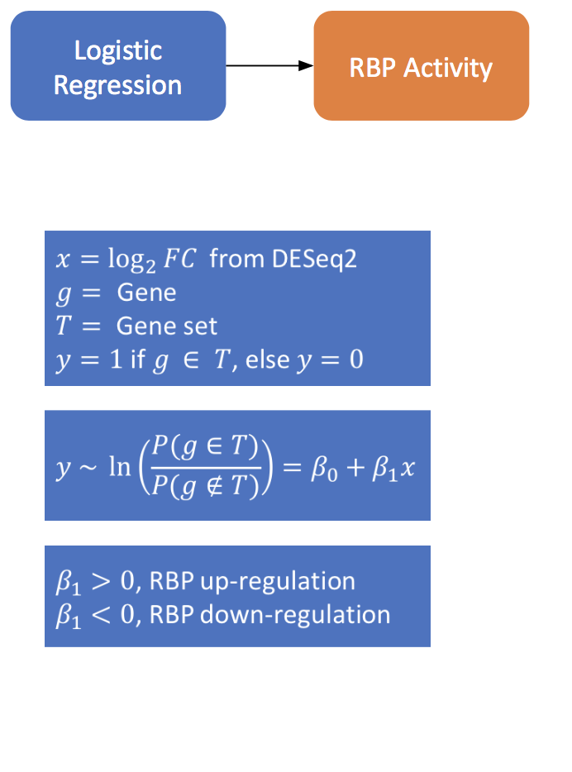
1 kb
1 kb
Network Construction
5’ UTR
exon
intron
exon
3’UTR
1 kb
1 kb
RBP₁
RBP₂
RBP₃
RBP_{k}
G₁
G₂
G₃
G_{n-1}
G_{n}
RBP₃
RBP₂
RBP2
G₃
G₁
G₂
G_{n-1}
G_{n}
RBP₁
 |  |  |  | … |  |  | Significance
 | G₁ | G₂ | G₃ | … | G_{n-1} | G_{n}
RBP₁ | 1 | 1 | 1 | … | 0 | 0
RBP₂ | 1 | 1 | 0 | … | 0 | 1
RBP₃ | 1 | 0 | 1 | … | 1 | 0
RBP_{k} | 0 | 0 | 0 | … | 1 | 1
****
**

Slide 25
Analysis from pooled patients
Network Construction
RBP
Prioritization
Analysis from individual patients

Slide 26
Binding profiles
SNPs
1000 Genomes Project rare and common SNPs are used
QC
Binding Annotation
Network Construction
Motif Scanning
Rare DAF%
For each RBP, we can obtain a Rare DAF %, for coding and noncoding regions
SNPs
RBFOX2, BS₁
RBFOX2, BS_{n}
rare
Rare DAF%
common
Features, e.g. GC
Background Correction
Annotation score
Hot score
Motif score
Rscore

Slide 27
Features, e.g. GC
Binding profiles
Background Correction
500bp
QC
GC
…
…
30.3
31.2
32.6
64.3
65.2
65.1
30.3
29.5
28.1
Binding Annotation
Network Construction
Motif Scanning
SNPs
…
GC
28-30%
GC
30-32%
GC
32-34%
…
GC
62-64%
GC
64-66%
GC
66-68%
…
Rare DAF%
Calculate rare DAF for each 2% bin (coding and noncoding)
Features, e.g. GC
Background Correction
Annotation score
Hot score
Motif score
Rscore

Slide 28
Features, e.g. GC
Background Correction

Slide 29
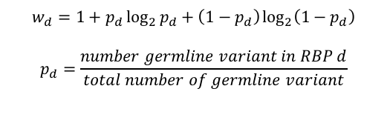
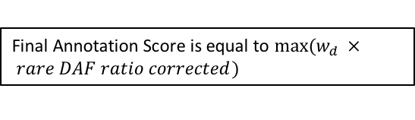
Binding profiles
Binding Annotation
 | Regulatory Noncoding | Coding
Classification | 3’ UTR, 3’ UTR extended, 5’ UTR, 5’ UTR extended, Nearby Intron | Coding Exon
QC
Binding Annotation
Network Construction
Motif Scanning
SNPs
Annotation score
Rare DAF%
RBFOX2, BS₁
RBFOX2, BS_{n}
coding BS₁
coding BS_{n}
RBFOX2, noncoding BS₁
noncoding BS_{n}
Features, e.g. GC
rare
All RBPs
common
Background Correction
Obtain a Rare DAF ratio (GC corrected) for noncoding, and coding regions of each RBP.
Annotation score
Hot score
Motif score
$$w_{d}=1+p_{d}\log_{2}{p_{d}}+\left(1−p_{d}\right)\log_{2}\left(1−p_{d}\right)$$
$$p_{d}=\frac{number germline variant in RBP d}{total number of germline variant}$$
Final Annotation Score is equal to $max(w_{d } × rare DAF ratio corrected)$
Rscore

Slide 30
Hot score
Binding profiles
QC
Binding Annotation
Network Construction
Motif Scanning
SNPs
Rare DAF%
Features, e.g. GC
Background Correction
Annotation score
Hot score
Motif score
Rscore

Slide 31
Coding Region GC Analysis
Noncoding Region GC Analysis

Slide 32
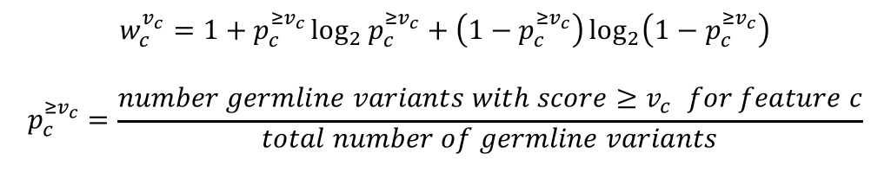
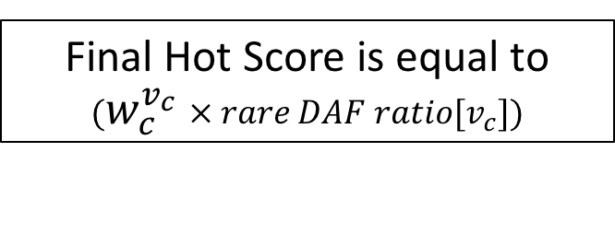
Hot score
Noncoding
Coding
*
*The cutoff where 1% of the data falls results in an unstable Rare DAF Ratio, and therefore the max rare DAF ratio before this cutoff is used.
*
We select the Recurrence cutoff for considering a region “hot” such that 5% of the data falls above that cutoff
$$w_{c}^{v_{c}}=1+p_{c}^{{≥v}_{c}}\log_{2}{p_{c}^{{≥v}_{c}}}+\left(1−p_{c}^{{≥v}_{c}}\right)\log_{2}\left(1−p_{c}^{{≥v}_{c}}\right)$$
$$p_{c}^{{≥v}_{c}}=\frac{number germline variants with score{≥v}_{c} for feature c}{total number of germline variants}$$
Final Hot Score is equal to $(w_{c}^{v_{c}} × rare DAF ratio{[v}_{c}])$

Slide 33
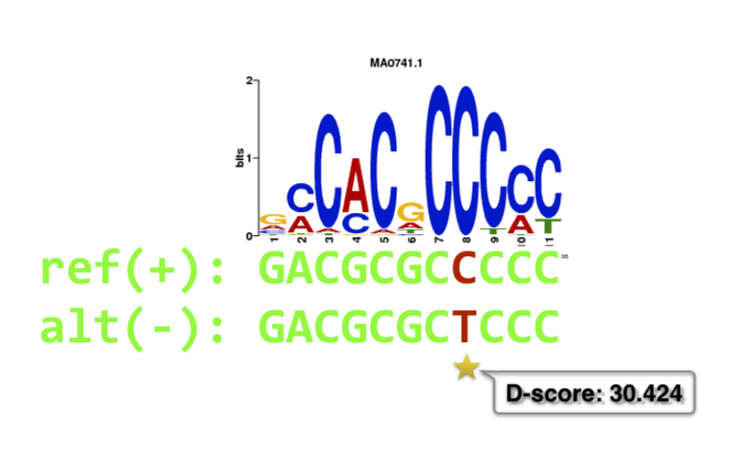
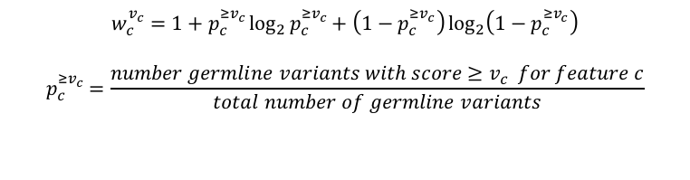
Binding profiles
Motif score
QC
Binding Annotation
Network Construction
Motif Scanning
SNPs
Rare DAF%
Features, e.g. GC
$$w_{c}^{v_{c}}=1+p_{c}^{{≥v}_{c}}\log_{2}{p_{c}^{{≥v}_{c}}}+\left(1−p_{c}^{{≥v}_{c}}\right)\log_{2}\left(1−p_{c}^{{≥v}_{c}}\right)$$
$$p_{c}^{{≥v}_{c}}=\frac{number germline variants with score{≥v}_{c} for feature c}{total number of germline variants}$$
Background Correction
Motif
Breaking
Annotation score
Hot score
Motif score
Rscore

Slide 34
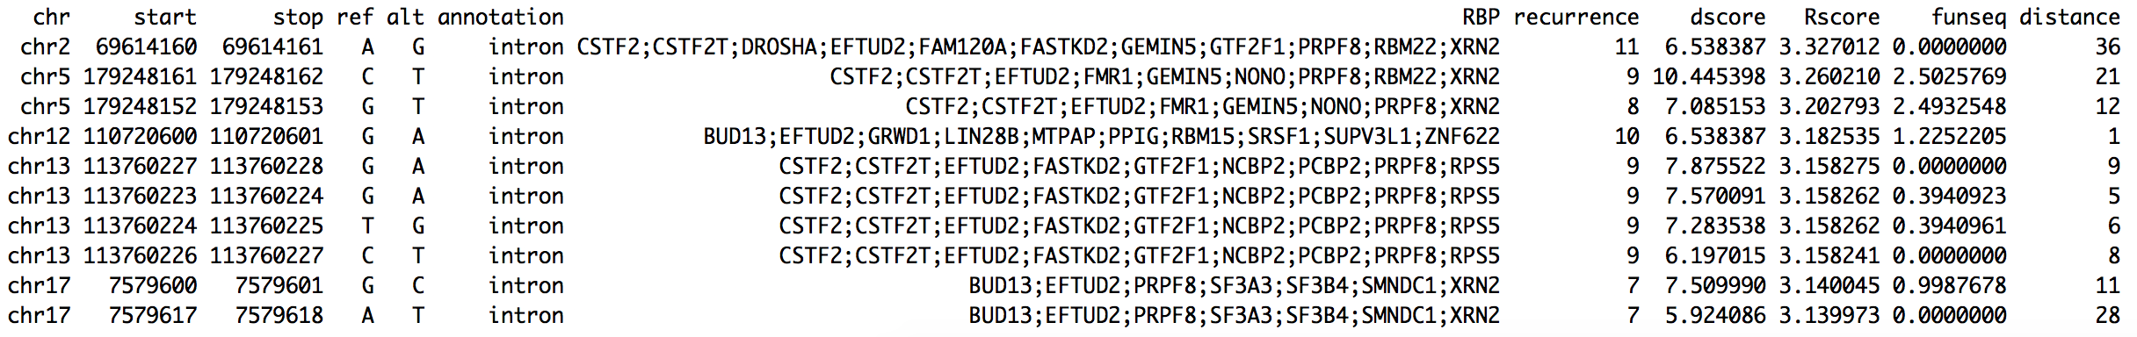
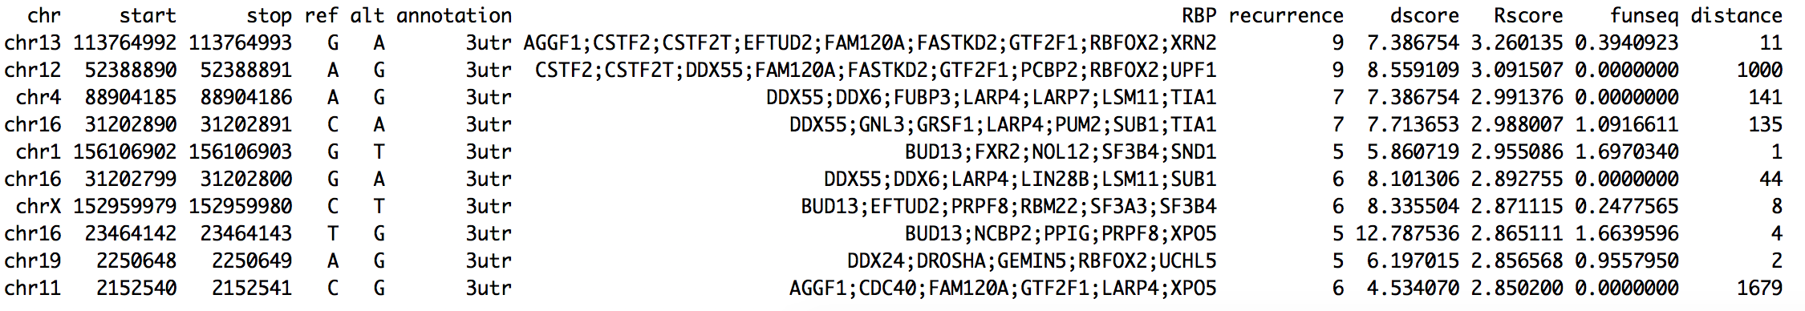
Enrichment of HGMD variants in RBP regions
 | # Genomic variants | Genomic length | Genomic p | RBP Variants | RBP length | RBP p | Enrichment | Binomial p_{val} | Length Ratio
3’ UTR | 770 | 41676932 | 1.85e-05 | 220 | 5640993 | 3.90e-05 | 2.11 | 4.01e-23 | 13.54%
3’ UTR ext. | 1588 | 63984260 | 2.48e-05 | 532 | 2534367 | 2.10e-04 | 8.46 | 4.97e-292 | 3.96%
5’ UTR | 930 | 17075609 | 5.45e-05 | 268 | 2120360 | 1.26e-04 | 2.32 | 7.56e-34 | 12.42%
5’ UTR ext. | 2126 | 70816790 | 3.00e-05 | 390 | 2795556 | 1.40e-04 | 4.65 | 1.36e-129 | 3.95%
Nearby intron | 9103 | 33380774 | 2.73e-04 | 2149 | 4272630 | 5.03e-04 | 1.84 | 1.53e-146 | 12.80%
Coding | 95510 | 35345952 | 2.70e-03 | 31284 | 10841177 | 2.89e-03 | 1.07 | 5.87e-31 | 30.67%
Rscore
Top 10 intron HGMD variants, based on Rscore
Top 10 3’ UTR HGMD variants, based on Rscore

Slide 35
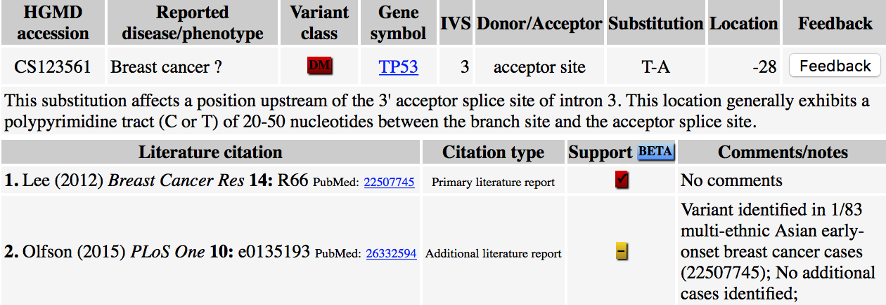
Example 1
chr17 : 7,579,618
A>T
28 bp
Breaks SF3B4 Motif

Slide 36
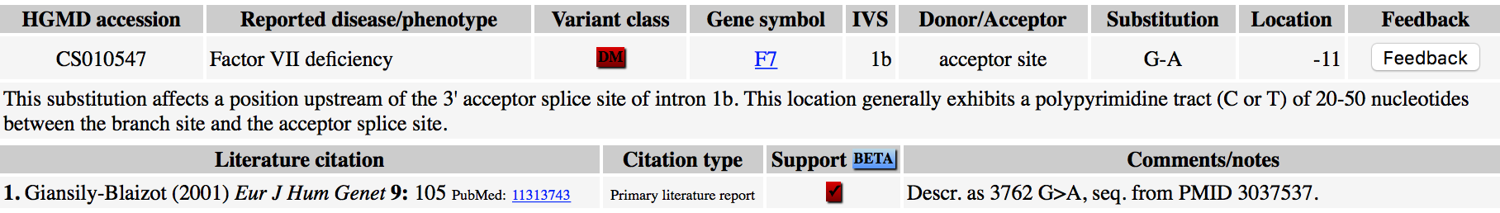
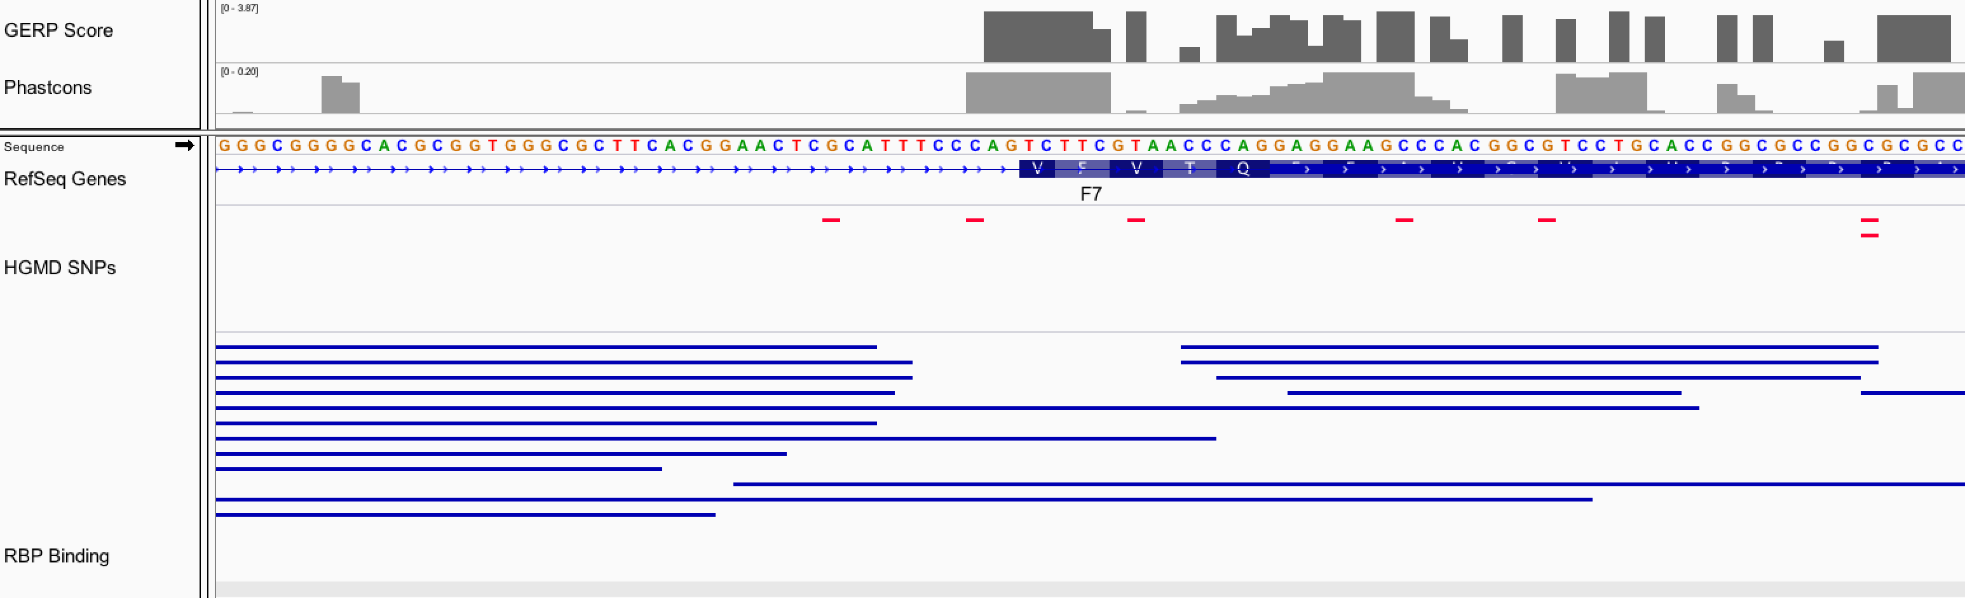
11 bp
chr13 : 113,764,993
G>A

