Slide 2
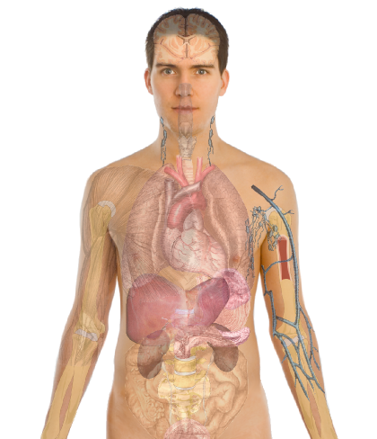
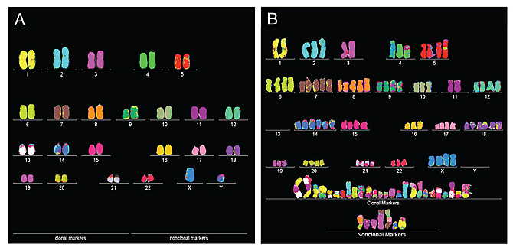
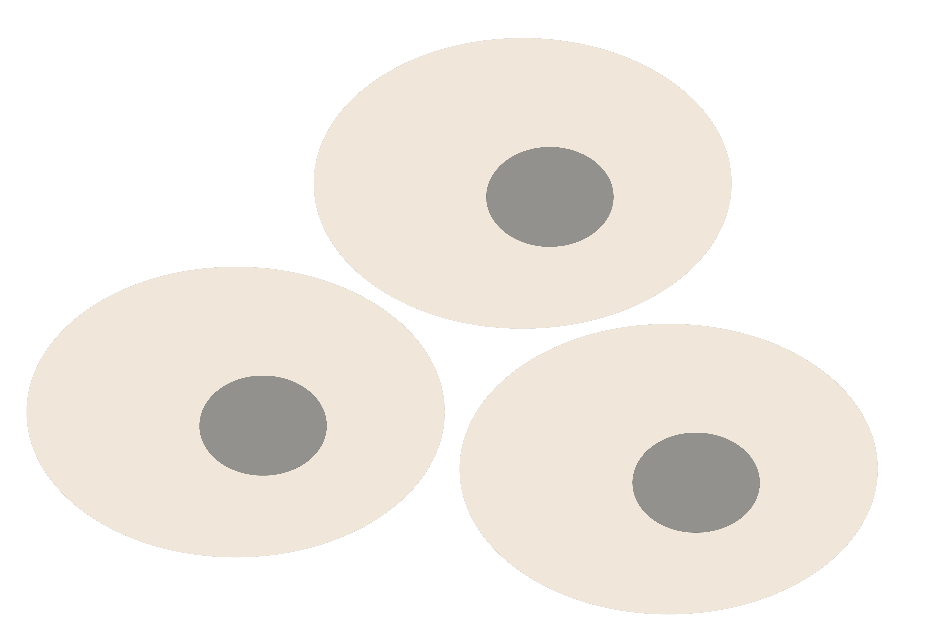
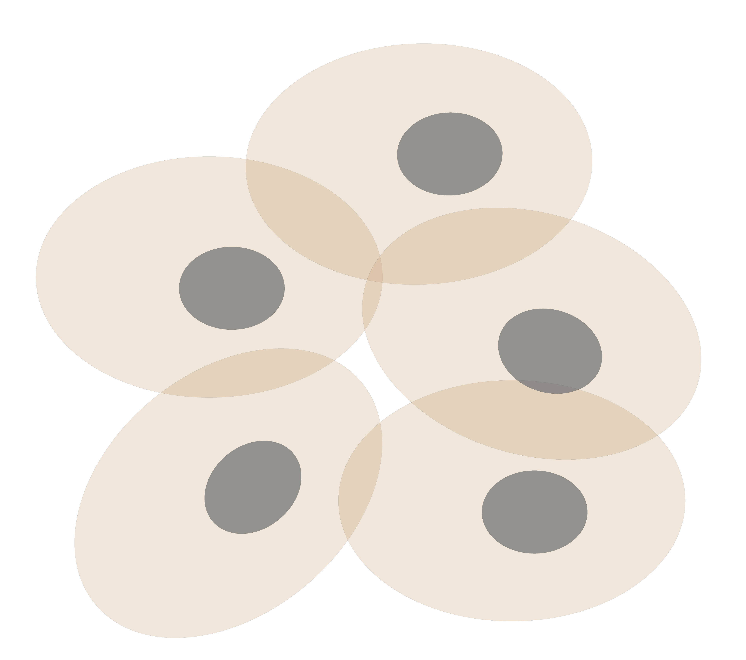
Personal Genomics
as a Gateway into Biology
Personal genomes soon will become a commonplace part of medical research & eventually treatment (esp. for cancer). They will provide a primary connection for biological science to the general public.
normal
tumor

Slide 3
Personal Genomics
as a Gateway into Biology
Personal genomes soon will become a commonplace part of medical research & eventually treatment (esp. for cancer). They will provide a primary connection for biological science to the general public.

Slide 4


Slide 5
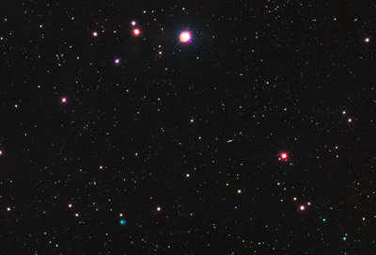











Sequence Universe
SRA ~1 petabyte
TCGA endpoint: ~2.5 Petabytes
~1.5 PB exome
~1 PB whole genome
TCGA 2.3 Petabytes
in CGHub
Clinical
RNASeq
Epigenome
222
TB
miRNA
ARRA
Autism
29
TB
32 TB
34 TB
NHLBI ESP
68 TB
40
TB
GTeX
ADSP
NHGRI LSSP
Star formation
100K Genomes England
Heidi Sofia, 7-16-15
Notes:
TCGA is the largest single project in the visible sequence universe to date.
TCGA is depicted at the center of the solar system because it integrates DNA, RNA-Seq, miRNA, epigenomic, and clinical data.
Currently there is over a Petabyte of TCGA data deposited in the CGHub cancer genomics repository (https://cghub.ucsc.edu/summary_stats.html).
This scale dwarfs its closest competitors which are shown as planets in orbit:
1000G 222 TB http://www.ncbi.nlm.nih.gov/bioproject/28889
ADSP 68 TB http://www.ncbi.nlm.nih.gov/bioproject/202226
NHGRI LSSP 40 TB http://www.ncbi.nlm.nih.gov/bioproject?term=NHGRI%20Large%20Scale%20Sequencing%20Program%5BTitle%5D
GTeX 34 TB http://www.ncbi.nlm.nih.gov/bioproject/75899
NHLBI ESP 32 TB http://www.ncbi.nlm.nih.gov/bioproject/165957
HMP 29 TB http://www.ncbi.nlm.nih.gov/bioproject/43021
ARRA Autism 24 TB http://www.ncbi.nlm.nih.gov/bioproject/74861
ENCODE 9 TB http://www.ncbi.nlm.nih.gov/bioproject/63441
Projects just starting now, like 100K Genomes England, may eventually overtake TCGA.

Slide 6
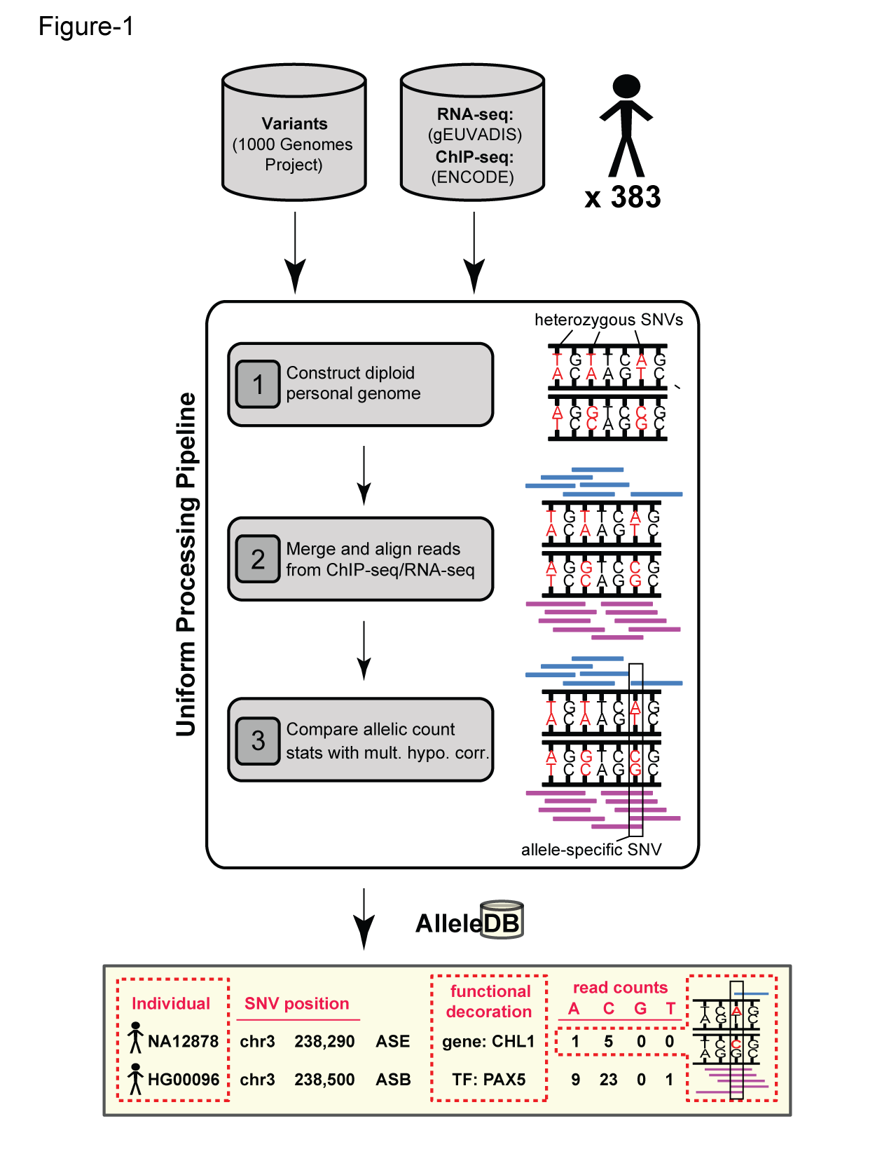
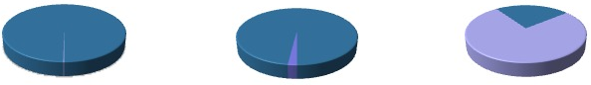
Human Genetic Variation
Population of
2,504 peoples
A Cancer Genome
A Typical Genome
Origin of Variants
Class of Variants
 | Coding | Non-coding
Germ-line | 22K | 4.1 – 5M
Somatic | ~50 | 5K
SNP | 3.5 – 4.3M
Indel | 550 – 625K
SV | 2.1 – 2.5K (20Mb)
Total | 4.1 – 5M
SNP | 84.7M
Indel | 3.6M
SV | 60K
Total | 88.3M
Prevalence of Variants
Common
Common
Passenger
Driver (~0.1%)
Rare* (1-4%)
Rare (~75%)
* Variants with allele frequency < 0.5% are considered as rare variants in 1000 genomes project.
The 1000 Genomes Project Consortium, Nature. 2015. 526:68-74
Khurana E. et al. Nat. Rev. Genet. 2016. 17:93-108

Slide 7

Finding Key Variants
Germline
CAN YOU FIND THE PANDA?
Common variants
  Can be associated with phenotype (ie disease) via a Genome-wide Association Study (GWAS), which tests whether the frequency of alleles differs between cases & controls.
  Usually their functional effect is weaker.
  Many are non-coding
  Issue of LD in identifying the actual causal variant.
Rare variants
  Associations are usually underpowered due to low frequencies.
  They often have larger functional impact
  Can be collapsed in the same element to gain statistical power (burden tests).
  In some cases, causal variants can be identified through tracing inheritance of Mendelian subtypes of diseases in large families.
McCarthy, M. et al. Nat. Rev. Genet. 2008. 9, 356-369, Zuk, O. et al. PNSA. 2014. Vol. 11, no. 4, MacArthur DG et al. Nature 2014. 508:469-476

Slide 8
Association of Variants with Diseases
Common
Variants
Healthy
Rare or
Somatic
Variants
Pooled
Variants
High
Function
Impact
Diseased
Burden Test
GWAS Positive

Slide 9
Finding Key Variants
Somatic
CAN YOU FIND THE PANDA?
Overall
  Often these can be conceptualized as very rare variants
  A challenge to identify somatic mutations contributing to cancer is to find driver mutations & distinguish them from passengers.
Drivers
  Driver mutation is a mutation that directly or indirectly confers a selective growth advantage to the cell in which it occurs.
  A typical tumor contains 2-8 drivers; the remaining mutations are passengers.
Passengers
  Conceptually, a passenger mutation has no direct or indirect effect on the selective growth advantage of the cell in which it occurred.
Vogelstein B. Science 2013. 339(6127):1546-1558

Slide 10

(Finding the key mutations in ~3M Germline variants &
~5K Somatic Variants in a Tumor Sample)
Cancer drivers: Significance & identification

Slide 11
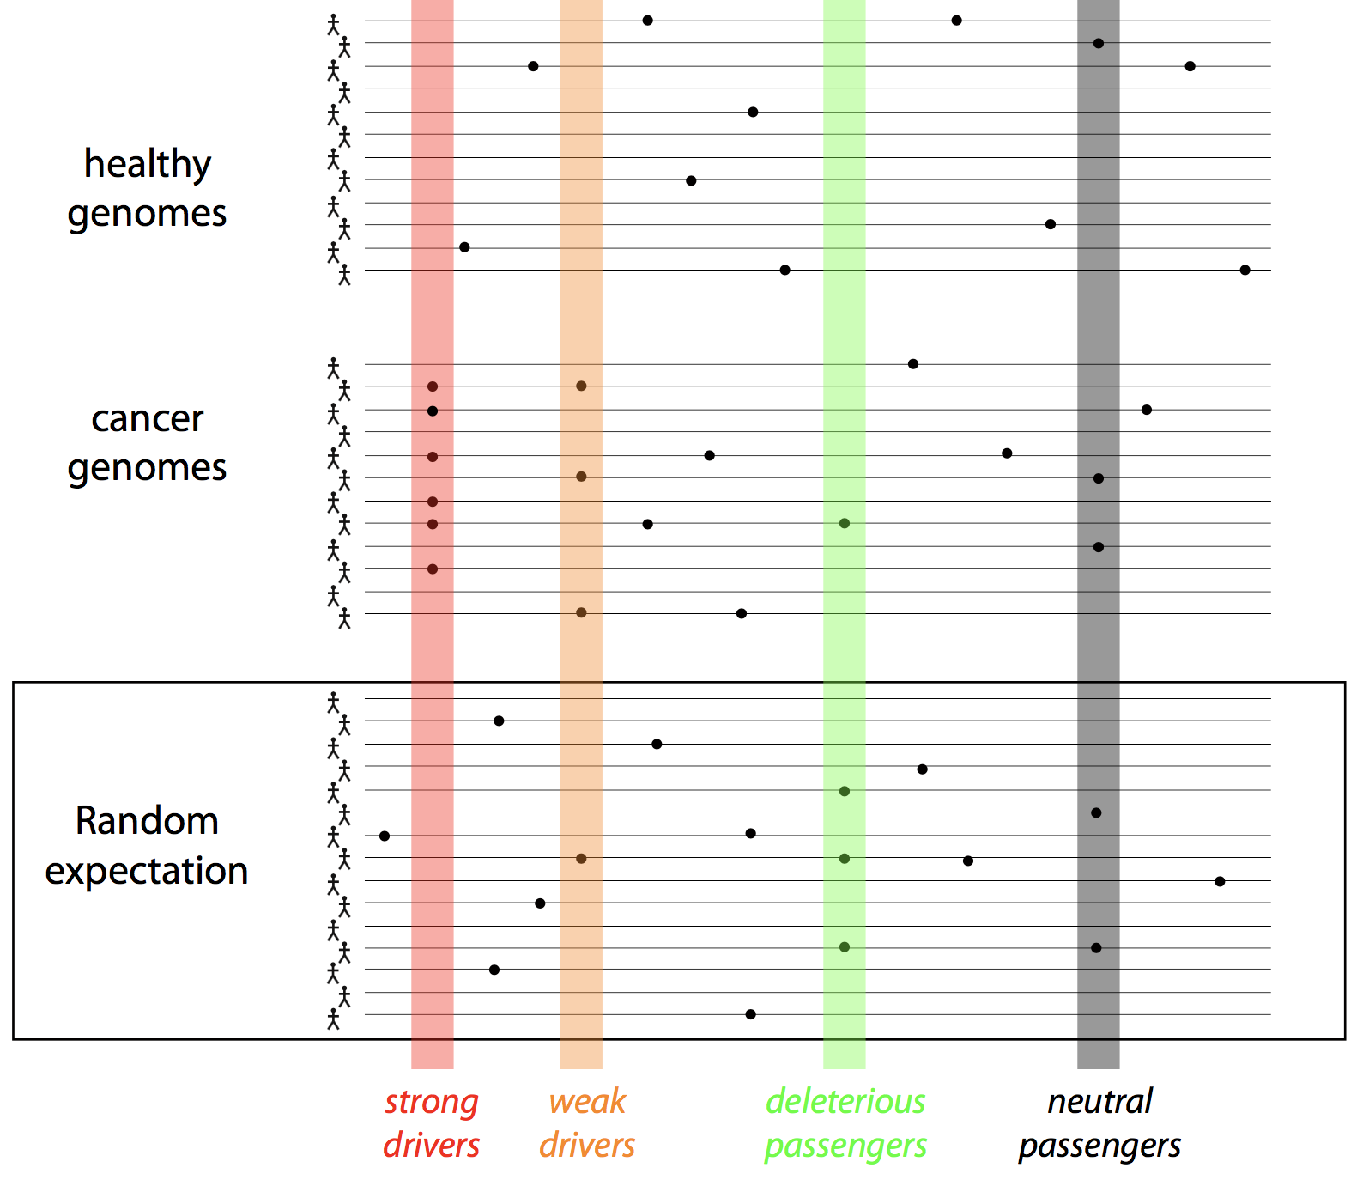
Cancer drivers: Significance & identification: frequency-based approaches

Slide 12
How to identify drivers – mutation recurrence (LARVA) and functional impact (Funseq)

Slide 13


Mutation recurrence
Cancer Type 1
Cancer Type 2
Cancer Type 3

Slide 14
Mutation recurrence
Cancer Type 1
Cancer Type 2
Cancer Type 3
Early replicated regions
Late replicated regions

Slide 15
Noncoding annotations
Cancer Type 1
Cancer Type 2
Cancer Type 3
Early replicated regions
Late replicated regions
Does not format to std. theme

Slide 16
Noncoding annotations
Cancer Type 1
Cancer Type 2
Cancer Type 3
Early replicated regions
Late replicated regions
Does not format to std. theme

Slide 17


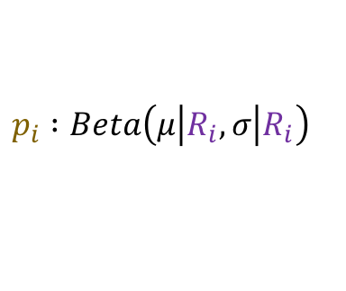
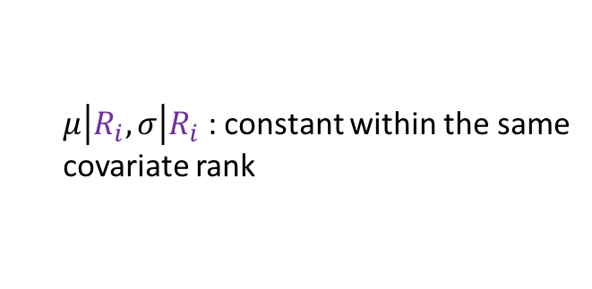

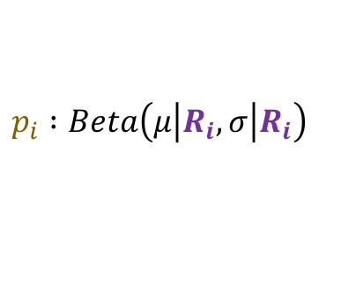

Cancer Somatic Mutation Modeling
Parametric Models
4 models to evaluate the significance of mutation burden
  3 parametric
  1 non-parametric
Suppose there are k genome elements. For element i, define:
  n_{i}: total number of nucleotides
  x_{i}: the number of mutations within the element
  p: the mutation rate
  R_{i}: the covariate rank of the element
Non-parametric model is useful when covariate data is missing for the studied annotations
  Also sidesteps issue of properly identifying and modeling every relevant covariate (possibly hundreds)
Non-Parametric Models
Model 1: Constant Background Mutation Rate (Model from Previous Work)
Model 3a: Random Permutation of Input Annotations
$$x_{i} :Binomial\left(n_{i},p\right)$$
Assume constant background mutation rate in local regions. Shuffle annotations within local region to assess background mutation rate.
Model 2a: Varying Mutation Rate
with Single Covariate Correction
$$x_{i} :Binomial\left(n_{i},p_{i}\right)$$
$$p_{i} :Beta\left(μ\left|R_{i}\right.,σ\left|R_{i}\right.\right)$$
Model 3b: Random Permutation of Input Variants
$μ\left|R_{i}\right.,σ\left|R_{i}\right.$ : constant within the same
covariate rank
Model 2b: Varying Mutation Rate
with Multiple Covariate Correction
Assume constant background mutation rate in local regions. Shuffle variants within local region to assess background mutation rate.
$$x_{i} :Binomial\left(n_{i},p_{i}\right)$$
$$p_{i} :Beta\left(μ\left|R_{i}\right.,σ\left|R_{i}\right.\right)$$
$μ\left|R_{i}\right.,σ\left|R_{i}\right.$ : constant within the same
covariate rank
[Lochovsky et al. under review]
[Lochovsky et al. NAR (’15)]

Slide 18
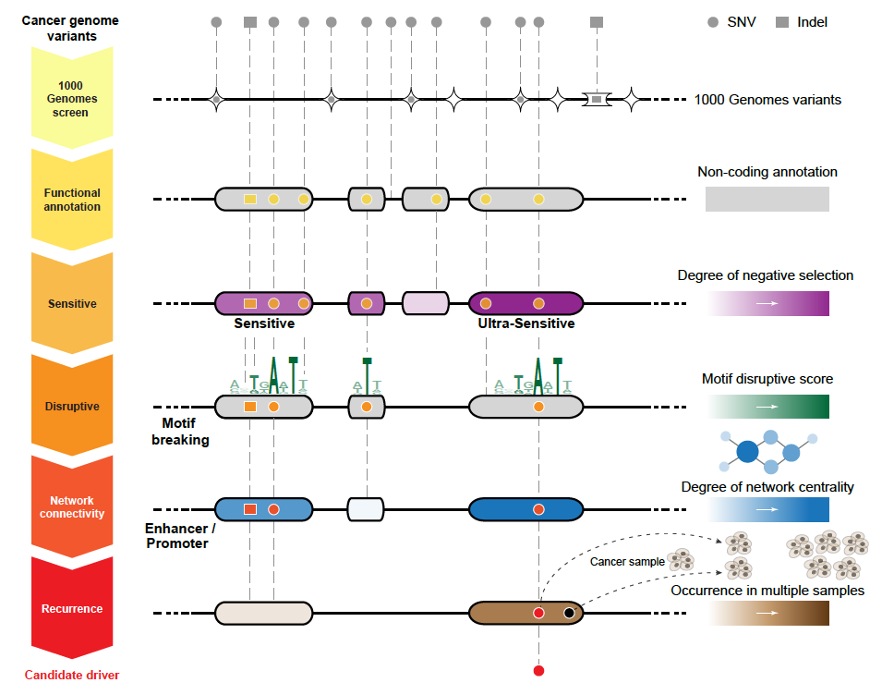
Identification of non-coding candidate drivers amongst somatic variants: Scheme
[Khurana et al., Science (‘13)]

Slide 19
PCAWG rich resource to look at variations in cancer

Slide 20
PCAWG : most comprehensive resource for cancer whole genome analysis
Goal of PCAWG:
To understand role of non-coding regions of cancer genomes in cancer progression.
Looking beyond single nucleotide variants in cancer genome
    Large structural variations
    Somatic copy number aberrations
    Extending know mutational signature repertoire
    Mapping cancer evolution history by analyzing clonal architecture
Jointly analyzing ~2800 whole genome tumor/normal pairs
  > 580 researchers
  16 thematic working groups
  > 130 research project

Slide 23
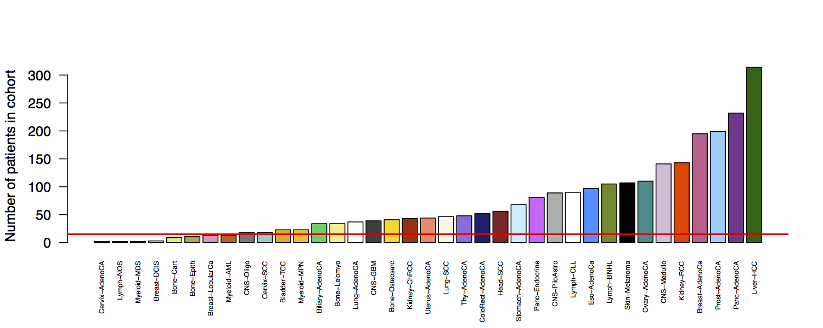
Cohorts: 29 individual tumor types + 3 lineages + 1 pan-cancer = 33 cohorts
2583 representative samples
29 cohorts with 2528 cases (>97.5% of all cases)
Red line indicates 15 patients
Rhienbay et. al.

Slide 24
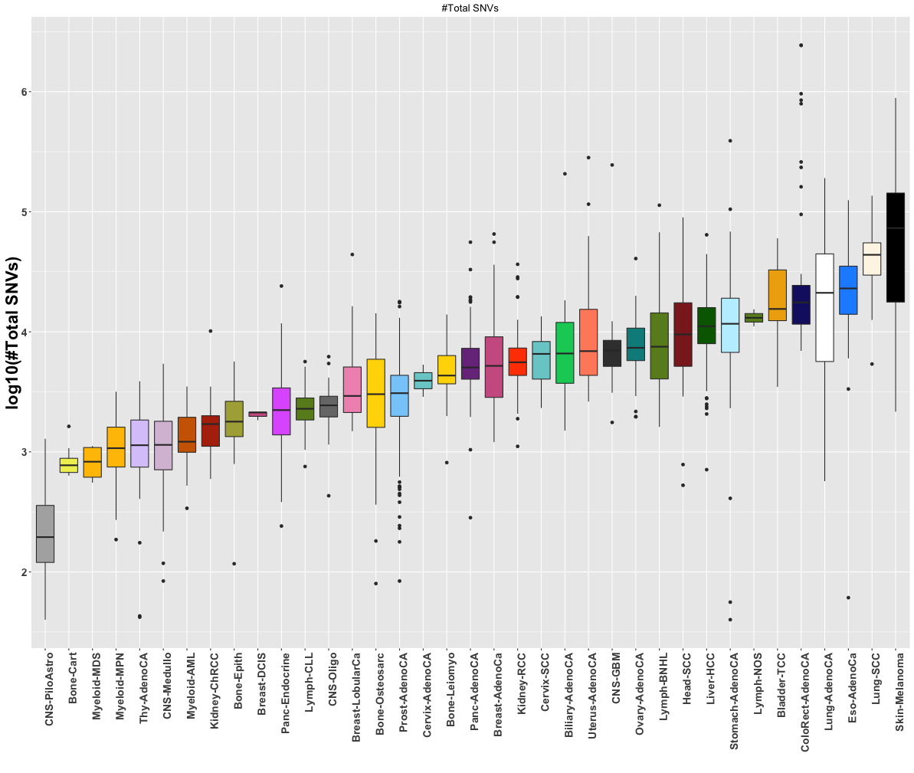
PCAWG : Mutation frequency distribution across cohorts
  Only handful of driver mutations ( <= 4) but thousands of passengers.
  What are these passengers doing in a typical cancer genome

Slide 25
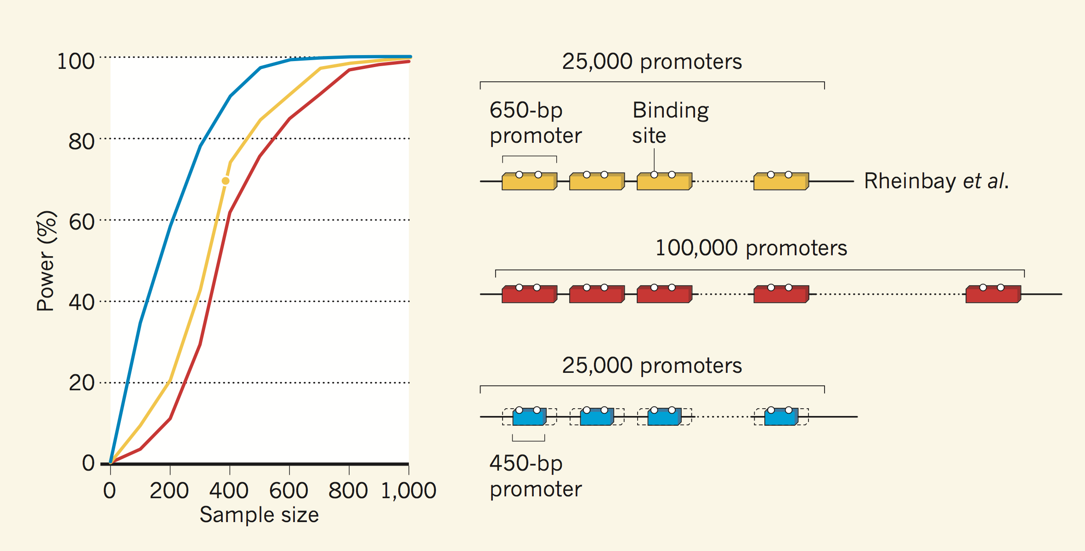
Improving discovery of cancer-driving mutations in the non-coding genome
S. Kumar & M. Gerstein, Nature (2017)

Slide 26
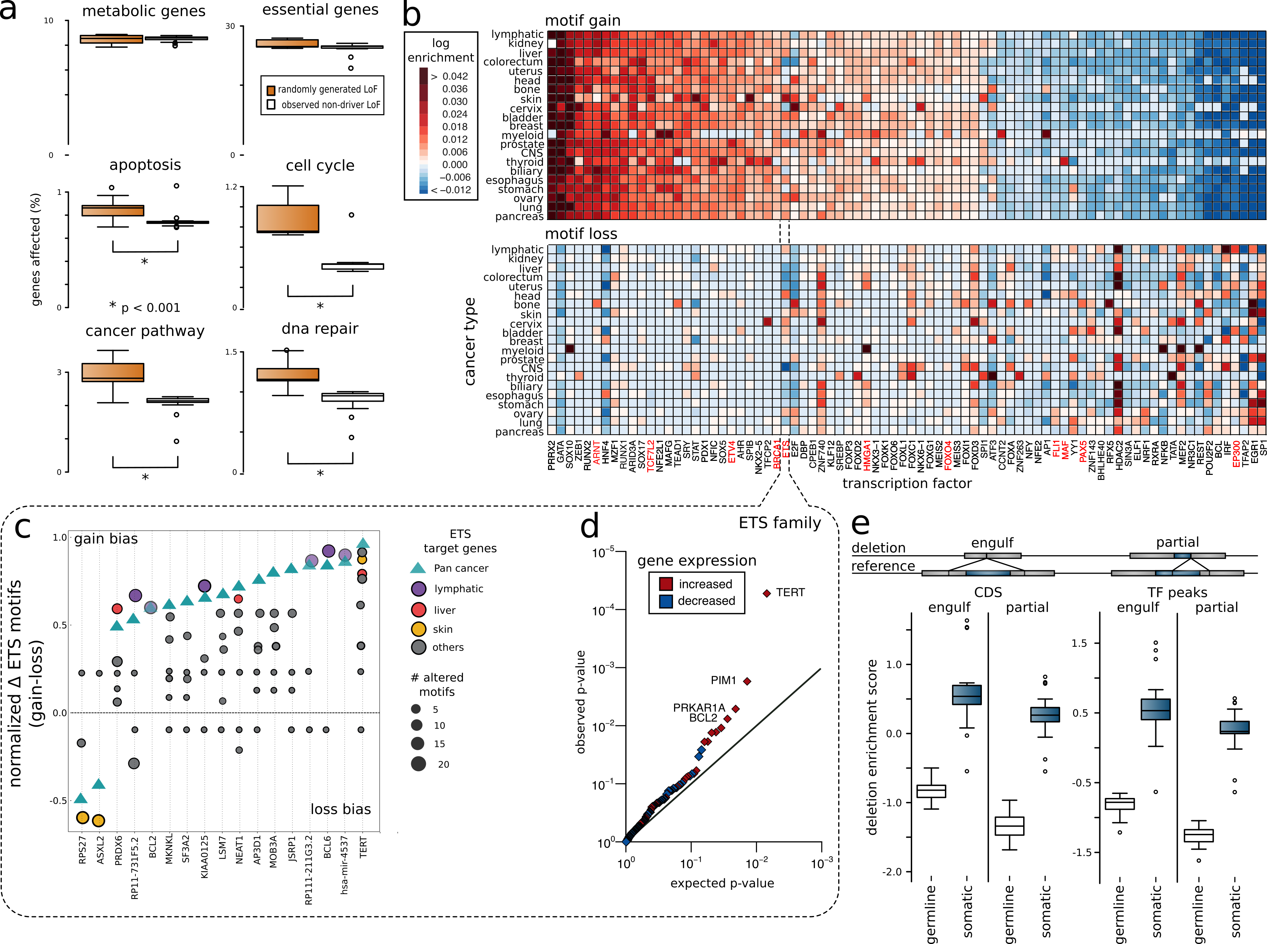
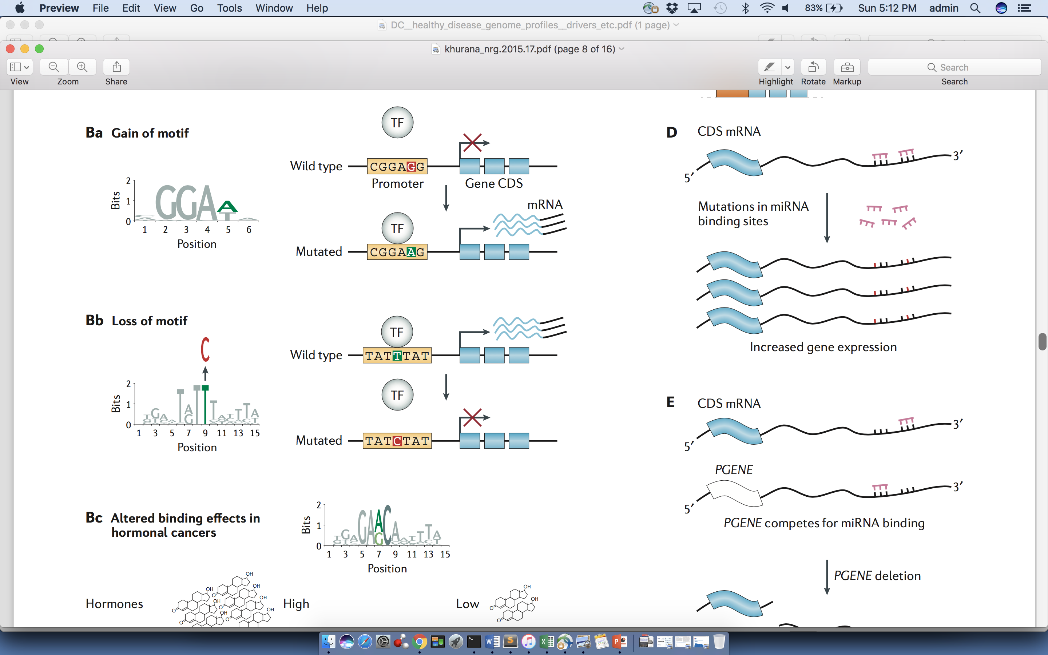
Passengers burdening of TF binding landscape
≈ç

Slide 27
Structural variation burden across cancer types

Slide 28
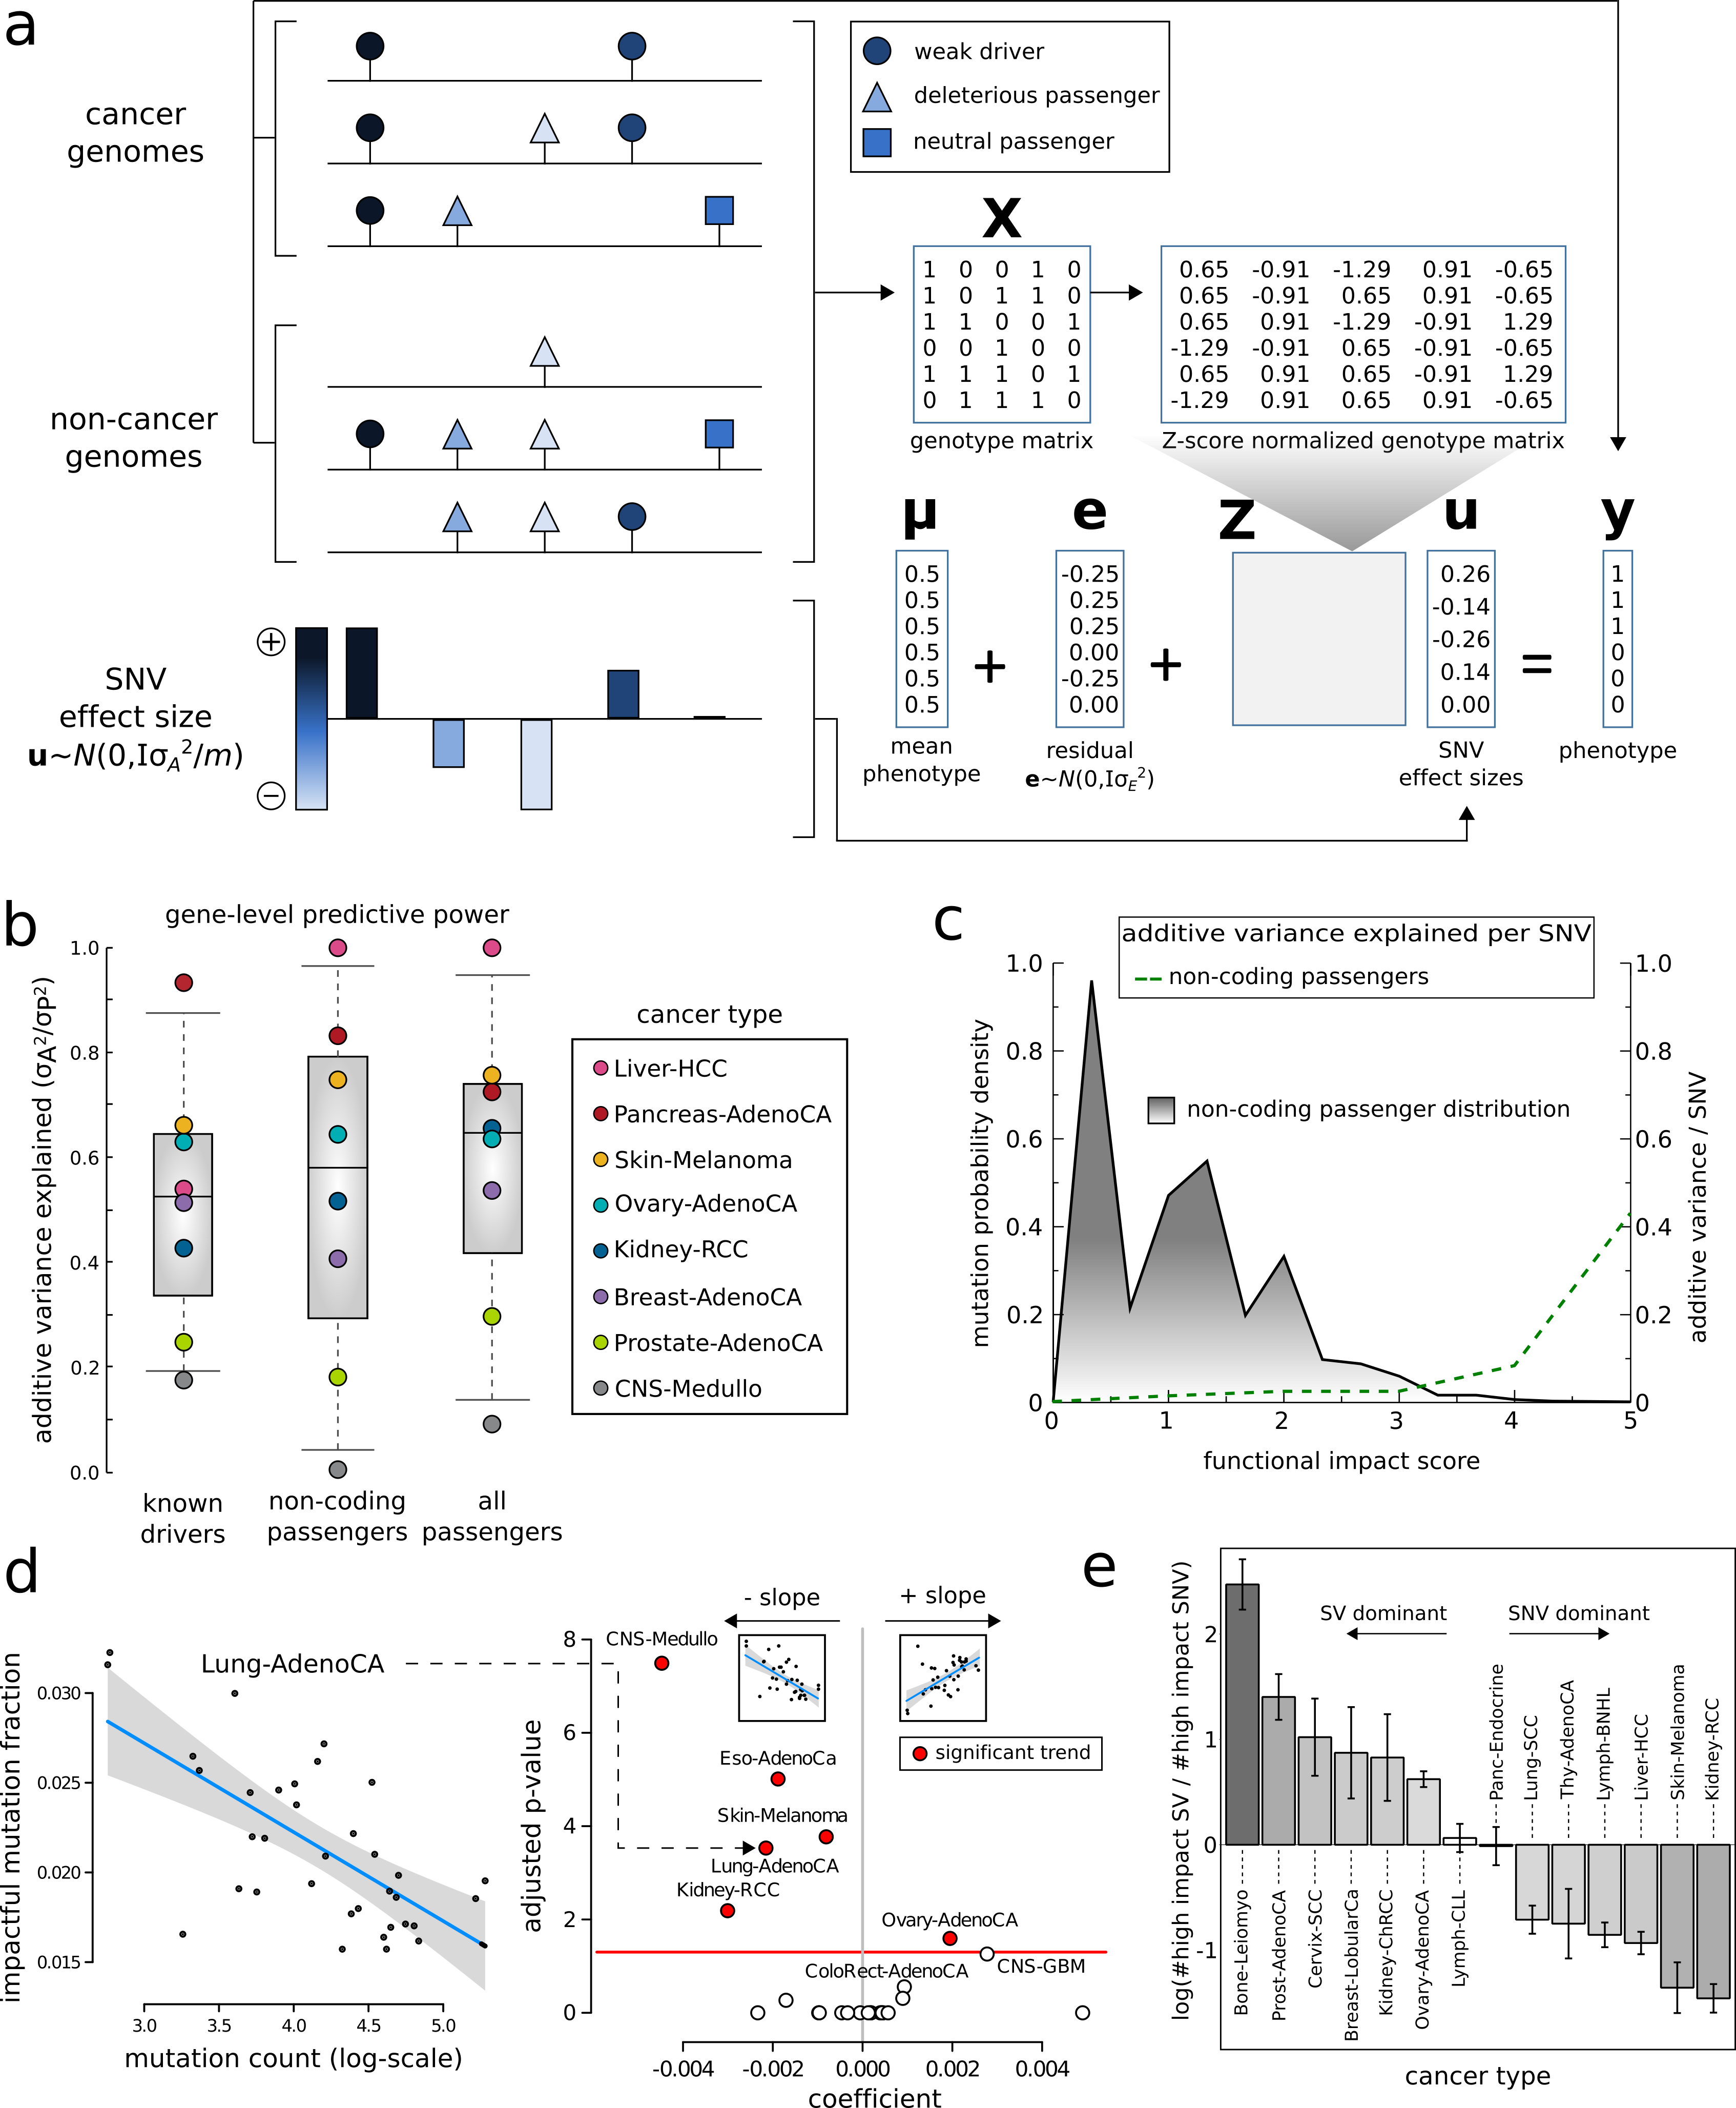
Fraction of high impact nominal passengers in PCAWG cohorts

Slide 29
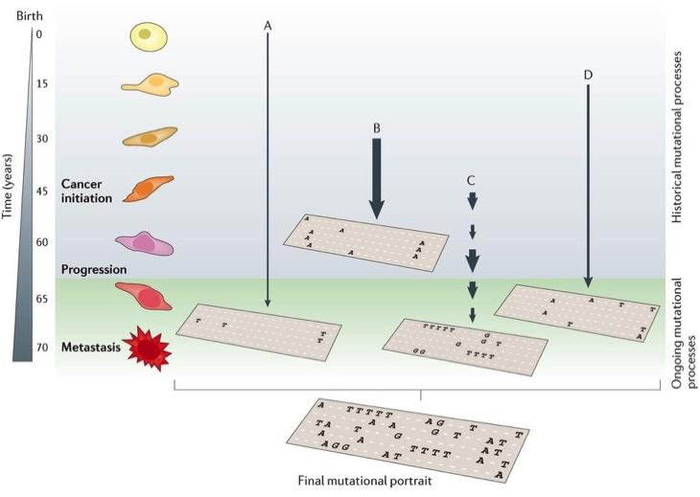
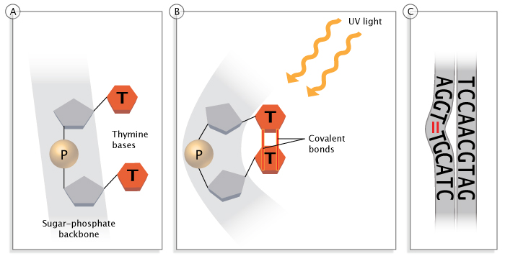
Mutational Processes
Multiple processes shape the genome
  Tumor sequencing shows a life-long accumulation of mutations
Mutational processes carry signatures
  e.g. UV light cause pyrimidine dimer
Clancy, Nature Education, 2008
Helleday, Eshtad & Nik-Zainal, Nature Reviews Genetics, 2014

Slide 30
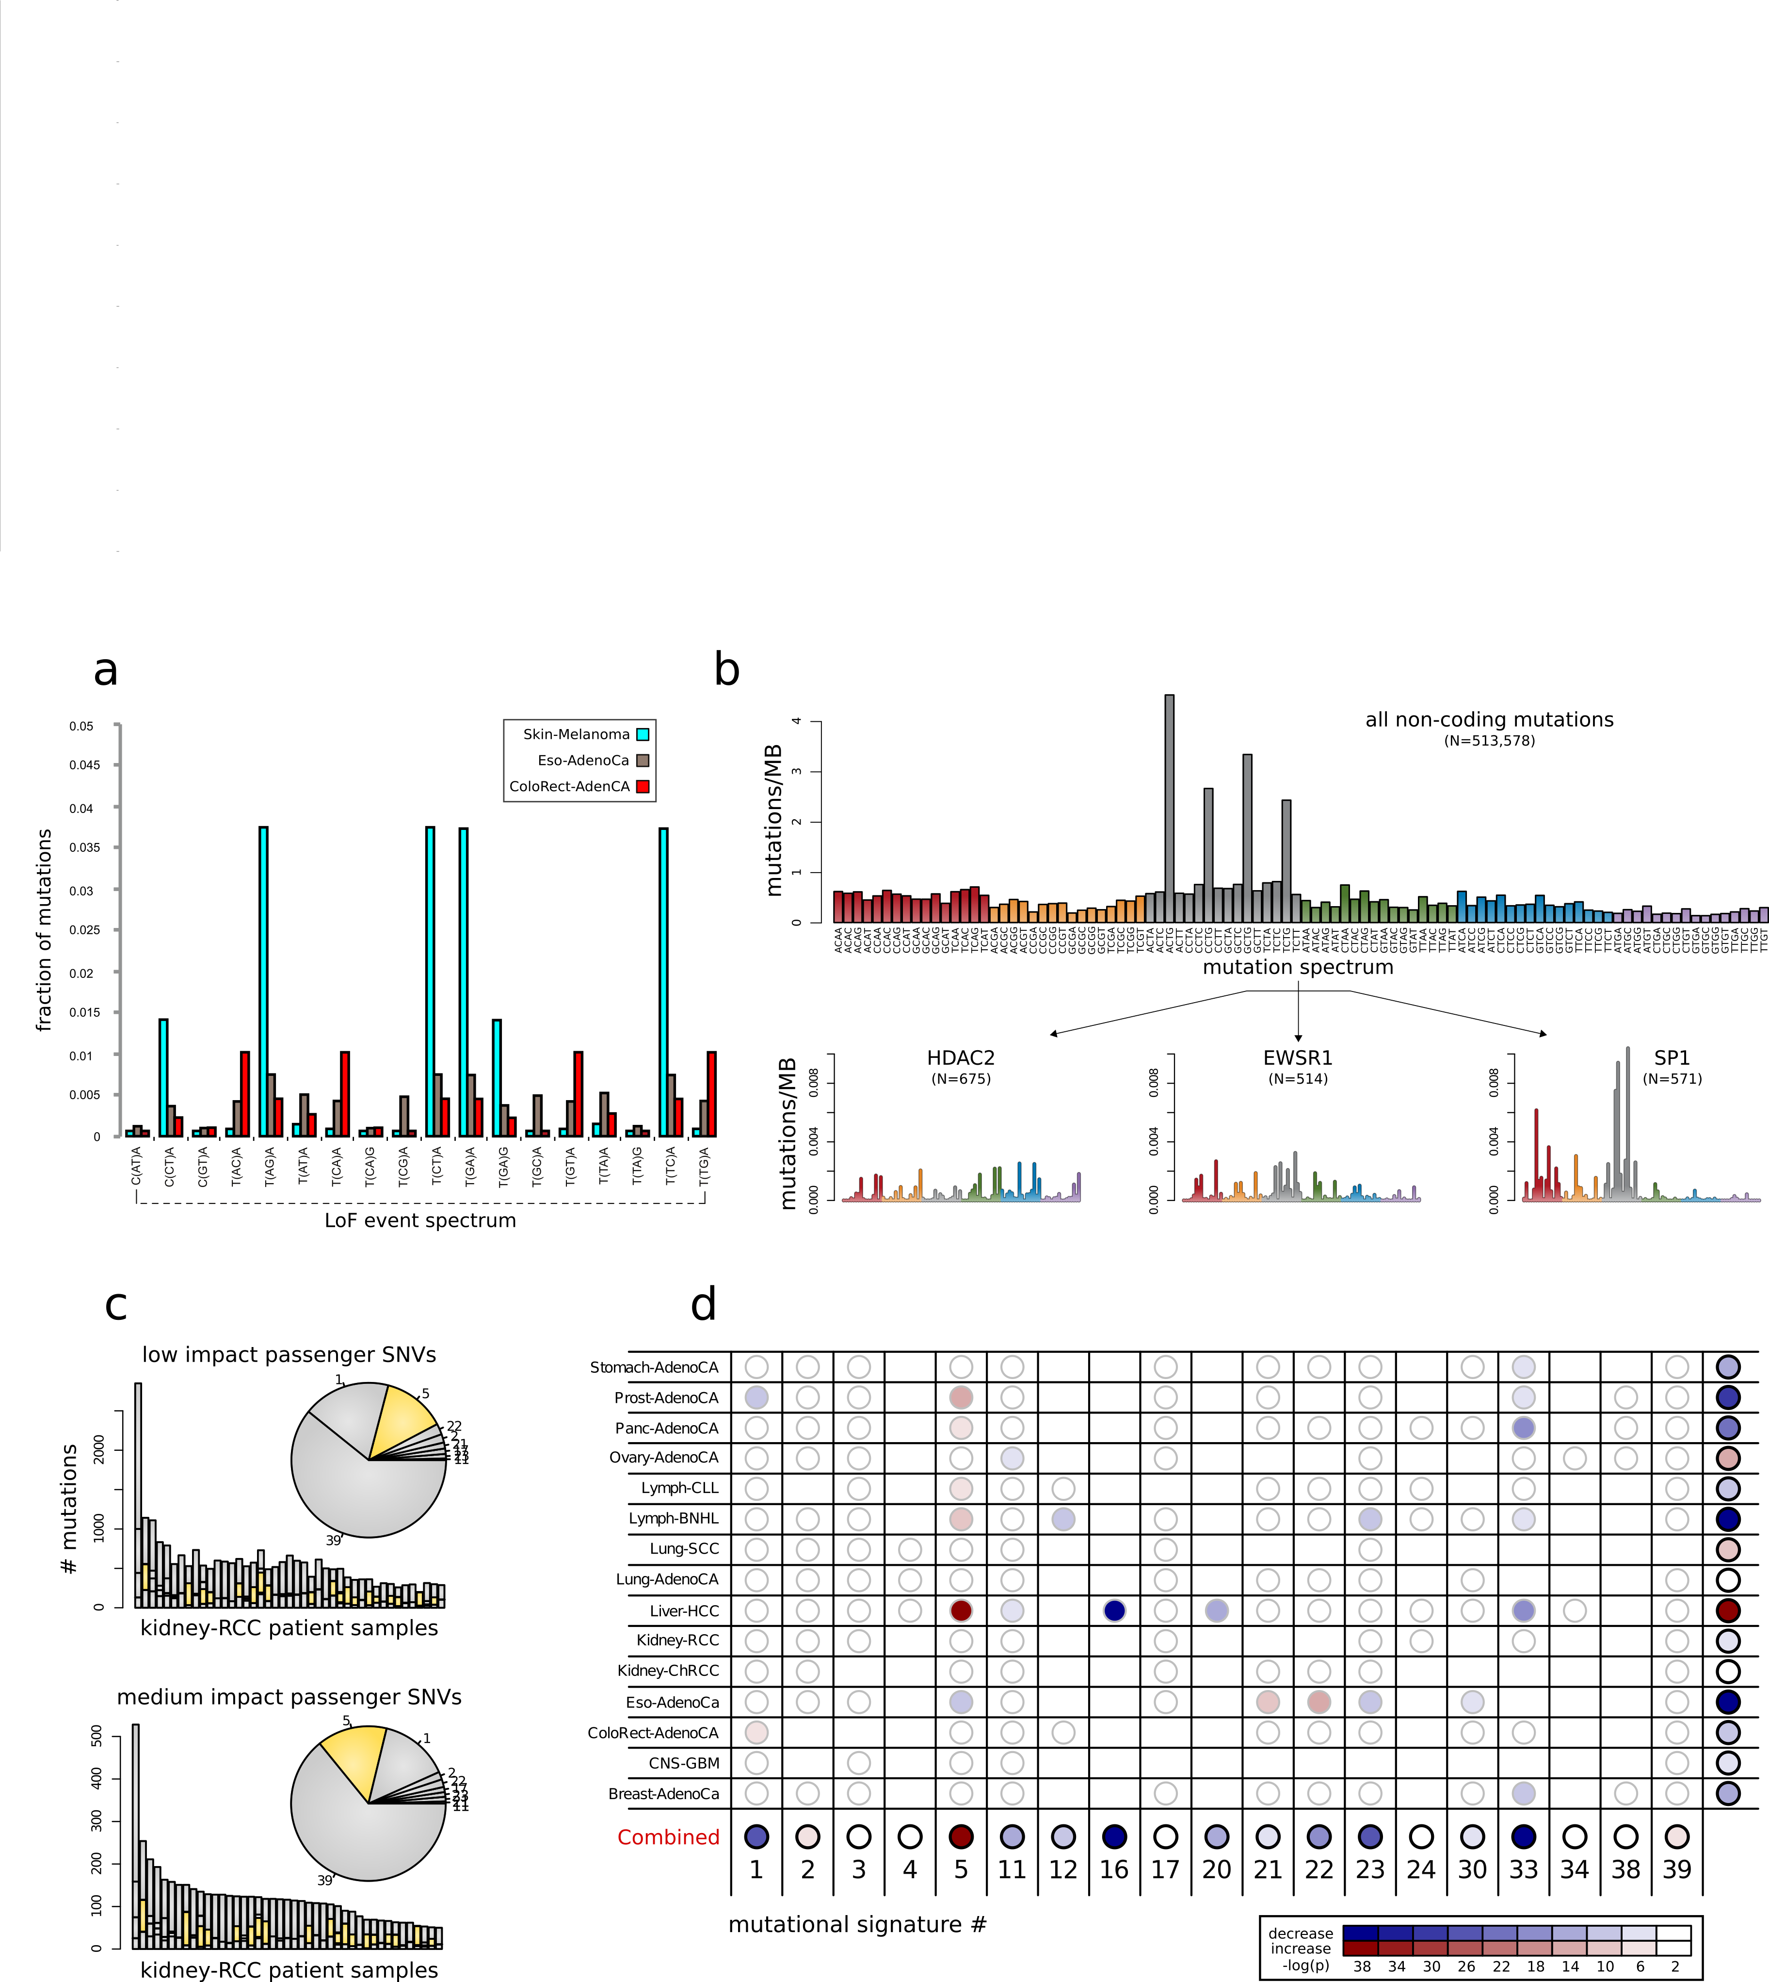
De-convoluting mutational signature and functional impact of nominal passengers in PCAWG

Slide 31
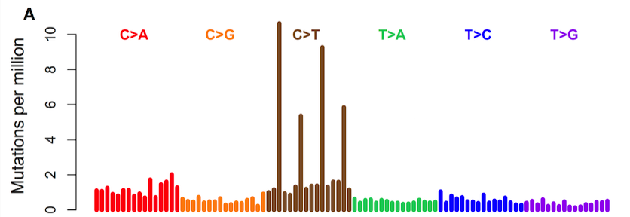
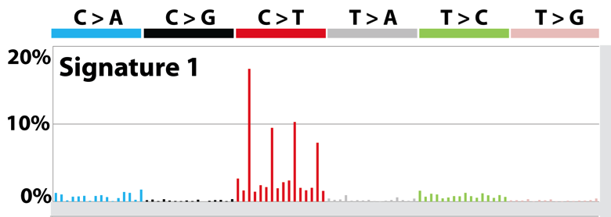
Mutational Context and Signatures
We can decompose the mutations based on the context
Mutation spectrum is further broken down to mutation signatures, which represent mutational processes
  NMF/clustering on large cancer cohorts
  Linked some signatures with biological processes/mutagens
Mutation spectrum observed
Mutation signature inferred

Slide 32
De-convoluting mutational signature and functional impact of nominal passengers in PCAWG

Slide 33
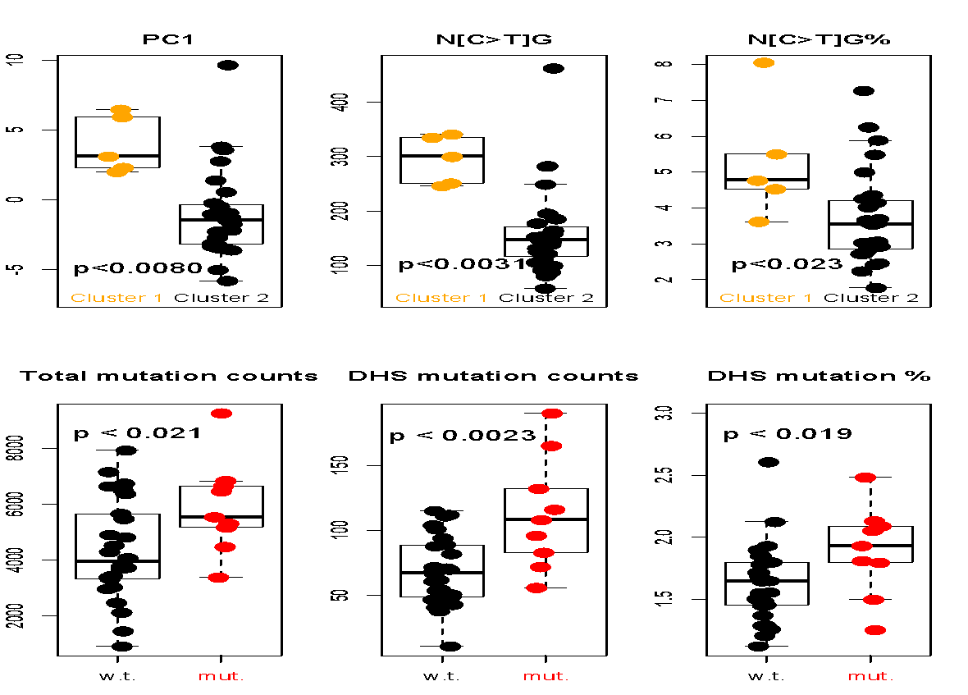
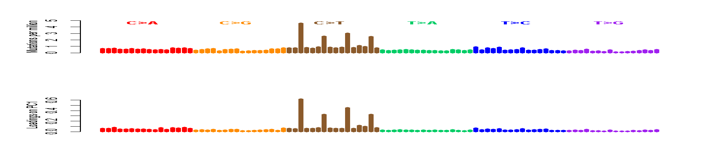
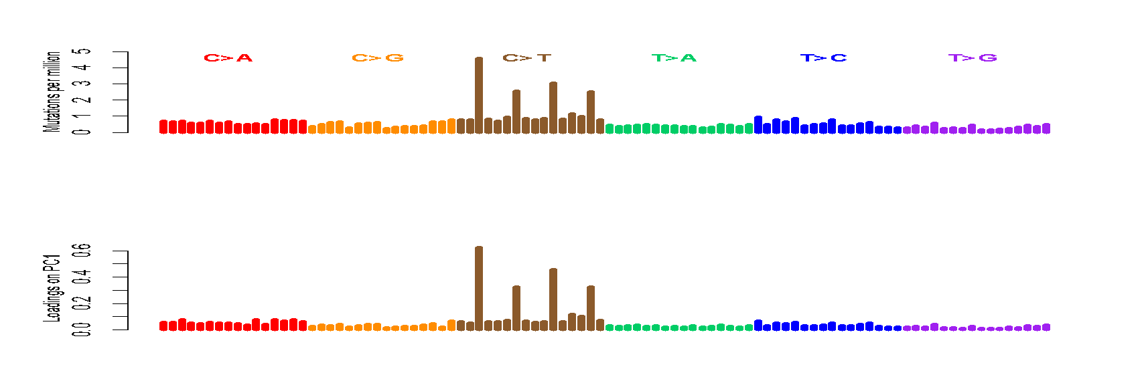
CpGs Drive Inter-patient Variation
The Loading on PC1 is mostly [C>T]G
Confirmed by higher C>T% in CpGs in the hypermethylated group (cluster1)
A[C>T]G
G[C>T]G
C[C>T]G
T[C>T]G
S. Li, B. Shuch and M. Gerstein PLOS Genetics 2017

Slide 34
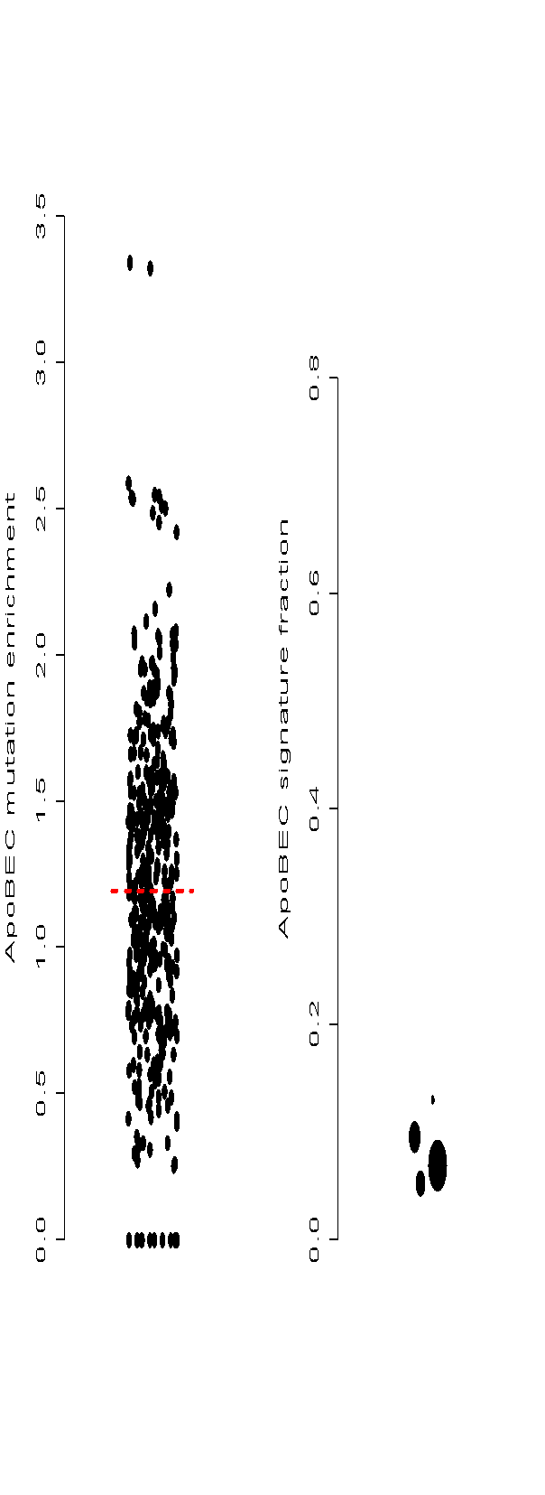


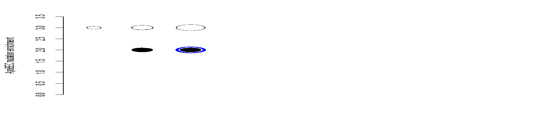
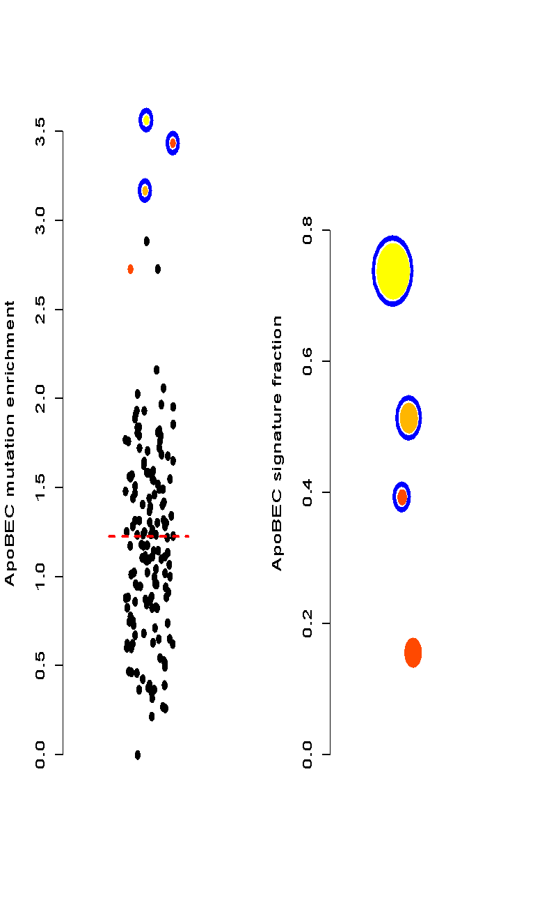

Discover ApoBEC Signature
enrichment
-log(p-value)
3.6
7.2
22
50
100
150
RCC samples
ApoBEC signature is observed
in chRCC but never in ccRCC.
We found a pRCC has ApoBEC
signature
Three samples that are urothelial
cancer (UC) but mislabeled
and processed through the
pipeline (internal positive controls)
total mutations
UC samples
pRCC & UC
ccRCC
S. Li, B. Shuch and M. Gerstein PLOS Genetics 2017

Slide 35

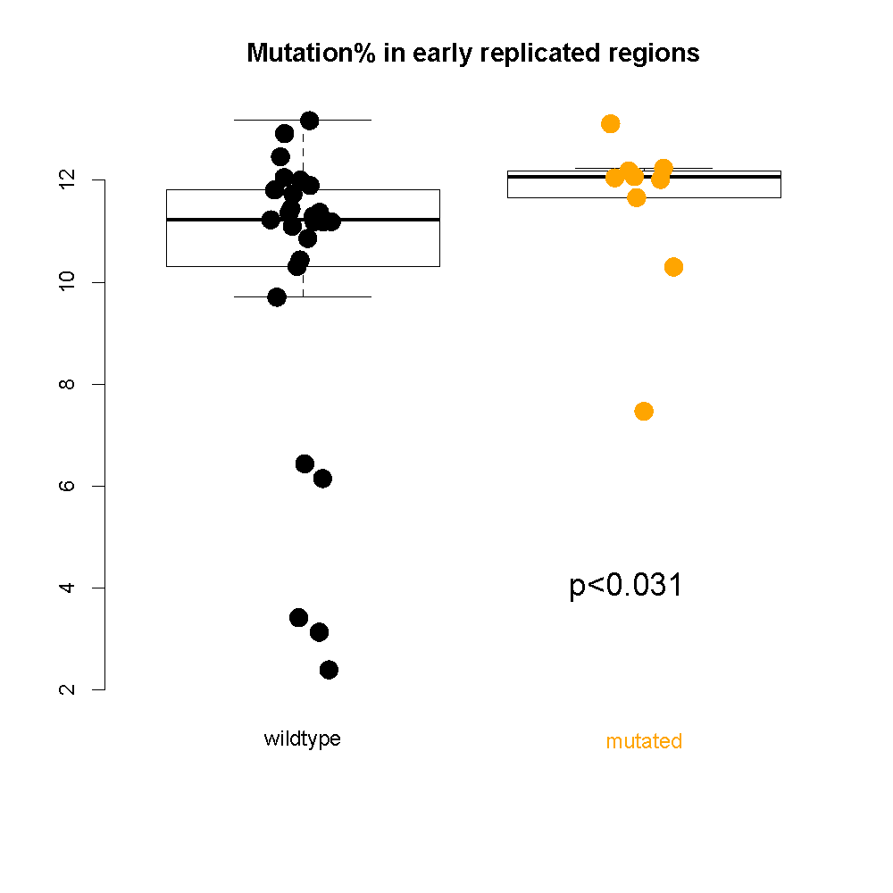
Chromatin Remodeling Failure Changes Mutational Landscape
Samples with CR defect accumulate more mutations in open chromatin/early replicated regions; Interactions between mutational landscape and driver mutations.
S. Li, B. Shuch and M. Gerstein PLOS Genetics 2017

Slide 36
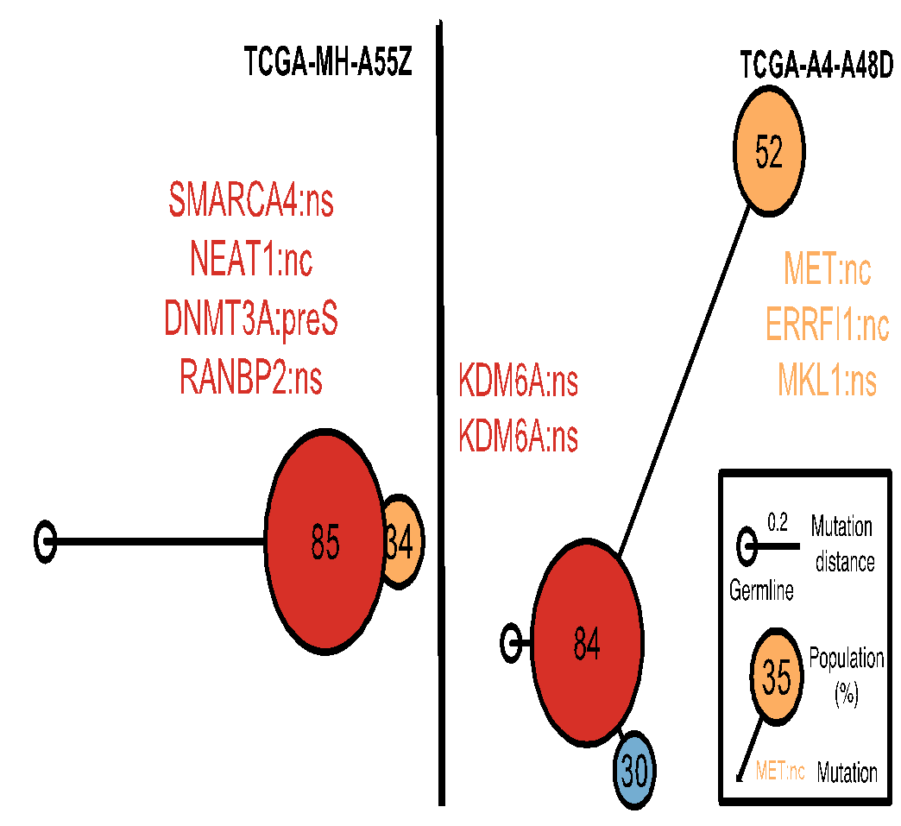

Construct Evolutionary Trees in pRCC
Infer mutation order and tree structure based on mutation abundance (PhyloWGS, Deshwar et al., 2015)
MET: noncoding
ERRFI1: noncoding
DNMT3A: premature stop
NEAT1: noncoding
SMARCA4: missense
KDM6A: missense
S. Li, B. Shuch and M. Gerstein PLOS Genetics 2017

Slide 37
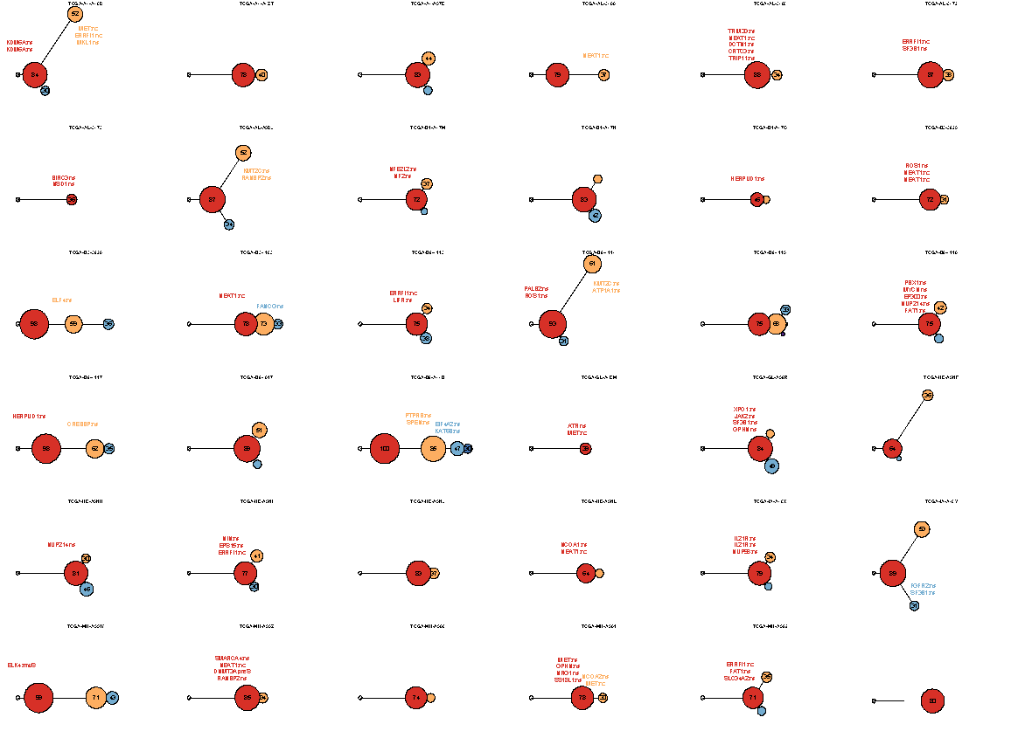
Mutation
distance
Populations
(%)
0.5
Germline
S. Li, B. Shuch and M. Gerstein PLOS Genetics 2017

Slide 38
Mutation
distance
Populations
(%)
0.5
Germline
S. Li, B. Shuch and M. Gerstein PLOS Genetics 2017

Slide 39
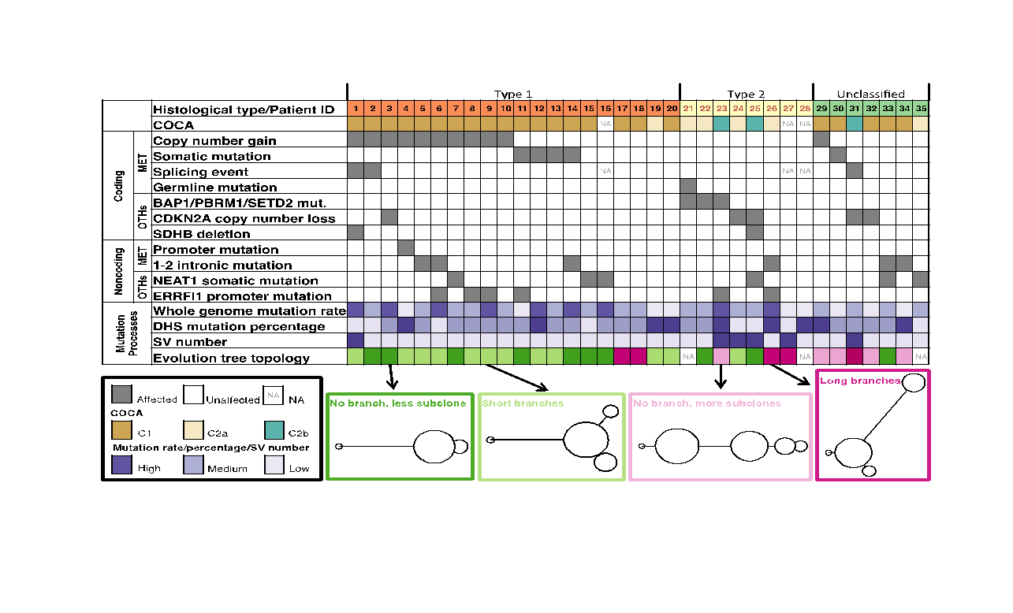
Tree Topology Correlates with Molecular Subtypes
S. Li, B. Shuch and M. Gerstein PLOS Genetics 2017

Slide 40
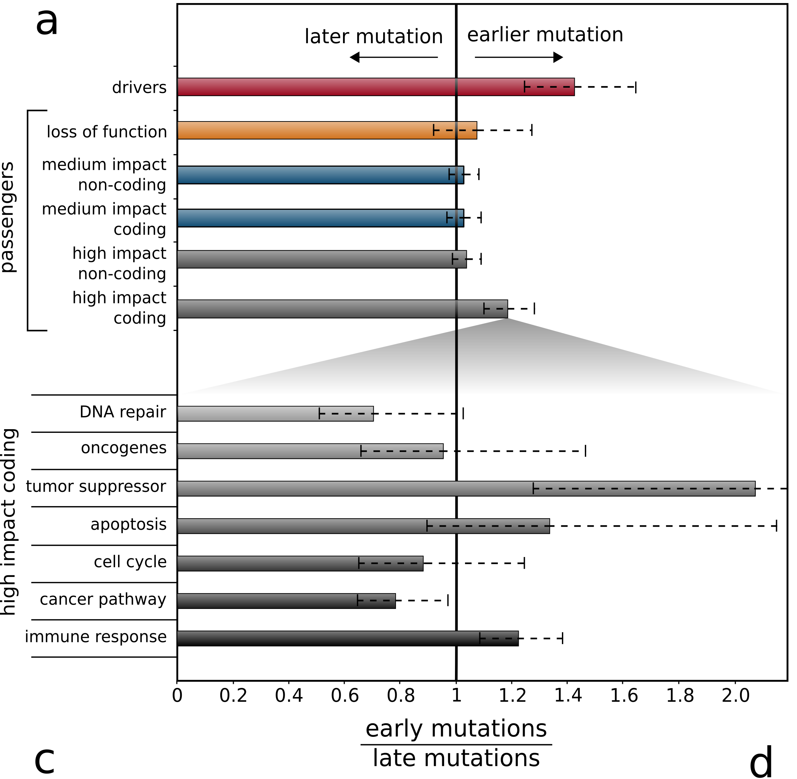
Subclonal architecture of nominal passengers in PCAWG

Slide 41

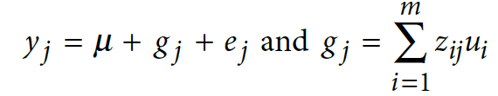


Additive effects model to quantify cumulative variance
Model for the effect of an individual SNP on a phenotype
Extension to model the combined effects of multiple SNPs
where: y=phenotype; x_ij is the ’genetic dosage’ of the i’th SNP in individual j, taking values {0,1}; a_i is the fixed effect size of SNP i, and e_j is the residual effect
where: z_ij is a ‘normalized genetic dosage’, i.e. the z-score of x_ij; u_i is the effect
size of SNP i treated as a random variable; g_j is the combined effect of all SNPs for individual j

Slide 42
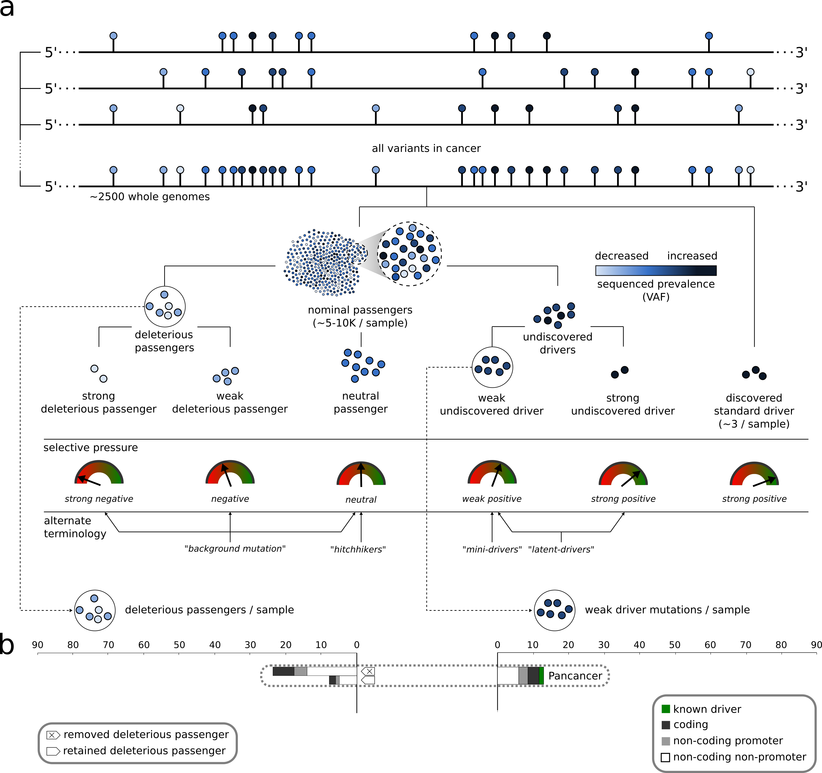
Extending canonical model of driver and passengers

